Slide 1
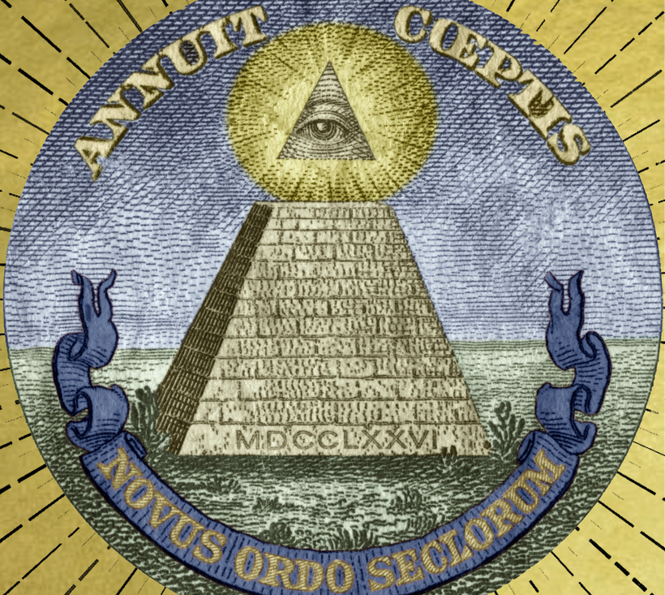
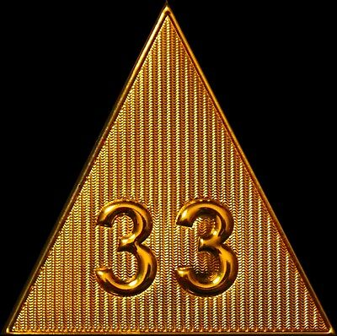
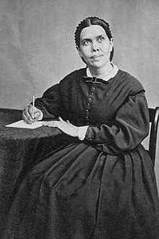
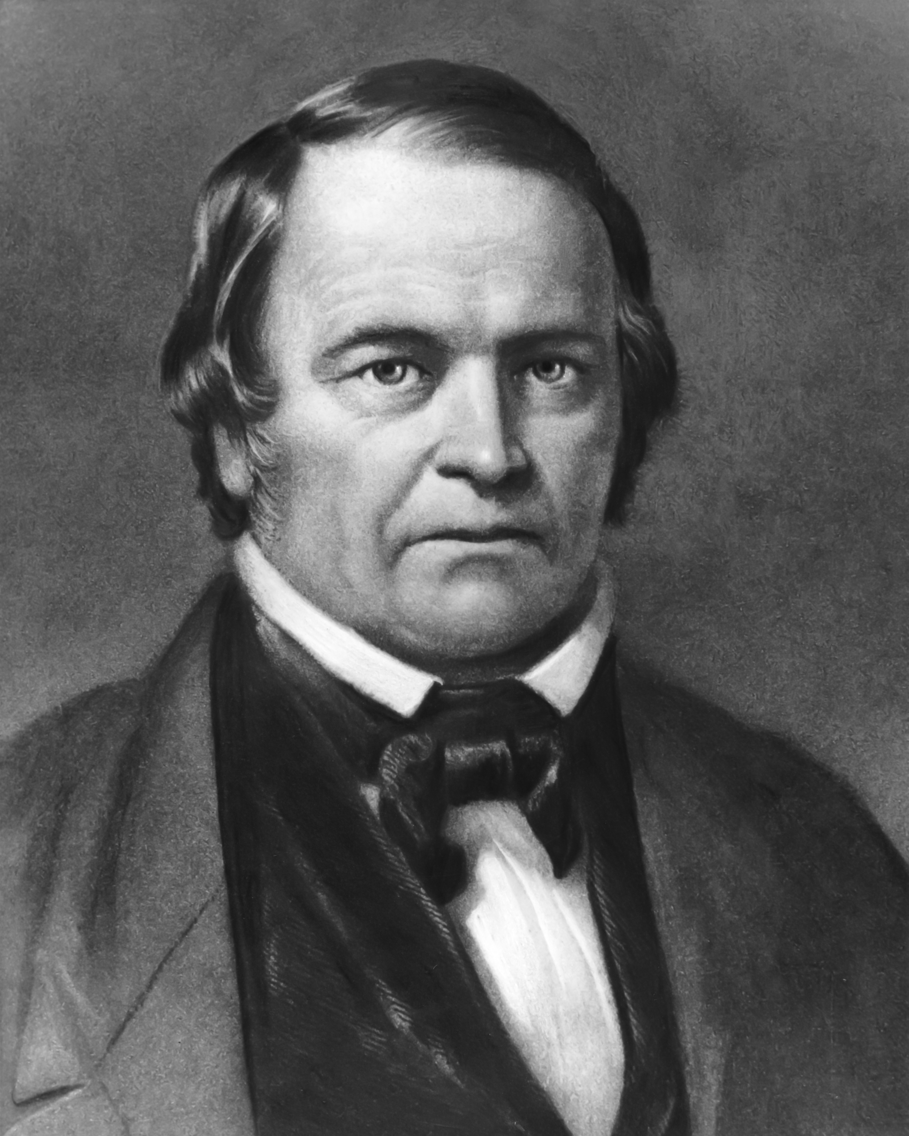
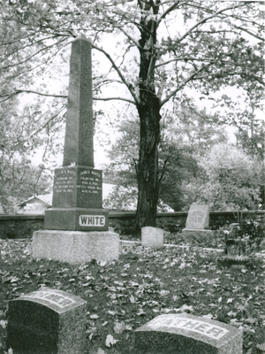
Freemasonry and Seventh-day Adventism

Slide 2
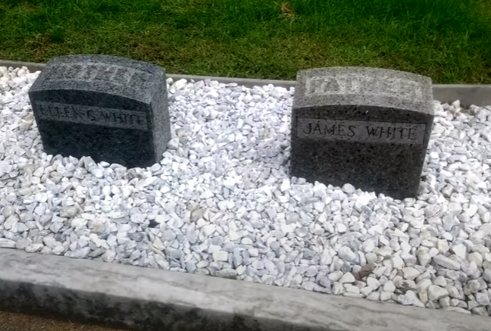
The Charge: SDA are Freemason to the Core!
The Evidence:
William Miller was a Freemason—he’s the founder!
The early pioneers, even James White and John Loughborough can be seen in photographs doing the “hidden hand” gesture
Ellen White used Freemason language in her writings!
The White Family gravestone is marked with an Obelisk—an occult pagan symbol!

Slide 3
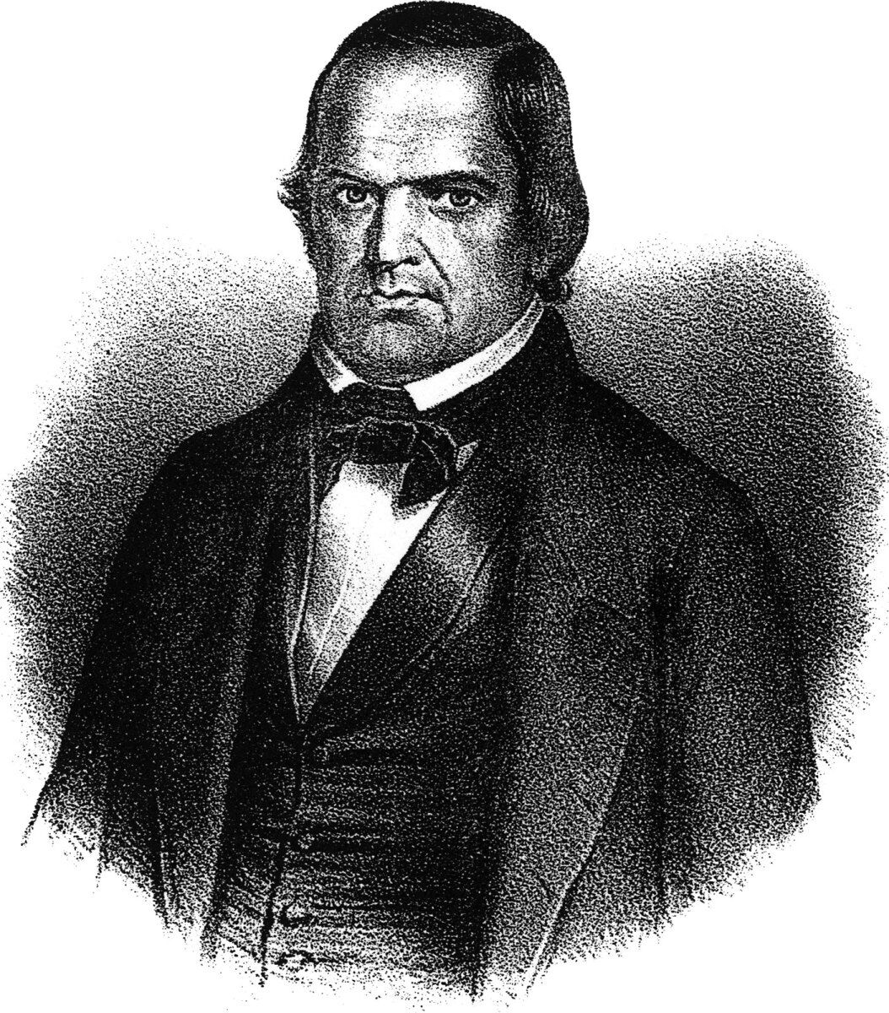
Evidence #1: William Miller a Freemason?
Miller (listed as Capt. Miller) is later given as one of the early masters of Morning Star Lodge, No. 27. This lodge is said to have been "organized in Poultney prior to 1800, though the exact date is not known." David L. Rowe's recent Miller biography God's Strange Work: William Miller and the End of the World . . . David L. Rowe, God's Strange Work: William Miller and the End of the World (Eerdmans: 2008) gives extensive documentation of Miller's Masonic connections, noting that he attended a meeting as a youth on March 4, 1798; joined the Morning Star Lodge in Poultney and eventually rose to the rank of Grand Master. David L. Rowe, God's Strange Work: William Miller and the End of the World (Eerdmans: 2008), p. 27.
"It was here that Mr. Miller became a member of the Masonic fraternity in which, by his own perseverance, he succeeded in attaining the highest degree that lodges in the country could confer.“, "Memoirs of William Miller", by Silvester Bliss, Published by Joshua V. Himes: 1853, p. 19.

Slide 4
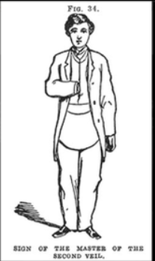
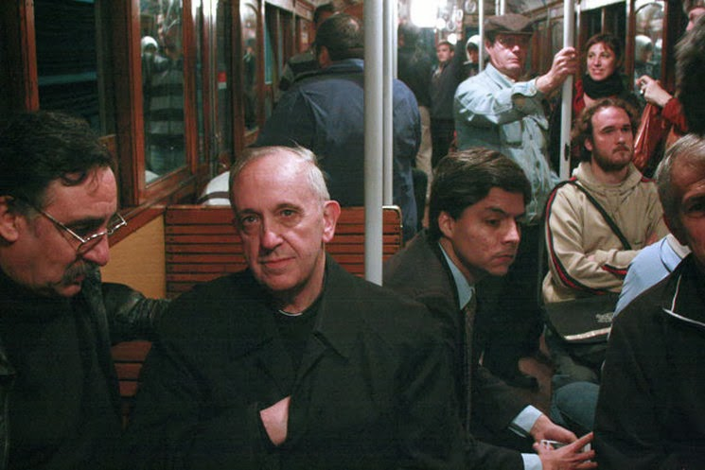
Evidence #2: Pioneers and the “Hidden Hand”
From “despierta tu que duermes” (Wake up you're sleeping) website:
Joseph Stalin, George Washington, Napoleon Bonaparte, Karl Marx, Simón Bolívar
https://despierta-tu-que-duermes.blogspot.com/2013/12/adventistas-del-septimo-dia-parte-2.html

Slide 5
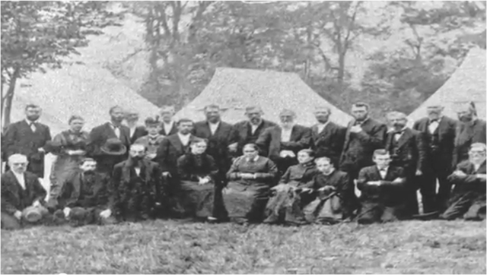
Loughborough or Andrews
James White

Slide 7
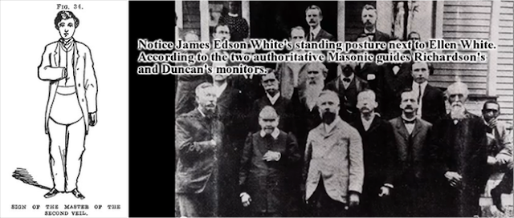
Ellen White May be doing the “Sign of the Fellow Craft”

Slide 9
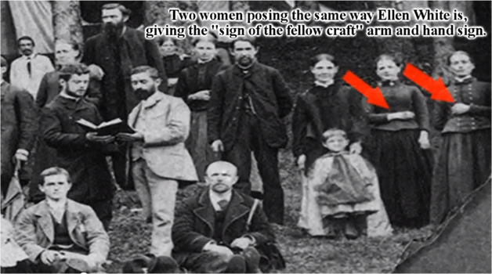

Slide 10
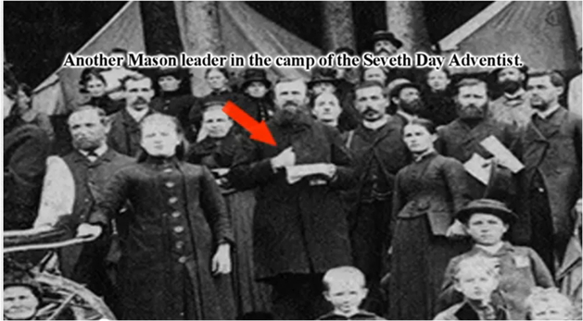

Slide 11
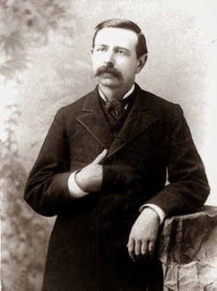
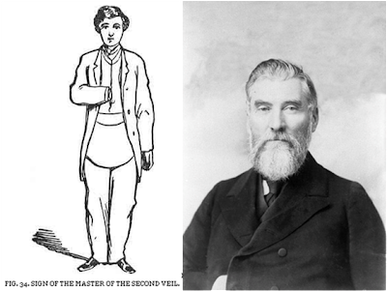
Adventist Pioneer: William Gage
Nathaniel C. McClure, twice president of the California Adventist Conference (1890-1891, 1894-1896).

Slide 12
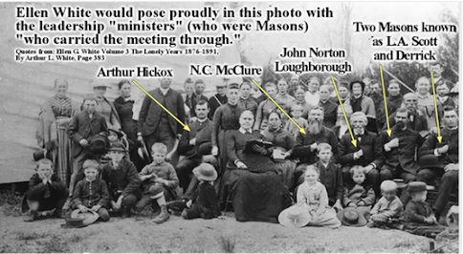

Slide 13
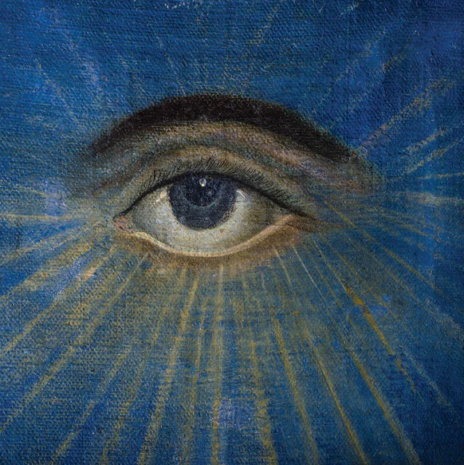
Evidence #3: EGW Uses Freemason Language?
“God cannot be deceived. He reads character correctly. He weighs motives. Nothing escapes his all-seeing eye; the thoughts, the intents and purposes of the heart,--all are discerned by him.” Testimony for the Physicians and Helpers of the Sanitarium (1879) {PH100 78.3}
“For a moment he saw the fearful spectacle of the graves giving up their dead, with secrets he had hoped were hidden forever. For a moment he felt as if he were standing before the eternal Judge, whose all-seeing eye was reading his soul, bringing to light mysteries supposed to be hidden with the dead.” Youth’s Instructor, May 31, 1900

Slide 14
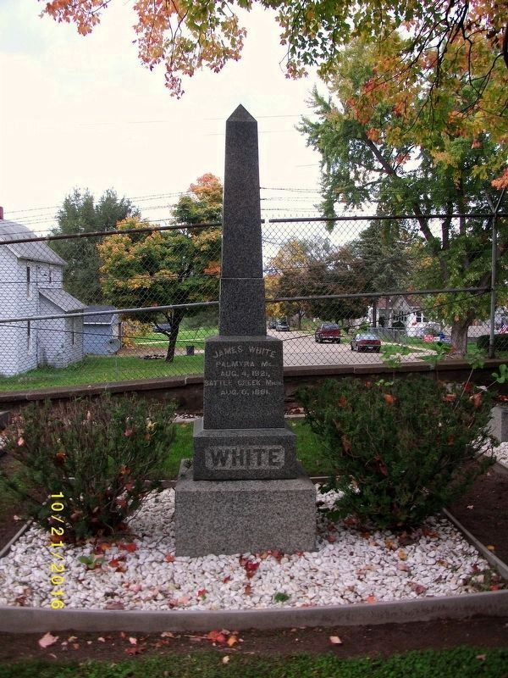
Evidence #3: EGW Uses Obelisk As a Gravestone
“God cannot be deceived. He reads character correctly. He weighs motives. Nothing escapes his all-seeing eye; the thoughts, the intents and purposes of the heart,--all are discerned by him.” Testimony for the Physicians and Helpers of the Sanitarium (1879) {PH100 78.3}
“For a moment he saw the fearful spectacle of the graves giving up their dead, with secrets he had hoped were hidden forever. For a moment he felt as if he were standing before the eternal Judge, whose all-seeing eye was reading his soul, bringing to light mysteries supposed to be hidden with the dead.” Youth’s Instructor, May 31, 1900

Slide 15
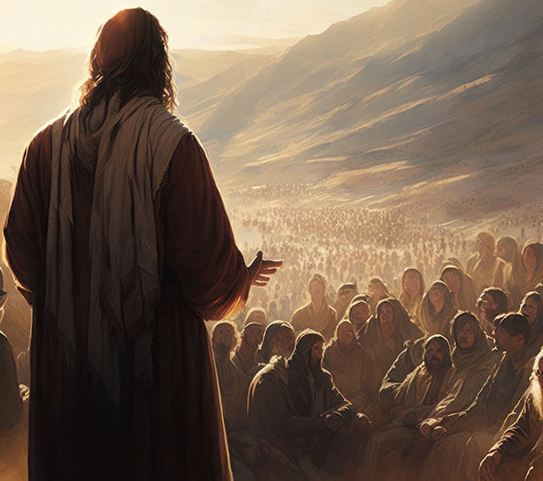
How Are We To Judge?
Matt. 7:15-23 “Beware of false prophets, which come to you in sheep's clothing, but inwardly they are ravening wolves. Ye shall know them by their fruits. Do men gather grapes of thorns, or figs of thistles? Even so every good tree bringeth forth good fruit; but a corrupt tree bringeth forth evil fruit. A good tree cannot bring forth evil fruit, neither can a corrupt tree bring forth good fruit. Every tree that bringeth not forth good fruit is hewn down, and cast into the fire. Wherefore by their fruits ye shall know them. Not every one that saith unto me, Lord, Lord, shall enter into the kingdom of heaven; but he that doeth the will of my Father which is in heaven. Many will say to me in that day, Lord, Lord, have we not prophesied in thy name? and in thy name have cast out devils? and in thy name done many wonderful works? And then will I profess unto them, I never knew you: depart from me, ye that work iniquity.”

Slide 16
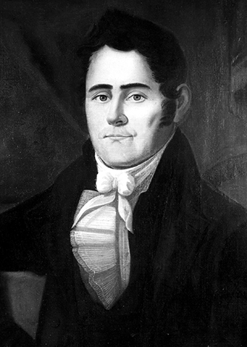
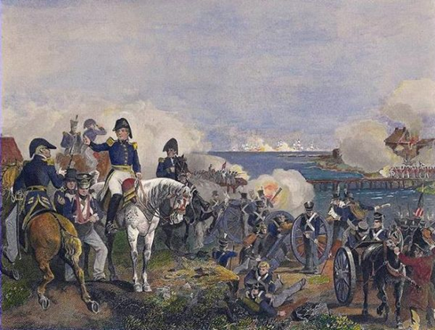
Evidence #1: William Miller Left Masonry and Condemned It
William Miller wasn’t just a Mason, he was a Deist as well; an avid reader of Voltaire who is one of the fathers of secular humanism who’s ideas led to the bloodshed carried out during the French Revolution. However, when William Miller served in War of 1812, he had a humbling experience at the Battle of Plattsburg:
“The fort I was in was exposed to every shot. Bombs, rockets, and shrapnel shells fell as thick as hailstones’, he said. One of these many shots had exploded two feet from him, wounding three of his men and killing another, but Miller survived without a scratch. Miller came to view the outcome of this battle as miraculous, and therefore at odds with his deistic view of a distant God far removed from human affairs. He later wrote, ‘It seemed to me that the Supreme Being must have watched over the interests of this country in an especial manner, and delivered us from the hands of our enemies” (Sylvester Bliss, Memoirs of William Miller, 1853, p. 32)

Slide 17
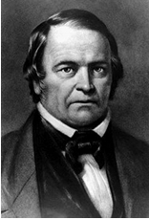
William Miller’s Conversion
“William Miller provided the impetus behind one of the most intense periods of millennial expectation in American history. Born in Pittsfield, Massachusetts, on 15 February 1782 and raised on the Vermont frontier, he grew up in the formative years of the new nation. His father was a veteran of the Revolutionary War, and though his mother was the daughter of a minister, Miller himself was moved early on by the rationalistic, enlightenment principles expounded by some of the most prominent revolutionaries. He proclaimed himself a Deist and rejected Christianity as superstition. When he returned home after service in the War of 1812, however, his attitude had changed. Observing that the United States had won the war despite the failings of many individuals who participated, he concluded that God had played a direct role in his nation’s victory. He began attending revival meetings and in 1815 had a dramatic conversion experience. As he described it, “God by his Holy Spirit opened my eyes. I saw Jesus as a friend, and my only help, and the Word of God as a perfect rule of duty.” He joined the Baptist Church and began to study the Bible in earnest.” Encyclopedia.com, William Miller, William Miller | Encyclopedia.com

Slide 18
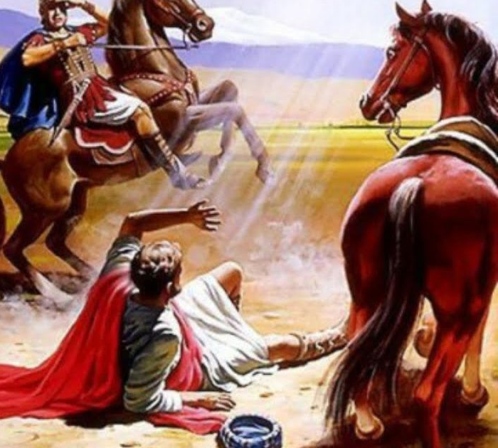
William Miller on Freemasonry
William Miller resigned his Masonic membership in 1831. The reason being? To “avoid fellowship with any practice that may be incompatible with the word of God among masons.” William Miller letter dated September 10, 1831
In 1833 Miller counseled in a letter to his friends to treat Freemasonry “as they would any other evil.“ William Miller letter dated April 10, 1833
Is there no path to redemption in Christ? Remember Moses was raised in the pagan and occult in Egypt, Aaron made the golden calf, Rehab was a pagan harlot, Ruth a pagan Moabite, Namaan was cleansed, Solomon brought paganism and occult to Israel but was forgiven and saved, King Manasseh of Judah was forgiven and saved, Mary Magdalene was redeemed from prostitution, Nicodemus and Joseph of Arimathea were saved from apostasy and pride, Apostle Paul was a murderer saved from Phariseeism

Slide 19
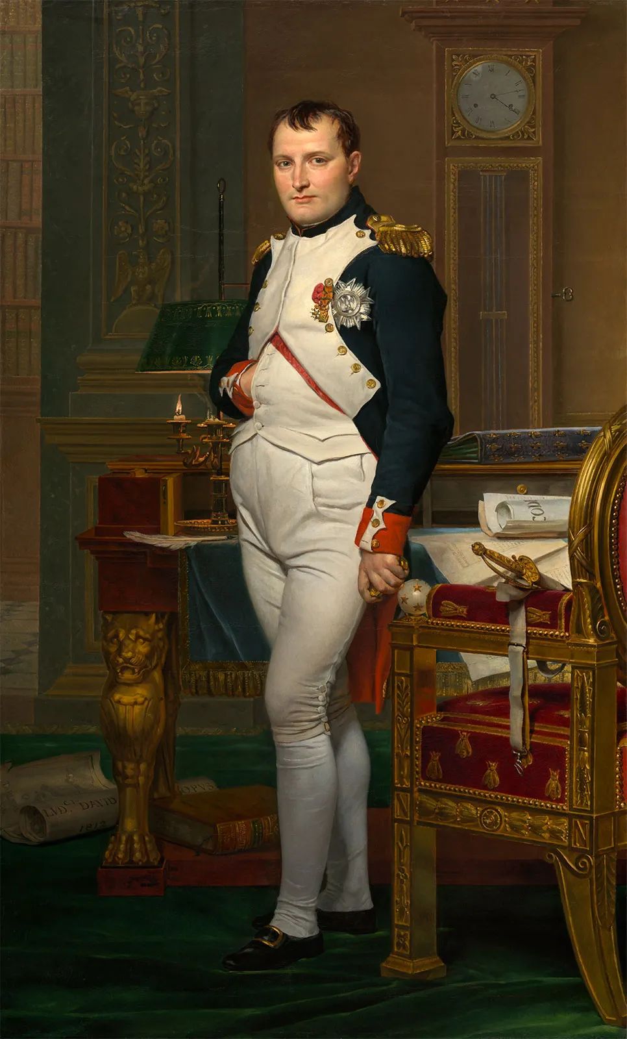
Evidence #2: Hand Signs
“in an article entitled, ‘Re-Dressing Classical Statuary: The Eighteenth-Century 'Hand-in-Waistcoat' Portrait.’ by Arline Meyer. Art Bulletin (College Art Association of America), Vol. 77, No.2, March 1995, p.45-64. Meyer points out that the 'hand-in' portrait type appeared with ‘relentless frequency’ during the eighteenth century and became almost a cliched pose in portrait painting. The pose was used so often by portraitists that one was even accused of not knowing how to paint hands. ‘In real life,’ Meyer observes, ‘the 'hand-held-in' was a common stance for men of breeding.’ . . . In 1738 Francois Nivelon published A Book Of Genteel Behavior describing the ‘hand-in-waistcoat’ posture as signifying ‘manly boldness tempered with modesty.’” –Why is Napoleon depicted with his hand in his coat?, By Tom Holmberg, Faq#12: Why is Napoleon's hand in his coat? (napoleon-series.org)

Slide 20
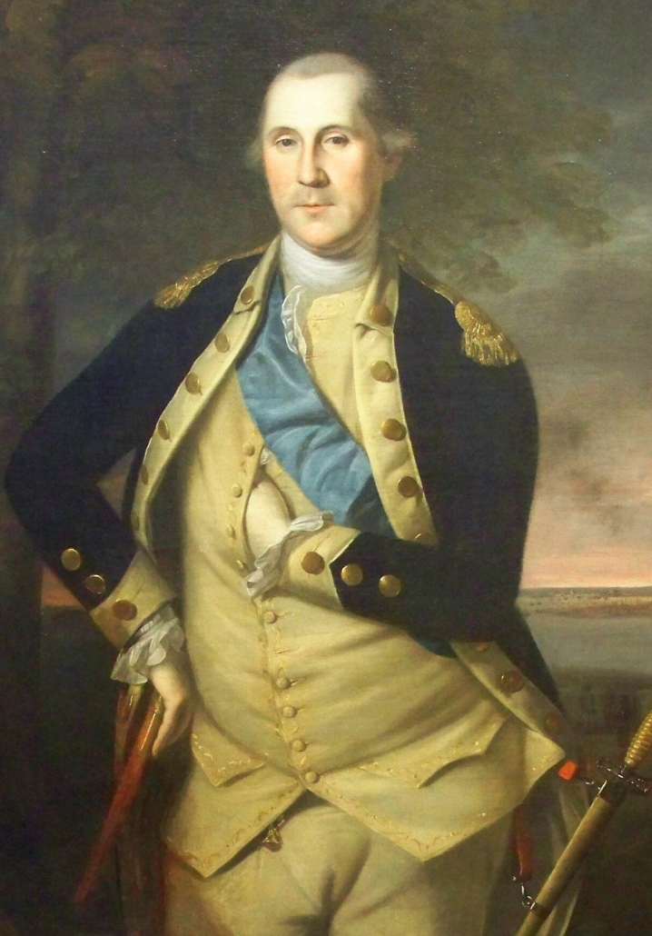
Myth---Busted
“The simple fact is that standing with one hand tucked inside a vest or jacket was a popular, dignified pose for gentlemen and royalty of that era. . . . The pose goes all the way back to the classical era when the proper stance for formal public speaking was having one hand inside the toga. By the eighteenth century, it had become a trademark pose for men of quality, nobles, and royals. Having a portrait painted was the prerogative of a distinguished gentleman, and the hand-in-vest pose was another symbol of his stature.”—Revisited Myth #3: Men posed with one hand inside the vest to save money since portrait painters gave a discount if they didn’t have to go to the extra work of painting the fingers. | History Myths Debunked (wordpress.com)

Slide 21
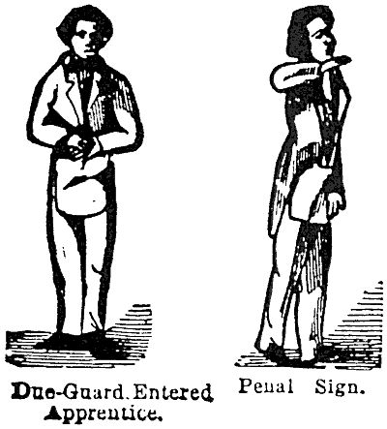
Personal Study
If you study the occult in depth long enough, you will learn a few things:
1. Occult symbols like to steal popular signs and repurpose them—effectively “hiding in plain sight”—notice their handshakes, stances, phrases like “all-seeing eye” and “cornerstone”—they like this because then there is one meaning for the profane and one meaning for the “enlightened”
2. Continued study will reveal that they actually claim everything—every symbol, shape, animal, plant, stance, handshake, and phrase—it gets ridiculous after awhile—they don’t own all creation
3. While it may be a legitimate “red flag” in our day, in Ellen White’s day the hand-in-waistcoat gesture was popular, normal, expected—Ellen and James lived in a real time in history and they were people of their time.
4. I’ve seen a website which was dedicated to “exposing” Bill Hughes for doing “Illuminati symbolism” during an interview with Danny Vierra.

Slide 22
Judge these Fruits!
“’And after these things I saw another angel come down from heaven, having great power; and the earth was lightened with his glory. And he cried mightily with a strong voice, saying, Babylon the great is fallen, is fallen, and is become the habitation of devils, and the hold of every foul spirit, and a cage of every unclean and hateful bird. For all nations have drunk of the wine of the wrath of her fornication, and the kings of the earth have committed fornication with her, and the merchants of the earth are waxed rich through the abundance of her delicacies. And I heard another voice from heaven, saying, Come out of her, my people, that ye be not partakers of her sins, and that ye receive not of her plagues. For her sins have reached unto heaven, and God hath remembered her iniquities. Reward her even as she rewarded you, and double unto her double according to her works: in the cup which she hath filled fill to her double. How much she hath glorified herself, and lived deliciously, so much torment and sorrow give her: for she saith in her heart, I sit a queen, and am no widow, and shall see no sorrow. Therefore shall her plagues come in one day, death, and mourning, and famine; and she shall be utterly burned with fire: for strong is the Lord God who judgeth her.’ Rev. 18:1-8. This terrible picture, drawn by John to show how completely the powers of earth will give them over to evil, should show those who have received the truth how dangerous it is to link up with secret societies or to join themselves in any way with those who do not keep God’s commandments.” (MS 135, 1902, 14MR, p. 152)

Slide 23
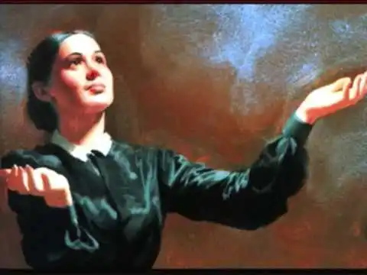
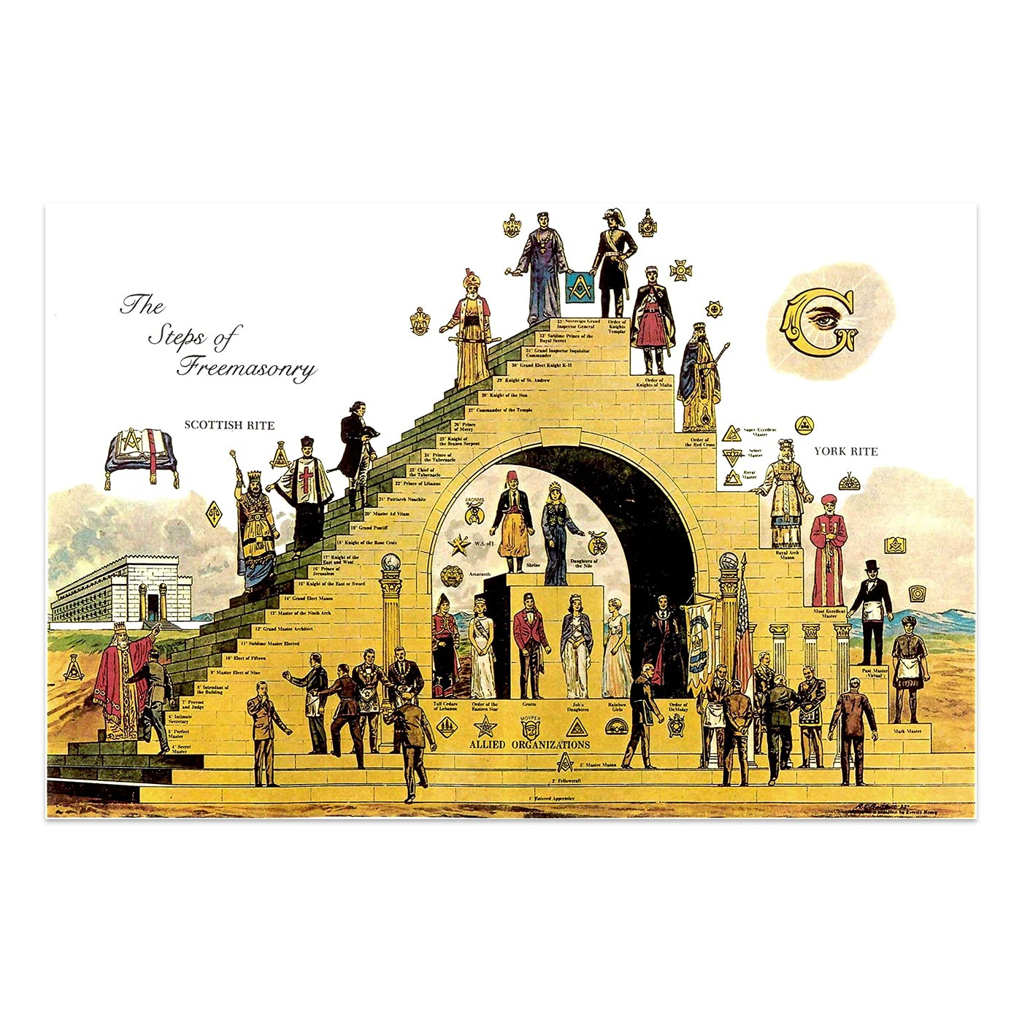
More Quotes
“A power from beneath is working to bring about the last great scenes in the drama,—Satan coming as Christ, and working with all deceivableness of unrighteousness in those who are binding themselves together in secret societies. Those who are yielding to the passion for confederation are working out the plans of the enemy. The cause will be followed by the effect” 8T, 27-28
“We are now to use all our entrusted capabilities in giving the last warning message to the world. In this work we are to preserve our individuality. We are not to unite with secret societies or with trades unions. We are to stand free in God, looking constantly to Christ for instruction. All our movements are to be made with a realization of the importance of the work to be accomplished for God.” 7T, p. 84

Slide 24
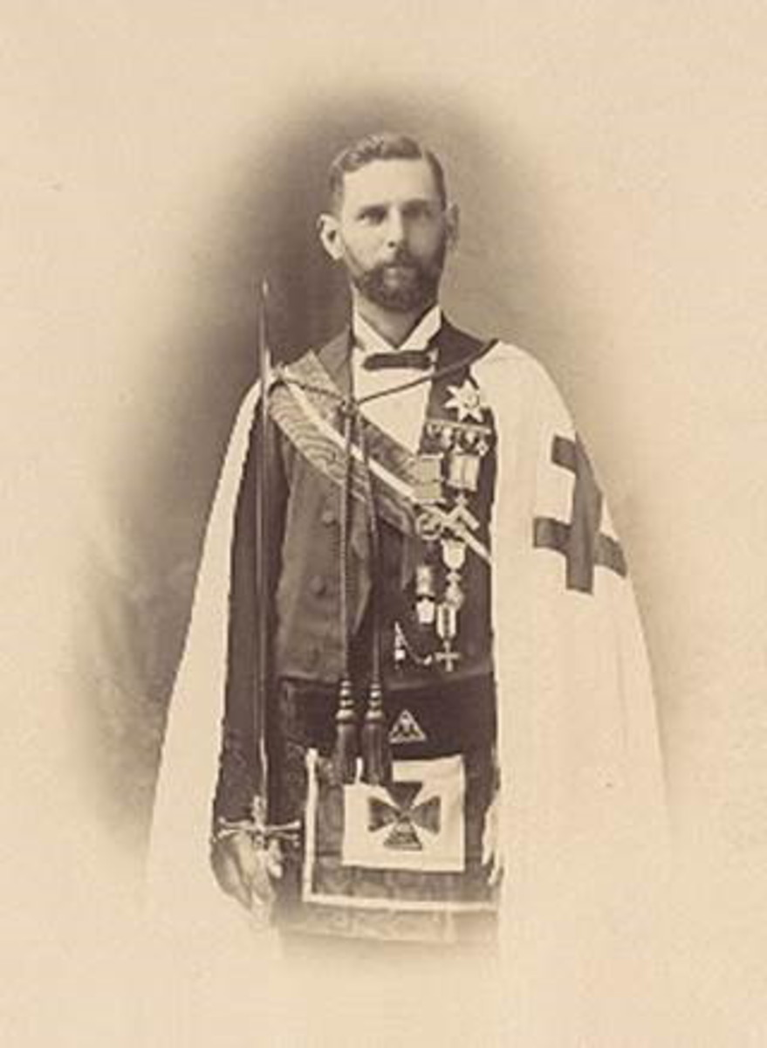
Brother Nathaniel Faulkhead
“On December 10, 1892, Faulkhead dreamed that Ellen White had a message for him. Deeply impressed, he sought her out when she returned to Melbourne a few days later and asked if she had something to say to him. She did have a message she had wanted to deliver for many months, but had been impressed not to do so, as it would have been unwelcome. She then discussed a 50-page document with Faulkhead, focusing mainly on his blunted spiritual perception as a consequence of his heavy commitment to Masonry and several other societies. She described what happened in the lodge meetings he attended, and twice made hand movements that startled Faulkhead, as they were secret signs known only to the highest ranking members of the Masonic lodge movement ­— signs no ordinary lodge member and certainly no woman could possibly have known. When he pointed out what she had done, he learned Ellen White was not aware she had provided those signals. This experience convinced Faulkhead that Ellen White’s testimony was from God.” Encyclopedia of SDA, Nathaniel Falkhead, ESDA | Faulkhead, Nathaniel D. (1860–1923) (adventist.org)
“I entreated for that precious soul that he should decide to give up his bondage of Freemasonry, and take his stand with us as a people. I prayed; and he prayed, as a man wrestling for his soul. We were both weeping and praying. He was converted.” 20MR, p. 167

Slide 25
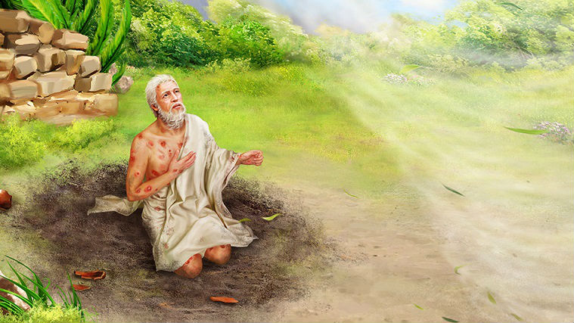
Evidence #3: The All Seeing Eye Quotes
Ps. 33:18 “Behold, the eye of the Lord is upon them that fear him, upon them that hope in his mercy”
Job 34:21 “For his eyes are upon the ways of man, and he seeth all his goings.”
Ps. 11:4 “The Lord is in his holy temple, the Lord's throne is in heaven: his eyes behold, his eyelids try, the children of men.”
Job 42:5 “I have heard of thee by the hearing of the ear: but now mine eye seeth thee.”
Ezra 5:5 “But the eye of their God was upon the elders of the Jews, that they could not cause them to cease, till the matter came to Darius: and then they returned answer by letter concerning this matter”
Prov. 15:3 “The eyes of the Lord are in every place, beholding the evil and the good.”

Slide 26
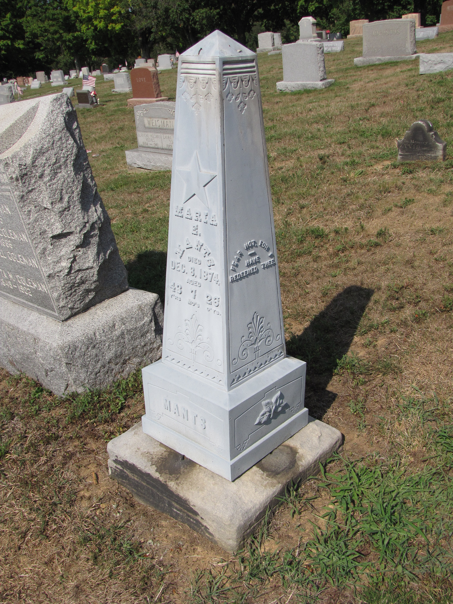
Evidence #4: Obelisks
“The obelisk is, to quote McDowell and Meyer in The Revival Styles in American Memorial Art, one of the "most pervasive of all the revival forms" of cemetery art. There is hardly a cemetery founded in the 1840s and 50s without some form of Egyptian influence in the public buildings, gates, tomb art, etc. Napoleon's 1798-99 Egyptian campaigns, the discoveries at the tombs of the Pharaohs, and our new Republic's need to borrow the best of the ancient cultures (Greek revival, classic revival, the prominence of classical studies and dress, etc.) led to a resurgence of interest in the ancient Egyptian culture. Obelisks were considered to be tasteful, with pure uplifting lines, associated with ancient greatness, patriotic, able to be used in relatively small spaces, and, perhaps most importantly, obelisks were less costly than large and elaborate sculpted monuments. There were many cultural reasons for the revival styles of the nineteenth century. Freemasonry, while part of the overall cultural influence, was not responsible for the prevalence of obelisks” –Jessie Lie Farber Association for Gravestone Studies | Symbolism in gravestones

Slide 27
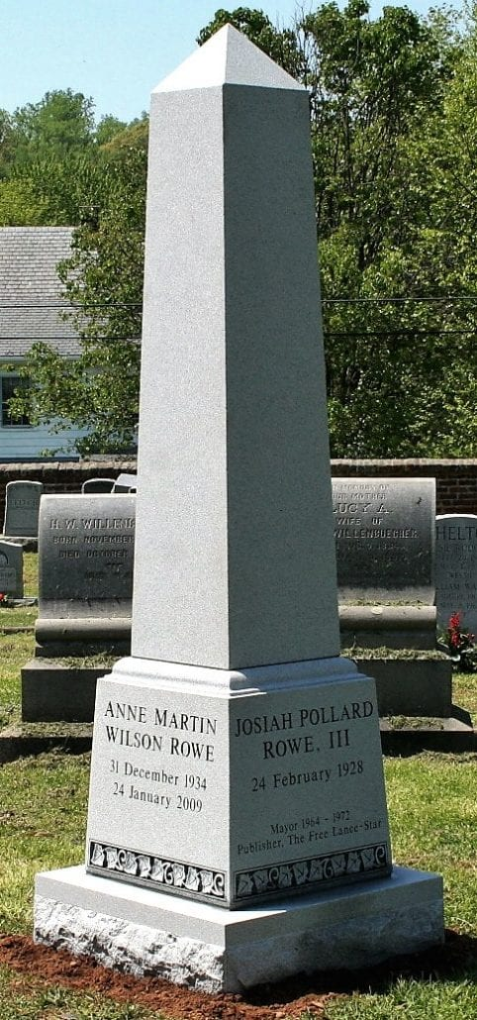
Another Source…
“The obelisk had a long and continuous tradition in American landscape design that began in the colonies and lasted well into the 19th century. The feature was utilized in both public and private gardens ranging in scale from a few feet to the tallest edifices in American architecture until the advent of the skyscraper. Obelisks persisted over time despite changes in garden styles, finding a place within the Anglo-Dutch landscapes of Williamsburg, Virginia, in the mid-18th century, as well as in the picturesque landscapes of rural cemeteries one hundred years later.” Obelisk - History of Early American Landscape Design (nga.gov)

Slide 28
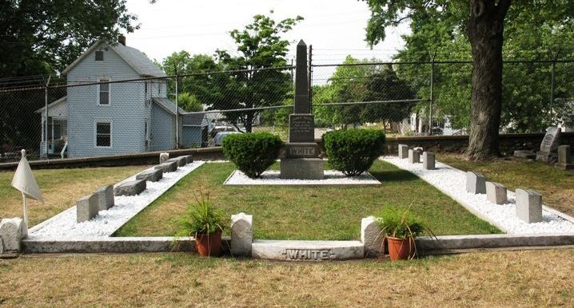

Slide 29
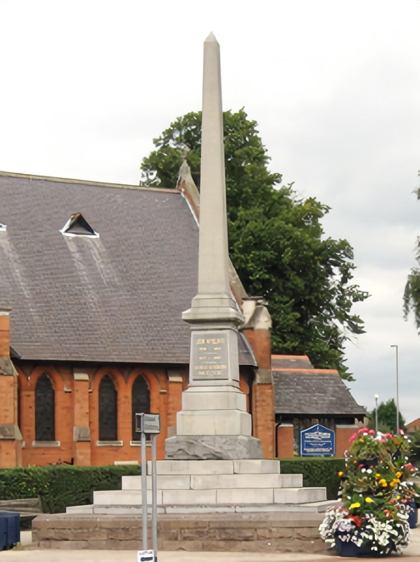
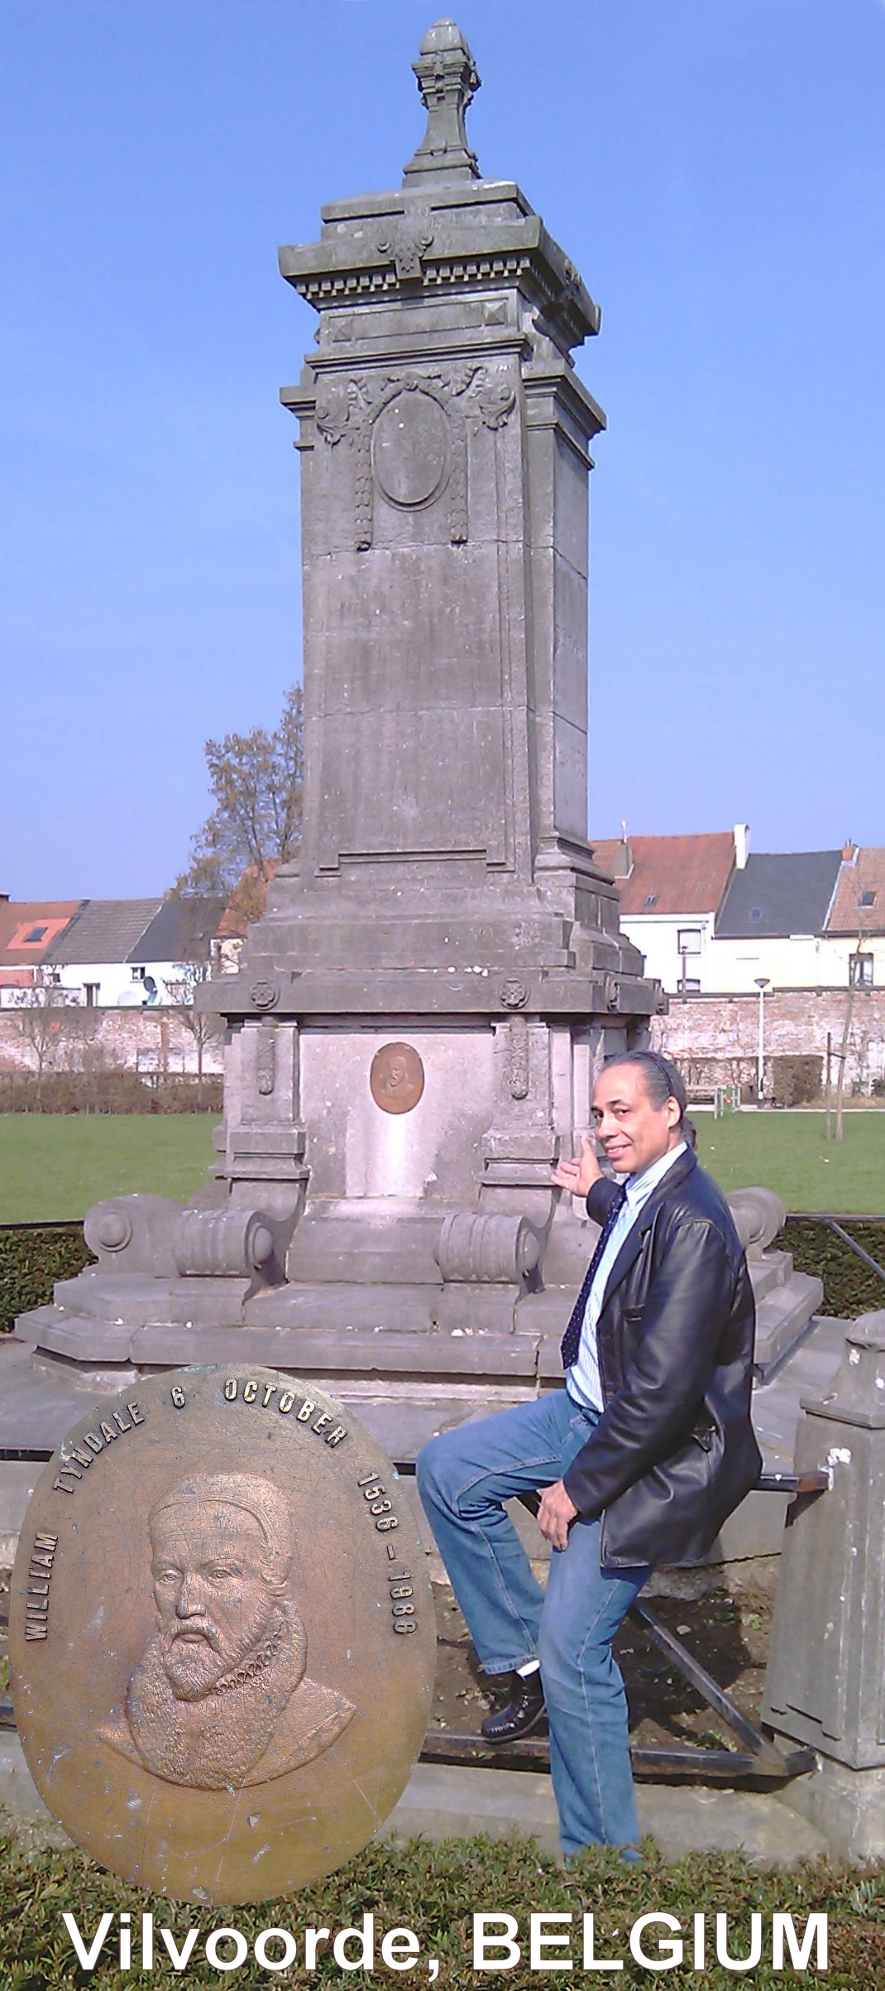
William Tyndale Gravestone, Vilvoorde, Belguim
John Wycliffe Memorial in Lutterworth, UK

Slide 30
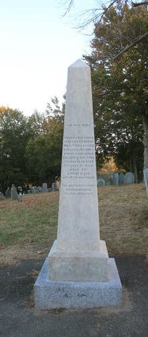
Hooks to Hang Your Doubts
“Light and darkness, truth and error, are before us. We are free to choose. God will never remove all excuse for unbelief. Those who look for hooks to hang their doubts upon, will find them close at hand. It is far easier to suggest doubts than to inspire faith. Because the natural heart is at enmity with God, a greater effort is required to believe than to doubt the word of the Most High. And Satan himself opposes everything that would strengthen faith. There is one course which all must pursue who honestly desire to be freed from doubts. They are cherishing some indulgence forbidden by the word of God, or neglecting some duty enjoined therein. Let those who complain that they walk in darkness, give heed to the light which already shines upon them, and they will receive greater light. Let them do every duty which has been made plain to their understanding, and they will be enabled to understand and perform those of which they are now in doubt. “If any man will do His will, he shall know of the doctrine.” ST, June 8, 1882
William Bradford
Plymouth, MA

