Slide 1
Final Scenes, pt. 18, Simon of Africa
Condemned for Compassion

Slide 2
A Must!
“It would be well for us to spend a thoughtful hour each day in contemplation of the life of Christ. We should take it point by point, and let the imagination grasp each scene, especially the closing ones. As we thus dwell upon His great sacrifice for us, our confidence in Him will be more constant, our love will be quickened, and we shall be more deeply imbued with His spirit. If we would be saved at last, we must learn the lesson of penitence and humiliation at the foot of the cross.” DA, pg. 83

Slide 3
The Backdrop
“Jesus was taken, faint with weariness and covered with wounds, and scourged in the sight of the multitude. "And the soldiers led Him away into the hall, called Praetorium, and they call together the whole band. And they clothed Him with purple, and platted a crown of thorns, and put it about His head, and began to salute Him, Hail, King of the Jews! And they . . . did spit upon Him, and bowing their knees worshiped Him." Occasionally some wicked hand snatched the reed that had been placed in His hand, and struck the crown upon His brow, forcing the thorns into His temples, and sending the blood trickling down His face and beard.
Wonder, O heavens! and be astonished, O earth! Behold the oppressor and the oppressed. A maddened throng enclose the Saviour of the world. Mocking and jeering are mingled with the coarse oaths of blasphemy. His lowly birth and humble life are commented upon by the unfeeling mob. His claim to be the Son of God is ridiculed, and the vulgar jest and insulting sneer are passed from lip to lip…

Slide 4
Cont.
…Satan led the cruel mob in its abuse of the Saviour. It was his purpose to provoke Him to retaliation if possible, or to drive Him to perform a miracle to release Himself, and thus break up the plan of salvation. One stain upon His human life, one failure of His humanity to endure the terrible test, and the Lamb of God would have been an imperfect offering, and the redemption of man a failure. But He who by a command could bring the heavenly host to His aid--He who could have driven that mob in terror from His sight by the flashing forth of His divine majesty--submitted with perfect calmness to the coarsest insult and outrage.” DA, pg. 734

Slide 5
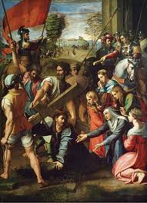
To Calvary
After having been scourged twice; having not eaten since the previous night; having gone from one mockery of a trial to another; Christ was unable to carry His cross. It was laid upon His bleeding shoulders, but He fell beneath the load. He could not continue.

Slide 6
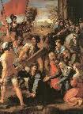
The Dilemma
“The crowd that followed the Saviour saw His weak and staggering steps, but they manifested no compassion. They taunted and reviled Him because He could not carry the heavy cross. Again the burden was laid upon Him, and again He fell fainting to the ground. His persecutors saw that it was impossible for Him to carry His burden farther. They were puzzled to find anyone who would bear the humiliating load. The Jews themselves could not do this, because the defilement would prevent them from keeping the Passover. None even of the mob that followed Him would stoop to bear the cross.” DA, pg. 742

Slide 7
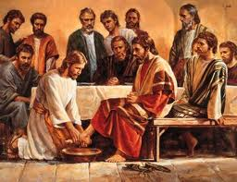
Somebody Else was There Too!
“A vast multitude followed Jesus from the judgment hall to Calvary. The news of His condemnation had spread throughout Jerusalem, and people of all classes and all ranks flocked toward the place of crucifixion. The priests and rulers had been bound by a promise not to molest Christ's followers if He Himself were delivered to them, and the disciples and believers from the city and the surrounding region joined the throng that followed the Saviour.” DA, pg. 741

Slide 8
Condemned for Compassion
The crowd that followed the Saviour saw His weak and staggering steps, but they manifested no compassion. They taunted and reviled Him because He could not carry the heavy cross. Again the burden was laid upon Him, and again He fell fainting to the ground. His persecutors saw that it was impossible for Him to carry His burden farther. They were puzzled to find anyone who would bear the humiliating load. The Jews themselves could not do this, because the defilement would prevent them from keeping the Passover. None even of the mob that followed Him would stoop to bear the cross.
At this time a stranger, Simon a Cyrenian, coming in from the country, meets the throng. He hears the taunts and ribaldry of the crowd; he hears the words contemptuously repeated, Make way for the King of the Jews! He stops in astonishment at the scene; and as he expresses his compassion, they seize him and place the cross upon his shoulders.” DA, pg. 742

Slide 9
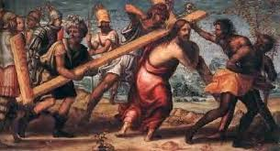
Simon Carries the Cross
Conference and independent Adventists would not carry Jesus’ cross. They refused to show Him compassion. Simon, the north African from Cyrene, showed compassion and carried it!! This was his crime. May we ever be guilty of the same crime!!!

Slide 10
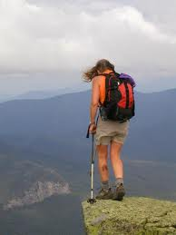
Claim and Action?!?
Simon’s sin was compassion! Since we are the professed people of God, living at the end of time, claiming to be following all of God’s commandments, how can we say we honor the last six commandments, which are love to man, when we don’t share the truth with others? The world is at the precipice; we are the only ones with a safety net; will we not share our net with others? May we be found guilty of compassion!!!!!

Slide 11
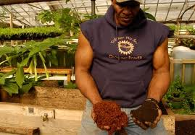
What of Simon?
Simon was from Cyrene, located in the region of North Africa. More than likely, he was a farmer. He wasn’t a physically weak fellow either. We know he had a family.
“And they compel one Simon a Cyrenian, who passed by, coming out of the country, the father of Alexander and Rufus, to bear his cross.” Mark 15:21

Slide 12
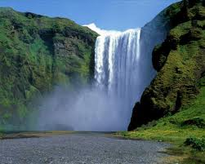
His Boys
“Simon had heard of Jesus. His sons were believers in the Saviour, but he himself was not a disciple.” DA, pg. 742
“One of His followers, a man who had not openly professed faith in Christ, yet believed on Him, was next seized. Upon him the cross was laid, and he bore it to the fatal spot.” Early Writings, pg. 175
“

Slide 13
At just the Right Time
“But like the stars in the vast circuit of their appointed path, God's purposes know no haste and no delay. Through the symbols of the great darkness and the smoking furnace, God had revealed to Abraham the bondage of Israel in Egypt, and had declared that the time of their sojourning should be four hundred years. "Afterward," He said, "shall they come out with great substance." Gen. 15:14. Against that word, all the power of Pharaoh's proud empire battled in vain. On "the self-same day" appointed in the divine promise, "it came to pass, that all the hosts of the Lord went out from the land of Egypt." Ex. 12:41. So in heaven's council the hour for the coming of Christ had been determined. When the great clock of time pointed to that hour, Jesus was born in Bethlehem.” DA, pg. 32
“He hath made every [thing] beautiful in his time:” Eccl. 3:11

Slide 14
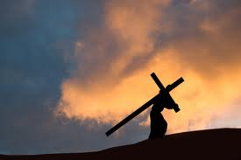
A Prayer was Heard
“The bearing of the cross to Calvary was a blessing to Simon, and he was ever after grateful for this providence. It led him to take upon himself the cross of Christ from choice, and ever cheerfully stand beneath its burden.” DA, pg. 742

Slide 15
‘Father, forgive them……….’
“His sympathies were deeply stirred in favor of Jesus; and the events of Calvary, and the words uttered by the Saviour, caused him to acknowledge that He was the Son of God.” EGW comments, SDA Commentary, pg. 1107

Slide 16
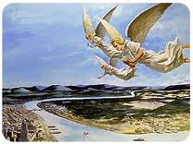
Christ’s Cross Today
Today, Christ has an unbearable cross and He needs our help. He needs us to bear it for Him. He has 3 messages in Revelation 14:6-12 that must be told so that He can come and put an end to all this suffering. The messages are not politically correct. In fact, they get people very angry!

Slide 17
The Messages Include…..
1. The judgment hour, victory over sin, and 1844.
2. The eternal nature of God’s law and the Sabbath.
3. The apostate Protestant churches are Babylon fallen since 1844.
4. The Roman Catholic Church system is the beast and Sunday is her mark. The papacy is STILL the antichrist power of Scripture!

Slide 18
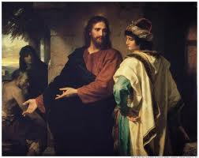
Hate/ Intolerant
We will be called …………
1. terrorists
2. Hate groups
3. Divisive
4. Intolerant
Will we bear this cross for One who gave His all for us? Will we, like Simon, show Christ compassion and share His messages? Our final chapters are being written!

