Slide 1
Ezekiel, pt. 25
Dividing the Land

Slide 2
“Thus saith the Lord GOD; This shall be the border, whereby ye shall inherit the land according to the twelve tribes of Israel: Joseph shall have two portions. And ye shall inherit it, one as well as another: concerning the which I lifted up mine hand to give it unto your fathers: and this land shall fall unto you for inheritance…So shall ye divide this land unto you according to the tribes of Israel.” Ezekiel 47:13,14,21

Slide 3
All Got an Inheritance Here
”And by the border of Dan, from the east side unto the west side, a portion for Asher. And by the border of Asher, from the east side even unto the west side, a portion for Naphtali. And by the border of Naphtali, from the east side unto the west side, a portion for Manasseh. And by the border of Manasseh, from the east side unto the west side, a portion for Ephraim. And by the border of Ephraim, from the east side even unto the west side, a portion for Reuben. And by the border of Reuben, from the east side unto the west side, a portion for Judah.” Ezekiel 48:2-7

Slide 4
The Rest Did Too
”As for the rest of the tribes, from the east side unto the west side, Benjamin shall have a portion. And by the border of Benjamin, from the east side unto the west side, Simeon shall have a portion. And by the border of Simeon, from the east side unto the west side, Issachar a portion. And by the border of Issachar, from the east side unto the west side, Zebulun a portion. And by the border of Zebulun, from the east side unto the west side, Gad a portion.” Ezekiel 48:23-27

Slide 5
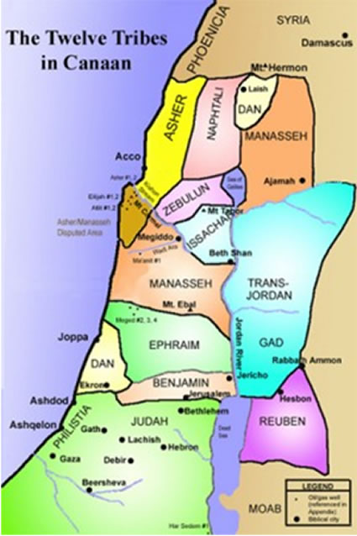
Divisions of Israel
Amazingly, the 12 tribes inherited the promised land. This has happened:
1. In the days of Joshua.
2. After the Babylonian captivity.
3. The Heavenly Promised Land will be inherited by Spiritual Israel, by MOST of them as well!
SHOCKING!

Slide 6
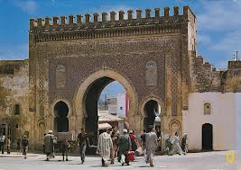
Names on the Gates into the city
How the names of the 12 tribes will be emblazoned over the gates to the New Jerusalem is amazing! That that dysfunctional group/family would have any connection to holiness, to purity, to glorify defies reality!

Slide 7
There They Are!!!
”And the gates of the city shall be after the names of the tribes of Israel: three gates northward; one gate of Reuben, one gate of Judah, one gate of Levi. And at the east side four thousand and five hundred: and three gates; and one gate of Joseph, one gate of Benjamin, one gate of Dan. And at the south side four thousand and five hundred measures: and three gates; one gate of Simeon, one gate of Issachar, one gate of Zebulun. At the west side four thousand and five hundred, with their three gates; one gate of Gad, one gate of Asher, one gate of Naphtali. It was round about eighteen thousand measures: and the name of the city from that day shall be, The LORD is there.” Ezekiel 48:31-35

Slide 8
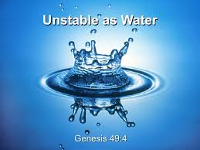
What Will The Gates Say?
Rueben- “Unstable as water, thou shalt not excel; because thou wentest up to thy father's bed; then defiledst thou it: he went up to my couch.” Gen. 49:4
“And it came to pass, when Israel dwelt in that land, that Reuben went and lay with Bilhah his father's concubine: and Israel heard it. Now the sons of Jacob were twelve:” Genesis 35:22 Will it say unstable or immoral??

Slide 9
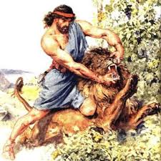
Hope for the immoral
David, Samson, Solomon, and a host of others who have fallen into moral impurity find hope through Reuben’s gate because they, like him, have fallen, repented, and found power in Christ to overcome. Rueben’s gate awaits them!!!

Slide 10
Searched his Heart!
“And the princes of Issachar were with Deborah; even Issachar, and also Barak: he was sent on foot into the valley. For the divisions of Reuben there were great thoughts of heart.” Judges 5:15
“ Search me, O God, and know my heart: try me, and know my thoughts: And see if there be any wicked way in me, and lead me in the way everlasting.” Ps. 139:23,24

Slide 11
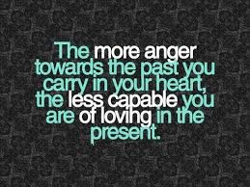
Simeon and Levi
”Simeon and Levi are brethren; instruments of cruelty are in their habitations…for in their anger they slew a man,…” Genesis 49:5,6
“And it came to pass on the third day, when they were sore, that two of the sons of Jacob, Simeon and Levi, Dinah's brethren, took each man his sword, and came upon the city boldly, and slew all the males.” Gen. 34:25

Slide 12
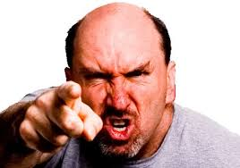
On Their Gate? Vicious Cruelty?
“For behold this selfsame thing, that ye sorrowed after a godly sort, what carefulness it wrought in you, yea, what clearing of yourselves, yea, what indignation, yea, what fear, yea, what vehement desire, yea, what zeal, yea, what revenge! In all things ye have approved yourselves to be clear in this matter.” 2 Corinthians 7:11

Slide 13
Hope For the Angry, Cruel
The children of Levi repented of their wickedness and showed their faithfulness of Mt. Sinai. They give hope for those who have allowed corrosive cruelty and anger to ruin their lives to be stored. Simeon and Levi’s gate is for them!

Slide 14
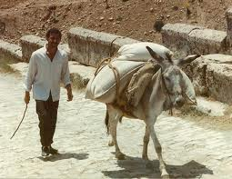
Burden Bearer’s Go Thru His Gate
“Issachar is a strong ass couching down between two burdens: And he saw that rest was good, and the land that it was pleasant; and bowed his shoulder to bear, and became a servant unto tribute.” Gen, 49:14,15
Not flashy, not flamboyant, Issachar just gets the job done!

Slide 15
Gad? Who?
Gad, a troop shall overcome him: but he shall overcome at the last.” Gen. 49:19
“When Leah saw that she had left bearing, she took Zilpah her maid, and gave her Jacob to wife. And Zilpah Leah's maid bare Jacob a son. And Leah said, A troop cometh: and she called his name Gad.” Gen. 30:9-11

Slide 16
The Survivor/Mixer
Think for a moment what life must have been for Zilpah.
1. She was Leah’s slave.
2. She was elevated to being Jacob’s wife, but at the same time, she was still, in Leah’s eyes, a slave.
3. She had to be so slick to survive the intrigues of being slave, wife, slave-wife; all at once!!!
4. She was the consummate survivor; she knew how to maneuver through situations. For her, it was survival!!! Gad learned the same!

Slide 17
Two Were Missing
“ Of the tribe of Juda were sealed twelve thousand. Of the tribe of Reuben were sealed twelve thousand. Of the tribe of Gad were sealed twelve thousand. Of the tribe of Aser were sealed twelve thousand. Of the tribe of Nepthalim were sealed twelve thousand. Of the tribe of Manasses were sealed twelve thousand. Of the tribe of Simeon were sealed twelve thousand. Of the tribe of Levi were sealed twelve thousand. Of the tribe of Issachar were sealed twelve thousand. Of the tribe of Zabulon were sealed twelve thousand. Of the tribe of Joseph were sealed twelve thousand. Of the tribe of Benjamin were sealed twelve thousand.” Rev. 7:4-8

Slide 18
Dan Was Never Wrong
“ And he said, Ye have taken away my gods which I made, and the priest, and ye are gone away: and what have I more? and what is this that ye say unto me, What aileth thee? And the children of Dan said unto him, Let not thy voice be heard among us, lest angry fellows run upon thee, and thou lose thy life, with the lives of thy household. And the children of Dan went their way: and when Micah saw that they were too strong for him, he turned and went back unto his house.” Judges 18:24-26

Slide 19
Ephraim Couldn’t Stoop
”And the men of Ephraim gathered themselves together, and went northward, and said unto Jephthah, Wherefore passedst thou over to fight against the children of Ammon, and didst not call us to go with thee? we will burn thine house upon thee with fire. And Jephthah said unto them, I and my people were at great strife with the children of Ammon; and when I called you, ye delivered me not out of their hands. And when I saw that ye delivered me not, I put my life in my hands, and passed over against the children of Ammon, and the LORD delivered them into my hand: wherefore then are ye come up unto me this day, to fight against me? Then Jephthah gathered together all the men of Gilead, and fought with Ephraim: and the men of Gilead smote Ephraim, because they said, Ye Gileadites are fugitives of Ephraim among the Ephraimites, and among the Manassites. And the Gileadites took the passages of Jordan before the Ephraimites: and it was so, that when those Ephraimites which were escaped said, Let me go over; that the men of Gilead said unto him, Art thou an Ephraimite? If he said, Nay; Then said they unto him, Say now Shibboleth: and he said Sibboleth: for he could not frame to pronounce it right. Then they took him, and slew him at the passages of Jordan: and there fell at that time of the Ephraimites forty and two thousand.” Judges 12: 1-6

Slide 20
Ephraim Was Better Than Everyone
Ephraim was one of the sons of Joseph. Every whim and desire was fulfilled by a willing servant. Ephraim came to look upon himself as a privileged character. Everyone lived for his comfort. He became selfish to the extreme. The world was his and he was the world.

