Slide 1
Revelation 19
Triumph and Judgment

Slide 2
The Salutation
Revelation 19:1-6 “And after these things I heard a great voice of much people in heaven, saying, Alleluia; Salvation, and glory, and honour, and power, unto the Lord our God: For true and righteous are his judgments: for he hath judged the great whore, which did corrupt the earth with her fornication, and hath avenged the blood of his servants at her hand. And again they said, Alleluia. And her smoke rose up for ever and ever. And the four and twenty elders and the four beasts fell down and worshipped God that sat on the throne, saying, Amen; Alleluia. And a voice came out of the throne, saying, Praise our God, all ye his servants, and ye that fear him, both small and great. And I heard as it were the voice of a great multitude, and as the voice of many waters, and as the voice of mighty thunderings, saying, Alleluia: for the Lord God omnipotent reigneth. “

Slide 3
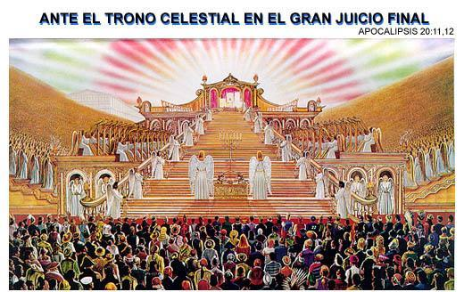
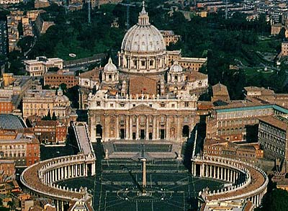
Glory and Judgment

Slide 4
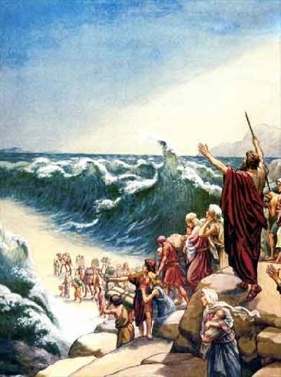
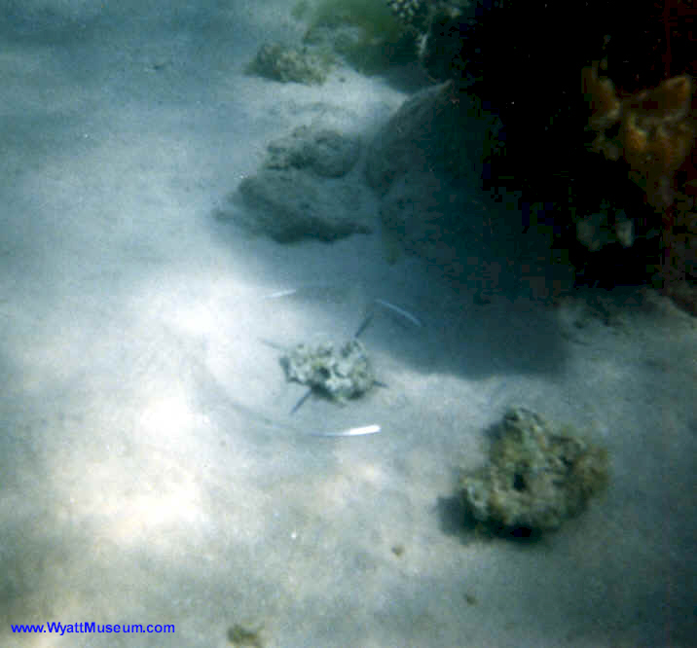
Victory and Defeat

Slide 5
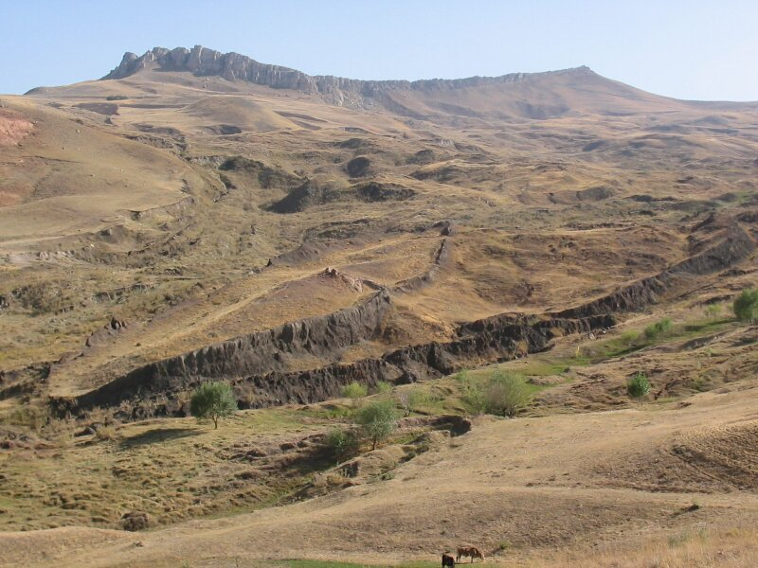
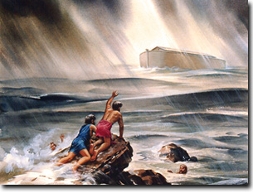
Triumph and Tragedy

Slide 6
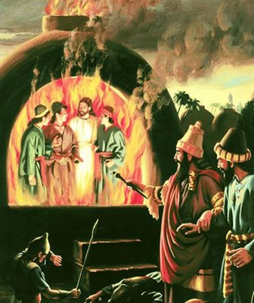
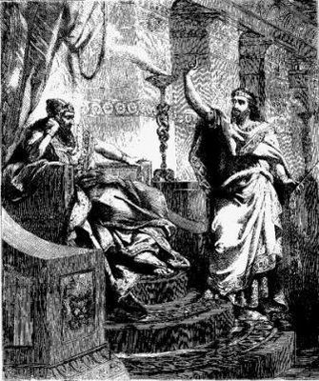
Honor and Humility

Slide 7
The Difference
“Let us be glad and rejoice, and give honour to him: for the marriage of the Lamb is come, and his wife hath made herself ready. And to her was granted that she should be arrayed in fine linen, clean and white: for the fine linen is the righteousness of saints. And he saith unto me, Write, Blessed are they which are called unto the marriage supper of the Lamb. And he saith unto me, These are the true sayings of God.” Revelation 19:7-9

Slide 8
The Wedding Garment
“And when the king came in to see the guests, he saw there a man which had not on a wedding garment: And he saith unto him, Friend, how camest thou in hither not having a wedding garment? And he was speechless. Then said the king to the servants, Bind him hand and foot, and take him away, and cast him into outer darkness; there shall be weeping and gnashing of teeth.
For many are called, but few are chosen.” Matthew 22:11-14

Slide 9
Clothed with a Righteousness not their own
Isaiah 64:6 “But we are all as an unclean thing, and all our righteousnesses are as filthy rags; and we all do fade as a leaf; and our iniquities, like the wind, have taken us away.”
Philippians 3:8-10 “Yea doubtless, and I count all things but loss for the excellency of the knowledge of Christ Jesus my Lord: for whom I have suffered the loss of all things, and do count them but dung, that I may win Christ, And be found in him, not having mine own righteousness, which is of the law, but that which is through the faith of Christ, the righteousness which is of God by faith: That I may know him, and the power of his resurrection, and the fellowship of his sufferings, being made conformable unto his death;”

Slide 10
The Bride
The children of God, renouncing all self-dependence, cling to Jesus and His righteousness alone.
“It is by living faith in Christ as our personal Saviour that his righteousness is imputed to us. In the parable of the supper, when the king came in to examine the guests, he found a man who had not on the wedding garment. He had accepted the invitation to the marriage feast, but had cast contempt upon his host in not laying aside his own garment for the wedding robe provided for him. There are many who are represented by this man. They have accepted the invitation to the marriage supper, but have failed to comply with the conditions for entrance to the feast. They will not lay aside the garments of their own self-righteousness, and put on the robe prepared for them at an infinite price. They have accepted the theory of the truth, but they do not possess and cultivate the faith that works by love and purifies the soul. They do not appropriate the truth to their individual needs, and become partakers of the divine nature. They are not willing to have the earthliness removed from their character, in order that the heavenly graces may be imparted. They will be speechless before the King when he comes in to examine the guests, and asks them why they have not put on the righteousness of Christ.” YI, October 28, 1897 par. 1

Slide 11
Am I wearing the Garment?
“By the wedding garment in the parable is represented the pure, spotless character which Christ's true followers will possess. To the church it is given "that she should be arrayed in fine linen, clean and white," "not having spot, or wrinkle, or any such thing." Rev. 19:8; Eph. 5:27. The fine linen, says the Scripture, "is the righteousness of saints." Rev. 19:8. It is the righteousness of Christ, His own unblemished character, that through faith is imparted to all who receive Him as their personal Saviour. The white robe of innocence was worn by our first parents when they were placed by God in holy Eden. . . . But when sin entered, they severed their connection with God, and the light that had encircled them departed. . . . Nothing can man devise to supply the place of his lost robe of innocence. . . . Only the covering which Christ Himself has provided can make us meet to appear in God's presence. This covering, the robe of His own righteousness, Christ will put upon every repenting, believing soul. . . . This robe, woven in the loom of heaven, has in it not one thread of human devising. Christ in His humanity wrought out a perfect character, and this character He offers to impart to us. "All our righteousnesses are as filthy rags." Isa. 64:6. Everything that we of ourselves can do is defiled by sin. But the Son of God "was manifested to take away our sins; and in him is no sin." 1 John 3:5. . . . By His perfect obedience He has made it possible for every human being to obey God's commandments. When we submit ourselves to Christ, the heart is united with His heart, the will is merged in His will, the mind becomes one with His mind, the thoughts are brought into captivity to Him; we live His life. This is what it means to be clothed with the garment of His righteousness. Then as the Lord looks upon us He sees, not the fig-leaf garment, not the nakedness and deformity of sin, but His own robe of righteousness, which is perfect obedience to the law of Jehovah. “ Maranatha, pg. 78

Slide 12
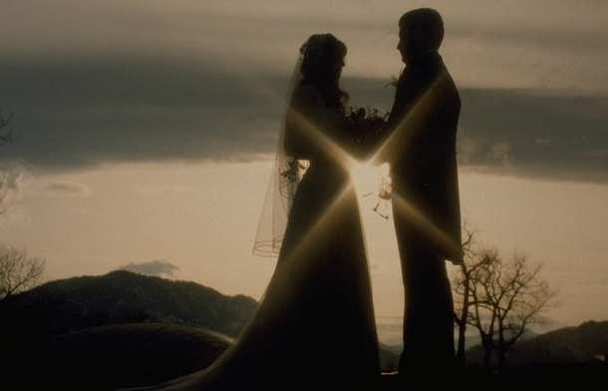
Revelation’s Main Point
Revelation 3:4,5,18
Rev. 4:4; Rev. 6:11
Rev. 7:9,14
All of these verses in Revelation point to the righteousness of Christ that He gives to helpless humanity.

Slide 13
The Gift
Rev. 19:10 “And I fell at his feet to worship him. And he said unto me, See thou do it not: I am thy fellow servant, and of thy brethren that have the testimony of Jesus: worship God: for the testimony of Jesus is the spirit of prophecy.”
Revelation 12:17 “ And the dragon was wroth with the woman, and went to make war with the remnant of her seed, which keep the commandments of God, and have the testimony of Jesus Christ.” These are the identifying marks of God’s final, end-time people.

Slide 14
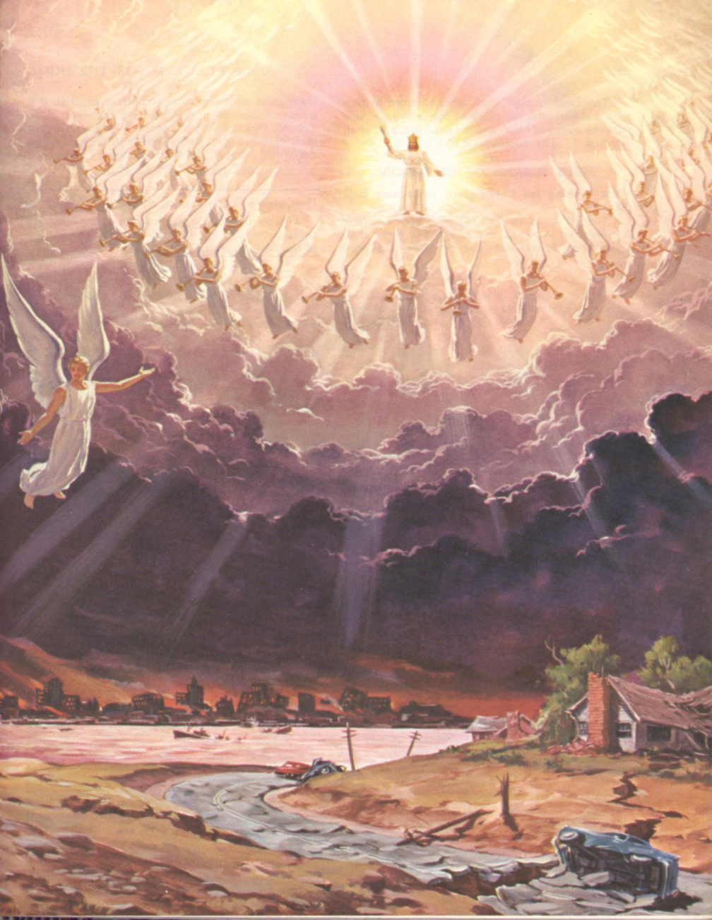
It is Time
Revelation 19:11-16 “And I saw heaven opened, and behold a white horse; and he that sat upon him was called Faithful and True, and in righteousness he doth judge and make war. His eyes were as a flame of fire, and on his head were many crowns; and he had a name written, that no man knew, but he himself. And he was clothed with a vesture dipped in blood: and his name is called The Word of God. And the armies which were in heaven followed him upon white horses, clothed in fine linen, white and clean. And out of his mouth goeth a sharp sword, that with it he should smite the nations: and he shall rule them with a rod of iron: and he treadeth the winepress of the fierceness and wrath of Almighty God. And he hath on his vesture and on his thigh a name written, KING OF KINGS, AND LORD OF LORDS. “

Slide 15
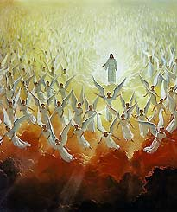
It is Time!
“Soon there appears in the east a small black cloud, about half the size of a man's hand. It is the cloud which surrounds the Saviour and which seems in the distance to be shrouded in darkness. The people of God know this to be the sign of the Son of man. In solemn silence they gaze upon it as it draws nearer the earth, becoming lighter and more glorious, until it is a great white cloud, its base a glory like consuming fire, and above it the rainbow of the covenant. Jesus rides forth as a mighty conqueror. Not now a "Man of Sorrows," to drink the bitter cup of shame and woe, He comes, victor in heaven and earth, to judge the living and the dead. "Faithful and True," "in righteousness He doth judge and make war.“ GC, 640,641

Slide 16
He is Coming!
And "the armies which were in heaven" (Revelation 19:11, 14) follow Him. With anthems of celestial melody the holy angels, a vast, unnumbered throng, attend Him on His way. The firmament seems filled with radiant forms--"ten thousand times ten thousand, and thousands of thousands." No human pen can portray the scene; no mortal mind is adequate to conceive its splendor. "His glory covered the heavens, and the earth was full of His praise. And His brightness was as the light." Habakkuk 3:3,4. As the living cloud comes still nearer, every eye beholds the Prince of life. No crown of thorns now mars that sacred head; but a diadem of glory rests on His holy brow. “ GC, 640,641

Slide 17
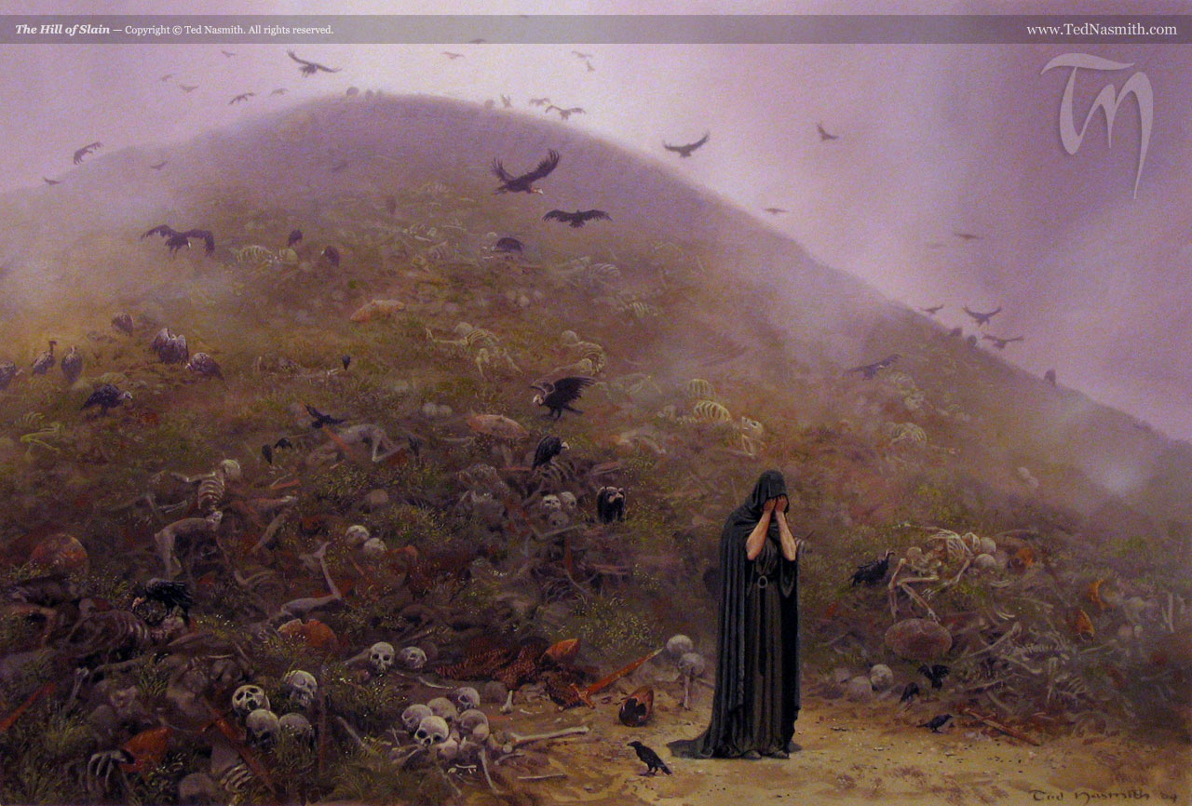
Wicked Slain by Christ’s Coming
“And I saw an angel standing in the sun; and he cried with a loud voice, saying to all the fowls that fly in the midst of heaven, Come and gather yourselves together unto the supper of the great God; That ye may eat the flesh of kings, and the flesh of captains, and the flesh of mighty men, and the flesh of horses, and of them that sit on them, and the flesh of all men, both free and bond, both small and great.” Revelation 19:17,18

Slide 18
The Wicked Try to Flee
Revelation 6:15-17 “And the kings of the earth, and the great men, and the rich men, and the chief captains, and the mighty men, and every bondman, and every free man, hid themselves in the dens and in the rocks of the mountains; And said to the mountains and rocks, Fall on us, and hide us from the face of him that sitteth on the throne, and from the wrath of the Lamb: For the great day of his wrath is come; and who shall be able to stand? “
“Enter into the rock, and hide thee in the dust, for fear of the LORD, and for the glory of his majesty. The lofty looks of man shall be humbled, and the haughtiness of men shall be bowed down, and the LORD alone shall be exalted in that day. For the day of the LORD of hosts shall be upon every one that is proud and lofty, and upon every one that is lifted up; and he shall be brought low:” Isaiah 13:10-12

Slide 19

Fighting to the very End
Revelation 19:19 “And I saw the beast, and the kings of the earth, and their armies, gathered together to make war against him that sat on the horse, and against his army.” The papacy and the leaders of this world will oppose the Second Coming of Christ with missiles, atomic warheads, and the like.

Slide 20

Their Fiery End
Revelation 19:20 “And the beast was taken, and with him the false prophet that wrought miracles before him, with which he deceived them that had received the mark of the beast, and them that worshipped his image.“

Slide 21
Rebellion will have an End
“These both were cast alive into a lake of fire burning with brimstone. And the remnant were slain with the sword of him that sat upon the horse, which sword proceeded out of his mouth: and all the fowls were filled with their flesh.” Revelation 19:20,21
“But the day of the Lord will come as a thief in the night; in the which the heavens shall pass away with a great noise, and the elements shall melt with fervent heat, the earth also and the works that are therein shall be burned up. Seeing then that all these things shall be dissolved, what manner of persons ought ye to be in all holy conversation and godliness, Looking for and hasting unto the coming of the day of God, wherein the heavens being on fire shall be dissolved, and the elements shall melt with fervent heat? Nevertheless we, according to his promise, look for new heavens and a new earth, wherein dwelleth righteousness.” 2Peter 3:10-13

Slide 22
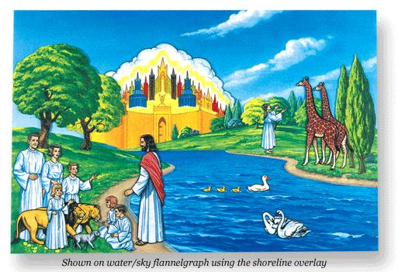
Faithfulness will have no End

