Slide 1
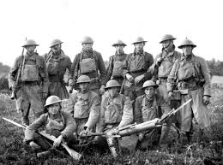
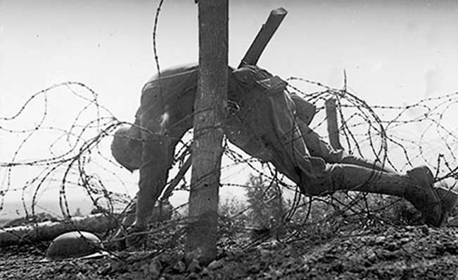

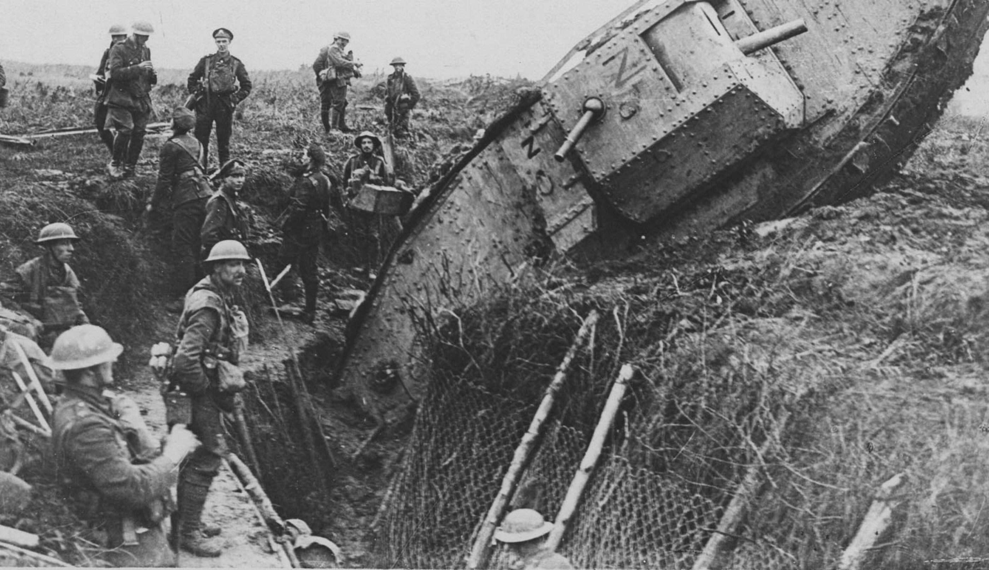
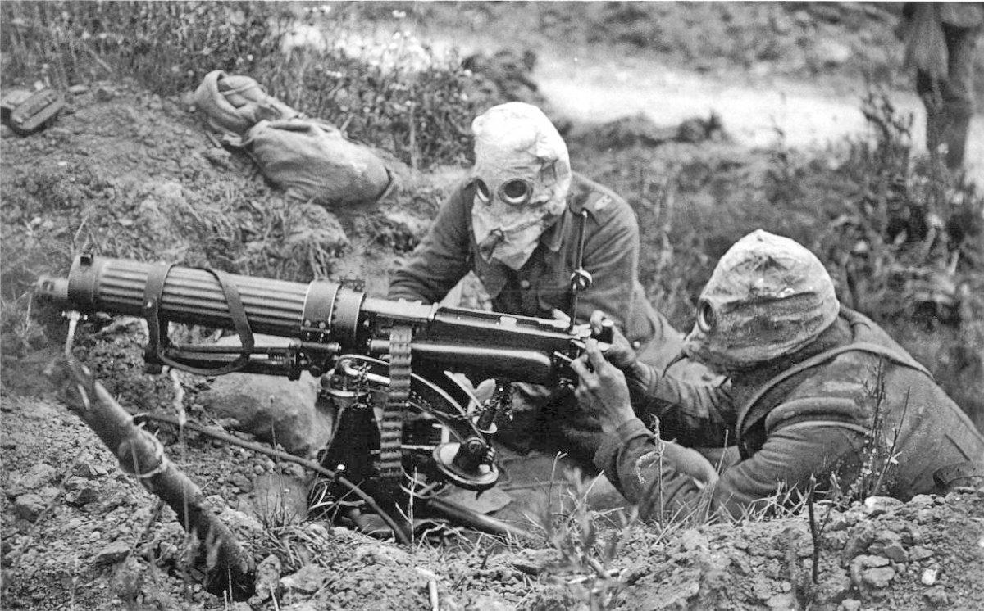

Slide 2
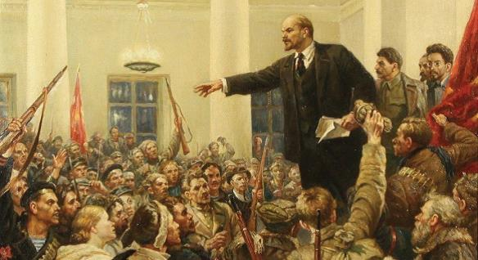

Slide 3
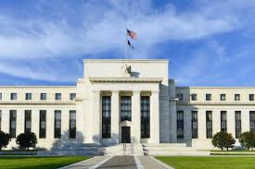
CRIME SCENE DO NOT CROSS CRIME SCENE DO NOT CROSS CRIME SCENE DO NOT CROSS CRIME SCENE DO NOT CROSS
CRIME SCENE DO NOT CROSS CRIME SCENE DO NOT CROSS CRIME SCENE DO NOT CROSS CRIME SCENE DO NOT CROSS

Slide 4
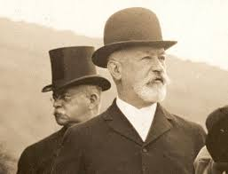
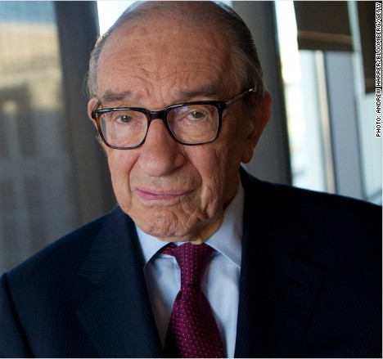
AMERICANS IN NAME ONLY
Jacob Schiff
Alan Greenspan

Slide 5
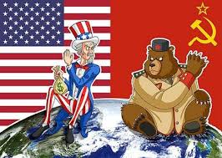
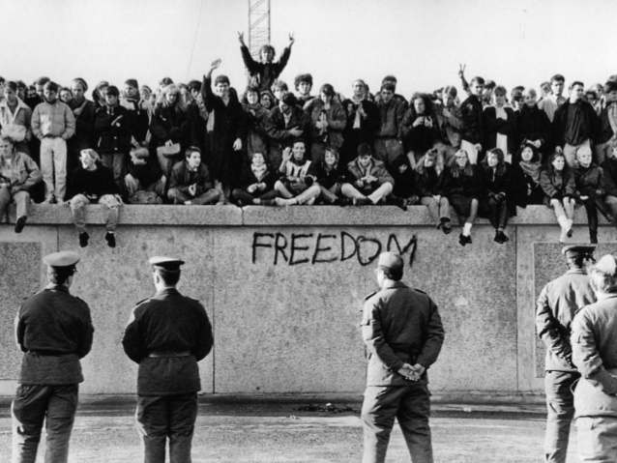
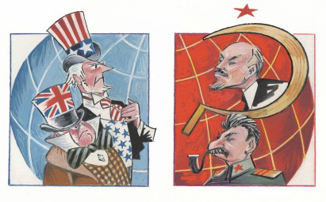
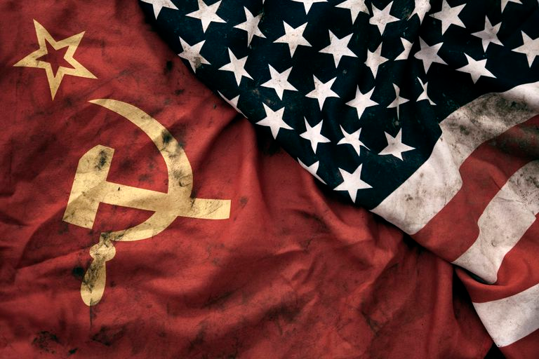

Slide 6
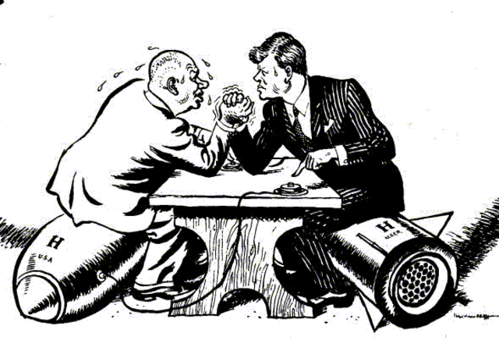


Slide 7
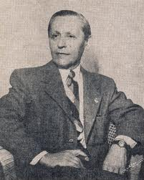
All the great nations, including the United States, were war-weary, devastated, and mourning their dead. Peace was the great universal desire. Thus, when it was proposed by Woodrow Wilson to set up a ‘League of Nations’ to ensure peace; all the great nations jumped on that bandwagon without even stopping to read the fine print in that insurance policy. — Myron Fagan, The Illuminati and the Council on Foreign Relations, Taped lecture.

Slide 8
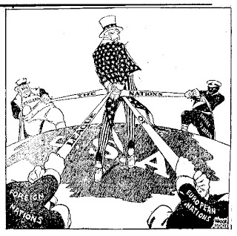
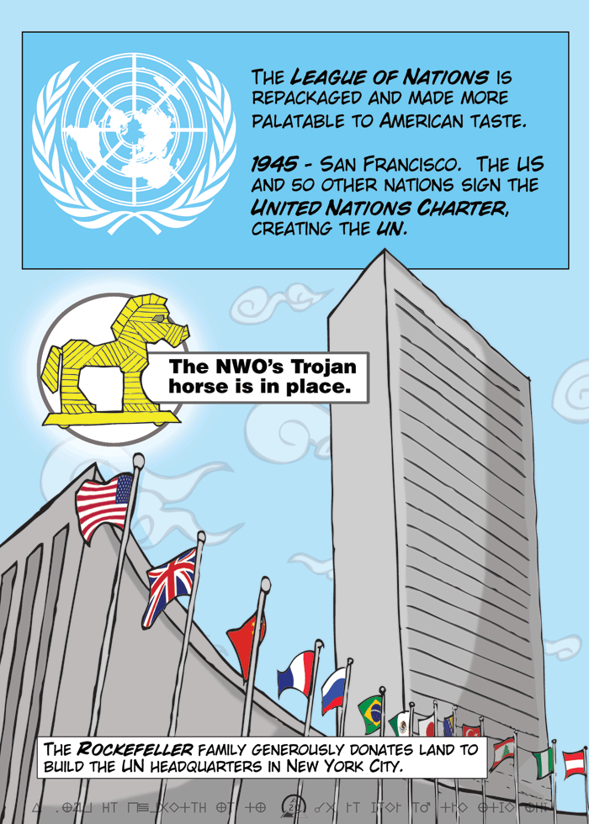

Slide 9
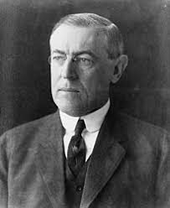
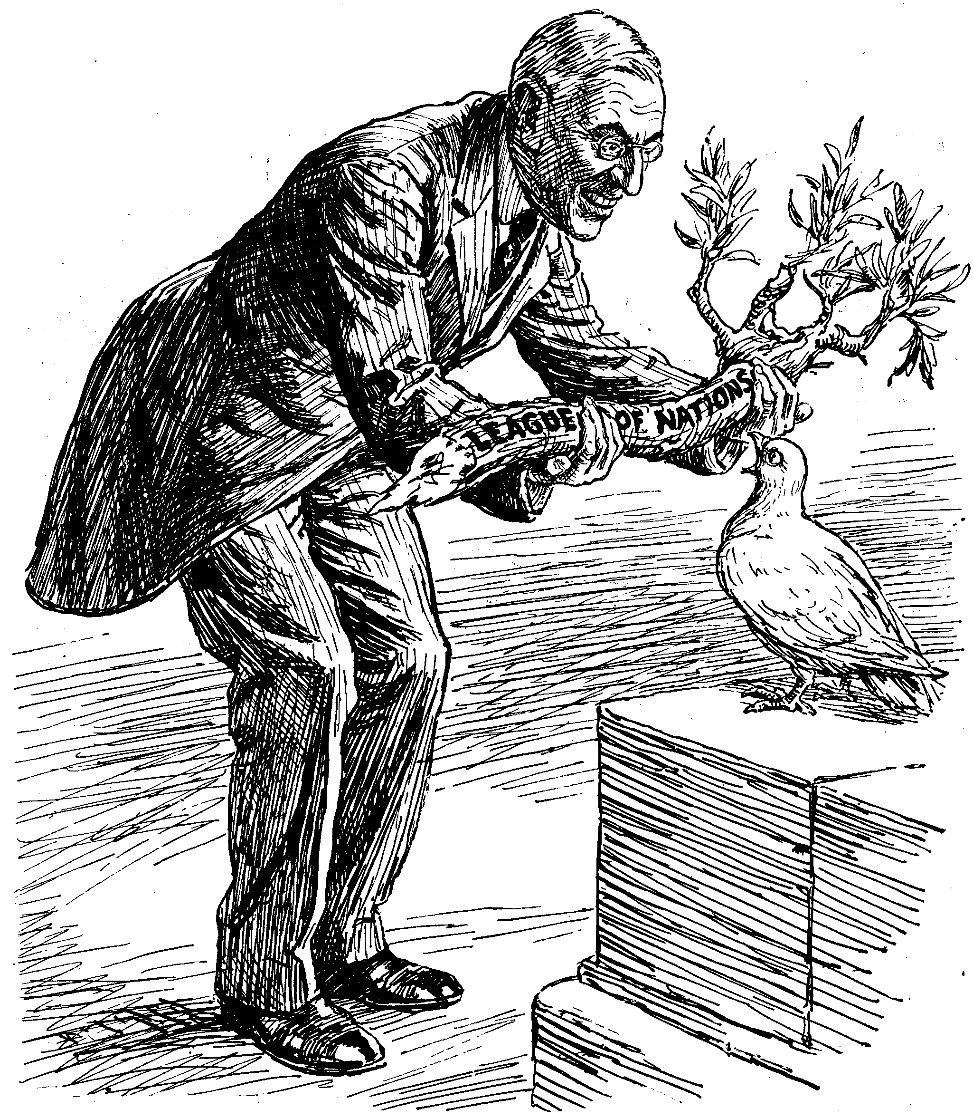
Woodrow Wilson’s League of Nations

Slide 10
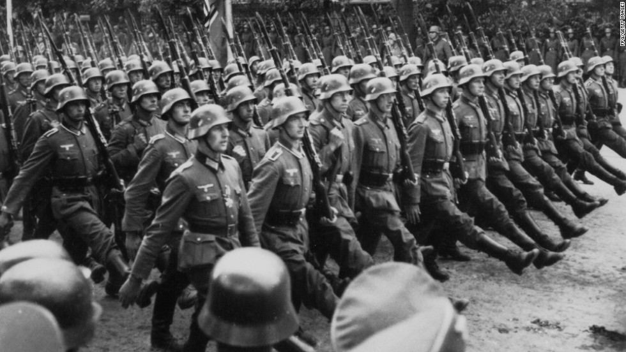
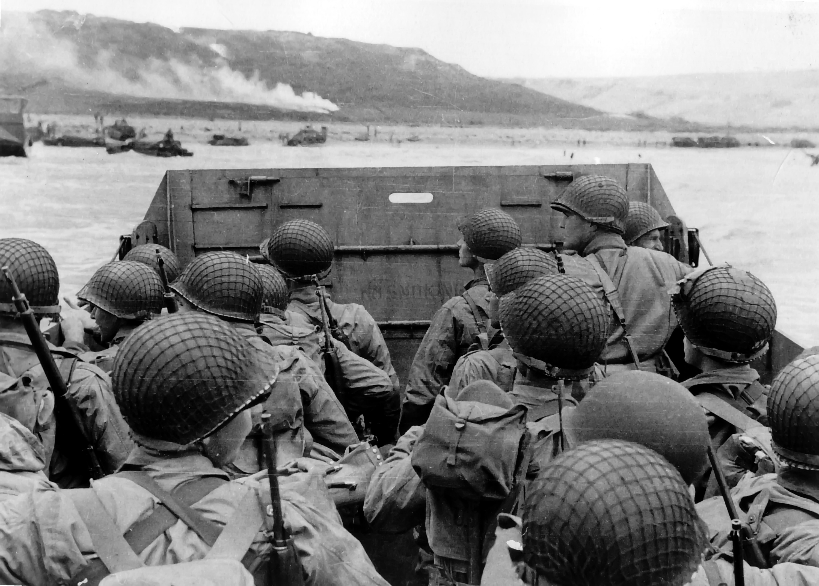
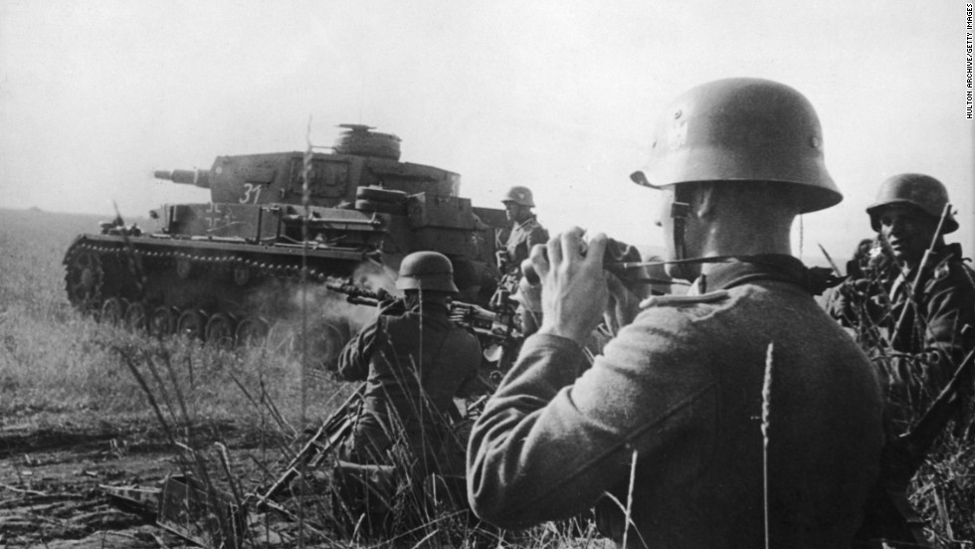
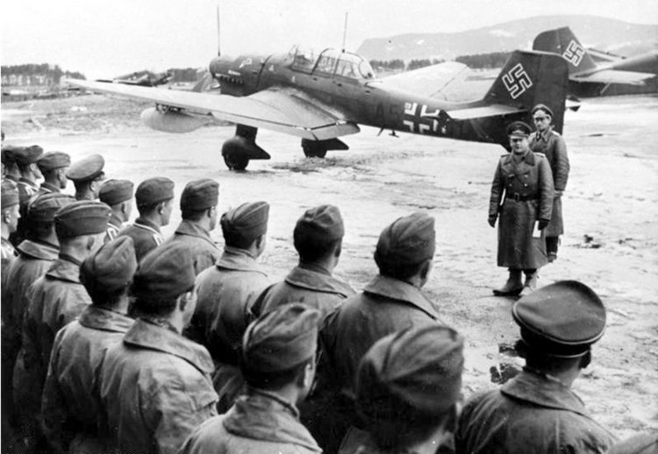

Slide 11


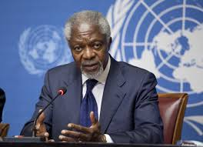
Kofi Annan
THE WORLD AND GOD’S CHURCH WORKING TOGETHER???

Slide 12
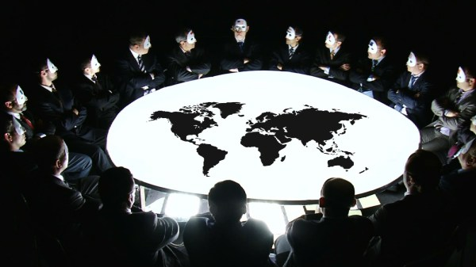

Slide 13
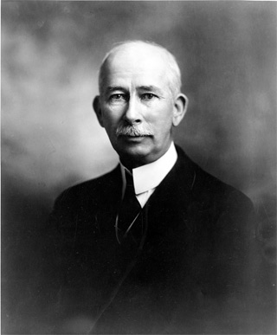
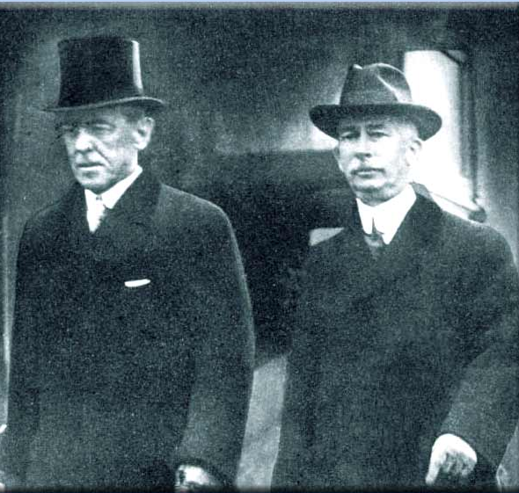
Edward Medell House

Slide 14

For seven long years Colonel House was Woodrow Wilson’s other self.... It was House who made the slate for the Cabinet, formulated the first policies of the Administration and practically directed the foreign affairs of the United States. We had, indeed, two Presidents for one.… Super ambassador, he talked to emperors and kings as an equal. He was the spiritual generalissimo of the Administration. — George Viereck, The Strangest Friendship in History: Woodrow Wilson and Colonel House, Liveright Publishers, pp. 18, 19, 33.

Slide 15
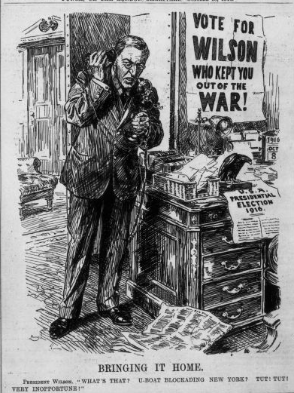
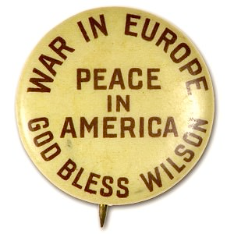
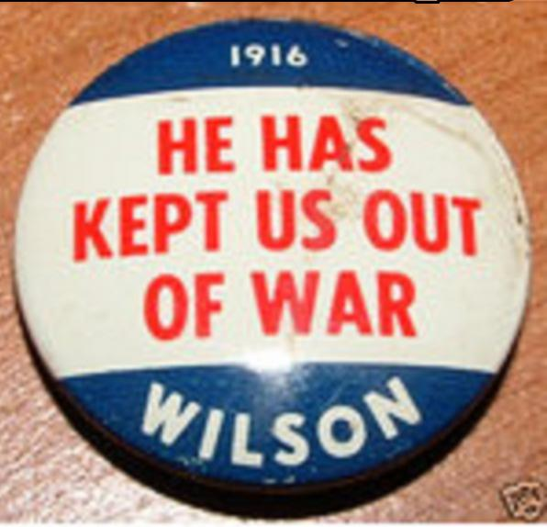

Slide 16
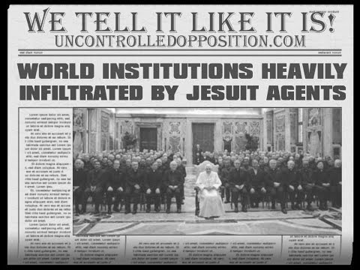
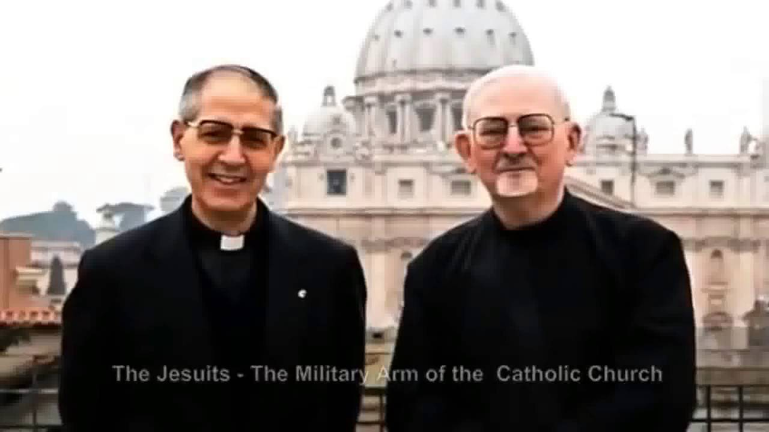

Slide 17
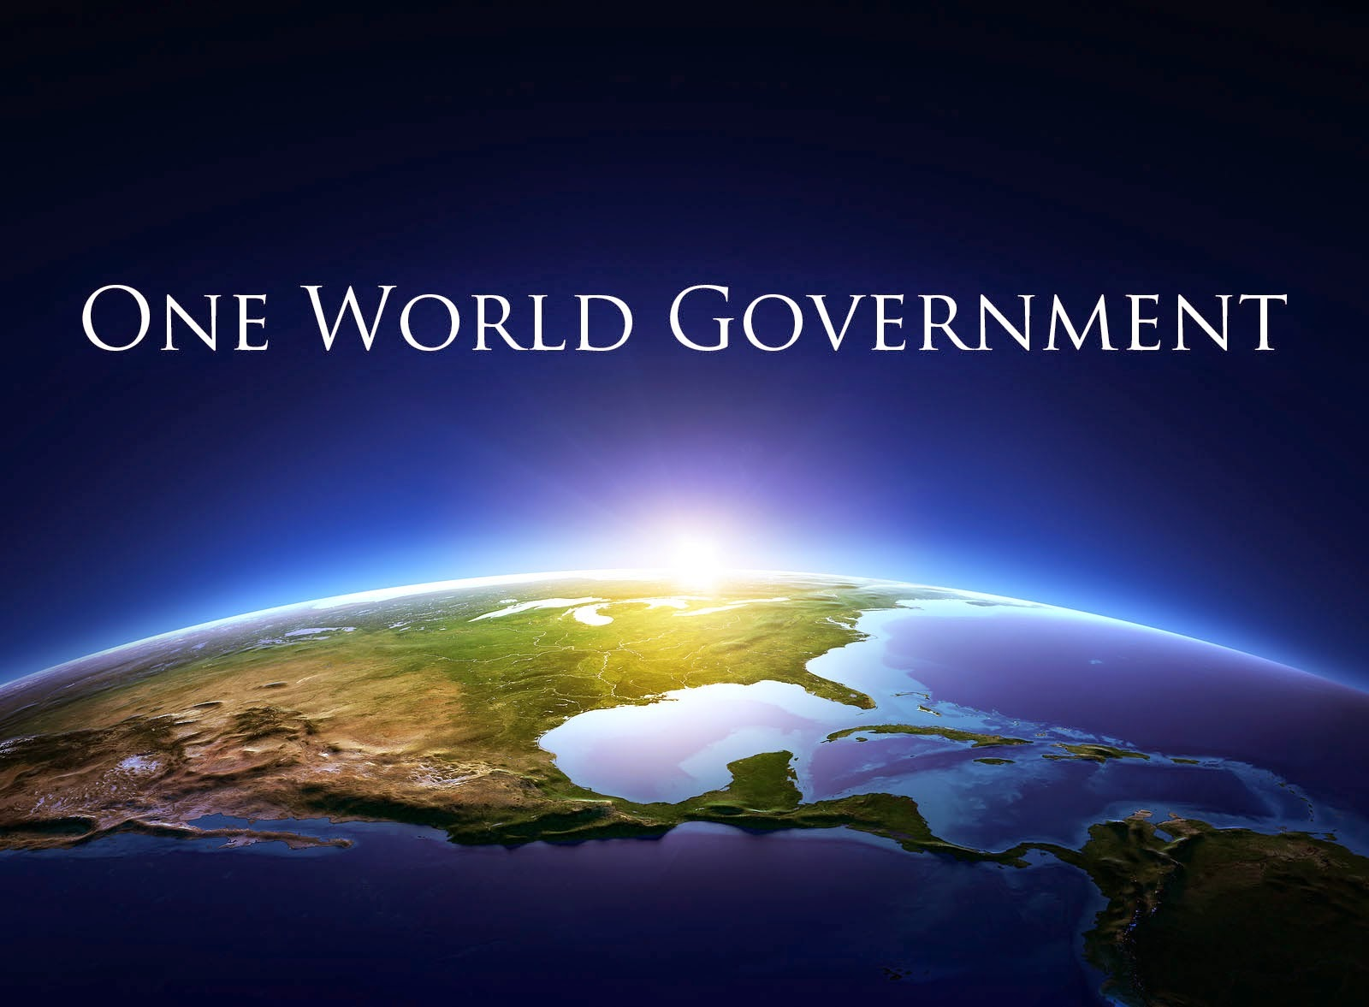
Satan’s Masterpiece

Slide 18
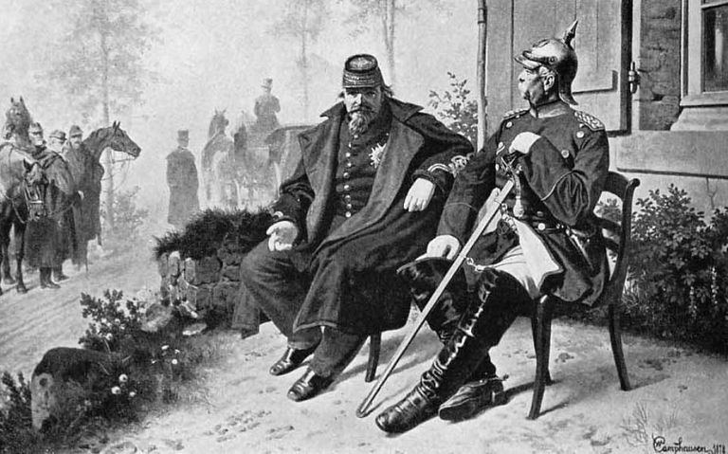

Slide 19
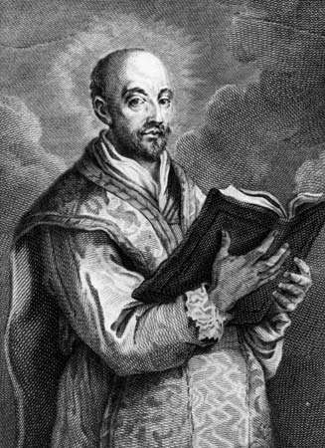
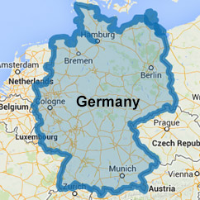
In the 1900s it’s time for payback! Hello world, here’s your new boogie man!

Slide 20
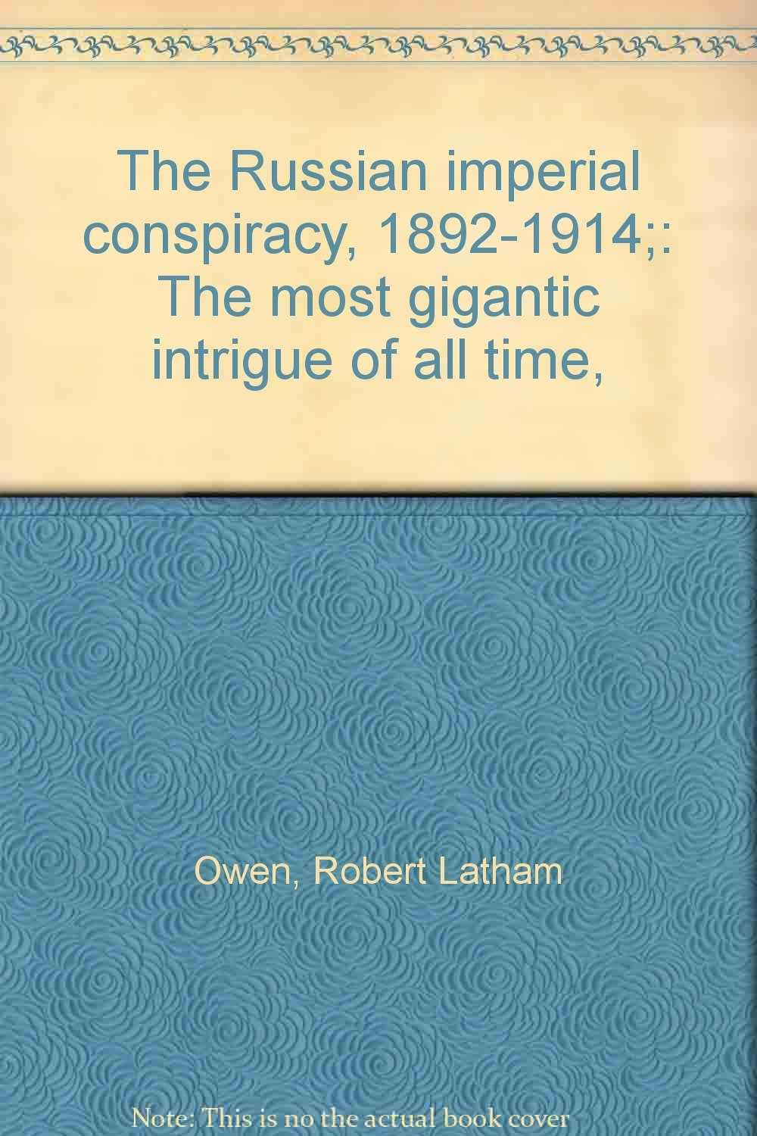
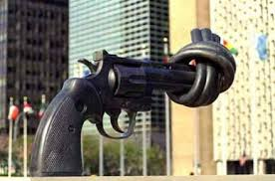

Slide 21
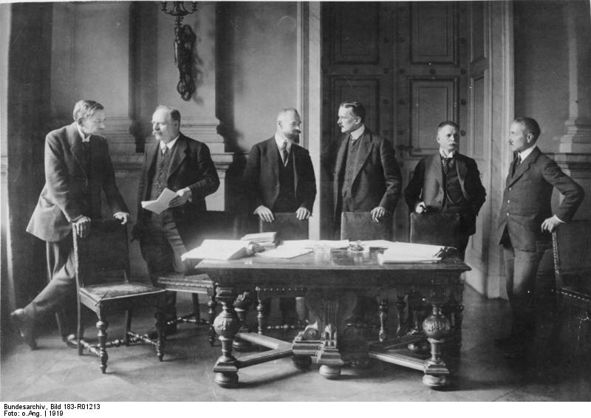
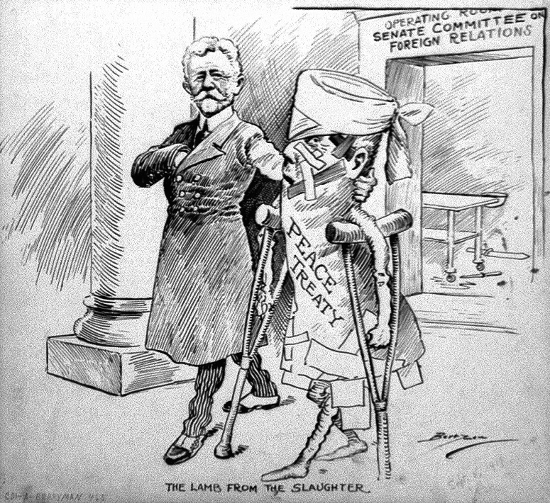

Slide 22
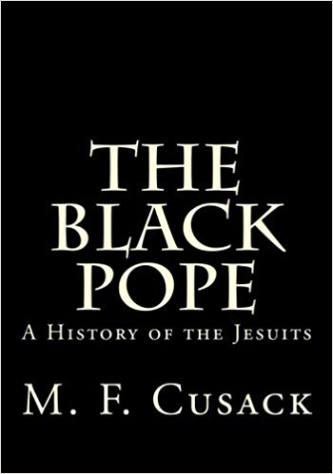
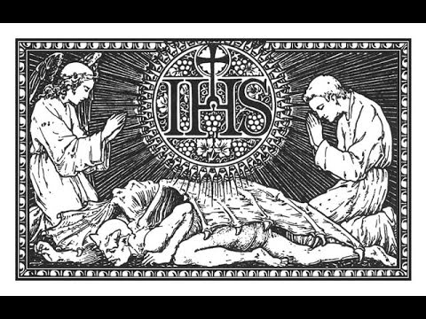

Slide 23
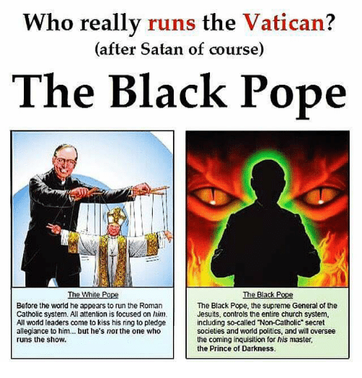

Slide 24
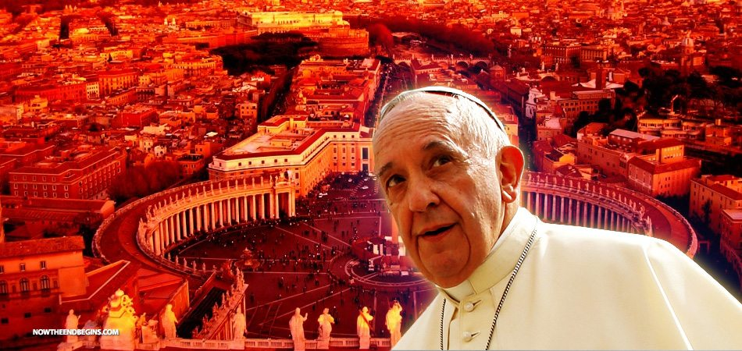

Slide 25
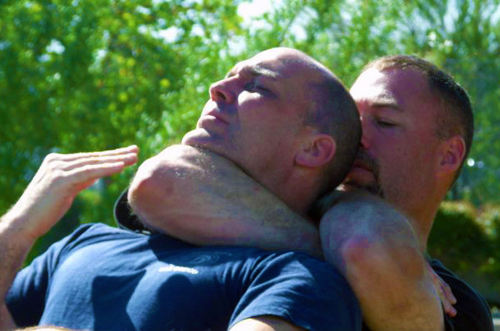

Slide 26
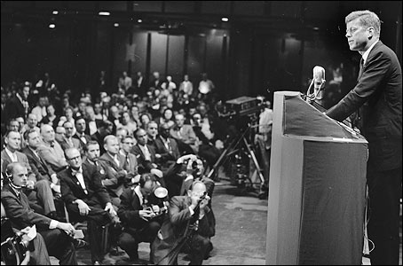
I believe in an America that is officially neither Catholic, Protestant nor Jewish; where no public official either requests or accepts instructions on public policy from the Pope, the National Council of Churches or any other ecclesiastical source; where no religious body seeks to impose its will directly or indirectly upon the general populace or the public acts of its officials; and where religious liberty is so indivisible that an act against one church is treated as an act against all.

Slide 27
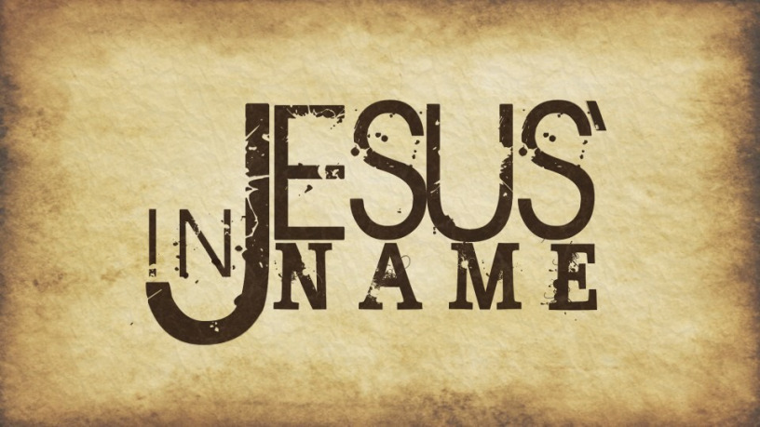

Slide 28


Slide 29


