Slide 1
Billy ‘Scam’ Graham

Slide 2
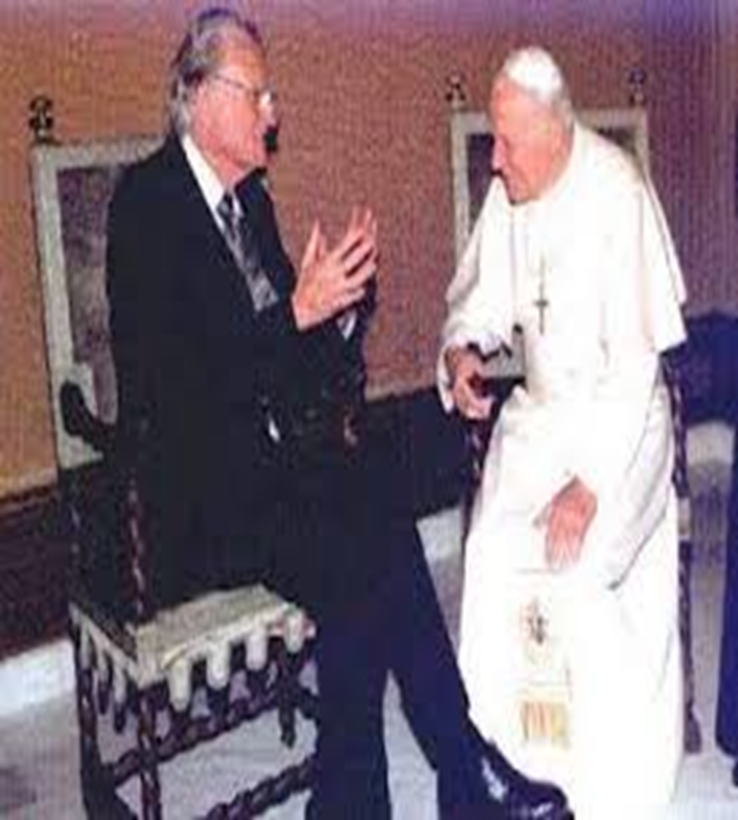

Slide 3
Christian Brother’s????
“In their accolades, Christian media everywhere is picturing Billy Graham as now being up in heaven. While I certainly hope to see him in heaven someday,” (Doug Bachelor)…..Well, lets see now. If Doug Bachelor thinks Billy Graham was a Christian and will be in heaven someday and Billy Graham says John Paul was his brother in Christ, then Doug Bachelor and John Paul are Christian brothers!!!!???? If a=b, And b=c, then a=c? Wow!!!!

Slide 4
One Menace! What Happened???
In 1948, Graham said, “The three gravest menaces faced by orthodox Christianity are communism, Roman Catholicism, and Mohammedanism,” NOW, he is continually saying nice things about the Catholics. In 1963 Dr. Graham spoke at Belmont Abbey College, a North Carolina Catholic school. On Nov. 21, 1967, he returned to Belmont Abbey to receive an honorary degree. At that time he made a shocking statement. He said, that he “knew of no greater honor” than the receiving of this degree. Then the shocker comes when he said, “The gospel that built this school and the gospel that brings me here tonight is still the way to salvation”… A disturbed Roman Catholic wrote Graham about some of the changes going on in the Catholic Church. In his answer, Graham wrote, “Above all, don’t pull out of the church! Stay in it, stay close to the Lord, and use these experiences as an opportunity to help your church be what God intends and what the world needs.” What an answer for a Baptist preacher to give. This was published in his newspaper column, “My Answer”. Billy Graham says: “Anyone who makes a decision at our meetings is referred to a local clergyman, Protestant, Catholic, or Jewish.” (1957) Roman Catholic Cardinal Cushing said: “I am 100% for the evangelist . . . I have never known a religious crusade that was more effective than Dr. Graham’s. I have never heard the slightest criticism of anything he has ever said from any Catholic source.” (1964) In 1963 Billy Graham said that he had a Roman Catholic bishop stand beside him and bless the “converts” as they came forward in Sao Paulo, Brazil. Bynum EL. Why We Cannot Support The Billy Graham Crusade. Tract # G-603. TABERNACLE BAPTIST CHURCH, Lubbock, Texas)

Slide 5
- 1967: Billy Graham was awarded an honorary degree by Catholic Belmont Abbey College. Graham told a predominantly Catholic audience: ‘Now we can speak to one another, work with one another and be brothers to one another...That gospel
that founded this [Catholic] school, that gospel has brought me here tonight is still the way of salvation’. (Gastonia Gazette, 22/11/67; ‘Evangelical Action’, 1/2/68) ‘It was founded in 1876 by the Benedictine monks of Belmont Abbey. The school is affiliated with the Roman Catholic Church and the Order of Saint Benedict.’

Slide 6
“Billy Graham was undoubtedly an ecumenicalist, as he praised the pope as his “brother” and treated Roman Catholicism as a valid expression of the Christian faith. Speaking of Pope John Paul II after his death, Graham stated, ‘I think he’s with the Lord, because he believed. He believed in the Cross. That was his focus throughout his ministry, the Cross, no matter if you were talking to him from personal issue or an ethical problem, he felt that there was the answer to all of our problems, the cross and the resurrection. And he was a strong believer.” by News Division · Published February 21, 2018 · Updated February 23, 2018

Slide 7
John Paul’s ‘Christian Message’!!!
Billy Graham: Pope John Paul II Was "Most Influential Voice" in 100 Years , By Michael Ireland , Chief Correspondent, ASSIST News Service CBN.com – LOS ANGELES, CALIFORNIA (ANS) -- Speaking on the April 2 edition of CNN's Larry King Live program Dr. Billy Graham said that that Pope John Paul II was the most influential voice for morality and peace in the world in the last 100 years. Dr. Graham told Larry King he had the privilege of seeing the Pope on several occasions at the Vatican. "And tonight, I have a very strange feeling of loss. I almost feel as though one of my family members has gone. I loved him very much and had the opportunity of discussing so many things with him. And we wrote each other several times during the years," Dr. Graham said. Larry King asked Dr. Graham: "Did he actually say to you once, "We are brothers' "? GRAHAM: That's correct. He certainly did. He held my hand the first time that I met him about 1981 -- he'd just been Pope for two years when I saw him first. Because when he was elevated to the papacy, I was preaching in his cathedral in Krakow that very day. And we had thousands of people in the streets. And watching the television today of Krakow has brought back many memories. KING: You said that he was an Evangelist. GRAHAM: He was, indeed. He traveled throughout the world to bring his Christian message to the world. And we see tonight the outpouring from the world that he touched. And I think he touched almost everybody in the whole world.”

Slide 8
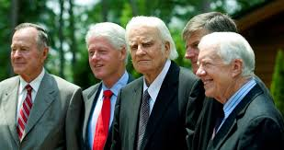
Is he Billy Scam or Billy Graham??
A famous pastor recently passed away. His name was Billy Graham. This message is not about Graham as a person. “For all have sinned, and come short of the glory of God; Being justified freely by his grace through the redemption that is in Christ Jesus:” Romans 3:23,24
Graham, like all of us, needs a Savior. This message is rather about the influence of ones life; his message, his influence, his friends, and those that supported his work. We will look at Billy Graham from this perspective.

Slide 9
Graham Courts Kings!
The previous photo was of Bill Graham, and several recent US presidents. Graham was friends with many of these men. The picture to our right sees Jesus and Pilate. They were representing two different worlds, 2 separate kingdoms. Why were Jesus and Pilate/Herod not friends? Jesus played no games with them!! Did Billy Graham play games with the rulers of the world??? The answer is obvious. “Can two walk together, except they be agreed?” Amos 3:3

Slide 10
The Friend of Presidents!?!?
Billy Graham was the friend of Presidents for 70 years. From Eisenhower to Obama, Graham patronized the leading men of the nation. WWJD???? Jesus was not the friend of kings; He rebuked them for their wickedness and sought to win them to the truth! One profound event of the 20th century was President Ronald Reagan appointing an ambassador to the Vatican in 1984. The man behind this was………….

Slide 12
The Ecumenical Juggernaut
“As far back as 1955 Dr. James E. Bennet and Rev. Jack Wyrtzen met with Billy Graham. Graham told them "that if some minister, who was a modernist, sent 50 of his people to Graham's meetings, and they were saved, he (Billy) would not tell them not to return to that modernistic church, because it would be unfair to the pastor!” Bundy, Billy Graham, op. cit., p.9. See also: David W. Cloud, Flirting with Rome: Evangelical Entanglement with Roman Catholicism (Volume I –Billy Graham) (Oak Harbor, WA: Way of Life Literature, 1993).

Slide 13
Pals!!
A letter from the Billy Graham Evangelistic Association (written by W H. Martindale) dated February 29, 1968 stated: "Mr. Graham, under no conditions, suggests affiliating with those who are, in their doctrines, contrary to the Scriptures.” Yet 11 years prior to this letter, Graham had had Norman Vincent Peale on his platform. Peale had written 46 books, the first one published in 1937. His book, The Power of Positive Thinking had already been in print for several years so his viewpoint was well-known.” Letter on file from the Billy Graham Evangelistic Association, dated February 29, 1968. Ruth Stafford Peale, "A Life of Faith and Love: Remembering Norman Vincent Peale 33°, Grand Cross, "The Scottish Rite Journal )September 1995, Vol. 104, No. 9), p.6.

Slide 14
Jesuit Puppet!
An active minister for six decades, he also became known as a writer of self-help books, working "to consciously integrate psychological insights with religious beliefs." A Mason for sixty-seven years, he served rather proudly as both a Grand Chaplain and Grand Prelate in his ninety-five year lifespan. For centuries, the Masonic Lodge has been under the control of the JESUITS!!!!!

Slide 15
Graham, Peale, the Jesuits!!!???

Slide 16
Billy Graham and Norman Vincent Peale
“An active minister for six decades, he also became known as a writer of self-help books, working "to consciously integrate psychological insights with religious beliefs." A Mason for sixty-seven years, he served rather proudly as both a Grand Chaplain and Grand Prelate in his ninety-five year lifespan…. Critics of Brother Peale charged that his approach was intellectually shallow as well as too reliant on optimism. Others held, according to Gardiner Shattuck, that he was "converting belief in God into belief in human potential and of distorting Christianity into a gospel of self-reliance…. Well-known religious figures who befriended and defended him included Billy Graham…To me, Freemasonry is one form of dedication to God and service to humanity. I am proud to walk in fraternal fellowship with my Brethren. Why am I a Freemason? Simply because I am proud to be near [a Brother] who wants to keep the moral standards of life at high level and leave something behind so others will benefit. Only as I personally become better can I help others to do the same…. In an interview with Phil Donahue in 1984, Peale said: “It’s not necessary to be born again. You have your way to God; I have mine. I found eternal peace in a Shinto shrine. … I’ve been to the Shinto shrines, and God is everywhere.” Donahue exclaimed, “But you’re a Christian minister; you’re supposed to tell me that Christ is the Way and the Truth and the Life, aren’t you?” Peale replied, “Christ is one of the ways! God is everywhere.” Sir Knight Norman Vincent Peale
A Powerful Positive Thinker , by Sir Knight Dr. Ivan Tribe

Slide 17
Ecumenical Juggernaut!
“It should also be mentioned that the committee for the 1957 New York Crusade was made up of about 120 modernists and unbelievers compared to about 20 fundamentalists. The Executive Committee was comprised of about 15 modernists and only 5 fundamentalists. Many of those on the committees denied the virgin birth, bodily resurrection of Christ, a literal heaven and a literal hell, the inspiration of Scripture, etc. The sad part is that those who went forward at this meeting were turned over to these modernist churches. After all, Graham usually only gives decision cards to those who participate in his meetings. (One exception was in the 1970s when Graham turned over decision cards to a Catholic diocese who had no official involvement in the crusade.) Therefore, all the fundamentalists who do not participate do not get any of the names. In other words, Graham's crusades only end up helping the liberal and unscriptural churches to prosper and grow. Can this be pleasing to God?” Zeller, op. cit., p.7; Martin, A Prophet with Honor, op. cit., p.222. The Berean Call (June 1997), p.4.

Slide 18
Come One, Come all, to the Greatest Show on Earth!
Graeme Keith, chairman of the Carolinas Billy Graham Crusade Committee, is quoted in the Charlotte Observer (March 1, 1996) as saying:
'We have Jewish, Catholic, Protestant and other denominations represented on the committee....Our goal is to make it the finest crusade Dr. Graham has ever conducted.' Graham has even gone further afield on occasion. At his 1966 World Congress on Evangelism in Berlin, Ethiopian Emperor Haile Selassie, who is head of the Coptic Orthodox Church, was featured. The Coptic Church is a blend of Christianity, Judaism, animism and paganism.“ Brad K. Gsell, The Legacy of Billy Graham (Charlotte, NC: Fundamental Presbyterian Publications, n.d.), p.28. I have a copy of a letter that the Billy Graham Evangelistic Association sent to an inquirer in 1968. Rev. W H. Martindale, writing for Billy Graham, stated: "There are many aspects of the Christian life that Mr. Graham does not touch upon because he does not believe that they are the duty and responsibility of the evangelist. Mr. Graham believes that we are saved through the blood of Christ, however, this aspect of Christian doctrine he does not emphasize in his messages. This is the duty and prerogative of the pastors. Every effort is made to see that the inquirers are oriented in a Bible preaching church.“ Letter in my files from W.H. Martindale, Spiritual Counselor for the Billy Graham Evangelistic Association, dated February 29, 1968. See also: David W. Cloud, "Billy Graham's Disobedience to the Word of God" (Updated March 2, 1999), p.9; Ian Paisley, "Billy Graham's Tragic Rome ward Run," O Timothy (1993, Vol. 10, Issue 9).

Slide 19
Modern Day Spiritualism
It is true that spiritualism is now changing its form and, veiling some of its more objectionable features, is assuming a Christian guise. But its utterances from the platform and the press have been before the public for many years, and in these its real character stands revealed. These teachings cannot be denied or hidden. Even in its present form, so far from being more worthy of toleration than formerly, it is really a more dangerous, because a more subtle, deception. While it formerly denounced Christ and the Bible, it now professes to accept both. But the Bible is interpreted in a manner that is pleasing to the unrenewed heart, while its solemn and vital truths are made of no effect. Love is dwelt upon as the chief attribute of God, but it is degraded to a weak sentimentalism, making little distinction between good and evil. God's justice, His denunciations of sin, the requirements of His holy law, are all kept out of sight. The people are taught to regard the Decalogue as a dead letter. Pleasing, bewitching fables captivate the senses and lead men to reject the Bible as the foundation of their faith. Christ is as verily denied as before; but Satan has so blinded the eyes of the people that the deception is not discerned.” GC, pgs. 557,558

Slide 20
Ecumenism
Graham's 1952 Pittsburgh crusade, the Pittsburgh Sun-Telegraph reported that Graham said:
"Many of the people who reach a decision for Christ at our meetings have joined the Catholic Church and we have received commendations from Catholic publications for the revived interest in their Church following our campaigns. This happened both in Boston and Washington. After all, one of our prime purposes is to help the churches in a community. If after we move on, the local (sic) churches do not feel the efforts of these meetings in increased membership and attendance, then our crusade would have to be considered a failure. “ Wilson Ewin, Under the New World Order: Evangelicals, Catholics and Israel: Conspiracy of the Ages (Compton, Quebec: Quebec Baptist Missions, n.d.), p.76. See also: David W. Cloud, Flirting with Rome (Volume I –Billy Graham) (Oak Harbor, WA: Way of Life Literature, 1993) Did you notice that Graham was only interested in a church's increased membership-but nothing was said about a person receiving Christ as his or her personal Lord and Savior. This is what is important-not church membership! Church membership could increase a 1000-fold but if people are not being saved, then all is in vain. Graham also gave a boost to the Catholic Church (in 1952) when he added that he "hoped to hear Bishop Fulton J. Sheen at one of the masses at St. Paul's Cathedral tomorrow.” "In 1968, Graham was in a meeting in San Antonio, Texas. He said that the Roman Church had given 'tremendous cooperation' in areas where he had held crusades. He added, 'A great part of our support today comes from Catholics. We never hold a crusade without priests and nuns being much in evidence in the audience."‘ By 1973 nuns were singing in the choir at Graham's crusades.” Wilson Ewin, Evangelism: The Trojan Horse of the 1990's (Compton, Quebec Baptist Missions, 1992).

Slide 21
In Bed with the Antichrist!
According to Foundation for January-February, 1990, the organ of the Roman Catholic Diocese of Albany, The Evangelist, for November 2, 1989, the following occurred: About 20, 000 persons are busy making ready for Billy Graham’s 1990 Capitol District Crusade, including representatives from 18 Protestant denominations in the area and a delegation of top Catholic officials appointed by Bishop Howard J Hubbard. The Graham Crusade, scheduled for April 22-29 at the Knickerbocker Arena in Albany, comes in response to a request made by Bishop Hubbard and other religious leaders, who three years ago, normally invited the world renowned evangelist to preach here. There are nine Catholics on the SO-person executive committee set up to direct the Crusade... Diocesan officials view the Graham Crusade. as 'a tool for evangelization,’ explained an executive committee member, Rev. James Kane, director of the diocesan ecumenical commission...As for the specific dogmatic content of Mr. Graham’s sermons, Father Kane said, "there is nothing that Catholics should feet uncomfortable with or be leery of." He said the evangelists emphasis on the Gospel and on the importance of the individuals personal relationship with Christ is consistent with Catholic teaching. However, he added, "we would, of course, emphasize the importance of the Eucharist and the Mass, the sacraments, and the importance of the structure and organization of the Church and its bishops and the pope".

Slide 22
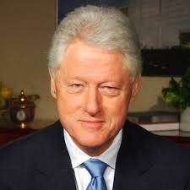
His Friends/Supporters
“From a biblical point of view, we should be headed in the direction of goodness and righteousness, away from crime and immorality and towards one’s neighbors who are in need. I’m encouraged by the emphasis Pres. Clinton and Hillary are putting on that.” Billy Graham, US News and World Report, 5-3-1993.

Slide 23
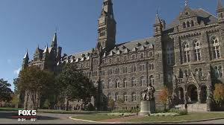
“Georgetown is the oldest Catholic and Jesuit-affiliated institution of higher education in the United States. The Jesuits have participated in the university's academic life, both as scholars and as administrators, since 1805; however, the university has always been governed independently of the church.” Wikipedia
Bill Clinton attended this Jesuit University and used that education to bring America to Rome’s knees through NAFTA, Anti-Terrorism legislation, Waco, and Oklahoma City tragedy!!!

Slide 24
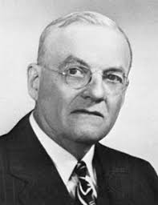
John Foster Dulles
“Eisenhower would later draw many Cabinet members from CFR ranks and become a CFR member himself. His primary CFR appointment was Secretary of State John Foster Dulles.” Wikipedia Dulles was a CFR member, a Jesuit front organization designed to control media, politicians, and religions! Dulles was a big backer of ………………….Billy Graham!

Slide 25
Bosom Buddies
“Communism represented the most grievous combination of threats imaginable, for it portended the annihilation of all that Americans held most dear. Graham held all of these views, and many other men and women who commanded respect held some or all of them too, including such worthies as Dean Acheson and John Foster Dulles. Far from being a voice crying in the wilderness, Graham found himself in good and strong company. Possibly he made communism more fearsome than any politician could do.” America’s Pastor: Billy Graham and the Shaping of a Nation, Grant Wacker.

Slide 26
As I picked up the Lake County News Herald for February 9, 1984 my eye was arrested by a headline which stated: "Graham's Help on Vatican Ties." The article proved to be an Associated Press release which said.- A spokesman for Billy Graham confirms that the evangelist played a behind-the-scenes role in President Reagan’s decision to establish formal diplomatic relations with the Vatican, a newspaper reported Yesterday. Early in 1983, Graham was asked by the president and adviser William Clark to make informal, private inquiries among evangelical Protestant leaders about likely response to such an action, said Donald Bialy, media director for the Billy Graham Evangelistic Association in Minneapolis. A copy of the seven-page letter that the Baptist evangelist sent to Clark was obtained by the Chicago Sun-Times, which quoted Graham as saying, 'If anyone can do it and get away with it, it is Mr. Reagan.‘ Generally moderate evangelicals were described by Graham as presenting few problems, especially if the point were made that the Pope was being recognized as a political head and not in his religious capacity. Since the birth of new evangelicalism in 1948, fundamentalists and new evangelicals had not agreed on many things. But, both groups had always stood in opposition to formal diplomatic relations with the Vatican. In reacting to the President's request, Mr. Graham might have become a spokesman for millions of Bible-believers by expressing solid opposition to Mr. Reagan’s proposed move. Instead, he chose to be an accomplice in a national crime.” Billy Graham’s Catholic Connection, By John Ashbrook

