Slide 1
Behind the Door pt 8:
1798… Payback! Pastor Bill Hughes

Slide 4
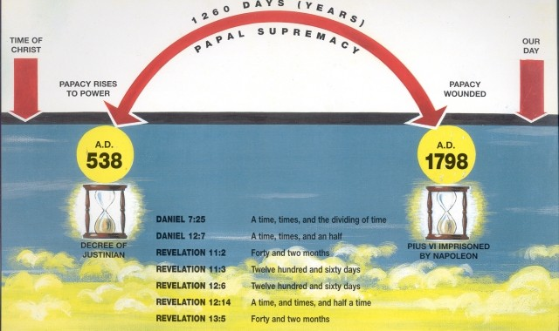

Slide 5
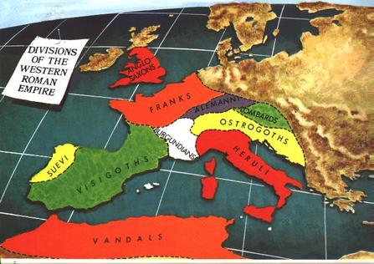

Slide 8
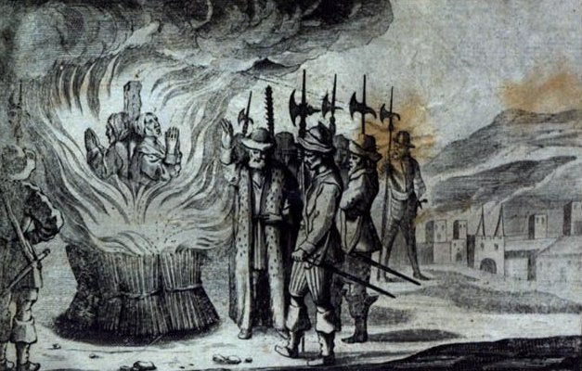

Slide 9
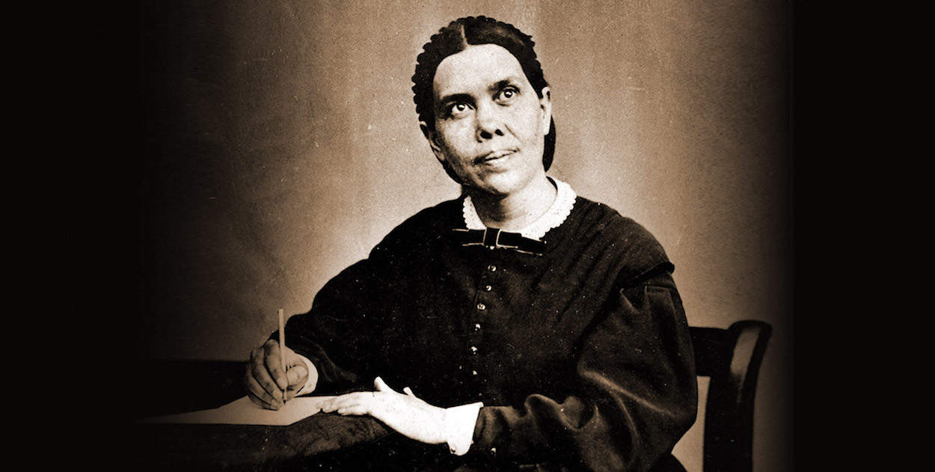

Slide 10
One Day = One Year (Ezekiel 4:6: “thou shalt bear the iniquity of the house of Judah forty days: I have appointed thee each day for a year”—see also Numbers 14:34: “After the number of the days in which ye searched the land, even forty days, each day for a year. . .”)

Slide 11
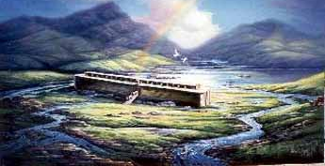

Slide 15
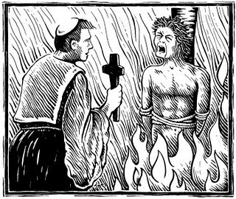
Protestants were tortured and slaughtered mercilessly during the Dark Ages. Killed for believing the Bible as it reads and not as the priests would choose to interpret. Over the 1260 period, the Catholic Church murdered 50 million (that is the lower estimates of sources) individuals total, including millions of Protestants across Europe

Slide 16
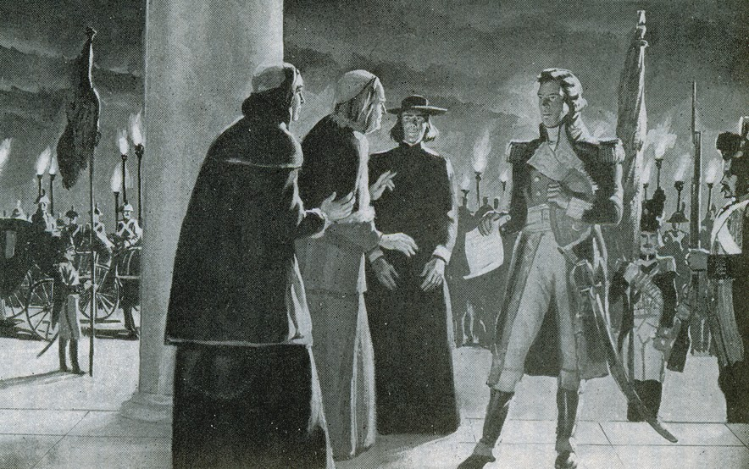
General Berthier of Napoleon’s French Military deposes the Pope in 1798

Slide 17
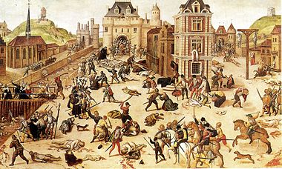
Saint Bartholomew's Day Massacre in Paris France, spreading to the countryside cost the lives of 70,000 Huguenots (Protestants). Catholics deceived the hopeful Huguenots that peace would be met between the 2 parties, but under this pretense, the bell tolled at the midnight hour giving the signal for the Catholics of France to murder the Protestants in their sleep (August 24, 1572)

Slide 18
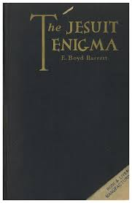

Slide 19
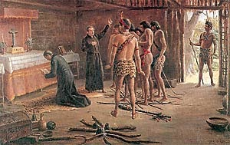
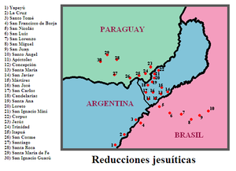

Slide 20
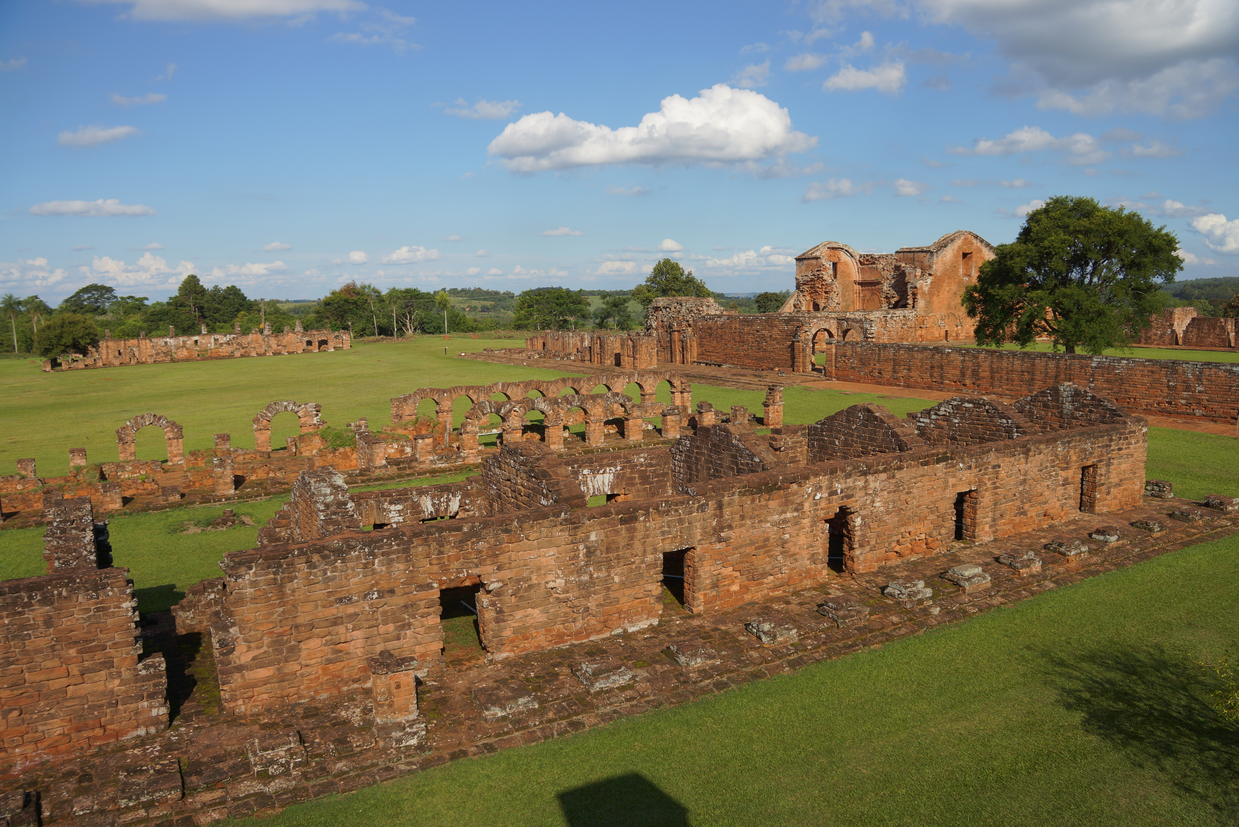

Slide 21
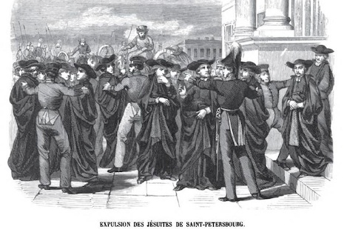

Slide 23
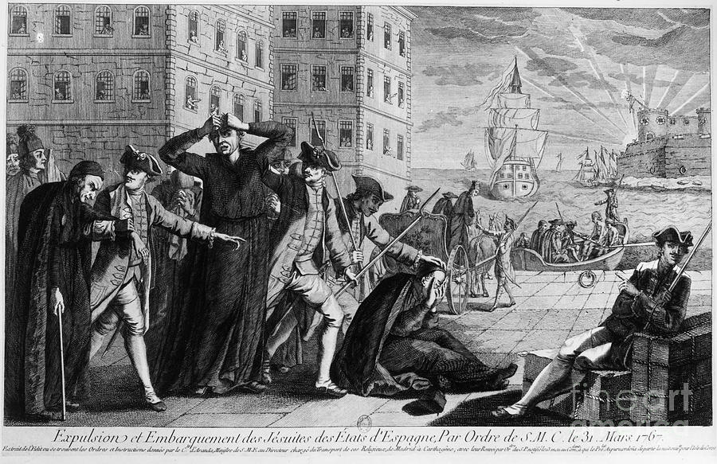

Slide 24
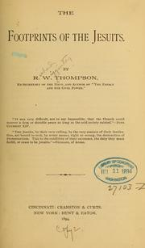
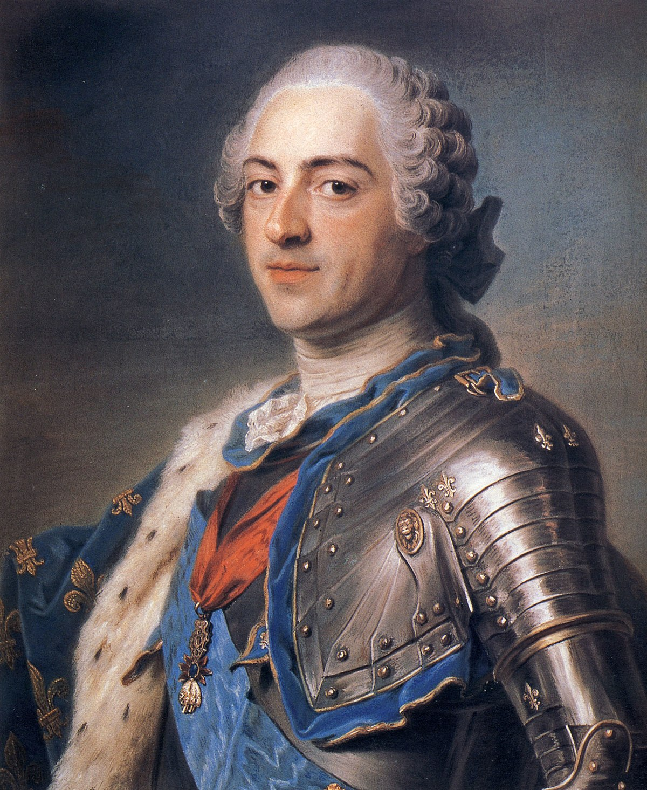
King Louis XV of France

Slide 25
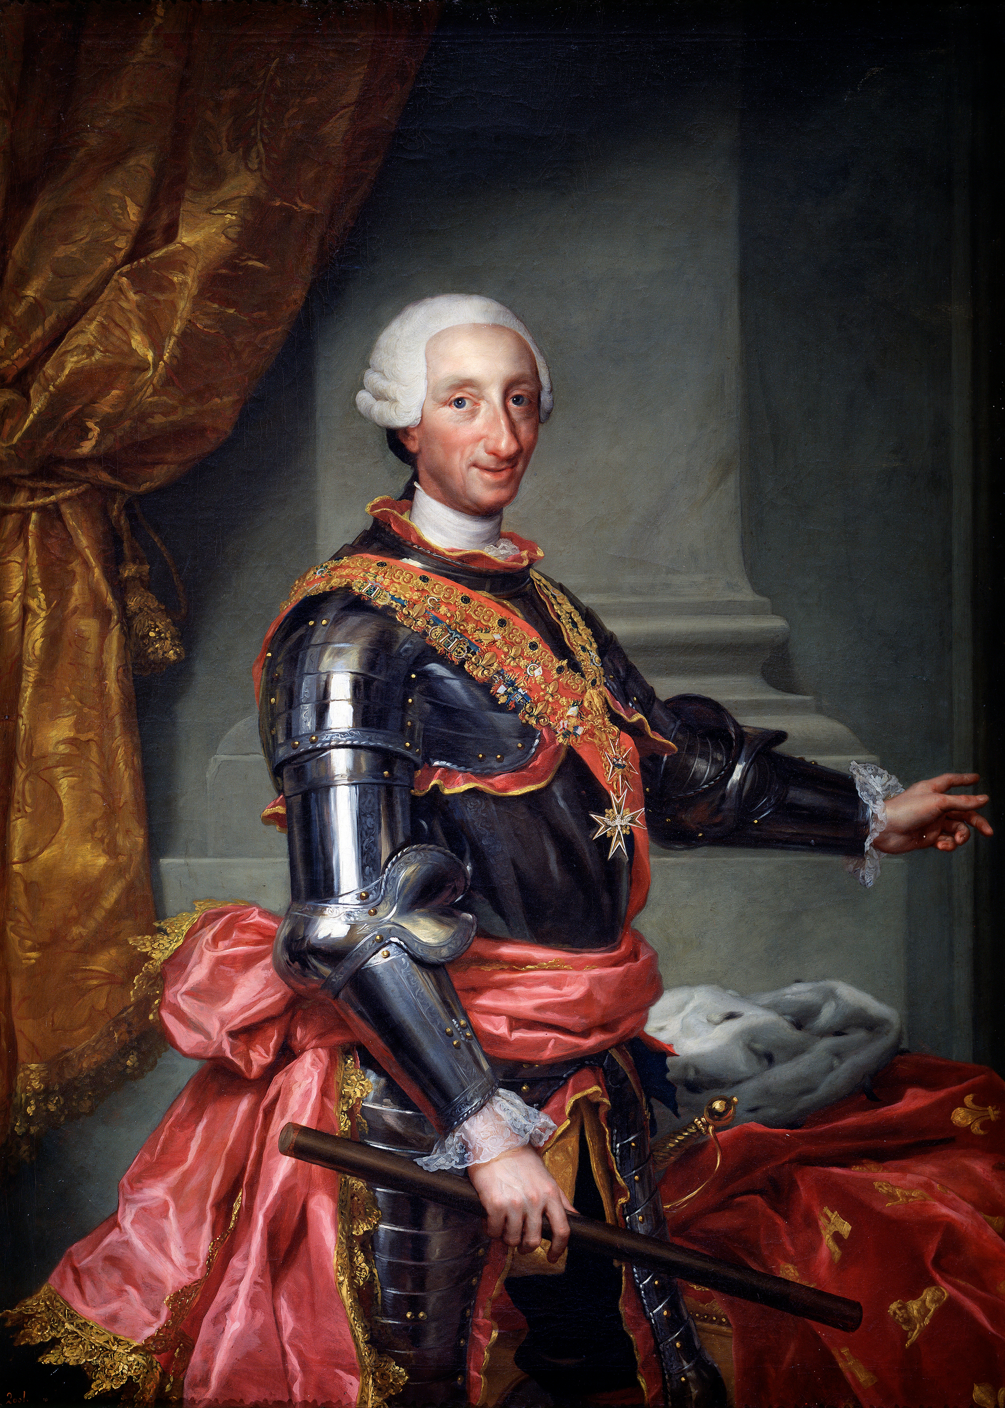
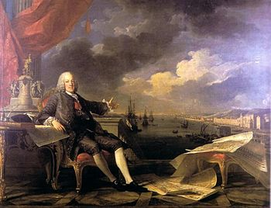
The Marquis of Pombal, who oversaw the suppression of the Jesuits in Portugal and its empire
King Charles III of Spain

Slide 26
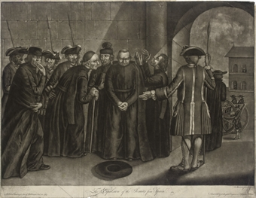

Slide 27
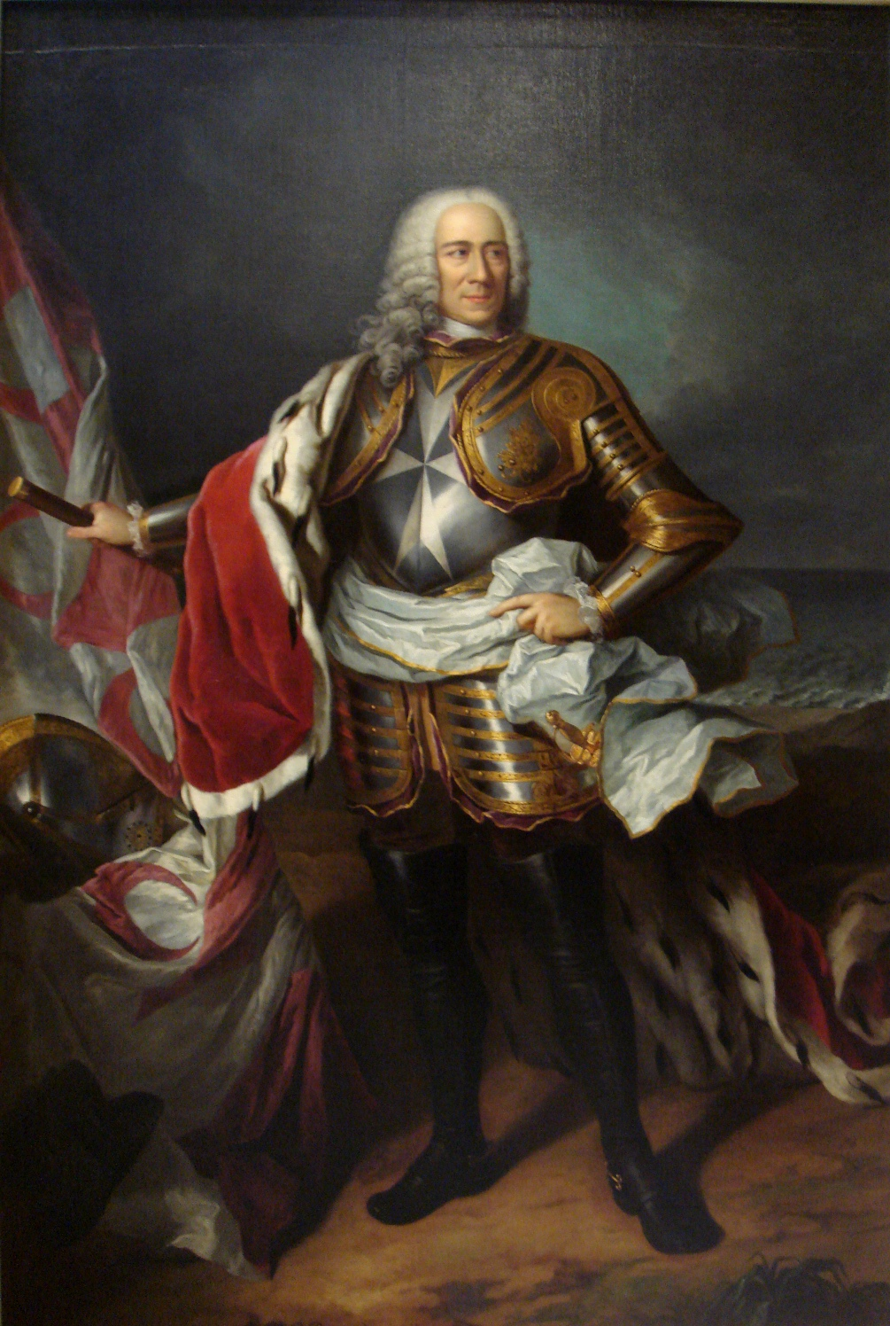
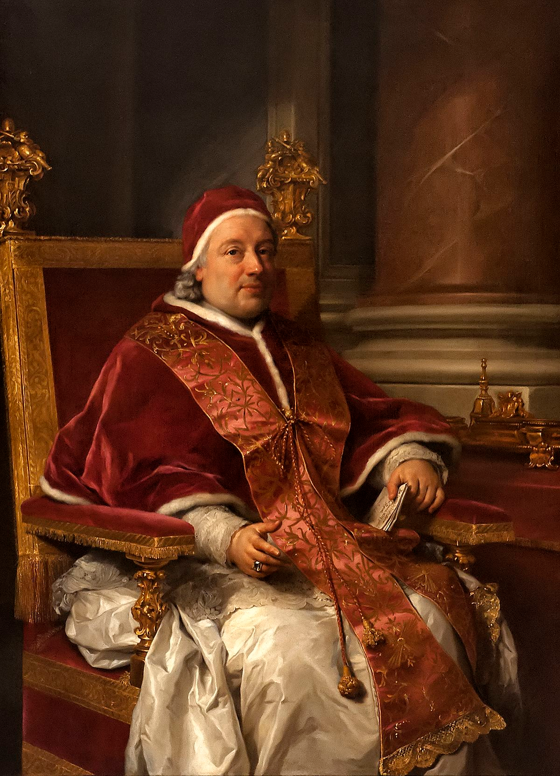
Manuel Pinto de Fonseca of Malta
Pope Clement XIII

Slide 28
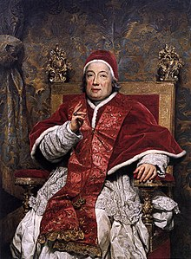
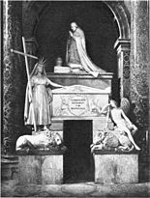
Pope Clement XIII’s Tomb

Slide 29
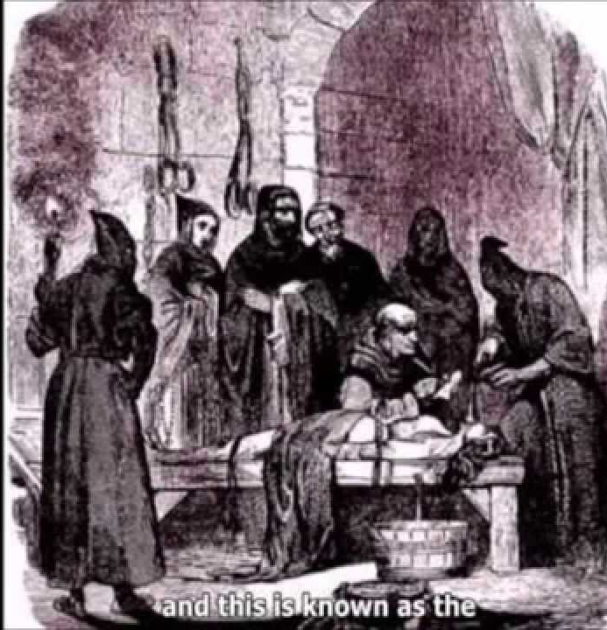

Slide 30
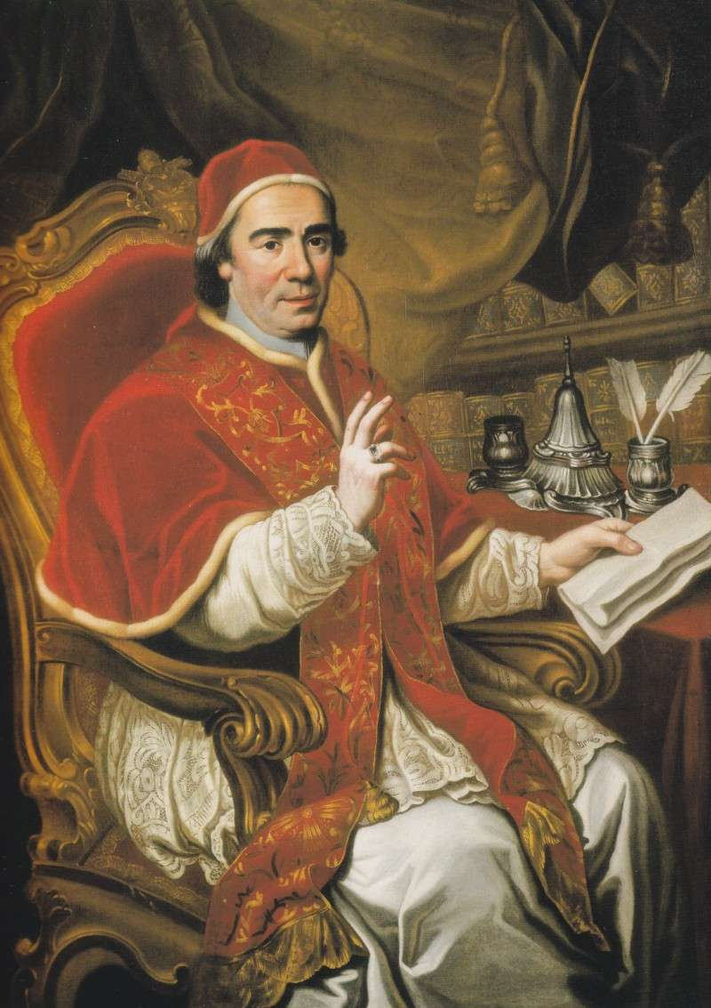
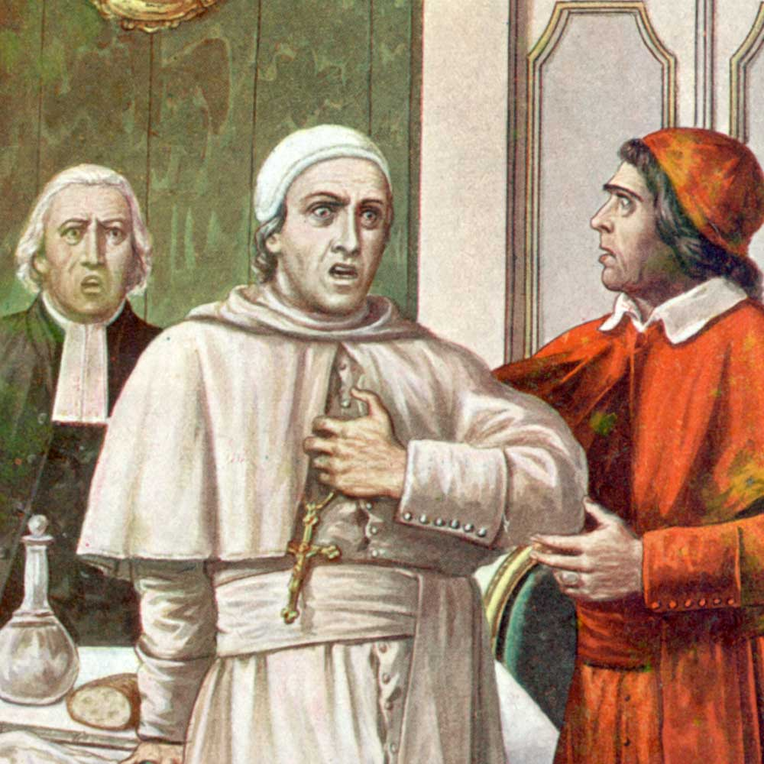
Pope Clement XIV poisoned in 1774… By who? I wonder…
Pope Clement XIV

