Slide 1
Massacre in Paris/Bible Prophecy
What Does it Mean?

Slide 2
Tragedy
On 7 January 2015, at about 11:30 CET (10:30 UTC), two masked gunmen forced their way into the offices of the French satirical weekly newspaper Charlie Hebdo in Paris, France. They killed 12 people, including the editor Stéphane "Charb" Charbonnier, 7 other Charlie Hebdo employees, and 2 National Police officers, and wounded 11 others. Charlie Hebdo had attracted attention for its depictions of Muhammad.
The gunmen were armed with AK-47 assault rifles, a shotgun, and an RPG launcher.^{[12][13][14]} They fired up to 50 shots with automatic weapons, shouting "Allahu Akbar", Arabic for "God is great".^{[15][16]}

Slide 3
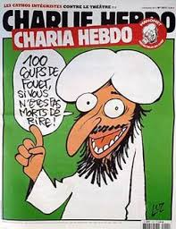
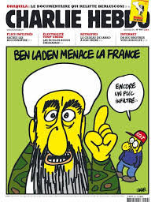
Killed For This????

Slide 4
Charlie Hebdo (French pronunciation: ​[ʃaʁli ɛbdo]; French for Weekly Charlie) is a satirical weekly newspaper in France that features cartoons, reports, polemics, and jokes. The publication is irreverent and stridently non-conformist in tone, is strongly secularist, antireligious^{[24]} and left-wing, and publishes articles that mock far-right politics, Catholicism, Islam, Judaism, Israel, politics, culture, and various other groups as local and world news unfolds. The magazine was published from 1969 to 1981, then has been again from 1992.^{[25]}
The newspaper has a history of attracting controversy, and was unsuccessfully sued in 2006 by Islamic organisations for having published the Jyllands-Posten Muhammad cartoons.^{[26][27]} The cover of a 2011 issue, dubbed "Charia Hebdo" (a pun on Islamic Sharia law), depicted a cartoon of the founder of Islam, Muhammad, whose depiction is forbidden in some interpretations of Islam.^{[28]} The newspaper's office, at the time in the 20th arrondissement, was fire-bombed and its website hacked.^{[29][30]}

Slide 5
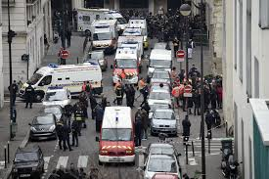
Pictures, Comments Overblown
Pictures and comments in this newspaper brought the deaths of several people and the injuries of many more!
A group of men united together to create sorrow, bloodshed, and heartache to many.
These extremists insanely reacted to this silly newspaper and hell resulted!

Slide 6
The World Responds
On 11 January 2015, up to 2 million people, including more than 40 world leaders, met in Paris for a rally of national unity to honour the 17 victims. In all, 3.7 million people joined demonstrations nationwide, in what officials called the largest public rally in France since World War II. The phrase Je suis Charlie (French for "I am Charlie") came to be a common worldwide sign of solidarity against the attacks. The remaining staff of Charlie Hebdo announced that publication was to continue, with plans for a print run of three million copies for the next week's issue,^{[23]} rather than its typical 60,000. The "survivors' issue" of Charlie Hebdo will also be sold outside France.

Slide 7
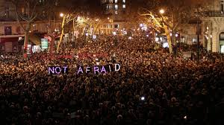

Slide 8
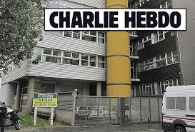
All Would Agree!
Millions across the world responded in grief and heartache over the senseless and ridiculous attacks on the newspaper ‘Charlie Hebdo’ in Paris! Millions were disgusted by these insane acts of cruelty and destruction! Some, though, took this way to far! Some made a statement that went far beyond Paris and the attack!

Slide 9
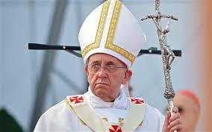
Someone Speaks!
The ‘world’s peacemaker’, the man who pretends to be the apostle of peace and good will for the world, had a response to the massacre in Paris. He, like the murderers, went way to far. His comments are as pathetic as the gunman’s bullets!

Slide 10
His Response
“Pope Francis on Monday denounced the religious fundamentalism that inspired the Paris massacres and ongoing Mideast conflicts, saying the attackers were enslaved by "deviant forms of religion" that used God as a mere ideological pretext to perpetuate mass killings.
In his annual foreign policy address to Vatican-based ambassadors, Francis called for a unanimous response from the international community to end "fundamentalist terrorism" in the Mideast. And he called for Muslim leaders in particular to condemn "extremist interpretations" of their faith that seek to justify such violence.” Huff Post, January 12, 2015

Slide 11
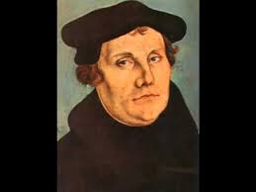
Religious Fundamentalism
‘a form of a religion, especially Islam or Protestant Christianity, that upholds belief in the strict, literal interpretation of scripture.
strict adherence to the basic principles of any subject or discipline.’
Are you a religious fundamentalist? I am!!

Slide 12
Religious Fundamentalism?
“But God will have a people upon the earth to maintain the Bible, and the Bible only, as the standard of all doctrines and the basis of all reforms. The opinions of learned men, the deductions of science, the creeds or decisions of ecclesiastical councils, as numerous and discordant as are the churches which they represent, the voice of the majority--not one nor all of these should be regarded as evidence for or against any point of religious faith. Before accepting any doctrine or precept, we should demand a plain "Thus saith the Lord" in its support.
Satan is constantly endeavoring to attract attention to man in the place of God. He leads the people to look to bishops, to pastors, to professors of theology, as their guides, instead of searching the Scriptures to learn their duty for themselves. Then, by controlling the minds of these leaders, he can influence the multitudes according to his will.” GC, pg. 595

Slide 13
Do These Fit?
Francis has put together murderous pigs who kill at the drop of a hat with those who conscientiously obey the word of God?
No one who humbly loves the word of God would ever be involved in such evil and wickedness!

Slide 14
Where it Goes!
“And then the great deceiver will persuade men that those who serve God are causing these evils. The class that have provoked the displeasure of Heaven will charge all their troubles upon those whose obedience to God's commandments is a perpetual reproof to transgressors. It will be declared that men are offending God by the violation of the Sunday sabbath; that this sin has brought calamities which will not cease until Sunday observance shall be strictly enforced….

Slide 15
and that those who present the claims of the fourth commandment, thus destroying reverence for Sunday, are troublers of the people, preventing their restoration to divine favor and temporal prosperity. Thus the accusation urged of old against the servant of God will be repeated and upon grounds equally well established: "And it came to pass, when Ahab saw Elijah, that Ahab said unto him, Art thou he that troubleth Israel? And he answered, I have not troubled Israel; but thou, and thy father's house, in that ye have forsaken the commandments of the Lord, and thou hast followed Baalim." 1 Kings 18:17, 18. As the wrath of the people shall be excited by false charges, they will pursue a course toward God's ambassadors very similar to that which apostate Israel pursued toward Elijah.” GC, pg .590

Slide 16
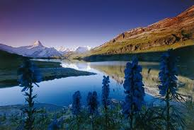
departing from usual or accepted standards, especially in social or sexual behavior.
"deviant behavior"
synonyms:aberrant, abnormal, atypical, anomalous, irregular, nonstandard; Morenonconformist, perverse, uncommon, unusual;
freakish, strange, odd, peculiar, bizarre, eccentric, idiosyncratic, unorthodox, exceptional;
warped, perverted;
informalkinky, quirky
"deviant behavior"
antonyms:normal

Slide 17
“Deviant Form of Religion”
According to ‘god’s spokesman’, deviant forms of religion caused the Paris Massacre. Deviant means someone who departs from the standard or norm in religious belief. The norm in religious belief is Sunday. Are you a deviant? The norm is the immortality of the soul; are you a deviant?
Unbelievable!!!

Slide 18
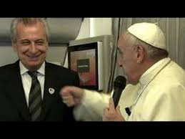

Slide 19
Another Focus of Francis
Giving an example of what he meant, the Pontiff referred to his friend and Vatican official Alberto Gasbarri who was standing next to him. Gasparri often organizes trips for the Pope and, as such, is often in close proximity to Francis.
"If my good friend Dr. Gasparri says a curse word against my mother, he can expect a punch in the nose," Francis said.
He then aimed his fist at Gasparri and threw a "pretend punch" as many of the attending journalists laughed.
“It’s normal," he said of his feigned reaction. "You cannot provoke. You cannot insult the faith of others. You cannot make fun of the faith of others."
The Pope also stated that he did not want to come off as condoning religious violence.

Slide 20
Circular Thinking
"To kill in the name of God is an aberration," he said.
But he went on to say that those who do make fun of the religious faith of others should expect some kind of retribution. Once again, he referred to this retribution as a "normal" reaction.
“They are provocateurs. And what happens to them is what would happen to Dr. Gasparri if he says a curse word against my mother. There is a limit.”
Francis did not make clear the nature of his logic regarding these two rather conflicting statements regarding freedom of speech and religious retribution against any speech which offends said religion. He did mention that liberty came with an obligation for the common good and to respect human dignity, but where he thought the line should be drawn exactly between the two was not specified.

Slide 21
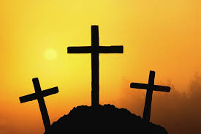
Faithful SDA’s with Killers in Paris!!
“Yea, and all that will live godly in Christ Jesus shall suffer persecution.” 2 Tim. 3:12
“Blessed are they which are persecuted for righteousness' sake: for theirs is the kingdom of heaven. Blessed are ye, when men shall revile you, and persecute you, and shall say all manner of evil against you falsely, for my sake. Rejoice, and be exceeding glad: for great is your reward in heaven: for so persecuted they the prophets which were before you.” Matthew 5:10-12

