Slide 1
Jesus Life, pt. 24 ‘Night on the Lake`

Slide 2
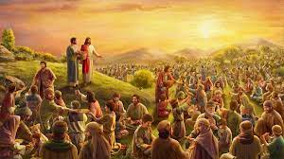
“And he commanded the multitude to sit down on the grass, and took the five loaves, and the two fishes, and looking up to heaven, he blessed, and brake, and gave the loaves to his disciples, and the disciples to the multitude. And they did all eat, and were filled: and they took up of the fragments that remained twelve baskets full. And they that had eaten were about five thousand men, beside women and children.” Matthew 14:19-21

Slide 3
Bread of Life!
“In full reliance upon God, Jesus took the small store of loaves; and although there was but a small portion for His own family of disciples, He did not invite them to eat, but began to distribute to them, bidding them serve the people. The food multiplied in His hands; and the hands of the disciples, reaching out to Christ Himself the Bread of Life, were never empty. The little store was sufficient for all. After the wants of the people had been supplied, the fragments were gathered up, and Christ and His disciples ate together of the precious, Heaven-supplied food. The disciples were the channel of communication between Christ and the people. This should be a great encouragement to His disciples today. Christ is the great center, the source of all strength. His disciples are to receive their supplies from Him. The most intelligent, the most spiritually minded, can bestow only as they receive. Of themselves they can supply nothing for the needs of the soul. We can impart only that which we receive from Christ; and we can receive only as we impart to others. As we continue imparting, we continue to receive; and the more we impart, the more we shall receive. Thus we may be constantly believing, trusting, receiving, and imparting.” DA, pgs. 369,370

Slide 4
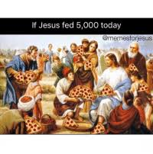
“I am that bread of life. Your fathers did eat manna in the wilderness, and are dead. This is the bread which cometh down from heaven, that a man may eat thereof, and not die. I am the living bread which came down from heaven: if any man eat of this bread, he shall live for ever: and the bread that I will give is my flesh, which I will give for the life of the world.” John 6:48-51

Slide 5
Do What you Can!!
“The work of building up the kingdom of Christ will go forward, though to all appearance it moves slowly and impossibilities seem to testify against advance. The work is of God, and He will furnish means, and will send helpers, true, earnest disciples, whose hands also will be filled with food for the starving multitude. God is not unmindful of those who labor in love to give the word of life to perishing souls, who in their turn reach forth their hands for food for other hungry souls. In our work for God there is danger of relying too largely upon what man with his talents and ability can do. Thus we lose sight of the one Master Worker. Too often the worker for Christ fails to realize his personal responsibility. He is in danger of shifting his burden upon organizations, instead of relying upon Him who is the source of all strength. It is a great mistake to trust in human wisdom or numbers in the work of God. Successful work for Christ depends not so much on numbers or talent as upon pureness of purpose, the true simplicity of earnest, dependent faith. Personal responsibilities must be borne, personal duties must be taken up, personal efforts must be made for those who do not know Christ. In the place of shifting your responsibility upon someone whom you think more richly endowed than you are, work according to your ability.” DA, pg. 370

Slide 6
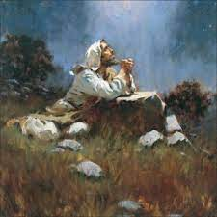
“Therefore they gathered them together, and filled twelve baskets with the fragments of the five barley loaves, which remained over and above unto them that had eaten. Then those men, when they had seen the miracle that Jesus did, said, This is of a truth that prophet that should come into the world. When Jesus therefore perceived that they would come and take him by force, to make him a king, he departed again into a mountain himself alone.” John 6:13-15

Slide 7
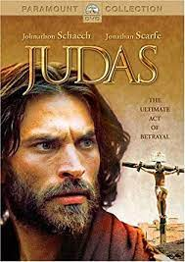
Judas Tried to set up earthly reign
“Notwithstanding the Saviour's own teaching, Judas was continually advancing the idea that Christ would reign as king in Jerusalem. At the feeding of the five thousand he tried to bring this about. On this occasion Judas assisted in distributing the food to the hungry multitude. He had an opportunity to see the benefit which it was in his power to impart to others. He felt the satisfaction that always comes in service to God. He helped to bring the sick and suffering from among the multitude to Christ. He saw what relief, what joy and gladness, come to human hearts through the healing power of the Restorer. He might have comprehended the methods of Christ. But he was blinded by his own selfish desires. Judas was first to take advantage of the enthusiasm excited by the miracle of the loaves. It was he who set on foot the project to take Christ by force and make Him king. His hopes were high. His disappointment was bitter.” DA, pg. 718

Slide 8
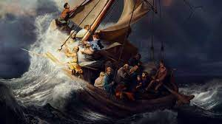
“And straightway Jesus constrained his disciples to get into a ship, and to go before him unto the other side, while he sent the multitudes away. And when he had sent the multitudes away, he went up into a mountain apart to pray: and when the evening was come, he was there alone. But the ship was now in the midst of the sea, tossed with waves: for the wind was contrary.” Matthew 14:22-24

Slide 9
Forgot what the Lord had Done!!!!
“ They had left Jesus with dissatisfied hearts, more impatient with Him than ever before since acknowledging Him as their Lord. They murmured because they had not been permitted to proclaim Him king. They blamed themselves for yielding so readily to His command. They reasoned that if they had been more persistent they might have accomplished their purpose. Unbelief was taking possession of their minds and hearts. Love of honor had blinded them. They knew that Jesus was hated by the Pharisees, and they were eager to see Him exalted as they thought He should be. To be united with a teacher who could work mighty miracles, and yet to be reviled as deceivers, was a trial they could ill endure. Were they always to be accounted followers of a false prophet? Would Christ never assert His authority as king? Why did not He who possessed such power reveal Himself in His true character, and make their way less painful? Why had He not saved John the Baptist from a violent death? Thus the disciples reasoned until they brought upon themselves great spiritual darkness. They questioned, Could Jesus be an impostor, as the Pharisees asserted?” DA, pg. 379, 380

Slide 10
Large Blessing/ Sidetracked
“Had they, out of the abundance of their hearts, been conversing together in regard to these things, they would not have entered into temptation. But their disappointment had absorbed their thoughts. The words of Christ, “Gather up the fragments, ... that nothing be lost,” were unheeded. Those were hours of large blessing to the disciples, but they had forgotten it all. They were in the midst of troubled waters. Their thoughts were stormy and unreasonable, and the Lord gave them something else to afflict their souls and occupy their minds. God often does this when men create burdens and troubles for themselves. The disciples had no need to make trouble. Already danger was fast approaching.” DA, pg. 380

Slide 11
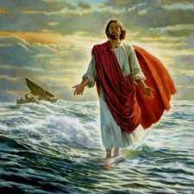
“And when he had sent the multitudes away, he went up into a mountain apart to pray: and when the evening was come, he was there alone. But the ship was now in the midst of the sea, tossed with waves: for the wind was contrary. And in the fourth watch of the night Jesus went unto them, walking on the sea. And when the disciples saw him walking on the sea, they were troubled, saying, It is a spirit; and they cried out for fear. But straightway Jesus spake unto them, saying, Be of good cheer; it is I; be not afraid.” Matthew 14:23-27

Slide 12
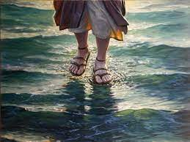
“Jesus had not forgotten them. The Watcher on the shore saw those fear-stricken men battling with the tempest. Not for a moment did He lose sight of His disciples. With deepest solicitude His eyes followed the storm-tossed boat with its precious burden; for these men were to be the light of the world. As a mother in tender love watches her child, so the compassionate Master watched His disciples. When their hearts were subdued, their unholy ambition quelled, and in humility they prayed for help, it was given them.” DA, pg. 381

Slide 13
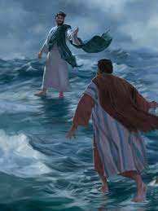
If we will…
“And Peter answered him and said, Lord, if it be thou, bid me come unto thee on the water. And he said, Come. And when Peter was come down out of the ship, he walked on the water, to go to Jesus. But when he saw the wind boisterous, he was afraid; and beginning to sink, he cried, saying, Lord, save me. And immediately Jesus stretched forth his hand, and caught him, and said unto him, O thou of little faith, wherefore didst thou doubt?” Matthew 14:28-31

Slide 14
We can Walk on Water!!
“Looking unto Jesus, Peter walks securely; but as in self-satisfaction he glances back toward his companions in the boat, his eyes are turned from the Saviour. The wind is boisterous. The waves roll high, and come directly between him and the Master; and he is afraid. For a moment Christ is hidden from his view, and his faith gives way. He begins to sink. But while the billows talk with death, Peter lifts his eyes from the angry waters, and fixing them upon Jesus, cries, “Lord, save me.” Immediately Jesus grasps the outstretched hand, saying, “O thou of little faith, wherefore didst thou doubt?” Walking side by side, Peter's hand in that of his Master, they stepped into the boat together. But Peter was now subdued and silent. He had no reason to boast over his fellows, for through unbelief and self-exaltation he had very nearly lost his life. When he turned his eyes from Jesus, his footing was lost, and he sank amid the waves.” DA, pg. 381

Slide 15
“Jesus read the character of His disciples. He knew how sorely their faith was to be tried. In this incident on the sea He desired to reveal to Peter his own weakness,—to show that his safety was in constant dependence upon divine power. Amid the storms of temptation he could walk safely only as in utter self-distrust he should rely upon the Saviour. It was on the point where he thought himself strong that Peter was weak; and not until he discerned his weakness could he realize his need of dependence upon Christ. Had he learned the lesson that Jesus sought to teach him in that experience on the sea, he would not have failed when the great test came upon him. Day by day God instructs His children. By the circumstances of the daily life He is preparing them to act their part upon that wider stage to which His providence has appointed them. It is the issue of the daily test that determines their victory or defeat in life's great crisis. Those who fail to realize their constant dependence upon God will be overcome by temptation. We may now suppose that our feet stand secure, and that we shall never be moved. We may say with confidence, “I know in whom I have believed; nothing can shake my faith in God and in His word.” But Satan is planning to take advantage of our hereditary and cultivated traits of character, and to blind our eyes to our own necessities and defects. Only through realizing our own weakness and looking steadfastly unto Jesus can we walk securely. “ DA, pg. 382

