Slide 1
What is the Difference Between Mormons, Jehovah’s Witnesses, and Seventh-day Adventists? pt 5

Slide 2
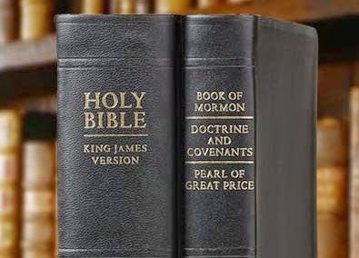
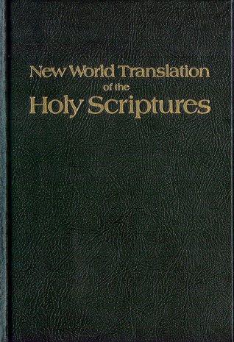
What We Will Study….
Origins of the Religion
Their Authorities and/or Authoritative Texts
Their Doctrinal Differences
Their Message to the World

Slide 3
Where is Russell Getting His Theology From?
“In the decades that followed it became apparent that, in order to achieve their goal of world domination, they would have to instigate a series of world wars which would result in the leveling of the old world order in preparation for the construction of the New World Order. This plan was outlined in graphic detail by Albert Pike, the Sovereign Grand Commander of the Ancient and Accepted Scottish Rite of Freemasonry, and the top Illuminist in America, in a letter to Giuseppe Mazzini dated August 15, 1871. Pike stated that the first world war was to be fomented in order to destroy Czarist Russia—and to place that vast land under the direct control of Illuminati agents. Russia was then to be used as a 'bogey man' to further the aims of the Illuminati worldwide. World War II was to be fomented through manipulation of the differences that existed between the German Nationalists and the Political Zionists. This was to result in an expansion of Russian influence and the establishment of a state of Israel in Palestine [May, 1948]. The Third World War was planned to result from the differences stirred up by Illuminati agents between the Zionists and the Arabs. The conflict was planned to spread worldwide. The Illuminati, said the letter, planned to "unleash the Nihilists and Atheists" and "provoke a formidable social cataclysm which in all its horror will show clearly to the nations the effect of absolute atheism, origin of savagery and of the most bloody turmoil. Then everywhere, the citizens, obliged to defend themselves against the world minority of revolutionaries, will exterminate those destroyers of civilization, and the multitude, disillusioned with Christianity, whose deistic spirits will from that moment be without compass [direction], anxious for an ideal, but without knowing where to render its adoration, will receive the true light through the universal manifestation of the pure doctrine of Lucifer, brought finally out in the public view, a manifestation which will result from the general reactionary movement which will follow the destruction of Christianity and atheism, both conquered and exterminated at the same time." Des Griffin, Descent Into Slavery, p. 38-39

Slide 4
Russell Tapped Into the Illuminati Plan???
Evidence:
1. Charles T. Russell was preaching false doctrines, and using them to set prophetic times, which correlated to actual events which were controlled by Rome
2. Charles T. Russell “knew” “naturally” Masonic handshakes and used them
3. Charles T. Russell promoted the Illuminati plan to reestablish the Nation of Israel—based again on false doctrines
4. Charles T. Russell was in direct contact with the Rothschilds family (aka Rome) and planned how to reestablish Israel for the Jews
5. Charles T. Russell was obsessed with Pagan mystic practices and symbols like Pyramidology, astrology, and winged disks

Slide 5
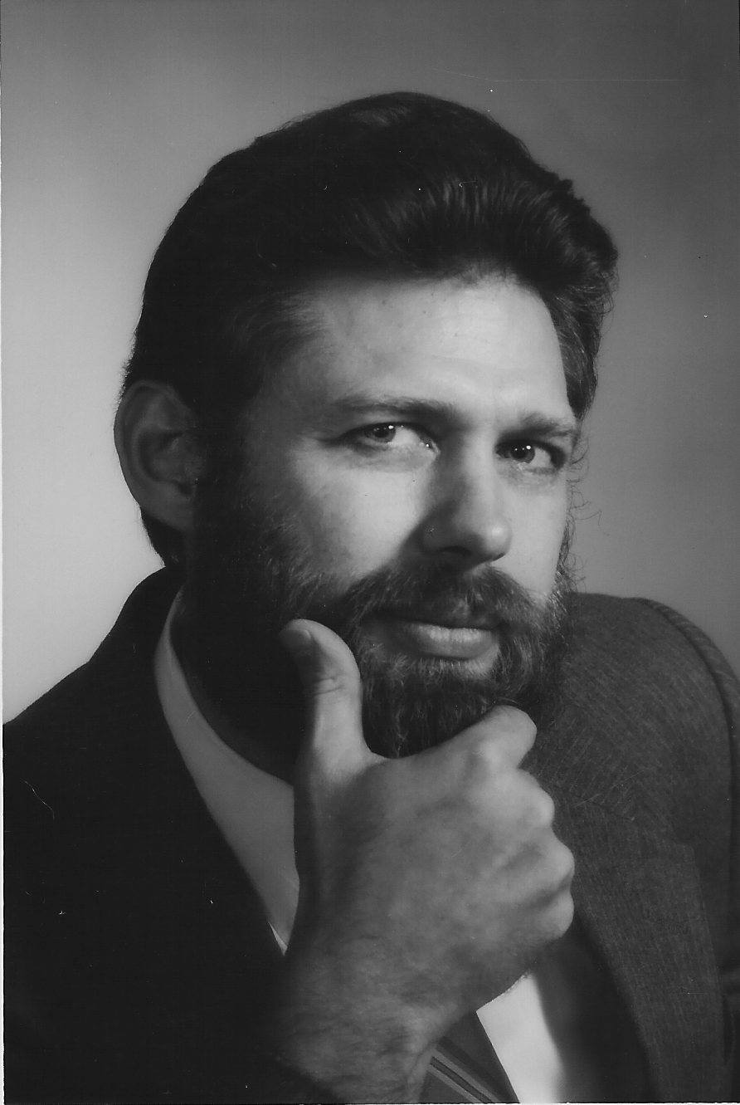
Fritz Springmeier Says Russell was a Satanist?
One of the strangest things for this Author was to continue running into evidence that seems to indicate Charles Taze Russell, the man who started the Jehovah’s Witnesses’ Watchtower Society, was secretly an important Satanist. Lest the reader devalue the evidence, permit this author to state that the evidence came in first before I came up with my theory that Russell was an important Satanist, and not vice-versa. Some of the outstanding clues are:
a.) C.T. Russell was definitely a Mason, yet he puts up some great smokescreens in his writing concerning his membership.
b.) C.T. Russell’s Bethel staff became concerned about his occultic activities and required him to take an oath forswearing any further occultic activities.
c.) In my previous book The Watchtower and the Masons, I study 35 parallel beliefs that Russell had with Masonry. I spent a page per parallel. These 35 are not in any way inclusive, Russell had many other identical ideas to what the Masonic lodges propogate.” Fritz Springmeier, Bloodlines of the Illuminati, p. 166 (PDF)

Slide 6
Satanic Assessment Continued…
d.) Various items from magic were part of Russell’s religious beliefs including healing handkerchiefs, phrenology, the Winged-Sun-Disk, Enochian Magical planes, etc.
e.) Russell’s family’s possible Illuminati links, and his wife’s possible connections with a family line of Satanists.
f.) Russell’s apparent secret Rosicrucian membership with the Quakertown, PA group of Rosicrucians, as revealed by the pyramid he ordered erected, his use of the Winged-Sun-Disk. and his cremation three days after his death.
g.) Russell owned a cemetary in Pittsburgh. Leading Satanists try to own cemetaries for several reasons. First, it facilitates the disposal of human sacrifices which are buried in pieces below the fresh holes dug for someone else’s burial. When the casket is placed in the hole, it would be rare for anyone to dig below the casket level ever again. Second, magic power is associated with cemetaries. The spiritual power of the dead is pulled up by making a circle of light over them then within the circle a naked Satanist lays. Third, specific bones are sought such as the skulls and left hands. Left hands are preserved in order to hold candles for certain ceremonies.
h.) Contacts from various places today indicate that the modern Watchtower Society is working with the New World Order. This implies that at some point the Society began cooperating with the New World Order. Russell seems to be the likeliest starting point.” Ibid.

Slide 7
Studies in the Scriptures Are More Than Writings
“If the six volumes of SCRIPTURE STUDIES are practically the Bible topically arranged, with Bible proof-texts given, we might not improperly name the volumes—the Bible in an arranged form. That is to say, they are not merely comments on the Bible, but they are practically the Bible itself, since there is no desire to build any doctrines or thought on any individual preference or on any doctrine or thought on any individual preference or on an individual wisdom, but to present the entire matter on the lines of the Word of God.” (Watchtower, September 15, 1910

Slide 8
But Don’t Study the Bible, You’ll Fall Into Darkness
“Furthermore, not only do we find that people cannot see the divine plan in studying the Bible by itself, but we see, also, that if anyone lays the SCRIPTURE STUDIES aside, even after he has used them, after he has become familiar with them, after he read them for ten years—if he then lays them aside and ignores them and goes to the Bible alone, though he has understood his Bible for ten years, our experience shows that within two years he goes into darkness. On the other hand, if he had merely read the SCRIPTURE STUDIES with their references and had not read a page of the Bible, as such, he would be in the light at the end of the two years, because he would have the light of the Scriputres” (Watchtower September 15, 1910)

Slide 9
Does God Agree?
2 Tim. 2:15 “Study to shew thyself approved unto God, a workman that needeth not to be ashamed, rightly dividing the word of truth.”
2 Tim. 3:16-17 “All scripture is given by inspiration of God, and is profitable for doctrine, for reproof, for correction, for instruction in righteousness: That the man of God may be perfect, thoroughly furnished unto all good works.”
Acts 17:11 “ These were more noble than those in Thessalonica, in that they received the word with all readiness of mind, and searched the scriptures daily, whether those things were so.”
Heb. 4:12 “For the word of God is quick, and powerful, and sharper than any twoedged sword, piercing even to the dividing asunder of soul and spirit, and of the joints and marrow, and is a discerner of the thoughts and intents of the heart.”

Slide 10
1914 Comes and Goes, but “We Did Not Say Positively…”
“Studying God’s Word, we have measured the 2520 years, the seven symbolic times, from that year 606 B.C. and have found that it reached down to October, 1914. as nearly as we were able to reckon. We did not say positively that this would be the year. We merely left every one to look at the facts of history and reckon for himself. Would this date be the time or would it be some other date? we asked.” (Watchtower, November 1, 1914)

Slide 11
My Speculations Failed, But It’s Ok Because We Love Each Other
“The Editor has been rejoicing in these blessed experiences. Even if the time of our change should not come within ten years, what more should we ask? Are we not a blessed, happy people? Is not our God faithful? If any one knows anything better, let him take it. If any of you ever find anything better, we hope you will tell us. We know of nothing better nor half as good as what we have found in the Word of God.” (Watchtower, December 15, 1914

Slide 12
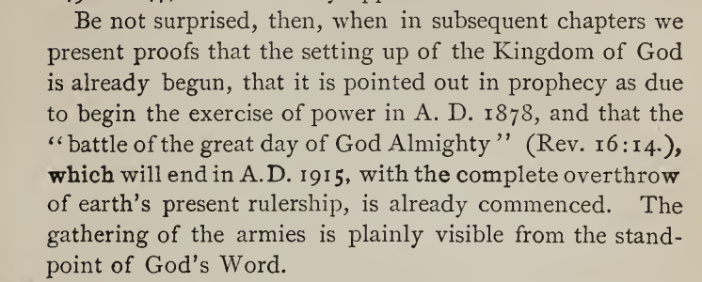
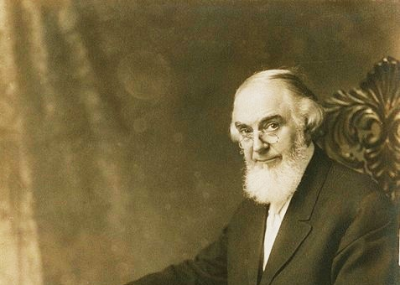
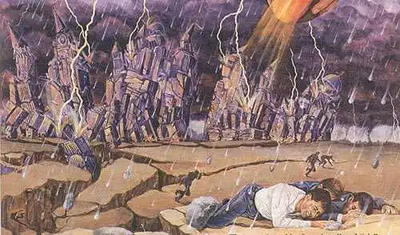
1914, Failed, New Light 1915
(Russell, The Time is at Hand, (1914 ed.) p. 101

Slide 13
What Does God Say About Russell’s Gospel?
Gal. 1:6-11 “I marvel that ye are so soon removed from him that called you into the grace of Christ unto another gospel: Which is not another; but there be some that trouble you, and would pervert the gospel of Christ. But though we, or an angel from heaven, preach any other gospel unto you than that which we have preached unto you, let him be accursed. As we said before, so say I now again, if any man preach any other gospel unto you than that ye have received, let him be accursed.

Slide 14
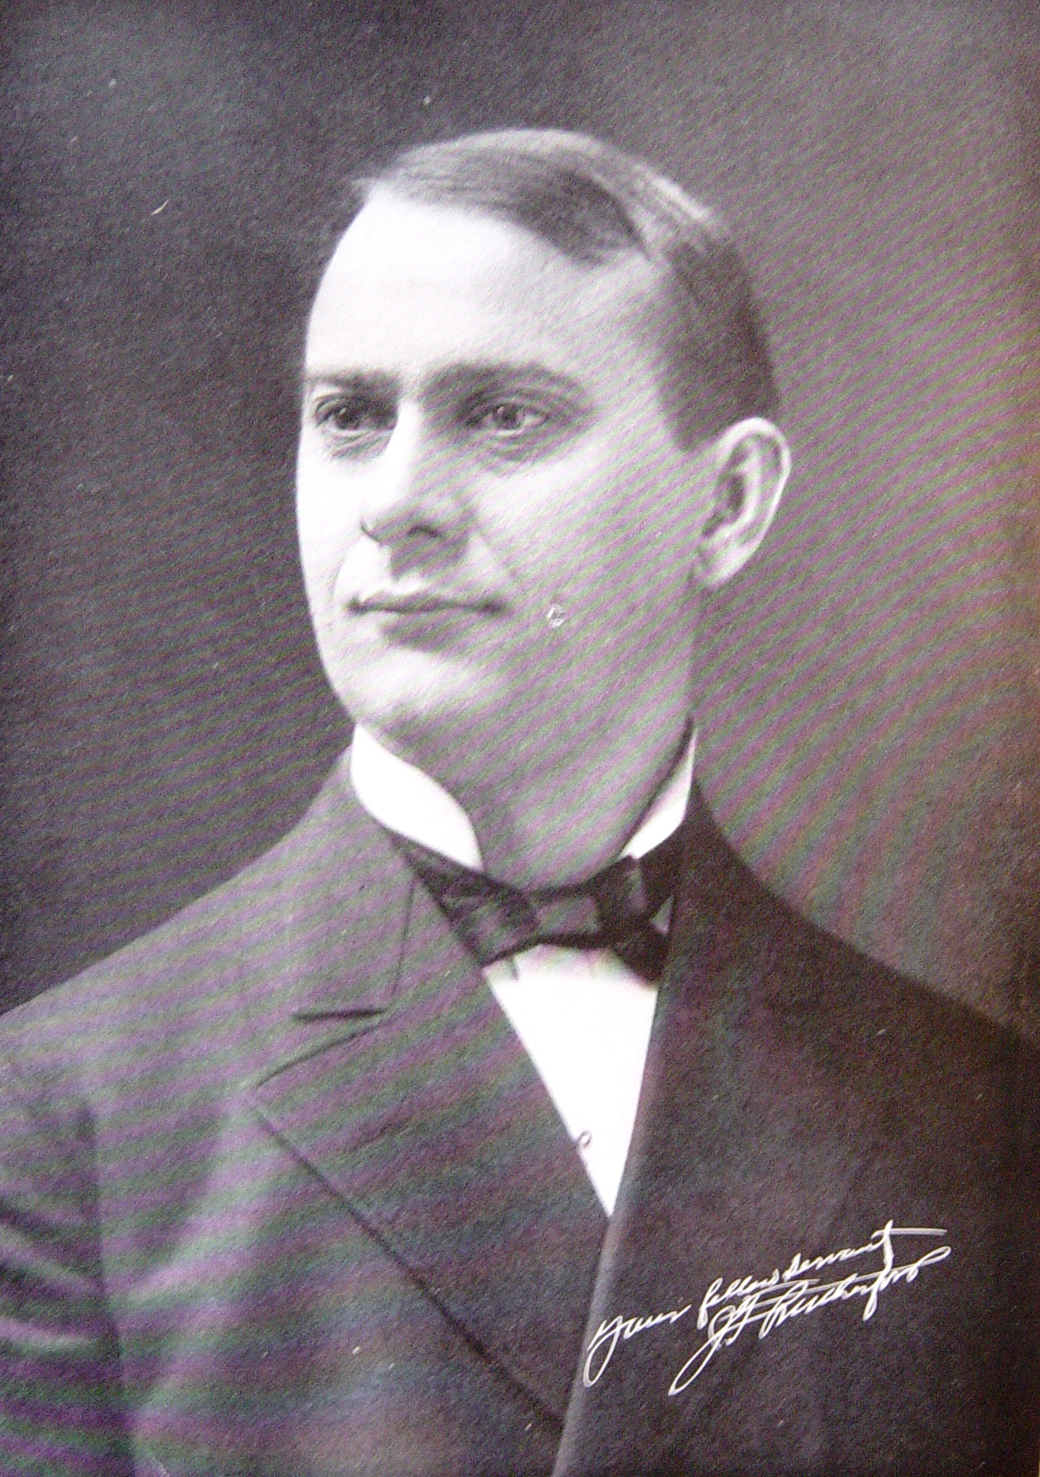
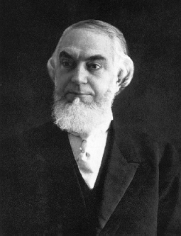
Russell to Rutherford
After Russell died in 1916, Joseph F. Rutherford obtained the presidency of the WatchTower Society, he began increasing and centralizing power, which upset many congregations of Bible Students which were accustomed to Russell’s democratic leadership. “Rutherford centralized organizational control of the Watch Tower Society. In 1919, he instituted the appointment of a director in each congregation, and a year later all members were instructed to report their weekly preaching activity to the Brooklyn headquarters” (Wikipedia, Jehovah’s Witnesses). The Bible Students splintered into the Stand Fast Movement, the Pastoral Bible Institute, the Laymen's Home Missionary Movement founded by PSL Johnson, and the Dawn Bible Students Association.

Slide 15
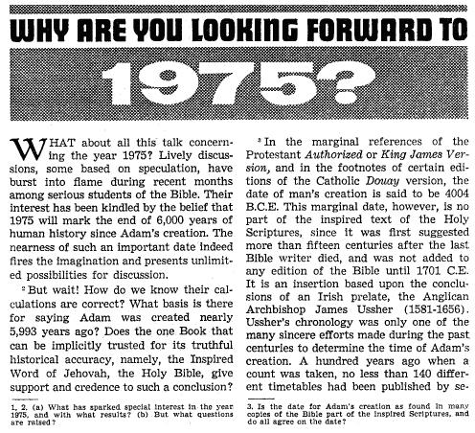
Rutherford and Jehovah’s Witness Synopsis
Rutherford set times for Armageddon between 1918-1920 (The Finished Mystery, p. 258 & 404), for the resurrection of the patriarchs in 1925 (The Way to Paradise, p. 224). Rutherford had a palace built called Beth Sarim in San Diego, in the 1920s as the dwelling place for the patriarchs and prophets, which became his residence, and later quietly sold by the organization. As a result of the new control policies and unfulfilled prediction many thousands left the Watchtower Society and started other Bible Student movements. Finally, by 1931, Rutherford introduced the new name “Jehovah’s Witnesses” in 1931 to distinguish them from the other Bible Student movements. Rutherford and the Jehovah’s Witnesses went on to set other times 1941 (WWII), 1975, the generation of 1914, on to overlapping generations. They created a new translation of the Bible called the NWT complete in 1961 (the translators remain anonymous).

Slide 16
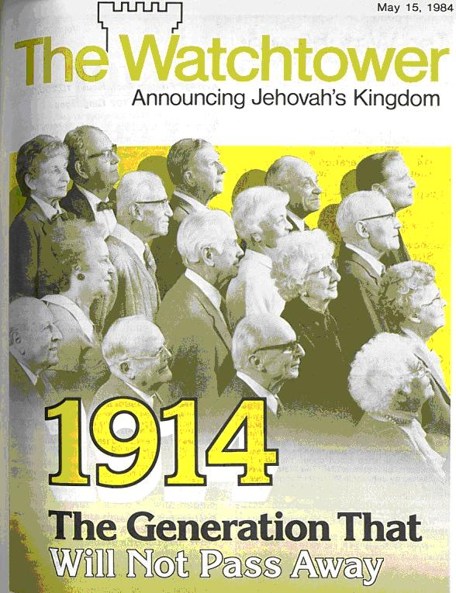
The Legacy:
Charles Taze Russell comes out of the branch of Millerism that went on to time-set and time-set and spiritualize away there false ideas—using the speculative ideas of 2520, pyramidology, and the 6,000 year cycle
Charles Taze Russell was a successful tract publisher who set multiple times for various event—all of which failed
Russell had knowledge of Masonic handshakes, planned Zionistic goals with the Rothschilds (Jesuits), and did not preach Christ to the Jews as necessary for salvation
The name “Russell” is one of the dominant family “bloodlines of the Illuminati” which rule the world in secret---Russell’s ties to Zionism and the Rothschilds makes this claim credible
After his death, Russell was replaced by a spiritual dictator Rutherford who continued to set times—all of which failed
The Jehovah’s Witnesses got their name from Rutherford in 1931, and went on to time-set more after his death and create a new Bible

Slide 17
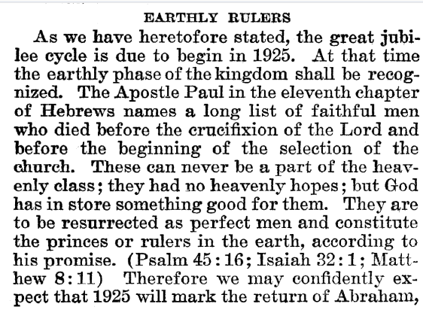
Rutherford Predicts Return of Abraham
Joseph F. Rutherford, (1920): Millions Now Living Will Never Die! p. 89-90

Slide 18
Time-setting Again! 1975
"Choosing the Best Way of Life". The Watchtower. March 15, 1980. pp. 17–18. With the appearance of the book Life Everlasting—in Freedom of the Sons of God, ... considerable expectation was aroused regarding the year 1975. ... there were other statements published that implied that such realization of hopes by that year was more of a probability than a mere possibility. It is to be regretted that these latter statements apparently overshadowed the cautionary ones and contributed to a buildup of the expectation already initiated. ... persons having to do with the publication of the information ... contributed to the buildup of hopes centered on that date.
"What will the 1970's Bring?". Awake!. Watch Tower Society. October 8, 1968. p. 14. Does this mean that the above evidence positively points to 1975 as the complete end of this system of things? Since the Bible does not specifically state this, no man can say... If the 1970s should see intervention by Jehovah God to bring an end to a corrupt world drifting toward ultimate disintegration, that should surely not surprise us.
"How Are You Using Your Life?". Our Kingdom Ministry. May 1, 1974. p. 63. Reports are heard of brothers selling their homes and property and planning to finish out the rest of their days in this old system in the pioneer service. Certainly, this is a fine way to spend the short time remaining before the wicked world's end.

Slide 19
Decline of the Watch Tower After Death
Chicago Daily Tribune October 30, 1949 pg 18: "Pastor Russell died in 1916. In the 33 years since, the methods of this sect have deviated completely from those of Pastor Russell and his manner of teaching."

Slide 20
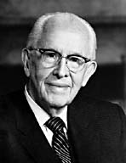
An Important Statement From an LDS Prophet
Prophet Ezra Taft: “the Book of Mormon is the keystone of our religion. This was the Prophet Joseph Smith’s statement. He testified that “the Book of Mormon was the most correct of any book on earth, and the keystone of our religion” (Introduction to the Book of Mormon). A keystone is the central stone in an arch. It holds all the other stones in place, and if removed, the arch crumbles.” (October 1986 General Conference)

