Slide 1
The Cleaver

Slide 2
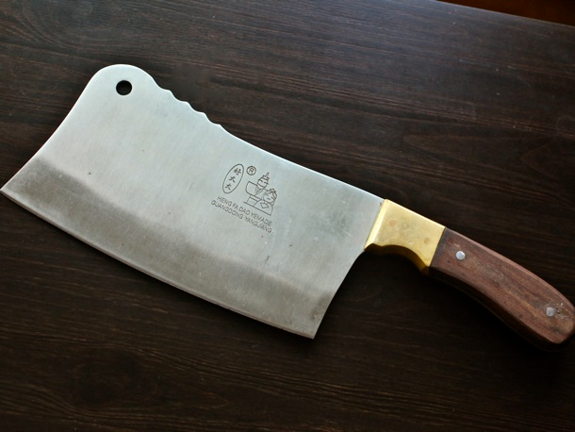
A behemoth
“One of my favorite knives is my heavy-duty, two-pound, full-tang, 8-inch-bladed behemoth of a cleaver that I got for $15 at a recently closed restaurant supply store in Boston's Chinatown. I use it nearly daily for taking apart chickens, hacking through animal bones, mincing beef or pork for hand-chopped burgers or dumplings, cleaving hearty vegetables…A cleaver is meant to be only for the toughest of the tough jobs, and will get beat up.” www.seriouseats.com/2010/08/how-to-choose-buy-care-for-a-meat-cleaver.html

Slide 3
The Cleaver of Truth
“Our habits of eating and drinking show whether we are of the world or among the number that the Lord by his mighty cleaver of truth has separated from the world.--U. T., Aug. 25, 1897. {HL 75.2}
”Yet the purpose of God must be accomplished. The knowledge of His will must be given to the world. God brought the hand of oppression upon His people, and scattered them as captives among the nations. In affliction many of them repented of their transgressions, and sought the Lord. Thus scattered throughout the countries of the heathen, they spread abroad the knowledge of the true God. {ST, January 25, 1910 par. 10}
In this day, God has called His church, as He called ancient Israel, to stand as a light in the earth. By the mighty cleaver of truth,--the messages of the first, second, and third angels,--He has separated a people from the churches and from the world, to bring them into a sacred nearness to Himself. He has made them the depositories of His law, and has committed to them the great truths of prophecy for this time. Like the holy oracles committed to ancient Israel, these are a sacred trust to be communicated to the world. {ST, January 25, 1910 par. 11}

Slide 4
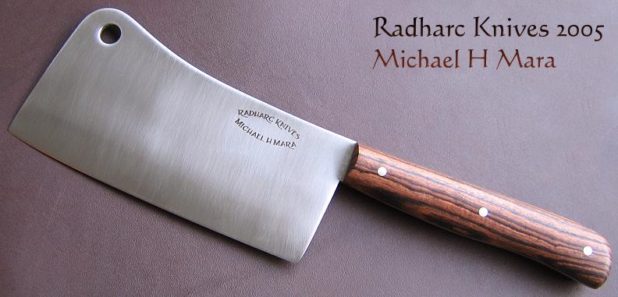
Designed for Distinctiveness
Our health habits clearly reveal if we have are following the world or if we are seeking clarity of mind to hear God’s voice. Those loyal to the 3 Angel’s messages distinguish themselves from the world and worldly churches!

Slide 5
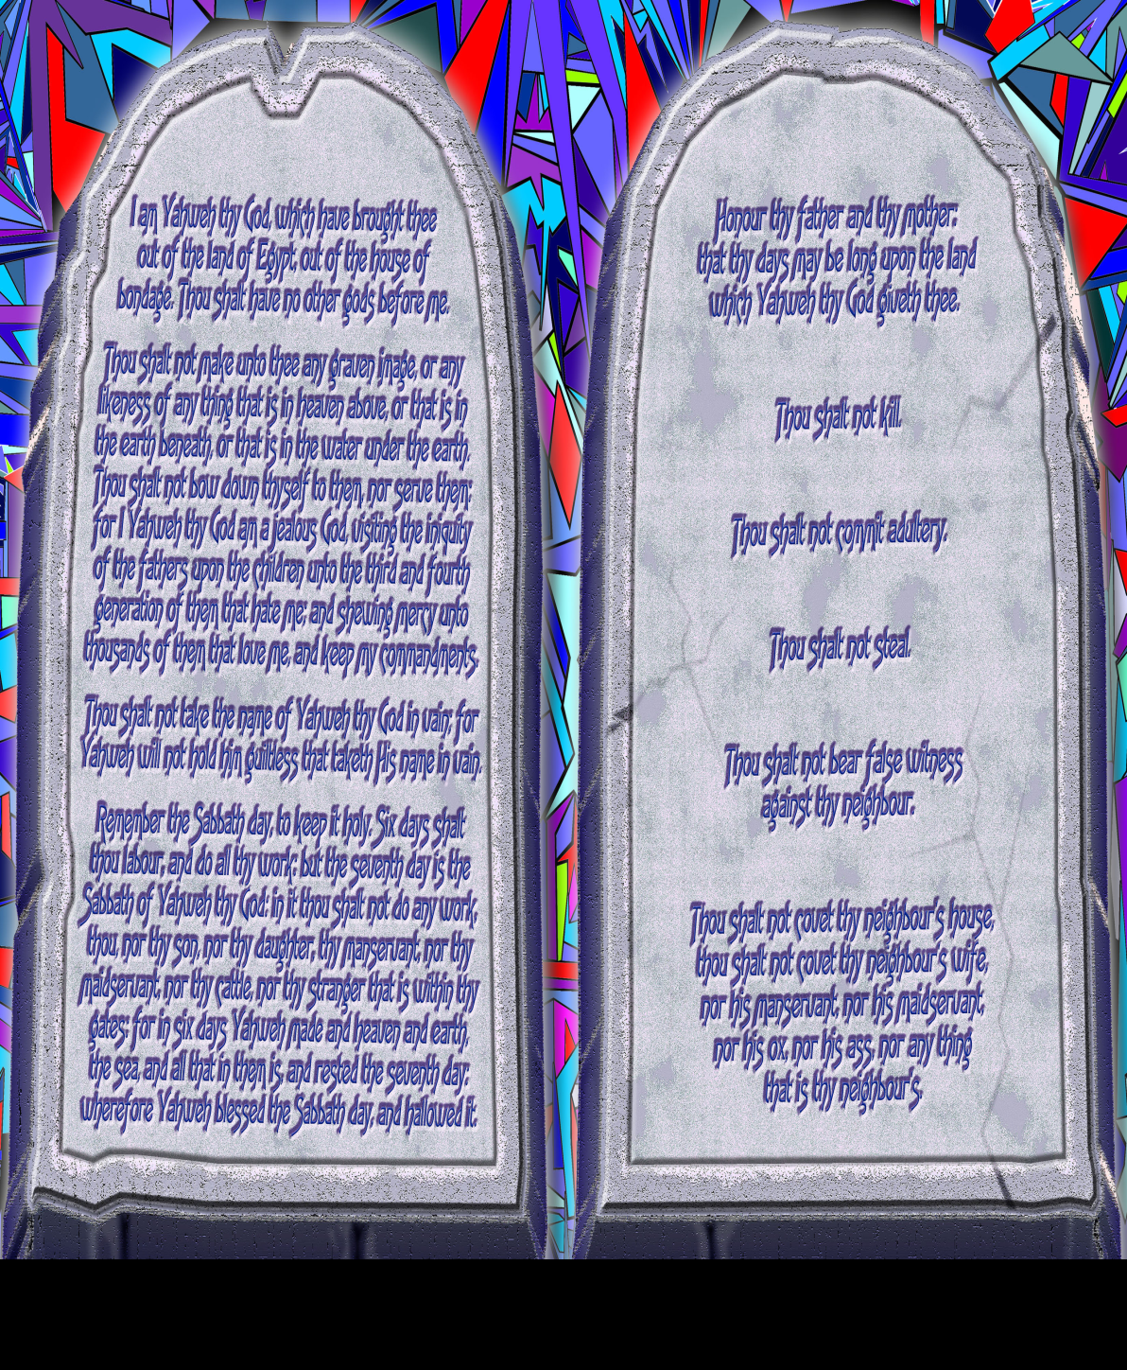
“Fear God”
This first phrase is referred to repeatedly in the Old Testament. “Let us hear the conclusion of the whole matter: Fear God, and keep his commandments: for this is the whole duty of man.“ Eccl. 12:13 “By mercy and truth iniquity is purged: and by the fear of the LORD men depart from evil.” Proverbs 16:6

Slide 6
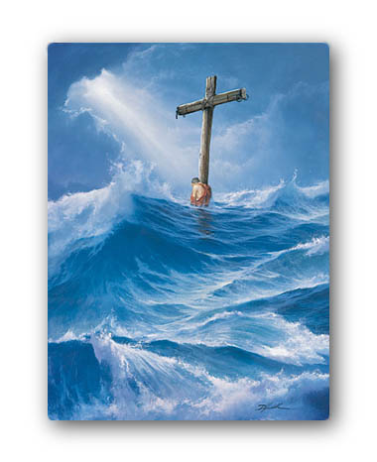
Drives us to Christ
Since we are bidden to follow all of God’s commandments, and by ourselves, we can’t, this phrase drives us to flee to Christ for forgiveness and for power to obey.
“Is the law then against the promises of God? God forbid: for if there had been a law given which could have given life, verily righteousness should have been by the law. But the scripture hath concluded all under sin, that the promise by faith of Jesus Christ might be given to them that believe. But before faith came, we were kept under the law, shut up unto the faith which should afterwards be revealed. Wherefore the law was our schoolmaster to bring us unto Christ, that we might be justified by faith. But after that faith is come, we are no longer under a schoolmaster.” Galatians 3:21-25

Slide 7

Give Glory to Him
Again, the Bible is very clear what this phrase means. “ What? know ye not that your body is the temple of the Holy Ghost which is in you, which ye have of God, and ye are not your own? For ye are bought with a price: therefore glorify God in your body, and in your spirit, which are God's.” 1 Corinthians 6:19,20
“Whether therefore ye eat, or drink, or whatsoever ye do, do all to the glory of God.” 1 Corinthians 10:31

Slide 8
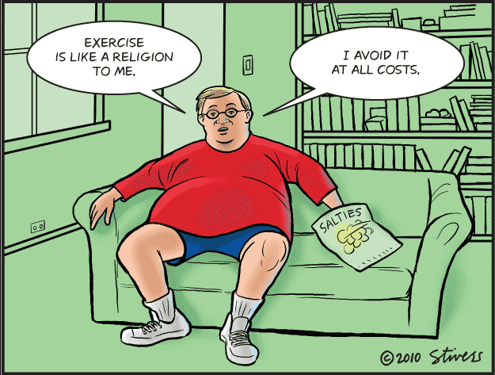
The Right Arm
The right arm is the right arm. The health message is not the body; it is not to be made the all in all message. It is not:
1. you can only eat two meals a day.
2. you should only eat fruit.
3. watch out for extremes!!
4. it is about health reform; not health deform!!
It is to be used to lead others to health and a desire to know more of Christ and the great truths for this time!

Slide 9
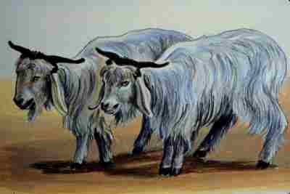
The hour of His judgment
“…for the hour of His judgment is come…” Rev. 14:7
“And he said unto me, Unto two thousand and three hundred days; then shall the sanctuary be cleansed.” Dan. 8:14
“For on that day shall the priest make an atonement for you, to cleanse you, that ye may be clean from all your sins before the LORD.” Leviticus 16:30

Slide 10
The One Unique Doctrine
1524- Sabbatarian Anabaptist Oswald Glait discovers the 7th day Sabbath.
1520’s- Andreas Carlstadt, an associate of Luther, writes on soul sleep of the dead.
1840’s-Millerite Adventists discover the investigative judgment; the only truly legal, logical base for the plan of salvation. It smacks once saved always saved, antinomianism, universalism, predestination to the curb. It reveals Christ as high priest in most holy place, and Christ as Lord of the Christian man and woman!
Our unique contribution to Christendom becomes our best kept secret!!

Slide 11
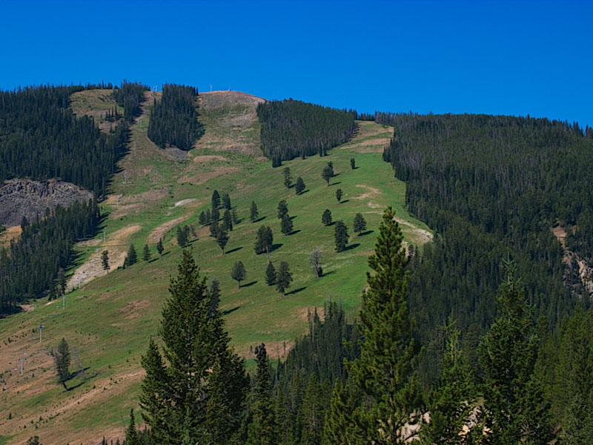
Worship Him
True worship involves honoring all of God’s commandments. False worship involves man made traditions. “But in vain they do worship me, teaching for doctrines the commandments of men.” Matthew 15:9 We are called to honor the commandment that reveals Him ‘that made heaven, and earth, and the sea, and the fountains of waters.’ verse 7
Only the 7th day Sabbath reveals Christ as the Creator. The Sabbath, while being the 7th day of the week, which is Saturday, is an integral part of the everlasting gospel.

Slide 12
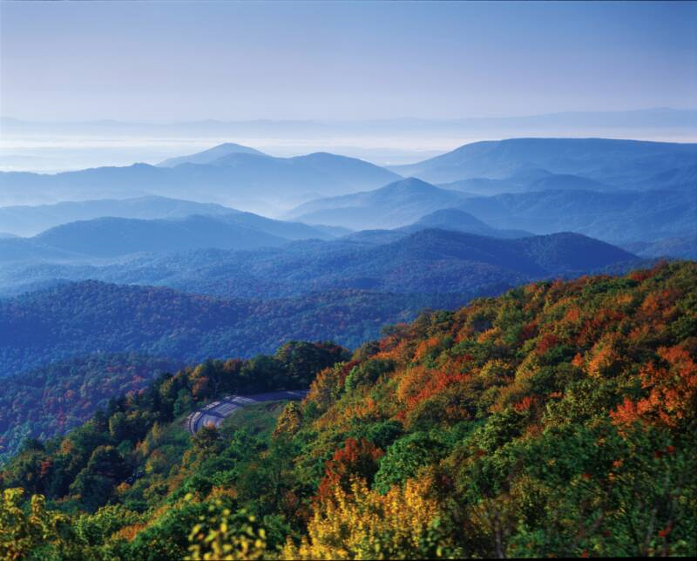
Sabbath-Sign of Christ’s Power
While it reveals Christ as Creator, it also reveals Him as a personal Savior in the human life.
“Speak thou also unto the children of Israel, saying, Verily my Sabbaths ye shall keep: for it [is] a sign between me and you throughout your generations; that [ye] may know that I [am] the LORD that doth sanctify you.” Ex.31:13
This is the message of Hebrews 4. “There remaineth therefore a rest to the people of God. For he that is entered into his rest, he also hath ceased from his own works, as God did from his. Let us labour therefore to enter into that rest, lest any man fall after the same example of unbelief.” verses 9-11

Slide 13
Sabbath-Sanctification
“It points to Him as both the Creator and the Sanctifier. It declares that He who created all things in heaven and in earth, and by whom all things hold together, is the head of the church, and that by His power we are reconciled to God. For, speaking of Israel, He said, "I gave them My Sabbaths, to be a sign between Me and them, that they might know that I am the Lord that sanctify them,"--make them holy. Ezek. 20:12. Then the Sabbath is a sign of Christ's power to make us holy. And it is given to all whom Christ makes holy. As a sign of His sanctifying power, the Sabbath is given to all who through Christ become a part of the Israel of God.” Desire of Ages, pg. 288

Slide 14

Babylon is Fallen
“And there followed another angel, saying, Babylon is fallen, is fallen, that great city, because she made all nations drink of the wine of the wrath of her fornication.” Revelation 14:8
By their rejection of the first angel’s message, the apostate Protestant churches are in a fallen condition. They have rejected:
1. the law of God
2. the health message
3. the judgment hour and Christ’s work in the Most Holy Place.
4. the 7th day Sabbath, which is Saturday.
5. the power of Christ has been rejected.

Slide 15
Brain Dead
“‘The Enemy Unmasked’, however, goes far beyond that to link many groups and individuals into a world-wide conspiracy that we do not believe is correct, and in fact, is very inflammatory and damaging to the efforts of Christian brotherhood and goodwill. I enjoy very much my fellowship with all Christian pastors and believers in my community, and I deeply regret that this book was printed and distributed anywhere. I believe it is harmful to the cause of Christ.” Adventist pastor, Silverton, OR
CHRISTIAN BROTHERHOOD AND GOODWILL??? CHRISTIAN PASTORS??? How about APOSTATE PROTESTANT MINISTERS??? How about rejecters of Christ and His Messages???
How about ‘And I heard another voice from heaven, saying, Come out of her, my people, that ye be not partakers of her sins, and that ye receive not of her plagues.’ Rev. 18:4

Slide 16
True Christians in Rome and A. Protestantism
“It is true that there are real Christians in the Roman Catholic communion. Thousands in that church are serving God according to the best light they have. They are not allowed access to His word, and therefore they do not discern the truth. [PUBLISHED IN 1888 AND 1911. SEE APPENDIX.] They have never seen the contrast between a living heart service and a round of mere forms and ceremonies. God looks with pitying tenderness upon these souls, educated as they are in a faith that is delusive and unsatisfying. He will cause rays of light to penetrate the dense darkness that surrounds them. He will reveal to them the truth as it is in Jesus, and many will yet take their position with His people.
But Romanism as a system is no more in harmony with the gospel of Christ now than at any former period in her history.” GC, pg. 565

Slide 17
The Cleaver Separates
Any butcher will tell you that when the cleaver comes down, everything flies. No more middle of the road, no more fence sitting, no more luke- warmness. When the cleaver hits, the birds that have flocked together are together! “And Elijah came unto all the people, and said, How long halt ye between two opinions? if the LORD [be] God, follow him: but if Baal, [then] follow him. And the people answered him not a word.” 1 Kings 18:21

Slide 18

The Third Angel’s Message
“And the third angel followed them, saying with a loud voice, If any man worship the beast and his image, and receive his mark in his forehead, or in his hand, The same shall drink of the wine of the wrath of God, which is poured out without mixture into the cup of his indignation; and he shall be tormented with fire and brimstone in the presence of the holy angels, and in the presence of the Lamb: And the smoke of their torment ascendeth up for ever and ever: and they have no rest day nor night, who worship the beast and his image, and whosoever receiveth the mark of his name.” Rev. 14:9-11

Slide 19
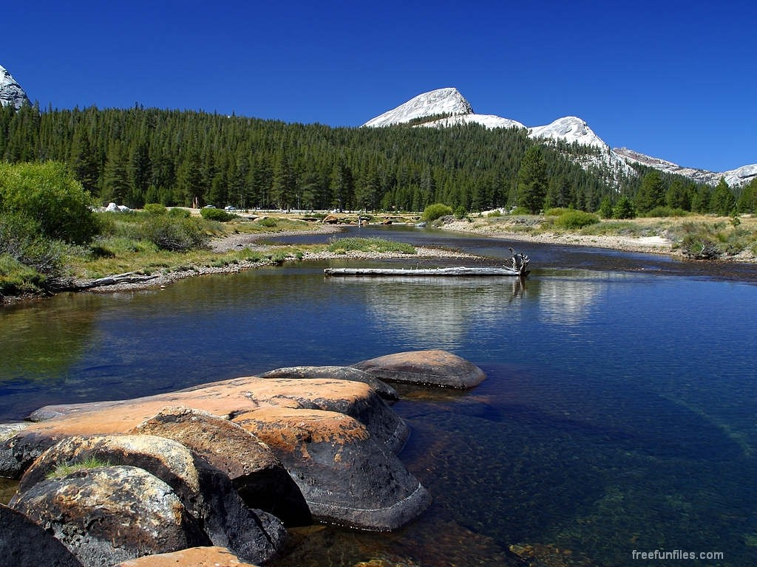
The Grand Finale
This final warning message centers around two systems: the beast and his image; the papacy and apostate Protestant churches, that are claiming the authority to dictate how humanity follows God!!
They seek to usurp authority that belongs solely to our Maker!! Not even the God of the Cosmos demands our obeisance!!!

Slide 20
Man in the Dust
“None but God can subdue the pride of man's heart. We cannot save ourselves. We cannot regenerate ourselves. In the heavenly courts there will be no song sung, To me that loved myself, and washed myself, redeemed myself, unto me be glory and honor, blessing and praise. But this is the keynote of the song that is sung by many here in this world. They do not know what it means to be meek and lowly in heart; and they do not mean to know this, if they can avoid it. The whole gospel is comprised in learning of Christ, His meekness and lowliness.
“What is justification by faith? It is the work of God in laying the glory of man in the dust, and doing for man that which it is not in his power to do for himself.-- Special Testimonies to Ministers and Workers (Series A, No. 9, 1897), pages 61, 62. TM, pg. 456

