Slide 1
A T Jones
Used Of God!

Slide 2
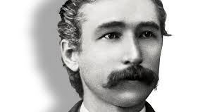
Alonzo Trevier Jones
Two men lit up the SDA movement in the late 1880’s. They were used in such a dynamic and dramatic way that Ellen White said the latter rain was beginning to fall! Heaven drew very near and used these two young men in a powerful way. One man was Alonzo T. Jones and he will be our study today!

Slide 3
Brief Biography
“Jones was a towering, angular man, with a loping gait and uncouth posturing's and gestures. Waggoner was a product of the schools, with a leonine head well packed with learning, and with a silver tongue. Jones was largely self-taught, a convert found as a private in the United States Army, who had studied day and night to amass a great store of historical and Biblical knowledge. Not only was he naturally abrupt, but he cultivated singularity of speech and manner, early discovering that it was an asset with his audiences.” Arthur Spaulding , Origin and History of Seventh Day Adventists, vol. 2, pg. 291

Slide 4
Fits Him to a Tee!
“Elder Smith, Jones declared early in the Minneapolis meetings, “has told you he does not know anything about this matter. I do, and I do not want you to blame me for what he does not know.”
These spirited words of A.T. Jones reveal a man who arrogantly spoke his mind without considering the effect they may have on the person addressed or the listeners!

Slide 5
Used Mightily By The Lord!
“The Lord in His great mercy sent a most precious message to His people through Elders Waggoner and Jones. This message was to bring more prominently before the world the uplifted Saviour, the sacrifice for the sins of the whole world. It presented justification through faith in the Surety; it invited the people to receive the righteousness of Christ, which is made manifest in obedience to all the commandments of God. Many had lost sight of Jesus. They needed to have their eyes directed to His divine person, His merits, and His changeless love for the human family. All power is given into His hands, that He may dispense rich gifts unto men, imparting the priceless gift of His own righteousness to the helpless human agent. This is the message that God commanded to be given to the world. It is the third angel's message, which is to be proclaimed with a loud voice, and attended with the outpouring of His Spirit in a large measure. The uplifted Saviour is to appear in His efficacious work as the Lamb slain, sitting upon the throne, to dispense the priceless covenant blessings, the benefits He died to purchase for every soul who should believe on Him. John could not express that love in words; it was too deep, too broad; he calls upon the human family to behold it. Christ is pleading for the church in the heavenly courts above, pleading for those for whom He paid the redemption price of His own lifeblood. Centuries, ages, can never diminish the efficacy of this atoning sacrifice. The message of the gospel of His grace was to be given to the church in clear and distinct lines, that the world should no longer say that Seventh-day Adventists talk the law, the law, but do not teach or believe Christ.” TM, pgs. 91,92

Slide 6
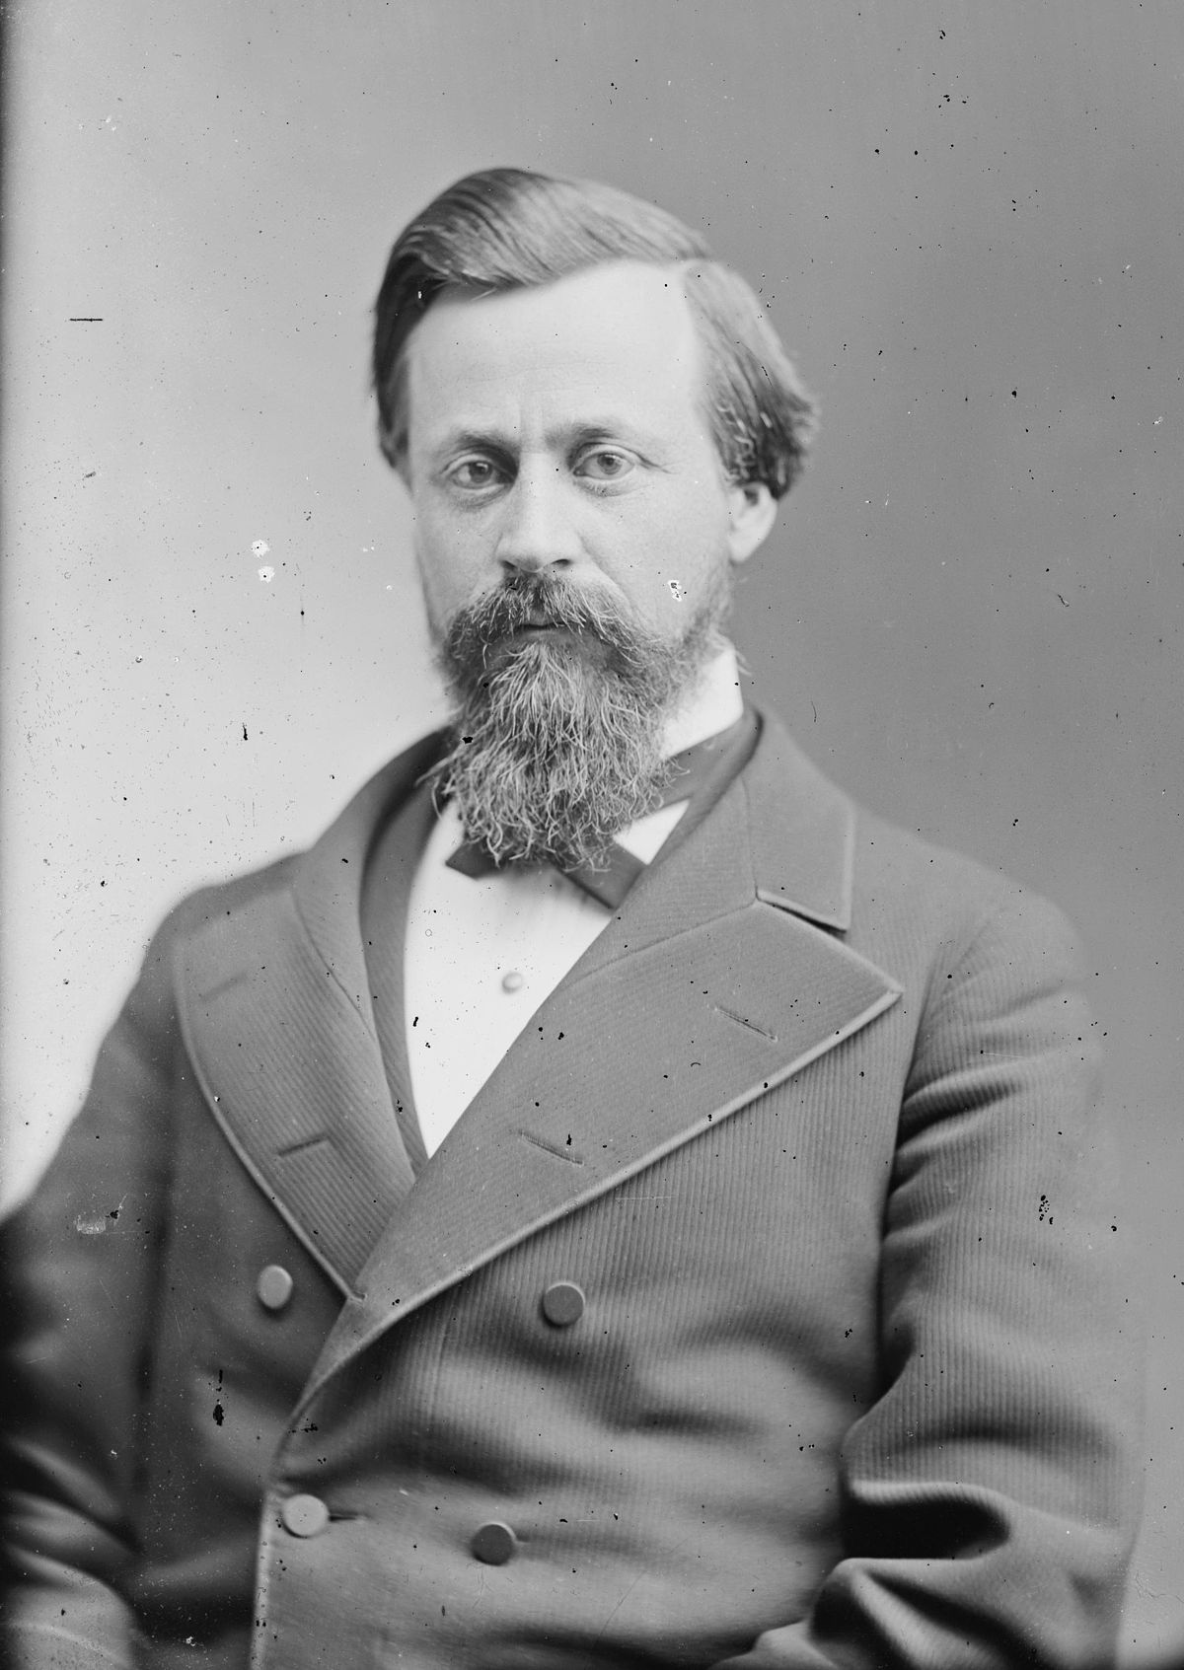
Henry Blair Sunday Law Bill
“It is well known to most of our readers that United States Senator Henry W. Blair, from New Hampshire, introduced in the Fiftieth Congress, May 211888, what has been commonly known as the " Blair Sunday-Rest bill," which was read twice, and referred to the Committee on Education and Labor. It was quite fully discussed pro and con. before the committee, with decided favors shown to those who favored the bill, by Mr. Blair, the author of the bill, who was also the chairman of the committee. Many millions of signatures to petitions for and against the bill came before Congress.” American Sentinel, Dec. 1889

Slide 7
Before Congress
THE NATIONAL SUNDAY LAW ARGUMENT OF ALONZO T. JONES Before the
United States Senate Committee on Education and Labor: at WASHINGTON, D. C.,
DEC. 13, 1888
“There are three particular lines in which I wish to conduct the argument: First, the (page 11) principles upon which we stand; second, the historical view; and, third, the practical aspect of the question. The principle upon which we stand is that civil government is civil, and has nothing to do in the matter of legislation, with religious observances in any way. The basis of this is found in the words of Jesus Christ in Matt. 22:21. When the Pharisees asked whether it was lawful to give tribute to Caesar or not, he replied: "Render therefore unto Caesar the things which are Caesar's; and unto God the things that are God's." In this the Saviour certainly separated that which pertains to Caesar from that which pertains to God. We are not to render to Caesar that which pertains to God; we are not to render to God by Caesar that which is God's.
Senator Blair. -- May not the thing due to Caesar be due to God also?
Mr. Jones. -- No, sir. If that be so, then the Saviour did entangle himself in his talk, the very thing which they wanted him to do. The record says that they sought "how they might entangle him in his talk." Having drawn the distinction which he has, between that which belongs to Caesar and that which belongs to God, if it be true that the same things belong to both, then he did entangle himself in his talk; and where is the force in his words which command us to render to Caesar that which belongs to Caesar, and to God the things that are God's?”

Slide 8
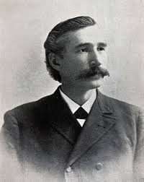
Spokesman for God and Adventism
With Ellen White in Australia and EJ Wagoneer in England, AT Jones took center stage in Adventism. He had received the endorsement of Heaven in his presentations on the righteousness of Christ in 1888 and later on that year, Jones spoke before the Congress of the united States over the Senator Henry Blair Sunday bill. To say that Jones became ‘larger than life’ to many Adventists is an understatement. In fact, a woman named Anna Rice Phillips sought Jones’ endorsement for her ‘prophetic gift’ in the early 1890’s and got it!!!

Slide 9
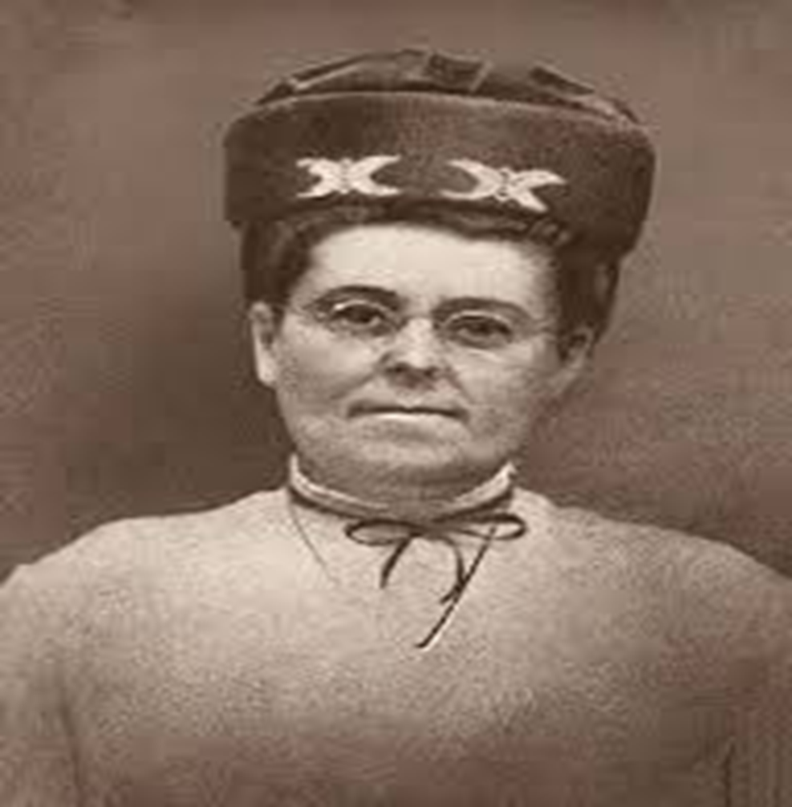
Prophetess Anna Rice-Phillips
In the 1890s Anna Rice-Phillips claimed that she was to join Ellen white in the prophetic office. Her cause was championed by none other than Alonzo T. Jones, a leading minister in Battle Creek. However, her testimonies consisted largely of spiritual trivia. Speaking of Anna Phillips, Ellen White said: “Childish figures and illustrations are employed in describing sacred, heavenly things, and there is a mingling of the sublime and the ridiculous. While the work has an appearance of great sanctity, it is calculated to ensnare and mislead souls….

Slide 10
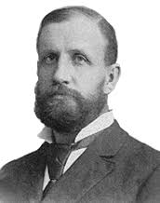
Continued
…Incredibly, one of the main reasons advanced for the acceptance of Anna Phillips was the so-called argument from silence: “our brethren...could see nothing objectionable in them.”
Fortunately, Ellen White was able to work quietly and kindly with this young woman. She eventually renounced her earlier spiritual experience and became a “trusted fruitful Bible instructor in the work of the church.”

Slide 11
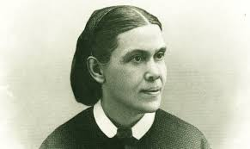
The Rice/Phillips Situation-1893/1894
With Ellen White gone to Australia by 1892, A T Jones began to topple. The beginning was his wholehearted endorsement of another prophetess, Anna Rice Phillips. This began a very unsettling slide for Jones that led to open apostasy from the truth!

Slide 12
Jones Blunders Again with Solusi
The Seventh Day Adventist missionaries came to Africa in July 1887. The “Cape Conference” was organized in 1892 with headquarters at Cape Town. There was an early interest in “carrying the gospel” north to the “Matabeles” in Southern Rhodesia (Zimbabwe) “but owing to the hostility of the native rulers, little progress was made until in 1893 Lobengula was overthrown, and the British government took possession of the country.” The following year, a missionary party arrived in Bulawayo and established the Solusi mission on a grant of 12,000 acres secured from Cecil Rhodes. From Solusi, many other missions were later established in Southern and Northern Rhodesia (Zambia) and Nyasaland (Malawi)…
In 1894, one year after the Matabele power was crushed in the newly founded colony of Rhodesia, new lands were opened for settlement. That was when the Adventist Mission Board voted to open a mission in Matabeleland. The Cape Conference contributed $2,500 to the enterprise, and A. T. Robinson interviewed Cecil Rhodes concerning permission to open mission work and the terms for securing land. Rhodes, after listening without apparent interest to Robinson’s presentation of the Adventist plan for industrial mission work, handed Robinson a sealed envelope addressed to his representative in Bulawayo. “Hand this to Dr. Jameson when you arrive,” Rhodes remarked, and Robinson was dismissed. (Our Story of Missions, 213)
Since Bulawayo was six weeks of travel in a covered wagon behind sixteen mules from the rail end to Kimberley, Robinson’s remark, “One could hardly guess how curious I was to know the contents of that epistle,” must surely rank as one of the great understatements in Adventist history. (Ibid.) As it turned out, Rhodes’ instructions to Jameson were to give the Adventists as much land as they could make use of. Twelve thousand acres were selected thirty-five miles west of Bulawayo, and Solusi Mission was founded.

Slide 13
Jones Clashes with EGW over church-state Separation
“In the 1890‘s, the colonial authorities in the land that we now call Zimbabwe, offered the Adventist Church land to build a school. It was to be the first Adventist school located in a predominantly non-Christian society. Without the land, it seemed that it would be impossible for the school to be established. But it was a classic case of state support for a religious school. This, of course, was opposed by A. T. Jones. And he succeeded in swinging the church behind his view. The 1895 General Conference Session, at the behest of religious liberty leaders, voted to bar the church leaders in Southern Africa from accepting the land grant and, then for good measure, went even further, to ban churches in America from receiving tax-exempt status. When Ellen White got news of the decisions of these 1895 General Conference Session votes, she expressed strong opposition to both. Writing in favor of receiving state aid, she stated: “Just as long as we are in this world, and the Spirit of God is striving with the world, we are to receive as well as to impart favors. We are to give to the world the light of truth as presented in the sacred Scriptures, and we are to receive from the world that which God moves upon them to do in behalf of His cause. God has not closed the door of mercy yet. The Lord still moves upon the hearts of kings and rulers in behalf of His people, and it becomes us who are so deeply interested in the religious liberty question not to cut off any favors, or withdraw ourselves from the help that God has moved men to give for the advancement of His cause.” “Let these men [Religious Liberty leaders] read the book of Nehemiah with humble hearts touched by the Holy Spirit, and their false ideas will be modified, and correct principles will be seen, and the present order of things will be changed.” Ellen G. White, Testimonies to Ministers and Gospel Workers, 200 & 202 (emphasis added).
Writing about the extreme positions taken by the religious liberty leaders on the issue of state funding, Ellen White went so far as to state: “Ideas of religious liberty are being woven with suggestions that do not come from the Holy Spirit, and the religious liberty cause is sickening…” Testimonies to Ministers and Gospel Workers, 200 (emphasis added).

Slide 14
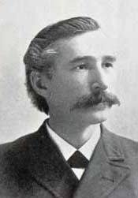
Jones Not Happy By This!
First, the Anna Rice Phillips affair and now the Solusi debacle in 1895. A T Jones was having trouble. Ellen White made it very clear that Jones was dead wrong over the Solusi land grant AND EGW made it very clear that his direction was not under the control of the Holy Spirit! The next problem came a few years later!

Slide 15
Jones and Organization
A war raged in Adventism in the 1890’s and into the 1900’s, culminating in the General Conference reorganization in 1901 and 1903. Unfortunately, Jones came out on the wrong side in this issue as well and he never got over this one! As far back as 1894, EGW had warned Jones and Wagoneer that their ideas on organization were wrong and not from God. In a letter of January 14, 1894, EGW declared, “Oh how Satan would rejoice to get in among this people, and disorgan9ize the work at a time when thorough organization is essential…Let not you nor Elder Wagoneer be incautious now, and advance things that are not proper, and not in accordance with the very message God has given.” When it came to organization, Jones believed that every person was to be under the control of God and be led by Him. With the Spirit leading each person, there would be perfect order in the Lord’s work. Jones failed to grasp the need for leaders to guide the work. He felt that was papal. This situation pushed Jones in the wrong direction, straight into the arms of pantheistic John Harvey Kellogg!

Slide 16
Over the Top
In the summer of 1903, at a time when affairs at the conference were most uncomfortable, he had an interview at Elmshaven with Ellen White, in which he told her that at the request of Dr. J. H. Kellogg he was planning to go to Battle Creek to teach Bible in the American Medical Missionary College. He hoped to be able to help Dr. Kellogg. She counseled him not to go. He promised Sister White that he would be guarded. She had been warned in vision that such a move on his part would lead to his downfall. She wrote of it thus: ATJEJW 3.3
“In vision I had seen him [A. T. Jones] under the influence of Dr. Kellogg. Fine threads were being woven around him, till he was being bound hand and foot, and his mind and his senses were becoming captivated.”—Letter 116, 1906. ATJEJW 3.4
Then, comments Ellen White, as she reported this to Brother Jones just before he went to Battle Creek, she could see “that his perceptions were becoming confused, and that he did not believe the warning given. The enemy works in a strange, wonderful way to influence human minds.”—Ibid. But Jones was sure that he would not fall away. He was a man with too much self-confidence.

Slide 17
How Are the Mighty Fallen!
December 29, 1905, Lost Spiritual Eyesight and Repudiated God’s Warnings.—“I send no more [testimonies to be read to the Battle Creek church] to A. T. Jones, for I have evidence that a work will have to be done for him before the Lord will accept his service. God has given him warnings which he has repudiated, and I am deeply grieved that he has so little spiritual eyesight.”—Letter 345, 1905 (written to G. W. Amadon, first elder of the Battle Creek church). ATJEJW 4.4
March 12, 1906, The Wrong Spirit and Demonstrations of Bitterness.—“You may be surprised to hear the words that you have heard from Elder A. T. Jones; but I am not at all surprised. This is the development of the man when the spirit that is counter to the Spirit of God comes upon him. In him as he is at the present time, you have a representation of a man who is not under the molding influence of the Spirit of God. The Lord accepts no such demonstrations of bitterness.... ATJEJW 4.5
“Read in my books, Patriarchs and Prophets and Great Controversy, the story of the first great apostasy. History is being repeated and will be repeated. Read then, and understand.”—Letter 98, 1906. ATJEJW 4.6
April 2, 1906, Captivated, Deluded, and Deceived.—“During the General Conference at Takoma Park [May, 1905], Elder Jones’s case was again presented to me. After this, I had a long conversation with him in which I pointed out his danger. But he was self-confident, and declared to me that Dr. Kellogg believed the truth and the testimonies just as firmly as the rest of us believed and advocated them. In this conversation Elder Jones manifested that which had been revealed to me regarding him, that in the place of receiving the warnings he was full of self-confidence; that he had exalted himself, and in the place of being prepared to help Dr. Kellogg, he had united with him to disbelieve and distrust, and falsely to accuse the ministers and others who were trying to save Dr: Kellogg and other physicians who were in peril.... ATJEJW 4.7

Slide 18
Warning after Warning
“I warned Elder Jones, but he felt that he was not in the least danger. But the fine threads have been woven about him, and he is now a man deluded and deceived. Though claiming to believe the testimonies, he does not believe them.”—Letter 116, 1906 (to Dr. David Paulson). ATJEJW 4.8
May 1, 1906, Chose Darkness Rather Than Light.—“I am sorry for A. T. Jones, who has been warned over and over again. Notwithstanding these warnings, he has allowed the enemy to fill his mind with thoughts of self-importance. Heed not his words, for he has rejected the plainest light and has chosen darkness instead. The Holy One hath given us messages clear and distinct, but some poor souls have been blinded by the falsehoods and the deceptive influences of satanic agencies, and have turned from truth and righteousness to follow these fallacies of satanic origin.”—Manuscript 39, 1906. ATJEJW 5.1
June 15, 1906, Voice Controlled by Dr. Kellogg.—“Dr. Kellogg controls the voice of Elder A. T. Jones, and will use him as his mouthpiece. My prayer is, O God, open Thou the blind eyes, that they may see; and the ears of the deaf that they may hear, and become humble.”—Letter 182, 1906. ATJEJW 5.2
July 5, 1906, Grieved the Holy Spirit.—“Elder A. T. Jones, Dear Brother,—Again and again your case has been presented before me. I am now instructed to say to you, You have had a large knowledge of truth, and less, far less, spiritual understanding. When you were called to the important work at Washington, you had need of far more of the humble grace that becometh a Christian. Since the Berrien Springs meeting, your attitude and the attitude of several others has grieved the Spirit of God. You have been weighed in the balance and found wanting…. ATJEJW 5.3

Slide 19
Tears Were Shed over this Man!
“Brother Jones, I have a message for you. In many respects you are a weak man. If I were to write out all that has been revealed to me of your weakness, and of the developments of your work that have not been in accordance with the course of a true Christian, the representation would not be pleasing. This may have to be done if you continue to justify yourself in a course of apostasy. Until your mind is cleared of the mist of perplexity, silence is eloquence on your part. ATJEJW 5.6
“I am so sorry that you are spoiling your record.... ATJEJW 5.7
“Brother Jones, will you not earnestly seek the Lord, that in your life there may be a humbling of self, and an exaltation of the principles of righteousness? The success and prosperity of your work will depend upon your following strictly where Jesus leads the way. God would have you stand as a faithful watchman, laboring earnestly for souls ready to perish. If you will consent to be a worker together with God, you may manifest in earnest words and works, the gracious influence of the Holy Spirit. True repentance will bring newness of life.”—Letter 242, 1906. ATJEJW 5.8
July 27, 1906, A Revival of the First Great Apostasy.—“My heart was filled with sorrow because of the course that J. H. Kellogg is following. And A. T. Jones is following the same course and voicing the same sentiments, with a most determined spirit. When a realization of this comes over me, with such force, great sorrow fills my soul. ATJEJW 5.9
“I have before me such a revival of the first great apostasy in the heavenly courts, that I am bowed down with an agony that cannot be expressed. It is in Battle Creek that the warnings that are given are entirely disregarded.”—Letter 248, 1906 (to D. H. Kress). ATJEJW 5.10

Slide 20
Powerful and Sobering
“I have seen Dr. Kellogg exerting a hypnotic influence upon persons, and at such times the arch deceiver was his helper. Those who sustain him are guilty with him. This blindness of understanding is a strange thing in our ranks. In regard to A. T. Jones, he has a theory of truth, which his books express and he dares not tear up his past experience, which has been published. But he virtually turns away from his former experience by his present course of action…. ATJEJW 6.2
“Dr. Kellogg has had every advantage to make impressions on human minds, and he will improve this to the best of his ability in an effort to destroy confidence in the testimonies. Those associated with him who have upheld him, will have to answer before God for their course of action.”—Letter 258, 1906. ATJEJW 6.3
September 30, 1907, Giving Heed to Doctrines of Devils.—“A. T. Jones, Dr. Kellogg, and Elder Tenney are all working under the same leadership. They are classing themselves with those of whom the apostle writes, ‘Some shall depart from the faith, giving heed to seducing spirits and doctrines of devils.’ In the case of A. T. Jones I can see the fulfillment of the warnings that were given me regarding him.”—Letter 306, 1907. ATJEJW 6.4
October 1, 1907, Now in Apostasy.—“I want to say to you, Brother and Sister Starr, that the time we have so long anticipated has come. A. T. Jones has come to the place where he voices the mind and faith of Dr. Kellogg. They have now taken a decided stand against the truth, and special efforts will be made to lead souls away. This apostasy has cost us dearly....Warning after warning has been given to these men, but they have set themselves first to deny the messages, and then to declare that they did not believe the testimonies. Their work against the truth has been as marked by deception as was the course of Canright. Many whose sympathies were with Dr. Kellogg have united with him, and have departed from the faith.”—Letter 316, 1907. ATJEJW 6.5
Nov. 11, 1908, Departed From the Faith.—“I must warn our people against laboring in any line in connection with A. T. Jones. He is one who has departed from the faith, and has given heed to seducing spirits. He knows not what manner of spirit he is of.”—Letter 330, 1908.

Slide 21
Plunging into darkness
November 10, 1911, Confession and Rebaptism the Only Way Back.—“Elder A. T. Jones, I have given you instruction in straight, clear lines in regard to the perverting influence under which you have placed yourself. Your lips have uttered perverse things. You have denied the clear light of truth, and have linked up with strange elements. I gave you a correct statement in regard to your position, but you went on doing the very things the Lord had warned you not to do. It has been a strange course for one who has been enlightened by the Lord as you have been, but you have acted very much like a man who has lost his bearings. The question is, Do you think you can still hold your membership in the Seventh-day Adventist Church and go on hurting the influence of this people by the tracts that you publish? You have done a cruel work. ATJEJW 6.7
“I have warned you in regard to these things. I presented the case as the Lord presented it to me. When your blind eyes are opened, when your spiritual eyesight is restored by the heavenly anointing. You will see that you have a work to do for your own soul, and to undo what you have done to confirm others in unbelief.... ATJEJW 6.8
“We should rejoice greatly if you would be really converted. The Lord will not receive you as a faithful minister, to be trusted with His Rock, unless you throw your lot in with His people, to confirm them in the faith—not to rule them according to human ideas.... ATJEJW 6.9
“If you wish to renew your covenant with God by confession and repentance and rebaptism, we shall rejoice with you. When you are converted, your self-sufficiency will disappear, and you will become meek and lowly in heart. When you see and repent of your mistakes, you will be a great blessing in helping others. The destroyer now takes advantage of your self-righteousness to weave into your experience his own ideas and theories. When you are really desirous of uniting with those from whom you have withdrawn yourself, the testimony will be borne that you looked up after you had stepped off the platform on which you had previously stood, and that hands were put beneath your arms, and you and Elder Waggoner were lifted once more on to the platform, standing there with shining countenances and uplifted hands. Has this time come?”—Letter 104, 1911.

Slide 22
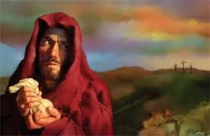
“The history of Judas (AT Jones) presents the sad ending of a life that might have been honored of God. Had Judas died before his last journey to Jerusalem he would have been regarded as a man worthy of a place among the twelve, and one who would be greatly missed. The abhorrence which has followed him through the centuries would not have existed but for the attributes revealed at the close of his history. But it was for a purpose that his character was laid open to the world. It was to be a warning to all who, like him, should betray sacred trusts.” DA, pg. 716

