Slide 1
Walter Rae: The PlaGiarist

Slide 2
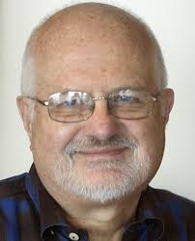
Seventh-day Adventist Controversy: Plagiarism Found in Prophet Books.”
On Thursday, October 23, 1980, the captivating headline across the front page of the Los Angeles Times read just like the above. Ellen White a plagiarist?? So said LA Times writer John Dart. Dart’s information came from a recent study from Ronald L. Numbers’ Prophetess of Health (1976). Prophetess of Health was widely read by the curious, and many readers had become unsettled by the evidence that Ellen White’s health messages had been shaped or borrowed from contemporary health reformers—and did not require a supernatural explanation.

Slide 3
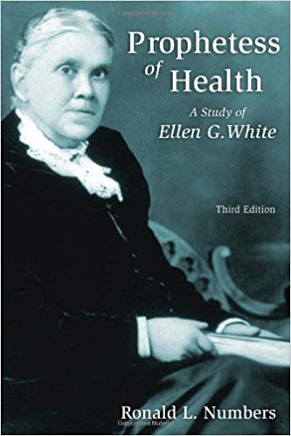
Still Catching Up!
‘Headlines shouting the deteriorating impact of high-fat, low-fiber diets and the sheer necessity of exercise were a century away. The profound linkage between the mind and body seemed far-fetched. Birth defects due to drugs and alcohol were not to be understood for another hundred years. The concept of cancer germs was a thought that was cross-grain with the medical world. Prenatal influences were considered of little importance. In many of these areas, as recently as a few decades ago, Ellen White seemed not only extreme but even fanatical. Imagine how she could have been viewed in 1863! The record is in, however. Those who believed in her role as God’s messenger, those who faithfully put her health principles into practice, became healthier, stronger, more productive people.’
From ‘Messenger of the Lord’

Slide 4

Where Did She Get That?
1. High fiber essential for healthy living.
2. Fresh air circulating in the home day and night.
3. Exercise critical for healthy body.
4. Daily baths.
5. Birth defects related to drugs and alcohol.
6. Prenatal influences were considered of little importance.
7. “Tell them that the time will soon come when there will be no safety in using eggs, milk, cream, or butter, because disease in animals is increasing.”
8. Connected meat eating to getting cancer.

Slide 5
Sure, she did!
While it is true that Ellen White adopted several of the health reform ideas of others in the 19th century, she had the keen insight to discard the negative or wrong things that these health reformers espoused. She advocated a vegetarian diet and the use of hydrotherapy in healing, which were prevalent during the 19th century, but she always avoided the extremes of such doctors as Graham and Thrall, among others! How did she know what to embrace of these men and what to reject? How did she advocate things they knew nothing about that were only discovered in the late 20th century? Plagiarism??????

Slide 6
Walter Rea
The L.A. Times religion news reporter, John Dart, had been researching Spectrum, Claremont Dialogue, Adventist Review, Ministry, and apologetical statements from the Ellen G. White Estate discussing the crisis created by Ronald L. Numbers’ Prophetess of Health (1976). Prophetess of Health was widely read by the curious, and many readers had become unsettled by the evidence that Ellen White’s health messages had been shaped or borrowed from contemporary health reformers—and did not require a supernatural explanation. When it came time to interview sources, Dart already knew much about White’s liberal borrowing (a euphemism for plagiarism) and the lively debate over the nature of her inspiration that had emerged during the past few years. Dart began his article by stating that he believed the main reason for her prodigious output could be explained by plagiarism. In a church body where “most persons...believed that White’s words came to her directly from God,” he continued; thinking that the Spirit of Prophecy was a “word thief” struck at the very heart of Adventism.

Slide 7
Going for the Jugular Vein!
Ellen White typically denied any literary dependency. Paraphrasing White herself, Dart wrote, “She was dependent on the spirit of the Lord in receiving and writing her views.” He also quoted from one of her letters: “Yet the words I employ in describing what I have seen are my own, unless they be spoken to me by an angel, which I always enclose in marks of quotation.” From another letter, written by White in 1906, Dart quoted White explaining that “all who believe the Lord has spoken through Sister White and has given her a message will be safe from the many delusions that will come in these last days.” Dart went on to give several examples of literary borrowing in the prophet’s books, noting that “[Walter] Rea is completing a manuscript for a book based on his research on White . . . that he has not found any major work by White that did not use a previously published source.” Rea, shockingly, identified White as “a plagiarist.”

Slide 8
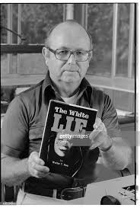
Ronald Numbers and Walter Rea
The Adventist Church was jolted in the public media by wrenching skepticism and doubt about the verity of its prophetess. Only this time, the defense of Ellen White’s legacy, glued to the pedestal of church authority, would have to rely on refutations and defenses provided by “Stewards of the Lord” (to use Mrs. White’s phrase). Syndicated in the Associated Press, the article traveled worldwide and swept into other media—some estimated that the “plagiarism story” was published in hundreds of newspapers and magazines.

Slide 9

Rea was born in 1922 in Minneapolis, but lived much of his life in California. He graduated from Pacific Union College in late 1944 and in January 1945 was hired as a pastor by the Seventh-day Adventist denomination. He started the first Adventist church in Lompoc, California, and served as a pastor in Lindsay and Madera before moving to Florida. He was pastor of Kress Memorial Church in Orlando, as well as in Fort Myers and Jacksonville before he returned to southern California where he led congregations in Pomona, Alhambra and Long Beach

Slide 10
Rea Continues!
“Almost from the first time I heard of her, early in my teens, I became a devotee of Ellen G. White and her writings. I learned to type by copying from her book Messages to Young People. In high school and college, I often went from room to room in the dormitory, gathering Ellen White quotations from others to use in my preparations for becoming a minister in the Seventh-day Adventist Church. It was during those days that I conceived the idea of preparing an Adventist commentary by compiling from the writings of Ellen White all the statements pertaining to each book of the Bible, each doctrine, and each Bible character. Early in my ministerial life, which began in central California in the latter 1940s, I compiled two volumes of Old and New Testament Bible biographies, incorporating with each entry the pertinent quotations found in Ellen White’s works. …and a third volume on Daniel and the Revelation, all based on Ellen White’s works, and soon these books were sold in most Adventist Book and Bible houses and used in many Adventist schools and colleges in North America.

Slide 11
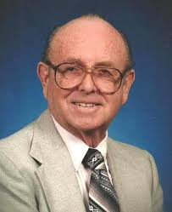
For many years Rea was a promoter of the writings of White, compiling three volumes of extracts from her materials; two volumes of Bible biographies from the Old and New Testaments and a volume of material on the Bible books of Daniel and Revelation. All of these were distributed through the denomination's book stores. He became aware that White used information and language from books by Alfred Edersheim in a number of her books. He began to compare her writings with contemporary sources known to be in her personal library and found many places where she appears to borrow material. As a result, a number of research projects were commissioned by the denomination's General Conference (GC).

Slide 12
From Rea’s Own Mouth!
“While working on my projected volume four (Ellen White’s quotations on Bible doctrines) I happened across something interesting at Orlando, Florida, where I was pastor of the Kress Memorial Church, named for doctors Daniel and Lauretta Kress, noted pioneers in the Adventist medical work. The Kress family gave me an old book by Ellen White, Sketches from the Life of Paul, published in 1883 but never reprinted. When I showed this book to a church member one day, I was told that the problem of the book was that it was too much like another book that had not been written by Ellen White, and that it had never been reprinted because of the close similarities. Being of an inquiring mind, I did a comparison study and discovered that some of the criticism seemed to be true. Later, after I transferred to California, the Wellesley P. Magan family, also from established pioneer Adventists, were members of my congregation. At the death of Wellesley’s father’s widow, Lillian Magan, I was given a book from the Magan family library—Elisha the Prophet by Alfred Edersheim. On the flyleaf was Ellen White’s signature. By now, because of my constant use of Ellen White’s books, I had become so familiar with them that I readily recognized similarities of wording and thought as I examined Edersheim’s book. Still later on, while studying at the University of Southern California toward a Ph.D. degree, I was shocked to come across a seven-volume work on Old Testament history by the same Edersheim. This time I found, in volumes one to four, that Edersheim’s chapter titles, subtitles, and page headings paralleled and were many times almost identical with the chapter titles of Ellen White’s Patriarchs and Prophets (1890). Time and study made it obvious that Mrs. White had obtained liberal help from these additional Edersheim works. Further investigation would reveal that Edersheim had written also a New Testament history on the life of Christ, and in this too there were additional similarities with Mrs. White’s Desire of Ages.” Rea, The White Lie, pgs. 19-22

Slide 13
Plagiarist or Researcher??
"She used The Great Teacher by John Harris, 1835, which they've admitted. She used The Life of Christ by William Hanna, 1863, which they've admitted. She used The Life of Christ by Farrar, which they have admitted, and others which they have admitted. My book will give a further list of those that she used. The Acts of the Apostles, she used The Life and Epistles of the Apostle Paul by Conybeare and Howson, The Life of Paul by Farrar, The Great Teacher by John Harris, Night Scenes of the Bible by Daniel March, and The Life of Paul by McDuff. And The Great Controversy I've read to you from Willie White, that in the new edition the reader will find more than 400 references to 88 authors and authorities, page 24, Willie White, General Conference, 1911. Patriarchs and Prophets, she used Paradise Lost by Milton Clarks Commentary, Night Scenes of the Bible by March, Edersheim's Old Testament, and even The Aprocrypha which F. D. Nichol talks about in his book published in 1951. So far, I have found William Hanna, John Harris, Fleetwood, Farrar, Andrews, and others. I have gotten that, by the way, from a list that Bob Olson from the White Estate has published on 'Mrs. White and Uninspired Sources.' Underwood, Gordon, Hanna, Krummacher, Cole, Jackson, Trall, Stowe, Broadman, Miller, Taylor, Kirk, Horace Mann and Able Stevens and others." – Rea’s book, pgs. 22,23

Slide 14
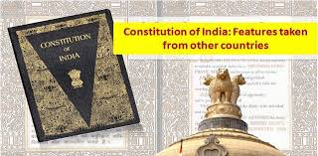
She Borrowed from Others!
Biggggggggg Dealllllllll!!! Ellen White, a woman with a 3rd grade education, was shown in vision the dramatic scenes of the Great Controversy spanning thousands of years, and the Lord told her to go write out what she had seen. Because she felt insufficient to meet the task, and because she was an avid reader, and sometimes came across material that she felt would explain what she saw, she chose to use the writer’s material. Walter Rea cried foul as did Dudley Canright 100 years prior. And it was splashed all over the news media all over the world!!!

Slide 15
Cosmic Scenes!
“Through the illumination of the Holy Spirit, the scenes of the long-continued conflict between good and evil have been opened to the writer of these pages. From time to time I have been permitted to behold the working, in different ages, of the great controversy between Christ, the Prince of life, the Author of our salvation, and Satan, the prince of evil, the author of sin, the first transgressor of God's holy law. Satan's enmity against Christ has been manifested against His followers. The same hatred of the principles of God's law, the same policy of deception, by which error is made to appear as truth, by which human laws are substituted for the law of God, and men are led to worship the creature rather than the Creator, may be traced in all the history of the past.…They may be traced in the history of patriarchs, prophets, and apostles, of martyrs and reformers. In the great final conflict, Satan will employ the same policy, manifest the same spirit, and work for the same end as in all preceding ages. That which has been, will be, except that the coming struggle will be marked with a terrible intensity such as the world has never witnessed. Satan's deceptions will be more subtle, his assaults more determined. If it were possible, he would lead astray the elect. Mark 13:22, R.V. As the Spirit of God has opened to my mind the great truths of His word, and the scenes of the past and the future, I have been bidden to make known to others that which has thus been revealed—to trace the history of the controversy in past ages, and especially so to present it as to shed a light on the fast-approaching struggle of the future. In pursuance of this purpose,…

Slide 16
His words Have Been Quoted
The great events which have marked the progress of reform in past ages are matters of history, well known and universally acknowledged by the Protestant world; they are facts which none can gainsay. This history I have presented briefly, in accordance with the scope of the book, and the brevity which must necessarily be observed, the facts having been condensed into as little space as seemed consistent with a proper understanding of their application. In some cases where a historian has so grouped together events as to afford, in brief, a comprehensive view of the subject, or has summarized details in a convenient manner, his words have been quoted; but in some instances no specific credit has been given, since the quotations are not given for the purpose of citing that writer as authority, but because his statement affords a ready and forcible presentation of the subject. In narrating the experience and views of those carrying forward the work of reform in our own time, similar use has been made of their published works.” Introduction to the Great Controversy

Slide 17
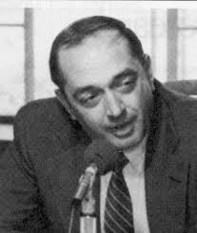
Let the Lawyer Speak!
After Numbers and Rea’s assertions of plagiarism, the General Conference had a Catholic attorney named Vincent Ramik investigate Ellen White and the charges of plagiarism to see if indeed, she had done wrong in her work. The following quote from Ramik summarizes his conclusions.

Slide 18
Ramik Slams Them!!
“Ellen White used the writings of others; but in the way she used them, she made them uniquely her own, ethically, as well as legally. And, interestingly, she invariably improved that which she “selected”! Review: Do you have anything you would like to add on this fascinating subject? Ramik: Yes. I believe it was Warren Johns who shared this analogy with me once when we were discussing this case and point. The situation is something like the builder who wishes to build a house. There are certain basic, essential units of building materials that are available to him—windows, doors, bricks, and so on. There are even certain recognizable kinds of textures and styles that have been created by various combinations of these different materials by earlier builders. The builder brings together many of these and uses them. Yet the design of the house, the ultimate appearance, the ultimate shape, the size, the feel, are all unique to the immediate, contemporary builder. He individually puts his own stamp upon the final product—and it is uniquely his. (And he doesn’t say—or need to say—I got this brick here, that door there, this window there, either!) I think it was that way with Ellen White’s use of words, phrases, clauses, sentences, paragraphs, yes, and even pages, from the writings of those who went before her. She stayed well within the legal boundaries of “fair use,” and all the time created something that was substantially greater (and even more beautiful) than the mere sum of the component parts. And I think the ultimate tragedy is that the critics fail to see this.” Interview with Vincent Ramik

Slide 19
Harris book, The Great Teacher The Defense Rests!
John Harris (1802-1856): “Suppose, for example, an inspired prophet were now to appear in the church, to add a supplement to the canonical books, – what a babel of opinions would he find existing on almost every theological subject! – and how highly probable is it that his ministry would consist, or seem to consist, in the mere selection and ratification of such of these opinions as accorded with the mind of god. Absolute originality would seem to be impossible. The inventive mind of man has already bodied forth speculative opinions in almost every conceivable form; forestalling and robbing the future of its fair proportion of novelties; and leaving it little more, even to a divine messenger, than the office of taking some of these opinions, and impressing them with the seal of heaven” (The Great Teacher, p. xxxi, 1836).

Slide 20
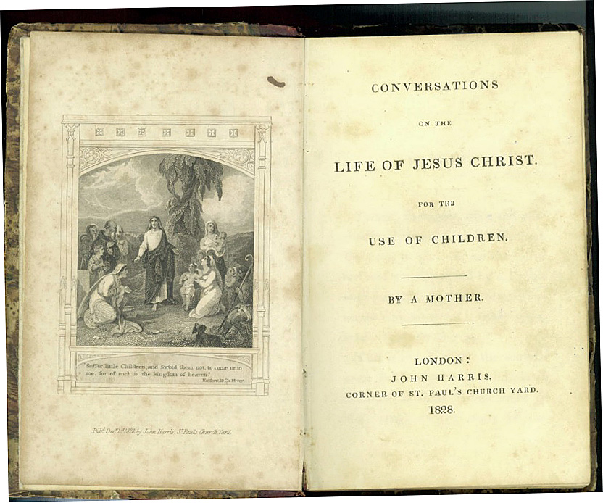
How Would the Prophet Know?
Harris’ quote is fascinating! A modern prophet would see viewpoints on all Bible subjects. Originality would be impossible! Ah, but heaven would know and would impress the prophet with what was right and true! ‘than the office of taking some of these opinions and impressing them with the seal of heaven”! Yes!

