Slide 1
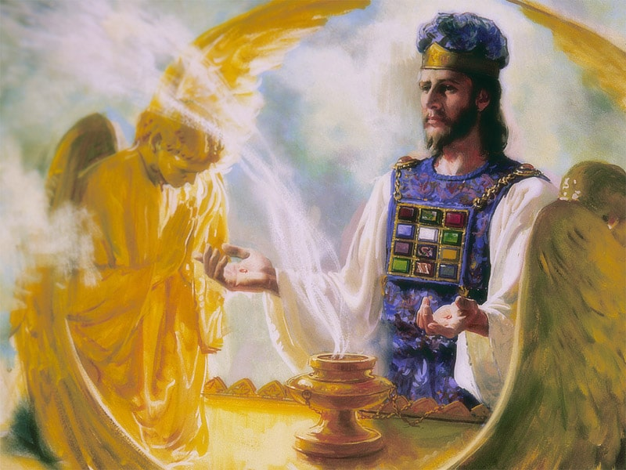
The Sanctuary pt 67: The Day of Atonement 14: The Devil’s Loud Cry and The Plagues

Slide 2
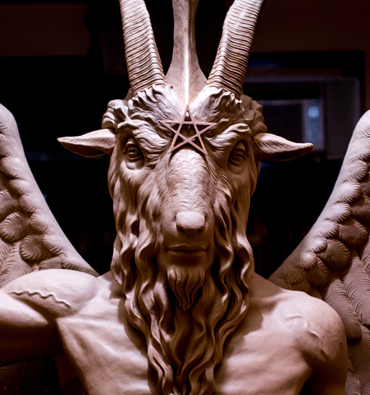
The Devil’s Ultimate Last Deception
“Satan came as an angel of light in the wilderness of temptation to deceive Christ; and he does not come to man in a hideous form, as he is sometimes represented, but as an angel of light. He will come personating Jesus Christ, working mighty miracles; and men will fall down and worship him as Jesus Christ. We shall be commanded to worship this being, whom the world will glorify as Christ. What shall we do?--Tell them that Christ has warned us against just such a foe, who is man's worst enemy, yet who claims to be God; and that when Christ shall make his appearance, it will be with power and great glory, accompanied by ten thousand times ten thousand angels and thousands of thousands; and that when he shall come, we shall know his voice.” Review and Herald, December 18, 1888

Slide 3
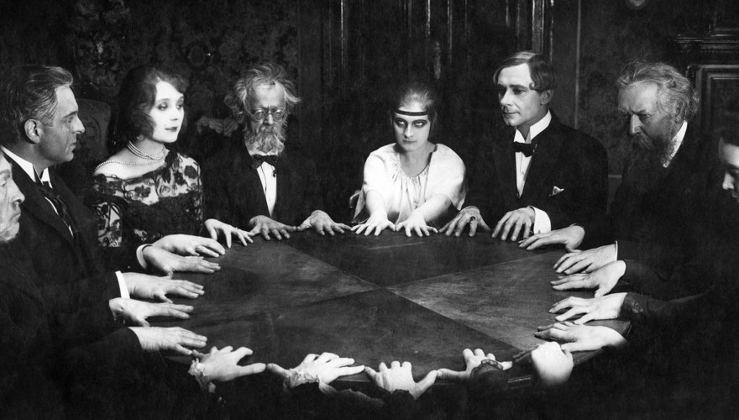
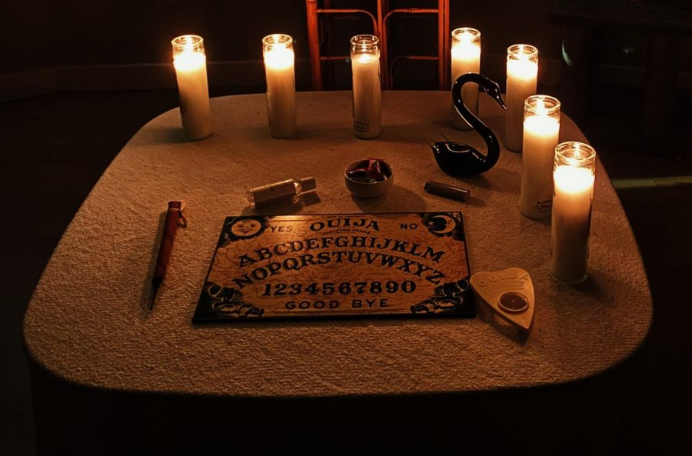
Spiritualism
“The doctrine of consciousness after death, of the spirits of the dead being in communion with the living, has no foundation in the Scriptures, and yet this theory is affirmed as truth. Through this false doctrine the way has been opened for the spirits of devils to deceive the people in representing themselves as the dead. Satanic agencies personate the dead, and thus bring souls into captivity. Satan has a religion, he has a synagogue and devout worshipers. To swell the ranks of his devotees he uses all manner of deception.” Signs of the Times, May 28, 1894

Slide 4
Smooth Messenger…
“When Jesus was on earth, Satan led the people to reject the Son of God, and to choose Barabbas, who in character represented Satan, the god of this world. The Lord Jesus Christ came to dispute the usurpation of Satan in the kingdoms of the world. The conflict is not yet ended; and as we draw near the close of time, the battle waxes more intense. As the second appearing of our Lord Jesus Christ draws near, satanic agencies are moved from beneath. Satan will not only appear as a human being, but he will personate Jesus Christ; and the world who has rejected the truth will receive him as the Lord of lords and King of kings. He will exercise his power, and work upon the human imagination. He will corrupt both the minds and the bodies of men, and will work through the children of disobedience, fascinating and charming, as does a serpent.” RH, April 14, 1896

Slide 5
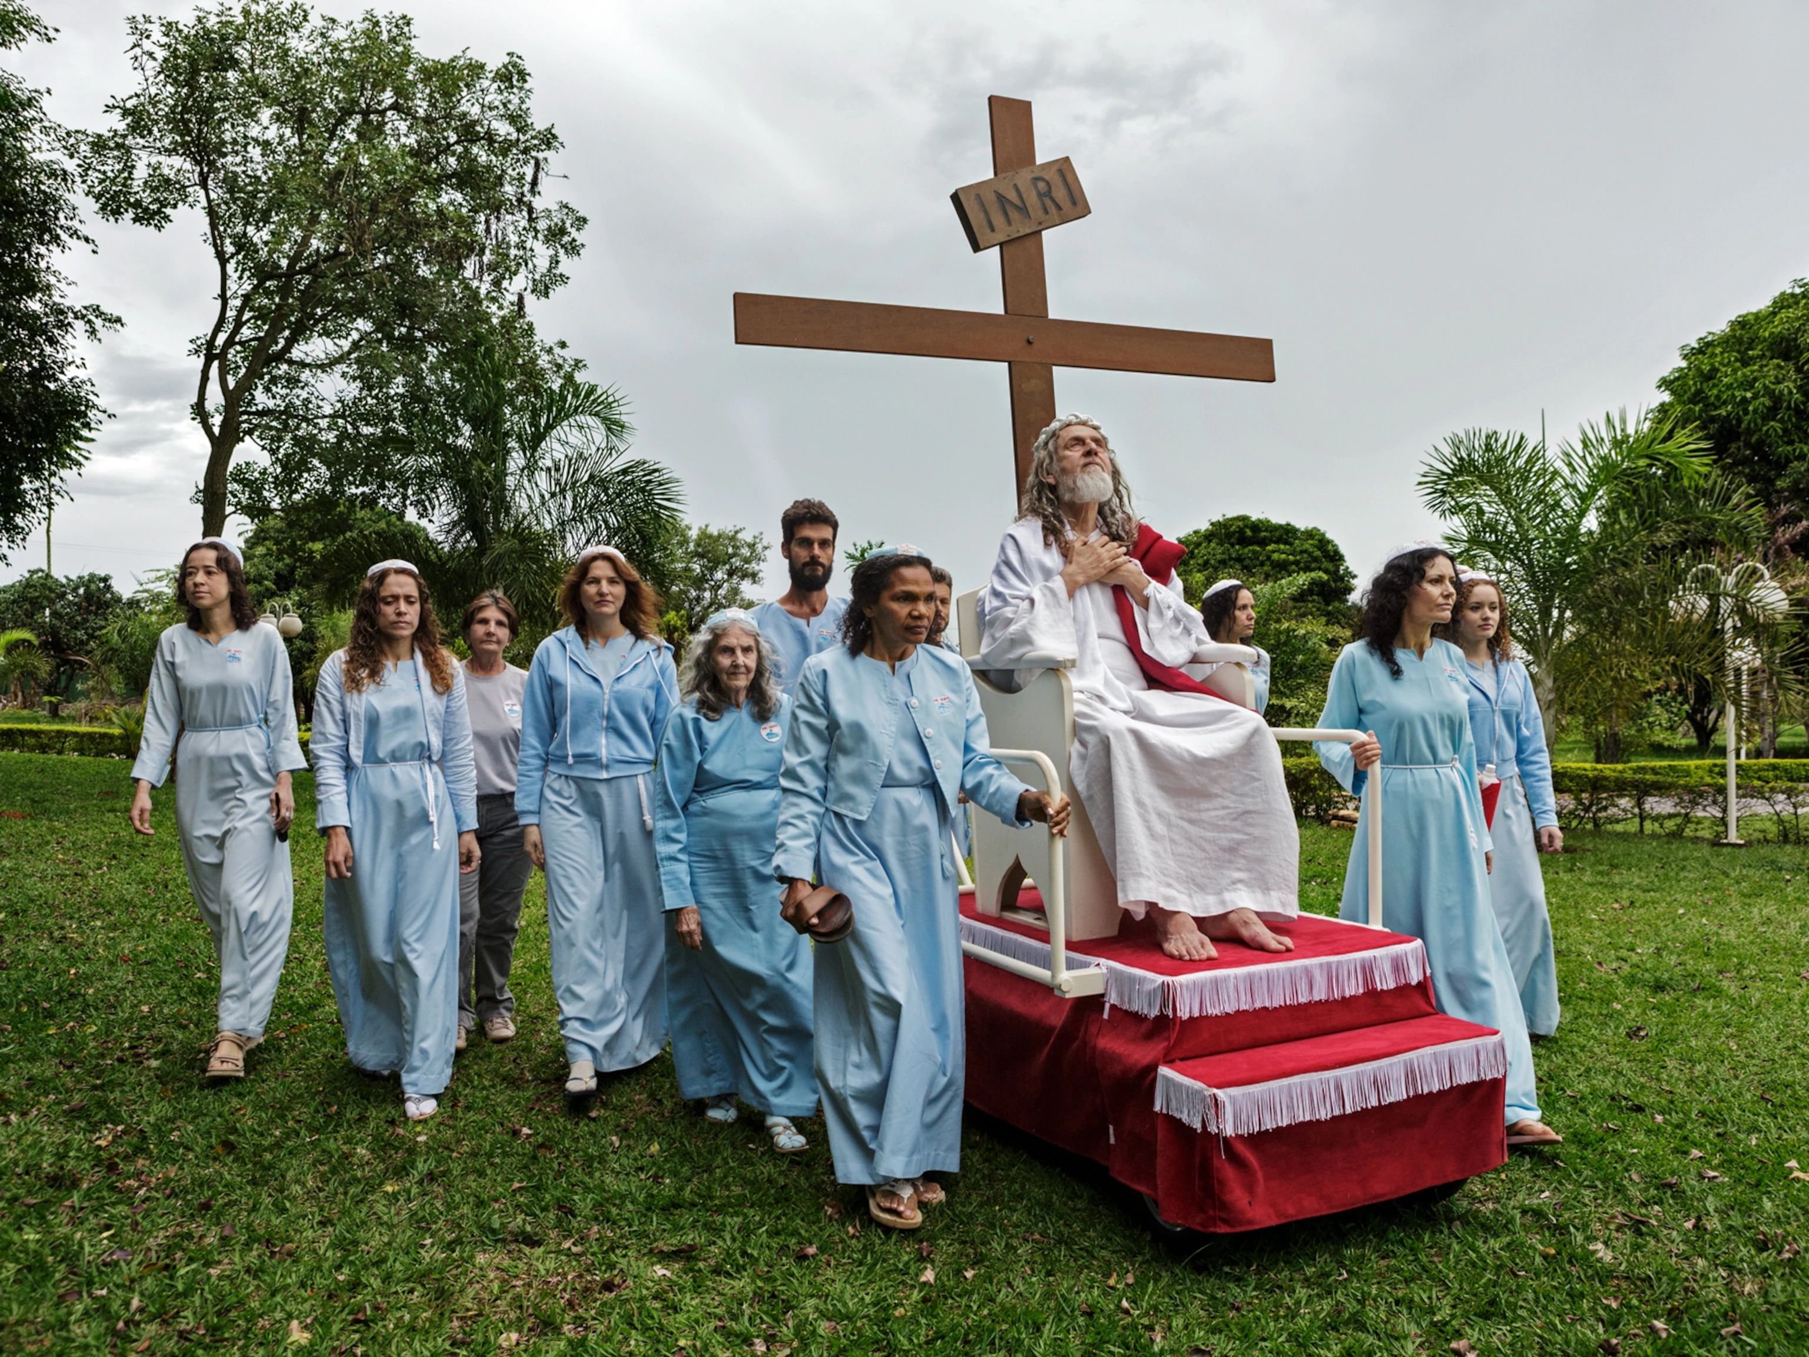
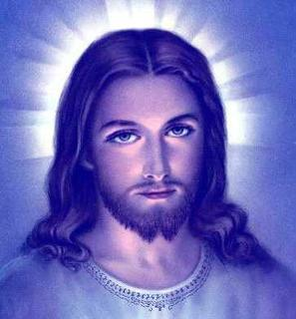
Biblical Proof of this Event?
Matt 24: 4-6, 23-27 “And Jesus answered and said unto them, Take heed that no man deceive you. For many shall come in my name, saying, I am Christ; and shall deceive many. And ye shall hear of wars and rumours of wars: see that ye be not troubled: for all these things must come to pass, but the end is not yet. . . . Then if any man shall say unto you, Lo, here is Christ, or there; believe it not. For there shall arise false Christs, and false prophets, and shall shew great signs and wonders; insomuch that, if it were possible, they shall deceive the very elect. Behold, I have told you before. Wherefore if they shall say unto you, Behold, he is in the desert; go not forth: behold, he is in the secret chambers; believe it not. For as the lightning cometh out of the east, and shineth even unto the west; so shall also the coming of the Son of man be.”

Slide 6
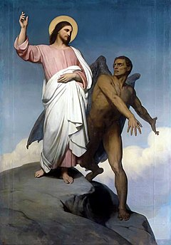
The Warning from 2 Corinthians
2 Cor. 11:13-15 “For such are false apostles, deceitful workers, transforming themselves into the apostles of Christ. And no marvel; for Satan himself is transformed into an angel of light. Therefore it is no great thing if his ministers also be transformed as the ministers of righteousness; whose end shall be according to their works.”

Slide 7
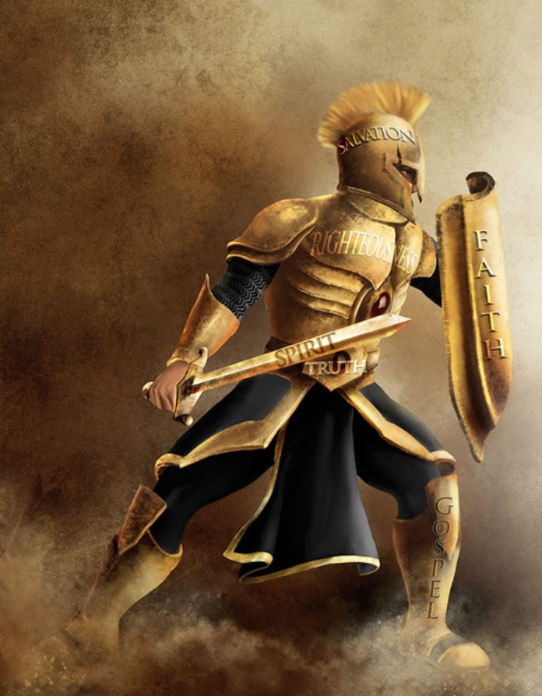
Receive No Doctrine but that which ye Have already received…
Gal. 1:6-9 “I marvel that ye are so soon removed from him that called you into the grace of Christ unto another gospel: Which is not another; but there be some that trouble you, and would pervert the gospel of Christ. But though we, or an angel from heaven, preach any other gospel unto you than that which we have preached unto you, let him be accursed. As we said before, so say I now again, if any man preach any other gospel unto you than that ye have received, let him be accursed.”

Slide 8
The False Christ Promotes the False Sabbath
“As the crowning act in the great drama of deception, Satan himself will personate Christ. The church has long professed to look to the Saviour's advent as the consummation of her hopes. Now the great deceiver will make it appear that Christ has come. In different parts of the earth, Satan will manifest himself among men as a majestic being of dazzling brightness, resembling the description of the Son of God given by John in the Revelation. Revelation 1:13-15. The glory that surrounds him is unsurpassed by anything that mortal eyes have yet beheld. The shout of triumph rings out upon the air: "Christ has come! Christ has come!" The people prostrate themselves in adoration before him, while he lifts up his hands and pronounces a blessing upon them, as Christ blessed His disciples when He was upon the earth. His voice is soft and subdued, yet full of melody. In gentle, compassionate tones he presents some of the same gracious, heavenly truths which the Saviour uttered; he heals the diseases of the people, and then, in his assumed character of Christ, he claims to have changed the Sabbath to Sunday, and commands all to hallow the day which he has blessed. He declares that those who persist in keeping holy the seventh day are blaspheming his name by refusing to listen to his angels sent to them with light and truth. This is the strong, almost overmastering delusion. Like the Samaritans who were deceived by Simon Magus, the multitudes, from the least to the greatest, give heed to these sorceries, saying: This is "the great power of God." Acts 8:10.” Darkness Before Dawn 41-42

Slide 9
Will Not Be Permitted to Counterfeit it ALL
“But the people of God will not be misled. The teachings of this false christ are not in accordance with the Scriptures. His blessing is pronounced upon the worshipers of the beast and his image, the very class upon whom the Bible declares that God's unmingled wrath shall be poured out. And, furthermore, Satan is not permitted to counterfeit the manner of Christ's advent. The Saviour has warned His people against deception upon this point, and has clearly foretold the manner of His second coming. "There shall arise false christs, and false prophets, and shall show great signs and wonders; insomuch that, if it were possible, they shall deceive the very elect. . . . Wherefore if they shall say unto you, Behold, He is in the desert; go not forth; behold, He is in the secret chambers; believe it not. For as the lightning cometh out of the east, and shineth even unto the west; so shall also the coming of the Son of man be." Matthew 24:24-27, 31; 25:31; Revelation 1:7; 1 Thessalonians 4:16, 17. This coming there is no possibility of counterfeiting. It will be universally known—witnessed by the whole world.” Darkness Before Dawn, p. 42

Slide 10
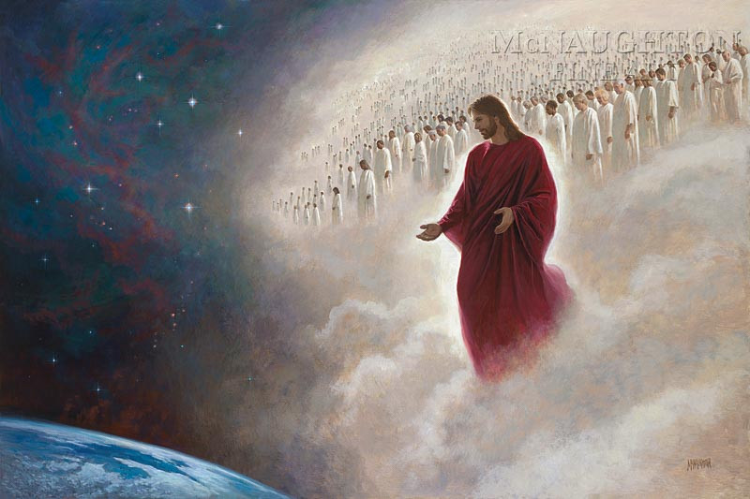
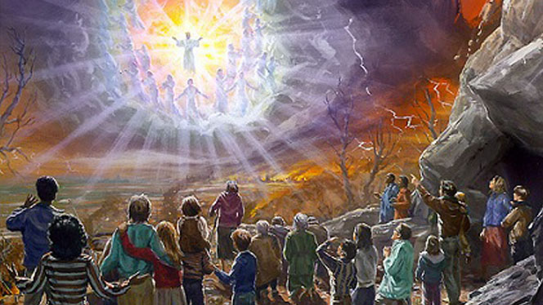
The True Second Coming
Jude 14-15 “And Enoch also, the seventh from Adam, prophesied of these, saying, Behold, the Lord cometh with ten thousands of his saints, To execute judgment upon all, and to convince all that are ungodly among them of all their ungodly deeds which they have ungodly committed, and of all their hard speeches which ungodly sinners have spoken against him.”
1 Thess. 4:16-17 “For the Lord himself shall descend from heaven with a shout, with the voice of the archangel, and with the trump of God: and the dead in Christ shall rise first: Then we which are alive and remain shall be caught up together with them in the clouds, to meet the Lord in the air: and so shall we ever be with the Lord.”

Slide 11
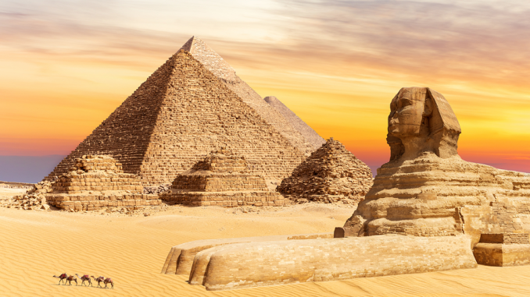
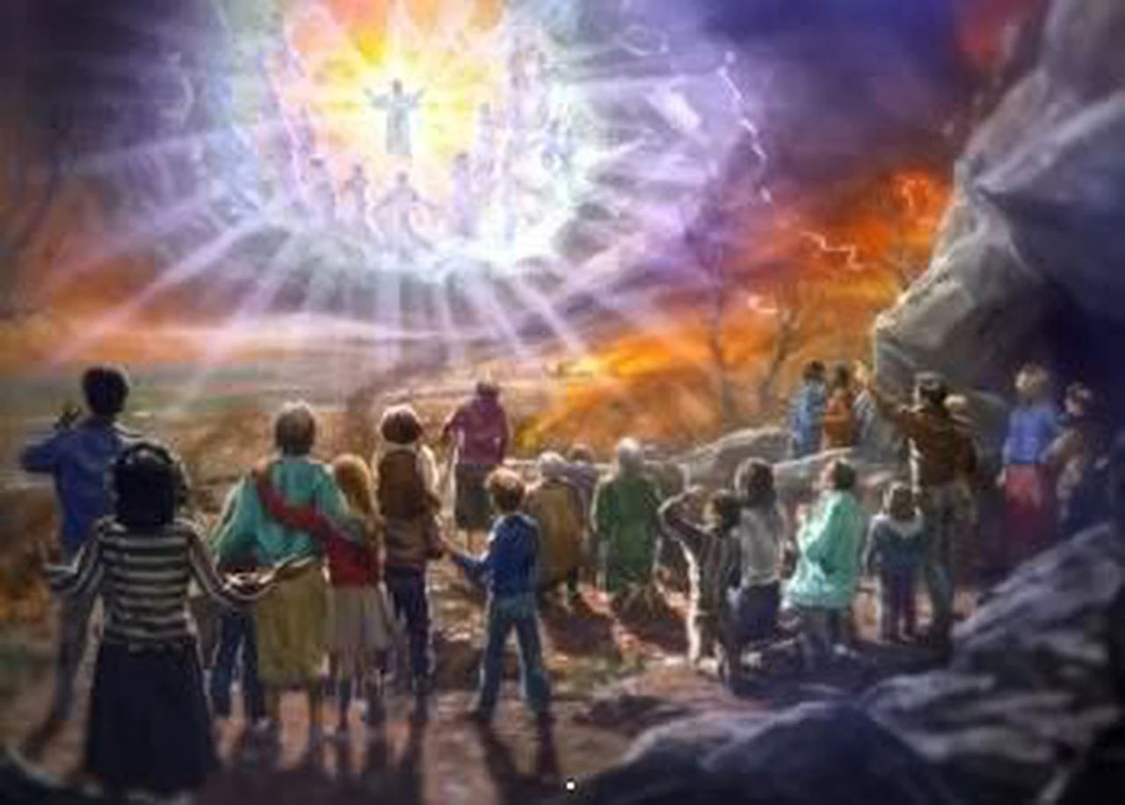
The Plagues Poured Out
Rev. 16:2-4, 8-12 “And the first went, and poured out his vial upon the earth; and there fell a noisome and grievous sore upon the men which had the mark of the beast, and upon them which worshipped his image. And the second angel poured out his vial upon the sea; and it became as the blood of a dead man: and every living soul died in the sea. And the third angel poured out his vial upon the rivers and fountains of waters; and they became blood. . . . And the fourth angel poured out his vial upon the sun; and power was given unto him to scorch men with fire. And men were scorched with great heat, and blasphemed the name of God, which hath power over these plagues: and they repented not to give him glory. And the fifth angel poured out his vial upon the seat of the beast; and his kingdom was full of darkness; and they gnawed their tongues for pain, And blasphemed the God of heaven because of their pains and their sores, and repented not of their deeds. And the sixth angel poured out his vial upon the great river Euphrates; and the water thereof was dried up, that the way of the kings of the east might be prepared.”

Slide 12
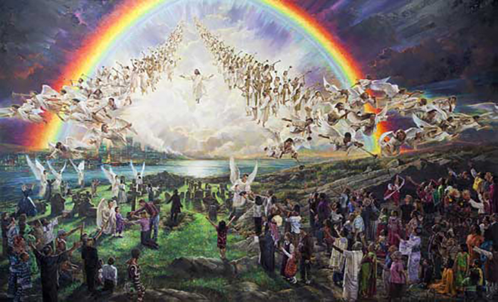
A Stark Picture
“Those who choose to make excuses and continue in sin and conformity to the world will be left to their idols. There will be a day when they will not beg to be excused, when not one will wish to be excused. When Christ shall come in His glory and the glory of His Father, with all the heavenly angels surrounding Him, escorting Him on His way with voices of triumph, while strains of the most enchanting music fall upon the ear, all will then be interested; there will not be one indifferent spectator. Speculations will not then engross the soul. The miser's piles of gold, which have feasted his eyes, are no more attractive. The palaces which the proud men of earth have erected, and which have been their idols, are turned from with loathing and disgust. No one pleads his lands, his oxen, his wife that he has just married, as a reason why he should be excused from sharing the glory that bursts upon his astonished vision. All want a share, but know that it is not for them.” 2T, p. 41

Slide 13
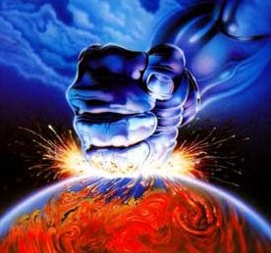
For the Rebellious: Too Late!
“In earnest, agonizing prayer they call for God to pass them not by. The kings, the mighty men, the lofty, the proud, the mean man, alike bow together under a pressure of woe, desolation, misery inexpressible; heart-anguished prayers are wrung from their lips. Mercy! mercy! Save us from the wrath of an offended God! A voice answers them with terrible distinctness, sternness, and majesty: "Because I have called, and ye refused; I have stretched out My hand, and no man regarded; but ye have set at nought all My counsel, and would none of My reproof: I also will laugh at your calamity; I will mock when your fear cometh.“ Then kings and nobles, the mighty man, and the poor man, and the mean man, alike, cry there most bitterly. They who in the days of their prosperity despised Christ and the humble ones who followed in His footsteps, men who would not humble their dignity to bow to Christ, who hated His despised cross, are now prostrate in the mire of the earth.” 2T, 41

Slide 14
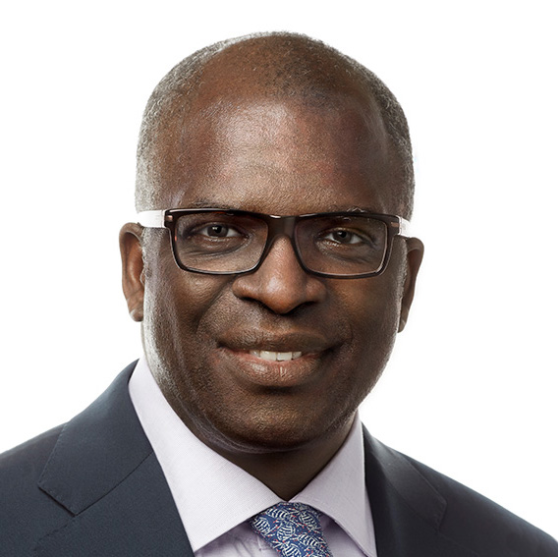
The Awful Consequences of Error
“Many of the wicked were greatly enraged as they suffered the effects of the plagues. It was a scene of fearful agony. Parents were bitterly reproaching their children, and children their parents, brothers their sisters, and sisters their brothers. Loud, wailing cries were heard in every direction, "It was you who kept me from receiving the truth which would have saved me from this awful hour." The people turned upon their ministers with bitter hate and reproached them, saying, "You have not warned us. You told us that all the world was to be converted, and cried, Peace, peace, to quiet every fear that was aroused. You have not told us of this hour; and those who warned us of it you declared to be fanatics and evil men, who would ruin us." But I saw that the ministers did not escape the wrath of God. Their suffering was tenfold greater than that of their people” EW, p. 282

Slide 15
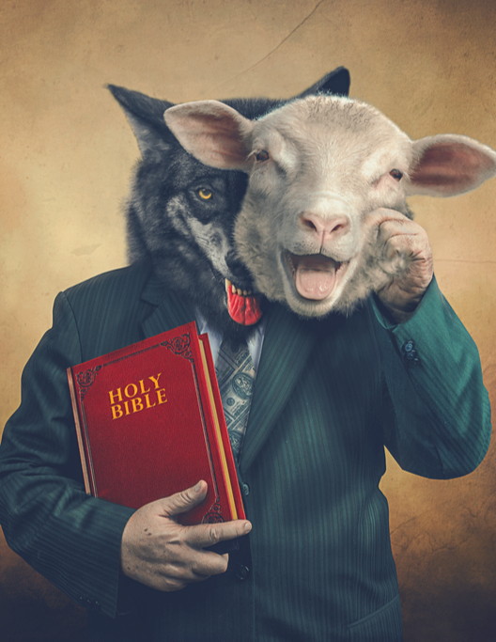
False Teachers Confronted By God!
“I saw that the priests who are leading on their flock to death are soon to be arrested in their dreadful career. The plagues of God are coming, but it will not be sufficient for the false shepherds to be tormented with one or two of these plagues. God's hand at that time will be stretched out still in wrath and justice and will not be brought to Himself again until His purposes are fully accomplished, and the hireling priests are led to worship at the feet of the saints, and to acknowledge that God has loved them because they held fast the truth and kept God's commandments, and until all the unrighteous ones are destroyed from the earth.” EW, p. 124

Slide 16
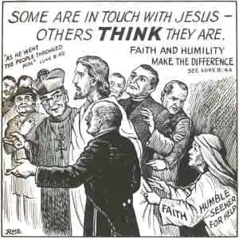
The Minister’s Office…
“The enemies of God's law, from the ministers down to the least among them, have a new conception of truth and duty. Too late they see that the Sabbath of the fourth commandment is the seal of the living God. Too late they see the true nature of their spurious sabbath and the sandy foundation upon which they have been building. They find that they have been fighting against God. Religious teachers have led souls to perdition while professing to guide them to the gates of Paradise. Not until the day of final accounts will it be known how great is the responsibility of men in holy office and how terrible are the results of their unfaithfulness. Only in eternity can we rightly estimate the loss of a single soul. Fearful will be the doom of him to whom God shall say: Depart, thou wicked servant.” GC, p. 640

Slide 17
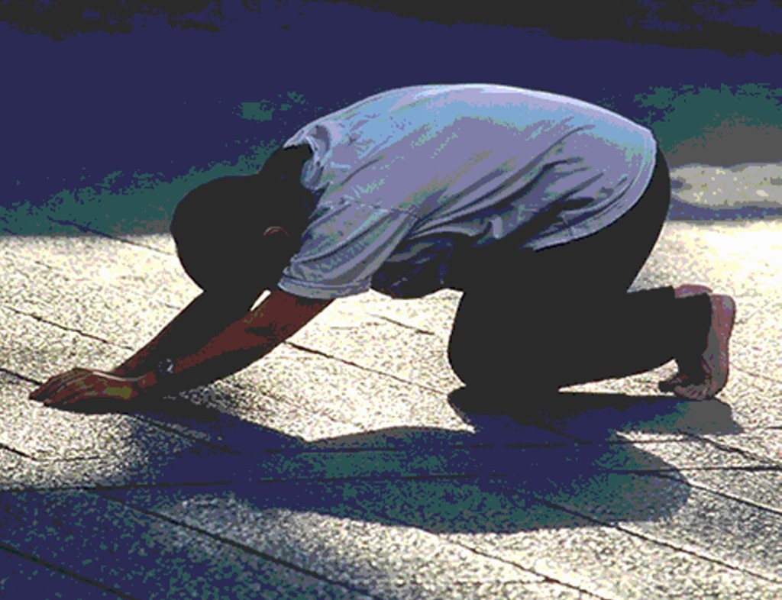
What is their Gain in the End?
“Their greatness has all at once left them, and they do not hesitate to bow to the earth at the feet of the saints. They then realize with terrible bitterness that they are eating the fruit of their own way, and are filled with their own devices. In their supposed wisdom they turned away from the high, eternal reward, rejected the heavenly inducement, for earthly gain. The glitter and tinsel of earth fascinated them, and in their supposed wisdom they became fools. They exulted in their worldly prosperity as though their worldly advantages were so great that they could through them be recommended to God, and thus secure heaven.” 2T, 42

Slide 18
Repentance Unto Death
1 Cor. 7:10 “For godly sorrow worketh repentance to salvation not to be repented of: but the sorrow of the world worketh death.”

Slide 19
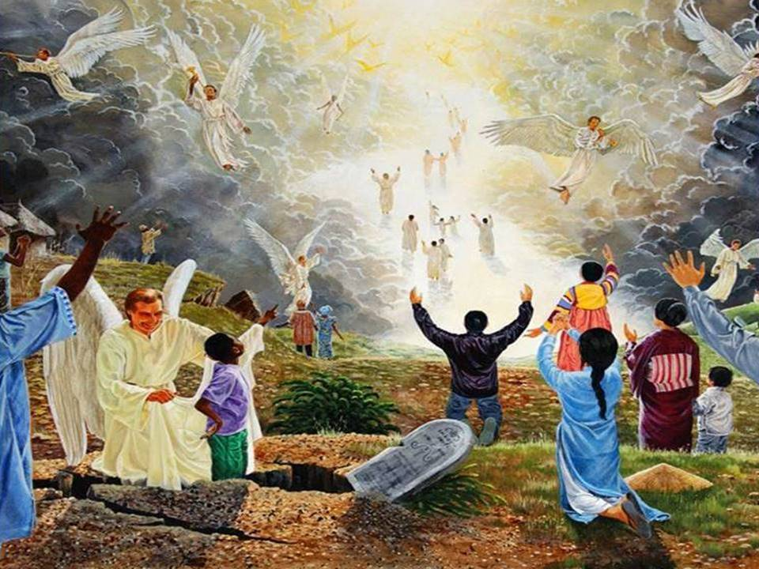
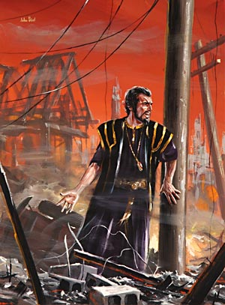
The Second Coming
“In the lives of all who reject truth there are moments when conscience awakens, when memory presents the torturing recollection of a life of hypocrisy and the soul is harassed with vain regrets. But what are these compared with the remorse of that day when "fear cometh as desolation," when "destruction cometh as a whirlwind"! Proverbs 1:27. Those who would have destroyed Christ and His faithful people now witness the glory which rests upon them. In the midst of their terror they hear the voices of the saints in joyful strains exclaiming: "Lo, this is our God; we have waited for Him, and He will save us." Isaiah 25:9. Amid the reeling of the earth, the flash of lightning, and the roar of thunder, the voice of the Son of God calls forth the sleeping saints. He looks upon the graves of the righteous, then, raising His hands to heaven, He cries: "Awake, awake, awake, ye that sleep in the dust, and arise!" Throughout the length and breadth of the earth the dead shall hear that voice, and they that hear shall live.” GC, 644

Slide 20
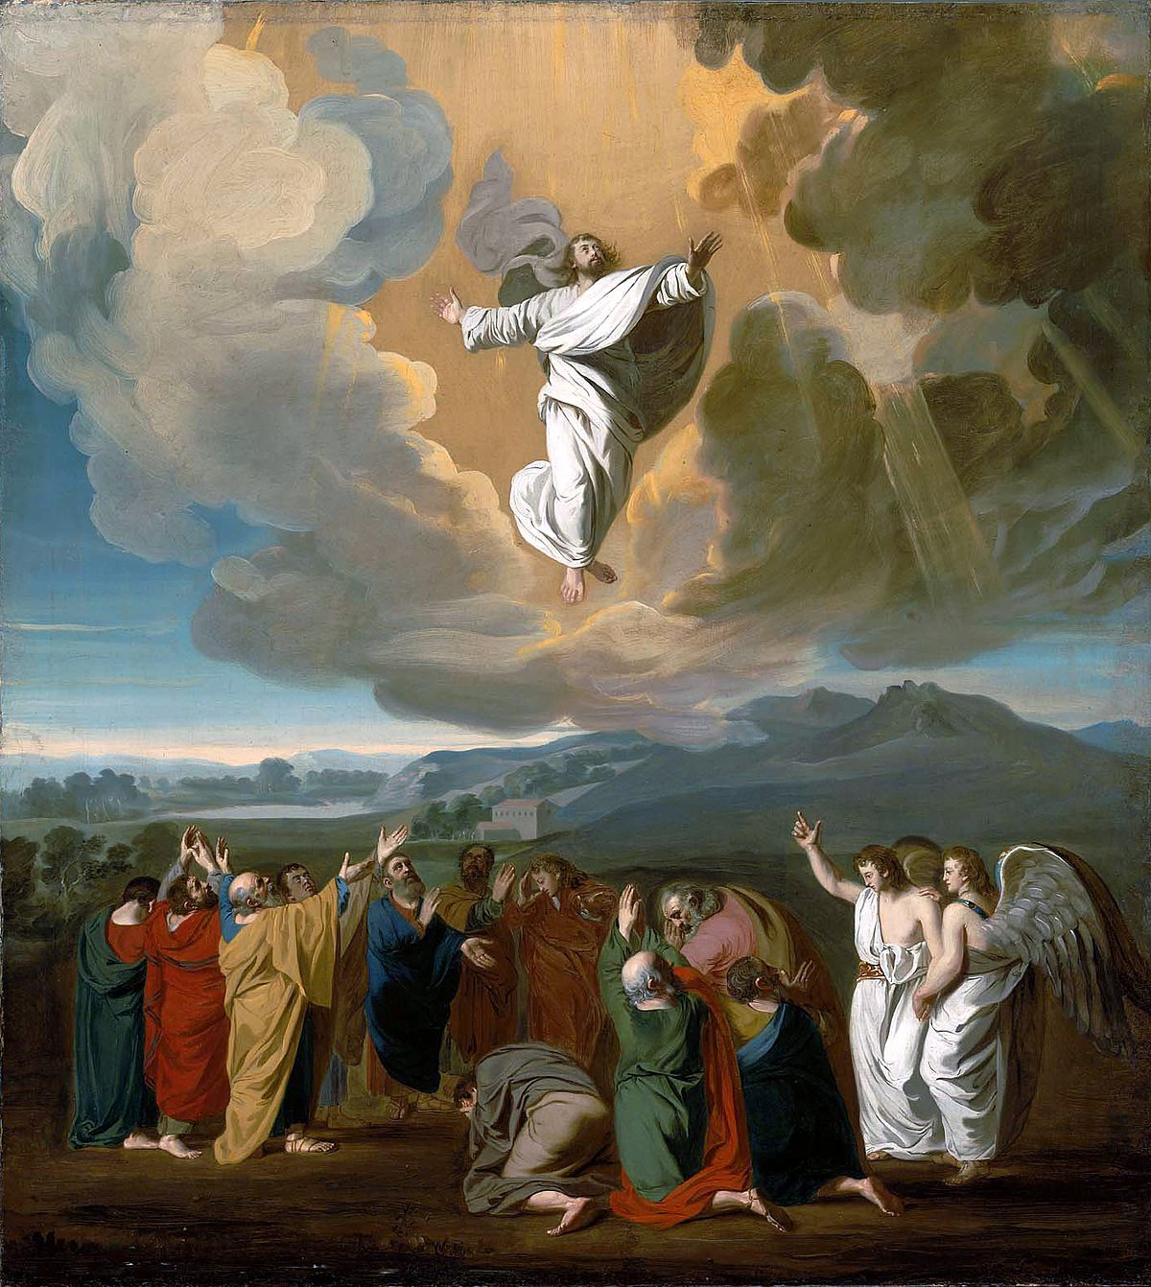
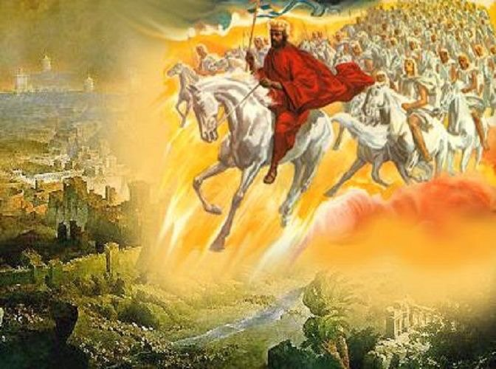
Destroyed At His Coming!
Rev. 19:11-18 “And I saw heaven opened, and behold a white horse; and he that sat upon him was called Faithful and True, and in righteousness he doth judge and make war. His eyes were as a flame of fire, and on his head were many crowns; and he had a name written, that no man knew, but he himself. And he was clothed with a vesture dipped in blood: and his name is called The Word of God. And the armies which were in heaven followed him upon white horses, clothed in fine linen, white and clean. And out of his mouth goeth a sharp sword, that with it he should smite the nations: and he shall rule them with a rod of iron: and he treadeth the winepress of the fierceness and wrath of Almighty God. And he hath on his vesture and on his thigh a name written, King Of Kings, And Lord Of Lords. And I saw an angel standing in the sun; and he cried with a loud voice, saying to all the fowls that fly in the midst of heaven, Come and gather yourselves together unto the supper of the great God; That ye may eat the flesh of kings, and the flesh of captains, and the flesh of mighty men, and the flesh of horses, and of them that sit on them, and the flesh of all men, both free and bond, both small and great.”

Slide 21
Positive for Saints, Negative for Wicked

Slide 22
The Wicked Judged By…
When the world's Redeemer walked among men, bearing insult, reproach, and scorn, the Father beheld each indignity. Every word of mockery, every sneer, every act of contumely and hate, was marked in the books of remembrance. The Jewish nation suffered terrible judgments, because they rejected the Lord from heaven; but their deeds were not fully requited. Those who mocked and crucified the Son of God will come forth from their graves, and the deeds done in secrecy and darkness, as well as those done in the light of day, will be presented before them as they appear before the infinite Father. Every transgression will receive its just recompense of reward in the day of final retribution. {RH, March 27, 1888 par. 11}

Slide 23
Jesus calls all, unbelief insult to God
Jesus alone has power to save from sin, to free from the power of evil; and to doubt him who has laid down his life for us, is to grieve and insult the Father, who has in one gift poured out all heaven to a lost world. "He that spared not his own Son, but delivered him up for us all, how shall he not with him also freely give us all things?" Unbelief is an offense to God. A plan has been provided so broad, so perfect, that every sinner may find forgiveness and redemption. However great may be the sin, the sinner has no excuse for remaining away from Christ; for Jesus draws every soul, and all may respond to the infinite love of God. The sinner may put his will on the side of God's will, and may become a laborer together with God. {RH, February 10, 1891

Slide 24
Wicked Judged Will Feel Every Wrong Act
Then those who pierced Christ will remember how they slighted His love and abused His compassion; how they chose in His stead Barabbas, a robber and murderer; how they crowned the Saviour with thorns, and caused Him to be scourged and crucified; how, in the agony of His death on the cross, they taunted Him, saying, "Let him now come down from the cross, and we will believe him." "He saved others; himself he cannot save." They will seem to hear again His voice of entreaty. Every tone of solicitude will vibrate as distinctly in their ears as when the Saviour spoke to them. Every act of insult and mockery done to Christ will be as fresh in their memory as when the satanic deeds were done. {6BC 1070.2}

Slide 25
