Slide 1
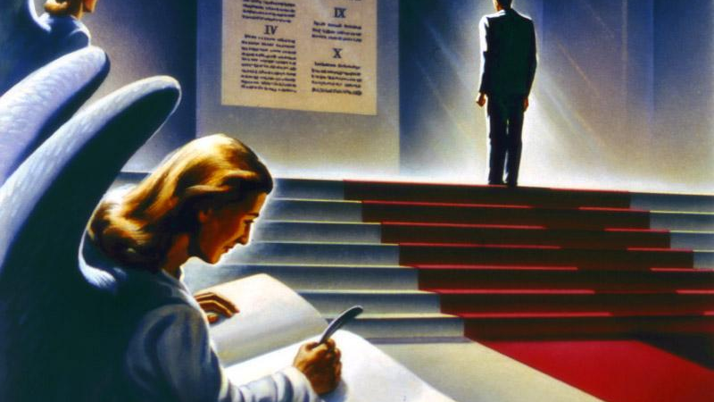
Final Judgment of the Wicked

Slide 2
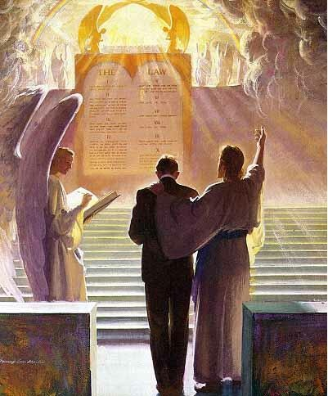
A Vision of the End…
Rev. 20:4-5 “And I saw thrones, and they sat upon them, and judgment was given unto them: and I saw the souls of them that were beheaded for the witness of Jesus, and for the word of God, and which had not worshipped the beast, neither his image, neither had received his mark upon their foreheads, or in their hands; and they lived and reigned with Christ a thousand years. But the rest of the dead lived not again until the thousand years were finished. This is the first resurrection.”

Slide 3
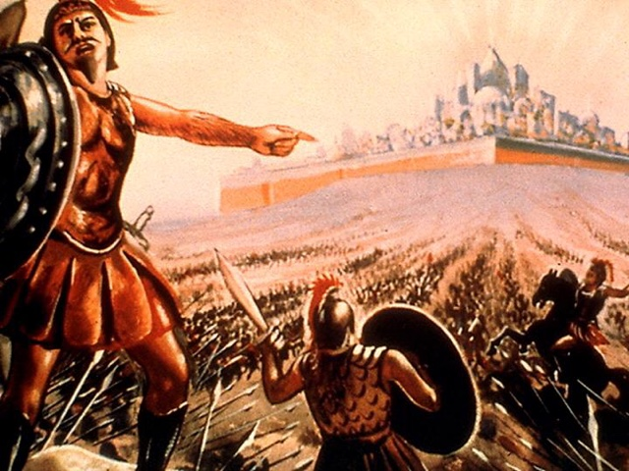
Rev. 20:7-9 “And when the thousand years are expired, Satan shall be loosed out of his prison, And shall go out to deceive the nations which are in the four quarters of the earth, Gog, and Magog, to gather them together to battle: the number of whom is as the sand of the sea. And they went up on the breadth of the earth, and compassed the camp of the saints about, and the beloved city: and fire came down from God out of heaven, and devoured them.”

Slide 4
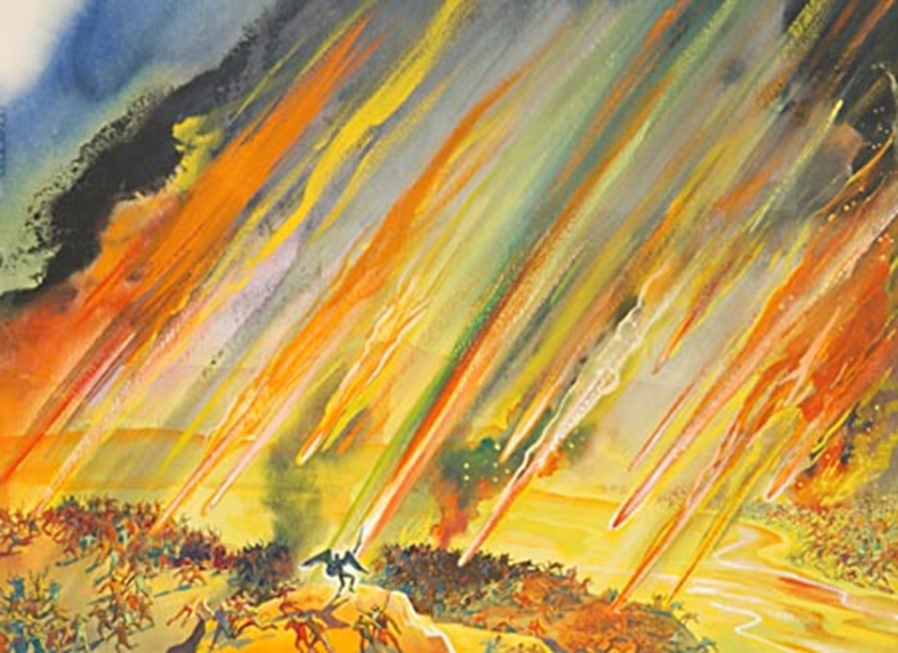
Rev. 20:10-12 “And the devil that deceived them was cast into the lake of fire and brimstone, where the beast and the false prophet are, and shall be tormented day and night for ever and ever. And I saw a great white throne, and him that sat on it, from whose face the earth and the heaven fled away; and there was found no place for them. And I saw the dead, small and great, stand before God; and the books were opened: and another book was opened, which is the book of life: and the dead were judged out of those things which were written in the books, according to their works.”

Slide 5
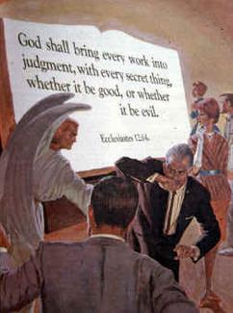
Rev. 20:13-15 “and they were judged every man according to their works. And death and hell were cast into the lake of fire. This is the second death. And whosoever was not found written in the book of life was cast into the lake of fire
What works will I be judged on??
Rom. 2:12 “For as many as have sinned without law shall also perish without law: and as many as have sinned in the law shall be judged by the law; (For not the hearers of the law are just before God, but the doers of the law shall be justified.”

Slide 6
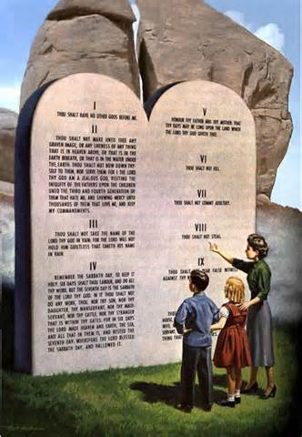
The Law of God is the Standard
James 2:12 “So speak ye, and so do, as they that shall be judged by the law of liberty.”
Ecclesiastes 12:13-14 “Let us hear the conclusion of the whole matter: Fear God, and keep his commandments: for this is the whole duty of man. For God shall bring every work into judgment, with every secret thing, whether it be good, or whether it be evil.

Slide 7
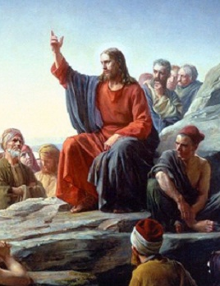
What encompasses Works?
2 Cor. 5:10 “For we must all appear before the judgment seat of Christ; that every one may receive the things done in his body, according to that he hath done, whether it be good or bad.”
Matt. 12:36 “But I say unto you, That every idle word that men shall speak, they shall give account thereof in the day of judgment.”

Slide 8
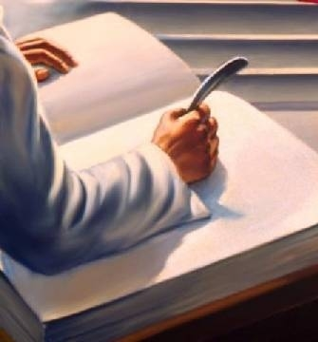
Mrs. White Puts it This Way
Every man's work passes in review before God, and is registered for faithfulness or unfaithfulness. Opposite each name in the books of heaven is entered, with terrible exactness, every wrong word, every selfish act, every unfulfilled duty, and every secret sin, with every artful dissembling. Heaven-sent warnings or reproofs neglected, wasted moments, unimproved opportunities, the influence exerted for good or for evil, with its far-reaching results, all are chronicled by the recording angel. The law of God is the standard by which the characters and the lives of men will be tested in the judgment. GC, 482

Slide 9
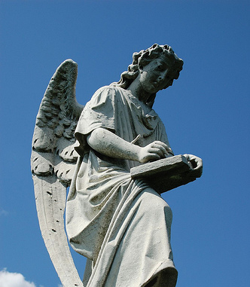
What Are the Books?
“The righteous dead will not be raised until after the Judgment at which they are accounted worthy of ‘the resurrection of life.’ Hence they will not be present in person at the tribunal when their records are examined, and their cases decided.”—GC, 482
“As the artist takes on the polished glass a true picture of the human face, so the angels of God daily place upon the books of heaven an exact representation of the character of every human being”—ST Feb. 11, 1903

Slide 10
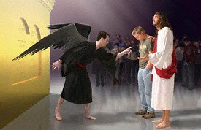
The Heavenly Tribunal
Rev. 12:10 “And I heard a loud voice saying in heaven, Now is come salvation, and strength, and the kingdom of our God, and the power of his Christ: for the accuser of our brethren is cast down, which accused them before our God day and night.”
Zechariah 3:1-4 “And he shewed me Joshua the high priest standing before the angel of the Lord, and Satan standing at his right hand to resist him. And the Lord said unto Satan, The Lord rebuke thee, O Satan; even the Lord that hath chosen Jerusalem rebuke thee: is not this a brand plucked out of the fire? Now Joshua was clothed with filthy garments, and stood before the angel. And he answered and spake unto those that stood before him, saying, Take away the filthy garments from him. And unto him he said, Behold, I have caused thine iniquity to pass from thee, and I will clothe thee with change of raiment. ”

Slide 11
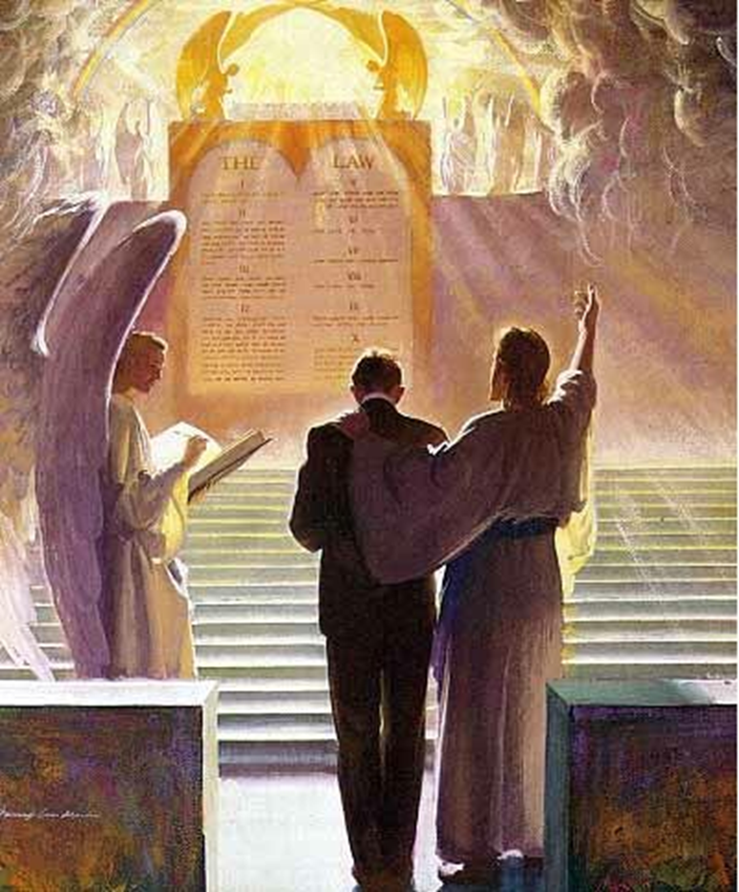
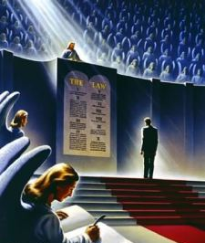

Slide 12
The Final Judgment
Jesus called forth the wicked dead; and they came up with the same feeble, sickly bodies that went into the grave. What a spectacle! What a scene! At the first resurrection all came forth in immortal bloom, but at the second the marks of the curse are visible on all. The kings and noblemen of the earth, the mean and low, the learned and unlearned, come forth together. All behold the Son of man; and those very men who despised and mocked Him, who put the crown of thorns upon His sacred brow and smote Him with the reed, behold Him in all His kingly majesty . . . And they know that He is the very one whom they crucified and derided in His expiring agony. And then there arises one long protracted wail of agony, as they flee to hide from the presence of the King of kings and Lord of lords. All are seeking to hide in the rocks, to shield themselves from the terrible glory of Him whom they once despised. And, overwhelmed and pained with His majesty and exceeding glory, they with one accord raise their voices, and with terrible distinctness exclaim, "Blessed is He that cometh in the name of the Lord!“—Story of Redemption, p. 418-419

Slide 13
Now Satan prepares for a last mighty struggle for the supremacy. . . as the wicked dead are raised and he sees the vast multitudes upon his side, his hopes revive, and he determines not to yield the great controversy. He will marshal all the armies of the lost under his banner and through them endeavor to execute his plans. The wicked are Satan's captives. In rejecting Christ they have accepted the rule of the rebel leader. They are ready to receive his suggestions and to do his bidding. Yet, true to his early cunning, he does not acknowledge himself to be Satan. He claims to be the prince who is the rightful owner of the world and whose inheritance has been unlawfully wrested from him. He represents himself to his deluded subjects as a redeemer, assuring them that his power has brought them forth from their graves and that he is about to rescue them from the most cruel tyranny. The presence of Christ having been removed, Satan works wonders to support his claims. He makes the weak strong and inspires all with his own spirit and energy. He proposes to lead them against the camp of the saints and to take possession of the City of God. With fiendish exultation he points to the unnumbered millions who have been raised from the dead and declares that as their leader he is well able to overthrow the city and regain his throne and his kingdom.—GC, p. 662

Slide 14
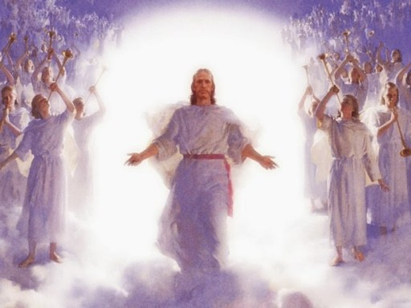
By command of Jesus, the gates of the New Jerusalem are closed, and the armies of Satan surround the city and make ready for the onset. Now Christ again appears to the view of His enemies. Far above the city, upon a foundation of burnished gold, is a throne, high and lifted up. Upon this throne sits the Son of God, and around Him are the subjects of His kingdom. The power and majesty of Christ no language can describe, no pen portray.—GC, p. 664-665

Slide 15
As soon as the books of record are opened, and the eye of Jesus looks upon the wicked, they are conscious of every sin which they have ever committed. They see just where their feet diverged from the path of purity and holiness, just how far pride and rebellion have carried them in the violation of the law of God. The seductive temptations which they encouraged by indulgence in sin, the blessings perverted, the messengers of God despised, the warnings rejected, the waves of mercy beaten back by the stubborn, unrepentant heart--all appear as if written in letters of fire. Above the throne is revealed the cross; and like a panoramic view appear the scenes of Adam's temptation and fall, and the successive steps in the great plan of redemption. The Saviour's lowly birth; His early life of simplicity and obedience; His baptism in Jordan; the fast and temptation in the wilderness; His public ministry, unfolding to men heaven's most precious blessings; the days crowded with deeds of love and mercy, the nights of prayer and watching in the solitude of the mountains; the plottings of envy, hate, and malice which repaid His benefits; the awful, mysterious agony in Gethsemane beneath the crushing weight of the sins of the whole world; His betrayal into the hands of the murderous mob—GC, 666-667

Slide 16
There are papist priests and prelates, who claimed to be Christ's ambassadors, yet employed the rack, the dungeon, and the stake to control the consciences of His people. There are the proud pontiffs who exalted themselves above God and presumed to change the law of the Most High. Those pretended fathers of the church have an account to render to God from which they would fain be excused. Too late they are made to see that the Omniscient One is jealous of His law and that He will in no wise clear the guilty. They learn now that Christ identifies His interest with that of His suffering people; and they feel the force of His own words: "Inasmuch as ye have done it unto one of the least of these My brethren, ye have done it unto Me." Matthew 25:40. The whole wicked world stand arraigned at the bar of God on the charge of high treason against the government of heaven. They have none to plead their cause; they are without excuse; and the sentence of eternal death is pronounced against them.—GC, 668

Slide 17
It is now evident to all that the wages of sin is not noble independence and eternal life, but slavery, ruin, and death. The wicked see what they have forfeited by their life of rebellion. The far more exceeding and eternal weight of glory was despised when offered them; but how desirable it now appears. "All this," cries the lost soul, "I might have had, but I chose to put these things far from me. Oh, strange infatuation! I have exchanged peace, happiness, and honor for wretchedness, infamy, and despair.“—SR, p. 425
Notwithstanding Satan has been constrained to acknowledge God's justice, and to bow to the supremacy of Christ, his character remains unchanged. The spirit of rebellion, like a mighty torrent, against bursts forth. Filled with frenzy, he determines not to yield the great controversy. The time has come for a last desperate struggle against the King of heaven. He rushes into the midst of his subjects and endeavors to inspire them with his own fury and arouse them to instant battle. But of all the countless millions whom he has allured into rebellion, there are none now to acknowledge his supremacy. His power is at an end. The wicked are filled with the same hatred of God that inspires Satan; but they see that their case is hopeless, that they cannot prevail against Jehovah. Their rage is kindled against Satan and those who have been his agents in deception. With the fury of demons they turn upon them, and there follows a scene of universal strife. –SR, 427-428

Slide 18
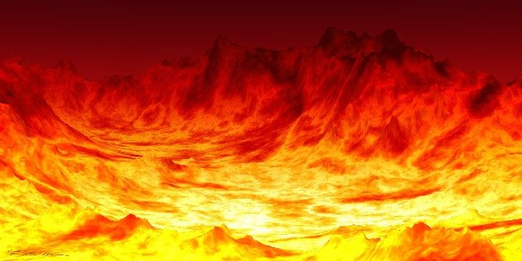
Fire comes down from God out of heaven. The earth is broken up. The weapons concealed in its depths are drawn forth. Devouring flames burst from every yawning chasm. The very rocks are on fire. The day has come that "shall burn as an oven." Mal. 4:1. The elements melt with fervent heat, the earth also and the works that are therein are burned up. (2 Peter 3:10.) . . . Some are destroyed as in a moment, while others suffer many days. All are punished according to their deeds. The sins of the righteous have been transferred to Satan, the originator of evil, who must bear their penalty. Thus he is made to suffer, not only for his own rebellion, but for all the sins which he has caused God's people to commit. His punishment is to be far greater than that of those whom he has deceived—SR 428,429

