Slide 1
Jesus Life, pt. 5 ‘Passover Visit’

Slide 2
Jesus’ First Passover
“Among the Jews the twelfth year was the dividing line between childhood and youth. On completing this year a Hebrew boy was called a son of the law, and also a son of God. He was given special opportunities for religious instruction, and was expected to participate in the sacred feasts and observances. It was in accordance with this custom that Jesus in His boyhood made the Passover visit to Jerusalem. Like all devout Israelites, Joseph and Mary went up every year to attend the Passover; and when Jesus had reached the required age, they took Him with them. There were three annual feasts, the Passover, the Pentecost, and the Feast of Tabernacles, at which all the men of Israel were commanded to appear before the Lord at Jerusalem. Of these feasts the Passover was the most largely attended. Many were present from all countries where the Jews were scattered. From every part of Palestine the worshipers came in great numbers. The journey from Galilee occupied several days, and the travelers united in large companies for companionship and protection. The women and aged men rode upon oxen or asses over the steep and rocky roads. The stronger men and the youth journeyed on foot. The time of the Passover corresponded to the close of March or the beginning of April, and the whole land was bright with flowers, and glad with the song of birds.” DA, pg. 75

Slide 3
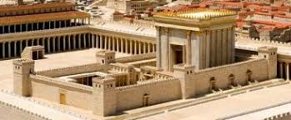
“With most of the people in the days of Christ, the observance of this feast had degenerated into formalism. But what was its significance to the Son of God! For the first time the child Jesus looked upon the temple. He saw the white-robed priests performing their solemn ministry. He beheld the bleeding victim upon the altar of sacrifice. With the worshipers He bowed in prayer, while the cloud of incense ascended before God. He witnessed the impressive rites of the paschal service. Day by day He saw their meaning more clearly. Every act seemed to be bound up with His own life. New impulses were awakening within Him. Silent and absorbed, He seemed to be studying out a great problem. The mystery of His mission was opening to the Savior. “ DA, pg. 78

Slide 4
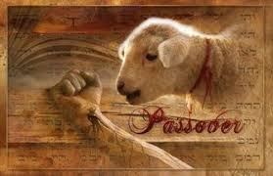
What a Revelation for Jesus at Passover
At 12 years of age, Jesus realized who He was and how His very life was wrapped up in the sanctuary service. He realized:
1. He was the lamb of God that takes away the sins of the world.
2. He was the great high priest of mankind after the eternal order of Melchesidek.
3. He was the Passover lamb slain for mankind!

Slide 5
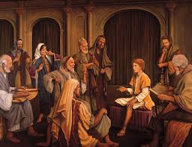
Incredible Moment at 12!
“Rapt in the contemplation of these scenes, He did not remain beside His parents. He sought to be alone. When the paschal services were ended, He still lingered in the temple courts; and when the worshipers departed from Jerusalem, He was left behind. In this visit to Jerusalem, the parents of Jesus wished to bring Him in connection with the great teachers in Israel. While He was obedient in every particular to the word of God, He did not conform to the rabbinical rites and usages. Joseph and Mary hoped that He might be led to reverence the learned rabbis, and give more diligent heed to their requirements. But Jesus in the temple had been taught by God. That which He had received, He began at once to impart.” DA, pg. 78

Slide 6
Forgot Their Job!!
“And when they had fulfilled the days, as they returned, the child Jesus tarried behind in Jerusalem; and Joseph and his mother knew not of it. But they, supposing him to have been in the company, went a day's journey; and they sought him among their kinsfolk and acquaintance. And when they found him not, they turned back again to Jerusalem, seeking him. And it came to pass, that after three days they found him in the temple, sitting in the midst of the doctors, both hearing them, and asking them questions.” Luke 2:43-46

Slide 7
Consumed by This? Doing our Job
Are we so consumed by this that we have no time to proclaim the 3 Angel’s Messages which is our job? I fear Adventism is so consumed by this that our mission is being lost sight of. Really, that is business as usual because Adventists have lost sight of this most precious sacred trust for a long time!

Slide 8
Lost as They Were!!
“Meanwhile Joseph and Mary were in great perplexity and distress. In the departure from Jerusalem they had lost sight of Jesus, and they knew not that He had tarried behind. The country was then densely populated, and the caravans from Galilee were very large. There was much confusion as they left the city. On the way the pleasure of traveling with friends and acquaintances absorbed their attention, and they did not notice His absence till night came on. Then as they halted for rest, they missed the helpful hand of their child. Supposing Him to be with their company, they had felt no anxiety. Young as He was, they had trusted Him implicitly, expecting that when needed, He would be ready to assist them, anticipating their wants as He had always done. But now their fears were roused. They searched for Him throughout their company, but in vain. Shuddering they remembered how Herod had tried to destroy Him in His infancy. Dark forebodings filled their hearts. They bitterly reproached themselves.” DA, pg. 80

Slide 9
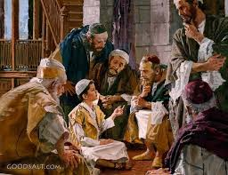
Jesus Went to Work!
“And it came to pass, that after three days they found him in the temple, sitting in the midst of the doctors, both hearing them, and asking them questions. And all that heard him were astonished at his understanding and answers.” Luke 2:46,47

Slide 10
Focusing on Scripture
“Jesus presented Himself as one thirsting for a knowledge of God. His questions were suggestive of deep truths which had long been obscured, yet which were vital to the salvation of souls. While showing how narrow and superficial was the wisdom of the wise men, every question put before them a divine lesson, and placed truth in a new aspect. The rabbis spoke of the wonderful elevation which the Messiah's coming would bring to the Jewish nation; but Jesus presented the prophecy of Isaiah, and asked them the meaning of those scriptures that point to the suffering and death of the Lamb of God. The doctors turned upon Him with questions, and they were amazed at His answers. With the humility of a child He repeated the words of Scripture, giving them a depth of meaning that the wise men had not conceived of. If followed, the lines of truth He pointed out would have worked a reformation in the religion of the day. A deep interest in spiritual things would have been awakened; and when Jesus began His ministry, many would have been prepared to receive Him. The rabbis knew that Jesus had not been instructed in their schools; yet His understanding of the prophecies far exceeded theirs. In this thoughtful Galilean boy they discerned great promise. They desired to gain Him as a student, that He might become a teacher in Israel…

Slide 11
Misunderstanding Prophecy!!!
…They wanted to have charge of His education, feeling that a mind so original must be brought under their molding. The words of Jesus had moved their hearts as they had never before been moved by words from human lips. God was seeking to give light to those leaders in Israel, and He used the only means by which they could be reached. In their pride they would have scorned to admit that they could receive instruction from anyone. If Jesus had appeared to be trying to teach them, they would have disdained to listen. But they flattered themselves that they were teaching Him, or at least testing His knowledge of the Scriptures. The youthful modesty and grace of Jesus disarmed their prejudices. Unconsciously their minds were opened to the word of God, and the Holy Spirit spoke to their hearts. They could not but see that their expectation in regard to the Messiah was not sustained by prophecy; but they would not renounce the theories that had flattered their ambition. They would not admit that they had misapprehended the Scriptures they claimed to teach. From one to another passed the inquiry, How hath this youth knowledge, having never learned? The light was shining in darkness; but “the darkness apprehended it not.” John 1:5, R. V. DA, pgs. 78-80

Slide 12
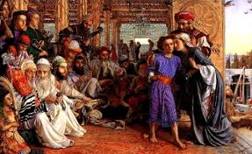
Flipping the Tables
“And when they saw him, they were amazed: and his mother said unto him, Son, why hast thou thus dealt with us? behold, thy father and I have sought thee sorrowing. And he said unto them, How is it that ye sought me? wist ye not that I must be about my Father's business? And they understood not the saying which he spake unto them.” Luke 2:48-50

Slide 13
“How is it that ye sought Me?” answered Jesus. “Wist ye not that I must be about My Father's business?” And as they seemed not to understand His words, He pointed upward. On His face was a light at which they wondered. Divinity was flashing through humanity. On finding Him in the temple, they had listened to what was passing between Him and the rabbis, and they were astonished at His questions and answers. His words started a train of thought that would never be forgotten. And His question to them had a lesson. “Wist ye not,” He said, “that I must be about My Father's business?” Jesus was engaged in the work that He had come into the world to do; but Joseph and Mary had neglected theirs. God had shown them high honor in committing to them His Son. Holy angels had directed the course of Joseph in order to preserve the life of Jesus. But for an entire day they had lost sight of Him whom they should not have forgotten for a moment. And when their anxiety was relieved, they had not censured themselves, but had cast the blame upon Him…..

Slide 14
MESSIAH!!
“It was natural for the parents of Jesus to look upon Him as their own child. He was daily with them, His life in many respects was like that of other children, and it was difficult for them to realize that He was the Son of God. They were in danger of failing to appreciate the blessing granted them in the presence of the world's Redeemer. The grief of their separation from Him, and the gentle reproof which His words conveyed, were designed to impress them with the sacredness of their trust. In the answer to His mother, Jesus showed for the first time that He understood His relation to God. Before His birth the angel had said to Mary, “He shall be great, and shall be called the Son of the Highest: and the Lord God shall give unto Him the throne of His father David: and He shall reign over the house of Jacob forever.” Luke 1:32, 33. These words Mary had pondered in her heart; yet while she believed that her child was to be Israel's Messiah, she did not comprehend His mission. Now she did not understand His words; but she knew that He had disclaimed kinship to Joseph, and had declared His Sonship to God.” DA, pg. 81

Slide 15
1. Shepherds
2. Wise men
3. Simeon and Anna at Dedication
4. Passover Visit
Four irrefutable moments where the Messiahship of Christ were revealed. Adventism would not listen!! The cross was ahead!!

Slide 16
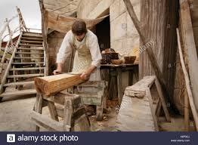
“And he went down with them, and came to Nazareth, and was subject unto them: but his mother kept all these sayings in her heart. And Jesus increased in wisdom and stature, and in favour with God and man.” Luke 2:51,52
“Jesus did not ignore His relation to His earthly parents. From Jerusalem He returned home with them, and aided them in their life of toil. He hid in His own heart the mystery of His mission, waiting submissively for the appointed time for Him to enter upon His work. For eighteen years after He had recognized that He was the Son of God, He acknowledged the tie that bound Him to the home at Nazareth, and performed the duties of a son, a brother, a friend, and a citizen.” DA, pg. 82

Slide 17
Thoughtful Hour!
“It would be well for us to spend a thoughtful hour each day in contemplation of the life of Christ. We should take it point by point, and let the imagination grasp each scene, especially the closing ones. As we thus dwell upon His great sacrifice for us, our confidence in Him will be more constant, our love will be quickened, and we shall be more deeply imbued with His spirit. If we would be saved at last, we must learn the lesson of penitence and humiliation at the foot of the cross.” DA, pg. 83

