Slide 1
Romans, pt.14
The Titanic Struggle:
The Battle Between Two Men

Slide 2
Summary of Romans 7:1-12
1. Paul illustrates the death of the old man of sin and being married to the new man, Christ Jesus.
2. Romans 7:1-5 is not talking about divorce and remarriage at all.
3. God helps those who realize they can’t help themselves.
4. While we are sinning, we are under the law.
5. When we are in submission to Christ, the law is wonderful; freedom and peace are the fruits!

Slide 3

Romans 7:13
“Was then that which is good made death unto me? God forbid. But sin, that it might appear sin, working death in me by that which is good; that sin by the commandment might become exceeding sinful.”

Slide 4

The problem lies in us: not in the law!
Paul makes it very clear that the law is not the problem. The law is perfect. The problem is sin and our involvement with it. The law simply does what it does; it reveals sin. “Whosoever committeth sin transgresseth also the law: for sin is the transgression of the law.” 1John 3:4 Since the law cannot lie, it points out sin wherever it is found. It is no respecter of persons!

Slide 5

Romans 7:14
“For we know that the law is spiritual: but I am carnal, sold under sin.”
The law applies not only to outward acts, but discerns the thoughts and intents of the mind. It tells us when our thoughts are going in the wrong direction. Only Christ can stop them! We can’t! This is where we must yield!

Slide 6
Desire of Ages, page 324
“When the soul surrenders itself to Christ, a new power takes possession of the new heart. A change is wrought which man can never accomplish for himself. It is a supernatural work, bringing a supernatural element into human nature. The soul that is yielded to Christ becomes His own fortress, which He holds in a revolted world, and He intends that no authority shall be known in it but His own. A soul thus kept in possession by the heavenly agencies is impregnable to the assaults of Satan. But unless we do yield ourselves to the control of Christ, we shall be dominated by the wicked one. We must inevitably be under the control of the one or the other of the two great powers that are contending for the supremacy of the world. It is not necessary for us deliberately to choose the service of the kingdom of darkness in order to come under its dominion. We have only to neglect to ally ourselves with the kingdom of light. If we do not co-operate with the heavenly agencies, Satan will take possession of the heart, and will make it his abiding place. The only defense against evil is the indwelling of Christ in the heart through faith in His righteousness. Unless we become vitally connected with God, we can never resist the unhallowed effects of self-love, self-indulgence, and temptation to sin.

Slide 7

The law Cannot be Legislated
Since the law is spiritual and the only way to obey that law is through the power of the Holy Spirit, no nation should never seek to enforce the law on its people. No nation collectively can keep the law of God; only the individual heart in submission to Christ can keep it!

Slide 8

Romans 7:15-17
“For that which I do I allow not: for what I would, that do I not; but what I hate, that do I. If then I do that which I would not, I consent unto the law that it is good. Now then it is no more I that do it, but sin that dwelleth in me.”

Slide 9
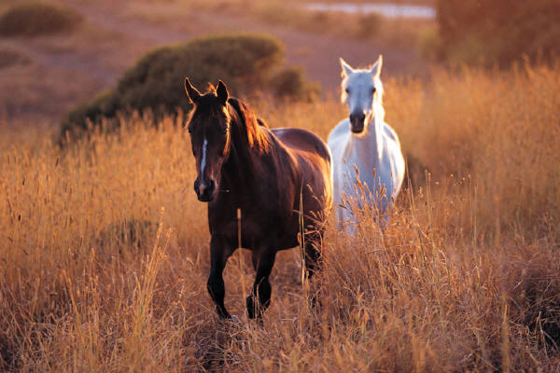
He Doesn’t Leave Willingly
When we embrace Christ as our Savior, the old man of sin doesn’t just go away. The carnal nature remains to afflict, tempt, discourage, and lead into sin. This is where submission to Christ becomes paramount. We must die daily to our old nature or he will take over and sin will reign.
“I protest by your rejoicing which I have in Christ Jesus our Lord, I die daily.“ 1Cor. 15:31 With the new man, Christ Jesus, “I can do all things through Christ which strengtheneth me.” Phil. 4:13

Slide 10

No Boasting
“For I know that in me (that is, in my flesh,) dwelleth no good thing: for to will is present with me; but how to perform that which is good I find not.” Romans 7:18
“Can the Ethiopian change his skin, or the leopard his spots? then may ye also do good, that are accustomed to do evil.” Jer. 13:23
There will be no boasting on the part of the converted Christian. They realize that in themselves is no good thing, and that any good they may do is the result of Jesus Christ working in their lives.

Slide 11
Thru Christ Alone
It is impossible for us, of ourselves, to escape from the pit of sin in which we are sunken. Our hearts are evil, and we cannot change them. "Who can bring a clean thing out of an unclean? not one." "The carnal mind is enmity against God: for it is not subject to the law of God, neither indeed can be." Job 14:4; Romans 8:7. Education, culture, the exercise of the will, human effort, all have their proper sphere, but here they are powerless. They may produce an outward correctness of behavior, but they cannot change the heart; they cannot purify the springs of life. There must be a power working from within, a new life from above, before men can be changed from sin to holiness. That power is Christ. His grace alone can quicken the lifeless faculties of the soul, and attract it to God, to holiness.
The Saviour said, "Except a man be born from above," unless he shall receive a new heart, new desires, purposes, and motives, leading to a new life, "he cannot see the kingdom of God." John 3:3, margin. The idea that it is necessary only to develop the good that exists in man by nature, is a fatal deception. "The natural man receiveth not the things of the Spirit of God: for they are foolishness unto him: neither can he know them, because they are spiritually discerned." "Marvel not that I said unto thee, Ye must be born again." 1 Corinthians 2:14; John 3:7. Of Christ it is written, "In Him was life; and the life was the light of men"--the only "name under heaven given among men, whereby we must be saved." John 1:4; Acts 4:12. Steps to Christ, Pgs. 18,19

Slide 12
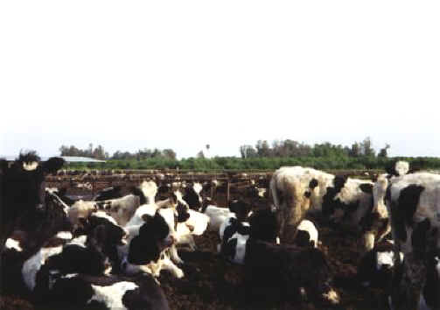
Romans 7:19-21
“For the good that I would I do not: but the evil which I would not, that I do. Now if I do that I would not, it is no more I that do it, but sin that dwelleth in me. I find then a law, that, when I would do good, evil is present with me.“
The first husband is a mean old man!! He is a tyrant, wanting us to wallow in the muck and mire of evil!!

Slide 13

We see the beauty of holiness; the law of God looks wonderful, but how to keep it is another story. While we see the beauty of God’s law, we also see the principle of sin dwelling in us, desiring things that will bring us into captivity and eventually destroy us. We, of ourselves, can only produce evil.
We are enslaved by sin and the law tells us that we are condemned. It can’t do anything more or less. The law is not the problem; the miserable old man of sin is the problem!

Slide 14
Every soul that refuses to give himself to God is under the control of another power. He is not his own. He may talk of freedom, but he is in the most abject slavery. He is not allowed to see the beauty of truth, for his mind is under the control of Satan. While he flatters himself that he is following the dictates of his own judgment, he obeys the will of the prince of darkness. Christ came to break the shackles of sin-slavery from the soul. "If the Son therefore shall make you free, ye shall be free indeed." "The law of the Spirit of life in Christ Jesus" sets us "free from the law of sin and death." Rom. 8:2.
In the work of redemption there is no compulsion. No external force is employed. Under the influence of the Spirit of God, man is left free to choose whom he will serve. In the change that takes place when the soul surrenders to Christ, there is the highest sense of freedom. The expulsion of sin is the act of the soul itself. True, we have no power to free ourselves from Satan's control; but when we desire to be set free from sin, and in our great need cry out for a power out of and above ourselves, the powers of the soul are imbued with the divine energy of the Holy Spirit, and they obey the dictates of the will in fulfilling the will of God.
The only condition upon which the freedom of man is possible is that of becoming one with Christ. "The truth shall make you free;" and Christ is the truth. Sin can triumph only by enfeebling the mind, and destroying the liberty of the soul. Subjection to God is restoration to one's self,--to the true glory and dignity of man. The divine law, to which we are brought into subjection, is "the law of liberty." James 2:12. DA, pg. 466

Slide 15
Romans 7:22-24
“We find that this union in which we are held — with the flesh — is not a pleasant union, but the husband to whom we are wedded is a task master, he is a tyrant who grinds us down so that we have no liberty. The flesh is tyrannical, and it holds us down, and makes us do, not as we wish to do, but as it wishes us to do. When we by the aid of Christ come to feel that this union is a galling bondage, then we awake to the real state of our condition, and realize that whereas it may have satisfied us for a time, now we hate it, and desire to rid ourselves of it, and become united to Christ.” Waggoner on Romans, pg. 57
“For I delight in the law of God after the inward man: But I see another law in my members, warring against the law of my mind, and bringing me into captivity to the law of sin which is in my members. O wretched man that I am! who shall deliver me from the body of this death?” The old man doesn’t want to die!!

Slide 16
One Answer: A New Man
“It is not enough to perceive the loving-kindness of God, to see the benevolence, the fatherly tenderness, of His character. It is not enough to discern the wisdom and justice of His law, to see that it is founded upon the eternal principle of love. Paul the apostle saw all this when he exclaimed, "I consent unto the law that it is good." "The law is holy, and the commandment holy, and just, and good." But he added, in the bitterness of his soul-anguish and despair, "I am carnal, sold under sin." Romans 7:16, 12, 14. He longed for the purity, the righteousness, to which in himself he was powerless to attain, and cried out, "O wretched man that I am! who shall deliver me from this body of death?" Romans 7:24, margin. Such is the cry that has gone up from burdened hearts in all lands and in all ages. To all, there is but one answer, "Behold the Lamb of God, which taketh away the sin of the world." John 1:29.
Many are the figures by which the Spirit of God has sought to illustrate this truth, and make it plain to souls that long to be freed from the burden of guilt. When, after his sin in deceiving Esau, Jacob fled from his father's home, he was weighed down with a sense of guilt. Lonely and outcast as he was, separated from all that had made life dear, the one thought that above all others pressed upon his soul, was the fear that his sin had cut him off from God, that he was forsaken of Heaven. In sadness he lay down to rest on the bare earth, around him only the lonely hills, and above, the heavens bright with stars. As he slept, a strange light broke upon his vision; and lo, from the plain on which he lay, vast shadowy stairs seemed to lead upward to the very gates of heaven, and upon them angels of God were passing up and down; while from the glory above, the divine voice was heard in a message of comfort and hope. Thus was made known to Jacob that which met the need and longing of his soul--a Saviour. With joy and gratitude he saw revealed a way by which he, a sinner, could be restored to communion with God. The mystic ladder of his dream represented Jesus, the only medium of communication between God and man.” Steps to Christ, pgs. 19,20

Slide 17

A New Husband
“O wretched man that I am! who shall deliver me from the body of this death? I thank God through Jesus Christ our Lord.’ Romans 7:24, 25a
Deliverance can happen if we look by faith to the New Husband, Jesus Christ.
“The only defense against evil is the indwelling of Christ in the heart through faith in His righteousness. Unless we become vitally connected with God, we can never resist the unhallowed effects of self-love, self-indulgence, and temptation to sin.” DA, pg. 324

Slide 18

One Has to Die!
“I thank God through Jesus Christ our Lord. So then with the mind I myself serve the law of God; but with the flesh the law of sin.” Romans 7:25
This is not the testimony of a converted man. This is the testimony of an adulterer. This comment reveals a person who is serving two masters; the old man of sin, the first husband and the Christ Jesus, the second husband. We cannot be married to two men at the same time. One has to die!

Slide 19
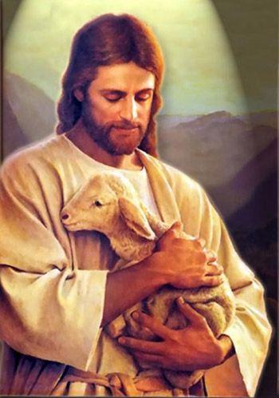
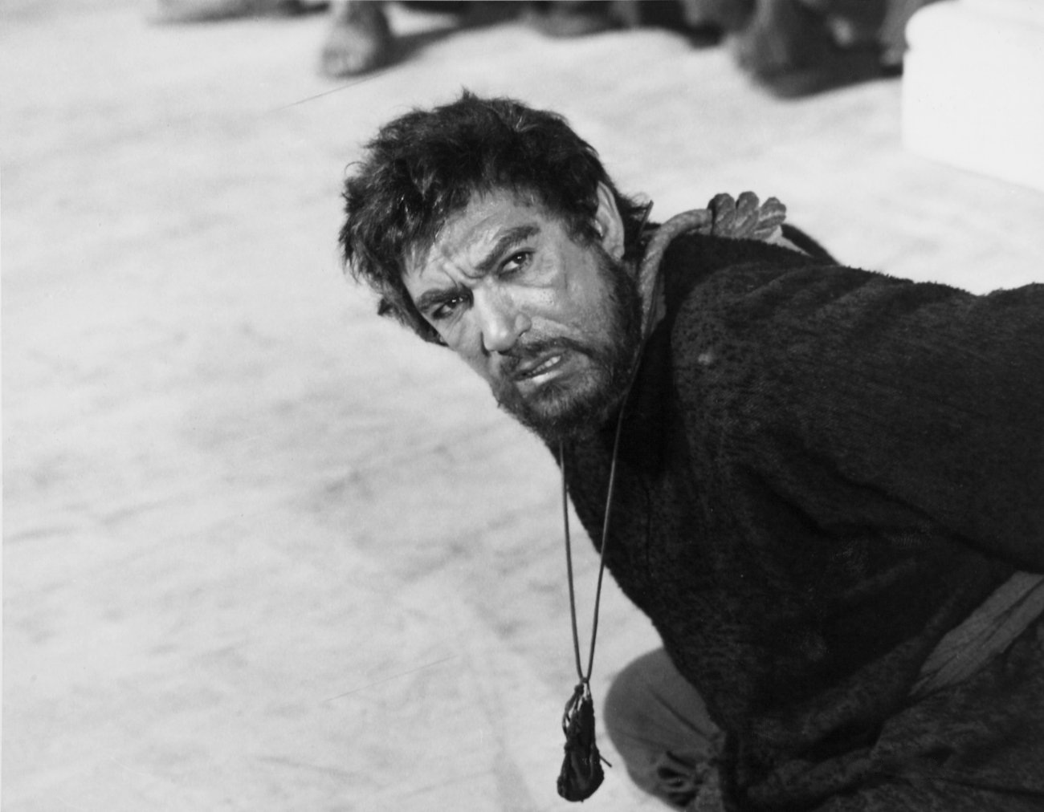
Who will It Be?
Christ or Barabbas?

