Slide 1
Communion

Slide 2
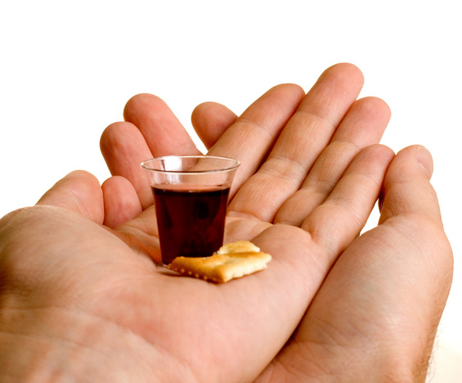
The Bread and the Juice
While Christ immortalized the communion service in the upper room, the emblems of the bread and juice have carried deep spiritual significance for ages. What simple and yet profound truths have various Bible stories attached to these two emblems?

Slide 3
In the Physical Realm
Our Lord has said, "Except ye eat the flesh of the Son of man, and drink His blood, ye have no life in you. . . . For My flesh is meat indeed, and My blood is drink indeed." John 6:53-55. This is true of our physical nature. To the death of Christ we owe even this earthly life. The bread we eat is the purchase of His broken body. The water we drink is bought by His spilled blood. Never one, saint or sinner, eats his daily food, but he is nourished by the body and the blood of Christ. The cross of Calvary is stamped on every loaf. It is reflected in every water spring. All this Christ has taught in appointing the emblems of His great sacrifice. The light shining from that Communion service in the upper chamber makes sacred the provisions for our daily life. The family board becomes as the table of the Lord, and every meal a sacrament.” DA, pg. 660

Slide 4
In the Spiritual Realm
“And how much more are Christ's words true of our spiritual nature. He declares, "Whoso eateth My flesh, and drinketh My blood, hath eternal life." It is by receiving the life for us poured out on Calvary's cross, that we can live the life of holiness. And this life we receive by receiving His word, by doing those things which He has commanded. Thus we become one with Him. "He that eateth My flesh," He says, "and drinketh My blood, dwelleth in Me, and I in him. As the living
Father hath sent Me, and I live by the Father: so he that eateth Me, even he shall live by Me." John 6:54, 56, 57. To the holy Communion this scripture in a special sense applies.” DA, pgs. 660,661

Slide 5
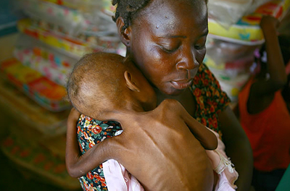
Deep Spiritual Truth
As the human being is dependent on daily bread and drink for physical survival, so must we partake of scriptural food and drink daily or we will be emaciated Christians. Some people feel that they can eat only once a week at church and be a healthy, vibrant Christian. Can we eat once a week of physical food and be a healthy, vibrant person? How crazy!!

Slide 6

Essential
“I am that bread of life. Your fathers did eat manna in the wilderness, and are dead. This is the bread which cometh down from heaven, that a man may eat thereof, and not die. I am the living bread which came down from heaven: if any man eat of this bread, he shall live for ever: and the bread that I will give is my flesh, which I will give for the life of the world. The Jews therefore strove among themselves, saying, How can this man give us his flesh to eat?
Then Jesus said unto them, Verily, verily, I say unto you, Except ye eat the flesh of the Son of man, and drink his blood, ye have no life in you.” Jn. 6:48-53

Slide 7

Regurgitated Food!
What if I come to church every week and take part in Sabbath school and then listen to the church service very attentively? I’m feeding on the Word of God. If that is all we’re doing is getting regurgitated food once a week, we are in trouble!

Slide 8
Mary/Martha
“The "one thing" that Martha needed was a calm, devotional spirit, a deeper anxiety for knowledge concerning the future, immortal life, and the graces necessary for spiritual advancement. She needed less anxiety for the things which pass away, and more for those things which endure forever. Jesus would teach His children to seize every opportunity of gaining that knowledge which will make them wise unto salvation. The cause of Christ needs careful, energetic workers. There is a wide field for the Martha's, with their zeal in active religious work. But let them first sit with Mary at the feet of Jesus. Let diligence, promptness, and energy be sanctified by the grace of Christ; then the life will be an unconquerable power for good.” CC 304

Slide 9
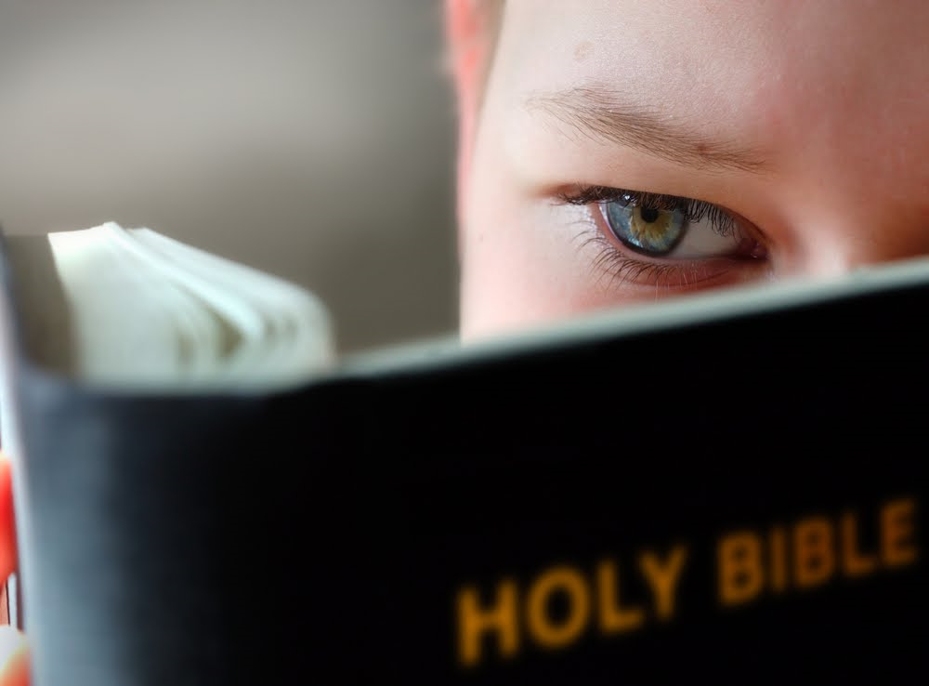
One of the Do’s
One of the simple do’s in the Christian life is to spend time sitting at the feet of Jesus, listening to His words. This is the only way that we can have a close relationship with Him. Coupling this with prayer, you have the antidote for a solid life with Christ. It isn’t something magical/mystical, it is very practical and simple!

Slide 10
An hour
“Many attend religious services, and are refreshed and comforted by the word of God; but through neglect of meditation, watchfulness, and prayer, they lose the blessing, and find themselves more destitute than before they received it. Often they feel that God has dealt hardly with them. They do not see that the fault is their own. By separating themselves from Jesus, they have shut away the light of His presence.
It would be well for us to spend a thoughtful hour each day in contemplation of the life of Christ. We should take it point by point, and let the imagination grasp each scene, especially the closing ones. As we thus dwell upon His great sacrifice for us, our confidence in Him will be more constant, our love will be quickened, and we shall be more deeply imbued with His spirit. If we would be saved at last, we must learn the lesson of penitence and humiliation at the foot of the cross.” DA, pg. 83
The communion bread and juice call us to this experience today!

