Slide 1
War on the Atonement, pt. 2

Slide 2
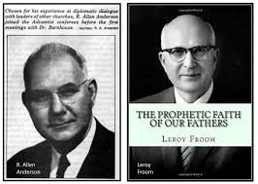
They Started it
Leroy Froom and Roy Allan Anderson were the pivotal men in Adventism that sought to annihilate the atonement of Christ in the Most Holy Place since 1844. They did this through the evangelical meetings with Martin and Barnhouse in the 1950’s. They were the key contributors to the awful book that resulted, entitled Questions on Doctrine. They sought to negate the atoning work of Christ since 1844 and to destroy the SOP statements that said this!

Slide 3
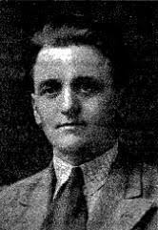
Edward Heppenstall
Heppenstall was one of the most influential scholars to come out against M. L. Andreasen's final generation theology. While upholding the "pillar" doctrines of the Adventist pioneers, he moved forward on the understanding on such issues as the human nature of Christ and the atonement. He emphasized, as did Questions on Doctrine, the atonement on the cross with a continuing ministry in heaven in the antitypical Day of Atonement. Beyond these issues, he stressed such teachings as the helplessness of human beings to do good of their own selves, justification by faith in relation to the entire plan of salvation, the impossibility of humanly achieving what some people think of as sinless perfection, the fact that Jesus was not just like other children of fallen Adam and the new covenant experience.[7]

Slide 4
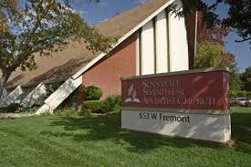
Testimony-1979
The brilliant, scholarly, Edward Heppenstall came to the Sunnyvale SDA Church in 1979. The sermon was on the atonement being finished at the cross. It was exclusively the atonement of Christ at the cross. There was NOTHING about what Christ wants to do in you or about what He is doing in heaven today, making atonement there: it was a message that made one think everything was done at the cross and all one had to do was believe that!

Slide 5
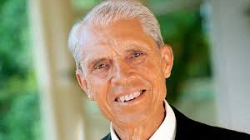
Whose Next?
Next up came Desmond Ford. Scholar, theologian, Biblical researcher; no one attacked the sanctuary doctrine and the atoning work of Christ in the heavenly sanctuary more than this man! The man’s entire study of the Bible placed everything as done, completed at the cross. All one had to do was acknowledge Christ’s death and they would be saved! This colored Ford’s understanding of the entire Bible. He made EVERYTHING spin or dance to this single tune!

Slide 6
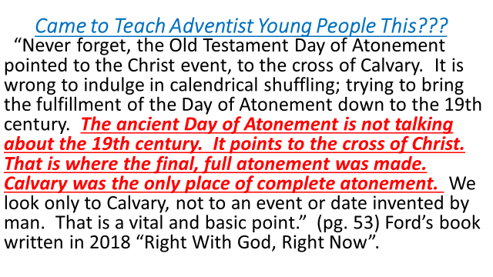

Slide 7
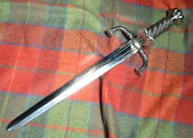
How Does it Feel?
“It is wrong to indulge in calendrical shuffling; trying to bring the fulfillment of the Day of Atonement down to the 19th century. The ancient Day of Atonement is not talking about the 19th century.”
Translate: The final atonement did not begin in 1844. Ellen White and the pioneers were wrong on the sanctuary! Daniel 8:14 was fulfilled in the time of Antiochus Epiphanes.
With that statement goes the three angel’s messages, the sanctuary, the SOP, the very rationale for the Advent movement!

Slide 8
Nowhere in Scripture is that Stated!
“The ancient Day of Atonement is not talking about the 19th century. It points to the cross of Christ. That is where the final, full atonement was made. Calvary was the only place of complete atonement. “
NOWHERE in the Bible does atonement ever occur when a sacrifice was made. Atonement IS ALWAYS and ONLY the work of the priest!
Notice: Leviticus 4:31 “And he shall take away all the fat thereof, as the fat is taken away from off the sacrifice of peace offerings; and the priest shall burn it upon the altar for a sweet savour unto the LORD; and the priest shall make an atonement for him, and it shall be forgiven him.” This was in the daily services.
Leviticus 16: 30-32 “For on that day shall the priest make an atonement for you, to cleanse you, that ye may be clean from all your sins before the LORD. It shall be a sabbath of rest unto you, and ye shall afflict your souls, by a statute for ever. And the priest, whom he shall anoint, and whom he shall consecrate to minister in the priest's office in his father's stead, shall make the atonement, and shall put on the linen clothes, even the holy garments:”
Desmond Ford is a liar and a deceiver!!!!!

Slide 9
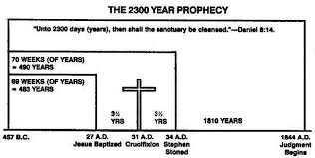
“We look only to Calvary, not to an event or date invented by man. That is a vital and basic point.” (pg. 53) Ford’s book written in 2018 “Right With God, Right Now”.
This is a direct assault on the prophecy of Daniel 8:14! This is an assault on 1844 and the movement of God that was raised up at that time- the Great Advent Movement!
This movement was blessed and authenticated by Bible research and the confirmation of the SOP!
Invented by man, Desmond????
Hogwash!

Slide 10
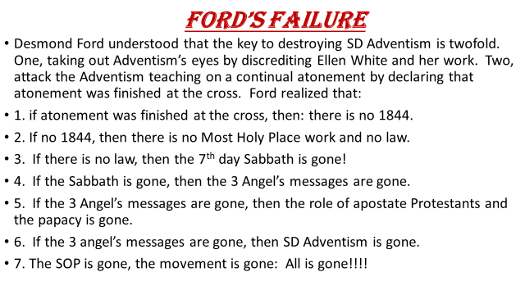

Slide 11
Ford on Hebrews!!!!
The Book of Hebrews Teaches That the Antitypical Day of Atonement
Was Fulfilled at the Cross.[14]
Reasons: 1. Hebrews portrays Christ as being in the Most Holy Place
of the heavenly sanctuary in the 1st century A.D.
2. Hebrews does not explicitly mention the heavenly
sanctuary as having two apartments; therefore, there
cannot be two phases to Christ's work as our high priest in
heaven.
3. The book of Hebrews abounds with Day of Atonement
language and imagery, and thus describes the fulfillment
of the antitypical Day of Atonement.

Slide 12
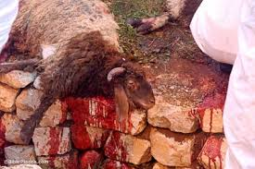
Let’s See What He Just Said!
1. The Day of Atonement in the Hebrew sanctuary pointed to Calvary??? Is that right???
Where was Calvary in the Hebrew sanctuary?
“And if any one of the common people sin through ignorance, while he doeth somewhat against any of the commandments of the LORD concerning things which ought not to be done, and be guilty; Or if his sin, which he hath sinned, come to his knowledge: then he shall bring his offering, a kid of the goats, a female without blemish, for his sin which he hath sinned. And he shall lay his hand upon the head of the sin offering, and slay the sin offering in the place of the burnt offering. And the priest shall take of the blood thereof with his finger, and put it upon the horns of the altar of burnt offering, and shall pour out all the blood thereof at the bottom of the altar. And he shall take away all the fat thereof, as the fat is taken away from off the sacrifice of peace offerings; and the priest shall burn it upon the altar for a sweet savour unto the LORD; and the priest shall make an atonement for him, and it shall be forgiven him.” Leviticus 4:27-31

Slide 13
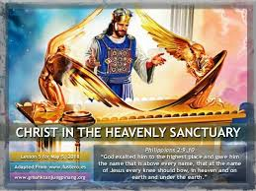
Sanctuary on Earth/Heaven
1. That is unmitigated bunk!
2. The book of Hebrews is ALL about paralleling the Old Testament sanctuary services as a type of the dual ministries to be carried on by Christ in the Heavenly Sanctuary!!
3. The book of Hebrews DOES NOT portray Christ in the Most Holy Place in 31 AD!
4. The sanctuary on earth had two apartments and SO DOES the Heavenly sanctuary!
5. Ford’s assertion that atonement is throughout Hebrews is WRONG: Hebrews is showing the type and antitype!

Slide 14
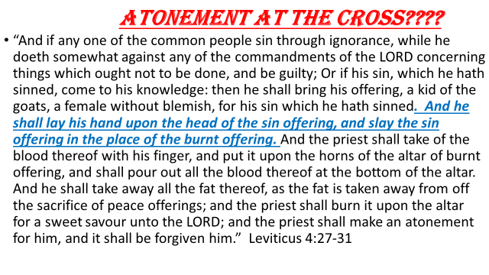
Partial Atonement in Daily Services

Slide 15
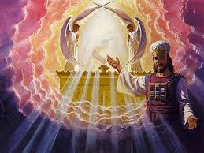
Atonement in 1844???
“And this shall be a statute for ever unto you: that in the seventh month, on the tenth day of the month, ye shall afflict your souls, and do no work at all, whether it be one of your own country, or a stranger that sojourneth among you: For on that day shall the priest make an atonement for you, to cleanse you, that ye may be clean from all your sins before the LORD. It shall be a sabbath of rest unto you, and ye shall afflict your souls, by a statute for ever.” Leviticus 16:29-31

Slide 16
Fundamental Beliefs 1981
In Christ’s life of perfect obedience to God’s will, His suffering, death, and resurrection, God provided the only means of atonement for human sin, so that those who by faith accept this atonement may have eternal life, and the whole creation may better understand the infinite and holy love of the Creator. This perfect atonement vindicates the righteousness of God’s law and the graciousness of His character; for it both condemns our sin and provides for our forgiveness. The death of Christ is substitutionary and expiatory, reconciling and transforming. The bodily resurrection of Christ proclaims God’s triumph over the forces of evil, and for those who accept the atonement assures their final victory over sin and death. It declares the Lordship of Jesus Christ, before whom every knee in heaven and on earth will bow.” pg. 5

Slide 17
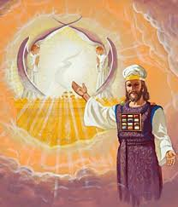
Study these Chapters
1. Patriarchs and Prophets, chapter 30 “The Sanctuary and its Services”.
2. Great Controversy, chapter 23, “What is the Sanctuary”.
3. Great Controversy, chapter 24, “ In the Holy of Holies”.
4. Great Controversy, chapter 28, “Facing Life’s Record”.
5. Lewis Walton’s Book, Decision at the Jordan

Slide 18

Since the Most Holy Place work of Christ also points to the law of God and the Sabbath, it is shocking to think that Adventism for the last 60 years has been placing everything at the cross. With atonement being centered on the cross, like all other churches teach, it negates Christ’s works in the sanctuary, it negates the law of God and the Sabbath. When the Sabbath/Sunday issue comes to the front, those Adventists who have been looking backwards and not upwards, will find themselves uniting with Sunday worshippers and receiving the mark of the beast!

Slide 19
Well, well, well!
“As the storm approaches, a large class who have professed faith in the third angel's message, but have not been sanctified through obedience to the truth, abandon their position and join the ranks of the opposition. By uniting with the world and partaking of its spirit, they have come to view matters in nearly the same light; and when the test is brought, they are prepared to choose the easy, popular side. Men of talent and pleasing address, who once rejoiced in the truth, employ their powers to deceive and mislead souls. They become the most bitter enemies of their former brethren. When Sabbathkeepers are brought before the courts to answer for their faith, these apostates are the most efficient agents of Satan to misrepresent and accuse them, and by false reports and insinuations to stir up the rulers against them.” GC, pg. 608

