Slide 1
Romans, pt. 18
God’s Mercy

Slide 2
Review of Romans 9:1-16
1. God has many children; some are true and some are not.
2. In spite of their decided advantages, most of Abraham’s seed failed.
3. God loved Esau, just as much as He loved Jacob; God just hated the miserable choices that Esau made in spite of God’s incredible mercies.
4. God doesn’t arbitrarily accept some and reject others. He causes blessings to shine upon all; people’s choices determine their destiny.

Slide 3
Romans 9:17-19
“For the scripture saith unto Pharaoh, Even for this same purpose have I raised thee up, that I might shew my power in thee, and that my name might be declared throughout all the earth. Therefore hath he mercy on whom he will have mercy, and whom he will he hardeneth. Thou wilt say then unto me, Why doth he yet find fault? For who hath resisted his will?”

Slide 4
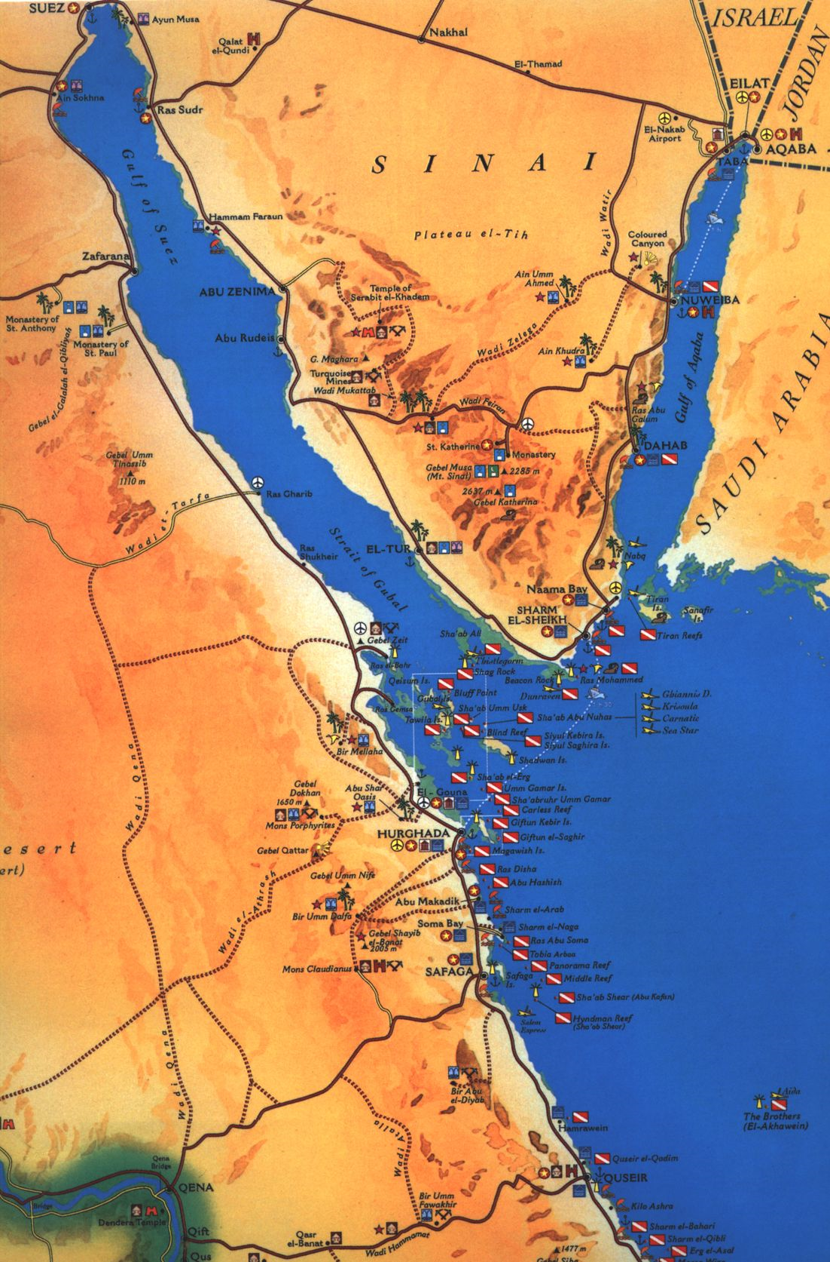
What More Could God Do?
God abundantly blessed Pharaoh in every way. He sent him the bounties of His grace, but Pharaoh resisted every effort of God’s to win his submission and Pharaoh perished in the waters of the Red Sea. It was not God’s arbitrary will that placed him there!

Slide 5
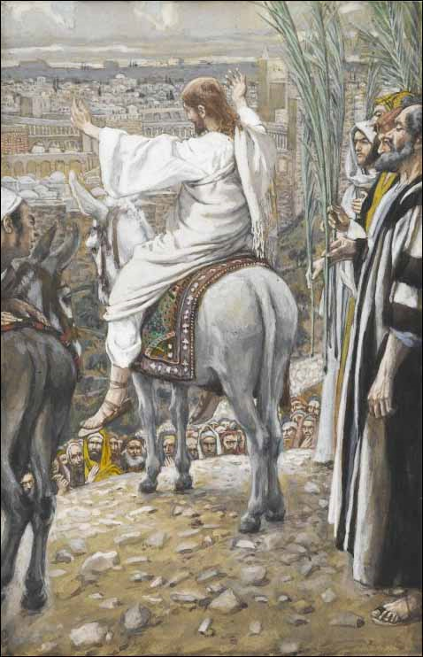
Christ Weeps over man’s Stubbornness
“And when he was come near, he beheld the city, and wept over it, Saying, If thou hadst known, even thou, at least in this thy day, the things which belong unto thy peace! but now they are hid from thine eyes. For the days shall come upon thee, that thine enemies shall cast a trench about thee, and compass thee round, and keep thee in on every side, And shall lay thee even with the ground, and thy children within thee; and they shall not leave in thee one stone upon another; because thou knewest not the time of thy visitation.” Luke 19:41-44

Slide 6
It Didn’t Have to Be!
“Jerusalem had been the child of His care, and as a tender father mourns over a wayward son, so Jesus wept over the beloved city. How can I give thee up? How can I see thee devoted to destruction? Must I let thee go to fill up the cup of thine iniquity? One soul is of such value that, in comparison with it, worlds sink into insignificance; but here was a whole nation to be lost. When the fast westering sun should pass from sight in the heavens, Jerusalem's day of grace would be ended. While the procession was halting on the brow of Olivet, it was not yet too late for Jerusalem to repent. The angel of mercy was then folding her wings to step down from the golden throne to give place to justice and swift-coming judgment. But Christ's great heart of love still pleaded for Jerusalem, that had scorned His mercies, despised His warnings, and was about to imbrue her hands in His blood. If Jerusalem would but repent, it was not yet too late. While the last rays of the setting sun were lingering on temple, tower, and pinnacle, would not some good angel lead her to the Saviour's love, and avert her doom? Beautiful and unholy city, that had stoned the prophets, that had rejected the Son of God, that was locking herself by her impenitence in fetters of bondage,--her day of mercy was almost spent! “ DA, pgs. 577,578

Slide 7
It’s About to Happen!
“A time is coming when the law of God is, in a special sense, to be made void in our land. The rulers of our nation will, by legislative enactments, enforce the Sunday law, and thus God’s people be brought into great peril. When our nation, in its legislative councils, shall enact laws to bind the consciences of men in
regard to their religious privileges, enforcing Sunday observance, and bringing oppressive power to bear against those who keep the seventh-day Sabbath[Saturday], the law of God will, to all intents and purposes, be made void in our land; and national apostasy will be followed by national ruin. “ E.G. White, Advent Review and Sabbath Herald, Review & Herald, {RH,December 18, 1888 par. 5}
"May Day: a Cry to God for Our Nation in Distress" will take place May 1 from sunrise to 2 p.m. at the Lincoln Memorial in Washington, D.C.
"Our nation faces what is perhaps the most serious moral crisis since the civil war as we've turned our backs on God and have clearly displeased him," Dr. James Dobson said in an invitation to Americans to attend the event. "May Day 2010 is a time to come together and proclaim what God has done in the past, to pray for forgiveness and to plead for God's mercy on all of us."
They will gather for one purpose: repentance.
The group will repent for how the nation has turned from God in every area of influence: 1) business 2) government, 3) media, 4) arts and entertainment, 5) education, 6) the family and 7) religion and invite God back into each area of Americans' lives.

Slide 8

Romans 9:20-23
“Nay but, O man, who art thou that repliest against God? Shall the thing formed say to him that formed it, Why hast thou made me thus? Hath not the potter power over the clay, of the same lump to make one vessel unto honour, and another unto dishonour? What if God, willing to shew his wrath, and to make his power known, endured with much longsuffering the vessels of wrath fitted to destruction: And that he might make known the riches of his glory on the vessels of mercy, which he had afore prepared unto glory, “

Slide 9
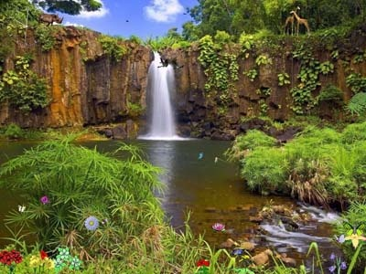
The Potter and the Clay
How many potters make pots for the purpose of destruction? How many potters make things, hoping to eventually destroy them? How ridiculous!
A potter makes every effort to bring a pot to perfection, not willing that any be destroyed, but that all should come to repentance.
“The Lord is not slack concerning his promise, as some men count slackness; but is longsuffering to us-ward, not willing that any should perish, but that all should come to repentance.” 2Peter 3:9

Slide 10
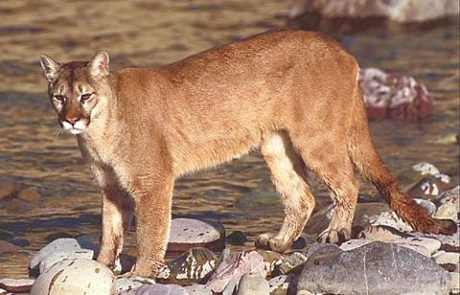
Longsuffering of God
God does everything possible to save humanity from sin and destruction. In the case of the antediluvians, God waited 120 years for them to repent, but because of their despicable rejection of Him, God had no choice but to execute judgment upon them!
“Which sometime were disobedient, when once the longsuffering of God waited in the days of Noah, while the ark was a preparing, wherein few, that is, eight souls were saved by water.” 1Peter 3:20

Slide 11
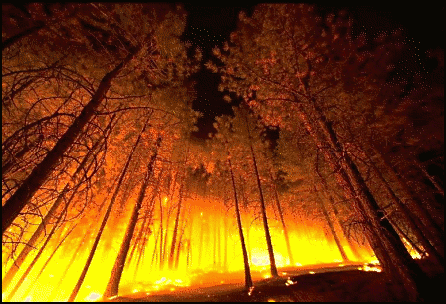
God’s Hope
In every case of exhausted patience, God has labored so long to bring people to submission and contentment. Whether it be Pharaoh, the antediluvians, King Saul, or the Jews, it was sinful, wicked persistence in evil that made it impossible for God to save them. So, it will be with Adventism and the world!

Slide 12
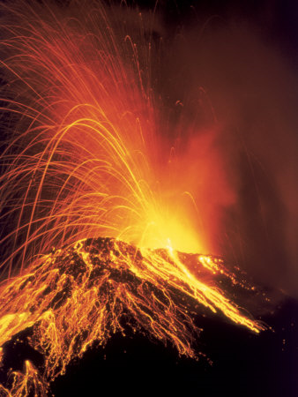
Romans 9:24-26
“Even us, whom he hath called, not of the Jews only, but also of the Gentiles? As he saith also in Osee, I will call them my people, which were not my people; and her beloved, which was not beloved. And it shall come to pass, that in the place where it was said unto them, Ye are not my people; there shall they be called the children of the living God.”

Slide 13
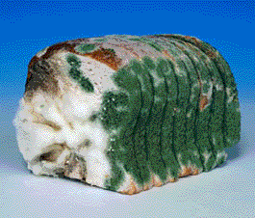
Hoarding the Manna
Through the wretched neglect of the Jews, the Gentiles were not blessed as were the Jews. Nevertheless, God, in His mercy, had granted the Gentiles great manifestations, both silently and loudly, that they might know Him.
“The Jews were scattered everywhere, and their expectation of the Messiah's coming was to some extent shared by the Gentiles. Among those whom the Jews styled heathen were men who had a better understanding of the Scripture prophecies concerning the Messiah than had the teachers in Israel. There were some who hoped for His coming as a deliverer from sin. Philosophers endeavored to study into the mystery of the Hebrew economy. But the bigotry of the Jews hindered the spread of the light. Intent on maintaining the separation between themselves and other nations, they were unwilling to impart the knowledge they still possessed concerning the symbolic service.” DA, pg 33

Slide 14
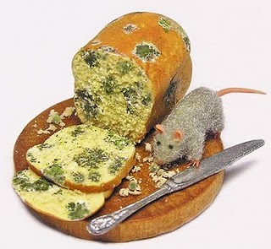
Welcome to Today
“The message of salvation is communicated to men through human agencies. But the Jews had sought to make a monopoly of the truth which is eternal life. They had hoarded the living manna, and it had turned to corruption. The religion which they tried to shut up to themselves became an offense. They robbed God of His glory, and defrauded the world by a counterfeit of the gospel. They had refused to surrender themselves to God for the salvation of the world, and they became agents of Satan for its destruction.
The people whom God had called to be the pillar and ground of the truth had become representatives of Satan. They were doing the work that he desired them to do, taking a course to misrepresent the character of God, and cause the world to look upon Him as a tyrant. The very priests who ministered in the temple had lost sight of the significance of the service they performed. They had ceased to look beyond the symbol to the thing signified. In presenting the sacrificial offerings they were as actors in a play. The ordinances which God Himself had appointed were made the means of blinding the mind and hardening the heart. God could do no more for man through these channels. The whole system must be swept away.” DA, pg. 36

Slide 15
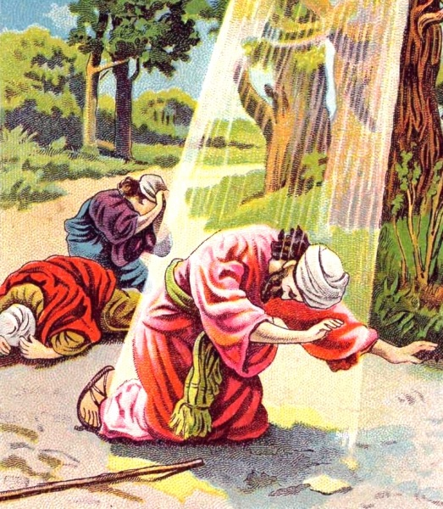
Concerted Effort
The Lord raised up a man, molded him, and prepared him in a concerted effort to reach the Gentiles with the truth of God for this time. Saul was his name!
“But the Lord said unto him, Go thy way: for he is a chosen vessel unto me, to bear my name before the Gentiles, and kings, and the children of Israel: For I will shew him how great things he must suffer for my name's sake.” Acts 9:15,16

Slide 16
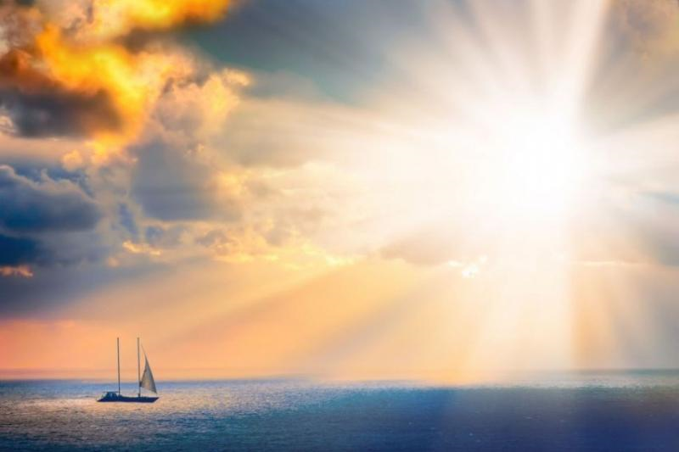
Light of the World
“Ye are the light of the world. A city that is set on an hill cannot be hid. Neither do men light a candle, and put it under a bushel, but on a candlestick; and it giveth light unto all that are in the house.” Matthew 5:14,15

Slide 17
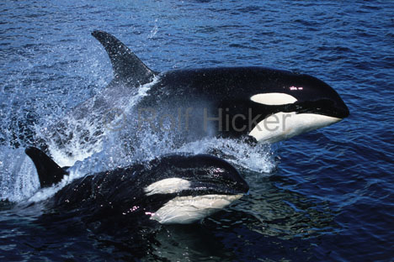
"Ye are the light of the world." The Jews thought to confine the benefits of salvation to their own nation; but Christ showed them that salvation is like the sunshine. It belongs to the whole world. The religion of the Bible is not to be confined between the covers of a book, nor within the walls of a church. It is not to be brought out occasionally for our own benefit, and then to be carefully laid aside again. It is to sanctify the daily life, to manifest itself in every business transaction and in all our social relations. True character is not shaped from without, and put on; it radiates from within. If we wish to direct others in the path of righteousness, the principles of righteousness must be enshrined in our own hearts. Our profession of faith may proclaim the theory of religion, but it is our practical piety that holds forth the word of truth. The consistent life, the holy conversation, the unswerving integrity, the active, benevolent spirit, the godly example,--these are the mediums through which light is conveyed to the world. “ DA, pg. 306,307

Slide 18
Romans 9:27-33
“Esaias also crieth concerning Israel, Though the number of the children of Israel be as the sand of the sea, a remnant shall be saved: For he will finish the work, and cut it short in righteousness: because a short work will the Lord make upon the earth. And as Esaias said before, Except the Lord of Sabaoth had left us a seed, we had been as Sodoma, and been made like unto Gomorrha. What shall we say then? That the Gentiles, which followed not after righteousness, have attained to righteousness, even the righteousness which is of faith. But Israel, which followed after the law of righteousness, hath not attained to the law of righteousness. Wherefore? Because they sought it not by faith, but as it were by the works of the law. For they stumbled at that stumblingstone; As it is written, Behold, I lay in Sion a stumblingstone and rock of offence: and whosoever believeth on him shall not be ashamed.”

Slide 19
Stone of Stumbling
Though there are multitudes of SDA’s today, only a small portion will be saved because God requires submission to Him and so few are willing to give it. God always has a remnant; it isn’t the great hoards of people. It is a small group of people.
The Gentiles/Apostate Protestants/Catholics who don’t keep the Sabbath and the law, but are living up to all the light they have will be saved, but the Adventist who knows the law, but refuses to surrender to Its gracious leadings will be left outside the city of God!
The Stone of stumbling, whom the SDA’s refused to submit to, will bring about their undoing.
“Jesus saith unto them, Did ye never read in the scriptures, The stone which the builders rejected, the same is become the head of the corner: this is the Lord's doing, and it is marvellous in our eyes? Therefore say I unto you, The kingdom of God shall be taken from you, and given to a nation bringing forth the fruits thereof. And whosoever shall fall on this stone shall be broken: but on whomsoever it shall fall, it will grind him to powder. “ Matthew 21:42-44

Slide 20
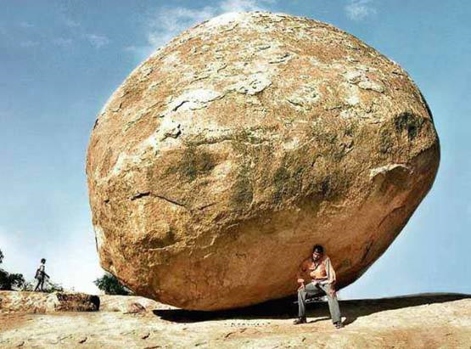
The Stone
“To those who believe, Christ is the sure foundation. These are they who fall upon the Rock and are broken. Submission to Christ and faith in Him are here represented. To fall upon the Rock and be broken is to give up our self-righteousness and to go to Christ with the humility of a child, repenting of our transgressions, and believing in His forgiving love. And so also it is by faith and obedience that we build on Christ as our foundation.
Upon this living stone, Jews and Gentiles alike may build. This is the only foundation upon which we may securely build. It is broad enough for all, and strong enough to sustain the weight and burden of the whole world. And by connection with Christ, the living stone, all who build upon this foundation become living stones. Many persons are by their own endeavors hewn, polished, and beautified; but they cannot become "living stones," because they are not connected with Christ. Without this connection, no man can be saved. Without the life of Christ in us, we cannot withstand the storms of temptation. Our eternal safety depends upon our building upon the sure foundation. Multitudes are today building upon foundations that have not been tested.” DA, pg. 599

