Slide 1
‘Secret Terrorists’ Stories
Once upon a time……………………..

Slide 2
Where will we Stand?
“On some positions, Cowardice asks the question, "Is it safe?" Expediency asks the question, "Is it politic?" And Vanity comes along and asks the question, "Is it popular?" But Conscience asks the question "Is it right?" And there comes a time when one must take a position that is neither safe, nor politic, nor popular, but he must do it because Conscience tells him it is right.” - Martin Luther King Jr.

Slide 3
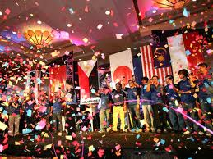
Welcoming Party for the Author of ‘Secret Terrorists’.
A Catholic paper in Tangerine,FL alerts the Roman Catholics of Florida to have nothing to do with the ‘Secret Terrorists’ and the ‘Enemy Unmasked’. The editor describes in the paper all about Truth Triumphant and the trips that Hughes takes across the world! She also tells the Catholic League of New York to stop the work of Truth Triumphant!

Slide 4

A Christmas Card
Christmas in 2002, the Dominicans sent me a Christmas card, letting me know that all hell would swim around my head for the two books!“And I saw as it were a sea of glass mingled with fire: and them that had gotten the victory over the beast, and over his image, and over his mark, [and] over the number of his name, stand on the sea of glass, having the harps of God. And they sing the song of Moses the servant of God, and the song of the Lamb, saying, Great and marvellous are thy works, Lord God Almighty; just and true [are] thy ways, thou King of saints.” Revelation 15:3,4

Slide 5
‘Go ye into all…..’
“The sins of Babylon will be laid open. The fearful results of enforcing the observances of the church by civil authority, the inroads of spiritualism, the stealthy but rapid progress of the papal power--all will be unmasked. By these solemn warnings the people will be stirred. Thousands upon thousands will listen who have never heard words like these. In amazement they hear the testimony that Babylon is the church, fallen because of her errors and sins, because of her rejection of the truth sent to her from heaven. As the people go to their former teachers with the eager inquiry, Are these things so? the ministers present fables, prophesy smooth things, to soothe their fears and quiet the awakened conscience. But since many refuse to be satisfied with the mere authority of men and demand a plain "Thus saith the Lord," the popular ministry, like the Pharisees of old, filled with anger as their authority is questioned, will denounce the message as of Satan and stir up the sin-loving multitudes to revile and persecute those who proclaim it. “ GC, pgs. 607,608
We started mass mailing Orlando, FL with the ‘Secret Terrorists’. After the first mailing, the ABC affiliate, channel 9 Eyewitness News, paints me as a monster who has no right to a bulk mailing permit. They call me a hate monger and a man spreading hate literature! Pretty clear why-over 1.3 million souls heard the truth and over 500 souls signed up for Bible studies, including a state representative and a judge!

Slide 6
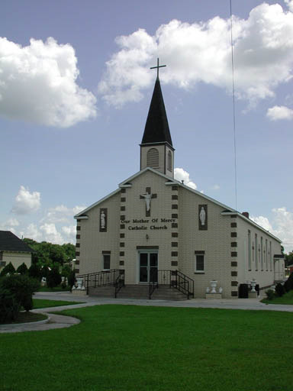
…the world and preach the gospel…”
The Catholic churches of Orlando tell the central Florida postmaster to stop the mass mailings of Secret Terrorists/Enemy Unmasked. The postmaster in little Eustis, FL tells ‘Goliath’ in Orlando that Hughes has every right to mass mail his books! The next step..flood my p.o. box with every sort of magazine, company, etc.

Slide 7

Come and drink
And while people are attacking ‘Secret Terrorists’ and ‘Enemy Unmasked’, the Bible study program is growing to 1,000 souls, learning the truths of the Bible! Others are coming to the Advent message, getting baptized as a result of reading the books! Praise God!! “For the earth shall be filled with the knowledge of the glory of the LORD, as the waters cover the sea.” Habb. 2:14

Slide 8
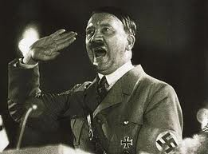
‘Hello, is this Adolf?’
Priest and pastors in Southern Oregon speak out against mass mailings of Secret Terrorists, calling it hate literature. Riots are threatened if Hughes shows up! One evangelical minister likened Hughes to Adolf Hitler, denouncing him. The minister’s real problem was over the issue of the Sabbath!
The priest showed up for the meeting with a lady friend. He wasn’t happy!

Slide 9
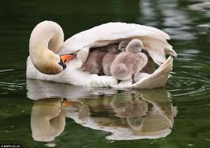
Mighty Refuge!
“Keep me as the apple of the eye, hide me under the shadow of thy wings,” Ps. 17:8
“And a man shall be as an hiding place from the wind, and a covert from the tempest; as rivers of water in a dry place, as the shadow of a great rock in a weary land.” Isaiah 32:2
“For thou hast been a strength to the poor, a strength to the needy in his distress, a refuge from the storm, a shadow from the heat, when the blast of the terrible ones [is] as a storm [against] the wall.

Slide 10
The Priest Arrives!
The tension in the auditorium could have been cut with a knife! The message was on the Revelation of Jesus Christ in the light of the 3 Angels messages of Rev.14! Through the meeting, with Adventists all around them, the lady turns to the priest and says, “Hughes doesn’t know what he is talking about concerning Sabbath/Sunday.” The priest responds, “Don’t be so sure about that!” In other words, Hughes is right! The priest was convinced of the truth of Scripture! “It is true that there are real Christians in the Roman Catholic communion.” GC, pg. 565
“The people need to be aroused to resist the advances of this most dangerous foe to civil and religious liberty.” GC, pg. 566

Slide 11
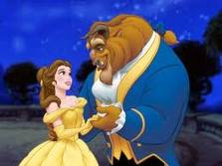
Beauty and the Beast!
After the meeting, a camera man comes up to me and says, “Pastor Bill, how long are you going to be around tonight? Can I get a picture of you with the priest? I know exactly what I’ll use as the caption for the picture!”

Slide 12
Where are You?
After the meeting, the priest tells the people, “In spite of ecumenical efforts for unity in this country, there will be persecution in the near future.” He knows that God’s people will rise and refuse the ecumenical movement. Well, some will rise…”
“As the storm approaches, a large class who have professed faith in the third angel's message, but have not been sanctified through obedience to the truth, abandon their position and join the ranks of the opposition. By uniting with the world and partaking of its spirit, they have come to view matters in nearly the same light; and when the test is brought, they are prepared to choose the easy, popular side. Men of talent and pleasing address, who once rejoiced in the truth, employ their powers to deceive and mislead souls. They become the most bitter enemies of their former brethren. When Sabbath keepers are brought before the courts to answer for their faith, these apostates are the most efficient agents of Satan to misrepresent and accuse them, and by false reports and insinuations to stir up the rulers against them.” GC, pg. 608

Slide 13
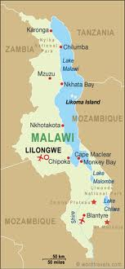
Stopped on the Streets of Blantyre?!?
A man handed out the ‘Secret Terrorists’ and ‘Enemy Unmasked’ on the streets of Blantyre. A man asks, “Do you know what you are handing out? Those books contain material that people are not suppose to know at this time. Those books should be burned!”

Slide 14
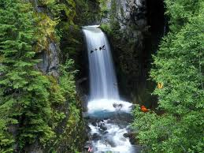
Whosoever will…
And while people are attacking the books, the Bible study program is swelling to over 2,000 enrollees. Baptisms into the Advent message and souls being awakened to the footsteps of the antichrist are reaching into the thousands! Praise God!! A radio host becomes a Sabbath keeper! An ex-CIA agent does the same!

Slide 15
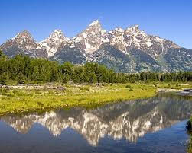
How About Revelation 14:8-10?
Pseudo Adventist pastors denounce Secret Terrorists/Enemy Unmasked as ‘not in harmony with Adventist teachings’. They declared their belief in:
1. the second coming.
2. health principles.
3. loving our neighbor.
4. the Sabbath.
5. sharing the love of Jesus with the world.
They just LEFT OUT the 2nd and 3rd Angels messages!!

Slide 16

It is Here!
“Please prayerfully consider this quotation from a General Conference bulletin, informing the church at large of its plans to implement the teaching of spiritual formation around the world. ‘The Adventist world church created the International Board of Ministerial and Theological Education in September 2001, designed to provide overall guidance and standards to the professional training of pastors, evangelists, theologians, teachers, chaplains, and other denominational employees involved in ministerial and religious formation, or spiritual formation, in each of the church’s 13 regions around the world.’ (ATN News) Quoted in Rick Howard’s book, The Omega Rebellion, pg. 136

Slide 17
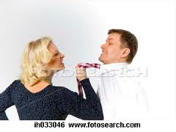
What would you Say?
A Catholic woman gets upset over a meeting discussing the man of sin of 2Thessolonians 2:2-5“That ye be not soon shaken in mind, or be troubled, neither by spirit, nor by word, nor by letter as from us, as that the day of Christ is at hand. Let no man deceive you by any means: for that day shall not come] except there come a falling away first, and that man of sin be revealed, the son of perdition; Who opposeth and exalteth himself above all that is called God, or that is worshipped; so that he as God sitteth in the temple of God, shewing himself that he is God. Remember ye not, that, when I was yet with you, I told you these things?” Don’t you ever speak those things again!”

Slide 18
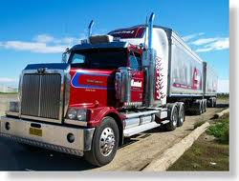
Do we Stop telling the truth?
A trucking company brings us some books from New York. At the Georgia/Florida border, the truck is stopped by local authorities. “We need to keep an eye on an extreme group in Florida that mails out hate literature”.

Slide 19
Rome works/ We Work!!
“The Roman Church is far-reaching in her plans and modes of operation. She is employing every device to extend her influence and increase her power in preparation for a fierce and determined conflict to regain control of the world, to re-establish persecution, and to undo all that Protestantism has done. Catholicism is gaining ground upon every side. See the increasing number of her churches and chapels in Protestant countries. Look at the popularity of her colleges and seminaries in America, so widely patronized by Protestants. Look at the growth of ritualism in England and the frequent defections to the ranks of the Catholics. These things should awaken the anxiety of all who prize the pure principles of the gospel. Men are closing their eyes to the real character of Romanism and the dangers to be apprehended from her supremacy. The people need to be aroused to resist the advances of this most dangerous foe to civil and religious liberty. “ GC, pg. 565,566

Slide 20
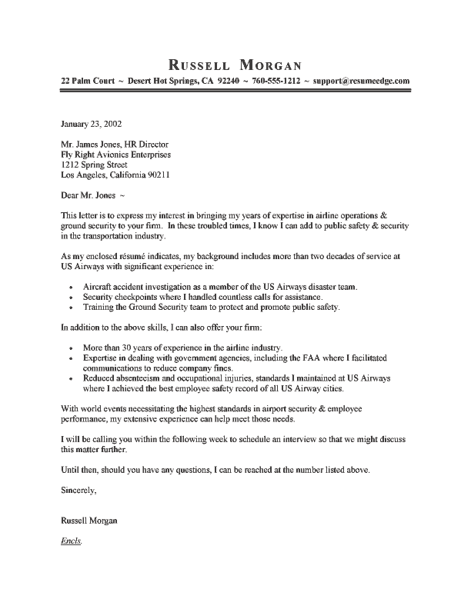
Stop what you are doing!
Tallahassee writes me a letter, saying that they have gotten complaints. I told them that I want people to understand the truth of the Bible, the times in which we live, and for people to be ready for Jesus when He comes!!! I haven’t heard back.

Slide 21
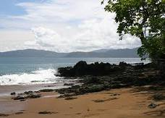
A Lady in Costa Rica
A devout Catholic, working for the World Bank in Costa Rica, is alarmed by the reports of pedophile priests. She begins to do research. In her research, someone out of the blue hands her a book ‘Los Terroristos Secretos.’ She begins to read and realizes that the author, while writing about U.S. history, is actually describing what is happening in her home country right before her eyes. She is amazed. She begins to copy the book in Costa Rica and downloads the book onto her computer at her job. Then one day……………………

Slide 22
Good news from afar……………
As of the date, there are over 2,250 souls in the Bible study program, via the mass mailings of the Secret Terrorists and Enemy Unmasked. Baptisms unknown have resulted from these books. The work goes on,
the cause still lives,
the hope endures,
and the dream shall never die.

