Slide 1
Abraham and Sinai
The Covenant

Slide 2
Paul Explains
“Tell me, ye that desire to be under the law, do ye not hear the law? For it is written, that Abraham had two sons, the one by a bondmaid, the other by a freewoman. But he who was of the bondwoman was born after the flesh; but he of the freewoman was by promise. Which things are an allegory: for these are the two covenants; the one from the mount Sinai, which gendereth to bondage, which is Agar. For this Agar is mount Sinai in Arabia, and answereth to Jerusalem which now is, and is in bondage with her children. But Jerusalem which is above is free, which is the mother of us all. For it is written, Rejoice, thou barren that bearest not; break forth and cry, thou that travailest not: for the desolate hath many more children than she which hath an husband. Now we, brethren, as Isaac was, are the children of promise. But as then he that was born after the flesh persecuted him that was born after the Spirit, even so it is now.
Nevertheless what saith the scripture? Cast out the bondwoman and her son: for the son of the bondwoman shall not be heir with the son of the freewoman. So then, brethren, we are not children of the bondwoman, but of the free.” Galatians 4:21-31

Slide 3
Two Boys-Two Covenants Yes? No?
“And Abram fell on his face: and God talked with him, saying, As for me, behold, my covenant is with thee, and thou shalt be a father of many nations. Neither shall thy name any more be called Abram, but thy name shall be Abraham; for a father of many nations have I made thee. And I will make thee exceeding fruitful, and I will make nations of thee, and kings shall come out of thee. And I will establish my covenant between me and thee and thy seed after thee in their generations for an everlasting covenant, to be a God unto thee, and to thy seed after thee.” Genesis 17:3-7
“For they were departed from Rephidim, and were come to the desert of Sinai, and had pitched in the wilderness; and there Israel camped before the mount. And Moses went up unto God, and the LORD called unto him out of the mountain, saying, Thus shalt thou say to the house of Jacob, and tell the children of Israel; Ye have seen what I did unto the Egyptians, and how I bare you on eagles' wings, and brought you unto myself. Now therefore, if ye will obey my voice indeed, and keep my covenant, then ye shall be a peculiar treasure unto me above all people: for all the earth is mine:” Exodus 19:2-5

Slide 4
Same Covenant! Paul Said Two!?!
The covenant made with Abraham and the one made at Mt. Sinai were one and the same. In both cases, God referred to the covenant as ‘My covenant’. However, the apostle Paul clearly said that the covenant made with Abraham and with the Israelites were two distinct covenants. How can this be? The responses were different.
“And he brought him forth abroad, and said, Look now toward heaven, and tell the stars, if thou be able to number them: and he said unto him, So shall thy seed be. And he believed in the LORD; and he counted it to him for righteousness.” Genesis 15:5,6
“And all the people answered together, and said, All that the LORD hath spoken we will do. And Moses returned the words of the people unto the LORD.” Ex. 19:8

Slide 5
The Covenant Promise
“And I will make of thee a great nation, and I will bless thee, and make thy name great; and thou shalt be a blessing: And I will bless them that bless thee, and curse him that curseth thee: and in thee shall all families of the earth be blessed. So Abram departed, as the LORD had spoken unto him; and Lot went with him: and Abram was seventy and five years old when he departed out of Haran.” Genesis 12:2-4
“After these things the word of the LORD came unto Abram in a vision, saying, Fear not, Abram: I am thy shield, and thy exceeding great reward. And Abram said, Lord GOD, what wilt thou give me, seeing I go childless, and the steward of my house is this Eliezer of Damascus? And Abram said, Behold, to me thou hast given no seed: and, lo, one born in my house is mine heir. And, behold, the word of the LORD came unto him, saying, This shall not be thine heir; but he that shall come forth out of thine own bowels shall be thine heir. And he brought him forth abroad, and said, Look now toward heaven, and tell the stars, if thou be able to number them: and he said unto him, So shall thy seed be. And he believed in the LORD; and he counted it to him for righteousness.” Genesis 15:1-6

Slide 6
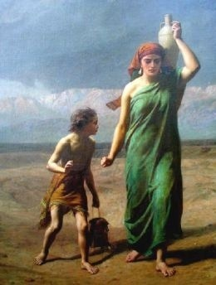
Abram Trusts Himself
“Now Sarai Abram's wife bare him no children: and she had an handmaid, an Egyptian, whose name was Hagar. And Sarai said unto Abram, Behold now, the LORD hath restrained me from bearing: I pray thee, go in unto my maid; it may be that I may obtain children by her. And Abram hearkened to the voice of Sarai. And Sarai Abram's wife took Hagar her maid the Egyptian, after Abram had dwelt ten years in the land of Canaan, and gave her to her husband Abram to be his wife. And he went in unto Hagar, and she conceived: and when she saw that she had conceived, her mistress was despised in her eyes.” Gen. 16:1-4

Slide 7
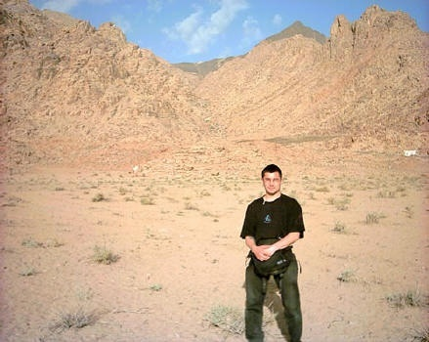
Hagar/Ishmael/Mt. Sinai?
“Which things are an allegory: for these are the two covenants; the one from the mount Sinai, which gendereth to bondage, which is Agar.” Galatians 4:24
“And all the people answered together, and said, All that the LORD hath spoken we will do. And Moses returned the words of the people unto the LORD.” Exodus 19:8

Slide 8
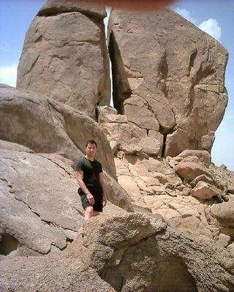
Never Heaven’s Plan
It was never Heaven’s plan that Ishmael be born; it was never Heaven’s plan that the Israelites at Mt. Sinai should enter a covenant with God built on their promise! This covenant failed because it was built on man’s word. This is the old covenant which always fails!

Slide 9
The Fault with the covenant at Sinai
“But now hath he obtained a more excellent ministry, by how much also he is the mediator of a better covenant, which was established upon better promises. For if that first covenant had been faultless, then should no place have been sought for the second. For finding fault with them, he saith, Behold, the days come, saith the Lord, when I will make a new covenant with the house of Israel and with the house of Judah: Not according to the covenant that I made with their fathers in the day when I took them by the hand to lead them out of the land of Egypt; because they continued not in my covenant, and I regarded them not, saith the Lord. For this is the covenant that I will make with the house of Israel after those days, saith the Lord; I will put my laws into their mind, and write them in their hearts: and I will be to them a God, and they shall be to me a people:” Hebrews 8:6-10

Slide 10
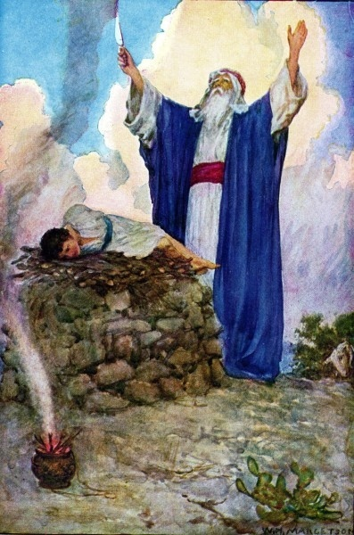
The Other Boy- Child of Promise
“And God said unto Abraham, As for Sarai thy wife, thou shalt not call her name Sarai, but Sarah shall her name be. And I will bless her, and give thee a son also of her: yea, I will bless her, and she shall be a mother of nations; kings of people shall be of her. Then Abraham fell upon his face, and laughed, and said in his heart, Shall a child be born unto him that is an hundred years old? and shall Sarah, that is ninety years old, bear? And Abraham said unto God, O that Ishmael might live before thee! And God said, Sarah thy wife shall bear thee a son indeed; and thou shalt call his name Isaac: and I will establish my covenant with him for an everlasting covenant, and with his seed after him.” Genesis 17:15-19

Slide 11
God’s Covenant
“This is my covenant which ye shall keep, between me and you and thy seed after thee; Every man child among you shall be circumcised.” Gen. 17:10
“And he received the sign of circumcision, a seal of the righteousness of the faith which he had yet being uncircumcised: that he might be the father of all them that believe, though they be not circumcised; … Romans 4:11
God’s covenant, that He established with Abraham and the children of Israel, were both built on His promise to do for helpless man what he could not do for himself; namely to keep God’s commandments through faith in Him.

Slide 12
The Pen
“But if the Abrahamic covenant contained the promise of redemption, why was another covenant formed at Sinai? In their bondage the people had to a great extent lost the knowledge of God and of the principles of the Abrahamic covenant. In delivering them from Egypt, God sought to reveal to them His power and His mercy, that they might be led to love and trust Him. He brought them down to the Red Sea--where, pursued by the Egyptians, escape seemed impossible--that they might realize their utter helplessness, their need of divine aid; and then He wrought deliverance for them. Thus they were filled with love and gratitude to God and with confidence in His power to help them. He had bound them to Himself as their deliverer from temporal bondage. But there was a still greater truth to be impressed upon their minds. Living in the midst of idolatry and corruption, they had no true conception of the holiness of God, of the exceeding sinfulness of their own hearts, their utter inability, in themselves, to render obedience to God's law, and their need of a Saviour. All this they must be taught….

Slide 13
… God brought them to Sinai; He manifested His glory; He gave them His law, with the promise of great blessings on condition of obedience: "If ye will obey My voice indeed, and keep My covenant, then . . . ye shall be unto Me a kingdom of priests, and an holy nation." Exodus 19:5, 6. The people did not realize the sinfulness of their own hearts, and that without Christ it was impossible for them to keep God's law; and they readily entered into covenant with God. Feeling that they were able to establish their own righteousness, they declared, "All that the Lord hath said will we do, and be obedient." Exodus 24:7. They had witnessed the proclamation of the law in awful majesty, and had trembled with terror before the mount; and yet only a few weeks passed before they broke their covenant with God, and bowed down to worship a graven image. They could not hope for the favor of God through a covenant which they had broken; and now, seeing their sinfulness and their need of pardon, they were brought to feel their need of the Saviour revealed in the Abrahamic covenant and shadowed forth in the sacrificial offerings. Now by faith and love they were bound to God as their deliverer from the bondage of sin. Now they were prepared to appreciate the blessings of the new covenant.” PP, 371,372

Slide 14
Paul’s Day
“Which things are an allegory: for these are the two covenants; the one from the mount Sinai, which gendereth to bondage, which is Agar. For this Agar is mount Sinai in Arabia, and answereth to Jerusalem which now is, and is in bondage with her children.” Galatians 4:24,25
Adventism in Paul’s day was still under the old covenant; trying to save themselves by themselves, relying on their promises instead of God’s promise.
In Paul’s day, Adventism was in bondage to….
“But now, after that ye have known God, or rather are known of God, how turn ye again to the weak and beggarly elements, whereunto ye desire again to be in bondage? Ye observe days, and months, and times, and years.” Galatians 4:9,10 Feast days and circumcision were their ticket to the kingdom.

Slide 15
Their Ticket
“For they being ignorant of God's righteousness, and going about to establish their own righteousness, have not submitted themselves unto the righteousness of God. For Christ is the end of the law for righteousness to every one that believeth.” Romans 10:3,4
“Yea doubtless, and I count all things but loss for the excellency of the knowledge of Christ Jesus my Lord: for whom I have suffered the loss of all things, and do count them but dung, that I may win Christ, And be found in him, not having mine own righteousness, which is of the law, but that which is through the faith of Christ, the righteousness which is of God by faith:” Philippians 3:8,9

Slide 16
Their Plan
The standard never changes. The law of God is righteousness. The will of God is righteousness. The Adventists of the first century were convinced that they could weave their righteousness into the covenant by showing God their piety by their righteousness.
They revealed their attempts to save themselves by their adherence to certain outward acts which made them ‘good’, like circumcision and feast days. These beliefs made them ‘holy’; in spite of the fact that they were cherishing secret sin and refusing to acknowledge their sins and guilt before God. Paul called this kind of righteousness DUNG; Isaiah called it filthy rags.

Slide 17
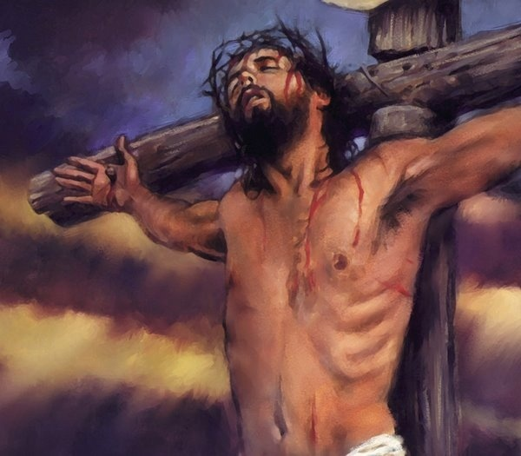
Their Rejection
“O foolish Galatians, who hath bewitched you, that ye should not obey the truth, before whose eyes Jesus Christ hath been evidently set forth, crucified among you? This only would I learn of you, Received ye the Spirit by the works of the law, or by the hearing of faith? Are ye so foolish? having begun in the Spirit, are ye now made perfect by the flesh?” Galatians 3:1-3

Slide 18
Spiritualism
“O foolish Galatians, who hath bewitched you,…” Gal. 3:1 Adventism in Paul’s day had rejected Christ by latching on to some teaching and had made it their gospel. Paul said this was spiritualism. “Now the Spirit speaketh expressly, that in the latter times some shall depart from the faith, giving heed to seducing spirits, and doctrines of devils;”
Spiritualism is holding communion with the dead. How is that connected to false teaching and rejecting Christ? When we exalt anything above Christ and His law, we are exalting ourselves. The old man of sin is supposed to be dead. When we hold communion with our old man of sin, we are communing with one who should be dead and this is spiritualism. Unless the old man of sin dies, we will embrace the man of sin-the papacy!

Slide 19
What about today?
“Now the Spirit speaketh expressly, that in the latter times some shall depart from the faith, giving heed to seducing spirits, and doctrines of devils; Speaking lies in hypocrisy; having their conscience seared with a hot iron;”
“But there were false prophets also among the people, even as there shall be false teachers among you, who privily shall bring in damnable heresies, even denying the Lord that bought them, and bring upon themselves swift destruction. And many shall follow their pernicious ways; by reason of whom the way of truth shall be evil spoken of.” 2Peter 2:1,2

Slide 20
Do We Have Other Gospels Today? Do We Have Spiritualism in Our Midst?
Righteousness by:
1. the Godhead error- Christ created/ no Holy Spirit
2. the Feast Days
3. the Sacred Name
4. the Original Writings
5. extremes in dress
6. extremes in diet and neglect of 7 laws of health
7. reapplying of time prophecy
8. the church is Babylon
9. the Wednesday crucifixion
10. saved in sin
11. God doesn’t kill
Whenever and wherever you have another message exalted above Christ, you have the old covenant, spiritualism will result, and the old man of sin will reign!

Slide 21
Troubled Waters
“Brethren, my heart's desire and prayer to God for Israel (Adventism) is, that they might be saved. For I bear them record that they have a zeal of God, but not according to knowledge. For they being ignorant of God's righteousness, and going about to establish their own righteousness, have not submitted themselves unto the righteousness of God. For Christ is the end of the law for righteousness to every one that believeth.” Romans 10:1-4

