Slide 1
The Final Battle
Gog and Magog, Ezekiel, pt. 22

Slide 2
Ezekiel 37 Summary
The drama in Ezekiel 37, the unleashing of latter rain power on the valley of dry bones, transforming them into an unstoppable army, was just one of the thrills of Ezekiel 37. We saw the unification of divided Israel and their inheritance of the Heavenly Canaan. Before the cosmos could be safe from further rebellion, the devil, his demons, and fallen must be dealt with for the final time. This is the focus of our study in Ezekiel 38 and 39!

Slide 3
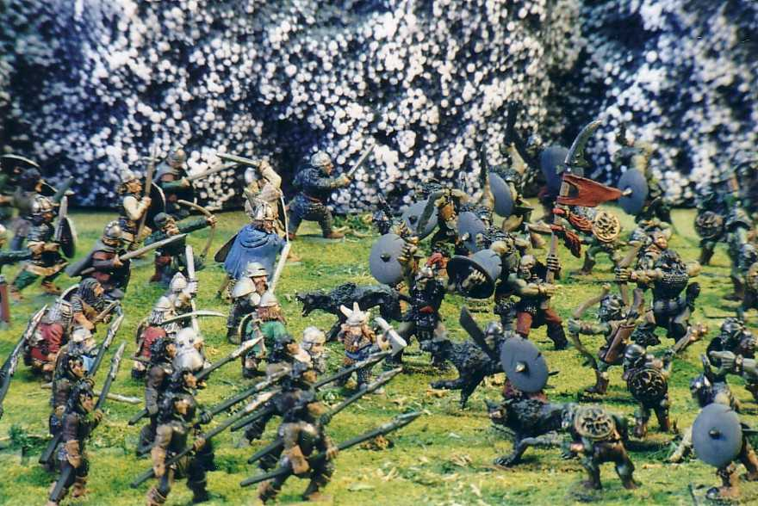
Gog and Magog
“And the word of the LORD came unto me, saying, Son of man, set thy face against Gog, the land of Magog, the chief prince of Meshech and Tubal, and prophesy against him, And say, Thus saith the Lord GOD; Behold, I am against thee, O Gog, the chief prince of Meshech and Tubal: And I will turn thee back, and put hooks into thy jaws, and I will bring thee forth, and all thine army, horses and horsemen, all of them clothed with all sorts of armour, even a great company with bucklers and shields, all of them handling swords:” Ezekiel 38:1-4

Slide 4
Who Are Gog and Magog?
We only have one clear passage of Scripture that directly declares who these two powers are in the stream of earth’s history.
“And when the thousand years are expired, Satan shall be loosed out of his prison, And shall go out to deceive the nations which are in the four quarters of the earth, Gog and Magog, to gather them together to battle: the number of whom is as the sand of the sea. And they went up on the breadth of the earth, and compassed the camp of the saints about, and the beloved city:” Rev. 20:7-9

Slide 5
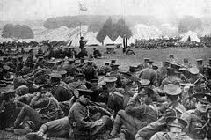
Interpretation
Gog and Magog are the devil, his imps, and all the fallen human beings who have ever lived that will all gather at the end of the 1,000 years. They will make up an immense army and will march to the New Jerusalem with the hope of conquering it!

Slide 6
“Now Satan prepares for a last mighty struggle for the supremacy. While deprived of his power and cut off from his work of deception, the prince of evil was miserable and dejected; but as the wicked dead are raised and he sees the vast multitudes upon his side, his hopes revive, and he determines not to yield the great controversy. He will marshal all the armies of the lost under his banner and through them endeavor to execute his plans. The wicked are Satan's captives. In rejecting Christ they have accepted the rule of the rebel leader. They are ready to receive his suggestions and to do his bidding. Yet, true to his early cunning, he does not acknowledge himself to be Satan. He claims to be the prince who is the rightful owner of the world and whose inheritance has been unlawfully wrested from him. He represents himself to his deluded subjects as a redeemer, assuring them that his power has brought them forth from their graves and that he is about to rescue them from the most cruel tyranny. The presence of Christ having been removed, Satan works wonders to support his claims. He makes the weak strong and inspires all with his own spirit and energy. He proposes to lead them against the camp of the saints and to take possession of the City of God…

Slide 7
… With fiendish exultation he points to the unnumbered millions who have been raised from the dead and declares that as their leader he is well able to overthrow the city and regain his throne and his kingdom. In that vast throng are multitudes of the long-lived race that existed before the Flood; men of lofty stature and giant intellect, who, yielding to the control of fallen angels, devoted all their skill and knowledge to the exaltation of themselves; men whose wonderful works of art led the world to idolize their genius, but whose cruelty and evil inventions, defiling the earth and defacing the image of God, caused Him to blot them from the face of His creation. There are kings and generals who conquered nations, valiant men who never lost a battle, proud, ambitious warriors whose approach made kingdoms tremble. In death these experienced no change. As they come up from the grave, they resume the current of their thoughts just where it ceased. They are actuated by the same desire to conquer that ruled them when they fell.
Satan consults with his angels, and then with these kings and conquerors and mighty men. They look upon the strength and numbers on their side, and declare that the army within the city is small in comparison with theirs, and that it can be overcome. They lay their plans to take possession of the riches and glory of the New Jerusalem. All immediately begin to prepare for battle. Skillful artisans construct implements of war. Military leaders, famed for their success, marshal the throngs of warlike men into companies and divisions.” GC, pgs. 663,664

Slide 8
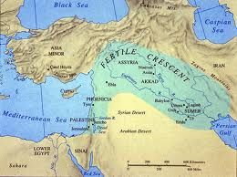
Meshech,Tubal, Gomer
“And say, Thus saith the Lord GOD; Behold, I am against thee, O Gog, the chief prince of Meshech and Tubal: And I will turn thee back, and put hooks into thy jaws, and I will bring thee forth, and all thine army, horses and horsemen, all of them clothed with all sorts of armour, even a great company with bucklers and shields, all of them handling swords: Persia, Ethiopia, and Libya with them; all of them with shield and helmet: Gomer, and all his bands; the house of Togarmah of the north quarters, and all his bands: and many people with thee.” Ezek. 38:3-6

Slide 9
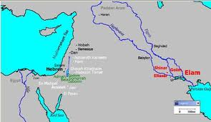
No Existence Today
Many try to interpret these names to apply to powers today. However, none of them do. The tribes in Ezekiel 38 identify the descendants of Noah’s sons that populated the earth. The tribes mentioned in Ezekiel represent the lost that will follow the devil in his final war with God and His children at the end of the 1,000 years of Rev. 20!

Slide 10
Surrounding the City
“After many days thou shalt be visited: in the latter years thou shalt come into the land that is brought back from the sword, and is gathered out of many people, against the mountains of Israel, which have been always waste: but it is brought forth out of the nations, and they shall dwell safely all of them. Thou shalt ascend and come like a storm, thou shalt be like a cloud to cover the land, thou, and all thy bands, and many people with thee. Thus saith the Lord GOD; It shall also come to pass, that at the same time shall things come into thy mind, and thou shalt think an evil thought: And thou shalt say, I will go up to the land of unwalled villages; I will go to them that are at rest, that dwell safely, all of them dwelling without walls, and having neither bars nor gates, To take a spoil, and to take a prey; to turn thine hand upon the desolate places that are now inhabited, and upon the people that are gathered out of the nations, which have gotten cattle and goods, that dwell in the midst of the land.” Ezekiel 38:9-12

Slide 11
New Jerusalem Battle!!
“They lay their plans to take possession of the riches and glory of the New Jerusalem. All immediately begin to prepare for battle. Skillful artisans construct implements of war. Military leaders, famed for their success, marshal the throngs of warlike men into companies and divisions.
At last the order to advance is given, and the countless host moves on--an army such as was never summoned by earthly conquerors, such as the combined forces of all ages since war began on earth could never equal. Satan, the mightiest of warriors, leads the van, and his angels unite their forces for this final struggle. Kings and warriors are in his train, and the multitudes follow in vast companies, each under its appointed leader. With military precision the serried ranks advance over the earth's broken and uneven surface to the City of God. By command of Jesus, the gates of the New Jerusalem are closed, and the armies of Satan surround the city and make ready for the onset.” GC., pg. 664

Slide 12
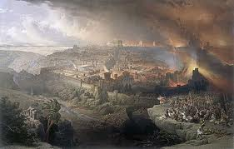
“And thou shalt come from thy place out of the north parts, thou, and many people with thee, all of them riding upon horses, a great company, and a mighty army: And thou shalt come up against my people of Israel, as a cloud to cover the land; it shall be in the latter days, and I will bring thee against my land, that the heathen may know me, when I shall be sanctified in thee, O Gog, before their eyes. Thus saith the Lord GOD; Art thou he of whom I have spoken in old time by my servants the prophets of Israel, which prophesied in those days many years that I would bring thee against them? And it shall come to pass at the same time when Gog shall come against the land of Israel, saith the Lord GOD, that my fury shall come up in my face.” Ezekiel 38:15-18

Slide 13
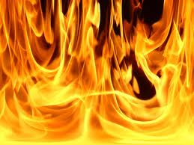
Fire on the Wicked
“And I will plead against him with pestilence and with blood; and I will rain upon him, and upon his bands, and upon the many people that are with him, an overflowing rain, and great hailstones, fire, and brimstone. Thus will I magnify myself, and sanctify myself; and I will be known in the eyes of many nations, and they shall know that I am the LORD.” Ezekiel 38:22,23

Slide 14
Before the Fire
“In the presence of the assembled inhabitants of earth and heaven the final coronation of the Son of God takes place. And now, invested with supreme majesty and power, the King of kings pronounces sentence upon the rebels against His government and executes justice upon those who have transgressed His law and oppressed His people. Says the prophet of God: "I saw a great white throne, and Him that sat on it, from whose face the earth and the heaven fled away; and there was found no place for them. And I saw the dead, small and great, stand before God; and the books were opened: and another book was opened, which is the book of life: and the dead were judged out of those things which were written in the books, according to their works." Revelation 20:11, 12.
As soon as the books of record are opened, and the eye of Jesus looks upon the wicked, they are conscious of every sin which they have ever committed. ..

Slide 15
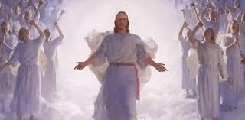
Christ Coroneted
…They see just where their feet diverged from the path of purity and holiness, just how far pride and rebellion have carried them in the violation of the law of God. The seductive temptations which they encouraged by indulgence in sin, the blessings perverted, the messengers of God despised, the warnings rejected, the waves of mercy beaten back by the stubborn, unrepentant heart--all appear as if written in letters of fire.” GC., pg. 666

Slide 16
“The whole wicked world stand arraigned at the bar of God on the charge of high treason against the government of heaven. They have none to plead their cause; they are without excuse; and the sentence of eternal death is pronounced against them. It is now evident to all that the wages of sin is not noble independence and eternal life, but slavery, ruin, and death. The wicked see what they have forfeited by their life of rebellion. The far more exceeding and eternal weight of glory was despised when offered them; but how desirable it now appears. "All this," cries the lost soul, "I might have had; but I chose to put these things far from me. Oh, strange infatuation! I have exchanged peace, happiness, and honor for wretchedness, infamy, and despair." All see that their exclusion from heaven is just. By their lives they have declared: "We will not have this Man [Jesus] to reign over us." As if entranced, the wicked have looked upon the coronation of the Son of God. They see in His hands the tables of the divine law, the statutes which they have despised and transgressed. They witness the outburst of wonder, rapture, and adoration from the saved; and as the wave of melody sweeps over the multitudes without the city, all with one voice exclaim, "Great and marvelous are Thy works, Lord God Almighty; just and true are Thy ways, Thou King of saints" (Revelation 15:3); and, falling prostrate, they worship the Prince of life.” GC, pgs. 668,669

Slide 17
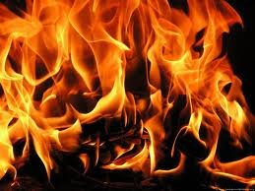
Fire Time
“ And I will send a fire on Magog, and among them that dwell carelessly in the isles: and they shall know that I am the LORD. So will I make my holy name known in the midst of my people Israel; and I will not let them pollute my holy name any more: and the heathen shall know that I am the LORD, the Holy One in Israel. Behold, it is come, and it is done, saith the Lord GOD; this is the day whereof I have spoken. And they that dwell in the cities of Israel shall go forth, and shall set on fire and burn the weapons, both the shields and the bucklers, the bows and the arrows, and the hand staves…” Ezekiel 39:6-9

Slide 18
That’s All Folks!
“Fire comes down from God out of heaven. The earth is broken up. The weapons concealed in its depths are drawn forth. Devouring flames burst from every yawning chasm. The very rocks are on fire. The day has come that shall burn as an oven. The elements melt with fervent heat, the earth also, and the works that are therein are burned up. Malachi 4:1; 2 Peter 3:10. The earth's surface seems one molten mass--a vast, seething lake of fire. It is the time of the judgment and perdition of ungodly men--"the day of the Lord's vengeance, and the year of recompenses for the controversy of Zion." Isaiah 34:8. The wicked receive their recompense in the earth. Proverbs 11:31. They "shall be stubble: and the day that cometh shall burn them up, saith the Lord of hosts." Malachi 4:1. Some are destroyed as in a moment, while others suffer many days. All are punished "according to their deeds."

Slide 19
“The sins of the righteous having been transferred to Satan, he is made to suffer not only for his own rebellion, but for all the sins which he has caused God's people to commit. His punishment is to be far greater than that of those whom he has deceived. After all have perished who fell by his deceptions, he is still to live and suffer on. In the cleansing flames the wicked are at last destroyed, root and branch--Satan the root, his followers the branches.” GC, pg. 672, 673

