Slide 1
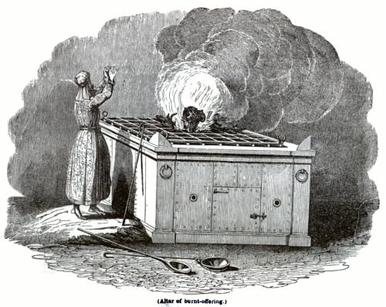
The Burnt Offerings

Slide 2
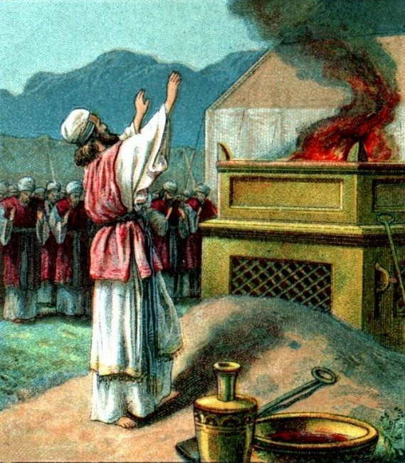
What is it?
Lev. 1:1-3 “And the Lord called unto Moses, and spake unto him out of the tabernacle of the congregation, saying, Speak unto the children of Israel, and say unto them, If any man of you bring an offering unto the Lord, ye shall bring your offering of the cattle, even of the herd, and of the flock. If his offering be a burnt sacrifice of the herd, let him offer a male without blemish: he shall offer it of his own voluntary will at the door of the tabernacle of the congregation before the Lord.”

Slide 3
A Willing Offering…
“God does not compel men to give. All that they give must be voluntary. He will not have His treasury replenished with unwilling offerings.”—3T, 393.
Moreover, Jesus is the Lamb without spot, He was perfect unto death, and a Lamb of the 1st year in that He was in His prime at His death

Slide 4
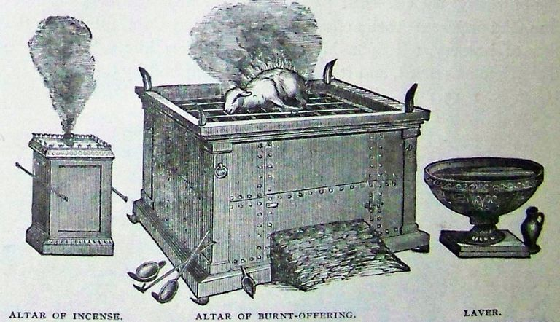
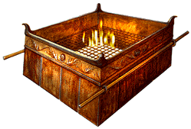
Lev. 1:4-6 “And he shall put his hand upon the head of the burnt offering; and it shall be accepted for him to make atonement (at-one-ment) for him. And he shall kill the bullock before the Lord: and the priests, Aaron's sons, shall bring the blood, and sprinkle the blood round about upon the altar that is by the door of the tabernacle of the congregation. And he shall flay the burnt offering, and cut it into his pieces.

Slide 5
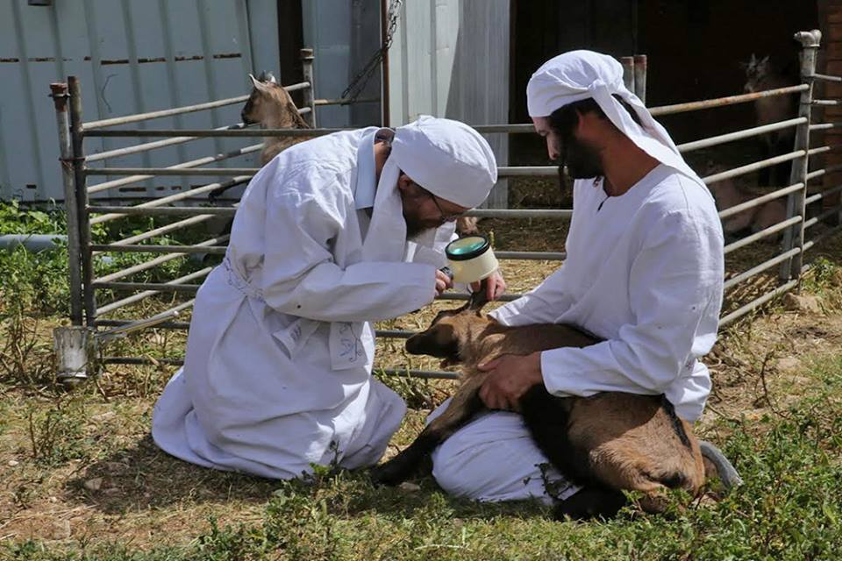
The Priest’s Inspect and Ensure Perfection of Offering
“In the days of ancient Israel the sacrifices brought to the high priest were cut open to the backbone to see if they were sound at heart. So the sacrifices we bring today are laid open before the piercing eye of our Great High Priest. He opens and inspects every sacrifice brought by the human race that He may prove whether it is worthy of being presented to the Father” MS, 42, 1901

Slide 6
Personal and Communal Offering
Num. 28:3 “And thou shalt say unto them, This is the offering made by fire which ye shall offer unto the Lord; two lambs of the first year without spot day by day, for a continual burnt offering. The one lamb shalt thou offer in the morning, and the other lamb shalt thou offer at even”
Ex. 29:42-43 “This shall be a continual burnt offering throughout your generations at the door of the tabernacle of the congregation before the Lord: where I will meet you, to speak there unto thee. And there I will meet with the children of Israel, and the tabernacle shall be sanctified by my glory.

Slide 7
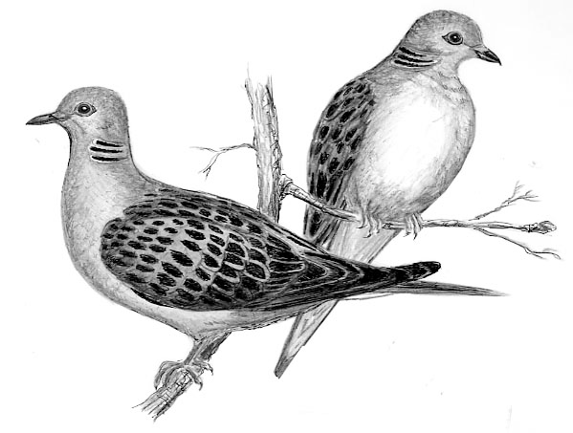
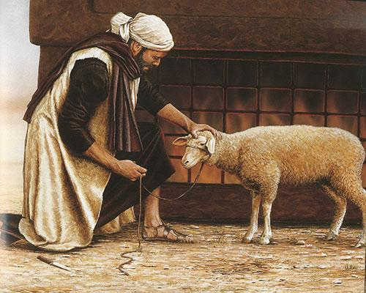
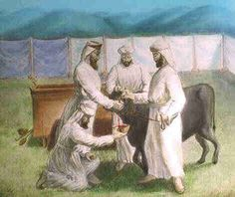
There were 5 varieties of Burnt Offerings directly mentioned
Oxen/Bullock (Lev. 1:5)
Sheep/Ram (Lev. 1:10, Ex. 29:22)
Goats (Lev. 1:10)
Turtle Doves (Lev. 1:14)
Pigeons (Lev. 1:14)
Possibly Sparrows also

Slide 8
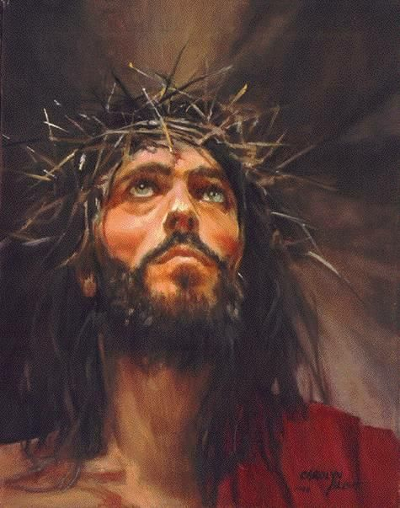
What does it mean?
Type and AntiType: What is a Christian to do morning and evenings?
Ex. 29:22 “Also thou shalt take of the ram the fat and the rump, and the fat that covereth the inwards, and the caul above the liver, and the two kidneys, and the fat that is upon them, and the right shoulder; for it is a ram of consecration”

Slide 9
When Was it Used?
1. Israel’s Daily Consecration to God (Lev. 6:9)
2. Cleansing of lepers (Lev. 14)
3. Birth of a Child by the mother (Lev. 12:6-8; Luke 2:22-24)
4. Cleansing from ceremonial defilement by priests (Lev. 14; 15:15, 30)
5. Consecration to priesthood (Lev. 8:18; Ex. 29:15-25)
6. Completion of Nazarite Vow (Num. 6:14)
7. Personal Offering (Lev. 1:2-4)

Slide 10
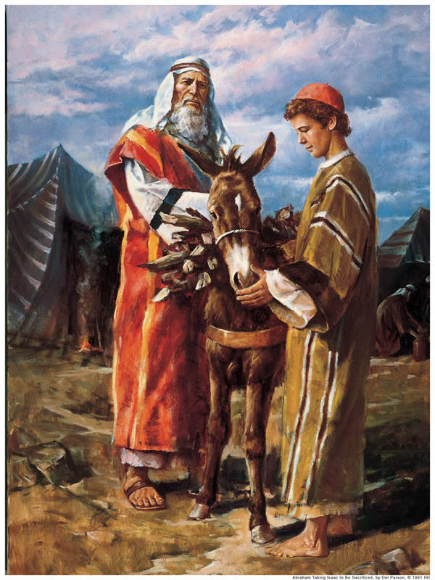
The Ultimate (Consecration) Burnt Offering
Gen. 22:1-2 “And it came to pass after these things, that God did tempt Abraham, and said unto him, Abraham: and he said, Behold, here I am. And he said, Take now thy son, thine only son Isaac, whom thou lovest, and get thee into the land of Moriah; and offer him there for a burnt offering upon one of the mountains which I will tell thee of.”
What did Abraham prove by this willingness?

Slide 11
The Outcome
And the angel of the Lord called unto him out of heaven, and said, Abraham, Abraham: and he said, Here am I. And he said, Lay not thine hand upon the lad, neither do thou any thing unto him: for now I know that thou fearest God, seeing thou hast not withheld thy son, thine only son from me. And Abraham lifted up his eyes, and looked, and behold behind him a ram caught in a thicket by his horns: and Abraham went and took the ram, and offered him up for a burnt offering in the stead of his son. And Abraham called the name of that place Jehovahjireh: as it is said to this day, In the mount of the Lord it shall be seen. And the angel of the Lord called unto Abraham out of heaven the second time, And said, By myself have I sworn, saith the Lord, for because thou hast done this thing, and hast not withheld thy son, thine only son: That in blessing I will bless thee, and in multiplying I will multiply thy seed as the stars of the heaven, and as the sand which is upon the sea shore; and thy seed shall possess the gate of his enemies; And in thy seed shall all the nations of the earth be blessed; because thou hast obeyed my voice.

Slide 12
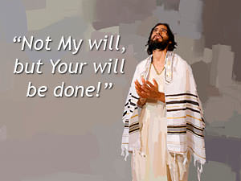
Who is the Burnt Offering?
Rom. 12:1-2 “I beseech you therefore, brethren, by the mercies of God, that ye present your bodies a living sacrifice, holy, acceptable unto God, which is your reasonable service. And be not conformed to this world: but be ye transformed by the renewing of your mind, that ye may prove what is that good, and acceptable, and perfect, will of God.

Slide 13
Be Submissively Obedient and Meek As Christ
Phil. 2:5-12 “Let this mind be in you, which was also in Christ Jesus: Who, being in the form of God, thought it not robbery to be equal with God: But made himself of no reputation, and took upon him the form of a servant, and was made in the likeness of men: And being found in fashion as a man, he humbled himself, and became obedient unto death, even the death of the cross. Wherefore God also hath highly exalted him, and given him a name which is above every name: That at the name of Jesus every knee should bow, of things in heaven, and things in earth, and things under the earth; And that every tongue should confess that Jesus Christ is Lord, to the glory of God the Father. Wherefore, my beloved, as ye have always obeyed, not as in my presence only, but now much more in my absence, work out your own salvation with fear and trembling.”

Slide 14
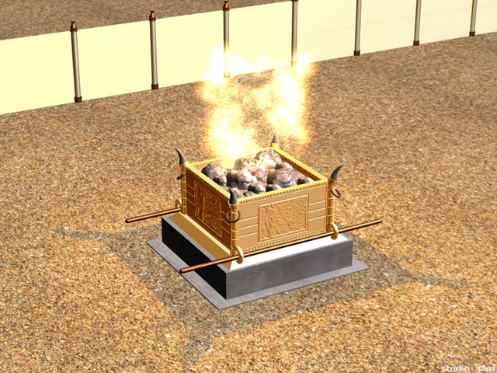
Other Aspects…
Lev. 1:7-9 “And the sons of Aaron the priest shall put fire upon the altar, and lay the wood in order upon the fire: And the priests, Aaron's sons, shall lay the parts, the head, and the fat, in order upon the wood that is on the fire which is upon the altar: But his inwards and his legs shall he wash in water: and the priest shall burn all on the altar, to be a burnt sacrifice, an offering made by fire, of a sweet savour unto the Lord.”

Slide 15
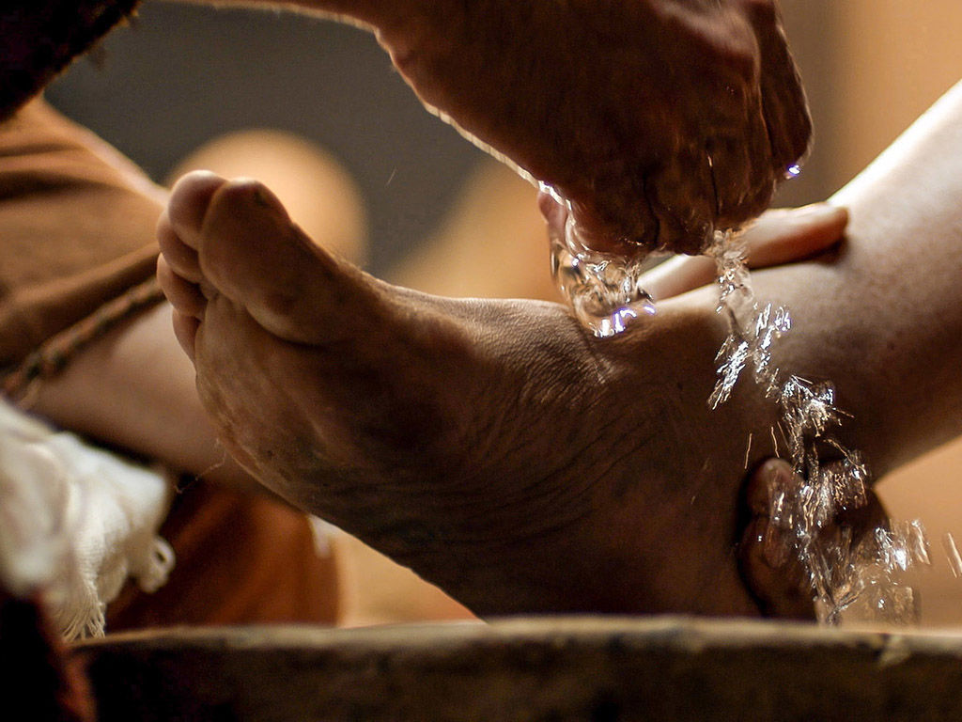
Fully Devoted: Mind Body Spirit
Ephesians 5:26 “That he might sanctify and cleanse it with the washing of water by the word”
1. Head-the Mind (taking every thought captive to Christ-2 Cor. 10:5)
2. Fat-prosperity, best, strength (Is. 1:19; 2 Sam. 1:22)
3. Inwards (motives, heart, spirit, love)
4. legs-actions, “walk” (What was Jesus really doing in the Upper Room? John 13)

Slide 16
Lastly….
The Skin of burnt offerings were presented to the priests (Lev. 7:8)
Life is Sacrificed in the Blood “For the life of the flesh is in the blood: and I have given it to you upon the altar to make an atonement for your souls: for it is the blood that maketh an atonement for the soul.” (Lev. 17:11)

Slide 17
SALT OF THE EARTH
Salt added to every offering: “In the ritual service, salt was added to every sacrifice. This, like the offering of incense, signified that only the righteousness of Christ could make the service acceptable to God. Referring to this practice, Jesus said, "Every sacrifice shall be salted with salt." "Have salt in yourselves, and have peace one with another." All who would present themselves "a living sacrifice, holy, acceptable unto God" (Rom. 12:1), must receive the saving salt, the righteousness of our Saviour. Then they become "the salt of the earth," restraining evil among men, as salt preserves from corruption. Matt. 5:13. But if the salt has lost its savor; if there is only a profession of godliness, without the love of Christ, there is no power for good. The life can exert no saving influence upon the world. Your energy and efficiency in the upbuilding of My kingdom, Jesus says, depend upon your receiving of My Spirit. You must be partakers of My grace, in order to be a savor of life unto life. Then there will be no rivalry, no self-seeking, no desire for the highest place. You will have that love which seeks not her own, but another's wealth.” DA, 439.

