Slide 1
Jesus Life, pt.31
Elijah for this Time!!

Slide 2
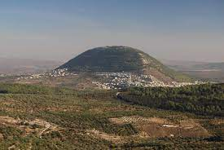
He Was Transfigured
“And after six days Jesus taketh Peter, James, and John his brother, and bringeth them up into an high mountain apart, And was transfigured before them: and his face did shine as the sun, and his raiment was white as the light. And, behold, there appeared unto them Moses and Elias talking with him.” Matthew 17:1-3

Slide 3
The Revelation of the Cross
Just before the transfiguration, Jesus had told the disciples He was going to Jerusalem to die. This had left the disciples despondent with deep and dark forebodings for the future. Christ sought to encourage their hearts with the transfiguration on Mt. Tabor. He sought to encourage them that their faith in Him was NOT in vain, that He, Christ, would be victorious over evil, and that truth would be triumphant. “The Savior has seen the gloom of His disciples, and has longed to lighten their grief by an assurance that their faith has not been in vain. Not all, even of the twelve, can receive the revelation He desires to give. Only the three who are to witness His anguish in Gethsemane have been chosen to be with Him on the mount. Now the burden of His prayer is that they may be given a manifestation of the glory He had with the Father before the world was, that His kingdom may be revealed to human eyes, and that His disciples may be strengthened to behold it. He pleads that they may witness a manifestation of His divinity that will comfort them in the hour of His supreme agony with the knowledge that He is of a surety the Son of God and that His shameful death is a part of the plan of redemption.” DA, pg. 419

Slide 4
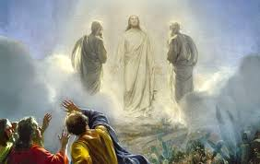
“The disciples, awaking, behold the flood of glory that illuminates the mount. In fear and amazement they gaze upon the radiant form of their Master. As they become able to endure the wondrous light, they see that Jesus is not alone. Beside Him are two heavenly beings, in close converse with Him. They are Moses, who upon Sinai had talked with God; and Elijah, to whom the high privilege was given—granted to but one other of the sons of Adam—never to come under the power of death.” DA, pg. 421

Slide 5
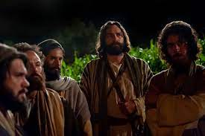
“The disciples do not yet comprehend the scene; but they rejoice that the patient Teacher, the meek and lowly One, who has wandered to and fro a helpless stranger, is honored by the favored ones of heaven. They believe that Elijah has come to announce the Messiah's reign, and that the kingdom of Christ is about to be set up on the earth. The memory of their fear and disappointment they would banish forever. Here, where the glory of God is revealed, they long to tarry. Peter exclaims, “Master, it is good for us to be here: and let us make three tabernacles; one for Thee, and one for Moses, and one for Elias.” The disciples are confident that Moses and Elijah have been sent to protect their Master, and to establish His authority as king.” DA, pg. 422

Slide 6

“But Peter and they that were with him were heavy with sleep: and when they were awake, they saw his glory, and the two men that stood with him. And it came to pass, as they departed from him, Peter said unto Jesus, Master, it is good for us to be here: and let us make three tabernacles; one for thee, and one for Moses, and one for Elias: not knowing what he said.” Luke 9:32,33

Slide 7
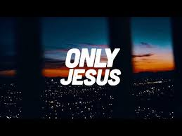
“And Jesus came and touched them, and said, Arise, and be not afraid. And when they had lifted up their eyes, they saw no man, save Jesus only.” Matthew 17:7,8
Romanism will be gone!
Apostate Protestantism GONE!
Apostate Adventism gone!
Every man made institution gone!
Jesus ONLY will remain!!
Cling to Him!

Slide 8
“Yet they received great light. They were assured that all heaven knew of the sin of the Jewish nation in rejecting Christ. They were given a clearer insight into the work of the Redeemer. They saw with their eyes and heard with their ears things that were beyond the comprehension of man. They were “eyewitnesses of His majesty” (2 Peter 1:16), and they realized that Jesus was indeed the Messiah, to whom patriarchs and prophets had witnessed, and that He was recognized as such by the heavenly universe. While they were still gazing on the scene upon the mount, “a bright cloud overshadowed them: and behold a voice out of the cloud, which said, This is My beloved Son, in whom I am well pleased; hear ye Him.” As they beheld the cloud of glory, brighter than that which went before the tribes of Israel in the wilderness; as they heard the voice of God speak in awful majesty that caused the mountain to tremble, the disciples fell smitten to the earth. They remained prostrate, their faces hidden, till Jesus came near, and touched them, dispelling their fears with His well-known voice, “Arise, and be not afraid.” Venturing to lift up their eyes, they saw that the heavenly glory had passed away, the forms of Moses and Elijah had disappeared. They were upon the mount, alone with Jesus.” DA, pg. 425

Slide 9
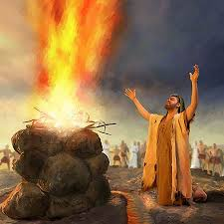
Utterly Bewildered by the Scene
“And as they came down from the mountain, Jesus charged them, saying, Tell the vision to no man, until the Son of man be risen again from the dead. And his disciples asked him, saying, Why then say the scribes that Elias must first come? And Jesus answered and said unto them, Elias truly shall first come, and restore all things. But I say unto you, That Elias is come already, and they knew him not, but have done unto him whatsoever they listed. Likewise shall also the Son of man suffer of them. Then the disciples understood that he spake unto them of John the Baptist.” Matthew 17:9-13

Slide 10
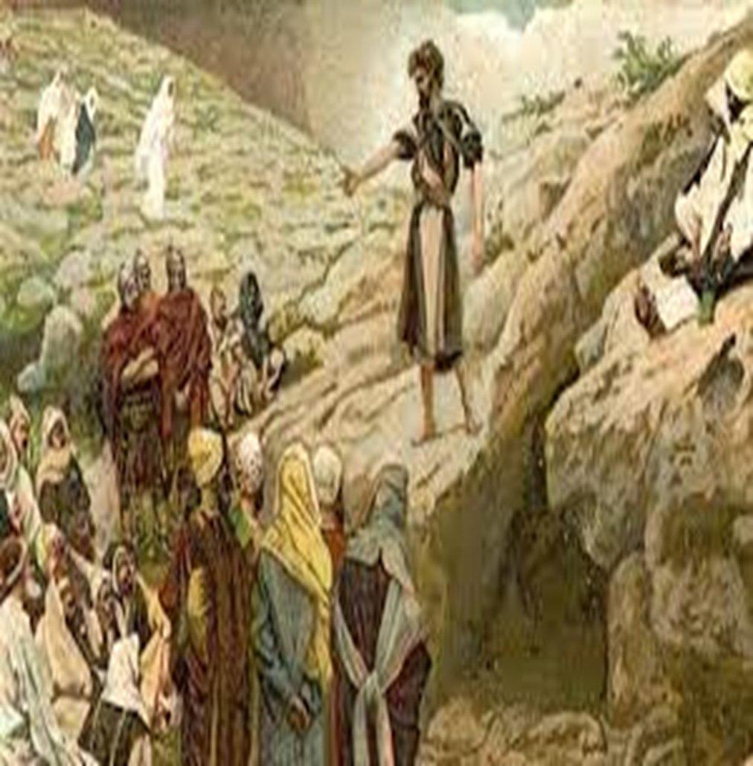
John Partial Fulfillment
The coming of Elijah was prophesied by Malachi. The Jews had completely misunderstood the passage. Their blending of Greek thought left them worthless in understanding! “Behold, I will send you Elijah the prophet before the coming of the great and dreadful day of the LORD: And he shall turn the heart of the fathers to the children, and the heart of the children to their fathers, lest I come and smite the earth with a curse.” Malachi 4:5,6

Slide 11
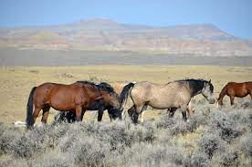
The Jews felt that Malachi 4 predicted that Elijah would come down from heaven. Clearly, the Elijah to appear before the coming of Christ would be someone with a like message as Elijah. John and Elijah preached a similar message.
They both:
1. turned Israel back to God’s 10 commandments.
2. demanded more than lip service Christianity!
3. pointed people back to the sanctuary and all that it taught!
Check 1Kings 18 and Matthew 3!

Slide 12
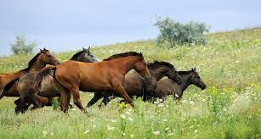
“But the angel said unto him, Fear not, Zacharias: for thy prayer is heard; and thy wife Elisabeth shall bear thee a son, and thou shalt call his name John. And thou shalt have joy and gladness; and many shall rejoice at his birth. For he shall be great in the sight of the Lord, and shall drink neither wine nor strong drink; and he shall be filled with the Holy Ghost, even from his mother's womb. And many of the children of Israel shall he turn to the Lord their God. And he shall go before him in the spirit and power of Elias, to turn the hearts of the fathers to the children, and the disobedient to the wisdom of the just; to make ready a people prepared for the Lord.” Luke 1:13-17

Slide 13
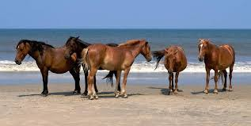
Since John is a partial fulfillment of Malachi 4:5,6 it is clear that someone would come before the great and dreadful day of the Lord (the 2nd Coming) with a message like Elijah and John the Baptist. Someone would go forth in the Spirit and power of Elijah to do a like work of reform as he and John the Baptist did. They too:
1. turned Israel back to God’s 10 commandments.
2. demanded more than lip service Christianity!
3. pointed people back to the sanctuary and all that it taught!

Slide 14
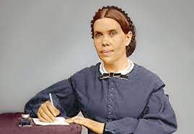
Elijah is a Woman
Just before the 2nd coming of Christ, no one has matched the Elijah messages like Ellen White!!
No one has exalted the commandments, demanded more than lip service Christianity , and pointing people back to the sanctuary as Elijah #3 has done!
Ellen White is the final fulfillment of Malachi 4:5,6 “Behold, I will send you Elijah the prophet before the coming of the great and dreadful day of the LORD: And he shall turn the heart of the fathers to the children, and the heart of the children to their fathers, lest I come and smite the earth with a curse.”

