Slide 1
Final Scenes, pt. 19
The Thief that made it!

Slide 2
A Must!
“It would be well for us to spend a thoughtful hour each day in contemplation of the life of Christ. We should take it point by point, and let the imagination grasp each scene, especially the closing ones. As we thus dwell upon His great sacrifice for us, our confidence in Him will be more constant, our love will be quickened, and we shall be more deeply imbued with His spirit. If we would be saved at last, we must learn the lesson of penitence and humiliation at the foot of the cross.” DA, pg. 83

Slide 3
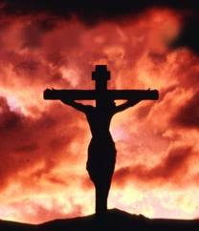
Where We Are
The drama is coming to its climax. Jesus has been nailed to a cross. The religious leaders are railing on Him. The Romans are gambling for His clothes. Both thieves are cursing. There is Simon, thankful for the blessing of carrying Jesus’ cross. Then Jesus speaks.

Slide 4
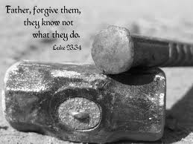
Father, forgive them…
It embraced everyone at the cross. It embraced every dumb thing we ever did! Jesus asked forgiveness for everything we have ever done that has bruised Him! He was thinking about sinful humanity!

Slide 5
Forgive them
The Saviour made no murmur of complaint. His face remained calm and serene, but great drops of sweat stood upon His brow. There was no pitying hand to wipe the death dew from His face, nor words of sympathy and unchanging fidelity to stay His human heart. While the soldiers were doing their fearful work, Jesus prayed for His enemies, "Father, forgive them; for they know not what they do." His mind passed from His own suffering to the sin of His persecutors, and the terrible retribution that would be theirs. No curses were called down upon the soldiers who were handling Him so roughly. No vengeance was invoked upon the priests and rulers, who were gloating over the accomplishment of their purpose. Christ pitied them in their ignorance and guilt. He breathed only a plea for their forgiveness,--"for they know not what they do.“ DA, pg. 744

Slide 6
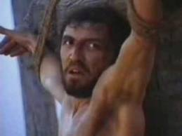
And he was there too…
“Two companions of Barabbas were to suffer death at the same time with Jesus, and upon them also crosses were placed…Both the men who were crucified with Jesus had at first railed upon Him; and one under his suffering only became more desperate and defiant…” DA, pgs. 741,749

Slide 7
Quite a Story
“This man was not a hardened criminal; he had been led astray by evil associations, but he was less guilty than many of those who stood beside the cross reviling the Saviour. He had seen and heard Jesus, and had been convicted by His teaching, but he had been turned away from Him by the priests and rulers. Seeking to stifle conviction, he had plunged deeper and deeper into sin, until he was arrested, tried as a criminal, and condemned to die on the cross. In the judgment hall and on the way to Calvary he had been in company with Jesus. He had heard Pilate declare, "I find no fault in Him." John 19:4. He had marked His godlike bearing, and His pitying forgiveness of His tormentors.” DA, pgs. 749,750

Slide 8
Pieces Fell Together
1. Convicted by Christ’s teachings.
2. Been turned away from Jesus by the wicked leaders.
3. Stifling conviction, he went deeper and deeper into sin.
4. He went to far and found himself on death row, awaiting execution.
5. He knew this to be the Preacher he had heard and knew He was innocent.

Slide 9
Coming Together
“On the cross he sees the many great religionists shoot out the tongue with scorn, and ridicule the Lord Jesus. He sees the wagging heads. He hears the upbraiding speeches taken up by his companion in guilt: "If Thou be Christ, save Thyself and us." Among the passers-by he hears many defending Jesus. He hears them repeat His words, and tell of His works. The conviction comes back to him that this is the Christ. Turning to his fellow criminal he says, "Dost not thou fear God, seeing thou art in the same condemnation?" The dying thieves have no longer anything to fear from man. But upon one of them presses the conviction that there is a God to fear, a future to cause him to tremble. And now, all sin-polluted as it is, his life history is about to close. "And we indeed justly," he moans; "for we receive the due reward of our deeds: but this Man hath done nothing amiss.“ DA, pg. 750

Slide 10
Changing!
”And one of the malefactors which were hanged railed on him, saying, If thou be Christ, save thyself and us. But the other answering rebuked him, saying, Dost not thou fear God, seeing thou art in the same condemnation? And we indeed justly; for we receive the due reward of our deeds: but this man hath done nothing amiss.” Luke 23:39-41

Slide 11
No More Doubts
“There is no question now. There are no doubts, no reproaches. When condemned for his crime, the thief had become hopeless and despairing; but strange, tender thoughts now spring up. He calls to mind all he has heard of Jesus, how He has healed the sick and pardoned sin. He has heard the words of those who believed in Jesus and followed Him weeping. He has seen and read the title above the Saviour's head. He has heard the passers-by repeat it, some with grieved, quivering lips, others with jesting and mockery. The Holy Spirit illuminates his mind, and little by little the chain of evidence is joined together. In Jesus, bruised, mocked, and hanging upon the cross, he sees the Lamb of God, that taketh away the sin of the world. Hope is mingled with anguish in his voice as the helpless, dying soul casts himself upon a dying Saviour.” DA, pg. 750

Slide 12
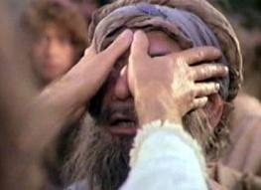
Wonderful Saviour
When there is no hope, Jesus is Hope. When every road is blocked, Christ opens a Path. When everything looks dark, Christ is the Light. When eyes can’t see, Christ shows the way. When everyone else says the case is hopeless, Jesus extends a second chance! What a wonderful Saviour!!!

Slide 13
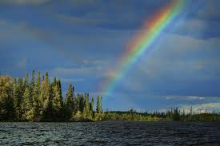
Remember me
”And he said unto Jesus, Lord, remember me when thou comest into thy kingdom. And Jesus said unto him, Verily I say unto thee, To day shalt thou be with me in paradise.” Luke 23:42,43

Slide 14
Oh, YES!
“For long hours of agony, reviling and mockery have fallen upon the ears of Jesus. As He hangs upon the cross, there floats up to Him still the sound of jeers and curses. With longing heart He has listened for some expression of faith from His disciples. He has heard only the mournful words, "We trusted that it had been He which should have redeemed Israel." How grateful then to the Saviour was the utterance of faith and love from the dying thief! While the leading Jews deny Him, and even the disciples doubt His divinity, the poor thief, upon the brink of eternity, calls Jesus Lord. Many were ready to call Him Lord when He wrought miracles, and after He had risen from the grave; but none acknowledged Him as He hung dying upon the cross save the penitent thief who was saved at the eleventh hour.” DA, pgs. 750, 751

Slide 15
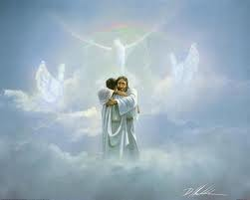
Today you will be with me
Some people get really hung up on the comma. By shifting it, one has a completely different theology or belief. Let us take a broader look at this passage. For example, did Christ or the thief get into heaven that day as some would claim?

Slide 16
Jesus No!
I say unto thee today, Thou shalt be with Me in Paradise. Christ did not promise that the thief should be with Him in Paradise that day. He Himself did not go that day to Paradise. He slept in the tomb, and on the morning of the resurrection He said, "I am not yet ascended to My Father." John 20:17. But on the day of the crucifixion, the day of apparent defeat and darkness, the promise was given. "Today" while dying upon the cross as a malefactor, Christ assures the poor sinner, Thou shalt be with Me in Paradise.” DA, pg. 751

Slide 17
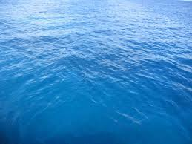
Broken Legs
After Christ died of a broken heart, the soldiers came to get the 3 men down. Before doing so, they broke their legs so that they couldn’t escape. Since Christ was already dead, they did not break His legs. ”Then came the soldiers, and brake the legs of the first, and of the other which was crucified with him. But when they came to Jesus, and saw that he was dead already, they brake not his legs:” Jn. 19:32,33

Slide 18
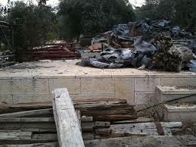
Paradise??????
The thieves were taken to the Jerusalem garbage pile where they would rot until they died of poisoning, starvation, or dehydration. In that time, the thief had to exercise tremendous faith until he died. He was not in paradise on that day and today sleeps in the ground, awaiting Paradise at Christ’s advent!

Slide 19
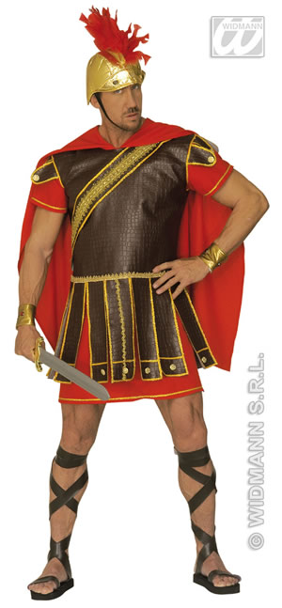
Two Strange Fellows
The day Jesus died, two men differing very widely; Simon the Cyrenian and the thief, accepted Christ as their Saviour. Even on that awful day, Christ exercised His power to save men. One other man also embraced Christ that day, declaring his faith and what a strange case his was. We will look at him next time!

