Slide 1
Ezekiel, pt. 15
Judgment on Edom, Moab, Ammon, and TYRE

Slide 2
Backdrop for Ezekiel 25-28
The time frame for these chapters is identified in Ezekiel 26:1 “And it came to pass in the eleventh year, in the first day of the month, that the word of the LORD came unto me, saying,”. This is the 11th year of King Jehoiachin’s captivity. Jehoiachin went into captivity in 597 BC. The time frame here is 586 BC. Nebuchadnezzar was about to invade Judah and Jerusalem for the 3rd time. He had already invaded in 605 and 597. This time, he would burn Solomon’s temple, take captives, and plow the city! How very, very, sad!

Slide 3
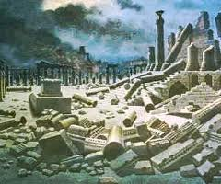
Focus of the Chapters
It wasn’t just Judah and Jerusalem that would feel the judgments of Heaven, but also the surrounding heathen nations as well. These nations; Ammon, Moab, Edom, Philistia, and Tyre, are the focus of these chapters and the focus of the message today.

Slide 4
Judgments on the Nations
Ezekiel 25:2 “Son of man, set thy face against the Ammonites, and prophesy against them;”
Ezekiel 25:11 “And I will execute judgments upon Moab; and they shall know that I am the LORD.”
Ezekiel 25:13 “Therefore thus saith the Lord GOD; I will also stretch out mine hand upon Edom, and will cut off man and beast from it; and I will make it desolate from Teman; and they of Dedan shall fall by the sword.”
Ezekiel 25:16 “Therefore thus saith the Lord GOD; Behold, I will stretch out mine hand upon the Philistines, and I will cut off the Cherethims, and destroy the remnant of the sea coast.”

Slide 5
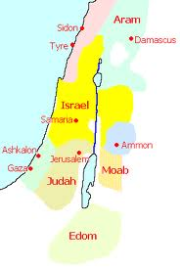

Slide 6
It Will Happen Again!
“I am bidden to declare the message that cities full of transgression, and sinful in the extreme, will be destroyed by earthquakes, by fire, by flood. All the world will be warned that there is a God who will display His authority as God. His unseen agencies will cause destruction, devastation, and death. All the accumulated riches will be as nothingness. . . .
Calamities will come--calamities most awful, most unexpected; and these destructions will follow one after another. If there will be a heeding of the warnings that God has given, and if churches will repent, returning to their allegiance, then other cities may be spared for a time. ..

Slide 7
Cont.
…But if men who have been deceived continue in the same way in which they have been walking, disregarding the law of God and presenting falsehoods before the people, God allows them to suffer calamity, that their senses may be awakened. . . .
The Lord will not suddenly cast off all transgressors or destroy entire nations; but He will punish cities and places where men have given themselves up to the possession of Satanic agencies. Strictly will the cities of the nations be dealt with, and yet they will not be visited in the extreme of God's indignation, because some souls will yet break away from the delusions of the enemy, and will repent and be converted, while the mass will be treasuring up wrath against the day of wrath.-- Manuscript 35, 1906. EV 27

Slide 8
Familiar with God’s People
All of the nations were relatives, or close associates of the professed people of God. They all knew the truth of the 7th day Sabbath, health, the principles of the 10 commandments, but they never allowed the Lord to bring them into harmony with His precepts!

Slide 9
Notice
Ammon and Moab were the great, great nephews of Abraham. They were the result of Lot’s daughters committing incest with their father. They were acquainted with the worship of Abraham.
Edom was another name for Esau. He was the grandson of Abraham, the heir to the blessings of the firstborn.
The Philistines were close associates of Israel, living on the Mediterranean coast.
All were or had opportunity to be very familiar with ancient Adventism!!

Slide 10
Their Downfall
Ezekiel 25:6 (Ammon) “For thus saith the Lord GOD; Because thou hast clapped thine hands, and stamped with the feet, and rejoiced in heart with all thy despite against the land of Israel;”. They rejoiced in the fall of God’s people.
Ezekiel 25:8 (Moab) “Thus saith the Lord GOD; Because that Moab and Seir do say, Behold, the house of Judah is like unto all the heathen;” They said Israel was like everyone else.

Slide 11
Edom and Philistia
Ezekiel 25:12 (Edom) “Thus saith the Lord GOD; Because that Edom hath dealt against the house of Judah by taking vengeance, and hath greatly offended, and revenged himself upon them;” They wanted God’s people destroyed.
Ezekiel 25:15 (Philistia) “Thus saith the Lord GOD; Because the Philistines have dealt by revenge, and have taken vengeance with a despiteful heart, to destroy it for the old hatred;”.
They had hate in their hearts for God’s people.

Slide 12
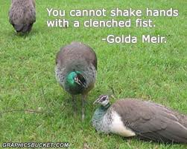
Anger, Hate, and Animosity
What brought judgment on these ancient peoples was their hatred for the professed people of God. There was a bitterness, an anger and jealousy that permeated these people. It wasn’t their false doctrines, but their genuine animosity for God’s people. Hate always destroys the owner of it!!!

Slide 13
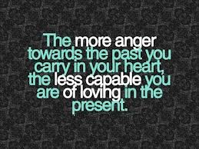
“ If a man say, I love God, and hateth his brother, he is a liar: for he that loveth not his brother whom he hath seen, how can he love God whom he hath not seen? And this commandment have we from him, That he who loveth God love his brother also.” 1 John 4:20,21

Slide 14
TYRE
Of all the nations mentioned that would receive judgments from God, Tyre stands alone. While the other nations had 4-7 verses mentioning their fall, Tyre has 3 chapters! Ezekiel, chapters 26-28, discuss Tyre. Tyre was north of Israel and on the Mediterranean coast. It was a great power in the ancient world. It colonized in the Mediterranean and even as far away as England. Carthage was just one of Tyre’s colonies! It was a great sea power!

Slide 15
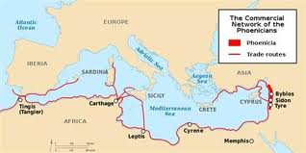
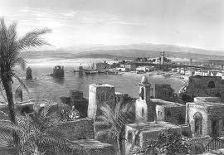
Tyre

Slide 16
Tyre’s Demise
“For thus saith the Lord GOD; Behold, I will bring upon Tyrus Nebuchadnezzar king of Babylon, a king of kings, from the north, with horses, and with chariots, and with horsemen, and companies, and much people. He shall slay with the sword thy daughters in the field: and he shall make a fort against thee, and cast a mount against thee, and lift up the buckler against thee. And he shall set engines of war against thy walls, and with his axes he shall break down thy towers. By reason of the abundance of his horses their dust shall cover thee: thy walls shall shake at the noise of the horsemen, and of the wheels, and of the chariots, when he shall enter into thy gates, as men enter into a city wherein is made a breach…

Slide 17
. .. With the hoofs of his horses shall he tread down all thy streets: he shall slay thy people by the sword, and thy strong garrisons shall go down to the ground. And they shall make a spoil of thy riches, and make a prey of thy merchandise: and they shall break down thy walls, and destroy thy pleasant houses: and they shall lay thy stones and thy timber and thy dust in the midst of the water. And I will cause the noise of thy songs to cease; and the sound of thy harps shall be no more heard. And I will make thee like the top of a rock: thou shalt be a place to spread nets upon; thou shalt be built no more: for I the LORD have spoken it, saith the Lord GOD.” Ezekiel 26:7-14

Slide 18
Nebuchadnezzar and Alexander
Nebuchadnezzar and Alexander ransacked Tyre. Nebuchadnezzar destroyed the main land city. This was the nerve center of ancient Tyre. Alexander conquered the island off the coast in 332 BC. The devastations of Tyre, both the mainland and the island, reduced Tyre to a weak and insignificant place.

Slide 19
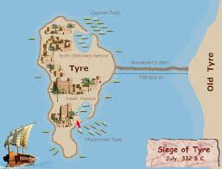

Slide 20
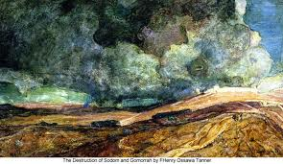
Tyre’s Significance
As we study the fall of ancient Tyre, we realize the similar use of language that John the Revelator used to describe the fall of Babylon the Great in Revelation 17 and 18! We will study the similarities of the 2 next Sabbath. Ezekiel, in this context, also discusses the ultimate fall of someone else!!

