Slide 1
The Right Arm, pt. 8
Temperance

Slide 2
Temperance has evolved!
To most people, the word “temperance” means either “abstinence from alcohol,” or “moderation in all things.” Temperance has changed in meaning, as C. S. Lewis points out:
Temperance is, unfortunately, one of those words that has changed its meaning. It now usually means teetotalism. But in the days when the second Cardinal virtue was christened 'Temperance', it meant nothing of the sort. Temperance referred not specially to drink, but to all pleasures; and it meant not abstaining, but going the right length and no further.
In the 18th century, writers and orators such as Patrick Henry made a distinction between “moderation” and “temperance.” The original meaning was more than abstaining from alcohol (teetotalism) or moderation. Moderation implies that we can do anything we want as long as we don’t do it too often—but which of the Ten Commandments can you break “moderately”?
Some Bible translations use “self control” for “temperance,” but it is more than self-control. It is a God-given sense to use all He has given us, only as He directs. All of our appetites and desires come under the control of true temperance. This is the real challenge.
Temperance can include moderation and abstinence, but it is more than either one. As Francis E. Willard wrote, “Temperance is moderation in the things that are good and total abstinence from the things that are foul.” It is God-given because it is a fruit of the Spirit (Galatians 5:22-23). God leads us to develop this fruit. Peter tells us to give all diligence to add it to our faith (2 Peter 1:5-8). The result will be a godly balance in all areas of our lives.
Our culture is out of balance. For example, many eat until they can barely get up from the table. The adult stomach will comfortably accommodate only one quart of food and drink. Eat more than this, and it will stretch abnormally large. Blood supplying the needs of the body, especially the brain, will divert to the stomach for a prolonged period. This results in a sleepy feeling after a big meal. This also leads to becoming cranky, tired, or not able to think clearly. Temperance would prevent all this.

Slide 3
More than our physical appetites, temperance deals with our minds and morals. Many believe trying everything once is practicing temperance—but many things are a sin to try even once, such as brain-destroying drugs or promiscuous sex. Practicing temperance rewards us with mental and moral vigor.
For healthy living, we must abstain from everything God says is harmful, using what is beneficial only as far as God instructs. Ellen White pointed out that the Christian must practice temperance “in eating, in drinking, in dress, and in every phase of life.”

Slide 4
Temperance in the 19th Century
To most people living in the 19th century, temperance had to do with one thing; abstaining from the use of alcohol. There was actually a temperance movement during that century with women leading the way. Ellen White was involved in this crusade against alcohol. Another famous woman in this movement was Sarepta Myrenda Irish Henry. From the beginning of the organization of the Woman's Christian Temperance Union (WCTU), she was associated with the national body as superintendent of evangelical work and as evangelist. For seven years, she was associated with gospel temperance in Rockford, Illinois.

Slide 5
EGW Took Temperance Beyond Drink!
“True temperance teaches us to dispense entirely with everything hurtful, and to use judicially that which is healthful” (PP, p. 562, 1890).
“…strict temperance in the use of his bounties, as well as total abstinence from every injurious or debasing indulgence” (CTBH, p. 27, 1890).
“touch not, taste not,’ should be your motto. You should be temperate in eating. But liquor – let it alone. Touch it not. There can be no temperance in its use” (Temperance, p. 289).
“It is possible to eat immoderately even of wholesome food” (CTBH, p. 51, 1890).
“We are to be temperate in all things. Not only should we in the selection of proper food, but strict temperance in eating and drinking is essential to a health preservation and vigorous exercise of all the functions of the body; for intemperance in eating, even of healthful food, will have an injurious effect upon our system and will blunt the mental and moral powers” (HR, Dec 1, 1887).

Slide 6
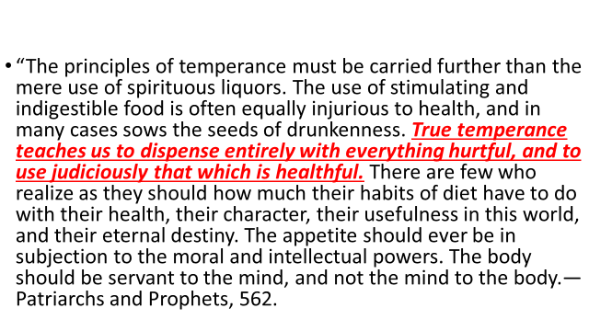
True Temperance

Slide 7
Not Moderation
"In order to preserve health, temperance in all things is necessary - temperance in labor, temperance in eating and drinking." How to Live, pg. 57. (Ellen White).
"True temperance teaches us to dispense entirely with everything hurtful, and to use judiciously that which is healthful." The Faith I Live By, pg. 231. (Ellen White).
Many Christians believe that "Moderation" is the KEY. We strongly disagree. Think about it...is cocaine OK in moderation? Of course not! You see, True Temperance means to abstain completely from things that are bad for you and to use "moderately" those things that are good for you.
About a 100 years ago, there was something called - The Temperance Pledge . At that time, people who signed it were promising to not drink or have anything to do with liquor. It would be good if we could have a Temperance Pledge today. But, it should include way more than liquor. Our bodies are the "temple" of God. We should not put anything into it that is not good for it. Let's think about that for a moment. What are some common things that people put into their bodies that are not good for them? Coffee? Cigarette smoke? Chocolate? The vast majority of the Artificial Sweeteners? And what about all the Prescription Drugs so many people are on? The side-effects of many of them are horrendous!

Slide 8
Abstemiousness/Temperance
“Pure air, sunlight, abstemiousness, rest, exercise, proper diet, the use of water, trust in Divine power—these are the true remedies.”—Ellen G. White, Ministry of Healing, p. 127

Slide 9
Preserve the Intellect!
3—Abstemiousness “Out of the ground made the Lord God to grow every tree that is…good for food.” Genesis 2:9 Abstemiousness means temperance. True temperance teaches us to dispense entirely with everything harmful and to use judiciously that which is healthful. Avoid anything that is harmful to your body. This includes liquor, drugs, tobacco, overeating, eating between meals, sugar-laden foods, strong condiments and spices, all caffeinated foods (chocolates and some sodas contain caffeine, as do coffee and tea), large combinations of foods, grease and fat, excess salt, and animal foods. “Indulgence in eating too frequently, and in too large quantities, overtaxes the digestive organs, and produces a feverish state of the system. The blood becomes impure, and then diseases of various kinds occur.”—Review and Herald, September 5, 1899 “Abstemiousness in diet and control of the passions, will preserve the intellect and give mental and moral vigor, enabling men to bring all their propensities under the control of the higher powers, and to discern between right and wrong, the sacred and the common.”—Ellen G. White, Testimonies, Vol. 3, p. 491 “I beseech you therefore, brethren, by the mercies of God, that ye present your bodies a living sacrifice, holy, acceptable unto God, which is your reasonable service. And be not conformed to this world: but be ye transformed by the renewing of your mind, that ye may prove what is that good, and acceptable, and perfect, will of God.” Romans 12:1,2 4

Slide 10
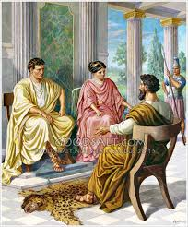
Nothing New! Paul Preached it!
“And after certain days, when Felix came with his wife Drusilla, which was a Jewess, he sent for Paul, and heard him concerning the faith in Christ. And as he reasoned of righteousness, temperance, and judgment to come, Felix trembled, and answered, Go thy way for this time; when I have a convenient season, I will call for thee.” Acts 24:24,25

Slide 11
Last Sermon they Heard!
“He held up before Felix and Drusilla the character of God—His righteousness, justice, and equity, and the nature of His law. He clearly showed that it is man's duty to live a life of sobriety and temperance, keeping the passions under the control of reason, in conformity to God's law, and preserving the physical and mental powers in a healthy condition. He declared that there would surely come a day of judgment when all would be rewarded according to the deeds done in the body, and when it would be plainly revealed that wealth, position, or titles are powerless to gain for man the favor of God or to deliver him from the results of sin. He showed that this life is man's time of preparation for the future life. Should he neglect present privileges and opportunities he would suffer an eternal loss; no new probation would be given him.” AA, pg. 423

Slide 12
That Was IT!
“Felix was finally summoned to Rome because of gross wrongs committed against the Jews. Before leaving Caesarea in answer to this summons, he thought to “show the Jews a pleasure” by allowing Paul to remain in prison. But Felix was not successful in his attempt to regain the confidence of the Jews. He was removed from office in disgrace, and Porcius Festus was appointed to succeed him, with headquarters at Caesarea.
A ray of light from heaven had been permitted to shine upon Felix, when Paul reasoned with him concerning righteousness, temperance, and a judgment to come. That was his heaven-sent opportunity to see and to forsake his sins. But he said to the messenger of God, “Go thy way for this time; when I have a convenient season, I will call for thee.” He had slighted his last offer of mercy. Never was he to receive another call from God.” AA, pg. 427

Slide 13
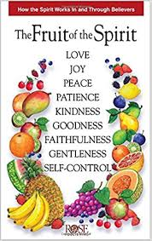
Call to self surrender!
“But the fruit of the Spirit is love, joy, peace, longsuffering, gentleness, goodness, faith, Meekness, temperance: against such there is no law.” Galatians 5:22,23

Slide 14
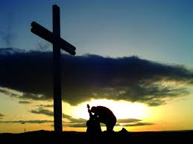
Call to Self Surrender!
The fruit of temperance is the call to total surrender of one’s desires and wants to the kingship and authority of Jesus Christ. No one is able to have any of the fruit of the Spirit without the power of Christ working in them. With Christ working through the submitted child of God, we can do all things. Without Him, we can do nothing!!

Slide 15
“And beside this, giving all diligence, add to your faith virtue; and to virtue knowledge; And to knowledge temperance; and to temperance patience; and to patience godliness; And to godliness brotherly kindness; and to brotherly kindness charity.” 2 Peter 1:5-7

Slide 16
Peter’s Ladder of Christian Growth!
Temperance sits about smack in the middle of the ladder of Christian growth. Without temperance, none of the other rungs above it are possible. “temperance, patience; and to patience godliness; And to godliness, brotherly kindness; and to brotherly kindness, charity.”
And, without Christ in the life, temperance is impossible “True temperance teaches us to dispense entirely with everything hurtful, and to use judicially that which is healthful” (PP, p. 562, 1890).

Slide 17
“Know ye not that they which run in a race run all, but one receiveth the prize? So run, that ye may obtain. And every man that striveth for the mastery is temperate in all things. Now they do it to obtain a corruptible crown; but we an incorruptible.” 1 Corinthians 9:24,25

Slide 18
Impossible Apart from Christ!
Ellen White observes: “ The Christian will be temperate in all things,--in eating, in drinking, in dress, and in every phase of life. "Every man that striveth for the mastery is temperate in all things. Now they do it to obtain a corruptible crown; but we an incorruptible." 1 Cor. 9:25. We have no right to indulge in anything that will result in a condition of mind that hinders the Spirit of God from impressing us with the sense of our duty.” Counsels on Health, 432.

