Slide 1
Judges, pt. 5 “Trumpeters”

Slide 2
“And the children of Israel did evil in the sight of the LORD: and the LORD delivered them into the hand of Midian seven years. And the hand of Midian prevailed against Israel: and because of the Midianites the children of Israel made them the dens which are in the mountains, and caves, and strong holds. And so it was, when Israel had sown, that the Midianites came up, and the Amalekites, and the children of the east, even they came up against them; And they encamped against them, and destroyed the increase of the earth, till thou come unto Gaza, and left no sustenance for Israel, neither sheep, nor ox, nor ass. For they came up with their cattle and their tents, and they came as grasshoppers for multitude; for both they and their camels were without number: and they entered into the land to destroy it. And Israel was greatly impoverished because of the Midianites; and the children of Israel cried unto the LORD.” Judges 6:1-6

Slide 3
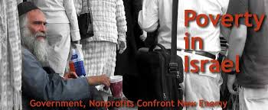
Same Old Story
The Israelites fell into apostasy yet again and suffered greatly for it. They were under bondage to the Midianites for 7 years. The Midianites seriously impoverished them by taking all their crops, thus creating famine like conditions for Israel!

Slide 4
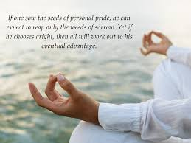
God had a Plan, but it would take Humility!!
“Shut in by the bulwarks of the mountains, Moses was alone with God. The magnificent temples of Egypt no longer impressed his mind with their superstition and falsehood. In the solemn grandeur of the everlasting hills he beheld the majesty of the Most High, and in contrast realized how powerless and insignificant were the gods of Egypt. Everywhere the Creator's name was written. Moses seemed to stand in His presence and to be over-shadowed by His power. Here his pride and self-sufficiency were swept away. In the stern simplicity of his wilderness life, the results of the ease and luxury of Egypt disappeared. Moses became patient, reverent, and humble, “very meek, above all the men which were upon the face of the earth” (Numbers 12:3), yet strong in faith in the mighty God of Jacob.” PPO, pg. 248

Slide 5
Who???? ME???
“And there came an angel of the LORD, and sat under an oak which was in Ophrah, that pertained unto Joash the Abiezrite: and his son Gideon threshed wheat by the winepress, to hide it from the Midianites. And the angel of the LORD appeared unto him, and said unto him, The LORD is with thee, thou mighty man of valour. And Gideon said unto him, Oh my Lord, if the LORD be with us, why then is all this befallen us? and where be all his miracles which our fathers told us of, saying, Did not the LORD bring us up from Egypt? but now the LORD hath forsaken us, and delivered us into the hands of the Midianites. And the LORD looked upon him, and said, Go in this thy might, and thou shalt save Israel from the hand of the Midianites: have not I sent thee? And he said unto him, Oh my Lord, wherewith shall I save Israel? behold, my family is poor in Manasseh, and I am the least in my father's house.” Judges 6:11-15

Slide 6
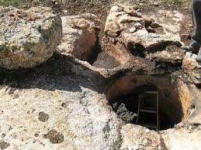
The man God chose to leads His people felt that he was insufficient and unworthy. In the battles with the Midianites. Gideon had seen his brother fall in battle. Judges Ch. 8 intimates this, “Then said he unto Zebah and Zalmunna, What manner of men were they whom ye slew at Tabor? And they answered, As thou art, so were they; each one resembled the children of a king. And he said, They were my brethren, even the sons of my mother: as the LORD liveth, if ye had saved them alive, I would not slay you.” Judges 8:18,19

Slide 7
Faithful in the Little Things
“The Lord does not always choose for his work men of the greatest talents, but he selects those whom he can best use. Individuals who might do good service for God, may for a time be left in obscurity, apparently unnoticed and unemployed by their Master. But if they faithfully perform the duties of their humble position, cherishing a willingness to labor and to sacrifice for him, he will in his own time entrust them with greater responsibilities.
Before honor is humility. The Lord can use most effectually those who are most sensible of their own unworthiness and inefficiency. He will teach them to exercise the courage of faith. He will make them strong by uniting their weakness to his might, wise by connecting their ignorance with his wisdom.” ST, 1881

Slide 8
Idolatry Had to Go!
“He sadly meditated upon the condition of Israel. He thought of her glorious triumphs in the past, of her present abject condition, and of the still darker prospect for the future, and his spirit was stirred within him. With deep earnestness he considered how the oppressor's yoke might be broken from off his people. To all appearance this was impossible. The Israelites were disheartened and discouraged. They had dishonored God by their idolatry, and they felt little confidence that he would work for them. Gideon almost despaired of inspiring the people with faith or courage, but he knew that the Lord would work mightily for Israel as he had done in the past. His whole soul cried out after God. He felt that although he might stand alone, yet if he had the assurance that God was with him, he would not fear to strike a blow against the oppressors. While Gideon's mind was absorbed in meditations like these, suddenly an angel of the Lord appeared to him and addressed him with the words, "The Lord is with thee, thou mighty man of valor.“ ST, 1881

Slide 9
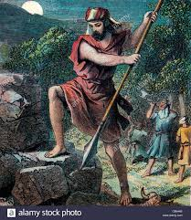
Before Gideon could go to war, the Baal idol had to be destroyed! “And it came to pass the same night, that the LORD said unto him, Take thy father's young bullock, even the second bullock of seven years old, and throw down the altar of Baal that thy father hath, and cut down the grove that is by it: And build an altar unto the LORD thy God upon the top of this rock, in the ordered place, and take the second bullock, and offer a burnt sacrifice with the wood of the grove which thou shalt cut down. Then Gideon took ten men of his servants, and did as the LORD had said unto him: and so it was, because he feared his father's household, and the men of the city, that he could not do it by day, that he did it by night.” Judges 6:25-27

Slide 10
“The deliverer of Israel must declare war upon idolatry before he went to battle with the enemies of his people. He must esteem the honor of God above the credit of his father, and regard the divine commands as more obligatory than parental authority. The offering of sacrifice unto the Lord had been committed to the priests and Levites, and had been restricted to the altar at Shiloh; but He who had established the Jewish economy, and to whom all its services pointed, had power to change its requirements. In this instance he saw fit to depart from the ritual appointment. It was of great importance that the deliverance of Israel should be preceded by a solemn protest against the worship of Baal, and an acknowledgment of Jehovah as the only true and living God.” ST, 1881

Slide 11
Signs of God’s Leading
“And the LORD said unto him, Surely I will be with thee, and thou shalt smite the Midianites as one man. And he said unto him, If now I have found grace in thy sight, then shew me a sign that thou talkest with me. Depart not hence, I pray thee, until I come unto thee, and bring forth my present, and set it before thee. And he said, I will tarry until thou come again. And Gideon went in, and made ready a kid, and unleavened cakes of an ephah of flour: the flesh he put in a basket, and he put the broth in a pot, and brought it out unto him under the oak, and presented it. And the angel of God said unto him, Take the flesh and the unleavened cakes, and lay them upon this rock, and pour out the broth. And he did so. Then the angel of the LORD put forth the end of the staff that was in his hand, and touched the flesh and the unleavened cakes; and there rose up fire out of the rock, and consumed the flesh and the unleavened cakes. Then the angel of the LORD departed out of his sight. And when Gideon perceived that he was an angel of the LORD, Gideon said, Alas, O Lord GOD! for because I have seen an angel of the LORD face to face.” Judges 6:16-22

Slide 12
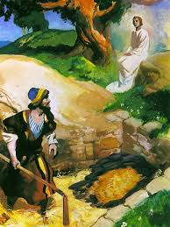
Before starting in on the Lord’s work and plan for his life, Gideon wanted the assurance of God’s leading and blessing. He asked for the Lord to remain while he prepared something for him. When Gideon returned with the meal, the Angel-the Lord Jesus-consumed the meal and Gideon knew it was God who was leading him!

Slide 13
More Assurances
“And he sent messengers throughout all Manasseh; who also was gathered after him: and he sent messengers unto Asher, and unto Zebulun, and unto Naphtali; and they came up to meet them. And Gideon said unto God, If thou wilt save Israel by mine hand, as thou hast said, Behold, I will put a fleece of wool in the floor; and if the dew be on the fleece only, and it be dry upon all the earth beside, then shall I know that thou wilt save Israel by mine hand, as thou hast said. And it was so: for he rose up early on the morrow, and thrust the fleece together, and wringed the dew out of the fleece, a bowl full of water. And Gideon said unto God, Let not thine anger be hot against me, and I will speak but this once: let me prove, I pray thee, but this once with the fleece; let it now be dry only upon the fleece, and upon all the ground let there be dew. And God did so that night: for it was dry upon the fleece only, and there was dew on all the ground.” Judges 6:35-40

Slide 14
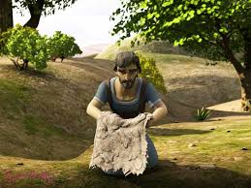
“Gideon deeply felt his own insufficiency for the great work before him. He dared not place himself at the head of the army without positive evidence that God had called him to this work, and that he would be with him. He prayed, "If thou wilt save Israel by mine hand, as thou hast said, behold, I will put a fleece of wool in the floor, and if the dew be on the fleece only, and it be dry upon all the earth beside, then shall I know that thou wilt save Israel by mine hand, as thou has said.“ The Lord granted the prayer of his servant. In the morning the fleece was wet, while the ground was dry. But now unbelief suggested that wool naturally absorbs moisture when there is any in the air, and that the test was not decisive. Hence, he asked a renewal of the sign, humbly pleading that unbelief might not move the Lord to anger. His request was granted. The Lord does not always choose for his work men of the greatest talents, but he selects those whom he can best use.” ST, 1881

Slide 15
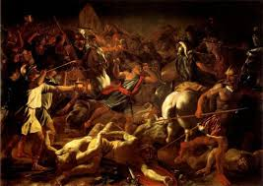
The Midianite Hoards! 100,000 plus
“Then all the Midianites and the Amalekites and the children of the east were gathered together, and went over, and pitched in the valley of Jezreel.” Judges 6:33

Slide 16
Another Severe Test!
“Then Jerubbaal, who is Gideon, and all the people that were with him, rose up early, and pitched beside the well of Harod: so that the host of the Midianites were on the north side of them, by the hill of Moreh, in the valley. And the LORD said unto Gideon, The people that are with thee are too many for me to give the Midianites into their hands, lest Israel vaunt themselves against me, saying, Mine own hand hath saved me. Now therefore go to, proclaim in the ears of the people, saying, Whosoever is fearful and afraid, let him return and depart early from mount Gilead. And there returned of the people twenty and two thousand; and there remained ten thousand.” Judges 7:1-3

Slide 17
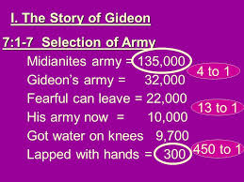
Down to 10,000
Already outnumbered 4 to 1, Gideon is now told he has too many men. The Midianites have over 125,000 men and Gideon has but 32,000. The Lord tells him he has too many men!!!!!! So, Gideon gives the command, “And the LORD said unto Gideon, The people that are with thee are too many for me to give the Midianites into their hands, lest Israel vaunt themselves against me, saying, Mine own hand hath saved me. Now therefore go to, proclaim in the ears of the people, saying, Whosoever is fearful and afraid, let him return and depart early from mount Gilead. And there returned of the people twenty and two thousand; and there remained ten thousand.” Judges 7:2,3

Slide 18
“As with ancient Israel, so it is with the people of God at this age of the world. The Lord can do but little for the children of men, because they are so ready to esteem themselves wiser than their Creator. If blessed with a measure of success, many become elated and self-confident, and forget their dependence upon God. There is too much reliance upon human plans and methods, and too little faith in the mighty God of Jacob; too much machinery, and too little of the life-giving Spirit and power of the Most High. Christ is the light of the world. All wisdom and all knowledge flow from Him who is the fountain of wisdom. He bids his followers, "Let your light so shine before men, that they may see your good works, and glorify your Father which is in Heaven." It is when reflected in his disciples, that the divine loveliness of Christ is revealed to the world. Those who depart from the simplicity of the gospel, have gone on in advance of their Leader; but Christ says, "Follow me.“ All who indulge pride and self-importance, "vaunting themselves against God," he will separate from his work; and, in their stead, will choose those who will walk in the path of humility and obedience, acknowledging that all their success comes from God.” ST, 1881

