Slide 1
Hebrews 8
‘The Sum of the Matter’

Slide 2
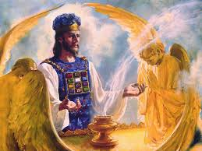
What is the Core?
When we add two numbers, we simply declare the answer to be the sum. It is the grand total of the numbers added together. Well, in Hebrews 8:1,2, Paul gave us the sum of the first 7 chapters in the book of Hebrews. Here it is……………………..

Slide 3
Hebrews 8:1,2
“Now of the things which we have spoken this is the sum: We have such an high priest, who is set on the right hand of the throne of the Majesty in the heavens; A minister of the sanctuary, and of the true tabernacle, which the Lord pitched, and not man.” Heb. 8:1,2
The essence of the first 7 chapters of Hebrews is: after His death and resurrection, Christ went back to minister in the Heavenly Sanctuary, to stand as the sole Mediator between God and man! He totally understands our failures, predicaments, and trials; He was tempted in all points like as we are, yet without sin, and we can go to Him to receive necessary HELP in our trials!

Slide 4
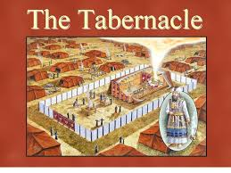
Can His Work there be illustrated for us?
We can not see into heaven so how can we be sure of what Jesus is doing there? Is there anything tangible for us to see that would clearly explain Christ’s work in the unknown? Paul tells us clearly there is and it is found in the work of the priests in the Old Testament sanctuary.

Slide 5
The Perfect Illustration
“For every high priest is ordained to offer gifts and sacrifices: wherefore it is of necessity that this man have somewhat also to offer. For if he were on earth, he should not be a priest, seeing that there are priests that offer gifts according to the law: Who serve unto the example and shadow of heavenly things, as Moses was admonished of God when he was about to make the tabernacle: for, See, saith he, that thou make all things according to the pattern shewed to thee in the mount.” Hebrews 8:3-5

Slide 6
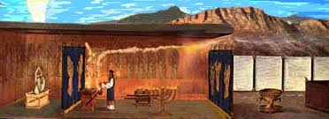
The OT priests were a Copy of Christ
Ah, the priests that ministered in the Old Testament sanctuary were representative of Christ and carried on ministries there just as Jesus would do in the heavenly sanctuary. They followed the Heavenly Pattern of Christ’ ministries. So, if we study what the priests did in the Old Testament temple, then we can know exactly what Jesus has been doing for the last several centuries.

Slide 7
How many ministries?
The Bible is very clear as to the work of the priests in the Old Testament sanctuary. They carried on work in the courtyard and the holy place throughout the year. This is noted in Leviticus 4. Then, once each year, the High Priest went into the Most Holy Place to cleanse the temple of sin that had been transferred there throughout the year.
Just as the priests carried on two ministries, so Christ would carry on two as well. From His ascension to 1844, Christ carried on work in the Holy Place. (Rev. 1:13-15) Then, in 1844, Christ began His work in the Most Holy Place. (Daniel 8:14, Rev. 14:7)

Slide 8
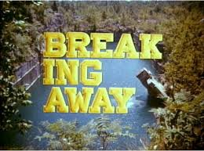
Breaks Away Slightly!
Paul is fascinating. He is talking about the sanctuary and Christ’s priestly ministries as a copy of the earthly. However, the OT sanctuary has a direct correlation to the covenant that was entered into at Mt. Sinai. Thus, Paul takes a slight diversion from the sanctuary and mentions the covenant at Sinai.

Slide 9
Sanctuary and Covenant!
“But now hath he obtained a more excellent ministry, by how much also he is the mediator of a better covenant, which was established upon better promises. For if that first covenant had been faultless, then should no place have been sought for the second.” Hebrews 8:6,7

Slide 10
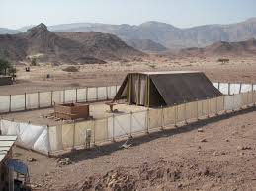
Old Covenant vs. New Covenant
The Old Covenant had:
1. priestly ministry.
2. temple.
3. sacrifices
The New Covenant has:
1. Christ’s priestly work.
2. The Heavenly sanctuary.
3. Christ our sacrifice.

Slide 11
One Problem with Old Covenant
“For finding fault with them, he saith, Behold, the days come, saith the Lord, when I will make a new covenant with the house of Israel and with the house of Judah: Not according to the covenant that I made with their fathers in the day when I took them by the hand to lead them out of the land of Egypt; because they continued not in my covenant, and I regarded them not, saith the Lord.” Hebrews 8:8,9

Slide 12
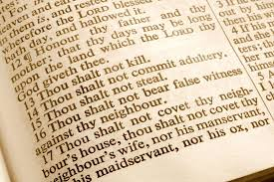
God’s Covenant always the same
My Covenant
To Noah-- Genesis 9:9-11
To Abraham-- Genesis 17:4-7
To Israel-- Exodus 19:5
In every case, the agreement was based in man’s totally inability to do anything right by themselves and their total dependence upon Christ to produce righteousness.

Slide 13
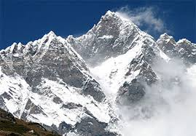
The Wrong Response!
“And Moses came and called for the elders of the people, and laid before their faces all these words which the LORD commanded him. And all the people answered together, and said, All that the LORD hath spoken we will do. And Moses returned the words of the people unto the LORD.” Ex. 19:7,8
“And Moses took half of the blood, and put it in basons; and half of the blood he sprinkled on the altar. And he took the book of the covenant, and read in the audience of the people: and they said, All that the LORD hath said will we do, and be obedient.” Ex. 24:7,8

Slide 14
Israel’s Failure and folly
“The people did not realize the sinfulness of their own hearts, and that without Christ it was impossible for them to keep God's law; and they readily entered into covenant with God. Feeling that they were able to establish their own righteousness, they declared, "All that the Lord hath said will we do, and be obedient." Exodus 24:7. They had witnessed the proclamation of the law in awful majesty, and had trembled with terror before the mount; and yet only a few weeks passed before they broke their covenant with God, and bowed down to worship a graven image. They could not hope for the favor of God through a covenant which they had broken; and now, seeing their sinfulness and their need of pardon, they were brought to feel their need of the Saviour revealed in the Abrahamic covenant and shadowed forth in the sacrificial offerings. Now by faith and love they were bound to God as their deliverer from the bondage of sin. Now they were prepared to appreciate the blessings of the new covenant.” PP, pgs. 371, 372

Slide 15
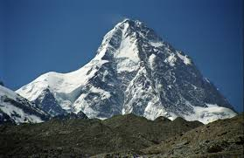
Still Impossible!
“For I bear them record that they have a zeal of God, but not according to knowledge. For they being ignorant of God's righteousness, and going about to establish their own righteousness, have not submitted themselves unto the righteousness of God. For Christ is the end of the law for righteousness to every one that believeth.” Rm. 10:2-4
“The only defense against evil is the indwelling of Christ in the heart through faith in His righteousness. Unless we become vitally connected with God, we can never resist the unhallowed effects of self-love, self-indulgence, and temptation to sin.” DA, pg. 324

Slide 16
Hebrews 8:10-13
“For this is the covenant that I will make with the house of Israel after those days, saith the Lord; I will put my laws into their mind, and write them in their hearts: and I will be to them a God, and they shall be to me a people: And they shall not teach every man his neighbour, and every man his brother, saying, Know the Lord: for all shall know me, from the least to the greatest. For I will be merciful to their unrighteousness, and their sins and their iniquities will I remember no more. In that he saith, A new covenant, he hath made the first old. Now that which decayed and waxed old is ready to vanish away.”

Slide 17
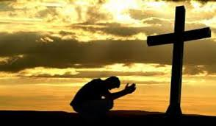
Through the submitted heart, willing to allow the Lord to have His way, the Lord can fill that person with His righteousness and enable them to overcome every inherited and cultivated tendency to evil. Praise the Lord! This is the covenant promise of the Lord!

