Slide 1
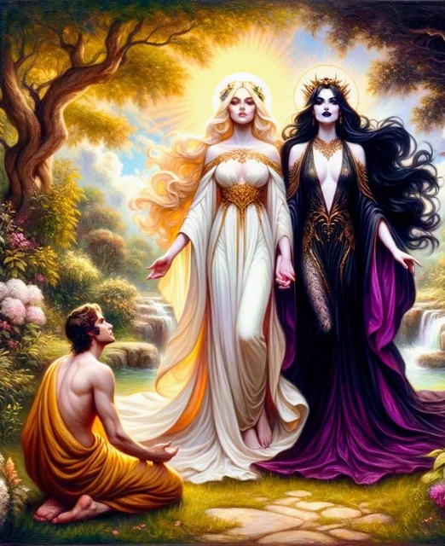
The History of Feminism

Slide 2
A Warning From the Bible: Societal Destruction
Is. 3:1-13 “For, behold, the Lord, the Lord of hosts, doth take away from Jerusalem and from Judah the stay and the staff, the whole stay of bread, and the whole stay of water. The mighty man, and the man of war, the judge, and the prophet, and the prudent, and the ancient, The captain of fifty, and the honourable man, and the counsellor, and the cunning artificer, and the eloquent orator. And I will give children to be their princes, and babes shall rule over them. And the people shall be oppressed, every one by another, and every one by his neighbour: the child shall behave himself proudly against the ancient, and the base against the honourable. When a man shall take hold of his brother of the house of his father, saying, Thou hast clothing, be thou our ruler, and let this ruin be under thy hand: In that day shall he swear, saying, I will not be an healer; for in my house is neither bread nor clothing: make me not a ruler of the people. For Jerusalem is ruined, and Judah is fallen: because their tongue and their doings are against the Lord, to provoke the eyes of his glory. The shew of their countenance doth witness against them; and they declare their sin as Sodom, they hide it not. Woe unto their soul! for they have rewarded evil unto themselves. Say ye to the righteous, that it shall be well with him: for they shall eat the fruit of their doings. Woe unto the wicked! it shall be ill with him: for the reward of his hands shall be given him. As for my people, children are their oppressors, and women rule over them. O my people, they which lead thee cause thee to err, and destroy the way of thy paths. The Lord standeth up to plead, and standeth to judge the people.”

Slide 3
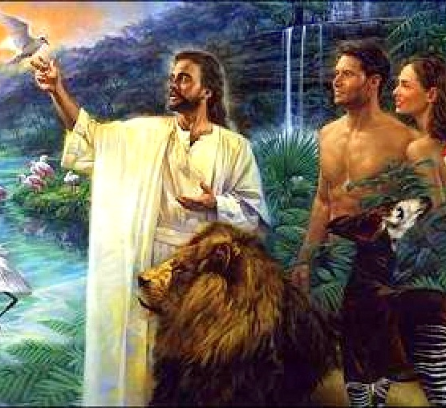
Men and Women: Are they Equal???
“God Himself gave Adam a companion. He provided “an help meet for him”—a helper corresponding to him—one who was fitted to be his companion, and who could be one with him in love and sympathy. Eve was created from a rib taken from the side of Adam, signifying that she was not to control him as the head, nor to be trampled under his feet as an inferior, but to stand by his side as an equal, to be loved and protected by him. A part of man, bone of his bone, and flesh of his flesh, she was his second self, showing the close union and the affectionate attachment that should exist in this relation.” PP, p. 46

Slide 4
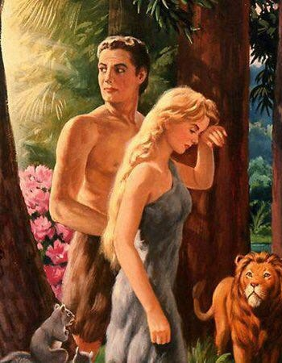
The Curse of Eve
Gen. 3:16-19 “Unto the woman he said, I will greatly multiply thy sorrow and thy conception; in sorrow thou shalt bring forth children; and thy desire shall be to thy husband, and he shall rule over thee. And unto Adam he said, Because thou hast hearkened unto the voice of thy wife, and hast eaten of the tree, of which I commanded thee, saying, Thou shalt not eat of it: cursed is the ground for thy sake; in sorrow shalt thou eat of it all the days of thy life; Thorns also and thistles shall it bring forth to thee; and thou shalt eat the herb of the field; In the sweat of thy face shalt thou eat bread, till thou return unto the ground; for out of it wast thou taken: for dust thou art, and unto dust shalt thou return.”

Slide 5
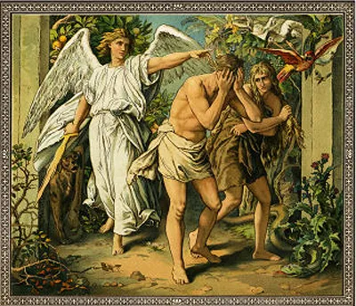
After the Fall…
“Eve was told of the sorrow and pain that must henceforth be her portion. And the Lord said, “Thy desire shall be to thy husband, and he shall rule over thee.” In the creation God had made her the equal of Adam. Had they remained obedient to God—in harmony with His great law of love—they would ever have been in harmony with each other; but sin had brought discord, and now their union could be maintained and harmony preserved only by submission on the part of the one or the other. Eve had been the first in transgression; and she had fallen into temptation by separating from her companion, contrary to the divine direction. It was by her solicitation that Adam sinned, and she was now placed in subjection to her husband. Had the principles enjoined in the law of God been cherished by the fallen race, this sentence, though growing out of the results of sin, would have proved a blessing to them; but man’s abuse of the supremacy thus given him has too often rendered the lot of woman very bitter and made her life a burden” PP, p. 58-59

Slide 6
A Short History of Feminism
First-wave feminism of the 19th and early 20th centuries was concerned primarily with legal inequalities like women’s suffrage and right to own property, legal autonomy
Second-wave feminism (1960s–1980s) sought to challenge gender norms, women began wearing the padded shoulder coats, pants, perceived cultural inequalities like being a stay-at-home-mom/wife
Third-wave feminism (1990s–2000s) expanded the second wave goals and women’s autonomy to challenge male-dominated fields like police, firefighters, perceived pay discrepancies, bringing more attention to any and all perceived oppressions
Fourth-wave feminism (early 2010s–present) expands on the third wave's focus on intersectionality, emphasizing body positivity, trans-inclusivity, and an open discourse about rape culture in the social media era—but don’t judge my provocative clothing

Slide 7
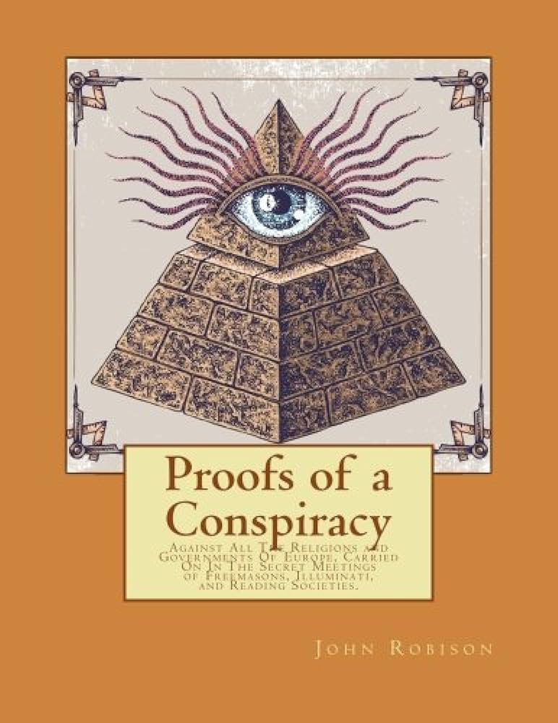
The Illuminati Would Use Feminism???
“There is no way of influencing men so powerfully as by means of the women. These should therefore be our chief study; we should insinuate ourselves into their good opinion, give them hints of emancipation from the tyranny of public opinion, and of standing up for themselves; it will be an immense relief to their enslaved minds to be freed from any one bond of restraint, and it will fire them the more, and cause them to work for us with zeal, without knowing that they do; for they will only be indulging their own desire of personal admiration. . . . We must win the common people in every corner. This will be obtained chiefly by means of schools, and by open, hearty behavior, show, condescension, popularity, and toleration of their prejudices, which we shall at leisure root out and dispel” (John Robison, Proofs of a Conspiracy, p. 111)

Slide 8
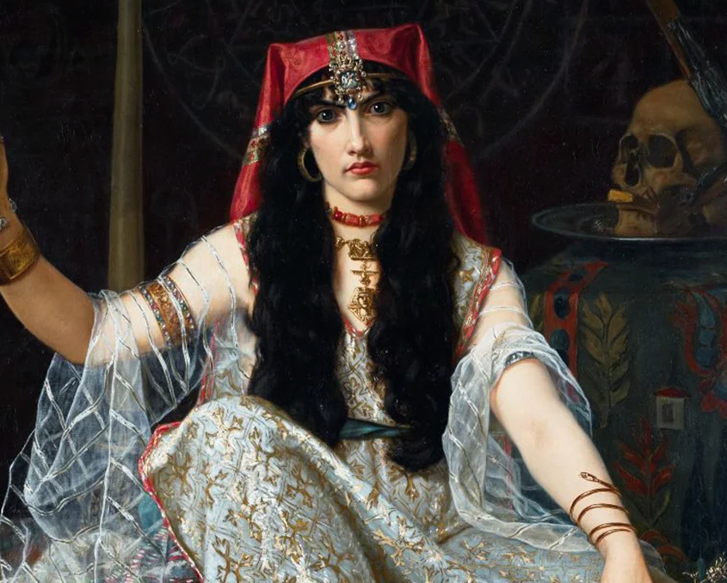
The Foundations
“The history of feminism tends to be written as a secular movement, one indifferent at best to the spiritual side of life, if not actively hostile. And while that might be true of some individual figures, most of feminist history has emerged from—and alongside—esoteric developments like Spiritualism, Theosophy, and Paganism. This history is mostly the result of the fact that the development of a feminist consciousness required the interrogation and breaking free from monotheistic Abrahamic religions, which used religious doctrines to justify the political and cultural subjugation of women.” Jessa Crispin, Nov. 17, 2021, https://daily.jstor.org/feminisms-hidden-spiritual-side/

Slide 9
Lucifer… The Light Bearer? A Feminist?
“It wasn’t just that suffragette Victoria Woodhull was branded a witch by the misogynistic press, depicted in a political cartoon as Mrs. Satan in Harper’s Weekly in 1872. She was also literally talking to the dead and participating in Spiritualist rituals. Often denied any position of real power in a Christian church, women instead found themselves able to lead services in more fringe sects, which had the added bonus of not being burdened with centuries of misogynistic thinking and texts. The emergence of Theosophy, and the influence of its leader Madame Helena Blavatsky, gave women alternatives to thinking about their place in the hierarchy. Unburdened from the sins of Eve, women like Woodhull argued against women’s involuntary domesticity in the heteronormative family and instead advocated for free love, the rights of sex workers, and reproductive freedom. When women like Woodhull and other feminists were taunted as witches, as Satanists, as demonic, they embraced these labels with pride, according to the anthropologist Kathryn Rountree. An early socialist American magazine based in Kansas that argued for women’s liberation took the title Lucifer: The Light Bearer. So yes, they were on the side of the devil here: Eve was a hero bringing enlightenment, the serpent was a truth teller, and together they fought against an authoritarian and punishing god. As the historian of religion Per Faxneld has documented, this was a shared experience with many freedom fighters, as various socialists and revolutionaries also embraced the figure of Satan as the ultimate symbol of rebellion and liberation. This push helped re-establish a hard line between church and state, dismantled arguments against allowing women freedom to participate in public life whether through career, politics, or education, and disempowered and marginalized Christian orthodoxy from western culture.” (Ibid.)

Slide 10
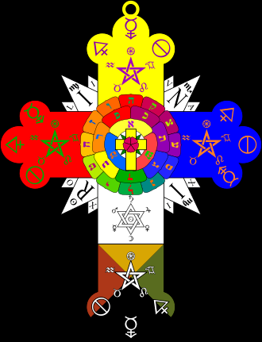
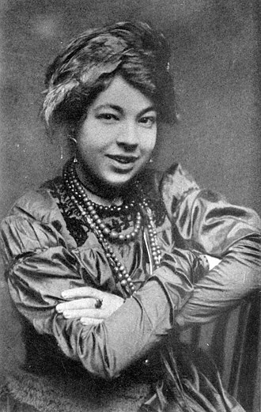
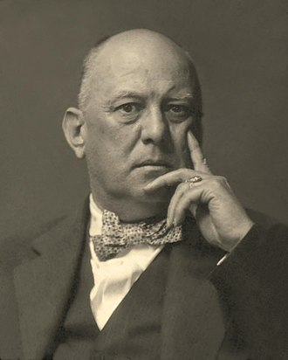
Scary Facts About the Early Feminists
Of all the early feminists (first-wave), nearly all of them were involved in witchcraft of some kind, seances, palm/tarot reading, secret societies like Heterodoxy (of which 1/3 were divorced), Theosophical Society (Laura Carter Holloway [1843-1930]) and Hermetic Order of the Golden Dawn (Aleister Crowley, Arthur Conan Doyle, Florence Farr [1860-1917], Annie Horniman [1860-1937], Gabrielle Borthwick [1866-1952], Pamela Colman Smith [occultist who illustrated the Rider-Waite tarot deck; the most widely used today! 1878-1951])—the roots of the Feminist movement have their origins in Spiritism and the Jesuit-Illuminati

Slide 11
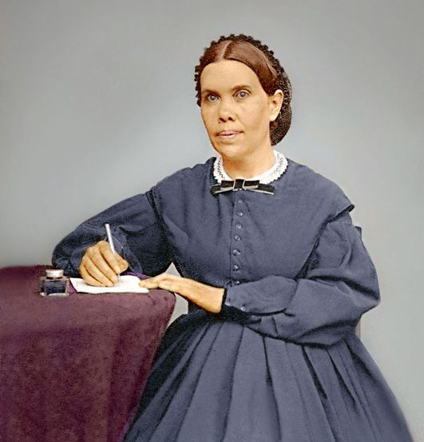
Ellen White on Secret Societies
“[Rev. 18:1-8 quoted]. This terrible picture, drawn by John to show how completely the powers of earth will give them over to evil, should show those who have received the truth how dangerous it is to link up with secret societies or to join themselves in any way with those who do not keep God’s commandments.” (MS 135, 1902, 14MR, p. 152)

Slide 12
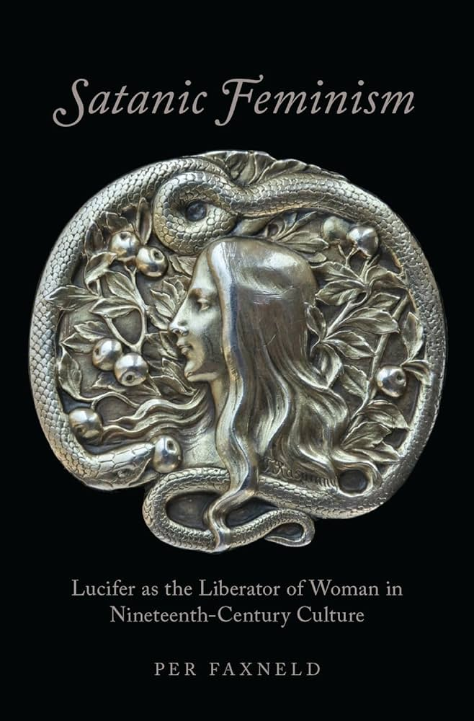
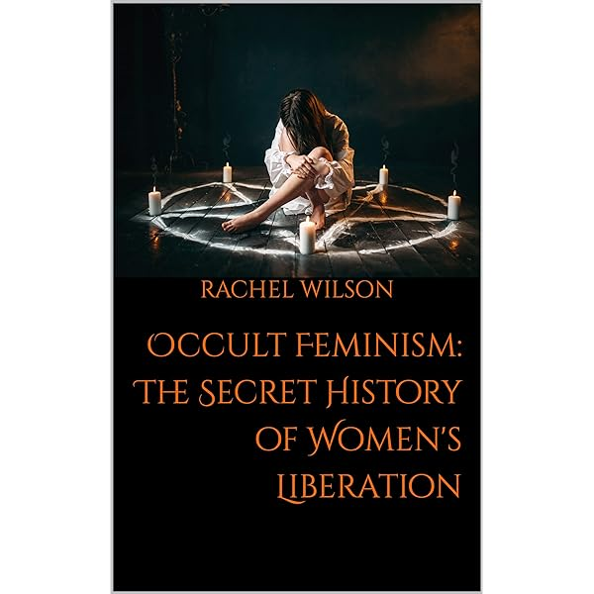
Occult Feminism
Rachel Wilson Interview on RattlesnakeTV: The DISTURBING Origins of Feminism That Nobody Talks About

Slide 13
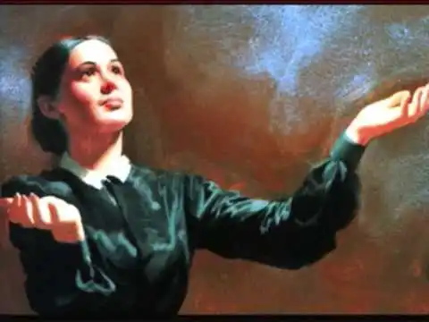
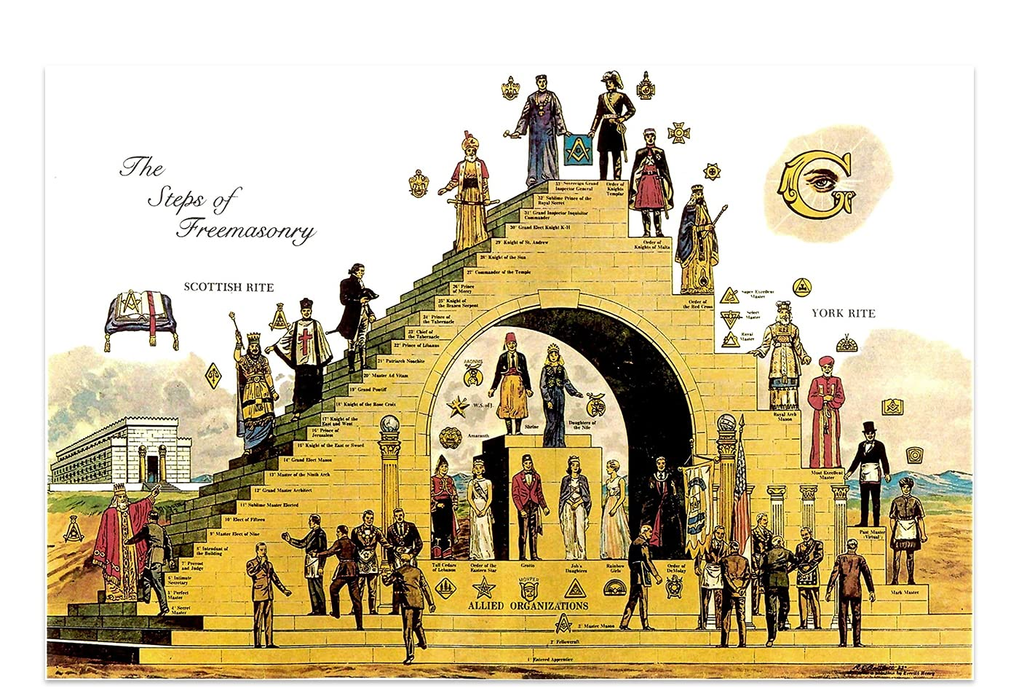
More Quotes on Secret Societies
“A power from beneath is working to bring about the last great scenes in the drama,—Satan coming as Christ, and working with all deceivableness of unrighteousness in those who are binding themselves together in secret societies. Those who are yielding to the passion for confederation are working out the plans of the enemy. The cause will be followed by the effect” 8T, 27-28
“We are now to use all our entrusted capabilities in giving the last warning message to the world. In this work we are to preserve our individuality. We are not to unite with secret societies or with trades unions. We are to stand free in God, looking constantly to Christ for instruction. All our movements are to be made with a realization of the importance of the work to be accomplished for God.” 7T, p. 84

Slide 14
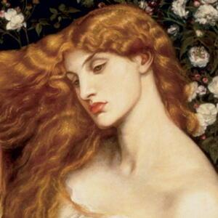
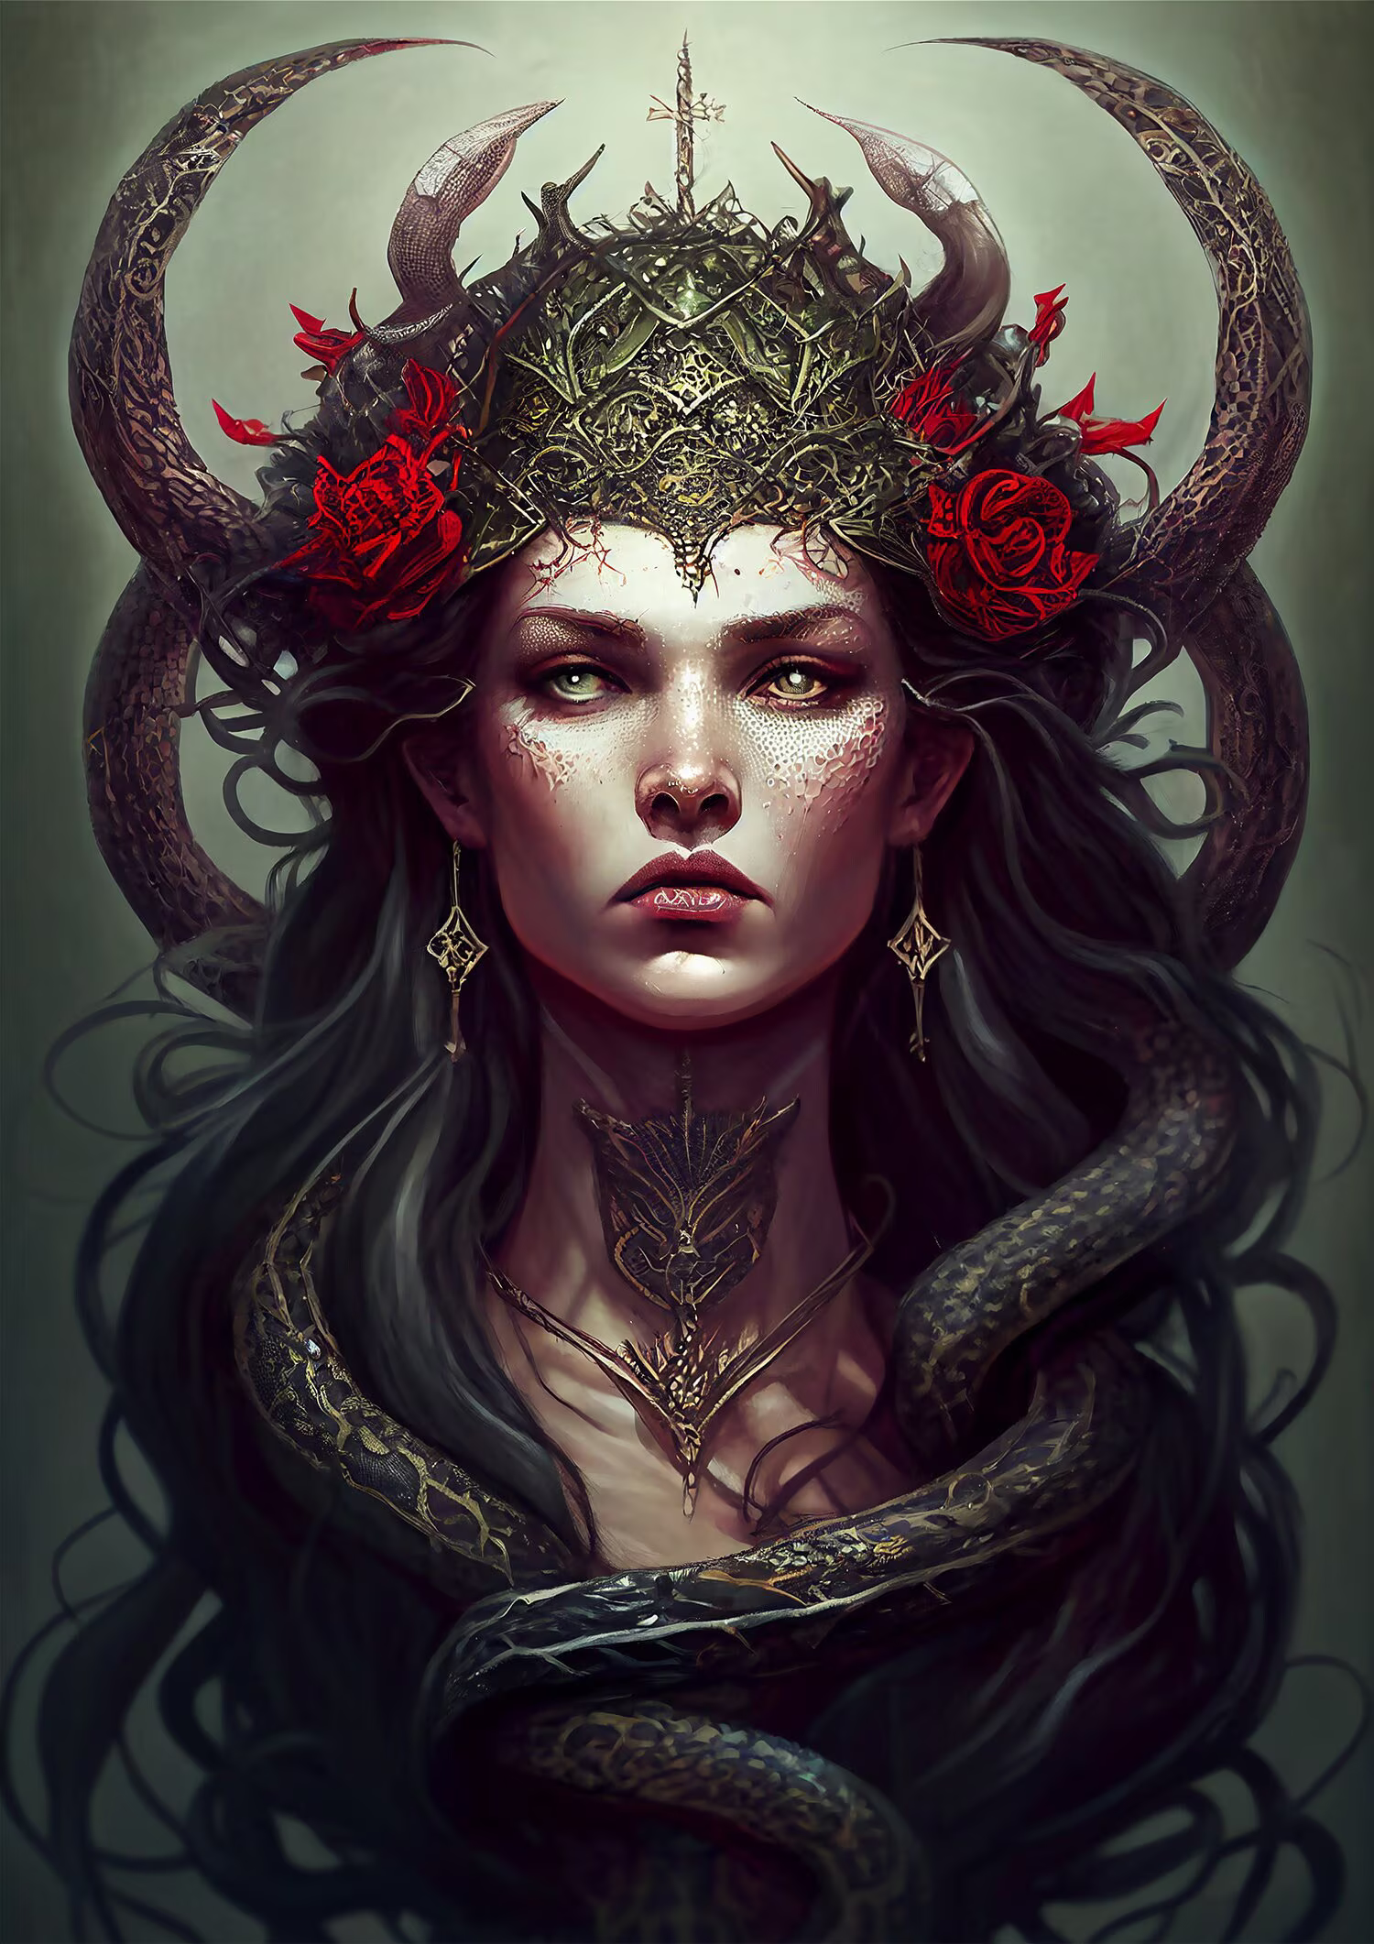
Lilith: Feminism’s Hero???
Lilith is a Feminist Icon, but also a deeply occult figure. Her story is almost identical to the story of Lucifer’s fall and His envy of Jesus Christ. This legend can be found in pseudepigraphal and occult sources like: Alphabet of Ben Sira 700AD, Babylonian Talmud (BT Shabbat 151b), Kabbalah 1200AD, but some sources suggest the story dates back earlier… The story goes like this: Lilith is the original woman, not created from Adam’s rib (Male and Female created He them—Gen. 1:27). However, Lilith would not submit but demanded equality with Adam, though Adam sought her out, she departed… So the angels sought to bring her back to Eden but she refused, so God turned her into a demon—grotesque. Now she prowls the earth seducing men via lust to destroy them and murding infants and even children in the womb.

Slide 15
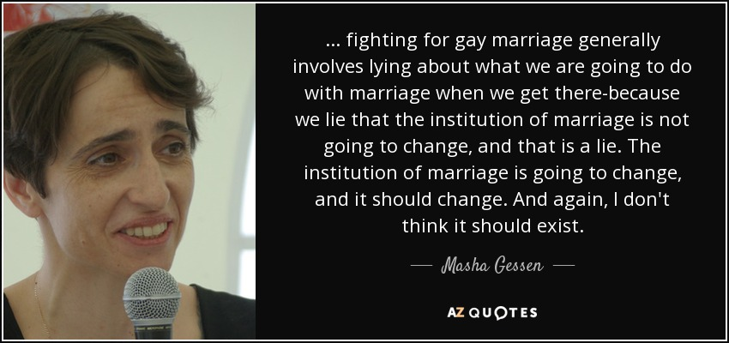
Society Destroyers
Modern Day Feminist Masha Gessen quoted in Mark Dice: They’re Doing it On Purpose

Slide 16
Modern Feminist Quotes…
“The nuclear family must be destroyed… Whatever its ultimate meaning, the break-up of families now is an objectively revolutionary process.” Linda Gordon
“I want to see a man beaten to a bloody pulp with a high-heel shoved in his mouth, like an apple in the mouth of a pig.” Andrea Dworkin
“Since marriage constitutes slavery for women, it is clear that the women’s movement must concentrate on attacking this institution. Freedom for women cannot be won without the abolition of marriage.” Sheila Cronin, the leader of the feminist organization NOW
“The proportion of men must be reduced to and maintained at approximately 10% of the human race.” Sally Miller Gearhart, in The Future – If There Is One – Is Female
“The more famous and powerful I get the more power I have to hurt men.” Sharon Stone
Source: https://thoughtcatalog.com/jake-fillis/2014/05/23-quotes-from-feminists-that-will-make-you-rethink-feminism/

Slide 17
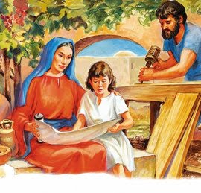
A Better Way!
“In the days of Christ the town or city that did not provide for the religious instruction of the young was regarded as under the curse of God. Yet the teaching had become formal. Tradition had in a great degree supplanted the Scriptures. . . . The child Jesus did not receive instruction in the synagogue schools. His mother was His first human teacher. From her lips and from the scrolls of the prophets, He learned of heavenly things. The very words which He Himself had spoken to Moses for Israel He was now taught at His mother’s knee. As He advanced from childhood to youth, He did not seek the schools of the rabbis. He needed not the education to be obtained from such sources; for God was His instructor.” DA, p. 69-70

Slide 18
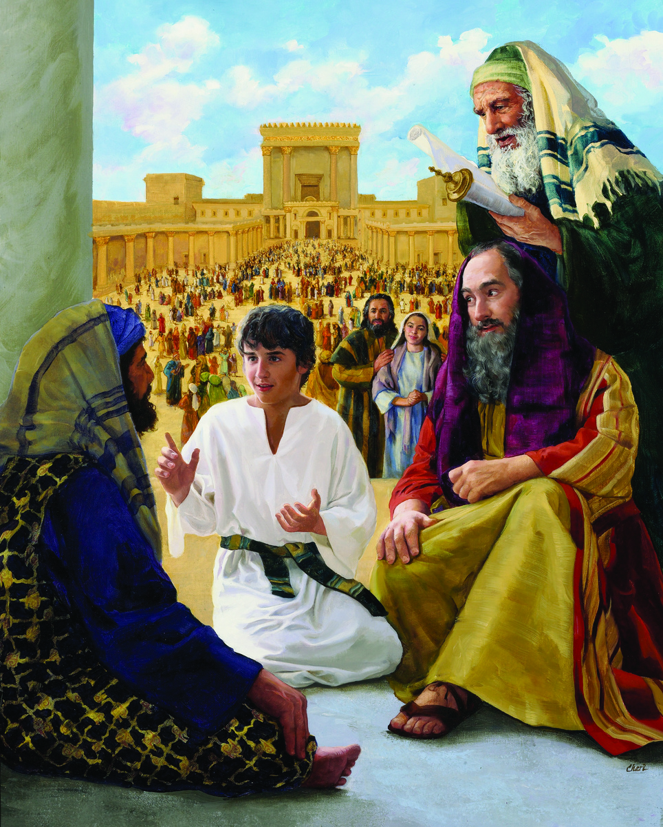
Thank God for Good Mothers!
“The rabbis knew that Jesus had not been instructed in their schools; yet His understanding of the prophecies far exceeded theirs. In this thoughtful Galilean boy they discerned great promise. They desired to gain Him as a student, that He might become a teacher in Israel. They wanted to have charge of His education, feeling that a mind so original must be brought under their molding. The words of Jesus had moved their hearts as they had never before been moved by words from human lips. God was seeking to give light to those leaders in Israel, and He used the only means by which they could be reached” DA, p. 79-80

Slide 19
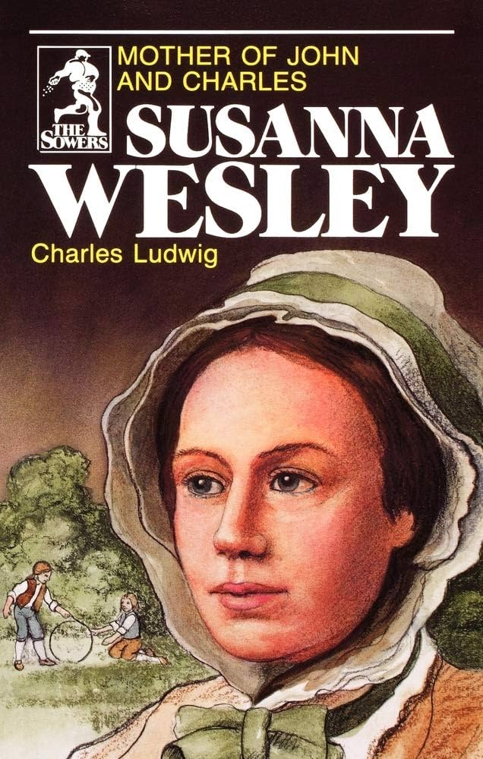
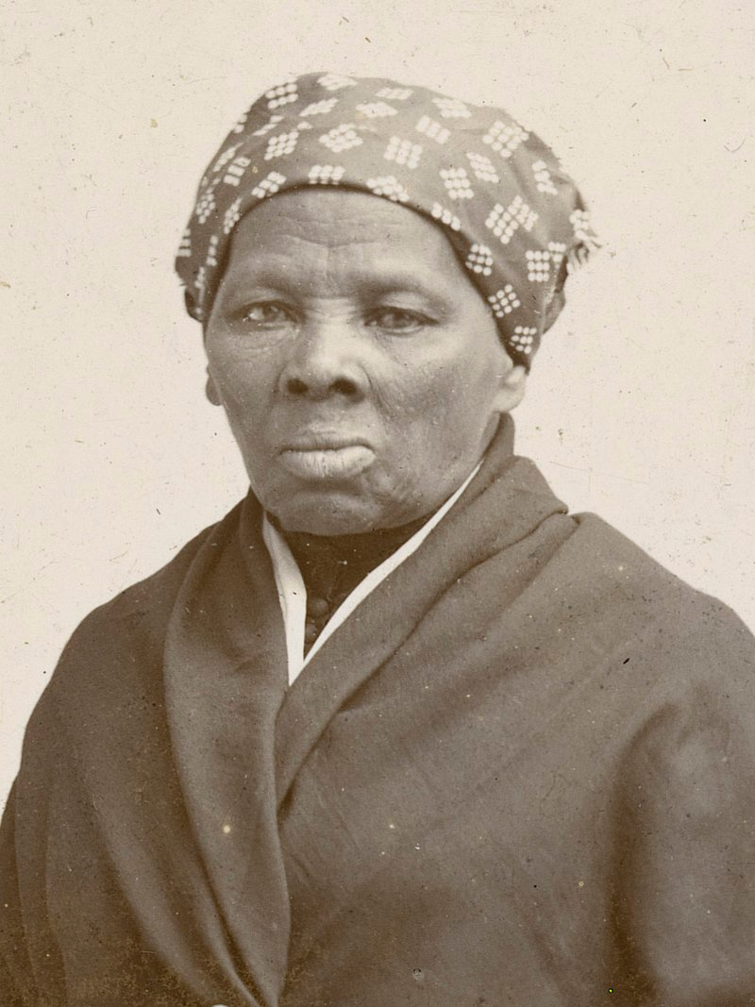
Powerful Godly Women!
Mary Magdelene, Martha, Salome, Mary the mother of Jesus, Rehab, Ruth, Widow of Zarephath, Woman at the Well, Deborah, Hulda the prophetess, Abigail, Mariam, Queen Esther
Augustine’s mother Monica, Susanna Wesley [9 kids], Harriet Tubman, Ellen White, Amy Carmichael, Corrie & Betsy Ten Boom, Esther Ann Kim, Gladys Aylward, Fanny Crosby, Mary Slessor

