Slide 1
For Men Only, pt. 2
Husbands…………………

Slide 2
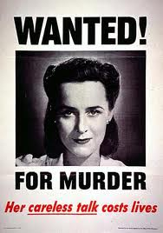
Divorce No, But…………………
Ruth Graham was once asked if she had ever thought of divorcing her very famous husband, Billy Graham. Her response was, “No, I’ve never thought about divorcing Billy. I have thought about murdering him a few times, though.”

Slide 3
Unconditionally
”Husbands, love your wives, even as Christ also loved the church, and gave himself for it; That he might sanctify and cleanse it with the washing of water by the word, That he might present it to himself a glorious church, not having spot, or wrinkle, or any such thing; but that it should be holy and without blemish. So ought men to love their wives as their own bodies. He that loveth his wife loveth himself. For no man ever yet hated his own flesh; but nourisheth and cherisheth it, even as the Lord the church:” Eph. 5:25-29

Slide 4
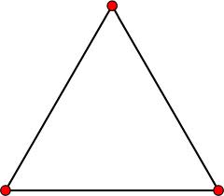
The Triangle Effect

Slide 5
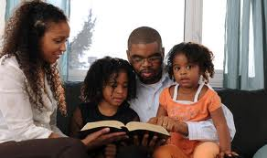
Christian Home Must Have Christ
“And this is life eternal, that they might know thee the only true God, and Jesus Christ, whom thou hast sent.” Jn. 17:3
“ And be found in him, not having mine own righteousness, which is of the law, but that which is through the faith of Christ, the righteousness which is of God by faith: That I may know him, and the power of his resurrection, and the fellowship of his sufferings, being made conformable unto his death;” Phil. 3:9,10

Slide 6
How Done?
”And the LORD God caused a deep sleep to fall upon Adam, and he slept: and he took one of his ribs, and closed up the flesh instead thereof; And the rib, which the LORD God had taken from man, made he a woman, and brought her unto the man.” Genesis 2:21,22

Slide 7
Side by Side
“God Himself gave Adam a companion. He provided "an help meet for him"--a helper corresponding to him-one who was fitted to be his companion, and who could be one with him in love and sympathy. Eve was created from a rib taken from the side of Adam, signifying that she was not to control him as the head, nor to be trampled under his feet as an inferior, but to stand by his side as an equal, to be loved and protected by him. A part of man, bone of his bone, and flesh of his flesh, she was his second self, showing the close union and the affectionate attachment that should exist in this relation. "For no man ever yet hated his own flesh; but nourisheth and cherisheth it." Ephesians 5:29. "Therefore shall a man leave his father and his mother, and shall cleave unto his wife; and they shall be one.“ PP. pg. 46

Slide 8
Mutual Submission
In order for there to be a happy home, there must be mutual submission to one another. There must be giving and taking because no body has the entire market on knowing everything. The weaknesses of one can become strengths for the family if both parties work together. NOONE knows everything. Work together!!!

Slide 9
Work Together
”Neither husband nor wife is to make a plea for rulership. The Lord has laid down the principle that is to guide in this matter. The husband is to cherish his wife as Christ cherishes the church. And the wife is to respect and love her husband. Both are to cultivate the spirit of kindness, being determined never to grieve or injure the other. . . . {AH 106.4}
Do not try to compel each other to do as you wish. You cannot do this and retain each other's love. Manifestations of self-will destroy the peace and happiness of the home. Let not your married life be one of contention. If you do, you will both be unhappy. Be kind in speech and gentle in action, giving up your own wishes. Watch well your words, for they have a powerful influence for good or for ill. Allow no sharpness to come into your voices. Bring into your united life the fragrance of Christ likeness. {AH 107.1}

Slide 10
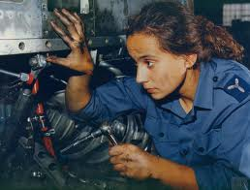
Admitting Strengths and Weaknesses
In our world, to admit weakness is considered bad, wrong. Wives are too smart to think that we are perfect. Men win and become so strong when they admit weakness in some area of life. Your wife may be an excellent mechanic!!!

Slide 11
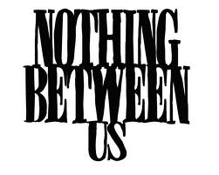
Nobody Comes Between
“Therefore shall a man leave his father and his mother, and shall cleave unto his wife: and they shall be one flesh.” Genesis 2:24 No one can be allowed to come between the partners. Parents, children, friends, hobbies, nothing can come between partners!

Slide 12
Time For Her
This can be time for her to have a hobby. Especially with young children, mom needs a break. Give her a block of time for her to enjoy. Men, you take care of the children. Let mom have time for her!

Slide 13
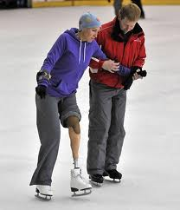
Time For Husband’s Attention
Do something fun with your wife. Enjoy each other’s time together. Go skating, shopping, walking, anything, but just the two of you. Make her the focal point of your attention. She will love that and YOU!

Slide 14
Early Attentions
“Though difficulties, perplexities, and discouragements may arise, let neither husband nor wife harbor the thought that their union is a mistake or a disappointment. Determine to be all that it is possible to be to each other. Continue the early attentions. In every way encourage each other in fighting the battles of life. Study to advance the happiness of each other. Let there be mutual love, mutual forbearance. Then marriage, instead of being the end of love, will be as it were the very beginning of love. The warmth of true friendship, the love that binds heart to heart, is a foretaste of the joys of heaven. “{AH 106.1}

Slide 15
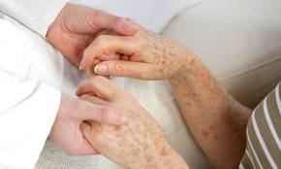
Time for Appreciation
Sit down with your wife and let her some things you really appreciate about her. Don’t tell her all the things you don’t appreciate, but tell her some of the things you do appreciate. Hold her by the hands, look into her eyes; let her know you mean it!

Slide 16
Appreciation
“Let each give love rather than exact it. Cultivate that which is noblest in yourselves, and be quick to recognize the good qualities in each other. The consciousness of being appreciated is a wonderful stimulus and satisfaction. Sympathy and respect encourage the striving after excellence, and love itself increases as it stimulates to nobler aims.” {AH 107.3}

Slide 17
Excellencies
“As life with its burden of perplexity and care meets the newly wedded pair, the romance with which imagination so often invests marriage disappears. Husband and wife learn each other's character as it was impossible to learn it in their previous association. This is a most critical period in their experience. The happiness and usefulness of their whole future life depend upon their taking a right course now. Often they discern in each other unsuspected weaknesses and defects; but the hearts that love has united will discern excellencies also heretofore unknown. Let all seek to discover the excellencies rather than the defects. Often it is our own attitude, the atmosphere that surrounds ourselves, which determines what will be revealed to us in another.” {AH 105.3}

Slide 18
Respect
We want our children to respect us and our wife. But, what happens if we show our wife disrespect around the children? We are teaching the children to dishonor their mother and your wife. If we have something to say of a negative nature to our wives, it should not be around the children. If we expect the children to be respectful ,we need to be too.

