Slide 1
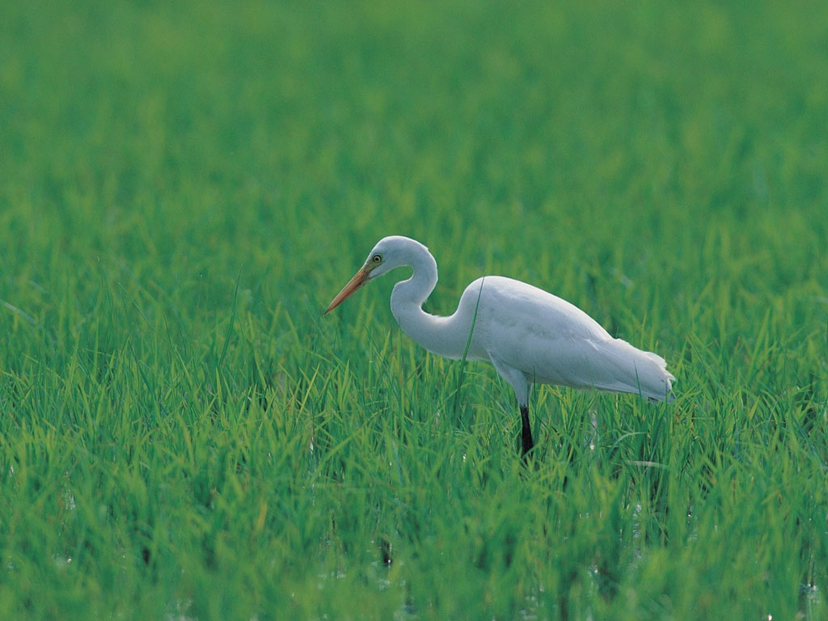
Book of Romans, pt.9
Romans 5:1-11

Slide 2
Romans 5:1,2
“Therefore being justified by faith, we have peace with God through our Lord Jesus Christ: By whom also we have access by faith into this grace wherein we stand, and rejoice in hope of the glory of God.”

Slide 3
The Gift
Forgiveness from God and acceptance from Him comes ONLY by faith in Jesus Christ. We can never earn it; we can never be good enough. We must accept the gift; individually before God, admitting our wrongs, confessing our sins, and peace comes. “If we confess our sins, he is faithful and just to forgive us our sins, and to cleanse us from all unrighteousness.” 1John 1:9

Slide 4
Peace without feeling
The peace God offers is not a feeling of euphoria. It isn’t a feeling at all. It is a restfulness of mind because we are no longer warring with heaven. We have accepted His way in our lives. This is the Sabbath rest!
“Peace, I leave with you; my peace I give unto you.” Jn. 14:27

Slide 5
The Glory of God
Through Christ’s gift of grace, we have access to more than forgiveness. We have opportunity to receive the grace of Christ which can change a human life. Our character can be changed from sin to purity; from wrong to right. The character of God can be reproduced in the humbled individual. The gospel is not living in sin; the gospel is power to change.

Slide 6
Tribulation Teaches
“And not only so, but we glory in tribulations also: knowing that tribulation worketh patience; And patience, experience; and experience, hope: And hope maketh not ashamed; because the love of God is shed abroad in our hearts by the Holy Ghost which is given unto us.” Romans 5:3-5

Slide 7
The School of Hard Knocks
Most of the time, we are not persecuted for righteousness sake, but we have trials because of our own foolish decisions and choices. We bear the consequences of our decisions. God uses the consequences to teach us to trust Him. We have such a hard time trusting Him because we have such a rebellious heart and like to do things our way. God is unbelievably patience with us proud, sinful, and arrogant mortals.

Slide 8
Joy!!!?
“My brethren, count it all joy when ye fall into divers temptations; Knowing this, that the trying of your faith worketh patience. But let patience have her perfect work, that ye may be perfect and entire, wanting nothing.” James 1:2-4

Slide 9
Are We Listening?
“God has always tried His people in the furnace of affliction. It is in the heat of the furnace that the dross is separated from the true gold of the Christian character. Jesus watches the test; He knows what is needed to purify the precious metal, that it may reflect the radiance of His love. It is by close, testing trials that God disciplines His servants. He sees that some have powers which may be used in the advancement of His work, and He puts these persons upon trial; in His providence He brings them into positions that test their character and reveal defects and weaknesses that have been hidden from their own knowledge. He gives them opportunity to correct these defects and to fit themselves for His service. He shows them their own weakness, and teaches them to lean upon Him; for He is their only help and safeguard. Thus His object is attained. They are educated, trained, and disciplined, prepared to fulfill the grand purpose for which their powers were given them. When God calls them to action, they are ready, and heavenly angels can unite with them in the work to be accomplished on the earth.” PP, pg. 129,130

Slide 10
Romans 5:6
“For when we were yet without strength, in due time Christ died for the ungodly.” When we, as a race, were at our lowest place, then Christ took us upon Himself. “And being found in fashion as a man, he humbled himself, and became obedient unto death, even the death of the cross.” Phil 2:8

Slide 11
Christ in the life
Since we have NO strength in ourselves, we are powerless to deal with sin. Since we have NO strength in ourselves, we must look for a power source to help us. That power source is Jesus Christ. He only can enable to resist sin and He will! “The only defense against evil is the indwelling of Christ in the heart through faith in His righteousness.” DA, pg. 324

Slide 12
Christ Our Righteousness
“To whom God would make known what is the riches of the glory of this mystery among the Gentiles; which is Christ in you, the hope of glory:” Col. 1:27
“That he would grant you, according to the riches of his glory, to be strengthened with might by his Spirit in the inner man; That Christ may dwell in your hearts by faith; that ye, being rooted and grounded in love,.” Eph. 3:16,17

Slide 13
Not our own righteousness
“Surely, shall one say, in the LORD have I righteousness and strength: even to him shall men come; and all that are incensed against him shall be ashamed.” Isa. 45:24
“I will go in the strength of the Lord GOD: I will make mention of thy righteousness, even of thine only.” Ps. 71:16
“this is his name whereby he shall be called, THE LORD OUR RIGHTEOUSNESS.’ Jer. 23:6

Slide 14
This is the Wedding Garment
“So those servants went out into the highways, and gathered together all as many as they found, both bad and good: and the wedding was furnished with guests. And when the king came in to see the guests, he saw there a man which had not on a wedding garment: And he saith unto him, Friend, how camest thou in hither not having a wedding garment? And he was speechless. Then said the king to the servants, Bind him hand and foot, and take him away, and cast him into outer darkness; there shall be weeping and gnashing of teeth.” Matthew 22:10-13

Slide 15
Romans 5:7,8
“For scarcely for a righteous man will one die: yet peradventure for a good man some would even dare to die. But God commendeth his love toward us, in that, while we were yet sinners, Christ died for us.” Rom. 5:7,8
‘Be still and know that He is God Be still and know He is our Father Come rest your head upon His breast -Listen to the rhythm of His unfailing heart of love Beating for His little ones Calling each of us to come Be still, Be still.’

Slide 16
The love of God
God’s love is revealed in the sacrifice of His Son and in His continued watch care of His children day by day. The love of God is revealed in human lives when “By this we know that we love the children of God, when we love God, and keep his commandments. For this is the love of God, that we keep his commandments: and his commandments are not grievous.” 1John 5:2,3

Slide 17
Saved by Christ
“Much more then, being now justified by his blood, we shall be saved from wrath through him. For if, when we were enemies, we were reconciled to God by the death of his Son, much more, being reconciled, we shall be saved by his life.” Romans 5:9,10

Slide 18
Our Friend
God is not our enemy, but we are His enemies. We fight against Him and create animosity toward God. He doesn’t need to be reconciled to us; we need to be reconciled to Him. The ball is in our court, not His! When we embrace Christ by faith, He takes our sins and sinful life, and gives to us forgiveness and a new Man to now control our life. Instead of us in charge, it is now Christ, the new Man, in charge.
“Wherefore, my brethren, ye also are become dead to the law by the body of Christ; that ye should be married to another, even to him who is raised from the dead, that we should bring forth fruit unto God.” Romans 7:4

Slide 19
His Death, our death; His Life, our life
Christ died. If we are willing to ask Him for forgiveness, He will forgive. Christ didn’t remain in the grave. He is alive. That life, He offers to us. If we accept it, He will change us. If we reject His life here, we will not want His life there.

Slide 20
Romans 5:11
“And not only so, but we also joy in God through our Lord Jesus Christ, by whom we have now received the atonement.”

Slide 21
Atonement
Paul could speak with absolute assurance that the atonement was a guarantee because of Christ’s death. This doesn’t mean that the atonement was complete at the cross. Paul is simply saying that Christ’s death assured the fact that atonement would be done; sin and its final destruction were made sure by Christ’s death. We will look at this more in our next study.

