Slide 1
Jesus Life pt. 35 Snares of Adventism

Slide 2
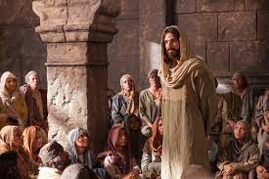
Parallels are Staggering!
The life of Christ was a war zone in which He did constant hand to hand combat with the ancient Adventism church! The war began at His birth and continued all His life. As Christ’s life on earth came to a close, we will see today some of the pitfalls the Adventists threw at Him to entrap and destroy Him and we will see how history is repeatiing!

Slide 3
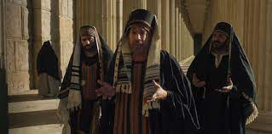
“All the while Jesus was at Jerusalem during the feast He was shadowed by spies. Day after day new schemes to silence Him were tried. The priests and rulers were watching to entrap Him. They were planning to stop Him by violence. But this was not all. They wanted to humble this Galilean rabbi before the people.
On the first day of His presence at the feast, the rulers had come to Him, demanding by what authority He taught. They wished to divert attention from Him to the question of His right to teach, and thus to their own importance and authority.” DA, pg. 455

Slide 4
He Wasn’t Educated in the Schools
“Now about the midst of the feast Jesus went up into the temple, and taught. And the Jews marvelled, saying, How knoweth this man letters, having never learned? Jesus answered them, and said, My doctrine is not mine, but his that sent me. If any man will do his will, he shall know of the doctrine, whether it be of God, or whether I speak of myself. He that speaketh of himself seeketh his own glory: but he that seeketh his glory that sent him, the same is true, and no unrighteousness is in him.” John 7:14-18

Slide 5
I Surrender All!
“The question of these cavilers Jesus met, not by answering the cavil, but by opening up truth vital to the salvation of the soul. The perception and appreciation of truth, He said, depends less upon the mind than upon the heart. Truth must be received into the soul; it claims the homage of the will. If truth could be submitted to the reason alone, pride would be no hindrance in the way of its reception. But it is to be received through the work of grace in the heart; and its reception depends upon the renunciation of every sin that the Spirit of God reveals. Man's advantages for obtaining a knowledge of the truth, however great these may be, will prove of no benefit to him unless the heart is open to receive the truth, and there is a conscientious surrender of every habit and practice that is opposed to its principles. To those who thus yield themselves to God, having an honest desire to know and to do His will, the truth is revealed as the power of God for their salvation. These will be able to distinguish between him who speaks for God, and him who speaks merely from himself.” DA, pg. 455

Slide 6

Submission is Key!
If we have the truth, and yet refuse to surrender our will to the control of the Holy Spirit, eventually, the truth will lose all of its beauty and we will forsake it in the end! “As the Jews departed from God, and failed to make the righteousness of Christ their own by faith, the Sabbath lost its significance to them. Satan was seeking to exalt himself and to draw men away from Christ, and he worked to pervert the Sabbath, because it is the sign of the power of Christ.” DA, pg. 283 “Self-surrender is the substance of the teachings of Christ.”
DA, pg. 523

Slide 7
Confused on Doctrine!
“Many among Christ's hearers who were dwellers at Jerusalem, and who were not ignorant of the plots of the rulers against Him, felt themselves drawn to Him by an irresistible power. The conviction pressed upon them that He was the Son of God. But Satan was ready to suggest doubt; and for this the way was prepared by their own erroneous ideas of the Messiah and His coming. It was generally believed that Christ would be born at Bethlehem, but that after a time He would disappear, and at His second appearance none would know whence He came. There were not a few who held that the Messiah would have no natural relationship to humanity. And because the popular conception of the glory of the Messiah was not met by Jesus of Nazareth, many gave heed to the suggestion, “Howbeit we know this Man whence He is: but when Christ cometh, no man knoweth whence He is.” DA, pg. 457

Slide 8
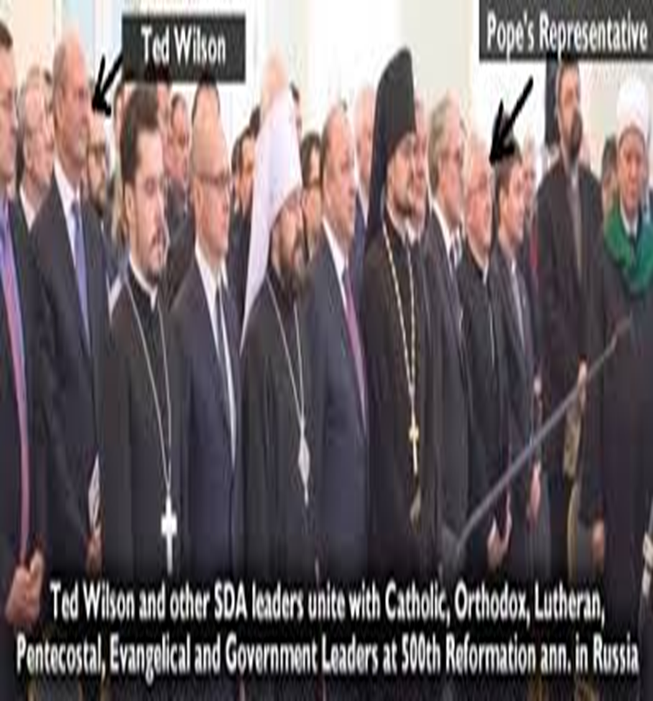
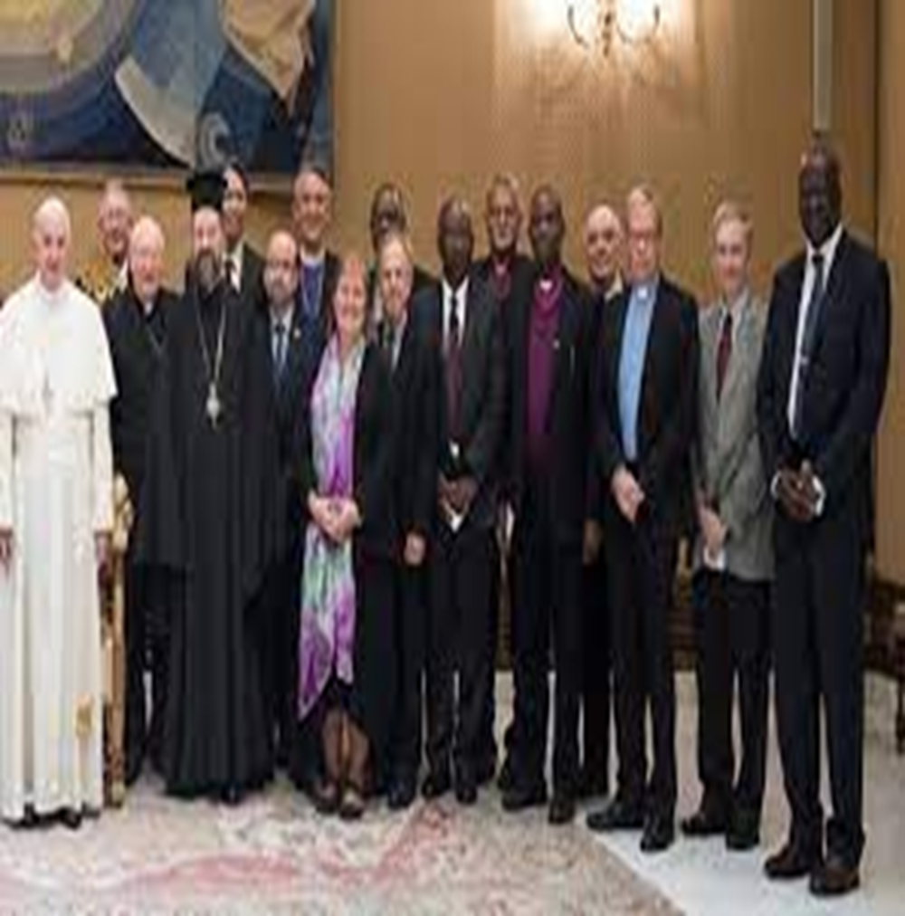
Confusion Today!!

Slide 9
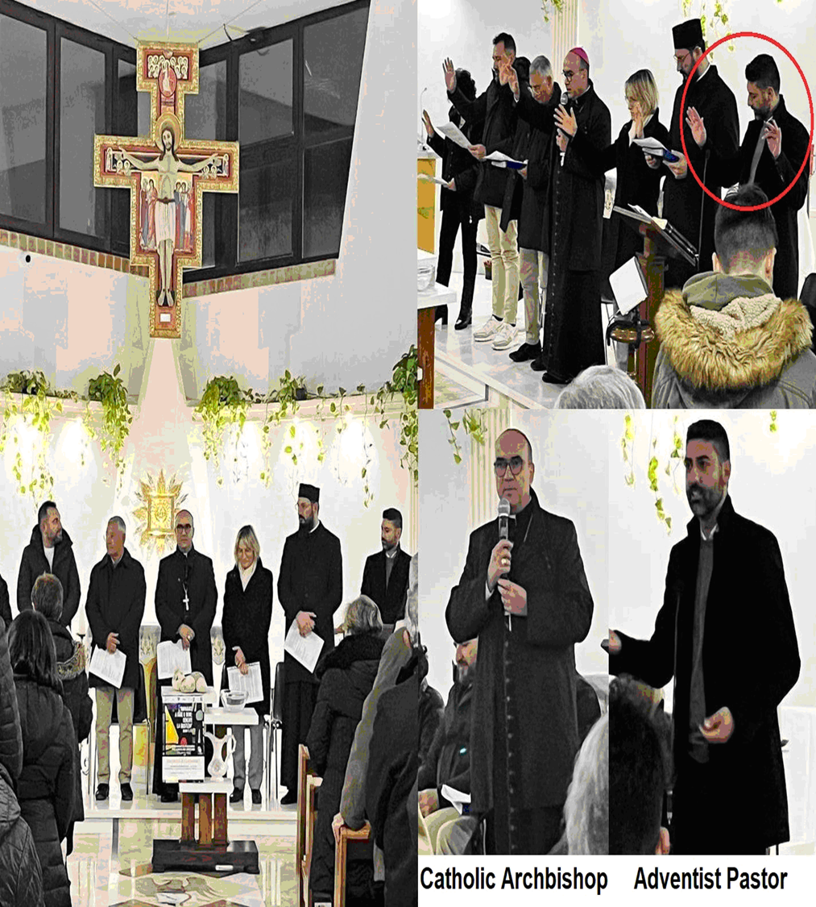
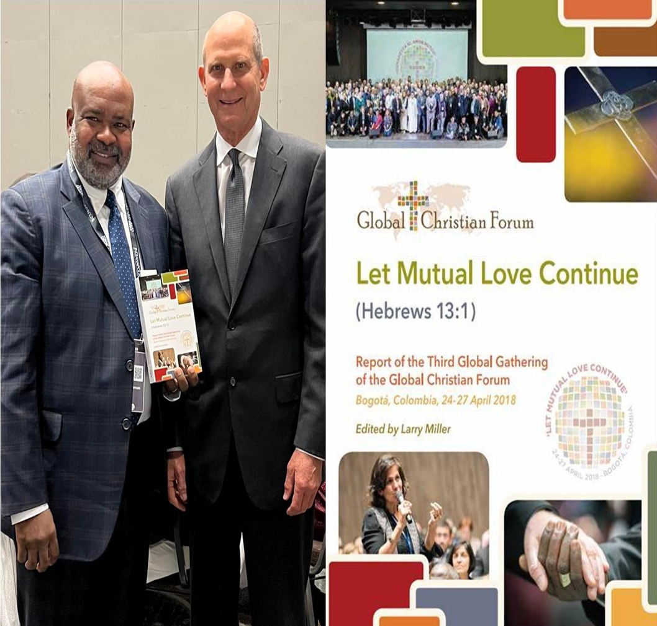

Slide 10
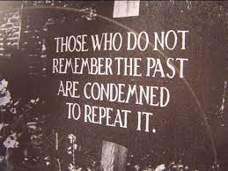
Repeating History!
“But the Israelites fixed their hopes upon worldly greatness. From the time of their entrance to the land of Canaan, they departed from the commandments of God, and followed the ways of the heathen. It was in vain that God sent them warning by His prophets. In vain they suffered the chastisement of heathen oppression. Every reformation was followed by deeper apostasy.” DA, pg. 28

Slide 11
To the Gentiles!!
“Then said Jesus unto them, Yet a little while am I with you, and then I go unto him that sent me. Ye shall seek me, and shall not find me: and where I am, thither ye cannot come. Then said the Jews among themselves, Whither will he go, that we shall not find him? will he go unto the dispersed among the Gentiles, and teach the Gentiles? What manner of saying is this that he said, Ye shall seek me, and shall not find me: and where I am, thither ye cannot come?” John 7:33-36

Slide 12
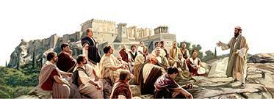
“ Little did these cavilers dream that in their mocking words they were picturing the mission of the Christ! All day long He had stretched forth His hands unto a disobedient and gainsaying people; yet He would be found of them that sought Him not; among a people that had not called upon His name He would be manifest. Romans 10:20, 21. Many who were convinced that Jesus was the Son of God were misled by the false reasoning of the priests and rabbis. These teachers had repeated with great effect the prophecies concerning the Messiah, that He would “reign in Mount Zion, and in Jerusalem, and before His ancients gloriously;” that He would “have dominion also from sea to sea, and from the river unto the ends of the earth.” Isaiah 24:23; Psalm 72:8. Then they made contemptuous comparisons between the glory here pictured and the humble appearance of Jesus.” DA, pg. 458

Slide 13
“God does not compel men to give up their unbelief. Before them are light and darkness, truth and error. It is for them to decide which they will accept. The human mind is endowed with power to discriminate between right and wrong. God designs that men shall not decide from impulse, but from weight of evidence, carefully comparing scripture with scripture. Had the Jews laid by their prejudice and compared written prophecy with the facts characterizing the life of Jesus, they would have perceived a beautiful harmony between the prophecies and their fulfillment in the life and ministry of the lowly Galilean. Many are deceived today in the same way as were the Jews. Religious teachers read the Bible in the light of their own understanding and traditions; and the people do not search the Scriptures for themselves, and judge for themselves as to what is truth; but they yield up their judgment, and commit their souls to their leaders. The preaching and teaching of His word is one of the means that God has ordained for diffusing light; but we must bring every man's teaching to the test of Scripture. Whoever will prayerfully study the Bible, desiring to know the truth, that he may obey it, will receive divine enlightenment. He will understand the Scriptures. “If any man will do His will, he shall know of the doctrine.” John 7:17, DA, pg. 459

Slide 14

“In the last day, that great day of the feast, Jesus stood and cried, saying, If any man thirst, let him come unto me, and drink. He that believeth on me, as the scripture hath said, out of his belly shall flow rivers of living water.” John 7:37,38

Slide 15
The Cry of Christ!!
“Jesus knew the wants of the soul. Pomp, riches, and honor cannot satisfy the heart. “If any man thirst, let him come unto Me.” The rich, the poor, the high, the low, are alike welcome. He promises to relieve the burdened mind, to comfort the sorrowing, and to give hope to the despondent. Many of those who heard Jesus were mourners over disappointed hopes, many were nourishing a secret grief, many were seeking to satisfy their restless longing with the things of the world and the praise of men; but when all was gained, they found that they had toiled only to reach a broken cistern, from which they could not quench their thirst. Amid the glitter of the joyous scene they stood, dissatisfied and sad. That sudden cry, “If any man thirst,” startled them from their sorrowful meditation, and as they listened to the words that followed, their minds kindled with a new hope. The Holy Spirit presented the symbol before them until they saw in it the offer of the priceless gift of salvation. The cry of Christ to the thirsty soul is still going forth, and it appeals to us with even greater power than to those who heard it in the temple.” DA, pg. 454

