Slide 1
What is the Difference Between Mormons, Jehovah’s Witnesses, and Seventh-day Adventists? pt 9

Slide 2
Final Thought on the 2300 Days: A Failed Prophecy?
Many critics of Seventh-day Adventism will insist that they are built on a false prophecy. It is true that the prophetic events foretold by William Miller did not happen—at least not in the way he had thought that they would. However, was the prophecy incorrect? Was the prophecy wrong? The day/principle had been tested and proven by the Bible, when Jesus said the “time is at hand” Mark 1:15—Jesus correctly understood that “time” period foretold was being fulfilled in real-time by His ministry. What time was that? It was the beginning of the 2300 day prophecy from Daniel 8 & 9, beginning in 457 BC, the first section of the prophecy was especially devoted to the Nation of Israel—the 490 day/year probationary time would close in 34 AD with the stoning of Stephen. Jesus, right on time, at the close of 483 years appeared on the scene in 27 AD [457 BC + 483 (69 weeks) = 27 AD], when His Messianic ministry began at His baptism. Daniel 9:27 “And he shall confirm the covenant with many for one week [7 days/years] and in the midst of the week he shall cause the sacrifice and the oblation to cease” True to the prophecies, Jesus came to “confirm the covenant”, but due to the foretold rejection of His message and mission, Jesus died halfway (in the midst) of the final 7 years of probationary time allotted to Israel. The Day/Year principle was confirmed again by the 1260 day/year reign of Papal Supremacy in Daniel 7. Again, by Millerite Josiah Litch when he predicted the fall of Ottoman Empire 2 years prior to their fulfillment, when Turkish powers accepted the protection of Christian allied forces in 1840.

Slide 3
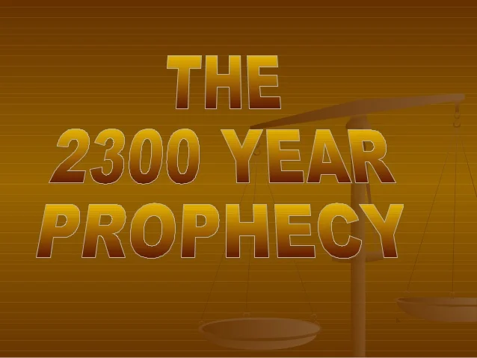
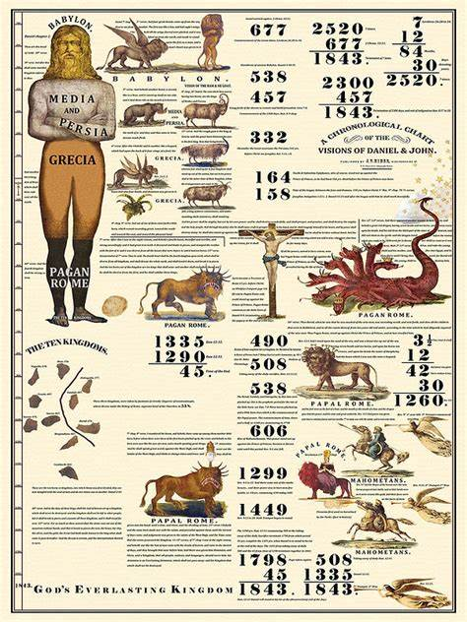
Final Thought on the 2300 Days: A Failed Prophecy?
So prophetic calculations are correct, the affirms that the “sanctuary” was a “replica” of the true which was in heaven, the 2nd Great Awakening, revival and reformation of life an character lend support to the fact that God was at work at that time, coupled with the shocking similarities between the experience AND understanding of the Millerite compared with the Disciples of Christ, coupled again with the silent yet astounding success of the writings of Ellen White—long after her death. Only one conclusion is logical: 2300 days is NOT a false prophecy. It is a true prophecy, which was misunderstood by the individuals who declared its message just like the experience of the Disciples. All honest truth-seekers, must admit this fact. If not, the critic must debunk the day/year principle, and provide logical substitutionary understanding of the same prophecies, debunk the heavenly sanctuary, explain what the 2nd Great Awakening and the reform of life and character that was happening at that time was really about—of men or heaven?, explain why the Millerites and Disciples share the same experience totally by coincidence, explain the success of Ellen White as an American female author who is simultaneously one of the most successful American authors of all time and also NEVER mentioned by mainstream media, feminists, and history.

Slide 4
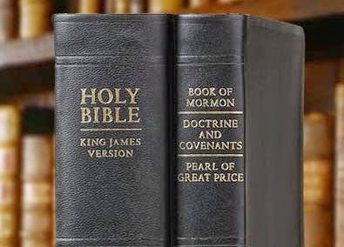
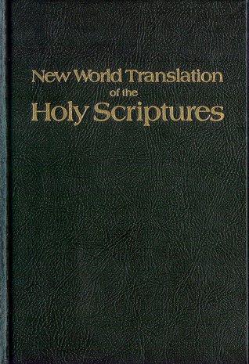
What We Will Study….
Origins of the Religion
Their Authorities and/or Authoritative Texts
Their Doctrinal Differences
Their Message to the World

Slide 5
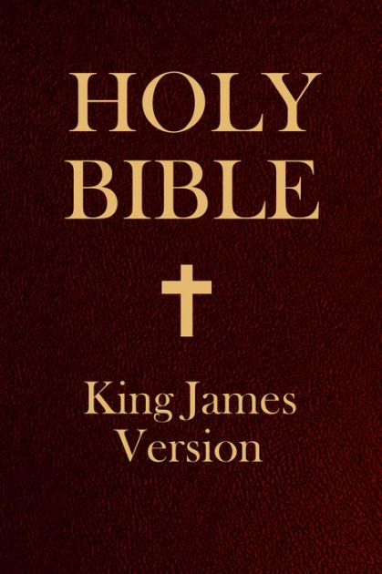
The Latter-day Saint’s First and Lowest Authority
“Mormons have a scriptural canon consisting of the Bible (both Old and New Testaments) [the Authorized King James Version], the Book of Mormon, and a collection of revelations and writings by Joseph Smith known as the Doctrine and Covenants and Pearl of Great Price.” Wikipedia, Mormons
“The Book of Mormon is divided into smaller books, titled after individuals named as primary authors or other caretakers of the ancient record the Book of Mormon describes itself as and, in most versions, is divided into chapters and verses. Its English text imitates the style of the King James Version of the Bible, and its grammar and word choice reflect Early Modern English.” Wikipedia, the Book of Mormon

Slide 6
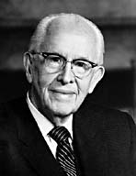
An Important Statement From an LDS Prophet
Prophet Ezra Taft: “the Book of Mormon is the keystone of our religion. This was the Prophet Joseph Smith’s statement. He testified that “the Book of Mormon was the most correct of any book on earth, and the keystone of our religion” (Introduction to the Book of Mormon). A keystone is the central stone in an arch. It holds all the other stones in place, and if removed, the arch crumbles.” (October 1986 General Conference)

Slide 7
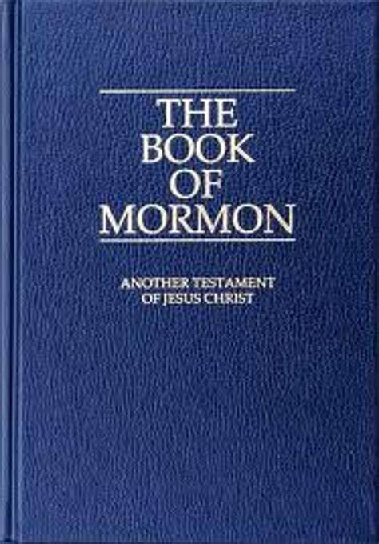
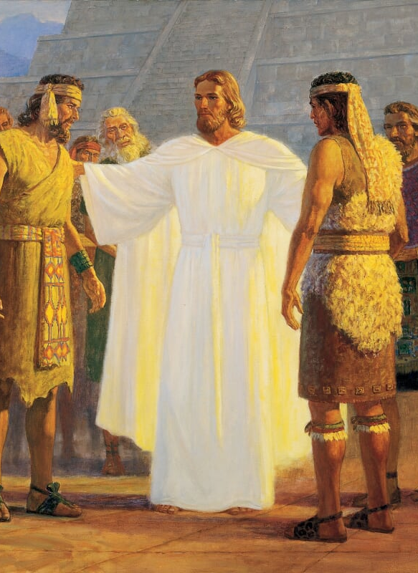
Synopsis of the Book Of Mormon
The Book of Mormon is a record written on golden plates, which were discovered when the Angel Moroni revealed the location to Joseph Smith in 1823, at the Hill Cumorah. Joseph Smith was unable to gain access to the plates in 1823 when he attempted to do so on the Autumnal Equinox September 22. The Book of Mormon is an account of the history between 2 ancient tribes descended from the tribes of Israel (600 BC) who were living in the United States before the pilgrims arrived; the light-skinned Nephites who were good, and the dark-skinned [a curse from God] Lamanites who were idolatrous and violent. Many massive wars were fought between these nations. According to the book, after Jesus died on the cross, He went to America and preached the gospel to these tribes, which resulted in a time of peace. The Lamanites’ skin began to turn lighter over generations as they maintained righteous principles in life. However, eventually the Lamanites again returned to their evil ways and waged war against the Nephites. The Nephites were eventually wiped out (421 AD), and only the record of the golden plates remained written by Nephites in an undiscovered language called “Reformed Eqyptian”. The book also contains doctrinal topics on the nature of God, atonement, priestly authority, and prophecy

Slide 8
Another Gospel???
Gal. 1:6-9 “I marvel that ye are so soon removed from him that called you into the grace of Christ unto another gospel: Which is not another; but there be some that trouble you, and would pervert the gospel of Christ. But though we, or an angel from heaven, preach any other gospel unto you than that which we have preached unto you, let him be accursed. As we said before, so say I now again, if any man preach any other gospel unto you than that ye have received, let him be accursed.

Slide 9
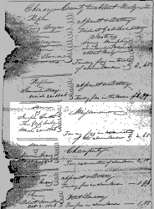
Recap of the Origins of the Book of Mormon
-Has a vision in 1823 of the Angel Moroni, telling him about the location of God’s 3rd Testament the Book of Mormon, while still practicing folk magic (Michael Quinn [1998], p. 30-31)
-The vision has different tellings, it’s an old bloody man named Nephi, according to his father’s account (Fayette Lapham [May 1870], Historical Magazine, p. 305-309)
-He is also still treasure-digging, a magical fraudulent practice—where dealings with “treasure guardians was common”—outlawed in New York, of which he was charged and found guilty in 1826
-Though Joseph Smith has been given the location of the Golden Plates/Book of Mormon, he does not retrieve it until 4 years later
Found in Norwich, NY

Slide 10
God or Demons Joseph? Which is it?
1 Cor. 10:20-21 “But I say, that the things which the Gentiles sacrifice, they sacrifice to devils, and not to God: and I would not that ye should have fellowship with devils. Ye cannot drink the cup of the Lord, and the cup of devils: ye cannot be partakers of the Lord's table, and of the table of devils.”

Slide 11
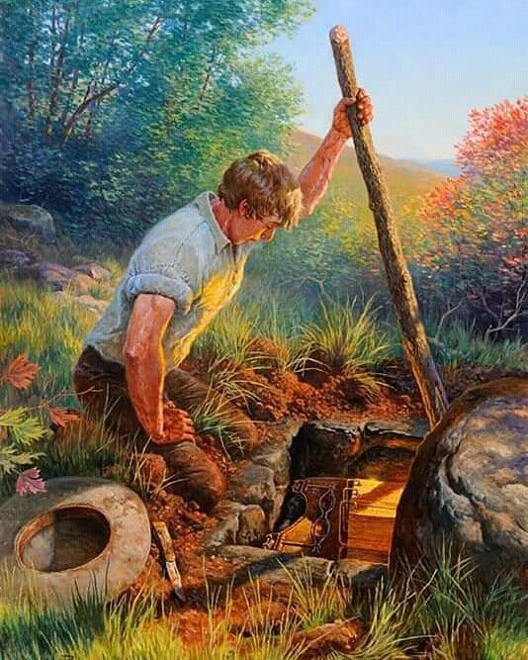
Joseph Smith’s Account of the 1st Attempt to Retrieve the Golden Plates
“Having removed the earth, I obtained a lever, which I got fixed under the edge of the stone, and with a little exertion raised it up. I looked in, and there indeed did I behold the plates, the Urim and Thummim, and the breastplate, as stated by the messenger. The box in which they lay was formed by laying stones together in some kind of cement. In the bottom of the box were laid two stones crossways of the box, and on these stones lay the plates and the other things with them. I made an attempt to take them out, but was forbidden by the messenger, and was again informed that the time for bringing them forth had not yet arrived, neither would it, until four years from that time; but he told me that I should come to that place precisely in one year from that time, and that he would there meet with me, and that I should continue to do so until the time should come for obtaining the plates.” (Joseph Smith History Ch. 1:52, churchofjesuschrist.org)

Slide 12
1st Attempt: The Treasure Guardian Angel Rejects Joseph Smith
“On attempting to take possession of the records [gold pates] a shock was produced upon his system, by an invisible power, which deprived him in a measure, of his natural strength. He desisted for an instant, and then made another attempt, but was more sensibly shocked than before. What was the occasion of this he knew not—there was the pure unsulied record, as had been described—he had heard of the power, of enchantment, and a thousand like stories, which held the hidden treasures of the earth, and sup[p]osed that physical exertion and personal strength was only necessary to enable him to yet obtain the object of his wish. He therefore made the third attempt with an increased exertion, when his strength failed him more than at either of the former times, and without premeditation he exclaimed, “why can I not obtained this book?” [“]because you have not kept the commandments of the Lord”, answered a voice, within a seeming short distance. He looked, and to his astonishment, there stood the angel who had previously given him the directions concerning this matter.” (Oliver Cowdery, 1834/35 Letter to W.W. Phelps, josephsmithpapers.org)

Slide 13
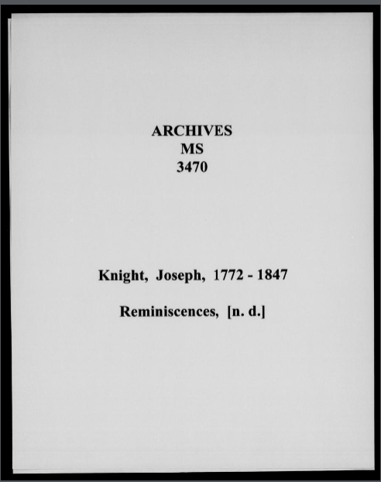
Account of Mormon Joseph Knight
"He [Joseph] exclaimed “why Cant I stur this Book?” And he was answered, “you have not Done rite; you should have took the Book and a gone right away. You cant have it now.” Joseph says, “when can I have it?” The answer was the 22nt Day of September next if you Bring the right person with you. Joseph says,” who is the right Person?” The answer was “your oldest Brother.”" (Joseph Knight [1772-1847], Reminiscences, p. 2 of 11, catalog.churchofjesuschrist.org)

Slide 14
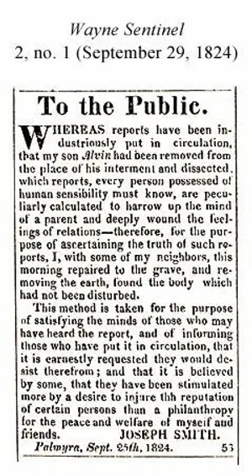
2nd Attempt: 1824 Fails
Unfortunately for Joseph, his eldest brother Alvin died just a few months [November 1823] after being told by the treasure guardian angel that he must be present in order to retrieve the golden plates. According to Joseph Smith’s mother Lucy Mack Smith, Alvin told Joseph just before he died to “do everything that lies in your power to obtain the Record. Be faithful in receiving instruction, and in keeping every commandment that is given you.” (Lucy Mack Smith, History of Joseph Smith, P. 87). Even more strange, at this time rumors circulated that Alvin’s body had been disturbed. Joseph Smith sr. published a suspicious article in the Wayne Sentinel on September 29, 1824 stated that he dug up Alvin’s grave to make sure no one had tampered with his son’s remains

Slide 15
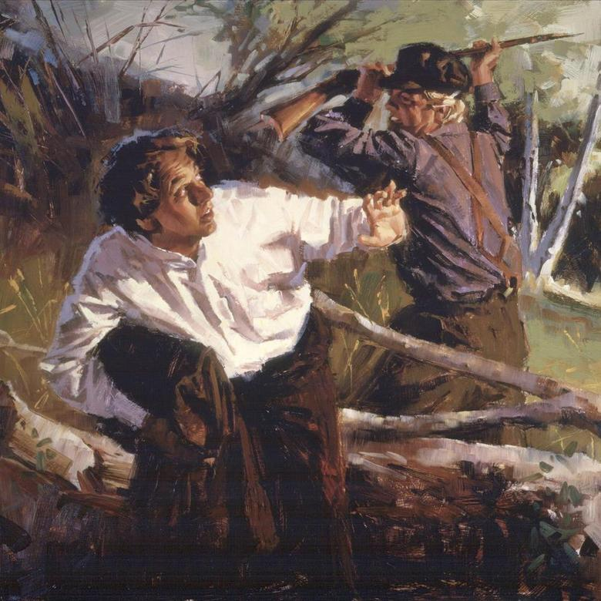
1827: Joseph Finally gets the golden plates
No record other than Joseph’s account exists for the 1825 & 1826 visits to the Hill Cumorah for the Golden Plates, but Joseph Knight’s Reminiscences papers claim that the treasure guardian angel told Joseph that he must come back with the “right person”—which Joseph found to be Emma Hale (his 1st wife) when he used his seer stone to locate her. On the Autumnal equinox in 1827, wearing all black, Joseph allegedly retrieved the golden plates.

Slide 16
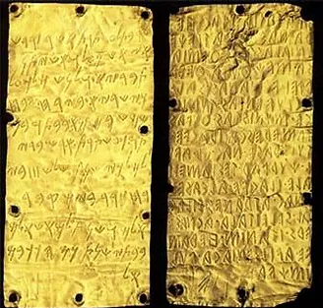
The Problem with the Plates
“The "unsealed portion" of the gold plates, that we are told comprise the Book of Mormon today, consisted of 12 plates. The first edition of the Book of Mormon is 590 pages, which means that every gold plate accounts for about 50 pages of text in English, which then is about 22,000 words in English per plate.” ldsdiscussions.org, Book of Mormon: Gold Plates of the Book of Mormon

Slide 17
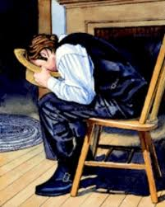
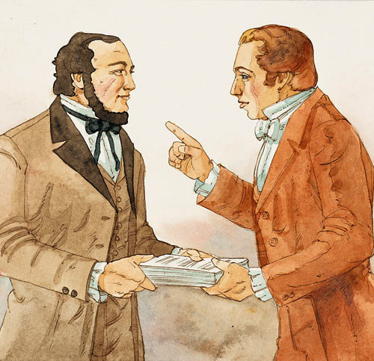
The Translation
“By aid of the seer stone, sentences would appear and were read by the Prophet and written by Martin [Harris] and when finished he would say "Written," and if correctly written that sentence would disappear and another appear in its place, but if not written correctly it remained until corrected, so that the translation was just as it was engraven on the plates, precisely in the language then used." ("One of the Three Witnesses," Millennial Star, Volume 44, p 86-87)
Keep in mind that Joseph Smith “translated” the golden plates by using his seer stone and looking in his hat (just like treasure-digging) and relaying the interpretation to a scribe—the golden plates were not even present. The original scribe Martin Harris, begged Joseph to bring the first 116 pages of the manuscript home to show his wife that the work he was engaged in was legitimate. However, the 116 pages were lost and Joseph was told NOT to retranslate them.

Slide 18
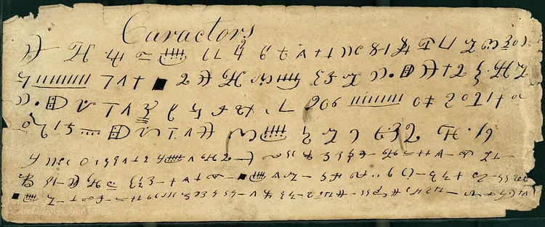
The Characters
Martin Harris was given characters from the golden plates by Joseph Smith, Martin Harris took these to a scholar Charles Anton, to confirm their Egyptian origin. As you can see, it does not appear to be Egyptian at all but looks like a variation of an English letters.

Slide 19
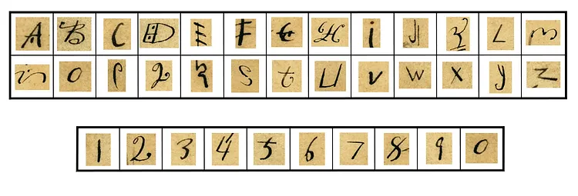
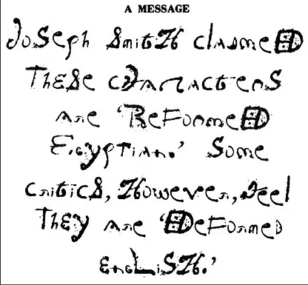
Sandra and Jerold Tanner took the characters and wrote the following: “Joseph Smith claimed these characters are reformed Egyptian. Some critics, however, feel they are deformed English”

Slide 20
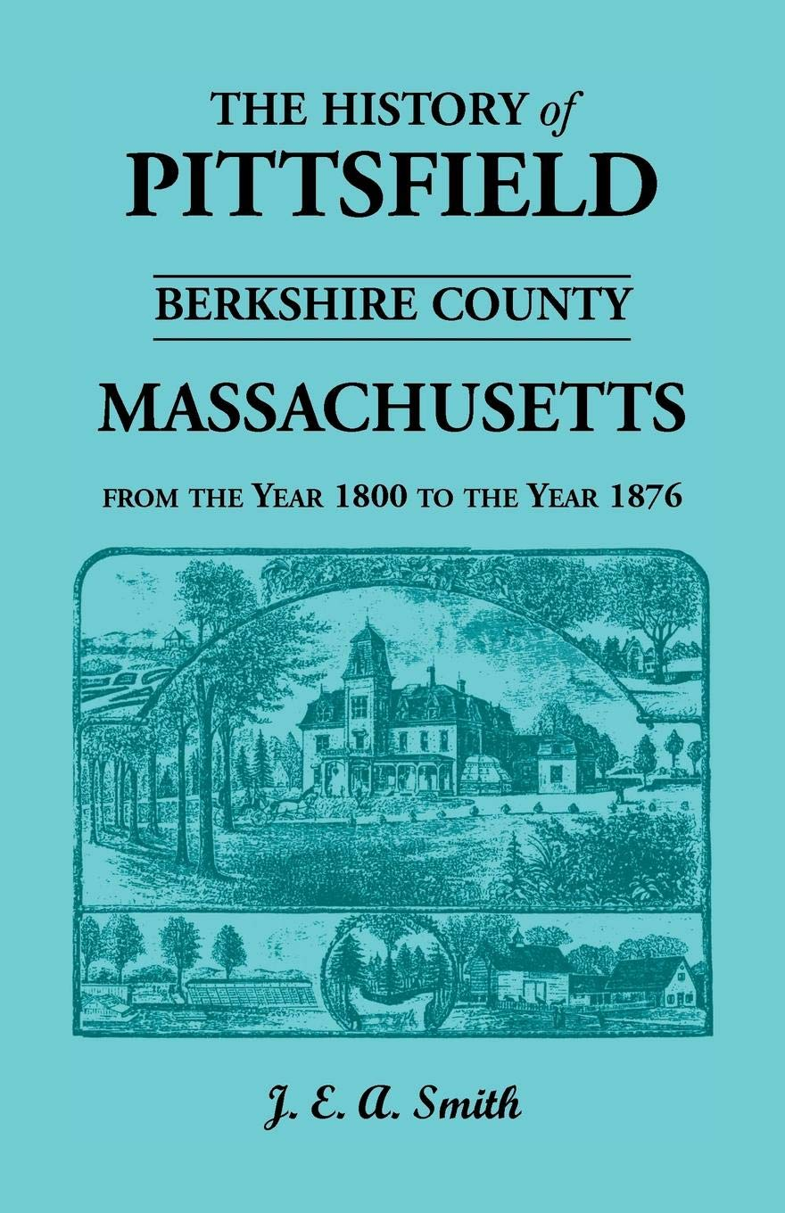
Native Americans = Lost Tribes???
J. E. A. Smith’s History of Pittsfield, [Mass.] 1734-1800 (written in 1869):
”On Indian Hill, in 1815, Capt. Joseph Merrick turned up with his plough a Jewish frontlet, which being opened, displayed the usual sentences of Hebrew scripture, beautifully inscribed upon parchment, which had been kept in perfect preservation by leathern casings. The theory that the American Indians are the descendants of the lost tribes of Israel had then many ardent supporters, who, of course, hailed Capt. Merrick’s waif as confirmation of their faith, in a double sense ‘strong as Holy Writ.’ Deposited with the Antiquarian Society at Worcester, it was learnedly discussed; and we still find it occasionally mentioned in books.”

Slide 21
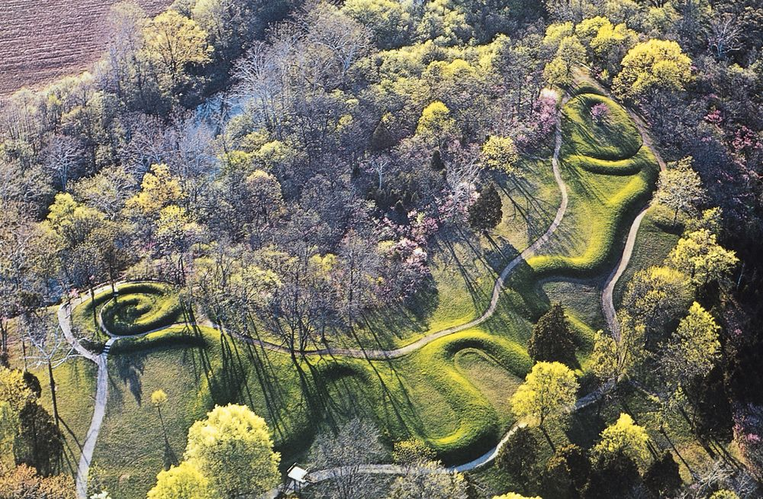
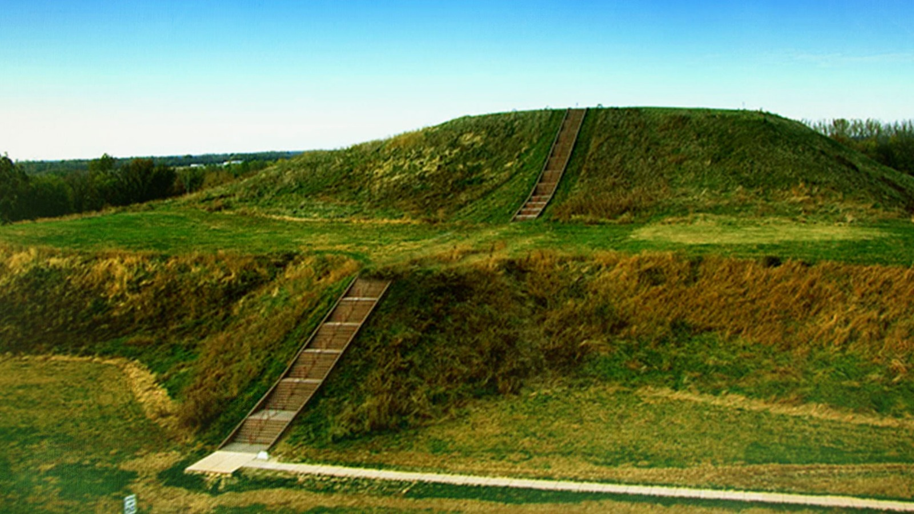
Moundbuilders
The Great Serpent Mound Ohio Historical Marker, Peebles, Ohio
The Cahokia Mounds State Historic Site, near St Louis, Missouri

Slide 22
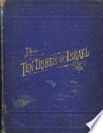
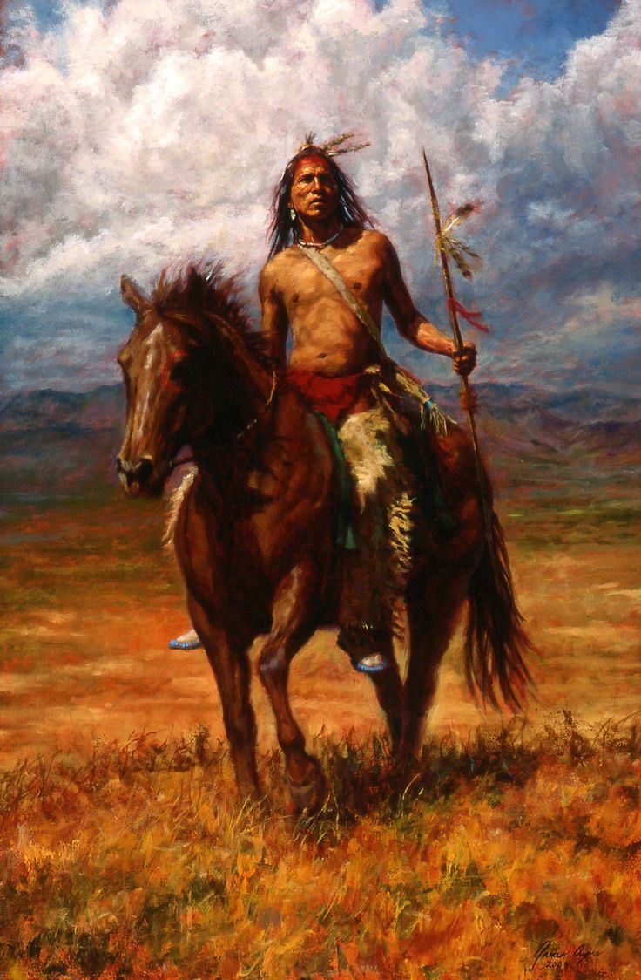
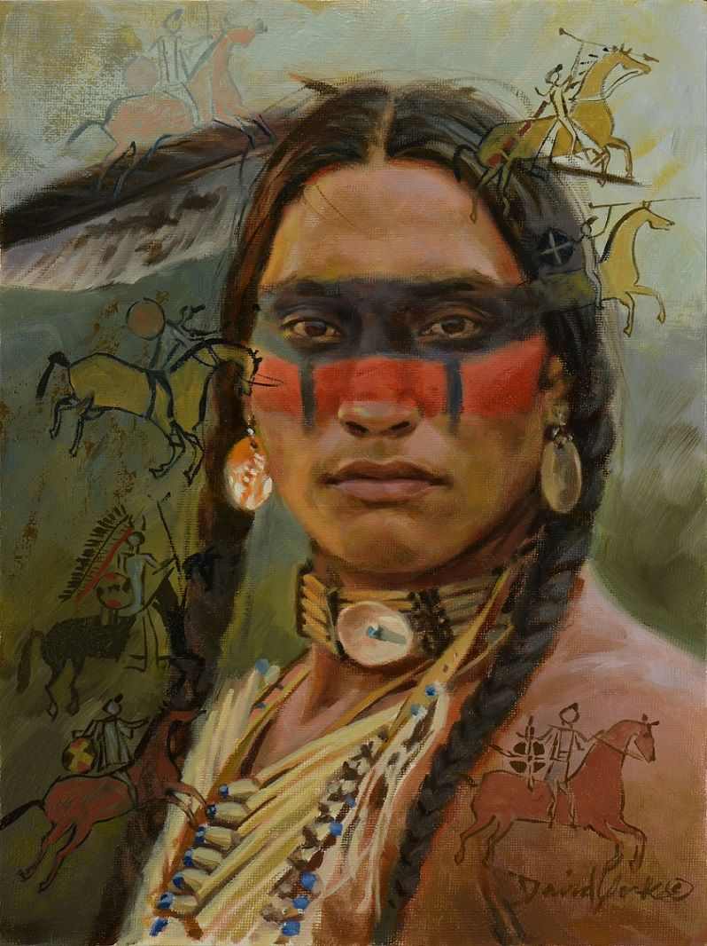
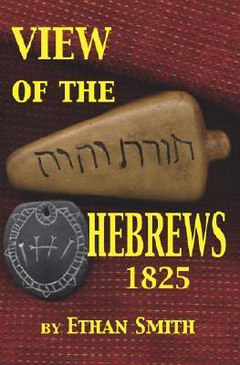
Belief in Indians being lost tribes common
-Ten Tribes of Israel (1883) Timothy Jenkins
-Discourse on the Evidences of the American Indians, Being the Descendants of the Lost Tribes of Israel Delivered Before the Mercantile Library Association, Clinton Hall (1837) M. M. Noah
-View of the Hebrews (1823) Ethan Smith, a Congregationalist minister in Vermont
“Numerous commentators on Mormon history, from LDS Church general authority B. H. Roberts to Fawn M. Brodie, biographer of Joseph Smith, have noted similarities in the content of View of the Hebrews and the Book of Mormon, which was first published in 1830, seven years after Ethan Smith's book.” Wikipedia, View of the Hebrews

Slide 23
DNA tests
“Mormon researchers such as anthropologist Thomas W. Murphy and ex-Mormon plant geneticist Simon Southerton state that the substantial collection of Native American genetic markers now available are not consistent with any detectable presence of ancestors from the ancient Middle East. They have argued that this poses substantial evidence to contradict the account in the Book of Mormon.” Wikipedia, Genetics and the Book of Mormon

Slide 24
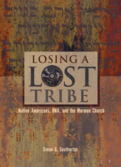
The DNA tells all… The Book of Mormon is False!
“For the past 175 years, the Latter-day Saint Church has taught that Native Americans and Polynesians are descended from ancient seafaring Israelites. Recent DNA research confirms what anthropologists have been saying for nearly as many years, that Native Americans are originally from Siberia and Polynesians from Southeast Asia. In the current volume, molecular biologist Simon Southerton explains the theology and the science and how the former is being reshaped by the latter. In the Book of Mormon, the Jewish prophet Lehi says the following after arriving by boat in America in 600 BCE: ‘Wherefore, I, Lehi, have obtained a promise, that inasmuch as those whom the Lord God shall bring out of the land of Jerusalem shall keep his commandments, they shall prosper upon the face of this land; and they shall be kept from all other nations, that they may possess this land unto themselves’ (2 Ne. 1:9).”—Losing a Lost Tribe, Book Cover, (2004) Simon Southerton

Slide 25
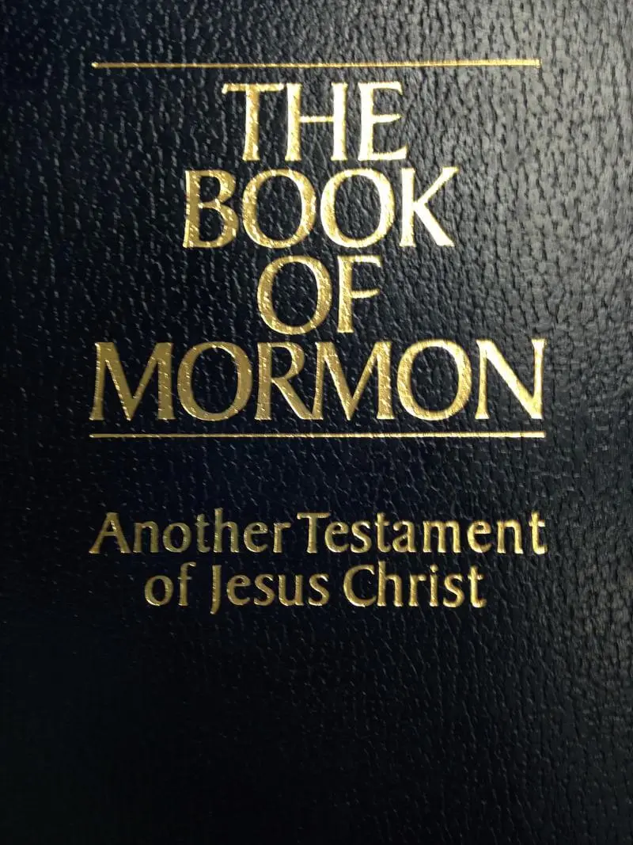
Changes to the Opening:
Introduction of the Book of Mormon, by Bruce R. McConkie (1981): "After thousands of years, all were destroyed except the Lamanites, and they are the principal ancestors of the American Indians."
Introduction of the Book of Mormon (2006): “After thousands of years, all were destroyed except the Lamanites, and they are among the ancestors of the American Indians.”

Slide 26
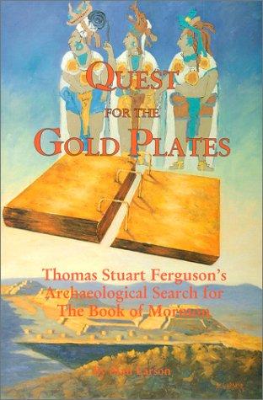
The Archeologist Who Lost His Faith in Mormonism
“Ferguson's public career as BOM defender began in 1941 when he published an article in the LDS church's monthly Improvement Era magazine (predecessor to the Ensign) espousing the then controversial "limited geography" model — that the BOM people occupied only a small region in Central America, not the entire Western Hemisphere, as had been traditionally thought. This was followed by several popular books, including Cumorah Where?, Ancient America and the Book of Mormon, co-authored with General Authority Milton R. Hunter, and One Fold and One Shepherd.”—Luke P. Wilson, A Mormon Champion's Loss of Faith | Institute for Religious Research (irr.org)
Stan Larson, Quest for the Gold Plates

Slide 27
“A lawyer by profession, Ferguson was a man whose ability and passion for defending the BOM attracted notice. J. Willard Marriot became his wealthy patron and apostle John A. Widtsoe his mentor. In 1952 Ferguson single-handedly founded the New World Archaeological Foundation (NWAF), with the vision of doing academically credible archaeological research in Central America to prove the BOM . . . Findings that once seemed promising evidence for the BOM, had proved fallacious: -Joseph Smith's 1842 identification of the ancient ruins of Palenque, Mexico as a Nephite city — which Ferguson had once cited as support for locating the Nephites in Mesoamerica — was now known to date not earlier than A.D. 600, after BOM times (22). Likewise, Joseph Smith's identification of impressive ruins and an engraved stone at Quirigua, Guatemala with such a stone mentioned in Omni 1:20, was now known to be impossible, since the ruins date after the BOM period (22-24). . . . Ferguson had come to doubt that the BOM is a translation of ancient records. To Larson's surprise, Ferguson frankly confirmed – "with no bitterness but with a touch of disappointment" – his "present skepticism about the historicity of the Book of Mormon" (xiv). ”—Ibid.

Slide 28
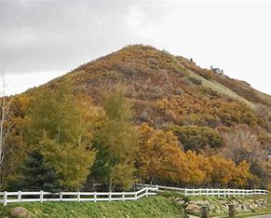
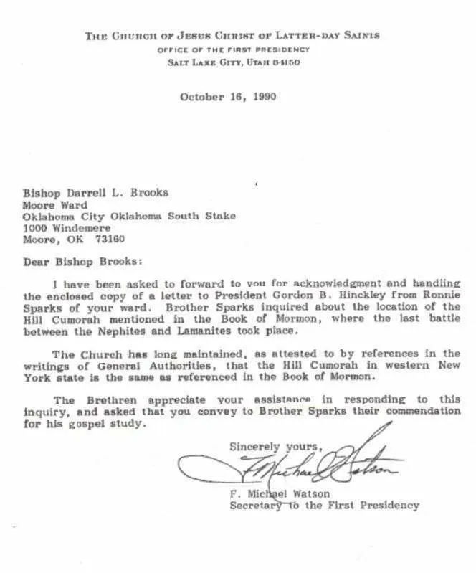
The Hill Cumorah
Elder B H Roberts, October 1927 General Conference: "Only three weeks ago, about now, I had the pleasure of standing upon the summit of the hill Cumorah in company with President Grant. Being there upon the height...I could not refrain from recalling the time when Moroni stood upon the crown of that hill with the evidence of the ruins of the civilization of his people about him. And this warning, written in the book of Ether, let me say, in closing, comes from the prophet of God who was also the historian of the great Jaredite nation, by abridging and translating their history into the Nephite language. This warning comes, then, from the historian of one civilization that had perished about the hill Cumorah; it came also from the same man who was a witness of the destruction of the civilization of his own people at the same place.“
Letter from the office of the First Presidency, 1990: "The Church has long maintained, as attested to by references in the writings of General Authorities, that the Hill Cumorah in western New York state is the same as referenced in the Book of Mormon."

Slide 29
Whoops!
—BYU Journal of Book of Mormon Studies,
vol. 14, no. 2, article 7, July 31 2005 “Looking for Artifacts at New York’s Hill Cumorah”
“the church owns Hill Cumorah and has had plenty of time to study and scan the hill for ancient artifacts and remains. There is nothing to be found - no stone box that held the 'gold plates,' no abundance of weaponry from these unprecedented battles, and no bodies from among the hundreds of thousands that died” ldsdiscussions.org, Book of Mormon: Official LDS Essay on Book of Mormon Geography, Annotated

Slide 30
The New Policy on the Geography
Official Church Position: “The Church does not take a position on the specific geographic locations of Book of Mormon events in the ancient Americas. Speculation on the geography of the Book of Mormon may mislead instead of enlighten; such a study can be a distraction from its divine purpose.”—Book of Mormon Geography (churchofjesuschrist.org), Gospel Topics Essay
It’s obvious to see that the reason that the Church “does not take a position” is because when the Book of Mormon is examined in the light of any field of study: archeology, geography, linguistics, Egyptology, theology, DNA tests, and history—they are proven false. There have been found no coins, weapons, buildings, bodies from these massive battles (hundreds of thousands are said to have died at the Hill Cumorah alone). If they had some solid evidence of the events of Book of Mormon is would be plastered on every Mormon edifice in the world, presented at every opportunity, and celebrated within the church—but this is not the case.

Slide 31
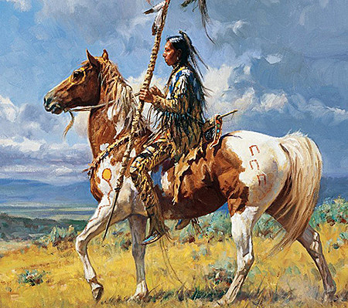
Other Problems in the Book of Mormon
1 Nephi 18:25 “And it came to pass that we did find upon the land of promise, as we journeyed in the wilderness, that there were beasts in the forests of every kind, both the cow and the ox, and the ass and the horse, and the goat and the wild goat, and all manner of wild animals, which were for the use of men. And we did find all manner of bore, both of cgold, and of silver, and of copper.
Enos 1:21 “And it came to pass that the people of Nephi did till the land, and raise all manner of grain, and of fruit, and flocks of herds, and flocks of all manner of cattle of every kind, and goats, and wild goats, and also many horses.”

Slide 32
The Book of Mormon Evidence of Fraud:
The Source (Joseph Smith-treasure-digger) is untrustworthy
The Story is doubtful (the magical overtones—Alvin)
The Characters do not make sense (Deformed English)
The Math does not add up (12 Golden Plates 22k words per page)
The DNA does not match (Indians are not Israelites)
The Archeology does not exist (No evidence of great battles, etc.)
The writings are not accurate (horses, sheep, etc.)
However, the evidence that Joseph Smith is lying is more reliable:
Joseph Smith’s accounts do not match his followers or family retelling of the same accounts (Joseph Smith vs Joseph Knight and the Alvin story)
Joseph Smith is involved in magic before, during and after the golden plates vision (treasure-digging—never finds anything for anyone, power of 3, the color black, autumnal equinox)
Joseph Smith is convicted of fraud (glass-looking) in 1826, breaking the law in New York
Joseph Smith never shows the golden plates to anyone except a few private viewings of only his most devout followers
The Book of Mormon seems to follow “View of the Hebrews”, and the characters are certified fake (looks like English)
Joseph Smith “translates” the plates by using the same methods used for glass-looking
Joseph Smith asks God 3 times to allow Martin Harris to take the first 116 pages, God allows, the pages lost, and Joseph Smith cannot retranslate them—when Joseph Smith loses control, his prophetic gifts do not work—Jeremiah rewrote his book!

Slide 33
Time-setting Again! 1975
"Choosing the Best Way of Life". The Watchtower. March 15, 1980. pp. 17–18. With the appearance of the book Life Everlasting—in Freedom of the Sons of God, ... considerable expectation was aroused regarding the year 1975. ... there were other statements published that implied that such realization of hopes by that year was more of a probability than a mere possibility. It is to be regretted that these latter statements apparently overshadowed the cautionary ones and contributed to a buildup of the expectation already initiated. ... persons having to do with the publication of the information ... contributed to the buildup of hopes centered on that date.
"What will the 1970's Bring?". Awake!. Watch Tower Society. October 8, 1968. p. 14. Does this mean that the above evidence positively points to 1975 as the complete end of this system of things? Since the Bible does not specifically state this, no man can say... If the 1970s should see intervention by Jehovah God to bring an end to a corrupt world drifting toward ultimate disintegration, that should surely not surprise us.
"How Are You Using Your Life?". Our Kingdom Ministry. May 1, 1974. p. 63. Reports are heard of brothers selling their homes and property and planning to finish out the rest of their days in this old system in the pioneer service. Certainly, this is a fine way to spend the short time remaining before the wicked world's end.

Slide 34
Decline of the Watch Tower After Death
Chicago Daily Tribune October 30, 1949 pg 18: "Pastor Russell died in 1916. In the 33 years since, the methods of this sect have deviated completely from those of Pastor Russell and his manner of teaching."

