Slide 1

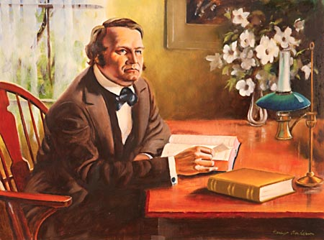
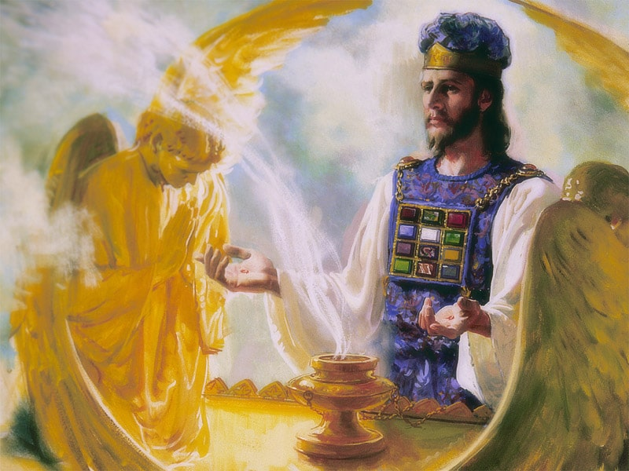
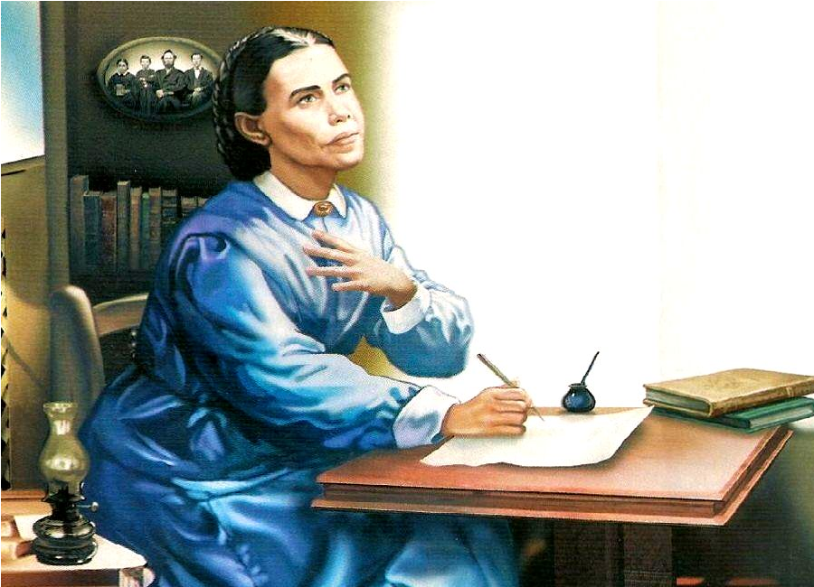
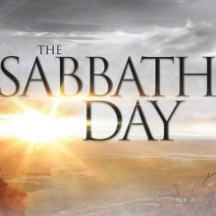
The 2300 Days

Slide 2
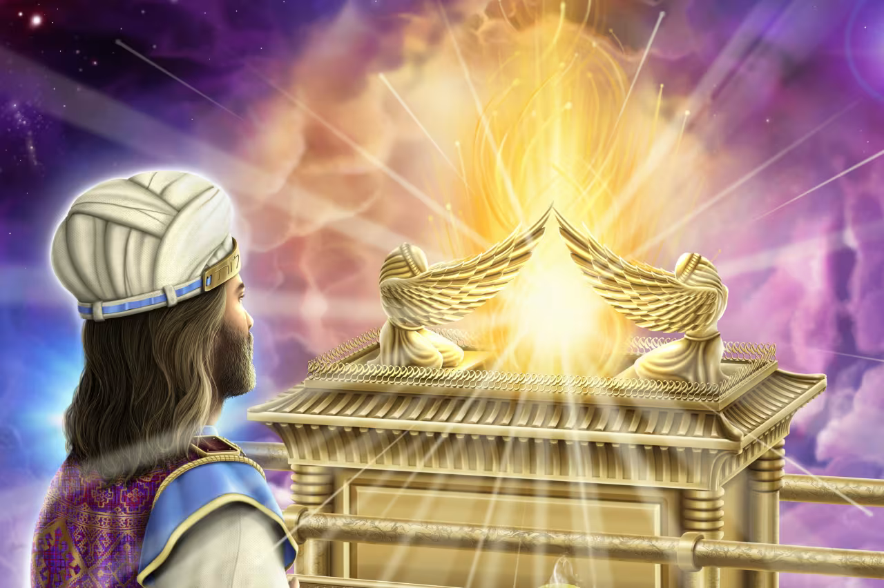
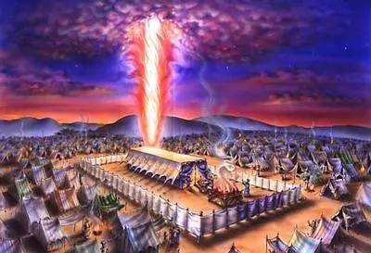
Recap…
We have now learned that the 2300 year prophecy would end 2300 years AFTER the Decree to Restore and to Build Jerusalem—which was the Decree of Artaxerxes in 457BC, adding 2300 years brings us to 1844. However, Daniel 8:14 is all about the Restoration of the Sanctuary (Sanctuary doctrine, heavenly sanctuary and its principles), which will happen on the Antitypical Day of Atonement feast day signified by the answer to the saint’s question of when the Sanctuary would be restored—the answer was “then shall the sanctuary be cleansed”—the cleansing of the Sanctuary only occurred on the Hebrew Feast Day The Day of Atonement, or Judgment, when all Israel was to be judged by God.

Slide 3
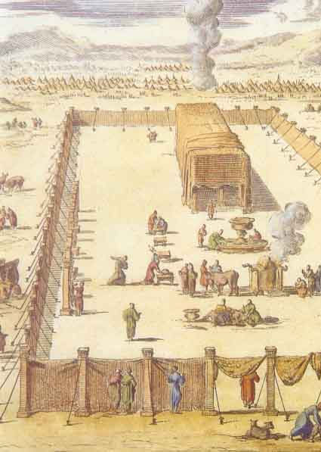
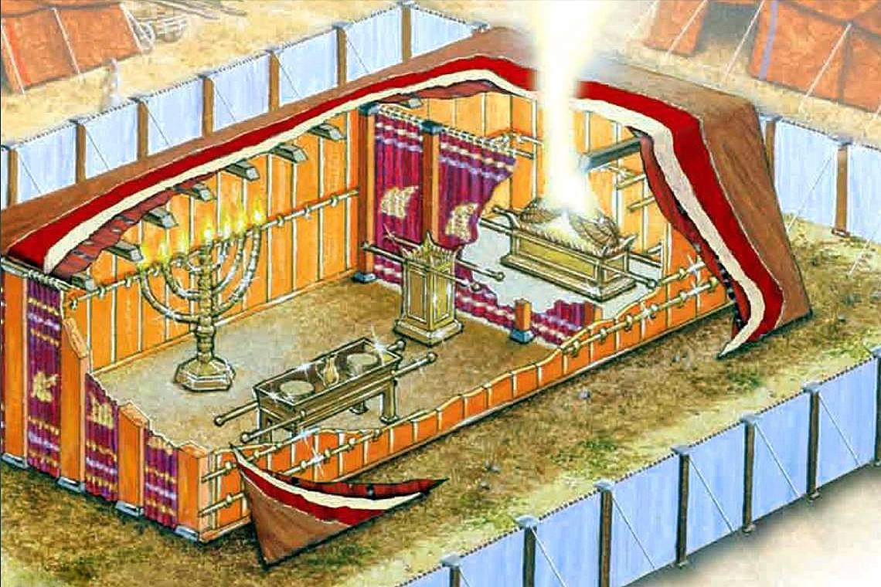
Daniel 8 Revisited…
Dan. 8:11-14 “Yea, he magnified himself even to the prince of the host, and by him the daily sacrifice was taken away, and the place of the sanctuary was cast down. And an host was given him against the daily sacrifice by reason of transgression, and it cast down the truth to the ground; and it practised, and prospered. Then I heard one saint speaking, and another saint said unto that certain saint which spake, How long shall be the vision concerning the daily sacrifice, and the transgression of desolation, to give both the sanctuary and the host to be trodden under foot? And he said unto me, Unto two thousand and three hundred days; then shall the sanctuary be cleansed.”

Slide 4

The Great Controversy
The Millerite Movement took as their supreme passage Daniel 8:14. All the other prophecies discovered and taught served to this end: that the 2300 days were almost fulfilled, and that God would Return and cleanse the earth (the sanctuary in their minds) by fire. After their identical experience with the Disciples in misunderstanding the event to take place, 50 of the 50,000 Millerites clung to the correctness of the time periods and prophecies (all others either renounced their views, or the time periods, and/or set new times). The “key” ended up being the Sanctuary doctrine—Jesus did not cleanse the earth by fire after the 2300 days, but He entered into the most holy place instead; this was the Antitypical Day of Atonement on October 22, 1844: therefore without fully understanding, the very things that Daniel 8:14 promised (1. the end of the 2300 days/years prophecy beginning in 457BC; 2. The restoration of the Sanctuary doctrines beginning during the Reformation; 3. This event would coincide with the Day of Judgment/Atonement)—isn’t it interested that the book “The Great Controversy recounts the history of the church, how it was to lose the Sanctuary doctrines, and how one-by-one those same doctrines were restored? Culminating in the Millerite Movement? Without fully understanding, Ellen White penned the very history specifically outlined in Daniel 8.

Slide 5
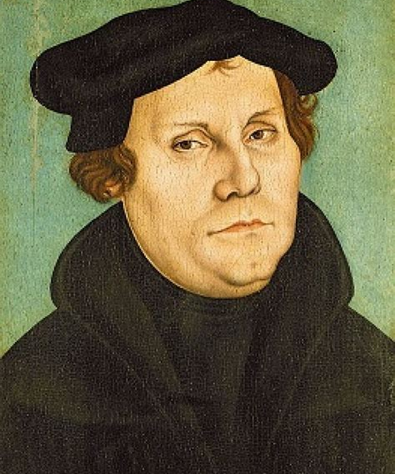
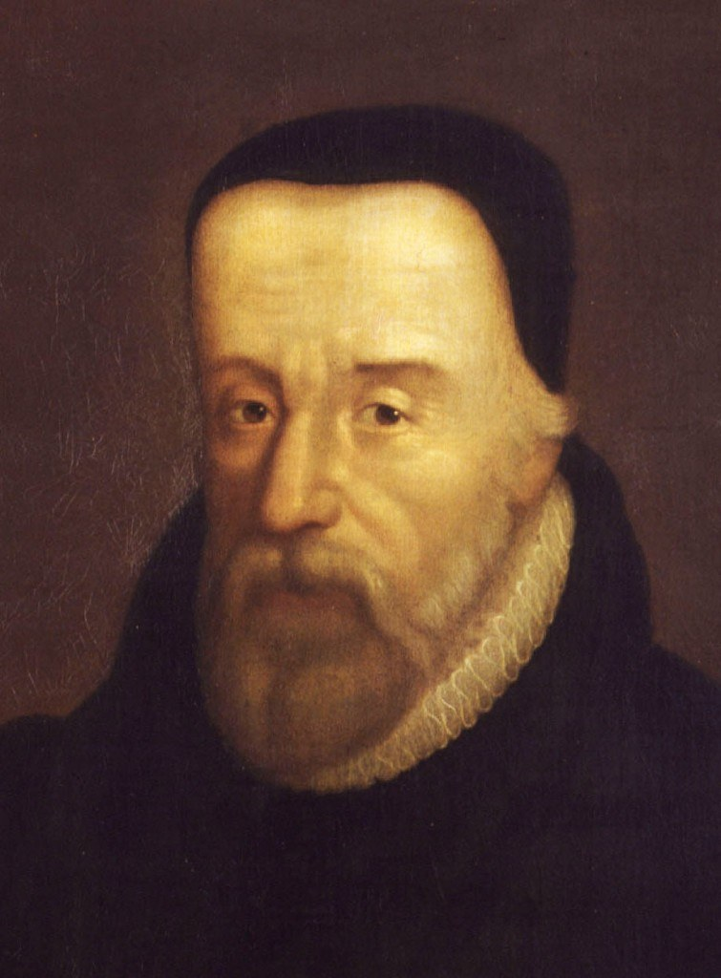
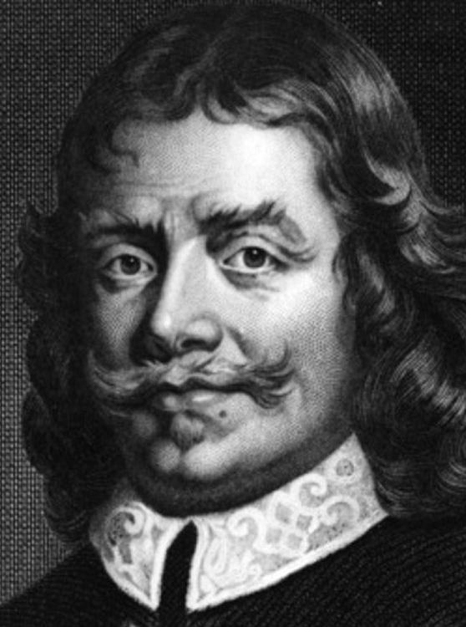
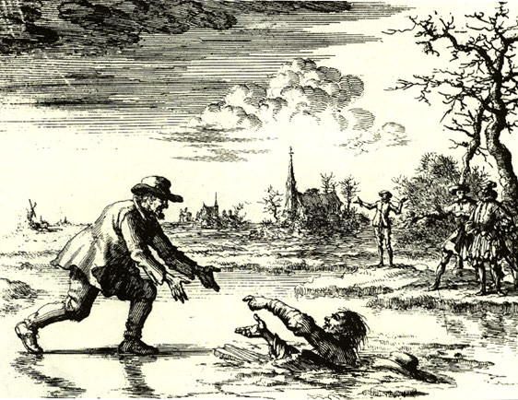
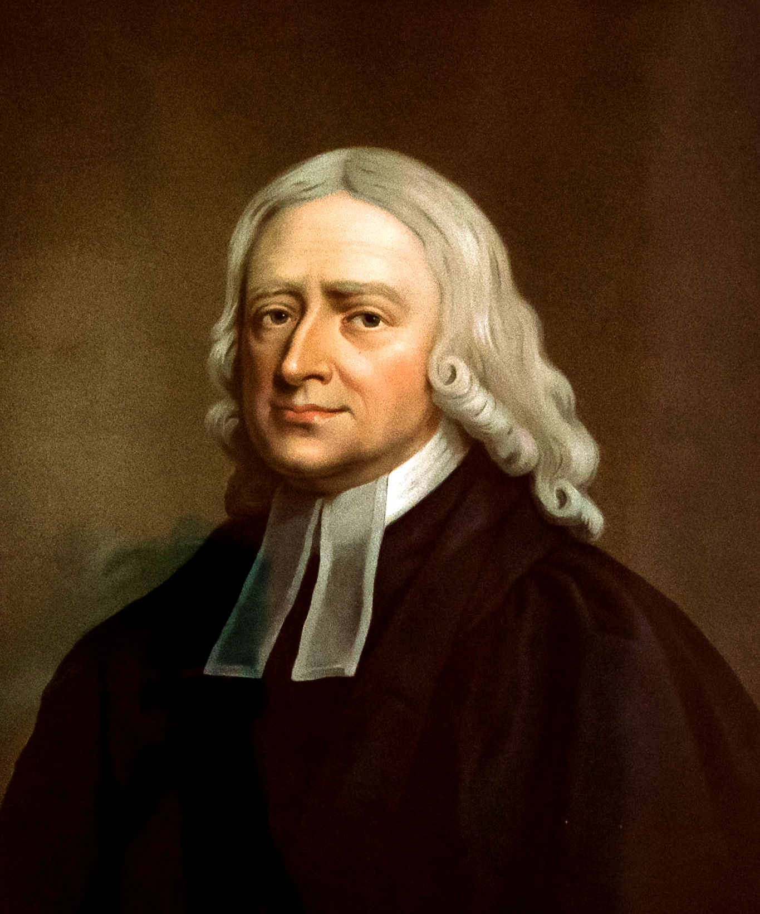
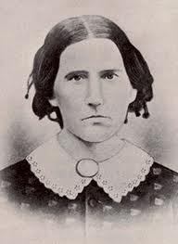
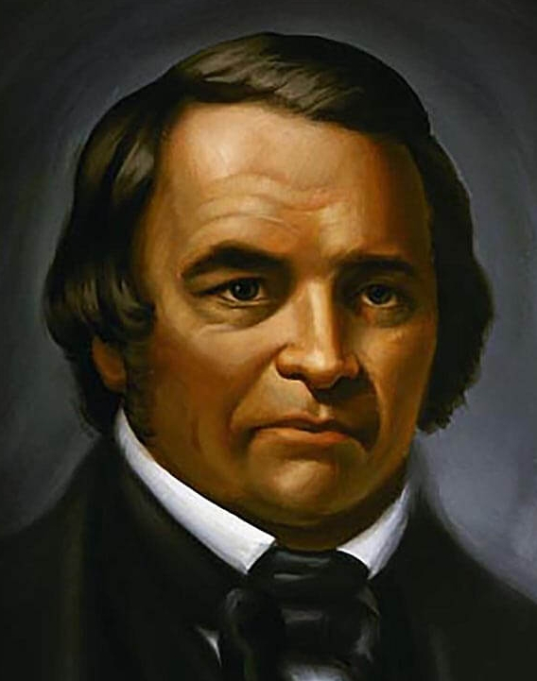
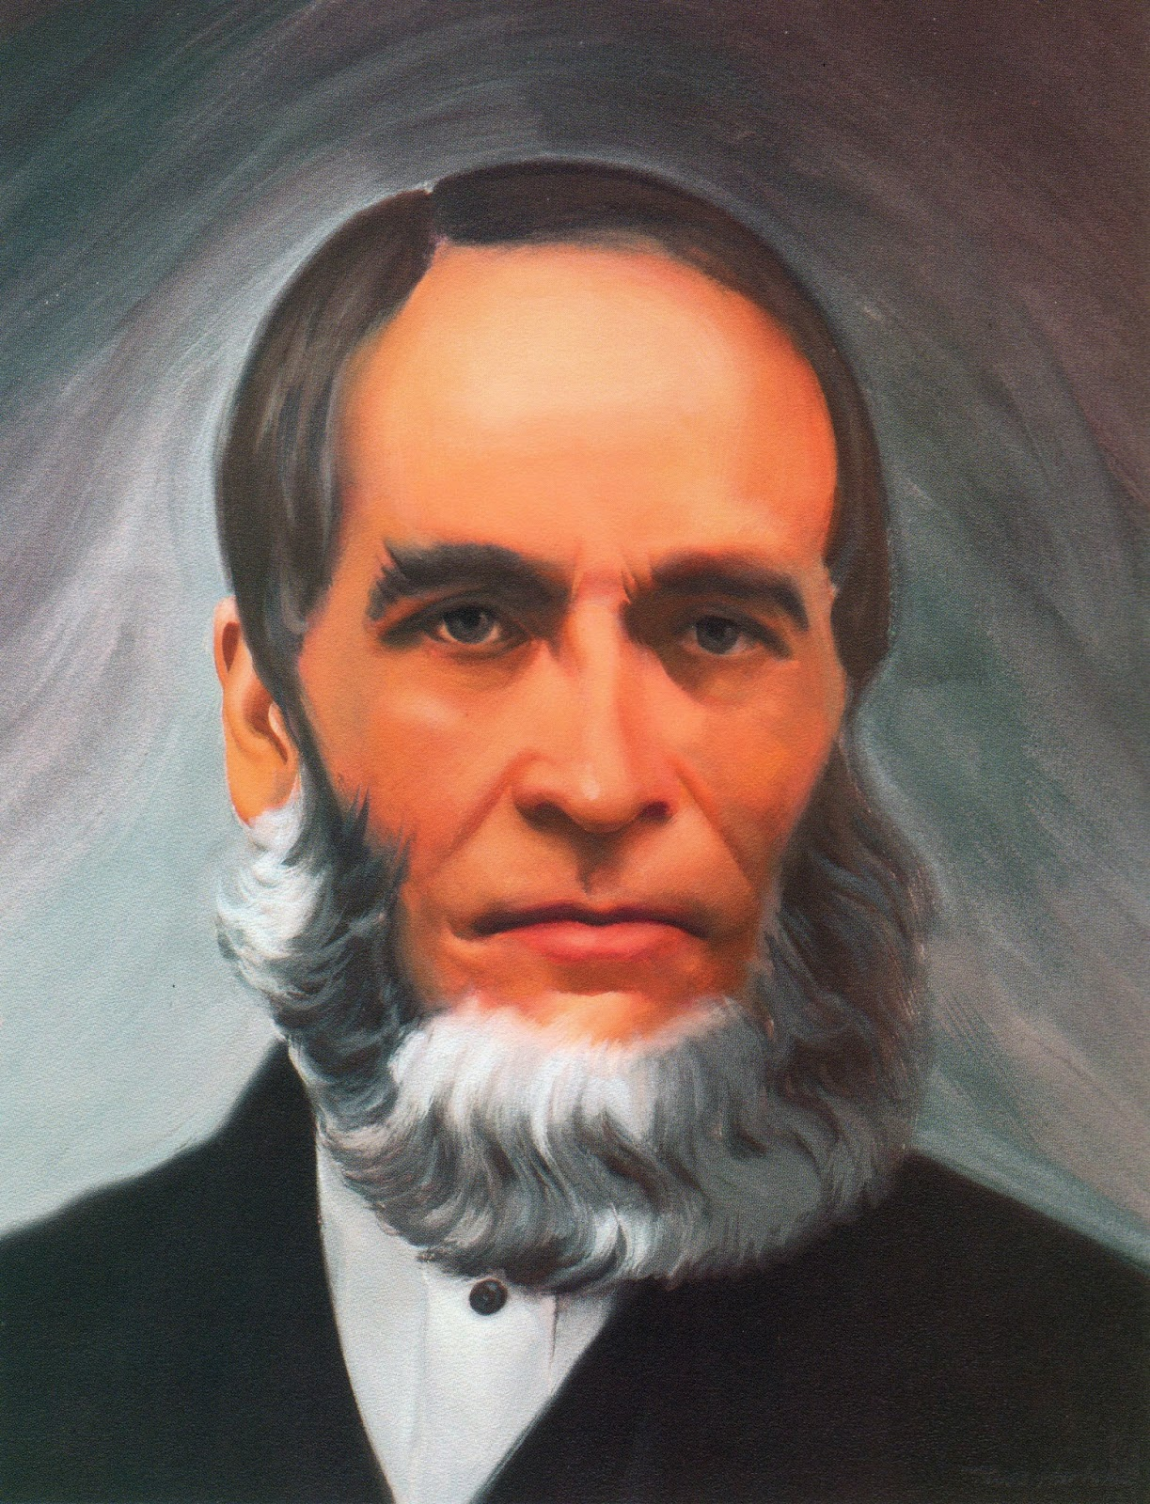
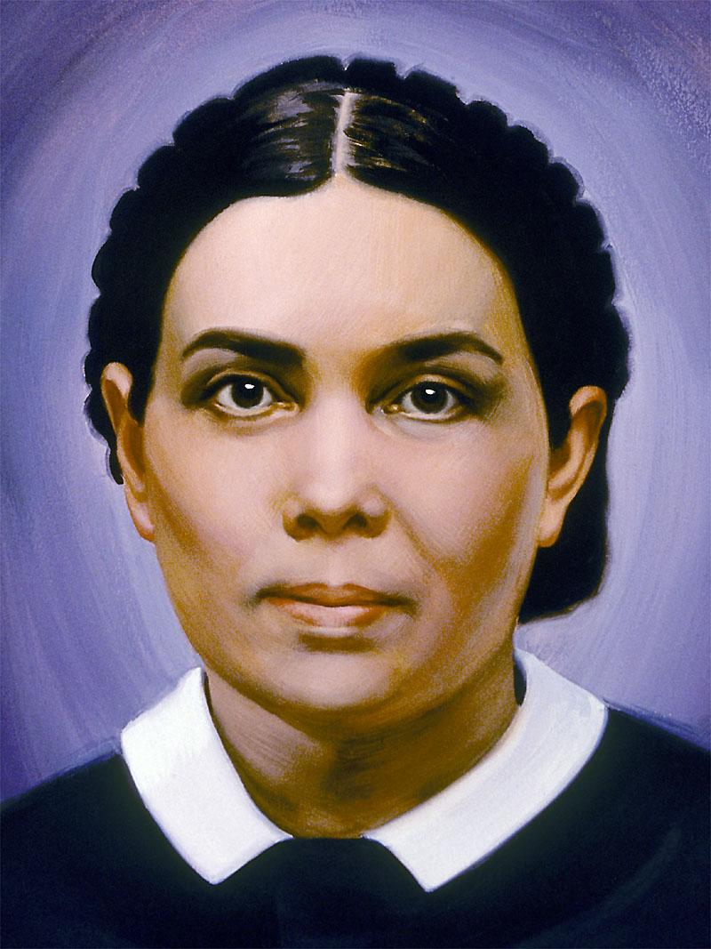

The Reformation Began Recovering the Sanctuary
The Reformation Rediscovered lost truths of the Sanctuary—effectively beginning the process of restoring the spiritual Sanctuary, culminating in the full restoration by Christ in 1844:
Justification by Faith – Altar of Burnt Offering Restored
Baptism and Communion – Laver and Drink Offering Restored
Sola Scriptura – Daily Bread/Shewbread Restored
Evangelism – Candlestick Restored
Prayer in the Spirit – Altar of Incense Restored
Righteousness by Faith – Merits of Christ/incense and oil restored
1844
7. Sabbath – Law of God Restored
8. Health Message – Manna Restored
9. Justification By Faith – Aaron’s Rod/Mercy Seat Restored
10. 3 Angel’s Messages – Judgment Hour/Day of Atonement Message Restored
11. State of the Dead – Investigative Judgment Understanding Restored

Slide 6
William Miller (1782-1849): William Miller was an American Patriot and served in various offices of local government. In 1810, he moved to Poultney, Vermont where he shook off his Baptist upbringing in favor of Deism. He stated “I became acquainted with the principal men in that village [Poultney, Vermont], who were professedly Deists; but they were good citizens, and of a moral and serious deportment. They put into my hands the works of Voltaire, [David] Hume, Thomas Paine, Ethan Allen, and other deistical writers.” (Miller, William (1845). Wm. Miller's Apology and Defence. Boston, p. 24). However everything changed when he served as a captain in the War of 1812, where at the victory of the Battle of Plattsburgh (Sept. 6-11, 1814) it was evident that God had intervened on behalf of the heavily outmanned and outgunned American forces—Miller survived the battle without so much as a scratch. Recounting the affair, he said: “It seemed to me that the Supreme Being must have watched over the interests of this country in an especial manner, and delivered us from the hands of our enemies... So surprising a result, against such odds, did seem to me like the work of a mightier power than man” (Bliss, Sylvester (1853). Memoirs of William Miller, p. 32, 53). Miller was discharged from the military in 1815, and began attending the Baptist Church again in Low Hampton, NY. At this time he retained deistic views of God, until one Sunday he was volunteered to read the pastor’s sermon to the congregation during one of the pastor’s absences. It was about the duty of parents to children. William Miller was so touched by the sermon that he choked up while reading; in his own words: “Suddenly the character of a Savior was vividly impressed upon my mind. It seemed that there might be a Being so good and compassionate as to Himself atone for our transgressions, and thereby save us from suffering the penalty of sin. I immediately felt how lovely such a Being must be; and imagined that I could cast myself into the arms of, and trust in the mercy of, such a One.” (Miller, William (1845). Wm. Miller's Apology and Defence, p. 5). Miller was converted and renounced Deism. When challenged by his former Deist friends on “contradictions” in the Bible, Miller undertook to reconcile these apparent “contradictions”—trusting that the Bible would render sufficient answers to these questions.

Slide 7
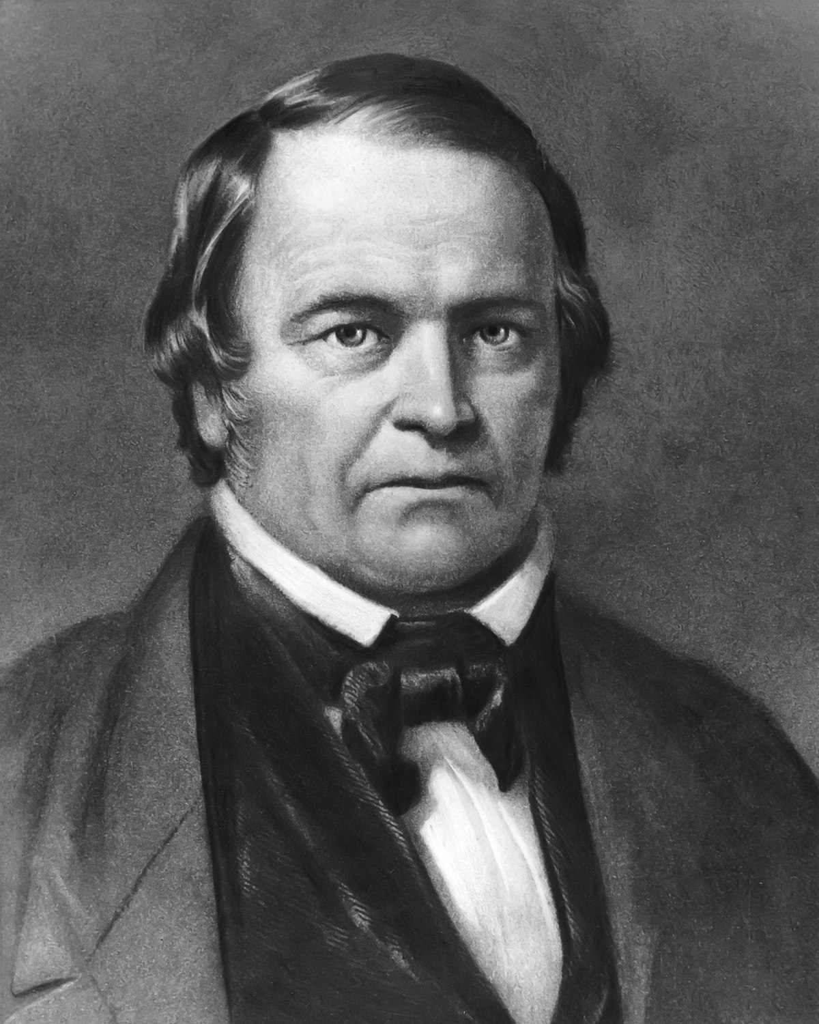
Trusting in the Bible as the Word of God, capable of giving satisfying answers to all perceived “errors” and “contradictions” William Miller began studying the Bible intensely in 1816; beginning with Genesis 1:1. By 1818 he was studying the Book of Daniel. He calculated the 2300 days mentioned in Daniel 8:14 using the Day-Year Principle to end in 1843/1844— identifying the decree to restore and build Jerusalem from Persian King Artaxerxes I in 457BC as the starting point for the prophecy (from Daniel 9:24-27). He interpreted the passage: “then shall the Sanctuary be cleansed” (Dan. 8:14) as meaning that Jesus Christ would Return to “cleanse” the earth by fire at the close of the 2300 day/year period. In 1818, he stated: “I was thus brought... to the solemn conclusion, that in about twenty-five years from that time 1818 [ending in 1843] all the affairs of our present state would be wound up” (Miller, William (1845). Wm. Miller's Apology and Defence, p. 11-12). He continued studying his views to be sure of his interpretation. Finally in 1831 he gave his first formal lecture in the town of Dresden, NY. In 1832, Miller submitted a series of articles to the Vermont Telegraph outlining his understanding of the prophecies he had been studying. The response was overwhelming: “I began to be flooded with letters of inquiry respecting my views; and visitors flocked to converse with me on the subject” (Miller, William (1845). Wm. Miller's Apology and Defence, p. 24). Unable to meet the numerous requests, Miller published: Evidence from Scripture and History of the Second Coming of Christ, about the Year 1844: Exhibited in a Course of Lectures in 1834 so that all could read about what he had discovered in the prophecies of Daniel and Revelation. In 1840, the movement grew when Joshua V. Himes allied with Miller, publishing Signs of the Times and organizing lectures for William Miller. When pressed by the people to apply a specific date for the Second Coming, Miller caved, and in 1843 predicted: “My principles in brief, are, that Jesus Christ will come again to this earth, cleanse, purify, and take possession of the same, with all the saints, sometime between March 21, 1843, and March 21, 1844” (Dick, Everett N. (1994). William Miller and the Advent Crisis, p. 96–97).

Slide 8
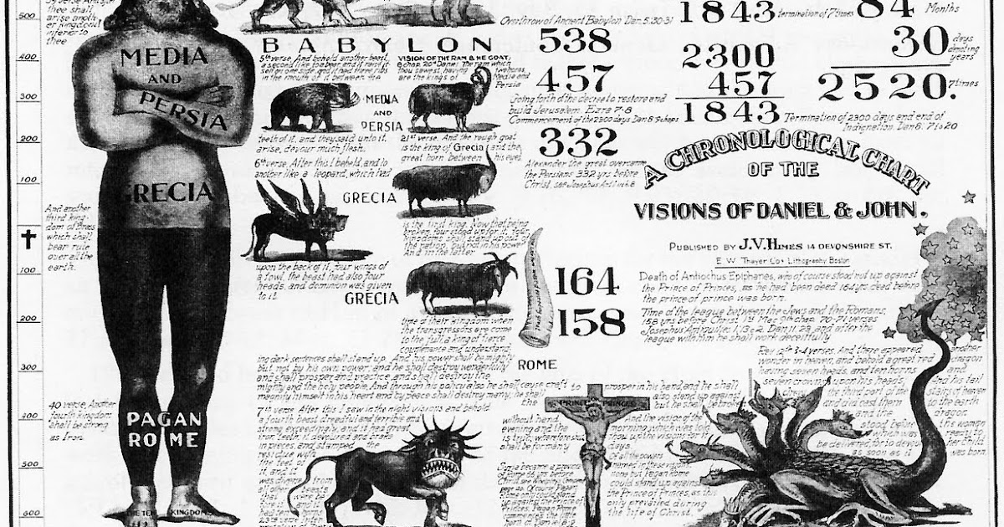
William Miller Gives the First Date
“My principles in brief, are, that Jesus Christ will come again to this earth, cleanse, purify, and take possession of the same, with all the saints, sometime between March 21, 1843, and March 21, 1844.” William Miller quoted in James White, Sketches of the Christian Life and Public Labors of William Miller, p. 182

Slide 10
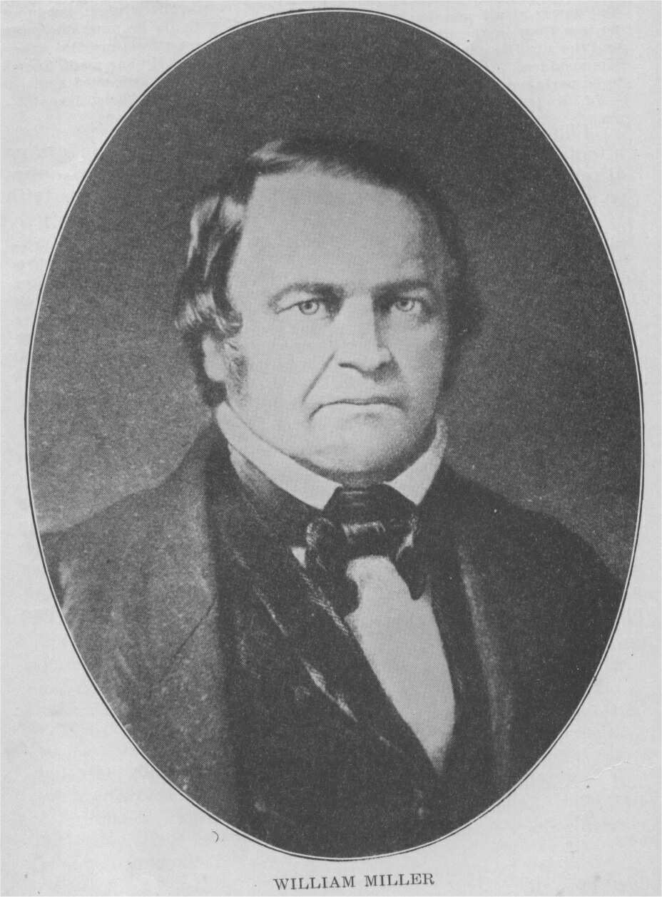
The Mistake Explained: Rabbinic vs Karaite Calendar
“As far back as April, and then in June and December of 1843, and in February of 1844 – months before Miller’s original date expired for the ending of the “Jewish year 1843” at the time of the vernal equinox in 1844- his associates (Sylvester Bliss, Josiah Litch, Joshua V. Himes, Nathaniel Southard, Apollos Hale, Nathan Whiting, and others) came to a definite conclusion. This was that the solution of Daniel’s prophecy is dependent upon the ancient or original Jewish form of luni-solar time, and not upon the altered modern rabbinical Jewish calendar . . . They therefore began to shift from Miller’s original date for the ending of the 2300 years (at the equinox in March), over to the new moon of April, 1844.”--(L. E. Froom, Prophetic Faith of Our Fathers, Review & Herald Publishing Assoc., 1982, Vol. IV, 796)

Slide 11
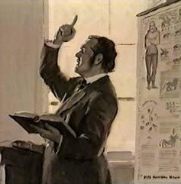
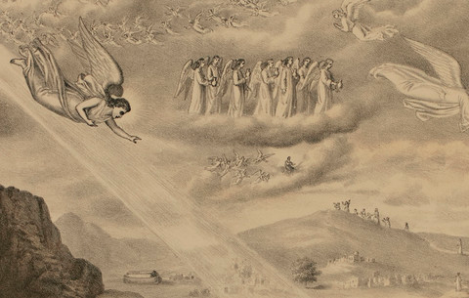
1843-Spring 1844 Pass…
After the time periods (March 21, 1843-March 21, 1844; then April 18/19, 1844) came and went with no return of Jesus Christ, the Millerites were still hopeful and eager for Christ’s Return. The Message of Habbakuk’s tarrying time was applied to the Millerite’s experience in awaiting the fulfillment of the 2300 days:
Hab. 2:2-4 “And the Lord answered me, and said, Write the vision, and make it plain upon tables, that he may run that readeth it. For the vision is yet for an appointed time, but at the end it shall speak, and not lie: though it tarry, wait for it; because it will surely come, it will not tarry. Behold, his soul which is lifted up is not upright in him: but the just shall live by his faith.”

Slide 12
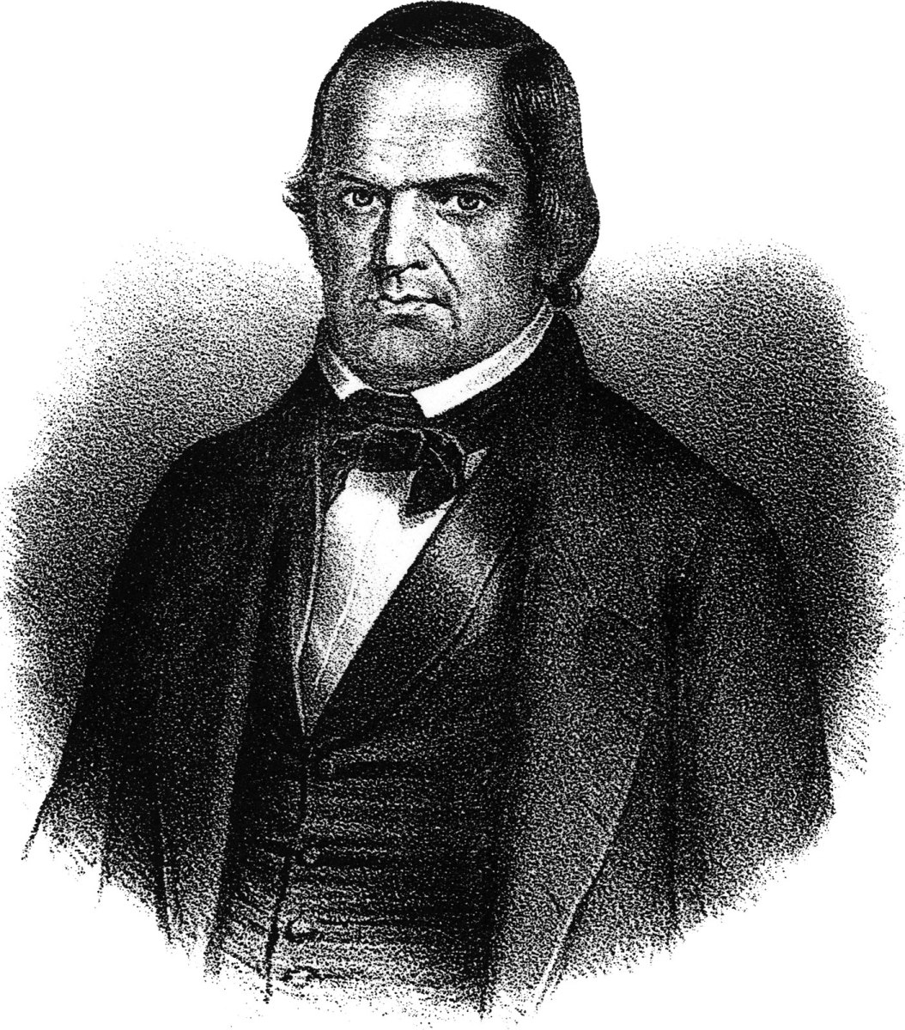
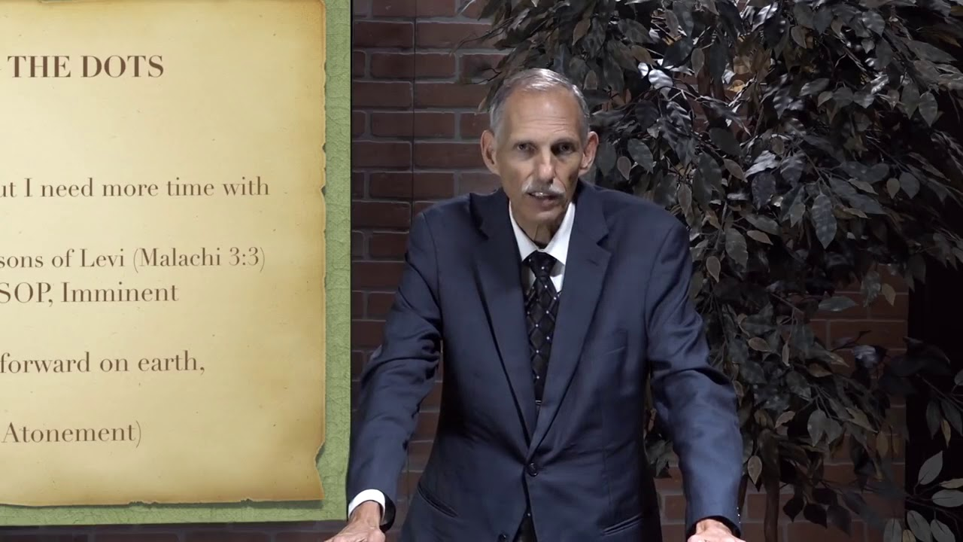
The Courage to Admit the Mistake!
“’I confess my error, and acknowledge my disappointment; yet I still believe that the day of the Lord is near, even at the door; and I exhort you, my brethren, to be watchful, and not let that day come upon you unawares. The wicked, the proud, and the bigot, will exult over us. I will try to be patient. God will deliver the godly out of temptation, and will reserve the unjust to be punished at Christ’s appearing.’”—William Miller quoted in Sylvester Bliss, Memoirs of William Miller, p. 256
VS

Slide 13
Ellen White Gives Context
“When the year 1843 entirely passed away unmarked by the advent of Jesus, those who had looked in faith for his appearing were for a time left in doubt and perplexity. But notwithstanding their disappointment, many continued to search the Scriptures, examining anew the evidences of their faith, and carefully studying the prophecies to obtain further light. The Bible testimony in support of their position seemed clear and conclusive. Signs which could not be mistaken pointed to the coming of Christ as near. The believers could not explain their disappointment; yet they felt assured that God had led them in their past experience. Their faith was greatly strengthened by the direct and forcible application of those scriptures which set forth a tarrying time. As early as 1842, the Spirit of God had moved upon Charles Fitch to devise the prophetic chart, which was generally regarded by Adventists as a fulfillment of the command given by the prophet Habakkuk, "to write the vision and make it plain upon tables." No one, however, then saw the tarrying time, which was brought to view in the same prophecy. After the disappointment, the full meaning of this scripture became apparent. Thus speaks the prophet: [Habakkuk 2:2, 3 Quoted]. A portion of Ezekiel's prophecy also was a source of much strength and comfort to believers: "And the word of the Lord came unto me, saying, Son of man, what is that proverb that ye have in the land of Israel, saying, The days are prolonged, and every vision faileth? Tell them therefore, Thus saith the Lord God:" "The days are at hand, and the effect of every vision." "I will speak, and the word that I shall speak shall come to pass; it shall be no more prolonged." "They of the house of Israel say, The vision that he seeth is for many days to come, and he prophesieth of the times that are far off. Therefore say unto them, Thus saith the Lord God: There shall none of my words be prolonged any more, but the word which I have spoken shall be done. [Ezekiel 12:21-25, 27, 28.]”—Spirit of Prophecy Vol IV, 241-242

Slide 14
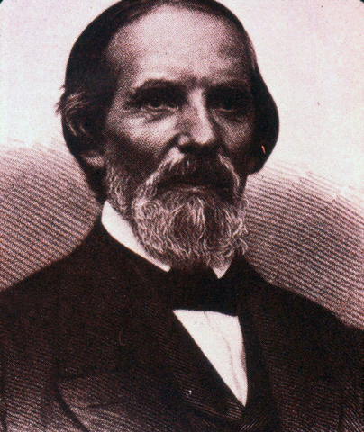
Samuel S. Snow’s 7 Month Message!
In August 1844, at a camp meeting in Exeter, New Hampshire Millerite Samuel S. Snow preached the correct timing of the end of the 2300 day (year) prophecy. Here is what Samuel Snow saw in the prophecy:
The command to restore and build Jerusalem by Artazerxes occurred in the “5th month” according to Ezra 7:8—putting the decree in the fall NOT spring, time for travel from Persia to Jerusalem pushes the date back further.
The cleansing of the sanctuary happened during the Day of Atonement which was on the 10th day of the 7th month, using the Karaite calendar—this would concur on October 22, 1844
--This Message was considered the 7 Month Message, or the true “Midnight Cry”

Slide 15
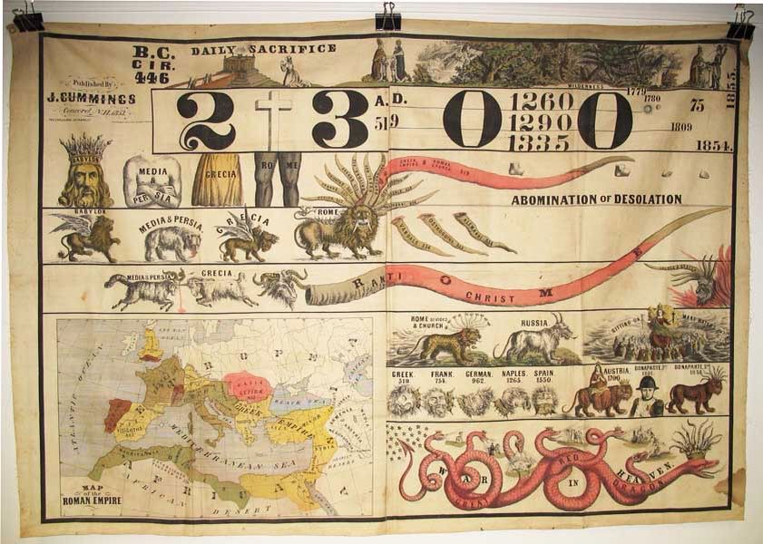
Millerites Get Back to Work!
“It swept over the land with the velocity of a tornado, and it reached hearts in different and distant places almost simultaneously”—Southard, N., Midnight Cry, Oct. 31, 1844.

Slide 16
SOP Clarity
“The preaching of the first angel's message and of the "midnight cry" tended directly to repress fanaticism and dissension. Those who participated in these solemn movements were in harmony; their hearts were filled with love for one another and for Jesus, whom they expected soon to see. The one faith, the one blessed hope, lifted them above the control of any human influence, and proved a shield against the assaults of Satan. "While the bridegroom tarried, they all slumbered and slept. And at midnight there was a cry made, Behold, the bridegroom cometh; go ye out to meet him. Then all those virgins arose, and trimmed their lamps." Matthew 25:5-7. In the summer of 1844, midway between the time when it had been first thought that the 2300 days would end, and the autumn of the same year, to which it was afterward found that they extended, the message was proclaimed in the very words of Scripture: "Behold, the Bridegroom cometh!“ That which led to this movement was the discovery that the decree of Artaxerxes for the restoration of Jerusalem, which formed the starting point for the period of the 2300 days, went into effect in the autumn of the year 457 B.C., and not at the beginning of the year, as had been formerly believed. Reckoning from the autumn of 457, the 2300 years terminate in the autumn of 1844.”—GC, p. 398-399

Slide 17
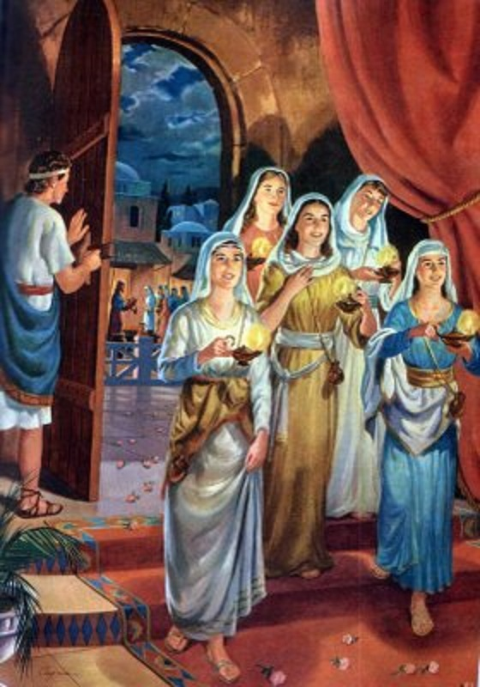
Always Bible-Based!
Matt. 25:5-13 “While the bridegroom tarried, they all slumbered and slept. And at midnight there was a cry made, Behold, the bridegroom cometh; go ye out to meet him. Then all those virgins arose, and trimmed their lamps. And the foolish said unto the wise, Give us of your oil; for our lamps are gone out. But the wise answered, saying, Not so; lest there be not enough for us and you: but go ye rather to them that sell, and buy for yourselves. And while they went to buy, the bridegroom came; and they that were ready went in with him to the marriage: and the door was shut. Afterward came also the other virgins, saying, Lord, Lord, open to us. But he answered and said, Verily I say unto you, I know you not. Watch therefore, for ye know neither the day nor the hour wherein the Son of man cometh.”

Slide 18
The Great Disappointment
“Had the disciples realized that Christ was going to judgment and to death, they could not have fulfilled this prophecy. In like manner Miller and his associates fulfilled prophecy and gave a message which Inspiration had foretold should be given to the world, but which they could not have given had they fully understood the prophecies pointing out their disappointment, and presenting another message to be preached to all nations before the Lord should come. The first and second angels' messages were given at the right time and accomplished the work which God designed to accomplish by them. The world had been looking on, expecting that if the time passed and Christ did not appear, the whole system of Adventism would be given up. But while many, under strong temptation, yielded their faith, there were some who stood firm. The fruits of the advent movement, the spirit of humility and heart searching, of renouncing of the world and reformation of life, which had attended the work, testified that it was of God. They dared not deny that the power of the Holy Spirit had witnessed to the preaching of the second advent, and they could detect no error in their reckoning of the prophetic periods.”—GC, p. 405

Slide 19
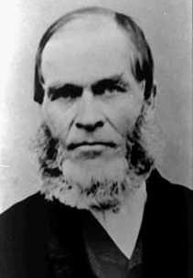
The Disappointment Cut Deep!
“Our fondest hopes and expectations were blasted, and such a spirit of weeping came over us as I never experienced before. It seemed that the loss of all earthly friends could have been no comparison. We wept, and wept, till the day dawn. I mused in my own heart, saying, My advent experience has been the richest and brightest of all my christian experience. If this had proved a failure, what was the rest of my christian experience worth? Has the Bible proved a failure? Is there no God—no heaven—no golden home city—no paradise? Is all this but a cunningly devised fable? Is there no reality to our fondest hopes and expectation of these things? And thus we had something to grieve and weep over, if all our fond hopes were lost. And as I said, we wept till the day dawn.”—Hiram Edson, undated manuscript of his life and experience, quoted in: George R. Knight, William Miller and the Rise of Adventism (Nampa, ID: Pacific Press, 2010), p. 184.

Slide 20
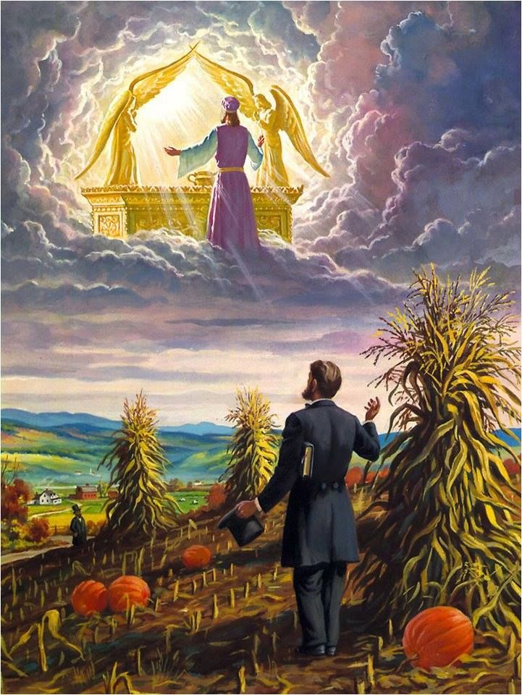
Hiram Edson’s “vision” of the Sanctuary
“When October 23, 1844, dawned and the little group of Millerites huddled in Edson’s farm had managed to check the first outpouring of grief, Edson led the way to his barn. Here they gathered and spent the morning in prayer. After this season of prayer, Edson, accompanied by his friend Owen Crosier, decided to make a trip across his cornfield. They wanted to visit some of their Millerite neighbors and encourage them. As they were making their way across the field Edson stopped short and seemed to stare straight ahead. Puzzled, Crosier pulled to an abrupt stop behind him calling out “Brother Edson, what are you stopping for?””—lineagejourney.com/read/hiram-Edson-the-farmer-in-the-cornfield/

Slide 21

“To which Edson replied, “God is answering our morning prayer, giving light regarding our disappointment”. Edson later explained that as he was walking he felt as if a hand was laid on his shoulder and he seemed to have a vision of the heavenly sanctuary where he saw that Jesus had that very day entered into the Most Holy Place of the Heavenly Sanctuary to begin the work of judgment. Crosier and Edson along with their friend and neighbor Franklin B. Hahn spent the next several weeks and months poring over their Bibles studying the themes of the sanctuary and judgment. In March of 1845, they published their findings in a small paper called “The Day Dawn”. Crosier, being a school teacher, wrote the article while Edson and his wife sold their best silverware to raise money to fund the publication and Hahn had the material published.”—Ibid.

Slide 22
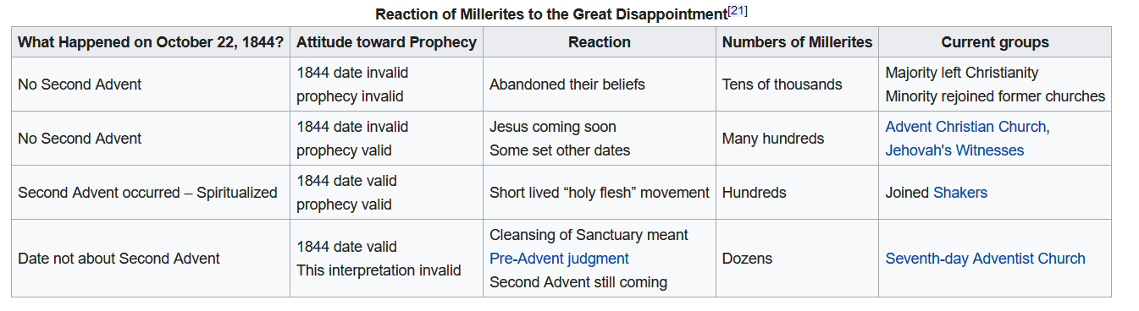
The Remnant of the Remnant

Slide 23
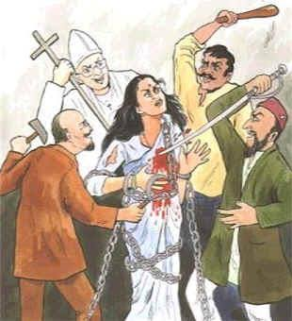


Fanatical Movements Spring Up
-Charles Taze Russel-founder of the Jehovah’s Witnesses, was converted to Adventism (NOT SDA) by Jonas Wendell in 1870
-Charles Darwin published Origin of the Species in 1859
-Karl Marx and Friedrich Engels publish the Communist Manifesto in 1848
-Offshoots of true Millerism founded “holy flesh movement”—prerunner of Pentacostalism
-Codex Sinaiticus, a corrupt version of the Bible hailed as “oldest/most reliable” discovered by a fake Protestant (Constantin von Tischendorf) with strong ties to Rome in 1844
-Civil War Breaks out in 1860s, Rome attempts overthrow of America

Slide 24
Did the Millerite Movement Fulfill the Prophecy’s of Daniel 8:14???
Was the Sanctuary Restored? Yes! The Reformation had restored most of the Sanctuary doctrines; the Millerites and SDAs finished restoring the Sabbath, the Law of God, Righteousness by Faith, the State of the Dead, the Judgment, and the understanding of the importance of the 3 Angel’s Messages—it was a worldwide message, included the midnight cry, had a Great Disappointment as did the disciples--The Millerite Movement stands without a peer on the stage of history
Were the 2300 Days Fulfilled? Yes! Only the Millerite Movement out of any Christian movement has emphasized the importance and calculation of the time in Daniel 8—with some errors due to calculations, calendars, the time was refined and correlated correctly only when the Day of Atonement was considered—this was a worldwide message—the Millerite Movement stands again without a peer!
Did the 2300 Days and Restoration of the Sanctuary Doctrine Occur on the Day of Atonement? Yes! It was the late 7-month message—the key to calculating the time and corresponding it correctly to the Antitypical Day of Atonement—This discovery was an afterthought, a search for answers, it restored the vigor of the movement at a crucial time—this could not have been planned if they tried! The Millerite Movement again stands in history as the ONLY Christian Movement that fulfills and answers the prophecies given in Daniel 8:14, and it’s not even close!

Slide 25

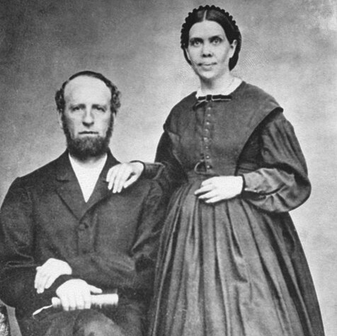
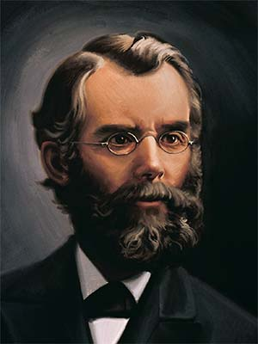
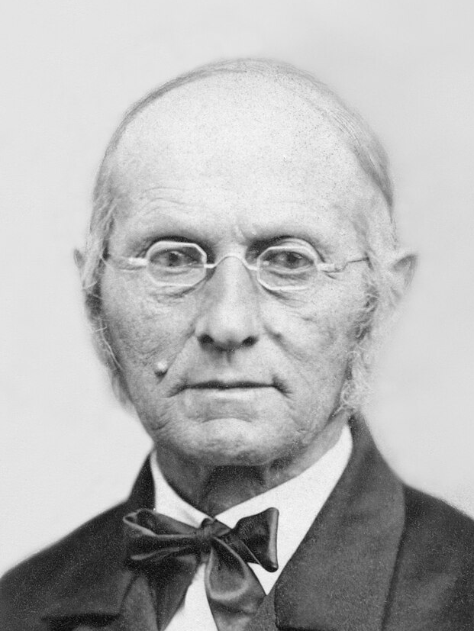
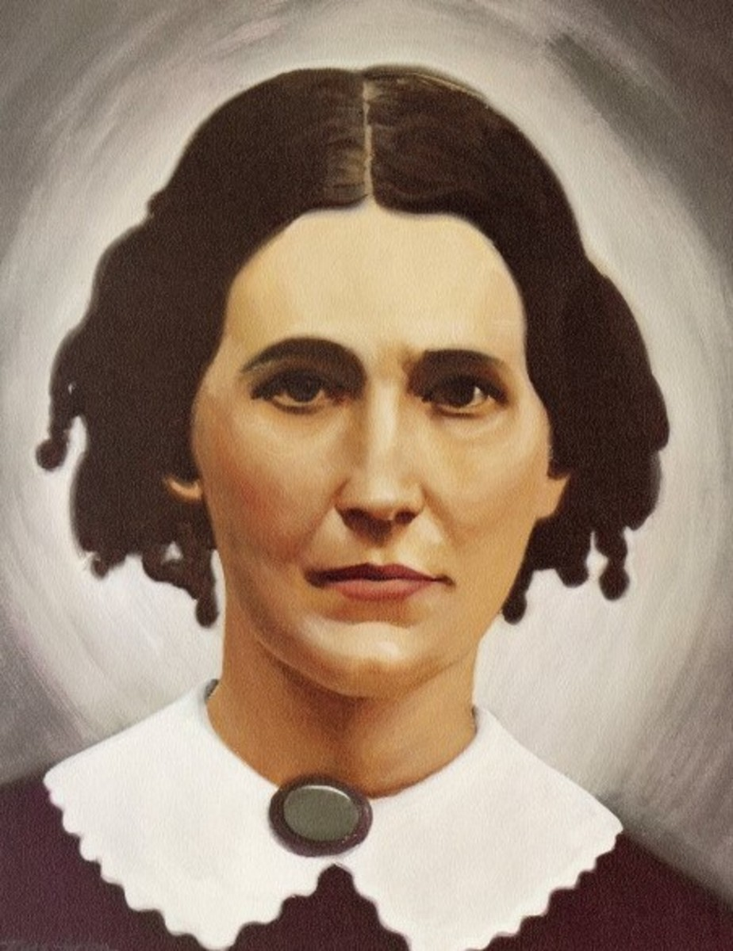
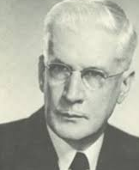
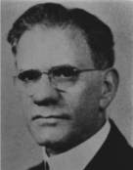
The Fruits Testify…
William Miller’s Millerite Movement bore massive fruits. Picking up where the Reformation stalled, the Millerites began studying the Bible like never before and rediscovered important Bible truths like: The State of the Dead, Prophecies of Daniel and Revelation, The Sabbath, The Investigative Judgment, The Sanctuary, Atonement, Health Principles, Binding Claims of the Law of God, Righteousness by Faith, Importance of Evangelism, Prayer, and Reading, Devotion Time, The Literal Second Coming of Christ, the Remnant, Present Truth, and more. The gift of the Spirit of Prophecy was given to Ellen White to guide this rediscovery. James and Ellen White [top right] devoted their lives to the proclamation of the 3rd Angel’s Message; Joseph Bates and Rachel Oaks [middle right] worked to reestablish the 7th Day Sabbath; John N. Andrews [middle left] was the 1st missionary to Europe and wrote the book The History of the Sabbath; Francis Nichol [bottom left] was an editor, sanitarium official, and apologetics author who wrote many works defending Adventism; Benjamin Wilkinson [bottom right] was a university professor and authored Truth Triumphant. Other names worthy of note include: JN Loughborough, Spalding & Magan, Stephen Haskell, Hyram Edson, Sylvester Bliss, ML Andreason, and many more…

Slide 26
Explain the time of the end and the Reformation, restoring the Sanctuary
Elijah and the restoration of the altar
Explain the Millerite movement and the 2300 days as the only ones who understood the significance of this passage
Walk through the events and the errors, highlight the importance of the sanctuary throughout
Loughborough’s account, etc.

