Slide 1
Golden Rule, pt. 4 ‘Titanic and McFadden’

Slide 2
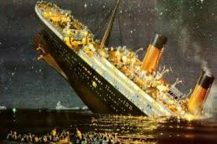

Slide 3
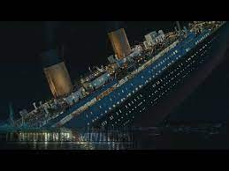
The Unsinkable Sunk!!
The Titanic sank in the early morning hours of 15 April 1912 in the North Atlantic Ocean, four days into her maiden voyage from Southampton to New York City. Could this have had anything to do with the Federal Reserve Bank? Could this unsinkable ship have had anything to do with wealthy people opposed to the central bank? Could this ship have been created by anyone tied to the banksters?

Slide 4
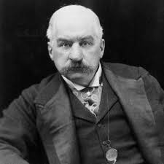
Owner of the Titanic
JP Morgan had been pushing for the federal Reserve Bank for decades. He had been financed by the Rothschilds and his business interests were completely tied up with theirs. Morgan had representatives at Jekyll Island who definitely wanted a central bank! Did Morgan have motive for wanting to use the Titanic as a death ship for any wealthy men who were on board?

Slide 5
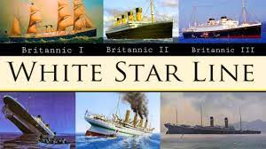
The building of the Titanic began in 1909 at a shipyard in Belfast, the capitol of Northern Ireland. Belfast was a Protestant haven and was hated by the Jesuits. World War One began just a few years later. The Titanic was one of a fleet of ships owned by the White Star Line, an international shipping company. “Banking was not the only business in which Morgan had a strong financial interest. Using his control over the nation’s railroads as financial leverage, he had created an international shipping trust which included Germany’s two largest lines plus one of the two in England, the White Star Lines.” — CFJI, p. 246.

Slide 6
The Plan, the Sinking, the Fed!
The plan to establish a new central bank in America was hatched at Jekyll Island, GA in 1910. “In November 1910, six men – Nelson Aldrich, A. Piatt Andrew, Henry Davison, Arthur Shelton, Frank Vanderlip and Paul Warburg – met at the Jekyll Island Club, off the coast of Georgia, to write a plan to reform the nation’s banking system.” .” by Gary Richardson and Jessie Romero, Federal Reserve Bank of Richmond
The Titanic sank in the early morning hours of 15 April 1912 in the North Atlantic Ocean, four days into her maiden voyage from Southampton to New York City.
It took many months and nearly straight party-line voting, but on December 23, 1913, the Senate passed and President Woodrow Wilson signed the Federal Reserve Act.
It fits a perfect timeline!!

Slide 7
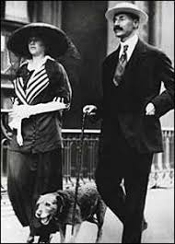
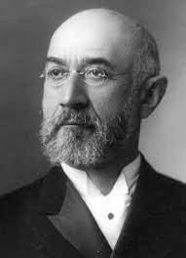
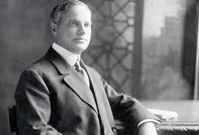
Any Wealthy People Opposed to Federal Reserve?
John Jacob Astor, Isador Strauss, and Benjamin Guggenheim were all opposed to the Federal Reserve Bank. All 3 men died on board the Titanic on its maiden voyage. The fact that everyone who opposed the central bank had attempts made on their lives fits nicely into this puzzle picture!!

Slide 8
Who is Morgan Robertson?
In 1898 a man named Morgan Robertson penned a book titled "Wreck of the Titan" about a luxury liner deemed unsinkable that was going too fast in the North Atlantic in April and hit an iceberg killing most everyone on board due to lack of lifeboats. 14 years later this fictional book would play out in real life exactly down to the name, with the wreck of the Titanic; but this time it would have major political implications. Some of the wealthiest men in the world were on that ship and some were opposed to the Federal Reserve and central banks.
FACT: JP Morgan funded/built the Titanic
FACT: JP Morgan was booked on the voyage but canceled at the last second.
FACT: Friend of JP Morgan, Milton Hersey, also canceled at the last moment and survived to build the Hersey food empire.
Fact : Jesuit Priest Francis Brown was on the Titanic. Before it sailed, he was told to get off!
Fact: Edward Smith worked for JP Morgan for 26 years. Had 8 warnings that night about icebergs. Regardless, he went full speed ahead!!

Slide 9
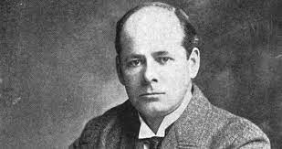
“Like the Titanic, the fictional ship sank after wrecking on an iceberg in April in the North Atlantic Ocean, and there were not enough lifeboats for all the passengers. The Titan would have survived a head-on collision with the iceberg, but a glancing encounter did more extensive damage. There are also similarities in size (800 ft [244 m] long for the Titan versus 882 ft 9 in [269 m] long for the Titanic), speed, and life-saving equipment.[2] After the Titanic's sinking, some people credited Robertson with precognition and clairvoyance, which he denied. Scholars attribute the similarities to Robertson's extensive knowledge of shipbuilding and maritime trends.” Wikipedia

Slide 10
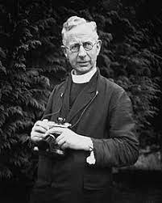
You Decide
So many pieces of this puzzle put together a very remarkable story. The White Star Line, JP Morgan, the Rothschilds, the Jesuits, Morgan Robertson, Federal Reserve, death to the opposition just like always, Francis Browne, Edward Smith and 8 warnings about icebergs…
Within a few years of Titanic’s maiden voyage, the Federal Reserve act is passed! You decide!!
Something stinks in Dodge!!

Slide 11
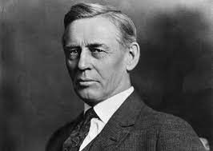
Lindbergh Saw it!!
He was best known as a critic of the “money trust,” the big Wall Street financiers led by J. P. Morgan, and as a reformer who sought to bring banking under democratic control. When World War I broke out in 1914, Lindbergh vocally opposed United States involvement. He argued that only the bankers and other “war profiteers” would benefit from a war with Germany. In 1916 he supported the Gore–McLemore resolution, which responded to German submarine warfare by urging Americans to avoid booking passage on the armed vessels of belligerent nations.

Slide 12
Opposed the Money Vultures!
In Congress, Lindbergh was one of the first outspoken critics of the Federal Reserve. His stature grew when he was featured in an article in The American Magazine: "It was a Swede from Minnesota who first raised in Congress the hue-and-cry of the Money Trust Hunt—'a Swede who dreams', a fellow member described him—Charles A. Lindbergh."[4] Lindbergh declared, "This Act establishes the most gigantic trust on Earth. When the President signs this bill, the invisible government by the Monetary Power will be legalized, the people may not know it immediately, but the day of reckoning is only a few years removed ... The worst legislative crime of the ages is perpetrated by this banking bill."[5] In 1917 Lindbergh brought articles of impeachment against members of the Federal Reserve Board of Governors, including Paul Warburg and William P. G. Harding, charging that they were involved "... in a conspiracy to violate the Constitution and laws of the United States ..."[6]

Slide 13
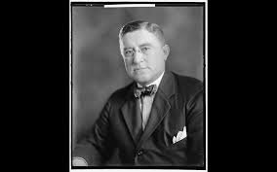
Who is Louis T. McFadden?
In 1914, McFadden was elected as a Republican Representative to the Sixty-fourth Congress and to the nine succeeding Congresses. He served as Chairman of the United States House Committee on Banking and Currency during the Sixty-sixth through Seventy-first Congresses, or 1920-1931…. McFadden later became a "vociferous foe of the Federal Reserve", which he claimed was created and operated by Jewish banking interests who conspired to economically control the United States. In a speech in the House of Representatives in December 1931, McFadden accused Paul Warburg, one of the leading forces behind the Federal Reserve Act, of “having engineered the great depression.” On June 10, 1932, McFadden made a 25-minute speech before the House of Representatives in which he accused the Federal Reserve of deliberately causing the Great Depression.

Slide 14
Mc Fadden Cuts Lose!!
"Mr. Chairman, we have in this Country one of the most corrupt institutions the world has ever known. I refer to the Federal Reserve Board and the Federal Reserve Banks, hereinafter called the Fed. The Fed has cheated the Government of these United States and the people of the United States out of enough money to pay the Nation's debt. The depredations and iniquities of the Fed has cost enough money to pay the National debt several times over. This evil institution has impoverished and ruined the people of these United States, has bankrupted itself, and has practically bankrupted our Government. It has done this through the defects of the law under which it operates, through the maladministration of that law by the Fed and through the corrupt practices of the moneyed vultures who control it. Some people who think that the Federal Reserve Banks United States are Government institutions. They are private monopolies which prey upon the people of these United States for the benefit of themselves and their foreign customers; foreign and domestic speculators and swindlers; and rich and predatory money lender. In that dark crew of financial pirates there are those who would cut a man's throat to get a dollar out of his pocket; there are those who send money into states to buy votes to control our legislatures; there are those who maintain International propaganda for the purpose of deceiving us into granting of new concessions which will permit them to cover up their past misdeeds and set again in motion their gigantic train of crime.

Slide 15
"In 1912 the National Monetary Association, under the chairmanship of the late Senator Nelson W. Aldrich, made a report and presented a vicious bill called the National Reserve Association bill. This bill is usually spoken of as the Aldrich bill. Senator Aldrich did not write the Aldrich bill. He was the tool, if not the accomplice, of the European bankers who for nearly twenty years had been scheming to set up a central bank in this Country and who in 1912 has spent and were continuing to spend vast sums of money to accomplish their purpose. We were opposed to the Aldrich plan for a central bank. The men who rule the Democratic Party then promised the people that if they were returned to power there would be no central bank established here while they held the reigns of government. Thirteen months later that promise was broken, and the Wilson administration, under the tutelage of those sinister Wall Street figures who stood behind Colonel House, established here in our free Country the worm-eaten monarchical institution of the "King's Bank" to control us from the top downward, and from the cradle to the grave. The Federal Reserve Bank destroyed our old and characteristic way of doing business. It discriminated against our name commercial paper, the finest in the world, and it set up the antiquated name paper, which is the present curse of this Country and which wrecked every country which has ever given it scope; it fastened down upon the Country the very tyranny from which the framers of the Constitution sough to save us.” Congress, 1934

Slide 16
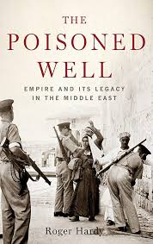
McFadden Murdered!!
It must be noted that Lindbergh's efforts to expose the plot were followed by those of Congressman Louis T. McFadden, who chaired the House Banking and Currency Committee for a ten year period. During his tenure, three attempts were made on his life. First, he was shot in Washington, D.C., then his food was poisoned. The third attempt was unfortunately successful. His mysterious death occurred while on a visit to New York City. The cause of death, as listed on the death certificate, was given as "heart failure", although more than enough evidence pointed to poisoning. It is my proffered opinion that Mr. McFadden was poisoned by members of the cartel. Without proper court orders demanding the exhumation and forensic pathology tests, we shall never know the true story. An Expose of The Federal Reserve Banking System.
An Article by Gunther K. Russbacher
And, the beat goes on!!!!

