Slide 1
Hebrews 10 “Slain from The Foundation of the World”

Slide 2
In Summary
Hebrews, chapters 8 and 9, laid out very clearly that the sanctuary on earth was a copy of the sanctuary in heaven. “For Christ is not entered into the holy places made with hands, which are the figures of the true; but into heaven itself, now to appear in the presence of God for us:” Heb. 9:24
These chapters also lay out with great force that the priestly ministries carried on the Old Testament were a replica of the ministries that Christ would carry on in heaven. “Now of the things which we have spoken this is the sum: We have such an high priest, who is set on the right hand of the throne of the Majesty in the heavens; A minister of the sanctuary, and of the true tabernacle, which the Lord pitched, and not man. For every high priest is ordained to offer gifts and sacrifices: wherefore it is of necessity that this man have somewhat also to offer. For if he were on earth, he should not be a priest, seeing that there are priests that offer gifts according to the law: Who serve unto the example and shadow of heavenly things, as Moses was admonished of God when he was about to make the tabernacle: for, See, saith he, that thou make all things according to the pattern shewed to thee in the mount.” Hebrews 8:1-5

Slide 3
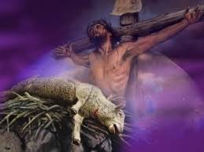
Hebrews 10 Finishes the Picture
What John the Baptist sought to teach ‘The next day John seeth Jesus coming unto him, and saith, Behold the Lamb of God, which taketh away the sin of the world.” Jn. 1:29 What Peter mentioned ‘But with the precious blood of Christ, as of a lamb without blemish and without spot:’ Paul puts the capstone on this teaching in Hebrews 10! “And all that dwell upon the earth shall worship him, whose names are not written in the book of life of the Lamb slain from the foundation of the world.” Rev. 13:8

Slide 4
Hebrews 10:1-10
“For the law having a shadow of good things to come, and not the very image of the things, can never with those sacrifices which they offered year by year continually make the comers thereunto perfect. For then would they not have ceased to be offered? because that the worshippers once purged should have had no more conscience of sins. But in those sacrifices there is a remembrance again made of sins every year. For it is not possible that the blood of bulls and of goats should take away sins. Wherefore when he cometh into the world, he saith, Sacrifice and offering thou wouldest not, but a body hast thou prepared me: In burnt offerings and sacrifices for sin thou hast had no pleasure. Then said I, Lo, I come (in the volume of the book it is written of me,) to do thy will, O God. Above when he said, Sacrifice and offering and burnt offerings and offering for sin thou wouldest not, neither hadst pleasure therein; which are offered by the law; Then said he, Lo, I come to do thy will, O God. He taketh away the first, that he may establish the second. By the which will we are sanctified through the offering of the body of Jesus Christ once for all.”

Slide 5
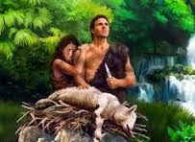
“The sacrificial offerings were ordained by God to be to man a perpetual reminder and a penitential acknowledgment of his sin and a confession of his faith in the promised Redeemer. They were intended to impress upon the fallen race the solemn truth that it was sin that caused death. To Adam, the offering of the first sacrifice was a most painful ceremony. His hand must be raised to take life, which only God could give. It was the first time he had ever witnessed death, and he knew that had he been obedient to God, there would have been no death of man or beast. As he slew the innocent victim, he trembled at the thought that his sin must shed the blood of the spotless Lamb of God. This scene gave him a deeper and more vivid sense of the greatness of his transgression, which nothing but the death of God's dear Son could expiate. And he marveled at the infinite goodness that would give such a ransom to save the guilty. A star of hope illumined the dark and terrible future and relieved it of its utter desolation.” PP, pg. 68

Slide 6
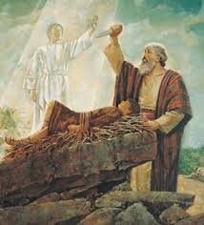
Sacrifices Continued by Every Faithful Soul
Abraham felt Christ’s sacrifice to the very depths. “And it came to pass after these things, that God did tempt Abraham, and said unto him, Abraham: and he said, Behold, here I am. And he said, Take now thy son, thine only son Isaac, whom thou lovest, and get thee into the land of Moriah; and offer him there for a burnt offering upon one of the mountains which I will tell thee of.” “Your father Abraham rejoiced to see my day: and he saw it, and was glad.” John 8:56

Slide 7
Sacrifice of Isaac
“It was to impress Abraham's mind with the reality of the gospel, as well as to test his faith, that God commanded him to slay his son. The agony which he endured during the dark days of that fearful trial was permitted that he might understand from his own experience something of the greatness of the sacrifice made by the infinite God for man's redemption. No other test could have caused Abraham such torture of soul as did the offering of his son. God gave His Son to a death of agony and shame. The angels who witnessed the humiliation and soul anguish of the Son of God were not permitted to interpose, as in the case of Isaac. There was no voice to cry, "It is enough." To save the fallen race, the King of glory yielded up His life. What stronger proof can be given of the infinite compassion and love of God? "He that spared not His own Son, but delivered Him up for us all, how shall He not with Him also freely give us all things?" Romans 8:32. PP, pg. 154

Slide 8
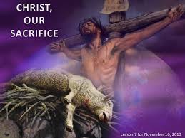
Messianic Promise of Ps. 40:8 fulfilled in Jesus
Nearly two thousand years ago, a voice of mysterious import was heard in heaven, from the throne of God, "Lo, I come." "Sacrifice and offering Thou wouldest not, but a body hast Thou prepared Me. . . . Lo, I come (in the volume of the Book it is written of Me,) to do Thy will, O God." Heb. 10:5-7. In these words is announced the fulfillment of the purpose that had been hidden from eternal ages. Christ was about to visit our world, and to become incarnate. He says, "A body hast Thou prepared Me." Had He appeared with the glory that was His with the Father before the world was, we could not have endured the light of His presence. That we might behold it and not be destroyed, the manifestation of His glory was shrouded. His divinity was veiled with humanity,--the invisible glory in the visible human form.” DA, pg. 23

Slide 9
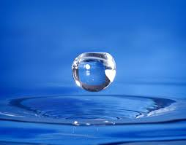
“And every priest standeth daily ministering and offering oftentimes the same sacrifices, which can never take away sins: But this man, after he had offered one sacrifice for sins for ever, sat down on the right hand of God; From henceforth expecting till his enemies be made his footstool. For by one offering he hath perfected for ever them that are sanctified.” Hebrews 10:11-14

Slide 10
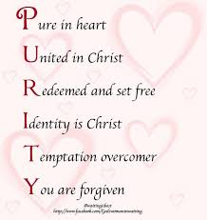
No Confusion Here
In Paul’s mind, the sacrifice of Christ was to lead to victory over sin in the life of the believer. He said that thru Christ, we are sanctified, or made holy. Hebrews 13:20, 21 says, “Now the God of peace, that brought again from the dead our Lord Jesus, that great shepherd of the sheep, through the blood of the everlasting covenant, Make you perfect in every good work to do his will, working in you that which is well pleasing in his sight, through Jesus Christ; to whom be glory for ever and ever. Amen.”

Slide 11
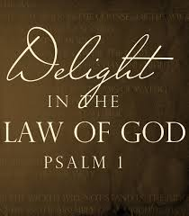
Law in the Mind/Heart
“Whereof the Holy Ghost also is a witness to us: for after that he had said before, This is the covenant that I will make with them after those days, saith the Lord, I will put my laws into their hearts, and in their minds will I write them; And their sins and iniquities will I remember no more. Now where remission of these is, there is no more offering for sin.” Hebrews 10:15-18

Slide 12
Christ Lived the Law!
“Satan represents God's law of love as a law of selfishness. He declares that it is impossible for us to obey its precepts. The fall of our first parents, with all the woe that has resulted, he charges upon the Creator, leading men to look upon God as the author of sin, and suffering, and death. Jesus was to unveil this deception. As one of us He was to give an example of obedience. For this He took upon Himself our nature, and passed through our experiences. "In all things it behooved Him to be made like unto His brethren." Heb. 2:17. If we had to bear anything which Jesus did not endure, then upon this point Satan would represent the power of God as insufficient for us. Therefore Jesus was "in all points tempted like as we are." Heb. 4:15. He endured every trial to which we are subject. And He exercised in His own behalf no power that is not freely offered to us. As man, He met temptation, and overcame in the strength given Him from God. He says, "I delight to do Thy will, O My God: yea, Thy law is within My heart." Ps. 40:8. As He went about doing good, and healing all who were afflicted by Satan, He made plain to men the character of God's law and the nature of His service. His life testifies that it is possible for us also to obey the law of God.
By His humanity, Christ touched humanity; by His divinity, He lays hold upon the throne of God. As the Son of man, He gave us an example of obedience; as the Son of God, He gives us power to obey.” DA, pg. 24

Slide 13
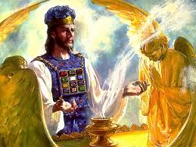
Priestly Ministry, Sacrifice, Victory
“Having therefore, brethren, boldness to enter into the holiest by the blood of Jesus, By a new and living way, which he hath consecrated for us, through the veil, that is to say, his flesh; And having an high priest over the house of God; Let us draw near with a true heart in full assurance of faith, having our hearts sprinkled from an evil conscience, and our bodies washed with pure water.” Hebrews 10:19-22

Slide 14
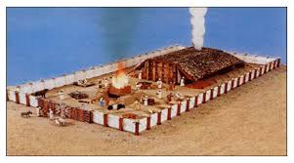
Christ was/is the veil
At every step of the way in the Christian life, it is thru Christ. Any growth or glory belongs to Him! Entering the courtyard, holy place, and finally, the most holy, all happened thru faith in the power of Christ! He is truly the veil!!!

Slide 15
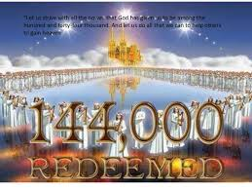
Amazing Material
The book of Hebrews focuses on:
1. the earthly sanctuary being a copy of the heavenly sanctuary.
2. the sacrifice of animals pointed to the sacrifice of Christ.
3. Christ is our great high priest, enabling God’s children to obey His law.
4. These concepts all fit together.
5. These four concepts Ford and all others seek to destroy!!!

Slide 16
God’s Faithfulness
“Let us hold fast the profession of our faith without wavering; (for he is faithful that promised;) And let us consider one another to provoke unto love and to good works: Not forsaking the assembling of ourselves together, as the manner of some is; but exhorting one another: and so much the more, as ye see the day approaching.” Hebrews 10:23-25

Slide 17
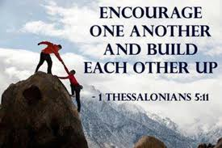
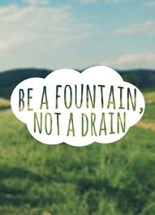
Encouraging One Another

