Slide 1
What is the Difference Between Mormons, Jehovah’s Witnesses, and Seventh-day Adventists? pt 31

Slide 2
Let’s Weigh the Evidence
Mormons
1. Evil Origin story—Joseph practices magic, contradicts his own stories, misspeaks for God like the false promises of treasure in Salem, then again in Missouri, clearly struggles with sexual sins as outlined in the happiness letter, joins freemasonry at the 33rd degree when it had been revealed by Captain Morgan how Satanic the organization was. Joseph even tries to run for president before being murdered
2. Evil Authorities—Joseph is the prophet who always requires more sacrifice from his people—their money, their lands, their daughters, and their minds—never him. His writings contradict archeology, history, and even earlier versions of themselves, the golden plates are only seen by his most trusted, his “Reformed Egyptian” looks like Deformed English, the BoM is lost but he cannot reinterpret them, his reformed KJV contradicts ancient Ms like Dead Sea Scrolls, many things are deleted or changed
JW’s
1. Evil Origin story—a religion built off of the fanatical infatuation with time-setting. Charles Taze Russell is obsessed with pyramidology—basing times for various events from the measurements in the pyramids later called Satan’s Bible by Rutherford. The false dates of 1873/4, 1910, 1914, 1915, 1918, 1925, 1931, 1975 are all set with no fruits! Each time the people re-live a great disappointment
2. Evil Authorities—Russell is like David Gates, he’s a proven charlatan yet keeps producing more times, he just “knows” Masonic handshakes. The Watchtower has constantly produced errors like ‘last generation’ being 1914, to some overlap, and setting times, and phrenology and astrology, yet claims to be the voice of God. The NWT is heralded by spiritualists, the translators remain anonymous, and contradicts itself—demoting Jesus. The Governing Body has protected pedophiles
SDA
1. Holy Origin story—Millerism is built on the true prophecies of Daniel 8, ending in 1844, but like the disciples the event is misunderstood. The work is attended with repentance, confession, true heart-work and great sacrifice (Rev. 10)—no military exploits against the U.S.! God then blesses the remnant little band with the gift of prophecy fulfilling Rev. 12:17
2. Holy Authorities—The KJV, even today is proven to be the most accurate English translation of the Bible in existence, standing the test of time and persecution. Secondly, Ellen White is proven to be a true prophetess, standing even the most scrupulous attacks—like plagiarism, the shut door, hypocrisy, contradictions, racism, and more. She is also the only one ever shown to pass the physical tests! She also has 0 failed prophecies

Slide 3
Mormon Doctrine in a Nutshell: The God Makers Ed Decker

Slide 4
Doctrine: You can be God, You Can see God, Marriage in Heaven
1 Tim. 6:15-16 “Which in his times he shall shew, who is the blessed and only Potentate, the King of kings, and Lord of lords; Who only hath immortality, dwelling in the light which no man can approach unto; whom no man hath seen, nor can see: to whom be honour and power everlasting. Amen.”
John 1:18 “No man hath seen God at any time, the only begotten Son, which is in the bosom of the Father, he hath declared him.”
1 Tim. 1:17 “Now unto the King eternal, immortal, invisible, the only wise God, be honour and glory for ever and ever. Amen.”
Matt. 22:29-30 “Jesus answered and said unto them, Ye do err, not knowing the scriptures, nor the power of God. For in the resurrection they neither marry, nor are given in marriage, but are as the angels of God in heaven.”

Slide 5
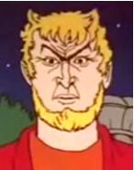
Other Doctrines of Note!
1. Jesus was selected to be Messiah caused the downfall of Lucifer, not the Commandments (See Is. 14:12, Ez. 28:15,17)
2. Joseph never acknowledged, nor passed the physical tests of a prophet like EGW did
3. Polygamy-John Taylor says it is the “everlasting covenant” William Wilford abolishes it in 1890, but its still being done behind the scenes causing another declaration to need to be made in 1905
4. There are 3 heavens vs the outer darkness—bad people go to lowest heaven, only dissenters and really evil people go to outer darkness
Ez. 18:20 “The soul that sinneth, it shall die. The son shall not bear the iniquity of the father, neither shall the father bear the iniquity of the son: the righteousness of the righteous shall be upon him, and the wickedness of the wicked shall be upon him.
5. Racist priesthood—Black people denied the priesthood until 1978! Because black people are cursed Lamanites with black skin
6. Restoration of the Aaronic and Melchizedek priesthoods—we are a royal holy priesthood (see Ex. 19:5-6, 1 Pet. 2:9-12

Slide 6
JW Doctrine in a Nutshell: Witnesses of Jehovah

Slide 7
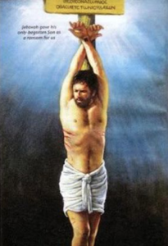
Doctrines: Jesus died on a stake!
Stauros (4716) Strong’s Concordance [stow-ros] 1) an upright stake esp. a pointed one, 2) a cross
Do word meanings change over time?
Meat used to mean just solid food
Gay used to mean happy
Awful and Awesome used mean the same thing (full of aw)
Bully used to be endearing, not a foe
Clue used to be a ball of yarn used to find your way through winding passages—now they’re hints
Dumb meant you were mute or silent
Mad meant crazy or insane not angry
Senile meant just old, not a loss of mental capacity
Egregious meant distinguished, not offensive

Slide 8
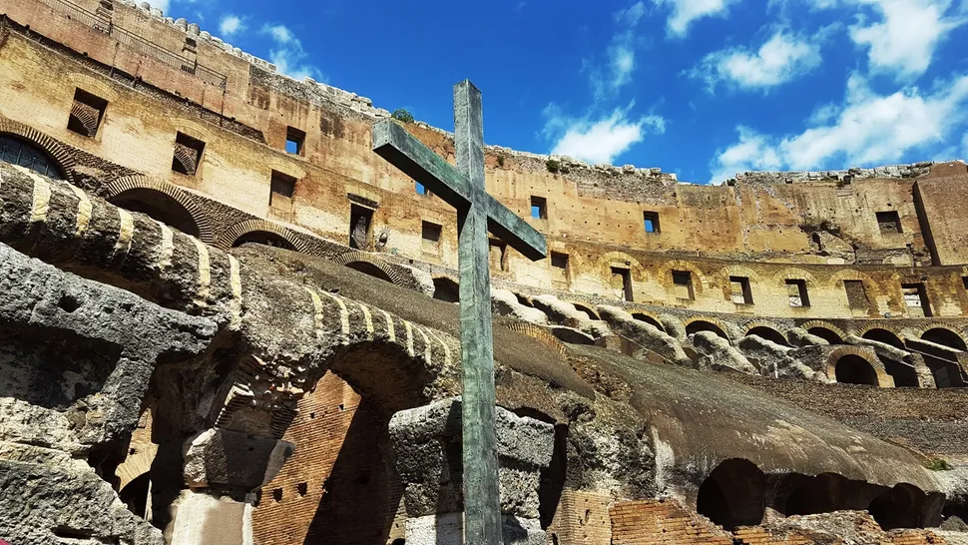
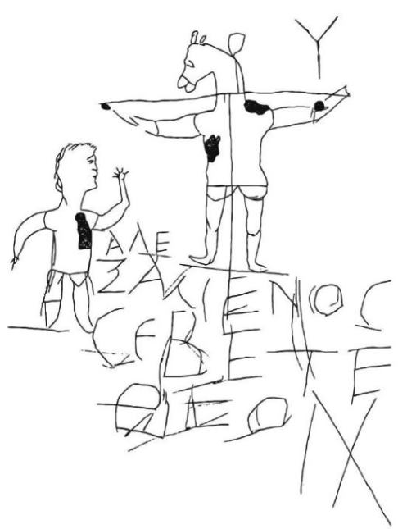
They Didn’t Use Crosses?
“A Roman citizen of no obscure station, having ordered one of his slaves to be put to death, delivered him to his fellow-slaves to be led away, and in order that his punishment might be witnessed by all, directed them to drag him through the Forum and every other conspicuous part of the city as they whipped him, and that he should go ahead of the procession which the Romans were at that time conducting in honour of the god. The men ordered to lead the slave to his punishment, having stretched out both his arms and fastened them to a piece of wood which extended across his breast and shoulders as far as his wrists, followed him, tearing his naked body with whips” Dionysius of Halicarnassus, Roman Antiquities, VII, 69:1-2
“The body of a man buried in northern Italy 2,000 years ago shows signs that he died after being nailed to a wooden cross, the method used for the execution of Jesus described in the Christian Bible.” https://www.livescience.com/62727-jesus-roman-crucifixion-found.html
The Alexamenos graffito: 1st-3rd Century “Alexamenos Worships

Slide 9
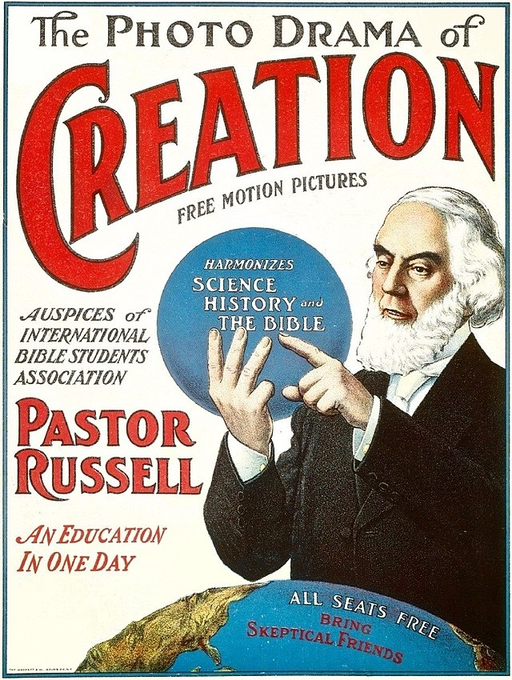
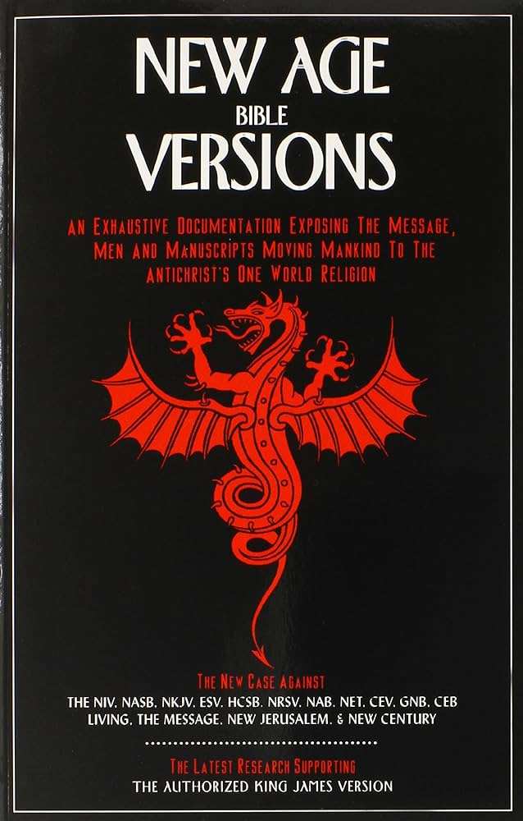
Other Doctrines of NOTE!
1. Jesus is a created being not God: John 10:30-33 “ I and my Father are one. Then the Jews took up stones again to stone him. Jesus answered them, Many good works have I shewed you from my Father; for which of those works do ye stone me? The Jews answered him, saying, For a good work we stone thee not; but for blasphemy; and because that thou, being a man, makest thyself God.” {In the NWT, Jesus is God because He is the “First and Last”}
2. State of the Dead—the dead sleep
3. Time-setting- 1914,1915,1918,1925,1931, Beth Sarim
4. Blood transfusions and vaccines until 2000s and 1950s respectively
5. Jesus was shaven vs not shaven
6. Masonic style communion
7. Holy Spirit is not a Person: 1 John 5:7 “For there are three that bear record in heaven, the Father, the Word, and the Holy Ghost: and these three are one.”
“Spiritualists (the term ascribed to Westcott by his son) believe ‘The doctrine of the Trinity seems to have no adherents in the advanced circles of the spirit world’ [The Spirit of Truth and The Spirit of Error, Keith Brooks]. Hort’s hostility to I John 5:7+8 haunts his writings. ‘It could be gotten rid of…’ [Life of Hort, Vol. II, p. 128] he stabs. Today on NIV editor admits, ‘It’s the strongest statement in the KJV on the Trinity’ [The NIV: The Making of a Contemporary Translation, p. 56]. So out it goes from the NIV, ESV, HCSB, NASB, and almost all new versions; its omission is masked to readers because most new versions split verse 8 in half, calling each half verse 7 and verse 8.” New Age Bible Versions, Gail Riplinger, p. 419

Slide 10
Trinity Doctrine Continued
Evidence that 1 John 5:7-8 existed in the original texts:
Versions: Old Syriac AD 170, Old Latin AD 200, Vulgate: 4th and 5th Century, Italic: 4th and 5th Century
Writers who quoted it: Tatian AD 150, Tertullian AD 200, Cyprian AD 225, Athanasius AD 350, Cassian AD 435, Jerome AD 450, Cassiadorius AD 480, Vigilius AD 484, Victor-Vita AD 489, Fulgentius AD 533, PS Athanasius AD 550
Writings: Liber Apologeticus AD 350, Council of Cathage AD 415 (Ibid., p. 421
“As the saints in the kingdom of God are accepted in the beloved, they hear: “Come, ye blessed of My Father, inherit the kingdom prepared for you from the foundation of the world.” And then the golden harps are touched, and the music flows all through the heavenly host, and they fall down and worship the Father and the Son and the Holy Spirit. And then what? What next did I see?” Ms139, 1906 para 32.

Slide 11
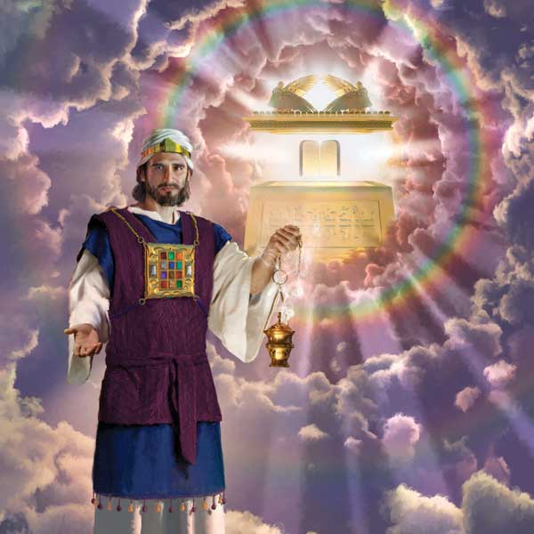
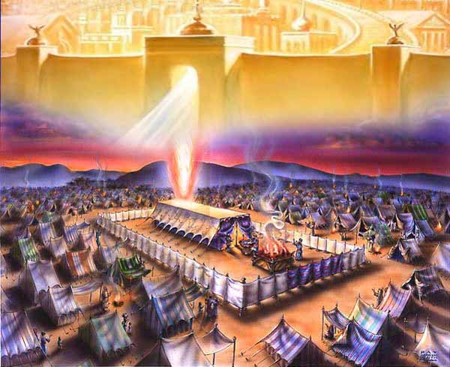
SDA Doctrines: Are They Legit?
1. The Sanctuary—Heb. 8:1-2 “Now of the things which we have spoken this is the sum: We have such an high priest, who is set on the right hand of the throne of the Majesty in the heavens; A minister of the sanctuary, and of the true tabernacle, which the Lord pitched, and not man.”---Rev. 11:19 “And the temple of God was opened in heaven, and there was seen in his temple the ark of his testament: and there were lightnings, and voices, and thunderings, and an earthquake, and great hail.”
2. The Sabbath—Rev. 12:17 “And the dragon was wroth with the woman, and went to make war with the remnant of her seed, which keep the commandments of God, and have the testimony of Jesus Christ.”---Rev. 22:14 “Blessed are they that do his commandments, that they may have right to the tree of life, and may enter in through the gates into the city”
3. Righteousness by Faith—Gal. 5:5 “For we through the Spirit wait for the hope of righteousness by faith.”---Rev. 14:12 “Here is the patience of the saints: here are they that keep the commandments of God, and the faith of Jesus” (See also Hab. 2:4—the Just shall live by faith!)
4. State of the Dead—Ecc. 9:5-6 “For the living know that they shall die: but the dead know not any thing, neither have they any more a reward; for the memory of them is forgotten.”---John 11 (Lazarus sleepeth)

Slide 12
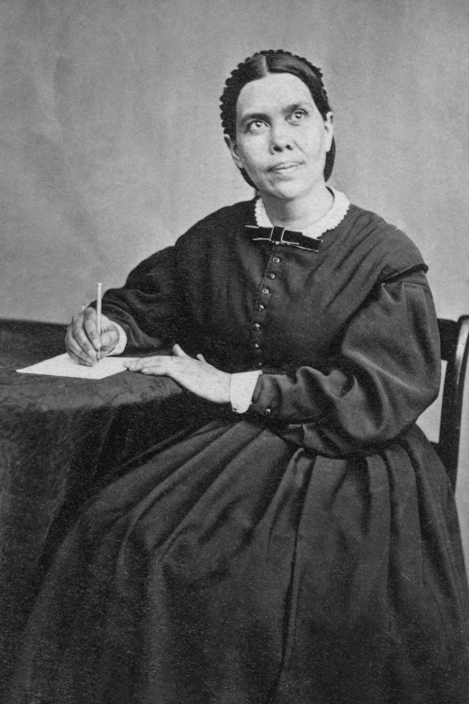
SDA Doctrines Continued
5. Spirit of Prophecy—Rev. 12:17→19:10 “And I fell at his feet to worship him. And he said unto me, See thou do it not: I am thy fellowservant, and of thy brethren that have the testimony of Jesus: worship God: for the testimony of Jesus is the spirit of prophecy.”—EGW passed every physical test, fulfilled prophecies, stands up against the charges against her priesthood—always sacrificed, never ate up the property, money, and children of her congregation, never held office or position in the church
6. Health Message—Science proves eating flesh foods and dairy especially, give you cancer: see “Forks Over Knives”, the 8 laws of Health stand as a testament to true wellness. EGW spoke against smoking and alcohol at a time when doctors were actually recommending their patients to smoke tobacco medicinally
7. Antichrist is the Pope—Mark of the Beast is Sunday—Rev. 14:9 “And the third angel followed them, saying with a loud voice, If any man worship the beast and his image, and receive his mark in his forehead, or in his hand”—Deut. 6 & 11, the Law of God was kept in the forehead and in the hand! All Protestants used to understand that the Pope was the Antichrist, but it has been lost to time. Even the Westminster Confession Article 25 which stated that the pope was the Antichrist was ratified by the English Parliament in 1646.

Slide 13
Final Messages for the World
LDS: The Final Message to the world is to convert the world to God’s true religion Mormonism, and reinstate the Missouri New Jerusalem and usher in the millennium. All will be saved, but dissenters will be lost eternally. The other churches are Babylon, and every person needs to follow God through the everlasting covenant via sealed marriages and become gods and start all over again.
JW: Convert all to the JW doctrine, adhering & submitting to the Governing Body, studying only via the Watch Tower and being prepared for the last days which are immanent, the other churches are Babylon in addition to Rome—JWs will be targeted in the last days for not receiving the mark of the beast
SDA: Everyone must be warned of the coming deception via the Papal takeover through the last warning messages found in Revelation 14—The Sabbath is the Seal of God, the Mark of the Beast is a Sunday Law, We can keep His Commandments through Faith, read the Bible and SOP, the health laws are the right arm of the 3rd Angel. We must prepare now to be ready for the outpouring of the Holy Spirit as in the days of the Apostles and give the Loud Cry message of Revelation 18—we know how to interpret Daniel and Revelation in its entirety!

Slide 14
Which Will You Believe???
Godliness, Truth, Prophecy, Holiness, Righteousness, Harmony, Love
Fanaticism, Occult, Hypocrisy, Gaslighting
Blasphemy, Deception, Lust, Lies, Racism

