Slide 1
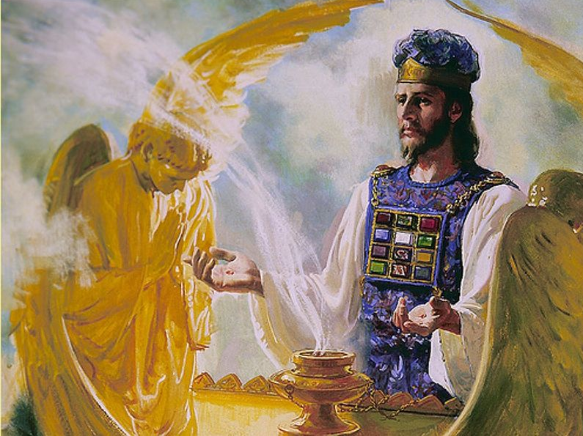
The Priest’s Garments

Slide 2
What is the Purpose of the Garments?
“Everything worn by the priest was to be whole and without blemish. By those beautiful official garments was represented the character of the great antitype, Jesus Christ. Nothing but perfection, in dress and attitude, in word and spirit, could be acceptable to God. He is holy, and His glory and perfection must be represented by the earthly service. Nothing but perfection could properly represent the sacredness of the heavenly service. Finite man might rend his own heart by showing a contrite and humble spirit. This God would discern. But no rent must be made in the priestly robes, for this would mar the representation of heavenly things.” –DA, 709

Slide 3
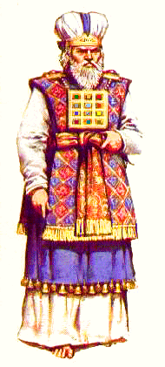
The Ribband of Blue
“Speak unto the children of Israel, and bid them that they make them fringes in the borders of their garments throughout their generations, and that they put upon the fringe of the borders a ribband of blue: And it shall be unto you for a fringe, that ye may look upon it, and remember all the commandments of the Lord, and do them ; and that ye seek not after your own heart and your own eyes, after which ye use to go a whoring: That ye may remember, and do all my commandments, and be holy unto your God. I am the Lord your God, which brought you out of the land of Egypt, to be your God: I am the Lord your God.”—Num. 15:38-41

Slide 4
The Linen Robes
Ex. 28:40-42 “And for Aaron's sons thou shalt make coats, and thou shalt make for them girdles, and bonnets shalt thou make for them, for glory and for beauty. And thou shalt put them upon Aaron thy brother, and his sons with him; and shalt anoint them, and consecrate them, and sanctify them, that they may minister unto me in the priest's office. And thou shalt make them linen breeches to cover their nakedness; from the loins even unto the thighs they shall reach”

Slide 5
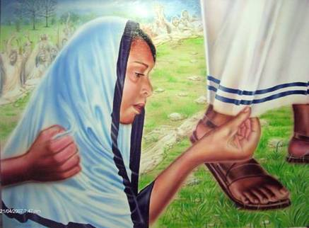
Commandments and Virtue
“And a woman having an issue of blood twelve years, which had spent all her living upon physicians, neither could be healed of any, Came behind him, and touched the border of his garment: and immediately her issue of blood stanched. And Jesus said, Who touched me? When all denied, Peter and they that were with him said, Master, the multitude throng thee and press thee, and sayest thou, Who touched me? And Jesus said, Somebody hath touched me: for I perceive that virtue is gone out of me.”—Luke 8:43-46

Slide 6
White=Christ’s Righteousness, which covers our sins
Rev. 19:8 “And to her was granted that she should be arrayed in fine linen, clean and white: for the fine linen is the righteousness of saints.”
Rev. 7:14 “And he said to me, These are they which came out of great tribulation, and have washed their robes, and made them white in the blood of the Lamb.”
Rev. 3:18 “I counsel thee to buy of me gold tried in the fire, that thou mayest be rich; and white raiment, that thou mayest be clothed, and that the shame of thy nakedness do not appear; and anoint thine eyes with eyesalve, that thou mayest see.

Slide 7
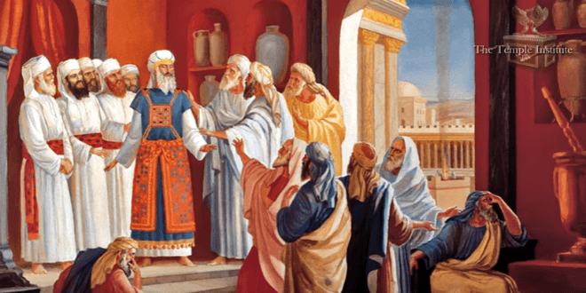
To Sum up the Common Priests…
“The robe of the common priest was of white linen, and woven of one piece. It extended nearly to the feet and was confined about the waist by a white linen girdle embroidered in blue, purple, and red”—PP, 350

Slide 8
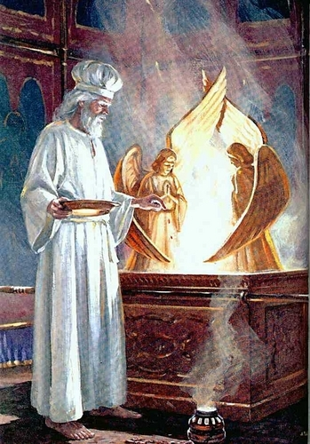
When did the High Priest Wear Common Garments?
Lev. 16:23 “And Aaron shall come into the tabernacle of the congregation, and shall put off the linen garments, which he put on when he went into the holy place, and shall leave them there:
As the high priest laid aside his gorgeous pontifical robes, and officiated in the white linen dress of the common priest, so Christ took the form of a servant, and offered sacrifice, Himself the priest, Himself the victim—DA, 25

Slide 9
The High Priest’s Garments…
Ex. 28:31-35 “And thou shalt make the robe of the ephod all of blue. And there shall be an hole in the top of it, in the midst thereof: it shall have a binding of woven work round about the hole of it, as it were the hole of an habergeon, that it be not rent. And beneath upon the hem of it thou shalt make pomegranates of blue, and of purple, and of scarlet, round about the hem thereof; and bells of gold between them round about: A golden bell and a pomegranate, a golden bell and a pomegranate, upon the hem of the robe round about. And it shall be upon Aaron to minister: and his sound shall be heard when he goeth in unto the holy place before the Lord, and when he cometh out, that he die not.”

Slide 10
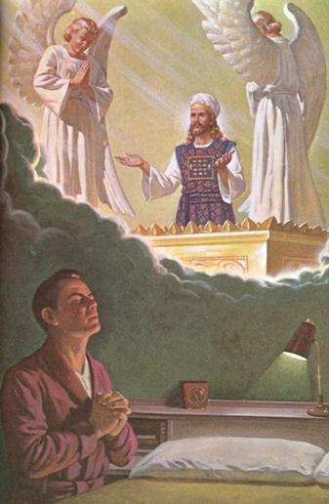
The Tinkling Bells: 1844’s Active Priest!
As Jesus moved out the Most Holy Place, I heard the tinkling of the bells upon His garment . . . Then I saw Jesus lay off His priestly attire and clothe Himself with His most kingly robes—Spirit of Prophecy, vol. 1, p. 198, 199
Only those in close communion with Christ, discern His workings: “There I beheld Jesus, a great High Priest, standing before the Father. On the hem of His garment was a bell and a pomegranate, a bell and a pomegranate. Then Jesus shewed me the difference between faith and feeling. And I saw those who rose up with Jesus would send up their faith to Him in the holiest, and pray, "My Father, give us Thy Spirit." Then Jesus would breathe upon them the Holy Ghost. In that breath was light, power, and much love, joy, and peace

Slide 11
The Sanctuary Tells All!
Then I turned to look at the company who were still bowed before the throne. They did not know that Jesus had left it. Satan appeared to be by the throne trying to carry on the work of God. I saw them look up to the throne and pray, My Father give us thy spirit. Then Satan would breathe on them an unholy influence. In it there was light and much power, but no sweet love, joy and peace. Satan's object was to keep them deceived and to draw back and deceive God's children. I saw one after another leave the company who were praying to Jesus in the Holiest, go and join those before the throne and they at once received the unholy influence of Satan—The Day-Star, Mar. 14, 1846

Slide 12
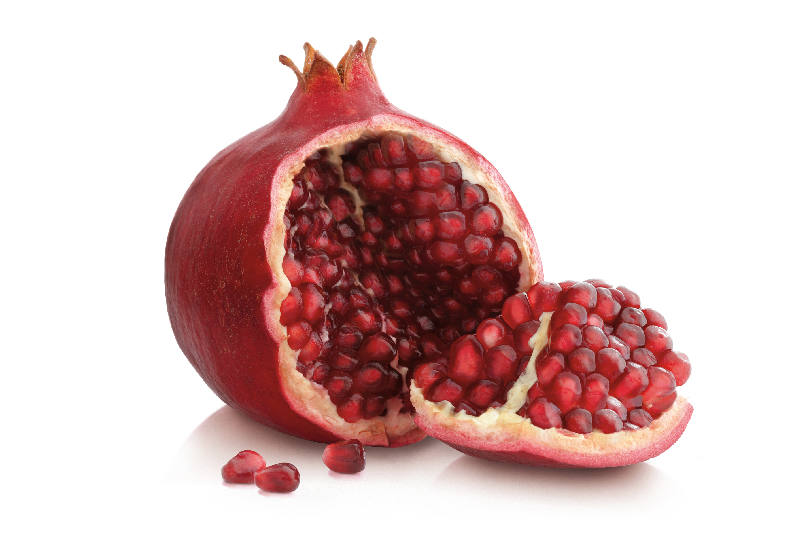
Pomegranates, the Fruitful Plant
John 15:8 “Herein is my Father glorified, that ye bear much fruit; so shall ye be my disciples.

Slide 13
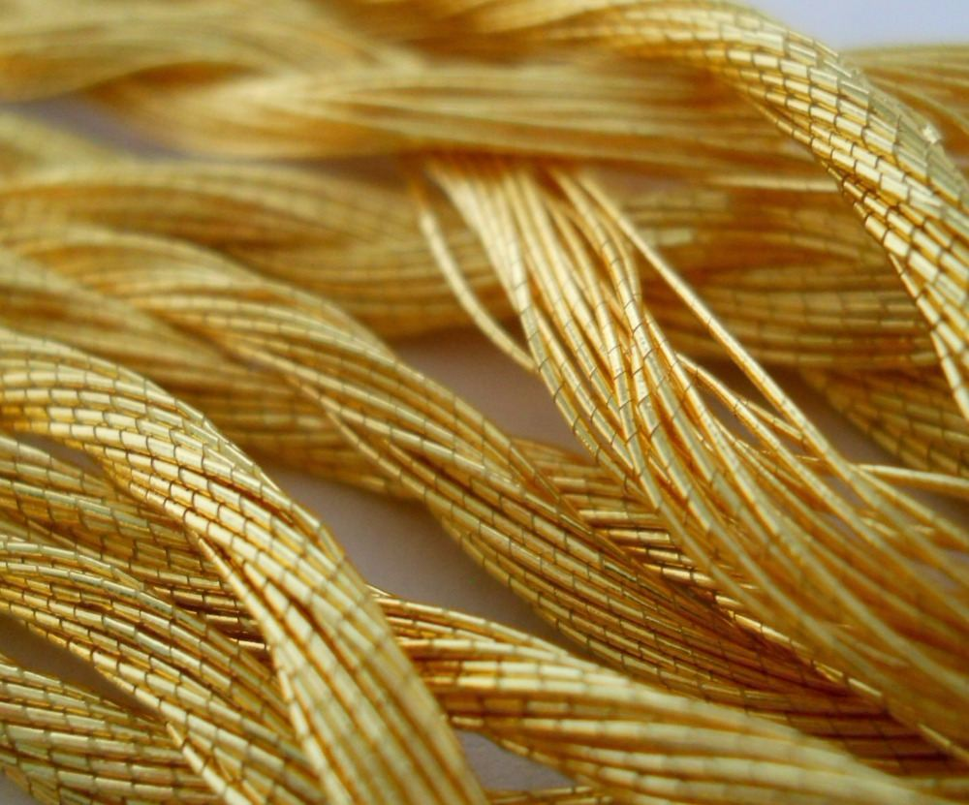
Colors…
Gold:
“The churches may yet obtain the gold of truth, faith, and love”—RH, July, 24, 1888
“The gold that he offers is without alloy, more precious than that of Ophir; for it is faith and love.”—RH, Aug. 7, 1894
“The gold tried in the fire is faith that works by love. Only this can bring us into harmony with God. We may be active, we may do much work; but without love, such love as dwelt in the heart of Christ, we can never be numbered with the family of heaven”—Christ’s Object Lessons, 158

Slide 14
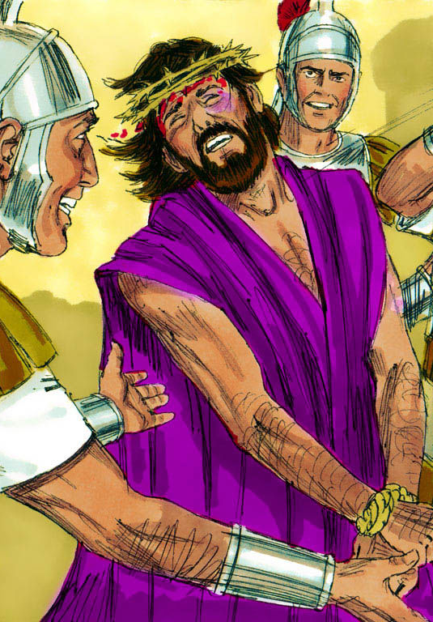
Scarlet: “Come now, and let us reason together, saith the Lord: though your sins be as scarlet, they shall be as white as snow; though they be red like crimson, they shall be as wool.”—Is. 1:18
Purple: “And the weight of the golden earrings that he requested was a thousand and seven hundred shekels of gold; beside ornaments, and collars, and purple raiment that was on the kings of Midian, and beside the chains that were about their camels' necks.”—Judges 8:26
John 19:5-Then came Jesus forth, wearing the crown of thorns, and the purple robe. And Pilate saith unto them, Behold the man!

Slide 15
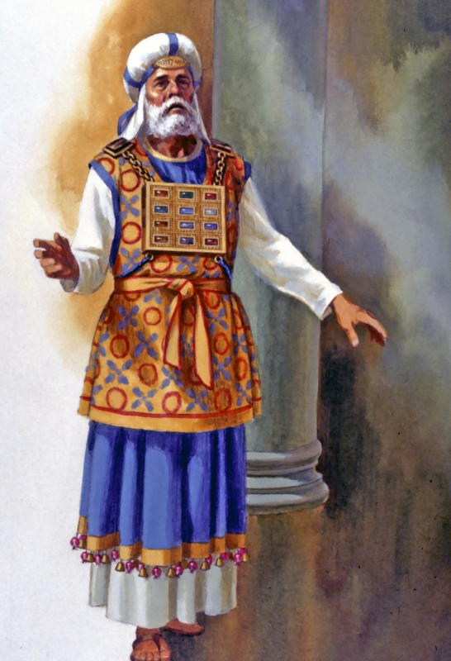
More of the High Priest’s Garments
Exodus 28:2-4 “And thou shalt make holy garments for Aaron thy brother for glory and for beauty. And thou shalt speak unto all that are wise hearted, whom I have filled with the spirit of wisdom, that they may make Aaron's garments to consecrate him, that he may minister unto me in the priest's office. And these are the garments which they shall make; a breastplate, and an ephod, and a robe, and a broidered coat, a mitre, and a girdle: and they shall make holy garments for Aaron thy brother, and his sons, that he may minister unto me in the priest's office.

Slide 16
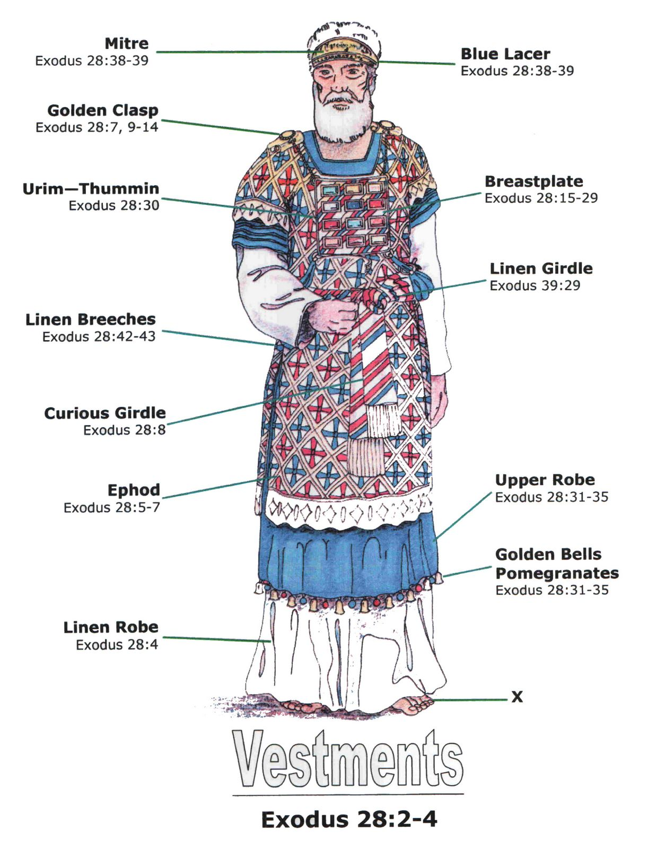
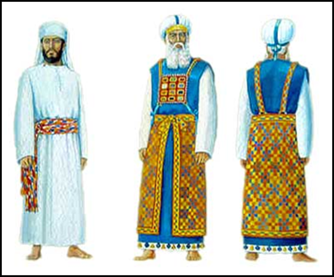

Slide 17
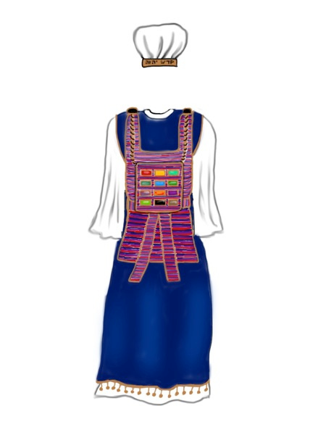
The Ephod
Ex. 28:6 “And they shall make the ephod of gold, of blue, and of purple, of scarlet, and fin twined linen, with cunning needlework. . . ”
“Outside this was the ephod, a short garment of gold, blue, purple, scarlet, and white. It was confined by a girdle of the same colors beautifully wrought. The ephod was sleeveless, and on its gold embroidered should-pieces were set two onyx stones, bearing the names of the twelve tribes of Israel.”—PP, 351

Slide 18
Ephod Continued…
Ex. 28:7-12 “It shall have the two shoulderpieces thereof joined at the two edges thereof; and so it shall be joined together. And the curious girdle of the ephod, which is upon it, shall be of the same, according to the work thereof; even of gold, of blue, and purple, and scarlet, and fine twined linen. And thou shalt take two onyx stones, and grave on them the names of the children of Israel: Six of their names on one stone, and the other six names of the rest on the other stone, according to their birth. With the work of an engraver in stone, like the engravings of a signet, shalt thou engrave the two stones with the names of the children of Israel: thou shalt make them to be set in ouches of gold. And thou shalt put the two stones upon the shoulders of the ephod for stones of memorial unto the children of Israel: and Aaron shall bear their names before the Lord upon his two shoulders for a memorial.”

Slide 19
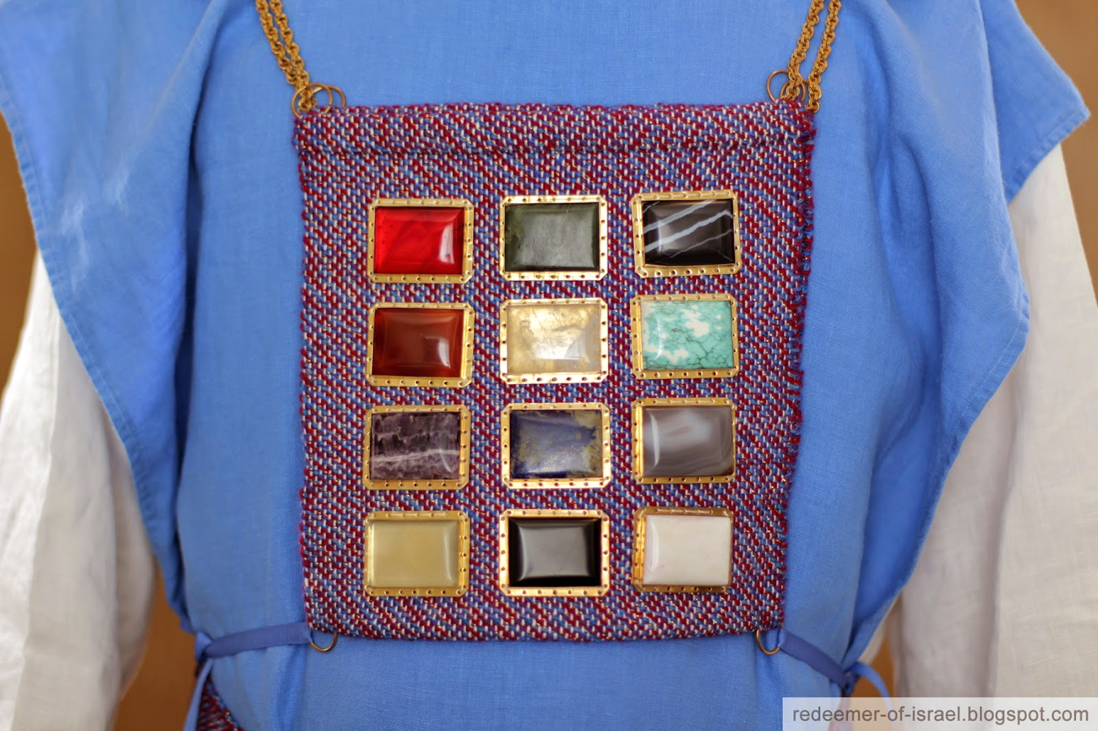
The Breastplate of…
Ex. 28:14, 15 “And two chains of pure gold at the ends; of wreathen work shalt thou make them, and fasten the wreathen chains to the ouches. And thou shalt make the breastplate of judgment with cunning work; after the work of the ephod thou shalt make it; of gold, of blue, and of purple, and of scarlet, and of fine twined linen, shalt thou make it.

Slide 20
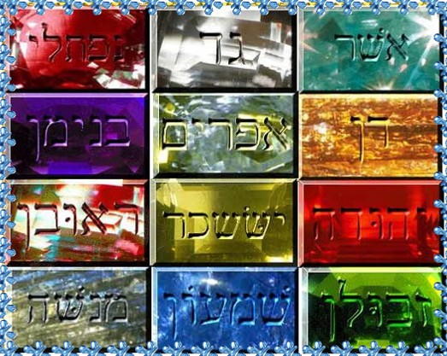
Ex. 28:16-21 “Foursquare it shall be being doubled; a span shall be the length thereof, and a span shall be the breadth thereof. And thou shalt set in it settings of stones, even four rows of stones: the first row shall be a sardius, a topaz, and a carbuncle: this shall be the first row. And the second row shall be an emerald, a sapphire, and a diamond. And the third row a ligure, an agate, and an amethyst. And the fourth row a beryl, and an onyx, and a jasper: they shall be set in gold in their inclosings. And the stones shall be with the names of the children of Israel, twelve, according to their names, like the engravings of a signet; every one with his name shall they be according to the twelve tribes.

Slide 21
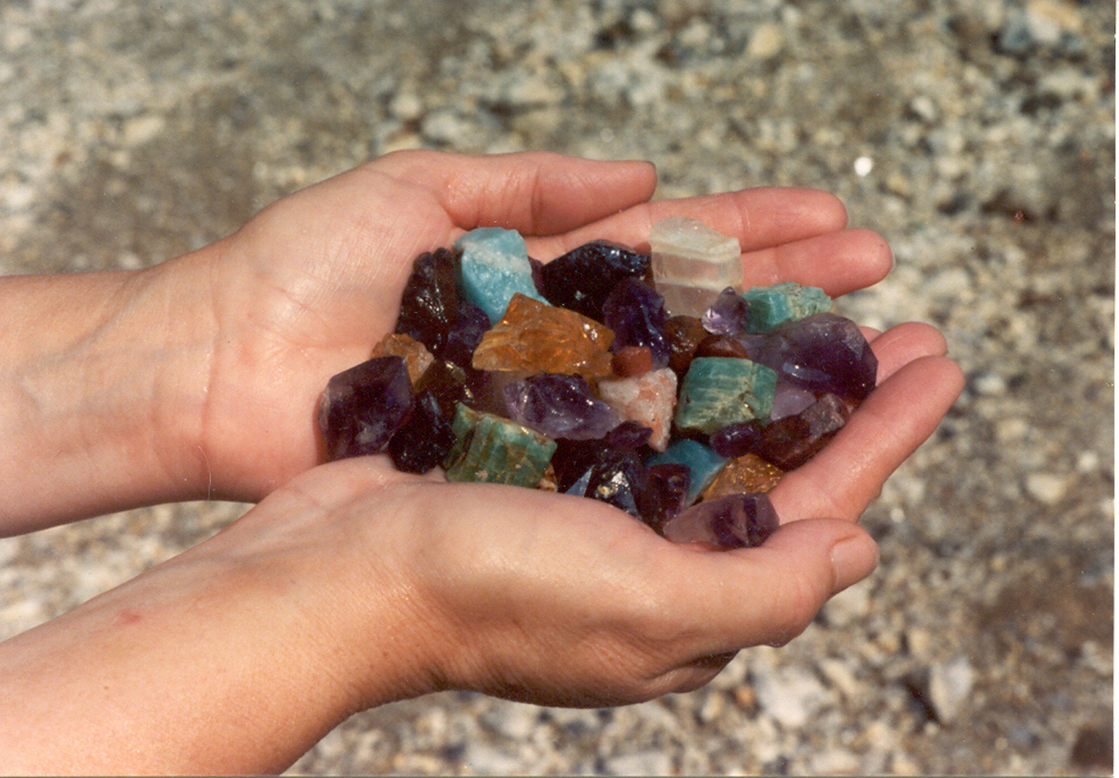
Separate Stones, Separate Characters…
“In the breastplate of the high priest there were many stones, but each stone had its special light, adding to the beauty of the whole. Every stone had its special significance, bearing its important message from God. There were many stones, but one breastplate. So there are many minds, but one Mind. In the church there are many members, each having his peculiar characteristics, but they form one family.”-- Letter 53, 1900.

Slide 22
More on the breastplate
“Over the ephod was the breastplate, the most sacred of the priestly vestments. This was of the same material as the ephod. It was the in the form of a square, measuring a span, and was suspended from the shoulders by a cord of blue from the golden rings. The border was formed of a variety of precious stones, the same that form the twelve foundations of the City of God.”—PP 351

Slide 23
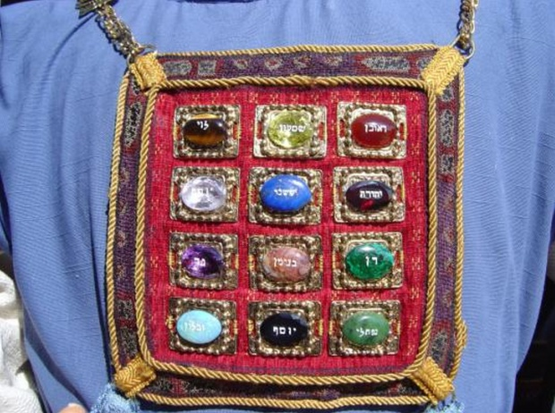
Ex. 28:29 “And Aaron shall bear the names of the children of Israel in the breastplate of judgment upon his heart, when he goeth in unto the holy place, for a memorial before the Lord continually.”
So Christ, the great high priest, pleading His blood before the Father in the sinner’s behalf, bears upon His heart the name of every repentant, believing soul—PP, 351

Slide 24
Urim and Thummim
Ex. 28:30 “And thou shalt put in the breastplate of judgment the Urim and the Thummim; and they shall be upon Aaron's heart, when he goeth in before the Lord: and Aaron shall bear the judgment of the children of Israel upon his heart before the Lord continually
Lev. 8:8 “And he put the breastplate upon him: also he put in the breastplate the Urim and the Thummim.”
Urim- 224: lights
Thummim- 8550: perfection

Slide 25
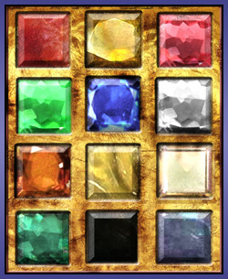
What is their purpose?
At the right and left of the breastplate were two large stones of great brilliancy. These were known as the Urim and Thummim. By them the will of God was made known through the high priest. When questions were brought for decision before the Lord, a halo of light encircling the precious stone at the right was a token of the divine consent or approval, while a cloud shadowing the stone at the left was an evidence of denial or disapprobation.—PP, 351

Slide 26
A Few Examples…
Psalm 143:10 “Teach me to do thy will; for thou art my God: thy spirit is good; lead me into the land of uprightness.”
Numbers 27:21 “And he shall stand before Eleazar the priest, who shall ask counsel for him after the judgment of Urim before the LORD: at his word shall they go out, and at his word they shall come in, both he, and all the children of Israel with him, even all the congregation. 1 Sam. 28:6 “And when Saul enquired of the Lord, the Lord answered him not, neither by dreams, nor by Urim, nor by prophets.”

