Slide 1
Glorious Land Assaulted

Slide 2
Time of the End
“And at the time of the end shall the king of the south push at him: and the king of the north shall come against him like a whirlwind, with chariots, and with horsemen, and with many ships; and he shall enter into the countries, and shall overflow and pass over. He shall enter also into the glorious land, and many countries shall be overthrown: but these shall escape out of his hand, even Edom, and Moab, and the chief of the children of Ammon. He shall stretch forth his hand also upon the countries: and the land of Egypt shall not escape. But he shall have power over the treasures of gold and of silver, and over all the precious things of Egypt: and the Libyans and the Ethiopians shall be at his steps. But tidings out of the east and out of the north shall trouble him: therefore he shall go forth with great fury to destroy, and utterly to make away many. And he shall plant the tabernacles of his palace between the seas in the glorious holy mountain; yet he shall come to his end, and none shall help him.” Dan. 11:40-45

Slide 3
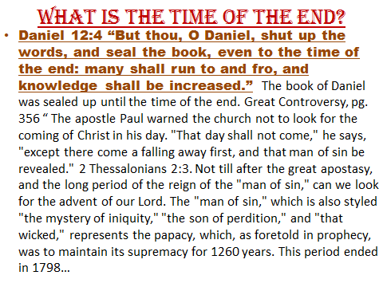

Slide 4
…The coming of Christ could not take place before that time. Paul covers with his caution the whole of the Christian dispensation down to the year 1798. It is this side of that time that the message of Christ's second coming is to be proclaimed.
No such message has ever been given in past ages. Paul, as we have seen, did not preach it; he pointed his brethren into the then far-distant future for the coming of the Lord. The Reformers did not proclaim it. Martin Luther placed the judgment about three hundred years in the future from his day. But since 1798 the book of Daniel has been unsealed, knowledge of the prophecies has increased, and many have proclaimed the solemn message of the judgment near. “ GC, pg. 356

Slide 5
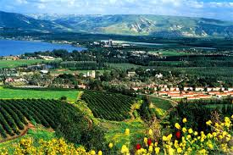
The Glorious Land!
“He shall enter also into the glorious land, and many countries shall be overthrown: but these shall escape out of his hand, even Edom, and Moab, and the chief of the children of Ammon.” Daniel 11:40 The king of the north would attack the glorious land. The glorious land in history was, of course, the land of Israel. “But he that cometh against him shall do according to his own will, and none shall stand before him: and he shall stand in the glorious land, which by his hand shall be consumed.” (verse 16)

Slide 6
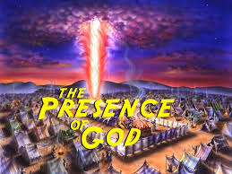
The King Reigns!
What made Israel glorious was the presence of God in their midst. “Great is the LORD, and greatly to be praised in the city of our God, in the mountain of his holiness. Beautiful for situation, the joy of the whole earth, is mount Zion, on the sides of the north, the city of the great King.” Ps. 48:1,2

Slide 7
Can the Presence of God be Forfeited?
“And his daughter in law, Phinehas' wife, was with child, near to be delivered: and when she heard the tidings that the ark of God was taken, and that her father in law and her husband were dead, she bowed herself and travailed; for her pains came upon her. And about the time of her death the women that stood by her said unto her, Fear not; for thou hast born a son. But she answered not, neither did she regard it. And she named the child Ichabod, saying, The glory is departed from Israel: because the ark of God was taken, and because of her father in law and her husband. And she said, The glory is departed from Israel: for the ark of God is taken.” 1 Samuel 4:19-22

Slide 8
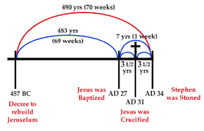
Was There a Prophecy?
“Seventy weeks are determined upon thy people and upon thy holy city, to finish the transgression, and to make an end of sins, and to make reconciliation for iniquity, and to bring in everlasting righteousness, and to seal up the vision and prophecy, and to anoint the most Holy.” Daniel 9:24

Slide 9
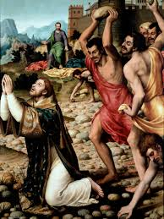
Did the Presence of God Depart?
“But he, being full of the Holy Ghost, looked up steadfastly into heaven, and saw the glory of God, and Jesus standing on the right hand of God, And said, Behold, I see the heavens opened, and the Son of man standing on the right hand of God.” Acts 7:55,56

Slide 10
Probation Closed, ICHABOD!
Probation closed on the professed people of God in 34 AD. The glory of God departed from His people. But, the Lord has always had a place in this world where He has manifest His glory. After 34 AD, where did the Lord manifest His glory? What became the glorious land after 34 AD? The book of Acts is quite obvious that the Christian church became the glorious land after 34 AD!!!

Slide 11
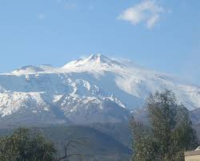
Since Daniel 11 is discussing the glorious land after 1798, in the time of the end, then, the glorious land after 1798 is God’s church at the end of time. Thus, the assault of the king of the north on the glorious land at the end would represent an attack on Seventh day Adventism!!!

Slide 12
What Would Be Attacked?
1. the Spirit of Prophecy
2. the message of victory over sin through faith in Jesus Christ!
3. the law of God and the Sabbath
4. the sanctuary
5. the distinctive standards in diet, dress, etc.
6. the 3 Angel’s messages

Slide 13
Foretold
“That night I dreamed that I was in Battle Creek looking out from the side glass at the door and saw a company marching up to the house, two and two. They looked stern and determined. I knew them well and turned to open the parlor door to receive them, but thought I would look again. The scene was changed. The company now presented the appearance of a Catholic procession. One bore in his hand a cross, another a reed. And as they approached, the one carrying a reed made a circle around the house, saying three times: "This house is proscribed. The goods must be confiscated. They have spoken against our holy order." Terror seized me, and I ran through the house, out of the north door, and found myself in the midst of a company, some of whom I knew, but I dared not speak a word to them for fear of being betrayed. I tried to seek a retired spot where I might weep and pray without meeting eager, inquisitive eyes wherever I turned. I repeated frequently: "If I could only understand this! If they will tell me what I have said or what I have done!"
I wept and prayed much as I saw our goods confiscated. I tried to read sympathy or pity for me in the looks of those around me, and marked the countenances of several whom I thought would speak to me and comfort me if they did not fear that they would be observed by others. I made one attempt to escape from the crowd, but seeing that I was watched, I concealed my intentions. I commenced weeping aloud, and saying: "If they would only tell me what I have done or what I have said!" My husband, who was sleeping in a bed in the same room, heard me weeping aloud and awoke me. My pillow was wet with tears, and a sad depression of spirits was upon me.” Test. Volume 1, pg. 578

Slide 14
Foretold
“The enemy of souls has sought to bring in the supposition that a great reformation was to take place among Seventh-day Adventists, and that this reformation would consist in giving up the doctrines which stand as the pillars of our faith, and engaging in a process of reorganization. Were this reformation to take place, what would result? The principles of truth that God in His wisdom has given to the remnant church, would be discarded. Our religion would be changed. The fundamental principles that have sustained the work for the last fifty years would be accounted as error. A new organization would be established. Books of a new order would be written. A system of intellectual philosophy would be introduced. The founders of this system would go into the cities, and do a…

Slide 15
wonderful work. The Sabbath of course, would be lightly regarded, as also the God who created it. Nothing would be allowed to stand in the way of the new movement. The leaders would teach that virtue is better than vice, but God being removed, they would place their dependence on human power, which, without God, is worthless. Their foundation would be built on the sand, and storm and tempest would sweep away the structure.” 1 Selected Messages, pgs. 204, 205

Slide 16
Great Controversy, pg. 608
“As the storm approaches, a large class who have professed faith in the third angel's message, but have not been sanctified through obedience to the truth, abandon their position and join the ranks of the opposition. By uniting with the world and partaking of its spirit, they have come to view matters in nearly the same light; and when the test is brought, they are prepared to choose the easy, popular side. Men of talent and pleasing address, who once rejoiced in the truth, employ their powers to deceive and mislead souls. They become the most bitter enemies of their former brethren. When Sabbath keepers are brought before the courts to answer for their faith, these apostates are the most efficient agents of Satan to misrepresent and accuse them, and by false reports and insinuations to stir up the rulers against them.” GC, pg. 608

Slide 17
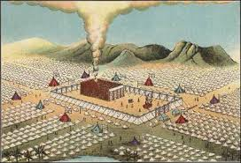
The Final Hurrah
“And he shall plant the tabernacles of his palace between the seas in the glorious holy mountain; yet he shall come to his end, and none shall help him.” Daniel 11:45

Slide 18
Urging the 1st Day
“There is need of a Sabbath reform among us…Others who are well acquainted with the Bible evidences that the seventh day is the Sabbath, enter into partnership with men who have no respect for God’s holy day. A Sabbath-keeper cannot allow men in his employ, paid by his money, to work on the Sabbath. If, for the sake of gain, he allows the business in which he has an interest to be carried on the Sabbath by his unbelieving partner, he is equally guilty with the unbeliever; and it is his duty to dissolve the relation, however much he may lose by so doing. Men may think they cannot afford to obey God, but they cannot afford to disobey him. Those who are careless in their observance of the Sabbath will suffer great loss.
The Lord has a controversy with his professed people in these last days. In this controversy men in responsible positions will take a course directly opposite to that pursued by Nehemiah. They will not only ignore and despise the Sabbath themselves, but they will try to keep it from others by burying it beneath the rubbish of custom and tradition. In churches and in large gatherings in the open air, ministers will urge upon the people the necessity of keeping the first day of the week.” RH, March 18, 1884

Slide 19
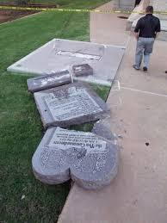
Before this is over, the great bulk of SDA’s will bow down to a Sunday law in obeisance to their pastors and conference officials! This will be the king of the North's final hurrah. However, the truth will march on and the king of the north will be destroyed!

