Slide 1
Prophecy Arise, pt. 15
Fundamentalism, Apologies, and Trump!

Slide 2

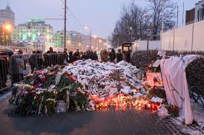
Charlie Hebdo and Paris Nov. 2015

Slide 3
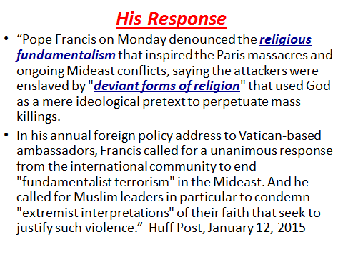

Slide 4
After Paris in November 2015
"“Fundamentalism is a disease that is in all religions. We Catholics we have some, some, many, who believe they have the absolute truth and go on dirtying others with slander, and libel, and they hurt, they hurt… And I say this because it is my church, we, everyone! And you have to fight. Religious fundamentalism is not religious. Why? Because there is God. ‘Idolatrous, as is idolatrous money… But fundamentalism that always ends in a tragedy or crime, it is a bad thing, but there is a bit ‘in all religions.” Pope Francis, during press conference on the plane returning to Rome from Africa.”

Slide 5
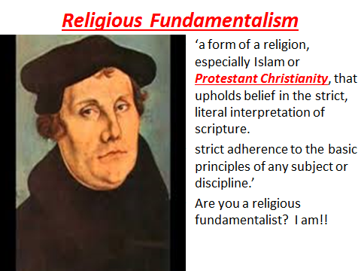
What is Fundamentalism?

Slide 6
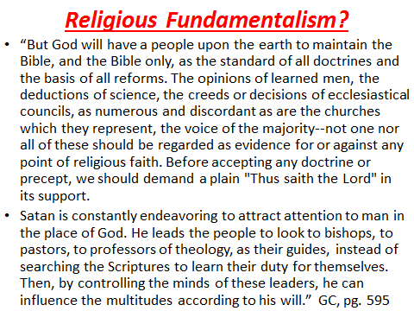

Slide 7
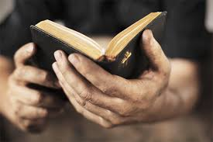
What Francis and the Devil Fear Most!
1. Pray.
2. Study
3. Share
“Who is she that looketh forth as the morning, fair as the moon, clear as the sun, and terrible as an army with banners?” Song of Solomon 6:10

Slide 8
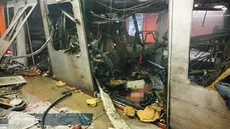
After Brussels
"We will do whatever is necessary to support our friend and ally Belgium in bringing to justice those who are responsible," Obama said. He said America's thoughts and prayers are with the people of Belgium.
Obama said Tuesday's attacks provided yet another reminder "that the world must unite," regardless of nationality, race or faith in "fighting against the scourge of terrorism."

Slide 9
Albert Pike, 1871
“The Third World War was planned to result from the differences stirred up by Illuminati agents between the Zionists and the Arabs. The conflict was planned to spread worldwide. The Illuminati planned to unleash the Nihilists and Atheists and provoke a formidable social cataclysm which in all its horror will show clearly to the nations the effect of absolute atheism, origin of savagery and of the most
bloody turmoil. Then everywhere, the citizens, obliged to defend themselves against the world minority of revolutionaries, will exterminate those destroyers of civilization, and the multitude, disillusioned with Christianity, whose deistic spirits will from that moment be without compass [direction], anxious for an ideal, but
without knowing where to render its adoration, will receive the true light through the universal manifestation of the pure doctrine of Lucifer, brought finally out in the public view, a manifestation which will result from the general reactionary movement which will follow the destruction of Christianity and atheism, -- Des Griffin, Descent Into Slavery, Emissary Publications, pp. 38, 39

Slide 10
Apologies for Past Sins!
SANTA CRUZ, Bolivia (AP) — Pope Francis apologized Thursday for the sins and "offenses" committed by the Catholic Church against indigenous peoples during the colonial-era conquest of the Americas. History's first Latin American pope "humbly" begged forgiveness during an encounter in Bolivia with indigenous groups and other activists and in the presence of Bolivia's first-ever indigenous president, Evo Morales. Francis noted that Latin American church leaders in the past had acknowledged "grave sins were committed against the native peoples of America in the name of God." St. John Paul II, for his part, apologized to the continent's indigenous for the "pain and suffering" caused during the 500 years of the church's presence on the continent during a 1992 visit to the Dominican Republic. But Francis went farther. "I humbly ask forgiveness, not only for the offenses of the church herself, but also for crimes committed against the native peoples during the so-called conquest of America," he said to applause and cheers from the crowd.

Slide 11
No Change!
“The Roman Church now presents a fair front to the world, covering with apologies her record of horrible cruelties. She has clothed herself in Christ like garments; but she is unchanged. Every principle of the papacy that existed in past ages exists today. The doctrines devised in the darkest ages are still held. Let none deceive themselves. The papacy that Protestants are now so ready to honor is the same that ruled the world in the days of the Reformation, when men of God stood up, at the peril of their lives, to expose her iniquity. She possesses the same pride and arrogant assumption that lorded it over kings and princes, and claimed the prerogatives of God. Her spirit is no less cruel and despotic now than when she crushed out human liberty and slew the saints of the Most High.” GC, pg. 571

Slide 12
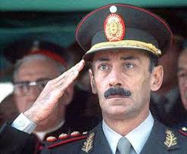
He Forgot the ‘Dirty War’.
This is the Argentinian dictator Jorge Videla who was serving a life sentence for war crimes between 1976-1983. His superior boss was Jesuit provincial, Pope Francis/Bergoglio! No apologies were made for the 1,000’s that were killed under his tutelage!

Slide 13
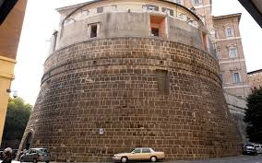
“And the light of a candle shall shine no more at all in thee; and the voice of the bridegroom and of the bride shall be heard no more at all in thee: for thy merchants were the great men of the earth; for by thy sorceries were all nations deceived. And in her was found the blood of prophets, and of saints, and of all that were slain upon the earth.” Rev. 18:23,24
He forgot to apologize for all the wars he is fomenting and the dirty drug money he collects while people die!

Slide 14
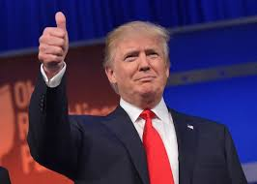
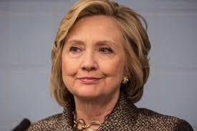
The Front Runners

Slide 15
Tied to…………………….Rome!
Both of the political frontrunners in the current election have secret ties to the Vatican. Donald Trump was educated at Fordham University in New City. Fordham is one of the pre eminent Jesuit universities in America. Many sources believe that Trump is a Knight of Malta. The Knights are soldiers of the pope, doing his bidding in the earth.
Clinton has ties to the Jesuits through the Masonic order of the Eastern Star. She also held communion with Eleanor Roosevelt during her first control of the White House!!!!

Slide 16
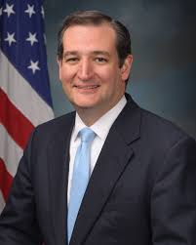
Most Dangerous of them All!
“In this sense the associated term "Seven Mountains Dominion" implies evangelical control over seven areas of the culture: family, religion, education, media, entertainment,business and government.” Wikipedia. Welcome to Ted Cruz’s World!!

Slide 17
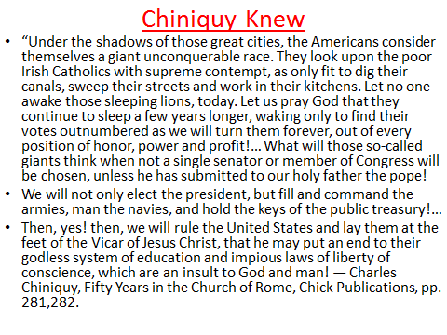

Slide 18
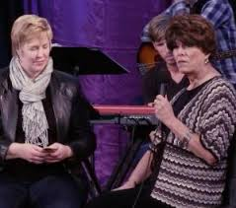
Without a Whimper!
December 12, 2015, the first ‘SDA’ transgender elder is teaching Sabbath School in the Hollywood ‘SDA’ Church. He/She declared, “One wonders if the recent 21 page document released by Andrews Seminary paves the way for this kind of gender confusion into the church.” Folcrum News, Jan. 9, 2016

Slide 19
Seminary Declares
1. While homosexuality is a distortion of the Edenic ideal, “there is no condemnation” for homosexually oriented persons as long as they “are in Christ Jesus” (Rom 8:1) and do not harbor or act upon their orientation and propensities. The same principle applies to those who struggle with heterosexual immorality (see Matt 5:27–28; Rom 6:1–23; 8:1–4; Col 3:1–10; James 1:14–15). Even as some individuals may experience a miraculous deliverance from sinful heterosexual and homosexual urges, others may have to wrestle with such tendencies all their lives (see Gal 5:16–25).9 One is not culpable for these involuntary tendencies, but for acting upon them either in imagination or actual practice.
2. “If I accept myself as a gay or lesbian person, do I have a place in the Church?” We are a Church made up of sinners saved by grace with love as its foundation (Matt 22:36–40) and such love should be shown equally to all members. Gay and lesbian members who choose to, and remain abstinent should be given the opportunity to participate in all church activities including leadership positions in the Church.

Slide 20

Ripe for the Picking
The world is ripe for the picking. The time for the truth to go like fire in a hayfield has arrived a long time ago. Within Adventism, homosexuality is now an accepted norm and Adventism does not know the time of her visitation!

Slide 21
Where are the Watchman?
“Again the word of the LORD came unto me, saying, Son of man, speak to the children of thy people, and say unto them, When I bring the sword upon a land, if the people of the land take a man of their coasts, and set him for their watchman: If when he seeth the sword come upon the land, he blow the trumpet, and warn the people; Then whosoever heareth the sound of the trumpet, and taketh not warning; if the sword come, and take him away, his blood shall be upon his own head. He heard the sound of the trumpet, and took not warning; his blood shall be upon him. But he that taketh warning shall deliver his soul. But if the watchman see the sword come, and blow not the trumpet, and the people be not warned; if the sword come, and take any person from among them, he is taken away in his iniquity; but his blood will I require at the watchman's hand. So thou, O son of man, I have set thee a watchman unto the house of Israel; therefore thou shalt hear the word at my mouth, and warn them from me.” Eze. 33:1-7

Slide 22
Confusion
“As the storm approaches, a large class who have professed faith in the third angel's message, but have not been sanctified through obedience to the truth, abandon their position and join the ranks of the opposition. By uniting with the world and partaking of its spirit, they have come to view matters in nearly the same light; and when the test is brought, they are prepared to choose the easy, popular side. Men of talent and pleasing address, who once rejoiced in the truth, employ their powers to deceive and mislead souls. They become the most bitter enemies of their former brethren. When Sabbath keepers are brought before the courts to answer for their faith, these apostates are the most efficient agents of Satan to misrepresent and accuse them, and by false reports and insinuations to stir up the rulers against them.” GC, pg. 608

