Slide 1
Against All Odds, pt. 2
Heaven’s Insanity!!

Slide 2
The Foolishness of God
“For Christ sent me not to baptize, but to preach the gospel: not with wisdom of words, lest the cross of Christ should be made of none effect. For the preaching of the cross is to them that perish foolishness; but unto us which are saved it is the power of God. For it is written, I will destroy the wisdom of the wise, and will bring to nothing the understanding of the prudent. Where is the wise? where is the scribe? where is the disputer of this world? hath not God made foolish the wisdom of this world? For after that in the wisdom of God the world by wisdom knew not God, it pleased God by the foolishness of preaching to save them that believe. For the Jews require a sign, and the Greeks seek after wisdom: But we preach Christ crucified, unto the Jews a stumbling block, and unto the Greeks foolishness; But unto them which are called, both Jews and Greeks, Christ the power of God, and the wisdom of God. Because the foolishness of God is wiser than men; and the weakness of God is stronger than men. For ye see your calling, brethren, how that not many wise men after the flesh, not many mighty, not many noble, are called: But God hath chosen the foolish things of the world to confound the wise; and God hath chosen the weak things of the world to confound the things which are mighty; And base things of the world, and things which are despised, hath God chosen, yea, and things which are not, to bring to naught things that are: That no flesh should glory in his presence. But of him are ye in Christ Jesus, who of God is made unto us wisdom, and righteousness, and sanctification, and redemption: That, according as it is written, He that glorieth, let him glory in the Lord.” 1 Corinthians 1:17-31

Slide 3
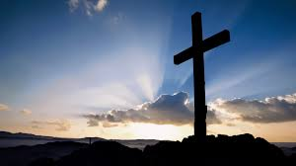
God Does the Foolish
The greatest event in the history of this planet was done in complete humiliation, without hope, and without any earthly promise of anything good! “. For the preaching of the cross is to them that perish foolishness; but unto us which are saved it is the power of God.” 1 Corinthians 1:18

Slide 4
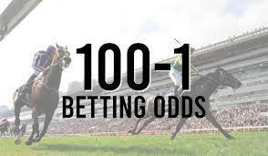
Confounding the Wise and Powerful
In the story today, the odds were outrageous. At first, the odds were impossible of anything but ignominious defeat! Numbers wise, the odds were horrible. The enemy had around 130,000 men while the people of God were roughly a fourth of that!! Then, the foolishness of God kicked in and the Lord said, “The people that are with thee are too many for me to give the Midianites into their hands, lest Israel vaunt themselves against me, saying, Mine own hand hath saved me. Now therefore go to, proclaim in the ears of the people, saying, Whosoever is fearful and afraid, let him return and depart early from mount Gilead. And there returned of the people twenty and two thousand; and there remained ten thousand.” Judges 7:2,3

Slide 5
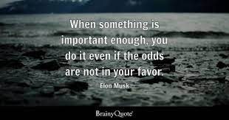
Self-Exaltation
The desire to exalt oneself is so pronounced in the human family that the Lord had to decree thus! Get rid of most of the army, otherwise men will take the credit for the works of God!! So, nearly 2/3 of the army was sent home! There was still a big problem and it had nothing to do with the enemy! There were still too many men in the Lord’s army! Ultimately, the army dwindled down to a tenth of its original size.

Slide 6
God’s Method
“God does not always choose for His work men of the greatest talents, but He selects those whom He can best use. “Before honor is humility.” Proverbs 15:33. The Lord can work most effectually through those who are most sensible of their own insufficiency, and who will rely upon Him as their leader and source of strength. He will make them strong by uniting their weakness to His might, and wise by connecting their ignorance with His wisdom. If they would cherish true humility, the Lord could do much more for His people; but there are few who can be trusted with any large measure of responsibility or success without becoming self-confident and forgetful of their dependence upon God. This is why, in choosing the instruments for His work, the Lord passes by those whom the world honors as great, talented, and brilliant. They are too often proud and self-sufficient. They feel competent to act without counsel from God.” PP, pg. 553

Slide 7
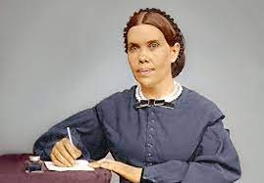
The Weakest of the Weak
In choosing a messenger for the final movement of God in this earth, He bypassed the worldly wise, those so puffed up in their own wisdom, and chose the weakest of the weak. Educated only through the third grade, weak and enfeebled by illness much of her life, God chose one who would be lowly enough to do His bidding and leave all the glory to Him! “For ye see your calling, brethren, how that not many wise men after the flesh, not many mighty, not many noble, are called: But God hath chosen the foolish things of the world to confound the wise; and God hath chosen the weak things of the world to confound the things which are mighty;” 1 Corinthians 1:26,27

Slide 8
God’s Plan Wins
“The most complete system that men have ever devised, apart from the power and wisdom of God, will prove a failure, while the most unpromising methods will succeed when divinely appointed and entered upon with humility and faith. Trust in God and obedience to His will are as essential to the Christian in the spiritual warfare as to Gideon and Joshua in their battles with the Canaanites. By the repeated manifestations of His power in behalf of Israel, God would lead them to have faith in Him—with confidence to seek His help in every emergency. He is just as willing to work with the efforts of His people now and to accomplish great things through weak instrumentalities. All heaven awaits our demand upon its wisdom and strength. God is “able to do exceeding abundantly above all that we ask or think.” Ephesians 3:20.

Slide 9
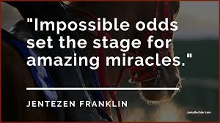
Still Too Many!
Down to 10,000 men, Gideon was told “The people are yet too many; bring them down unto the water, and I will try them for thee there: and it shall be, that of whom I say unto thee, This shall go with thee, the same shall go with thee; and of whomsoever I say unto thee, This shall not go with thee, the same shall not go.” Judges 7:4 Already the odds were horrendous and impossible, around 1 Israelite to every 13 Midianites, but the odds were about to get even worse! “And the LORD said unto Gideon, By the three hundred men that lapped will I save you, and deliver the Midianites into thine hand: and let all the other people go every man unto his place.” Judges 7:7

Slide 10
Success is Character, not Numbers
“By the simplest means character is often tested. Those who in time of peril were intent upon supplying their own wants were not the men to be trusted in an emergency. The Lord has no place in His work for the indolent and self-indulgent. The men of His choice were the few who would not permit their own wants to delay them in the discharge of duty. The three hundred chosen men not only possessed courage and self-control, but they were men of faith. They had not defiled themselves with idolatry. God could direct them, and through them He could work deliverance for Israel” PP, pg. 549

Slide 11
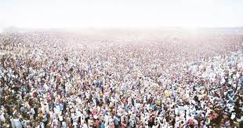
300 VS. 120,000
“Success does not depend upon numbers. God can deliver by few as well as by many. He is honored not so much by the great numbers as by the character of those who serve Him.” PP, pg. 549

Slide 12
The Insanity Continues
“And he divided the three hundred men into three companies, and he put a trumpet in every man's hand, with empty pitchers, and lamps within the pitchers. And he said unto them, Look on me, and do likewise: and, behold, when I come to the outside of the camp, it shall be that, as I do, so shall ye do. When I blow with a trumpet, I and all that are with me, then blow ye the trumpets also on every side of all the camp, and say, The sword of the LORD, and of Gideon. So Gideon, and the hundred men that were with him, came unto the outside of the camp in the beginning of the middle watch; and they had but newly set the watch: and they blew the trumpets, and brake the pitchers that were in their hands. And the three companies blew the trumpets, and brake the pitchers, and held the lamps in their left hands, and the trumpets in their right hands to blow withal: and they cried, The sword of the LORD, and of Gideon. And they stood every man in his place round about the camp: and all the host ran, and cried, and fled.” Judges 7:16-21

Slide 13
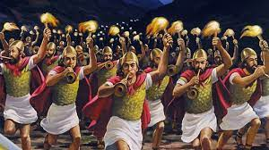
“The Lord can work most effectually through those who are most sensible of their own insufficiency, and who will rely upon Him as their leader and source of strength. He will make them strong by uniting their weakness to His might, and wise by connecting their ignorance with His wisdom. If they would cherish true humility, the Lord could do much more for His people; but there are few who can be trusted with any large measure of responsibility or success without becoming self-confident and forgetful of their dependence upon God. This is why, in choosing the instruments for His work, the Lord passes by those whom the world honors as great, talented, and brilliant. They are too often proud and self-sufficient. They feel competent to act without counsel from God.” PP, pg. 553

Slide 14
God Still Fights!!
“In this signal defeat not less than one hundred and twenty thousand of the invaders perished. The power of the Midianites was broken, so that they were never again able to make war upon Israel. The tidings spread swiftly far and wide, that Israel's God had again fought for His people. No words can describe the terror of the surrounding nations when they learned what simple means had prevailed against the power of a bold, warlike people. The leader whom God chose to overthrow the Midianites occupied no prominent position in Israel. He was not a ruler, a priest, or a Levite. He thought himself the least in his father's house. But God saw in him a man of courage and integrity. He was distrustful of himself and willing to follow the guidance of the Lord. God does not always choose for His work men of the greatest talents, but He selects those whom He can best use. “Before honor is humility.” Proverbs 15:33.” PP, pg. 553

Slide 15
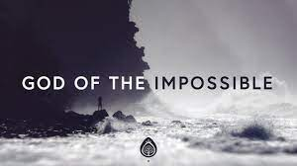
God of the Impossible!!
What is it, friend, today? Is it a mountain in your heart that appears to big? Is it a mountain without, at home, or at the job, or fearful of current events? What ever the mountain that looms, “For with God nothing shall be impossible.” Luke 1:37

