Slide 1











Why Christianity???
What’s The Difference???
?

Slide 2
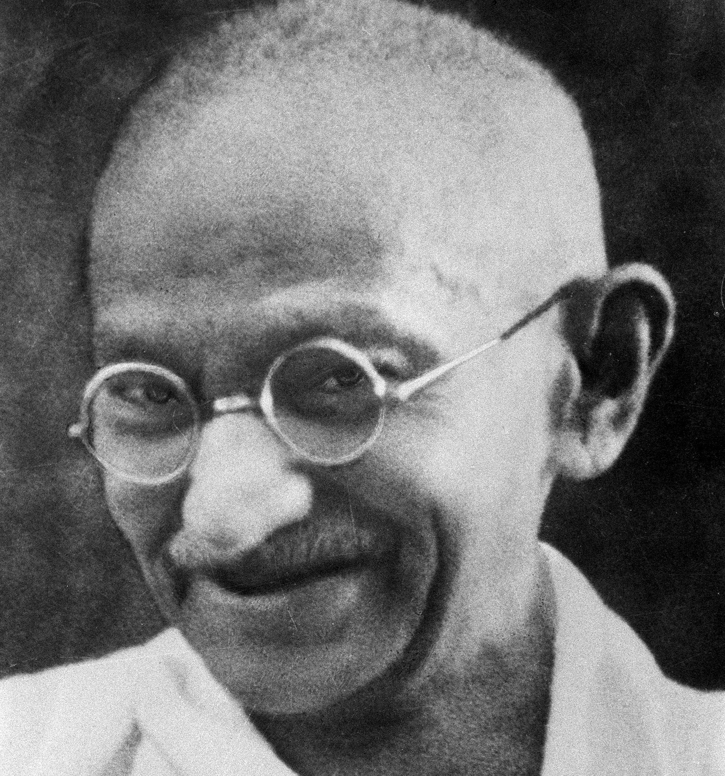
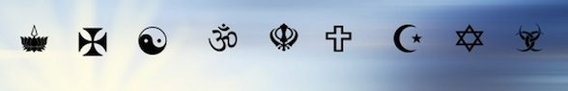
Are All Religions Really the Same?
“The various religions are like different roads converging on the same point. What difference does it make if we follow different routes, provided we arrive at the same destination?” Mahatma Gandhi

Slide 3
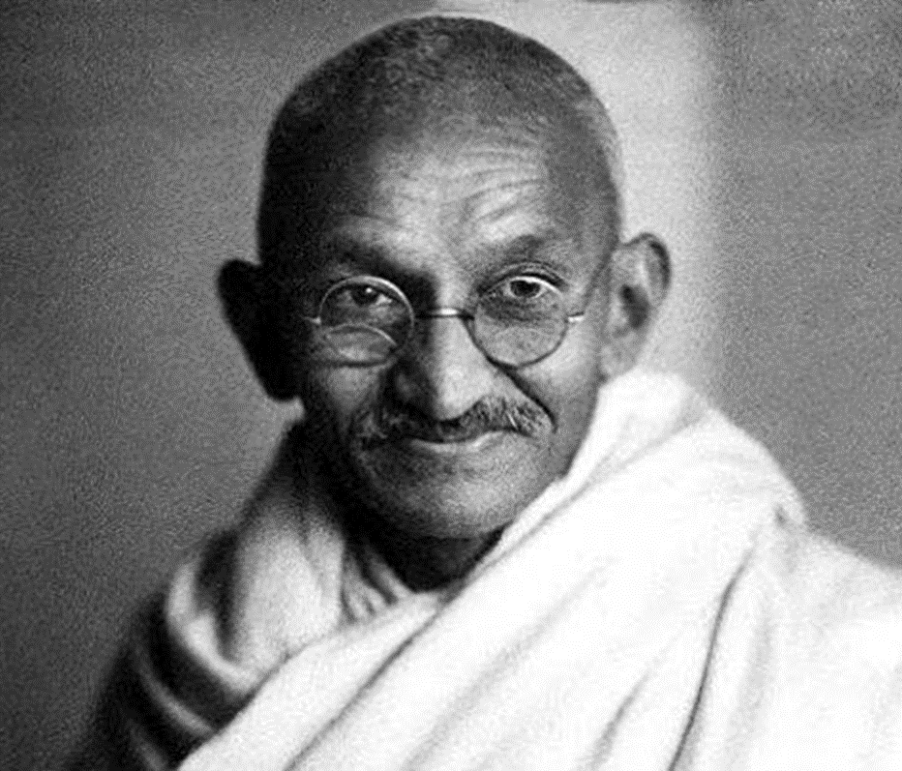
DID IT LAST FOR GANDHI??
“My days are numbered. I am not likely to live very long, perhaps a yearr or a little more. For the first time in 50 years I find myself in a slough of despond. All about me is darkness; I am praying for light”—Gandhi quoted in Give Me an Answer, Cliffe Knechtle, p. 20

Slide 4
Who is Correct???
Islam: The Jews call 'Uzair a son of Allah, and the Christians call Christ the son of Allah. That is a saying from their mouth; they but imitate what the unbelievers of old used to say. Allah's curse be on them: how they are deluded away from the Truth! (9:30, Yusif Ali)
Judaism: the whole complex of doctrines about the Son of God who died on the Cross to save humanity from sin and death - is incompatible with Judaism, and indeed in discontinuity with the Hebraism that preceded it." (Rayner, John D. A Jewish Understanding of the World, p. 187)
Hinduism: Jesus was a teacher and/or divine being (one of many “Ishtas”)—(Dean Halverson, The Compact Guide to World Religions, p. 92.
Buddhism: Personal self is an illusion. There is no us, I or you, or now—nor is there any God or gods, only teachers—Walpola Rahula, "What the Buddha Taught: Revised and Expanded Edition with Texts from Suttas and Dhammapada" Ch. 6; Keith Yandell and Harold Netland, "Buddhism: A Christian Exploration and Appraisal" 21
Bible: John 3:16 “For God so loved the world, that he gave his only begotten Son, that whosoever believeth in him should not perish, but have everlasting life.”

Slide 5


Slide 6


Slide 7
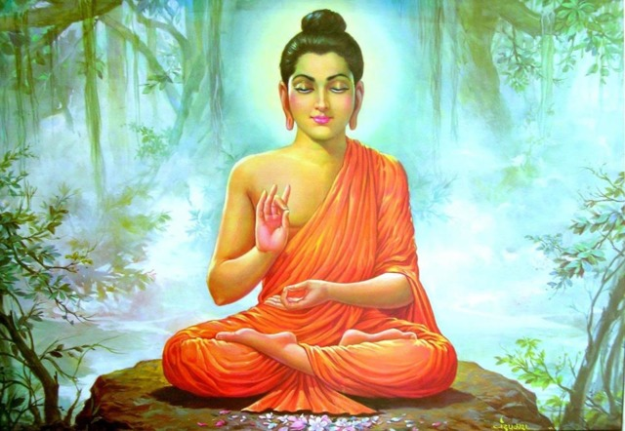
Siddhartha Stated:
“You must be your own lamps, be your own refuges. Take refuge in nothing outside yourselves. Hold firm to the truth as a lamp and refuge, and do not look for refuge to anything besides yourselves.”—quoted in William T. Debary, Sources of Indian Tradition vol. 1, p. 110.
Psalms 46:1 “God is our refuge and strength, a very present help in trouble.”
Romans 7:18 “For I know that in me (that is, in my flesh,) dwelleth no good thing”

Slide 8
The World Religions Can Be Divided Into 3 Major Worldviews…
1
2
3
ONLY THE UNIVERSE EXISTS
-Evolution
-Atheism
-Buddhism
-Jainism
-Paganism
-Satanism
ONLY GOD EXISTS
-Pantheism/Mother Earth
-Panentheism
-Hinduism
-Animism
-Buddhism
-Polytheism
-Paganism
BOTH GOD AND UNIVERSE EXISTS
-Christianity
-Judaism
-Islam
-Mormonism
-Scientology
-Polytheism
-Catholicism
-Paganism

Slide 9
And 2 Conceptions of Authority/God
You are God, god, can become god, or your own authority/savior:
-Evolution/Atheism
-Buddhism
-Mormonism
-Satanism
-New Age
-Pantheism
-Hinduism
-Jainism
-Polytheism
-Scientology
-Catholicism
You are Not God, a god, cannot become god, and are in need of saving:
-Christianity
-Catholicism
-Judaism
-Islam

Slide 10
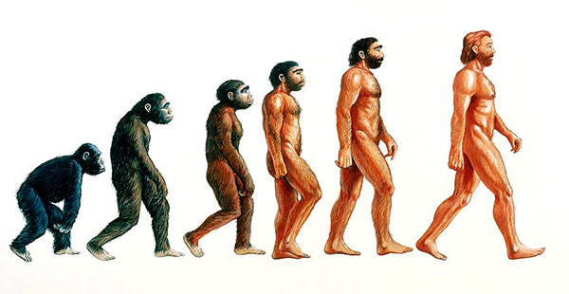
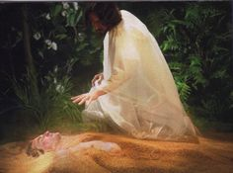
Major Questions that All Religions Face:
Origin: Where do we and this come from?
Meaning: Why are we here?
Morality: What is right and wrong?
Destiny: Where are we going?

Slide 11
Origin?
CREATED:
Christianity, Judaism, Islam: Gen. 1:1 “In the beginning God Created the heaven and the earth . . . So God created man in his own image, in the image of God created he him; male and female created he them.”—Created By God
ETERNAL UNIVERSE/REINCARNATION
Buddhism, Hinduism, Jainism: “When we die, the mind, with all the tendencies, preferences, abilities and characteristics that have been developed and conditioned in this life, re-establishes itself in a fertilized egg.”—www.buddhanet.net/e-learning/qanda05.htm
THE BIG BANG/UNIVERSE CREATED EVERYTHING
Evolution, Satanism: “our universe sprang into existence as ‘singularity’ around 13.7 billion years ago. What is a ‘singularity’ and where does it come from? Well, to be honest, we don't know for sure. Singularities are zones which defy our current understanding of physics. They are thought to exist at the core of ‘black holes.’—www.bigbangtheory.com

Slide 12

Meaning/Purpose
Christianity: Repent, Believe, Keep the Law by Faith, Spread the Gospel, gain everlasting life
Repent: “I came not to call the righteous, but sinners to repentance.” (Luke 5:32)
Believe: “For God so loved the world, that he gave his only begotten Son, that whosoever believeth in him should not perish, but have everlasting life.” (John 3:16)
Keep the Law by Faith: “To him that overcometh will I grant to sit with me in my throne, even as I also overcame, and am set down with my Father in his throne” (Rev. 3:21)

Slide 13

“By this we know that we love the children of God, when we love God, and keep his commandments. For this is the love of God, that we keep his commandments: and his commandments are not grievous. For whatsoever is born of God overcometh the world: and this is the victory that overcometh the world, even our faith. (1 John 5:2-4)
Spread the Gospel: “Go ye into all the world, and preach the gospel to every creature.” (Mark 16:15)

Slide 14
Buddhism: Every individual must overcome ignorance and desire through the 4 Noble Truths and the Eightfold Path, karma gained will decide the next life of reincarnation until one finally reaches transcendence (Nirvana) via enlightenment (and good works). The chain of truths that guide this are: suffering exists, it has a cause, it has an end, there is a way to attain release from suffering.—(Molloy, Comparative Religion, p. 129-137)
4 Noble Truths
To live is to suffer
Suffering comes from desire
To end suffering, end desire
Follow the 8-Fold Path to release from suffering
8-Fold Path
Right understanding Right work
Right intention Right effort
Right speech Right meditation
Right action Right Contemplation
NOTE: Hinduism is VERY similar in many respects: However, you can achieve oneness with Brahman (cosmic energy) via devotion to a god, gaining good karma, enlightenment (pantheism, mother earth)

Slide 15
Satanism: 9 Satanic Statements
1. Satan represents indulgence instead of abstinence!
2. Satan represents vital existence instead of spiritual pipe dreams!
3. Satan represents undefiled wisdom instead of hypocritical self-deceit!
4. Satan represents kindness to those who deserve it instead of love wasted on ingrates!
5. Satan represents vengeance instead of turning the other cheek!
6. Satan represents responsibility to the responsible instead of concern for psychic vampires!
7. Satan represents man as just another animal, sometimes better, more often worse than those that walk on all-fours, who, because of his “divine spiritual and intellectual development,” has become the most vicious animal of all!
8. Satan represents all of the so-called sins, as they all lead to physical, mental, or emotional gratification!
9. Satan has been the best friend the Church has ever had, as He has kept it in business all these years!
--Source: www.churchofsatan.com/nine-satanic-statements/
Note: Evolution is similar with is forms of hedonism, nihilism, etc. as well as atheism

Slide 16
Mormonism: Earth is a school of sorts, our purpose is to return to God as a more enlightened, mature and compassionate individual. We do this by following the newest light given in the Book of Mormon, and guidance of prophets Joseph Smith, Brigham Young, and new prophets.—www.Mormon.org/beliefs/purpose-of-life
Islam: To live life in accordance with the will of Allah, by spreading Islam by the sword, living every aspect of life according to Sharia law, total and unqualified submission to Allah, acknowledgment of Muhammed the prophet of Allah, and rejection of any and all other deities—God has no son. (www.Britannica.com/topic/Shariah; www.onereason.org/what-is-Islamic-spirituality/
Shariah Law:
-Criticizing Muhammad or Quran is punishable by death
-nonMuslim who leads a Muslim away from Islam is punishable by death (Marriage Also)
-A woman cannot testify in court against her rapists
-Testimonies of 4 male witnesses are required to prove a rape of a female (Quran 24:13)
-A woman who alleges rape without 4 male witnesses is guilty of adultery (death penalty)
-A male convicted of rape can have his own conviction dismissed if he marries his victim

Slide 17
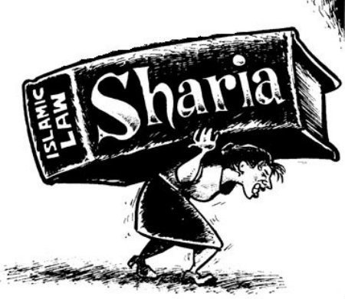
Shariah Law Continued
-Muslim men have sexual rights to any woman not covering there heads
-A woman can have 1 husband, a man can have 4 wives
-A man can marry an infant girl, at age 9 the marriage legally can be consummated
-A man can beat his wife for insubordination
-A man can divorce his wife; a woman needs her husband’s consent
-Lying to advance Islam is permissible
Source: www.billionbibles.org/sharia/sharia-law.html

Slide 18
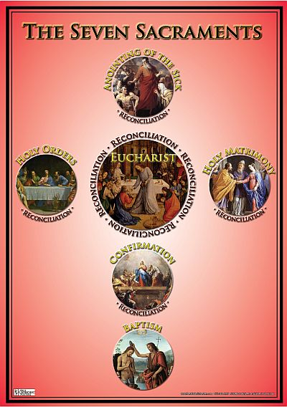
Catholicism: We are all sinners in need of grace. Our purpose is to gain that grace through various means: penance, the sacraments, attending mass, pilgrimages, indulgences, joining priesthood, praying to saints/church fathers for merit, praying to Mary, convents, or cloisters, and serving the Roman Catholic Church and will of the Pope. One must trust in the merits of Jesus Christ for salvation and sustain good works… Otherwise one must go the Hell or purgatory to burn off remaining sins
Grace=Faith+Sacraments+Good Works
The Sacraments:
-Baptism
-Eucharist
-Confirmation
-Reconciliation
-Anointing of the sick
-Marriage
-Holy orders
Source: Sadlier, 1994, Catechism of the Catholic Church

Slide 19

WHO’s GOD???
“For the Son of God became man so that we might become God.” (Ibid., p. 116)

Slide 20
Morality?
Christianity: “To the law and to the testimony: if they speak not according to this word, it is because there is no light in them.” (Is. 8:20)—” He that saith, I know him, and keepeth not his commandments, is a liar, and the truth is not in him.” (1 John 2:4)—The Bible, the Law of God, and the Testimony of Scripture
Evolution, Atheist, Satanist: Either there is no morality, or indulgence is the highest moral acquisition
Hinduism, Buddhism: pacifism, instruction of gurus and holy books, and self discovery, suppression of personal desires
Scientology: L. Ron Hubbard’s books, self enlightenment and application
Catholicism: The Catechism’s Ten Commandments, teachings, traditions of the church are equal with Scripture, Pope is infallible—can change morality when it conflicts with Scripture

Slide 21
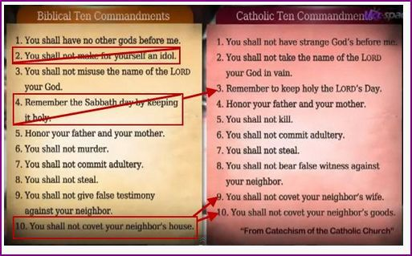

Slide 22
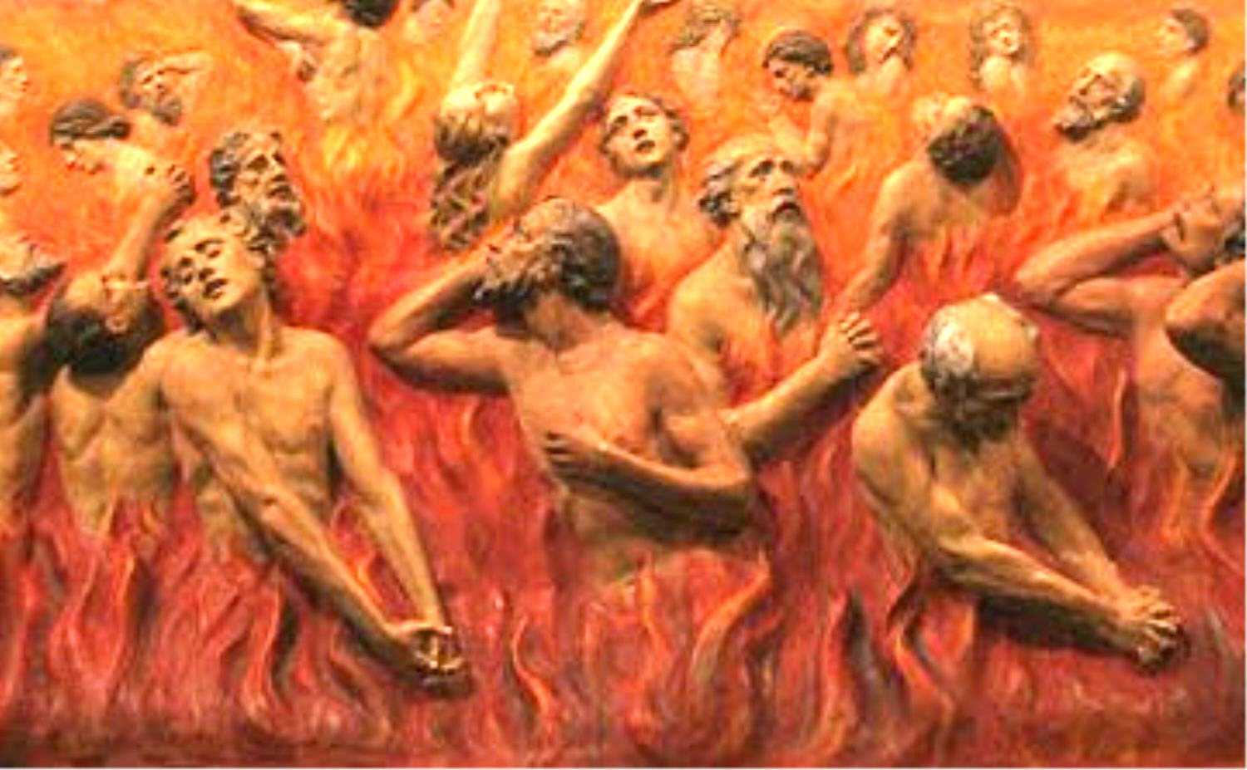
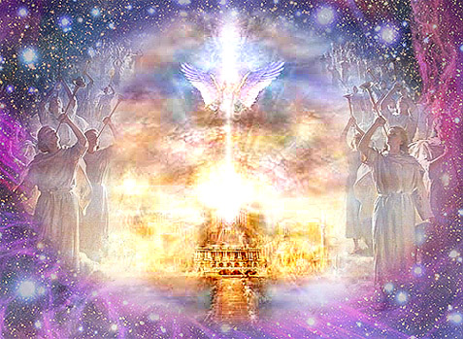
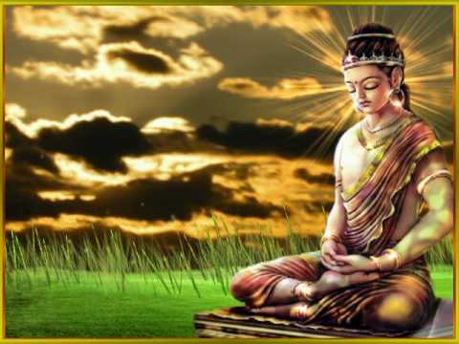

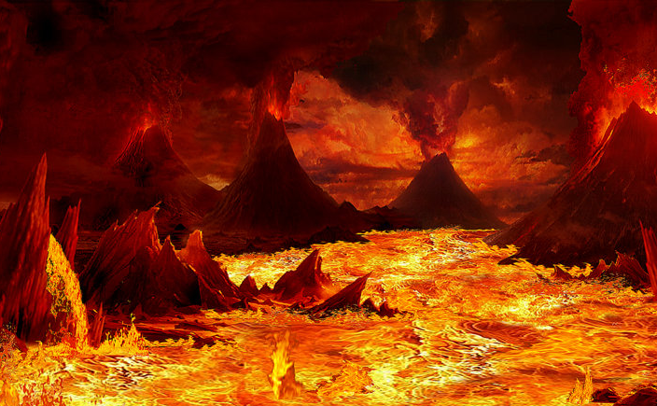
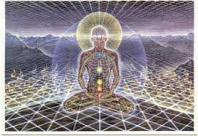
Destiny: Where are we going?

Slide 23
 | Christian | Catholic | Jewish | Hindu | Buddhist | Mormon | Evolution | Satanist | Islam
Origin | God | God | God | Universal E | ?Universe? | God | Big Bang | Big Bang | God
Meaning | Atone | Atone | Atone | Self Reali. | Enlighten | Learn | You decide | indulgence | Serve Allah
Morality | Bible, Decalogue | Bible, tradition, Pope | Talmud, Decalogue | Karma | Karma | Mormon Bible, prophets | You decide | Does not exist | Quran, Shariah Law
Destiny | Heaven | Heaven | Heaven | Universe | Nirvana | Heaven | Death | Death | Heaven
Goal | Overcome sin, spread Gospel | Serve Church, penance, | Overcome sin, serve God | transcend | Overcome desire | Learn | You decide | Indulgence | 72 Virgins in heaven
Jesus? | God | God | Teacher | Ishta/guru | Teacher | god | A person | Liar | prophet
Salvation gained? | Grace by Faith | Penance, obedience to church, works | works | Works devotion | Works: 8 fold path | Works | N/A | N/A | works
Soul | mortal | Immortal soul | ? | immortal | No self | Immortal soul | No soul | N/A | Immortal soul
Truth | Bible | Pope | Talmud | Vedas, Upanishad Bhagavad gita, | Buddha: 4 Noble truths | Book of Mormon | Relative | Relative | Quran

Slide 24
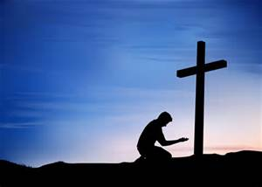

The MAJOR Difference is…..
“For by grace are ye saved through faith; and that not of yourselves: it is the gift of God: Not of works, lest any man should boast. For we are his workmanship, created in Christ Jesus unto good works, which God hath before ordained that we should walk in them.” (Eph. 2:8-10)
The Fruit Reveals the Tree, it does not change the tree

Slide 25
Major Differences Between Adventism Rest of Christianity….
1. Immortality of the Soul: “For the living know that they shall die: but the dead know not any thing, neither have they any more a reward; for the memory of them is forgotten.
⁶ Also their love, and their hatred, and their envy, is now perished; neither have they any more a portion for ever in any thing that is done under the sun . . . Whatsoever thy hand findeth to do, do it with thy might; for there is no work, nor device, nor knowledge, nor wisdom, in the grave, whither thou goest.” (Ecc. 9:5-6, 10)
“The dead praise not the LORD, neither any that go down into silence.” (Ps. 115:17)
“These things said he: and after that he saith unto them, Our friend Lazarus sleepeth; but I go, that I may awake him out of sleep. Then said his disciples, Lord, if he sleep, he shall do well. Howbeit Jesus spake of his death: but they thought that he had spoken of taking of rest in sleep. Then said Jesus unto them plainly, Lazarus is dead.” (John 11:11-14)

Slide 26
Is this a new Concept?
Pope Leo X Papal Bull of December 19, 1513:
“We do condemn and reprobate all who assert that the intelligent soul is mortal. . . All who adhere to the like erroneous assertions shall be shunned and punished as heretics.”
Luther:
We should learn to view our death in the right light, indeed not death, but a fine, sweet and brief sleep, which brings us release from this vale of tears, from sin and from the fear and extremity of real death and from all the misfortunes of this life, and we shall be secure and without care, rest sweetly and gently for a brief moment, as on a sofa, until the time when He shall call and awaken us together with all His dear children to His eternal glory and joy”—A Compend of Luther’s Theology, edited by Hugh Thomson Ker, Jr., p. 242
Tyndale:
And ye, in putting the departed souls in heaven, hell, and purgatory, destroy the arguments wherein Christ and Paul prove the Resurrection. . . And again, if the souls be in heaven . . . then what cause is there of the Resurrection?

Slide 27
2. Sabbath
The Sabbath is mentioned as being kept numerous times in Acts, here’s one major example: “And when the Jews were gone out of the synagogue, the Gentiles besought that these words might be preached to them the next sabbath. Now when the congregation was broken up, many of the Jews and religious proselytes followed Paul and Barnabas: who, speaking to them, persuaded them to continue in the grace of God. And the next sabbath day came almost the whole city together to hear the word of God.” (Acts 13:42-44)
“And woe unto them that are with child, and to them that give suck in those days! But pray ye that your flight be not in the winter, neither on the sabbath day:” (Matt. 24:19-20)
“And he took it down, and wrapped it in linen, and laid it in a sepulchre that was hewn in stone, wherein never man before was laid. And that day was the preparation, and the sabbath drew on. And the women also, which came with him from Galilee, followed after, and beheld the sepulchre, and how his body was laid. And they returned, and prepared spices and ointments; and rested the sabbath day according to the commandment.” (Luke 23:53-56)

Slide 28
“There is no mention of the cessation of the Sabbath and the institution of the Sunday in the gospels or in Paul’s writings, or in all the Bible; this has taken place by the apostolic Church instituting it without Scripture”—Dr. Johann Eck, Enchriridion of Commonplaces against Luther and other Enemies of the Church, 1533, p. 78-79

Slide 29
3. The Sanctuary
“Thy way, O God, is in the sanctuary: who is so great a God as our God?” (Ps. 77:13)
“Now of the things which we have spoken this is the sum: We have such an high priest, who is set on the right hand of the throne of the Majesty in the heavens; A minister of the sanctuary, and of the true tabernacle, which the Lord pitched, and not man. For every high priest is ordained to offer gifts and sacrifices: wherefore it is of necessity that this man have somewhat also to offer. For if he were on earth, he should not be a priest, seeing that there are priests that offer gifts according to the law: Who serve unto the example and shadow of heavenly things, as Moses was admonished of God when he was about to make the tabernacle: for, See, saith he, that thou make all things according to the pattern shewed to thee in the mount.” (Heb. 8:1-5)
“But Christ being come an high priest of good things to come, by a greater and more perfect tabernacle, not made with hands, that is to say, not of this building; Neither by the blood of goats and calves, but by his own blood he entered in once into the holy place, having obtained eternal redemption for us. . . For Christ is not entered into the holy places made with hands, which are the figures of the true; but into heaven itself, now to appear in the presence of God for us: (Heb. 9:11-12, 24)

Slide 30

Which Path Will You Choose?
Matt. 7:13-14 “Enter ye in at the strait gate: for wide is the gate, and broad is the way, that leadeth to destruction, and many there be which go in thereat: Because strait is the gate, and narrow is the way, which leadeth unto life, and few there be that find it.

