Slide 1
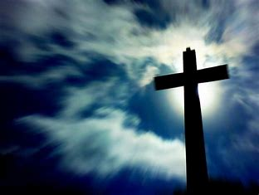
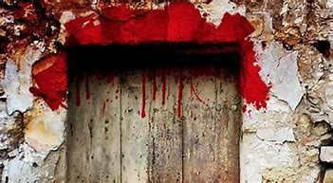
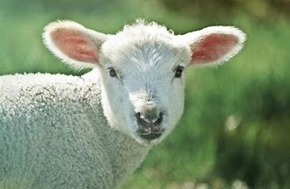
Our Passover…

Slide 2
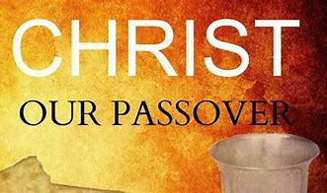
Christ is the Passover
1 Cor. 5:6-8 “Your glorying is not good. Know ye not that a little leaven leaveneth the whole lump? Purge out therefore the old leaven, that ye may be a new lump, as ye are unleavened. For even Christ our passover is sacrificed for us: Therefore let us keep the feast, not with old leaven, neither with the leaven of malice and wickedness; but with the unleavened bread of sincerity and truth.”

Slide 3
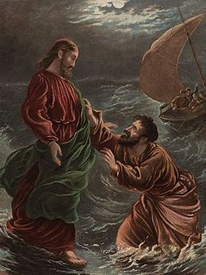
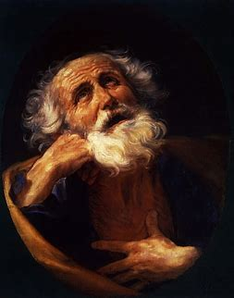
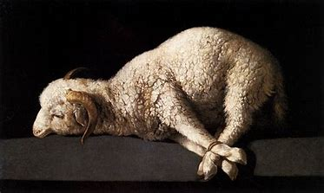
1 Pet. 1:18-21 “Forasmuch as ye know that ye were not redeemed with corruptible things, as silver and gold, from your vain conversation received by tradition from your fathers; But with the precious blood of Christ, as of a lamb without blemish and without spot: Who verily was foreordained before the foundation of the world, but was manifest in these last times for you, Who by him do believe in God, that raised him up from the dead, and gave him glory; that your faith and hope might be in God.

Slide 4
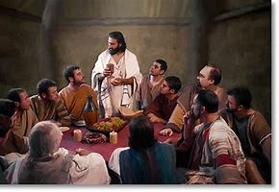
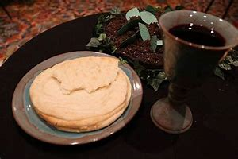
Jesus was sacrificed on the Passover
Mark 14:1, 16-18 “After two days was the feast of the passover, and of unleavened bread: and the chief priests and the scribes sought how they might take him by craft, and put him to death. . . And his disciples went forth, and came into the city, and found as he had said unto them: and they made ready the passover. And in the evening he cometh with the twelve. And as they sat and did eat, Jesus said, Verily I say unto you, One of you which eateth with me shall betray me.”

Slide 5
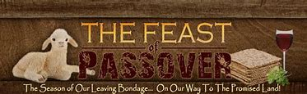
Christ was standing at the point of transition between two economies and their two great festivals. He, the spotless Lamb of God, was about to present Himself as a sin offering, that He would thus bring to an end the system of types and ceremonies that for four thousand years had pointed to His death. As He ate the Passover with His disciples, He instituted in its place the service that was to be the memorial of His great sacrifice. The national festival of the Jews was to pass away forever. The service which Christ established was to be observed by His followers in all lands and through all ages.—DA, 652

Slide 6
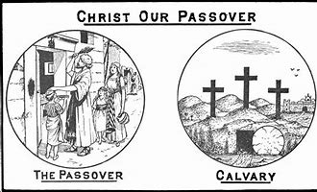

Slide 7
The First Passover: Plague to Unbelievers and Blessing to Believers
Ex. 11:1-4 “And the Lord said unto Moses, Yet will I bring one plague more upon Pharaoh, and upon Egypt; afterwards he will let you go hence: when he shall let you go, he shall surely thrust you out hence altogether. Speak now in the ears of the people, and let every man borrow of his neighbour, and every woman of her neighbour, jewels of silver and jewels of gold. And the Lord gave the people favour in the sight of the Egyptians. Moreover the man Moses was very great in the land of Egypt, in the sight of Pharaoh's servants, and in the sight of the people. And Moses said, Thus saith the Lord, About midnight will I go out into the midst of Egypt: And all the firstborn in the land of Egypt shall die, from the first born of Pharaoh that sitteth upon his throne, even unto the firstborn of the maidservant that is behind the mill; and all the firstborn of beasts.”

Slide 8
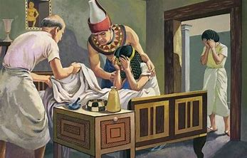
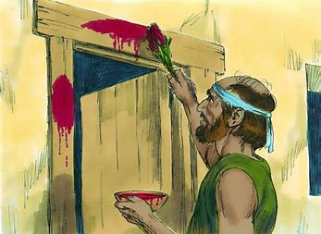
Ex. 11:6-7 “And there shall be a great cry throughout all the land of Egypt, such as there was none like it, nor shall be like it any more. But against any of the children of Israel shall not a dog move his tongue, against man or beast: that ye may know how that the Lord doth put a difference between the Egyptians and Israel.”

Slide 9
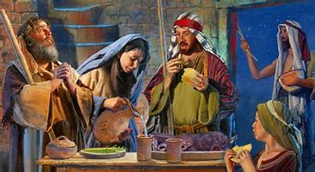
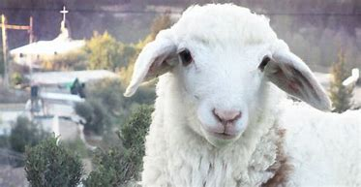
Passover Sacrifice and
Meal: Lamb Selected
Ex. 12:1-3 “And the Lord spake unto Moses and Aaron in the land of Egypt saying, This month shall be unto you the beginning of months: it shall be the first month of the year to you. Speak ye unto all the congregation of Israel, saying, In the tenth day of this month they shall take to them every man a lamb, according to the house of their fathers, a lamb for an house”

Slide 10
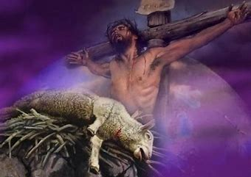
Ex. 12:5-6 “Your lamb shall be without blemish, a male of the first year: ye shall take it out from the sheep, or from the goats: And ye shall keep it up until the fourteenth day of the same month: and the whole assembly of the congregation of Israel shall kill it in the evening.”

Slide 11
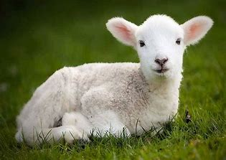

Perfect Lamb Selected on Day 10, sacrificed on Day 14
Dan. 9:24-25 “Seventy weeks are determined upon thy people and upon thy holy city, to finish the transgression, and to make an end of sins, and to make reconciliation for iniquity, and to bring in everlasting righteousness, and to seal up the vision and prophecy, and to anoint the most Holy. Know therefore and understand, that from the going forth of the commandment to restore and to build Jerusalem unto the Messiah the Prince shall be seven weeks, and threescore and two weeks: the street shall be built again, and the wall, even in troublous times.”

Slide 12
Dan. 9:26-27 “And after threescore and two weeks shall Messiah be cut off, but not for himself: and the people of the prince that shall come shall destroy the city and the sanctuary; and the end thereof shall be with a flood, and unto the end of the war desolations are determined. And he shall confirm the covenant with many for one week: and in the midst of the week he shall cause the sacrifice and the oblation to cease, and for the overspreading of abominations he shall make it desolate, even until the consummation, and that determined shall be poured upon the desolate.”

Slide 13
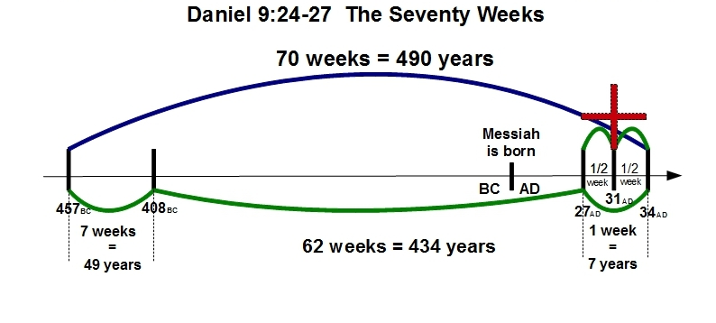
457 BC can be dated as the starting point of this prophecy based on Ezra 7’s recording of the restoration decree “in the seventh year of Artaxerxes”—which is confirmed in the Greek Olympiad, Ptolemy’s Canon, Elephantine Papyri, and various Babylonian Cuneiform Tablets

Slide 14
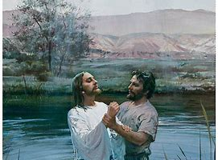
Luke 3:1-3 “Now in the fifteenth year of the reign of Tiberius Caesar, Pontius Pilate being governor of Judaea, and Herod being tetrarch of Galilee, and his brother Philip tetrarch of Ituraea and of the region of Trachonitis, and Lysanias the tetrarch of Abilene, Annas and Caiaphas being the high priests, the word of God came unto John the son of Zacharias in the wilderness. And he came into all the country about Jordan, preaching the baptism of repentance for the remission of sins”
15th year of Tiberius Caesar=27AD

Slide 15
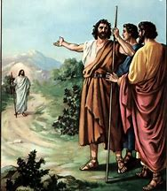
Further Confirmation that the Lamb was Selected in 27 AD!!!
John 1:29 “The next day John seeth Jesus coming unto him, and saith, Behold the Lamb of God, which taketh away the sin of the world.”

Slide 16
Jesus Confirms…
Mark 1: 9-15 “And it came to pass in those days, that Jesus came from Nazareth of Galilee, and was baptized of John in Jordan. And straightway coming up out of the water, he saw the heavens opened, and the Spirit like a dove descending upon him: And there came a voice from heaven, saying, Thou art my beloved Son, in whom I am well pleased. And immediately the spirit driveth him into the wilderness. And he was there in the wilderness forty days, tempted of Satan; and was with the wild beasts; and the angels ministered unto him. Now after that John was put in prison, Jesus came into Galilee, preaching the gospel of the kingdom of God, And saying, The time is fulfilled, and the kingdom of God is at hand: repent ye, and believe the gospel.”

Slide 17
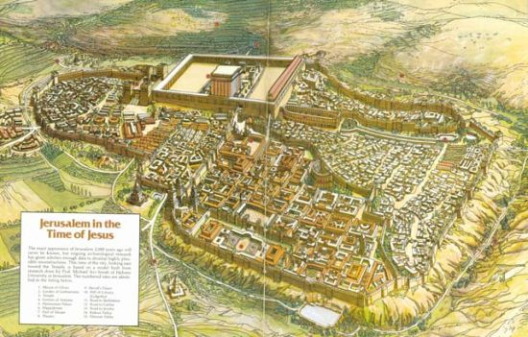
Passovers For Christ in Chronology
Jesus Baptized-27AD
First Passover (spring)-28AD (John 2:13, 23)=6 months of ministry
Second Passover-29AD (John 5:1)=1-1/2 years
Third Passover-30AD (John 6:4)=2-1/2 years
Final Passover-31AD=3-1/2 years

Slide 18
In Summary of the Hidden Prophecy in the Passover Feast…
Ancient Passover
1. Lamb selected 3-1/2 days prior to sacrifice
2. Without Blemish
3. Slain by and for the people
Jesus as Messiah
1. Jesus affirmed as Lamb of God and baptized 3-1/2 years before crucifixion
2. Without Sin/Perfect
3. Mockingly slain, but for the sins of the whole world

Slide 19
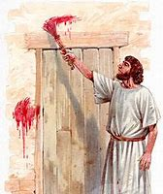
Back to Exodus
Ex. 12:7-9 “And they shall take of the blood, and strike it on the two side posts and on the upper door post of the houses, wherein they shall eat it. And they shall eat the flesh in that night, roast with fire, and unleavened bread; and with bitter herbs they shall eat it. Eat not of it raw, nor sodden at all with water, but roast with fire; his head with his legs, and with the purtenance thereof.”

Slide 20
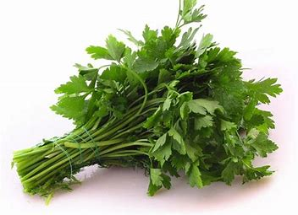
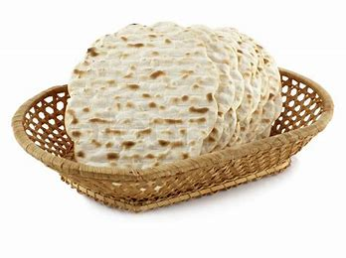
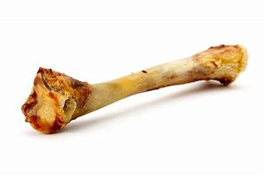
The lamb was to be eaten with bitter herbs, as pointing back to the bitterness of the bondage in Egypt. So when we feed upon Christ, it should be with contrition of heart, because of our sins. The use of unleavened bread also was significant. It was expressly enjoined in the law of the Passover, and as strictly observed by the Jews in their practice, that no leaven should be found in their houses during the feast. In like manner the leaven of sin must be put away from all who would receive life and nourishment from Christ.—PP 278

Slide 21
A Hard Saying
John 5:54-63 “Whoso eateth my flesh, and drinketh my blood, hath eternal life; and I will raise him up at the last day. For my flesh is meat indeed, and my blood is drink indeed. He that eateth my flesh, and drinketh my blood, dwelleth in me, and I in him. As the living Father hath sent me, and I live by the Father: so he that eateth me, even he shall live by me. This is that bread which came down from heaven: not as your fathers did eat manna, and are dead: he that eateth of this bread shall live for ever. These things said he in the synagogue, as he taught in Capernaum. Many therefore of his disciples, when they had heard this, said, This is an hard saying; who can hear it? When Jesus knew in himself that his disciples murmured at it, he said unto them, Doth this offend you? What and if ye shall see the Son of man ascend up where he was before? It is the spirit that quickeneth; the flesh profiteth nothing: the words that I speak unto you, they are spirit, and they are life.”

Slide 22
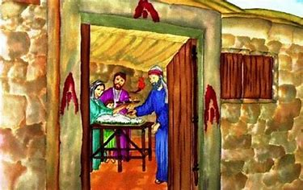
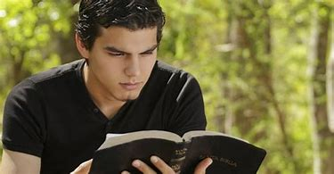

The Prophet Explains…
To eat the flesh and drink the blood of Christ is to receive Him as a personal Saviour, believing that He forgives our sins, and that we are complete in Him. It is by beholding His love, by dwelling upon it, by drinking it in, that we are to become partakers of His nature. What food is to the body, Christ must be to the soul. Food cannot benefit us unless we eat it, unless it becomes a part of our being. So Christ is of no value to us if we do not know Him as a personal Saviour. A theoretical knowledge will do us no good. We must feed upon Him, receive Him into the heart, so that His life becomes our life. His love, His grace, must be assimilated.—DA, 389

Slide 23
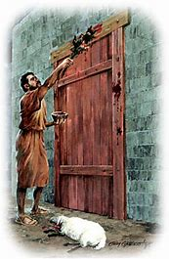
Ex. 12:10-12 “And ye shall let nothing of it remain until the morning; and that which remaineth of it until the morning ye shall burn with fire. And thus shall ye eat it; with your loins girded, your shoes on your feet, and your staff in your hand; and ye shall eat it in haste: it is the Lord's passover. For I will pass through the land of Egypt this night, and will smite all the firstborn in the land of Egypt, both man and beast; and against all the gods of Egypt I will execute judgment: I am the Lord.”

Slide 24
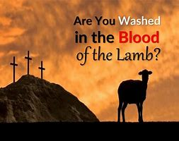
Ex. 12:13-14 “And the blood shall be to you for a token upon the houses where ye are: and when I see the blood, I will pass over you, and the plague shall not be upon you to destroy you, when I smite the land of Egypt. And this day shall be unto you for a memorial; and ye shall keep it a feast to the Lord throughout your generations; ye shall keep it a feast by an ordinance for ever.”

Slide 25
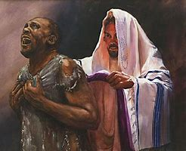
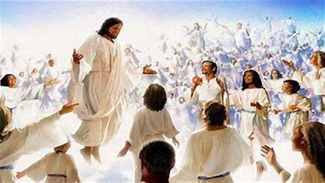
Washed in the Blood!
Rev. 12:11 “And they overcame him by the blood of the Lamb, and by the word of their testimony; and they loved not their lives unto the death.”
Rev. 7:14 “These are they which came out of great tribulation, and have washed their robes, and made them white in the blood of the Lamb”

Slide 26
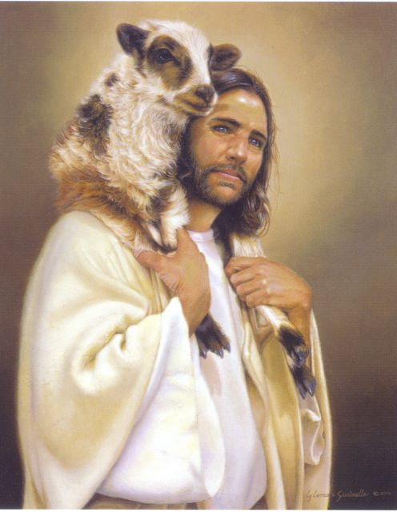
Lift up Jesus before the people. Strike the door-posts with the blood of with the blood of Calvary’s Lamb, and you are safe” RH Sept. 3, 1889

Slide 27
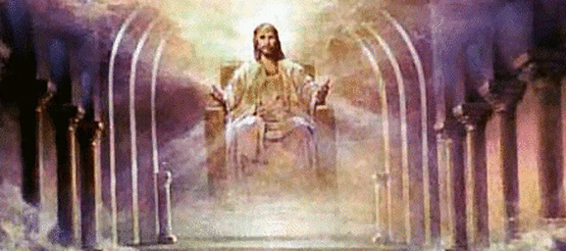
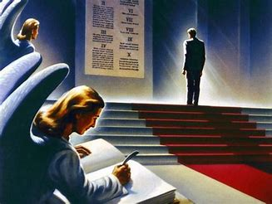
Ex. 12:21-23 “Then Moses called for all the elders of Israel, and said unto them, Draw out and take you a lamb according to your families, and kill the passover. And ye shall take a bunch of hyssop, and dip it in the blood that is in the bason, and strike the lintel and the two side posts with the blood that is in the bason; and none of you shall go out at the door of his house until the morning. For the Lord will pass through to smite the Egyptians; and when he seeth the blood upon the lintel, and on the two side posts, the Lord will pass over the door, and will not suffer the destroyer to come in unto your houses to smite you.”

Slide 28
Before obtaining freedom, the bondmen must show their faith in the great deliverance about to be accomplished. The token of blood must be placed upon their houses, and they must separate themselves and their families from the Egyptians, and gather within their own dwellings. Had the Israelites disregarded in any particular the directions given them, had they neglected to separate their children from the Egyptians, had they slain the lamb, but failed to strike the doorpost with blood, or had any gone out of their houses, they would not have been secure. They might have honestly believed that they had done all that was necessary, but their sincerity would not have saved them. All who failed to heed the Lord's directions would lose their first-born by the hand of the destroyer.—PP, 278

Slide 29
What are our “directions” today?
Matt. 5:17-19 “Think not that I am come to destroy the law, or the prophets: I am not come to destroy, but to fulfil. For verily I say unto you, Till heaven and earth pass, one jot or one tittle shall in no wise pass from the law, till all be fulfilled. Whosoever therefore shall break one of these least commandments, and shall teach men so, he shall be called the least in the kingdom of heaven: but whosoever shall do and teach them, the same shall be called great in the kingdom of heaven.”
Luke 10:25-26 “And, behold, a certain lawyer stood up, and tempted him, saying, Master, what shall I do to inherit eternal life? He said unto him, What is written in the law? how readest thou?”

Slide 30
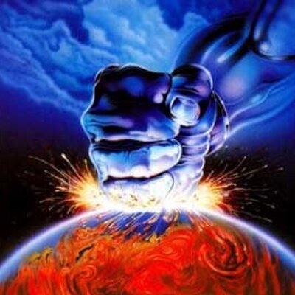
Foundational Doctrines which are largely NOT taught today in Seventh-day Adventism, nor majority Christianity. When was the last time you heard a message about:
The Law of God as Binding—highlighting the lost Sabbath
The Sanctuary: it’s messages, meanings, prophecies, the heavenly sanctuary, and importance for today
The State of the Dead
Righteousness by Faith (strength to overcome sin)
Investigative Judgment
Health Laws and their impact on spirituality
Babylon is fallen, in the form of Apostate Protestantism
Babylon the Great: The Antichrist power and their work in the world today
Prophecies of Daniel and Revelation

Slide 31
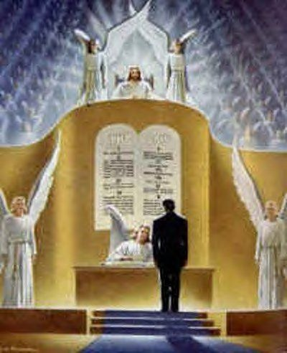
Babylon is fallen, in the form of Apostate Protestantism
Babylon the Great: The Antichrist power and their work in the world today
Prophecies of Daniel and Revelation
Soon Return of Christ
Evangelistic Focus of these truths
Matt. 28:19-20 “Go ye therefore, and teach all nations, baptizing them in the name of the Father, and of the Son, and of the Holy Ghost: Teaching them to observe all things whatsoever I have commanded you: and, lo, I am with you always, even unto the end of the world. Amen.”

Slide 32
How shall we work?
“Everywhere there is a tendency to substitute the work of organizations for individual effort. Human wisdom tends to consolidation, to centralization, to the building up of great churches and institutions. Multitudes leave to institutions and organizations the work of benevolence; they excuse themselves from contact with the world, and their hearts grow cold. They become self-absorbed and unimpressible. Love for God and man dies out of the soul. Christ commits to His followers an individual work,—a work that cannot be done by proxy. Ministry to the sick and the poor, the giving of the gospel to the lost, is not to be left to committees or organized charities. Individual responsibility, individual effort, personal sacrifice, is the requirement of the gospel. . .

Slide 33
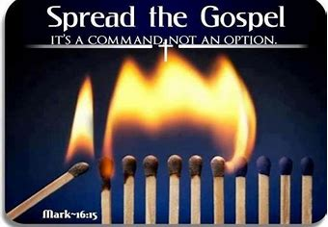
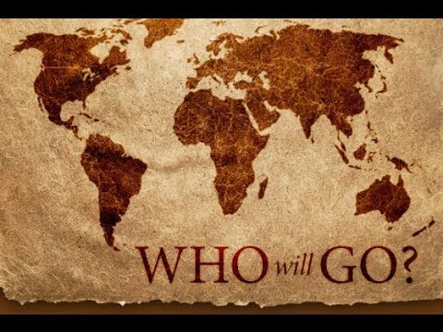
To everyone who becomes a partaker of His grace, the Lord appoints a work for others. Individually we are to stand in our lot and place, saying, “Here I am; send me.” Upon the minister of the word, the missionary nurse, the Christian physician, the individual Christian, whether he be merchant or farmer, professional man or mechanic,—the responsibility rests upon all. It is our work to reveal to men the gospel of their salvation. Every enterprise in which we engage should be a means to this end.”—Ministry of Healing, p. 147,148

Slide 34


Ex. 12:24 “And ye shall observe this thing for an ordinance to thee and to thy sons for ever.”
1 Sam. 1:22 “But Hannah went not up; for she said unto her husband, I will not go up until the child be weaned, and then I will bring him, that he may appear before the Lord, and there abide for ever.”

Slide 35

From Ex. 12:24 “For ever”
For 5704 (ad) (1) as far as, even to, until, up to, while
Ever 5769 (owlam or olam) (1) long duration, antiquity, futurity, forever, ever, perpetual, old, ancient

Slide 36
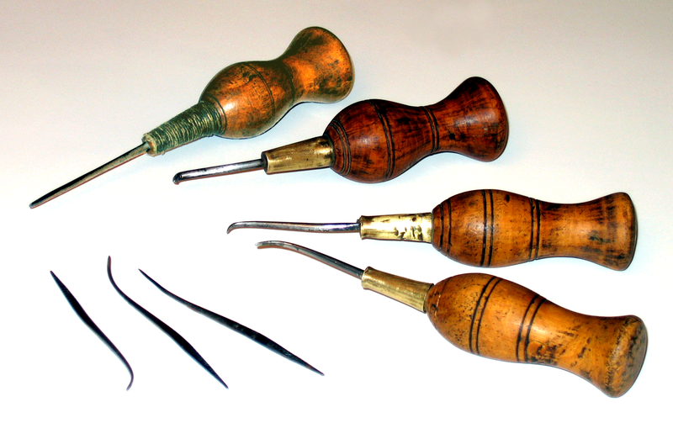
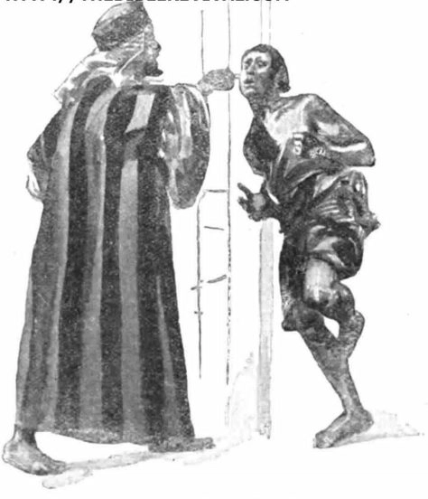
Deut. 15:12-17 “And if thy brother, an Hebrew man, or an Hebrew woman, be sold unto thee, and serve thee six years; then in the seventh year thou shalt let him go free from thee. And when thou sendest him out free from thee, thou shalt not let him go away empty: Thou shalt furnish him liberally out of thy flock, and out of thy floor, and out of thy winepress: of that wherewith the Lord thy God hath blessed thee thou shalt give unto him. And thou shalt remember that thou wast a bondman in the land of Egypt, and the Lord thy God redeemed thee: therefore I command thee this thing to day. And it shall be, if he say unto thee, I will not go away from thee; because he loveth thee and thine house, because he is well with thee; Then thou shalt take an aul, and thrust it through his ear unto the door, and he shall be thy servant for ever. And also unto thy maidservant thou shalt do likewise.”

Slide 37
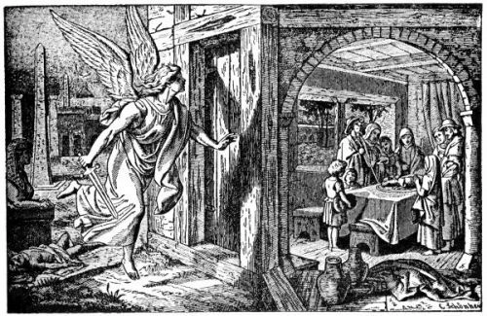
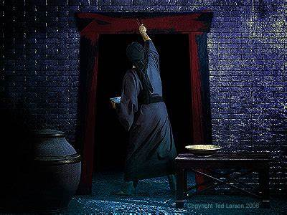
Ex. 12:26-29 “And it shall come to pass, when your children shall say unto you, What mean ye by this service? That ye shall say, It is the sacrifice of the Lord's passover, who passed over the houses of the children of Israel in Egypt, when he smote the Egyptians, and delivered our houses. And the people bowed the head and worshipped. And the children of Israel went away, and did as the Lord had commanded Moses and Aaron, so did they. And it came to pass, that at midnight the Lord smote all the firstborn in the land of Egypt, from the firstborn of Pharaoh that sat on his throne unto the firstborn of the captive that was in the dungeon; and all the firstborn of cattle.”

Slide 38
Ex. 12:30-36 “And Pharaoh rose up in the night, he, and all his servants, and all the Egyptians; and there was a great cry in Egypt; for there was not a house where there was not one dead. And he called for Moses and Aaron by night, and said, Rise up, and get you forth from among my people, both ye and the children of Israel; and go, serve the Lord, as ye have said. Also take your flocks and your herds, as ye have said, and be gone; and bless me also. And the Egyptians were urgent upon the people, that they might send them out of the land in haste; for they said, We be all dead men. And the people took their dough before it was leavened, their kneadingtroughs being bound up in their clothes upon their shoulders. And the children of Israel did according to the word of Moses; and they borrowed of the Egyptians jewels of silver, and jewels of gold, and raiment: And the Lord gave the people favour in the sight of the Egyptians, so that they lent unto them such things as they required. And they spoiled the Egyptians.”

Slide 39
Similarities with Sacrifice of Christ…
Jesus Christ and the Passover both were slain at evening time on Passover Day:
Mark 15:33-37 “And when the sixth hour was come, there was darkness over the whole land until the ninth hour. And at the ninth hour Jesus cried with a loud voice, saying, Eloi, Eloi, lama sabachtani? which is, being interpreted, My God, my God, why hast thou forsaken me? And some of them that stood by, when they heard it, said, Behold, he calleth Elias. And one ran and filled a sponge full of vinegar, and put it on a reed, and gave to him to drink, saying, Let alone; let us see whether Elias will come to take him down. And Jesus cried with a loud voice, and gave up the ghost”
Ex. 12:8 “with bitter herbs they shall eat it”, Ex. 12:29 “at midnight the LORD smote all the firstborn”

Slide 40


John 19:29-30 “Now there was set a vessel full of vinegar: and they filled a spunge with vinegar, and put it upon hyssop, and put it to his mouth. When Jesus therefore had received the vinegar, he said, It is finished: and he bowed his head and gave up the ghost.”
It is finished 5055 (teleo) (1) to bring to close, to finish, to end (2) to perform, to execute, complete, fulfill (3) to pay
OR
Ex. 12:22 “And ye shall take a bunch of hyssop”, Ex. 12:29-30 (some saved while others condemned)

Slide 41
What Was “Finished”?
“With a rending noise the inner veil of the temple is torn from top to bottom [Matt 27:51] by an unseen hand, throwing open to the gaze of the multitude a place once filled with the presence of God. In this place the Shekinah had dwelt. Here God had manifested His glory above the mercy seat. No one but the high priest ever lifted the veil separating this apartment from the rest of the temple. He entered in once a year to make an atonement for the sins of the people. But lo, this veil is rent in twain. The most holy place of the earthly sanctuary is no longer sacred. All is terror and confusion. The priest is about to slay the victim; but the knife drops from his nerveless hand, and the lamb escapes. Type has met antitype in the death of God's Son. The great sacrifice has been made. The way into the holiest is laid open. A new and living way is prepared for all. No longer need sinful, sorrowing humanity await the coming of the high priest. Henceforth the Saviour was to officiate as priest and advocate in the heaven of heavens. It was as if a living voice had spoken to the worshipers: There is now an end to all sacrifices and offerings for sin.”—DA, 757

Slide 42
End of earthly sanctuary ceremony and sacrifice
“They were not conscious that type had met antitype, that an infinite sacrifice had been made for the sins of the world. They knew not that there was no further value in the performance of the ritual service. But never before had that service been witnessed with such conflicting feelings. The trumpets and musical instruments and the voices of the singers were as loud and clear as usual. But a sense of strangeness pervaded everything. One after another inquired about a strange event that had taken place. Hitherto the most holy place had been sacredly guarded from intrusion. But now it was open to all eyes. The heavy veil of tapestry, made of pure linen, and beautifully wrought with gold, scarlet, and purple, was rent from top to bottom. The place where Jehovah had met with the high priest, to communicate His glory, the place that had been God's sacred audience chamber, lay open to every eye,—a place no longer recognized by the Lord. With gloomy presentiments the priests ministered before the altar. The uncovering of the sacred mystery of the most holy place filled them with dread of coming calamity. Many minds were busy with thoughts started by the scenes of Calvary. From the crucifixion to the resurrection many sleepless eyes were constantly searching the prophecies, some to learn the full meaning of the feast they were then celebrating, some to find evidence that Jesus was not what He claimed to be; and others with sorrowful hearts were searching for proofs that He was the true Messiah. Though searching with different objects in view, all were convicted of the same truth,—that prophecy had been fulfilled in the events of the past few days, and that the Crucified One was the world's Redeemer. Many who at that time united in the service never again took part in the paschal rites”—DA, 774-775

Slide 43
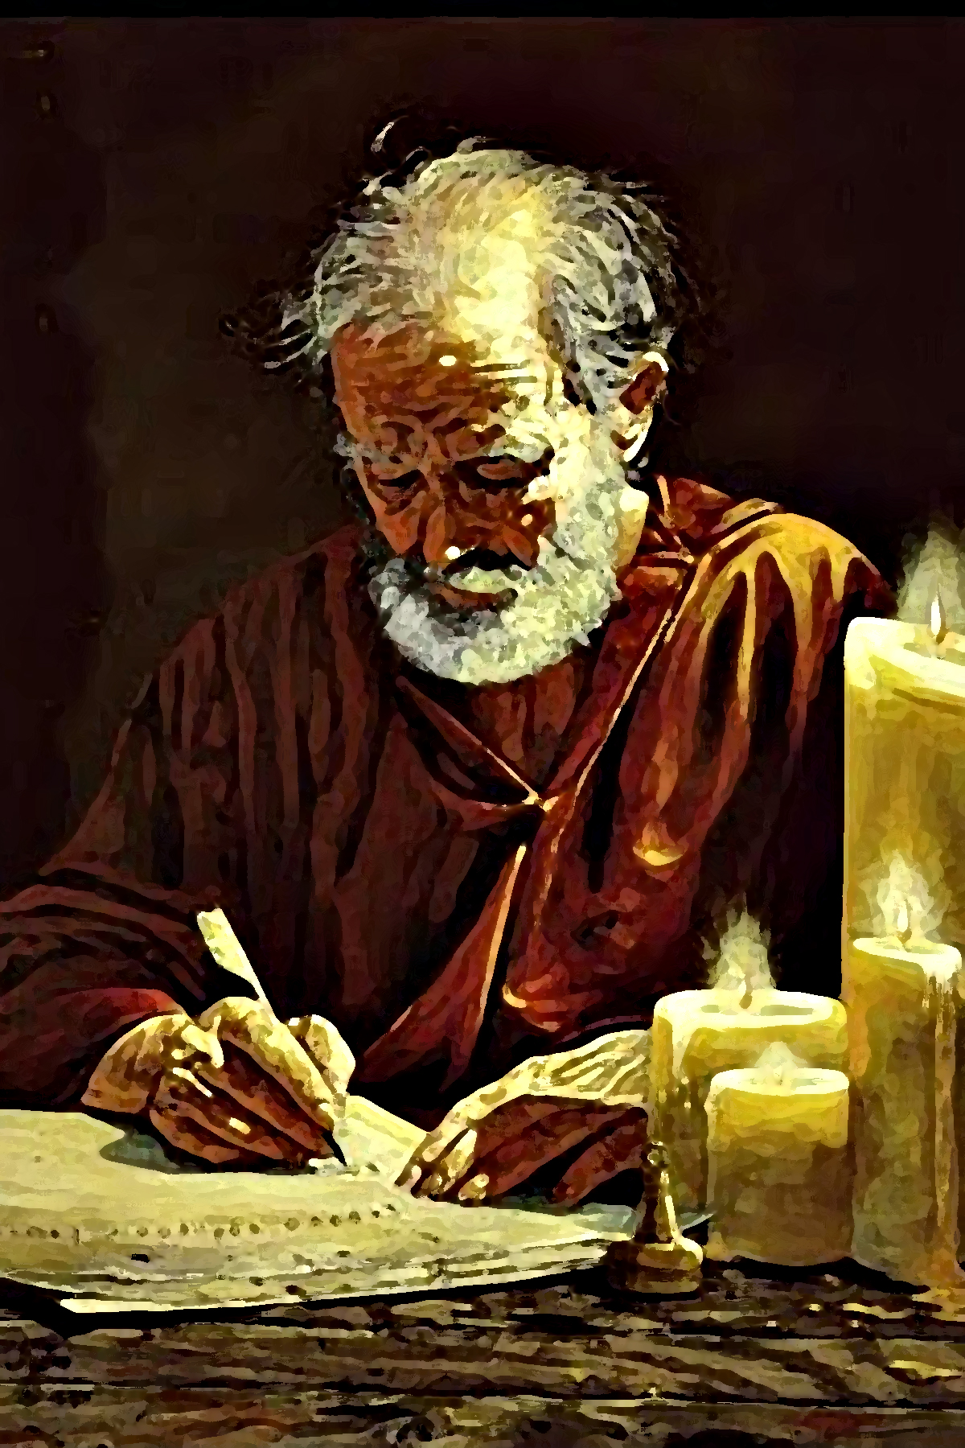
Paul Puts it this way…
Heb. 2:3 “How shall we escape, if we neglect so great salvation; which at the first began to be spoken by the Lord, and was confirmed unto us by them that heard him”

Slide 44
The warfare against God's law, which was begun in heaven, will be continued until the end of time. Every man will be tested. Obedience or disobedience is the question to be decided by the whole world. All will be called to choose between the law of God and the laws of men. Here the dividing line will be drawn. There will be but two classes. Every character will be fully developed; and all will show whether they have chosen the side of loyalty or that of rebellion. Then the end will come. God will vindicate His law and deliver His people. Satan and all who have joined him in rebellion will be cut off. Sin and sinners will perish, root and branch, (Malachi 4:1),—Satan the root, and his followers the branches. The word will be fulfilled to the prince of evil, "Because thou hast set thine heart as the heart of God; . . . I will destroy thee, O covering cherub, from the midst of the stones of fire. . . . Thou shalt be a terror, and never shalt thou be any more." Then "the wicked shall not be: yea, thou shalt diligently consider his place, and it shall not be;" "they shall be as though they had not been." Ezekiel 28:6-19; Psalm 37:10; Obadiah 16. This is not an act of arbitrary power on the part of God. The rejecters of His mercy reap that which they have sown. God is the fountain of life; and when one chooses the service of sin, he separates from God, and thus cuts himself off from life. He is "alienated from the life of God." Christ says, "All they that hate Me love death." Ephesians 4:18; Proverbs 8:36.”—DA, 763-764

