Slide 1
Papacy, CIA, Heroin, and War
Prophecy Arise, pt. 6

Slide 2
The Window Opens
Rev. 17 depicts the Vatican’s use of political leaders, high finance, churches, and war to bring about a revival of the world they dominated throughout the Dark Ages! While the Bible speaks in very general terms about this revival, modern history portrays this takeover in words we are all familiar with in terms, of names of people in the political, economic, and religious world. The peek begins!!!

Slide 3
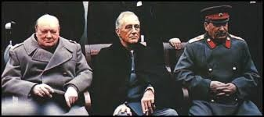
In Harmony?!?!?!
During WW 2, it was fast becoming obvious that the victors in the conflict would be the United States and the Soviet Union. However, they each have different ideologies; one was capitalistic; the other was communistic. A Cold War would ensue!

Slide 4
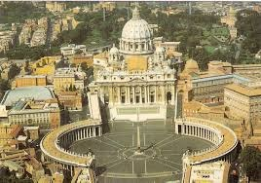
Both Sides Controlled by Rome!
Rev. 17:1,2, 18 declare, "And there came one of the seven angels which had the seven vials, and talked with me, saying unto me, Come hither; I will shew unto thee the judgment of the great whore that sitteth upon many waters: With whom the kings of the earth have committed fornication, and the inhabitants of the earth have been made drunk with the wine of her fornication…” “And the woman which thou sawest is that great city, which reigneth over the kings of the earth.”

Slide 5
Squaring Off
The Jesuits Created
In Russia, they told them to spread Communism throughout the world.
In America, they told them to stop Communism at all costs.
A Cold War erupted and nuclear war was very real. Russia became the ‘Evil Empire’; America became the ‘Great Satan’ and the Vatican presented a fair front to the world, appearing to be wonderful!

Slide 6
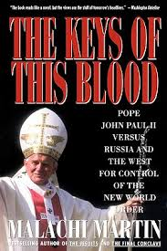
The Keys of this Blood

Slide 7
The Battle Begins
Russia annexes several countries and becomes the USSR or the Soviet Union.
The Jesuits in America create an organization to halt the spread of Communism. It was called the CIA- the Central Intelligence Agency or truly, the Catholic Intelligence Agency! How would they stop Communism? They would train men in countries throughout the world to fight against Communism. They would train them, arm them, feed them, and offer them huge money rewards for fighting on their behalf. Then, the dream of Papal world dominion could be a reality!

Slide 8
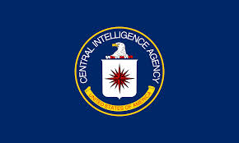
The Monster Arises
Wrapped in a horrific Cold War, with each side having the capability to destroy the world and each other, the Vatican could work behind the scenes to create their ultimate prize- the revival of the old world order.
“The beast that thou sawest was, and is not; and shall ascend out of the bottomless pit, and go into perdition: and they that dwell on the earth shall wonder, whose names were not written in the book of life from the foundation of the world, when they behold the beast that was, and is not, and yet is.” Rev. 17:8

Slide 9
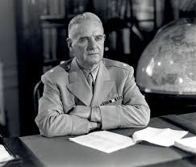
The Papal Catalyst
Wild Bill Donovan, Roman Catholic, Knight of Malta, would be the original head of the Office of Strategic Services, the forerunner to the CIA. “Donovan did not have an official role in the newly formed CIA but with his protégé Allen Dulles and others, he was instrumental in its formation. Having led the OSS during World War II, Donovan’s opinion was especially influential as to what kind of intelligence organization was needed as a bi-polar post-war world began to take shape.” Wikipedia

Slide 10
Donovan Called b Y Rome!
“ In 1945, the pope had held private audiences with Wild Bill Donovan to discuss the implementation of Gladio (the training of men in countries around the world) and had decorated him as a crusader against Communism with the Grand Cross of the Order of St. Sylvester, the oldest and most prestigious of papal knighthoods.” Paul Williams, Operation Gladio, pg. 47

Slide 11
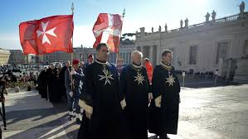
Knights of Malta
They are a military order that is utterly subservient to the Vatican. They go about secretly to carry out the purposes of Rome! John Roberts, Chief Justice of the Supreme Court, and Leon Panetta, former leader of the CIA, are some of the current famous Knights of Malta!

Slide 12
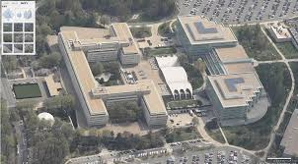
Secret Vatican Agency-CIA
The CIA was created during WW 2 to create upheaval throughout the world, to oppose the spread of Communism in order to revive the papacy to world dominion. The CIA has been run and peopled by predominantly Roman Catholics. From all the CIA has done, the Vatican alone has benefitted!

Slide 13
Financing the CIA
“Details of the overall United States intelligence budget are classified.[4] Under the Central Intelligence Agency Act of 1949, the Director of Central Intelligence is the only federal government employee who can spend "un-vouchered" government money.” Wikipedia
Based on this statement, it is clear that no one
is to know how the CIA is funded. It is classified information.

Slide 14
CIA Official, Tom Braden
“The Agency never had to account for the money it spent except to the President if he wanted to know…otherwise the funds were not only unaccountable, they were unvouchered, so there was really no means of checking them…Since it (CIA) was unaccountable, could hire as many people as it wanted…It could hire armies, it could buy banks.” Jamie Graham ‘The Secret History of the CIA’s Involvement in the Narcotics Trade’.

Slide 15
Getting the Financing
Paul Helliwell, Bill Donovan, James ‘Jesus’ Angleton, and Allen Dulles, after watching Chang Kai-Chek raise money for the Chinese National Army by selling drugs to Chinese people, realized that they could make billions of dollars for the CIA by selling heroin/cocaine to people in the ghetto of America’s big cities. These men, primarily Helliwell, made deals with drug lords in Burma, Thailand, and Vietnam. They would grow the poppy plants, manufacture it into heroin/opium/, sell it to the CIA agents, and then it would be sold in US cities! This is how the CIA would finance their projects of war!

Slide 16
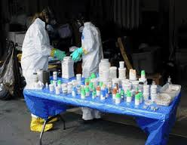
Drug Lords of the World!
“And the light of a candle shall shine no more at all in thee; and the voice of the bridegroom and of the bride shall be heard no more at all in thee: for thy merchants were the great men of the earth; for by thy sorceries were all nations deceived.” Rev. 18:23
Deceived by thy sorceries. Greek word Pharmakia!

Slide 17
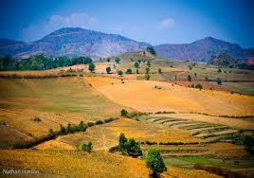
Burma’s Shan Plateau
Burma’s Shan Plateau became the largest opium producing region in the world! The protection of this heinous drug trade was carried on in America from 1947 to 1967 with not a single major drug bust. The number of heroin addicts rose from 20,000 to 150,000 during that time in America!

Slide 18
Money Hand over Fist
With the production of tons and tons of heroin and its sales in America, money was flowing like a river. This money had to be accounted for in some way if it were to be done legally. However, how do you pour billions of dollars of dirty money into banks without someone becoming suspicious? Impossible!! Where in the wide world could you find a secretive bank that answers to no one and who would be willing to dirty their hands in the blood money of narcotics?

Slide 19
Paul Williams- Operation Gladio
“The money had to be channeled through a financial firm that would not be subjected to scrutiny by US Treasury agents,… or international fiscal monitors. Only one such institution possessed such immunity, and it was located in the heart of ……………………………………………………………………………………………………………………………………………………………………………………VATICAN CITY!

Slide 20
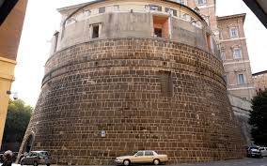
Vatican Bank
“The bank remains a sovereign financial agency within a sovereign state…it cannot be compelled to redress wrongs, not even the worst violations of international law. Nor can it be forced to release the source of any deposit. The bank resides under the jurisdiction of the pope. He owns it; he controls it!” Williams, pg. 45

Slide 21
Billions of Dirty Money!!!
“Because of its clandestine workings, millions can be deposited into the Vatican BANK (THE IOR) ON A CONTINOUS BASIS AND CHANNELED INTO Swiss bank accounts without the possibility of detection. It was the perfect place for the CIA and the Sicilian Mafia to launder their ill gotten gains of the narcotics trade and for the Roman Church to fund their political mission. According to Money Val (the anti money laundering committee of the council of Europe), it remains one of the world’s leading laundries for dirty cash under Pope Francis.” Williams, pg. 46

Slide 22
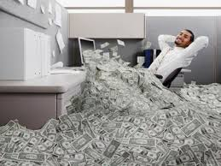
Merchants, Drugs, Papacy!
“The merchants of these things, which were made rich by her, shall stand afar off for the fear of her torment, weeping and wailing, And saying, Alas, alas, that great city, that was clothed in fine linen, and purple, and scarlet, and decked with gold, and precious stones, and pearls! For in one hour so great riches is come to naught. And every shipmaster, and all the company in ships, and sailors, and as many as trade by sea, stood afar off, And cried when they saw the smoke of her burning, saying, What city is like unto this great city!” Rev. 18:15-18

Slide 23
Pay Out
For every $100.00, the Vatican received $15.00.
For every $1,000, the Vatican received $150.00.
For every $1,000,000, Vatican $150,000.00.
For every $1,000,000,000, Vatican 150,000,000.00

Slide 24
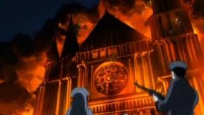
Pay Back
“ And they cast dust on their heads, and cried, weeping and wailing, saying, Alas, alas, that great city, wherein were made rich all that had ships in the sea by reason of her costliness! for in one hour is she made desolate. Rejoice over her, thou heaven, and ye holy apostles and prophets; for God hath avenged you on her. And a mighty angel took up a stone like a great millstone, and cast it into the sea, saying, Thus with violence shall that great city Babylon be thrown down, and shall be found no more at all.” Rev. 18:19-21

