Slide 1
The Book of Romans, pt. 5
Romans 3:1-20

Slide 2
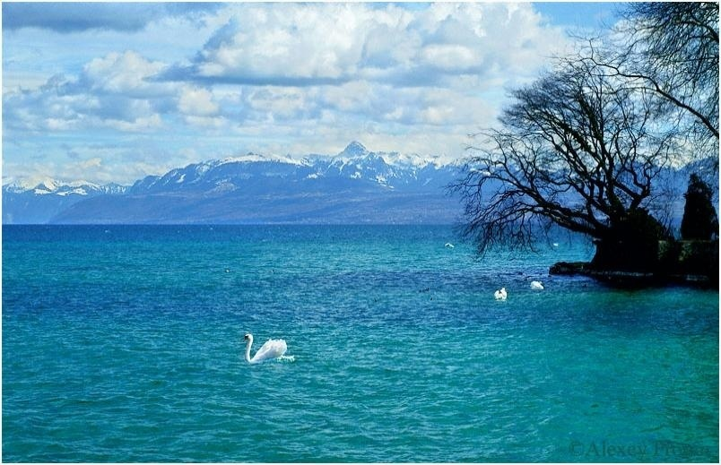
Summary of Romans 2:17-29
1. We must boast only in our knowledge of Christ.
2. Profession is worthless; only a heart where Christ abides has worth.
3. Religious acts of outward conformity have value as long as they represent what is happening inside.
4. Truly, circumcision and the Sabbath represent Christ as the master of our minds.

Slide 3
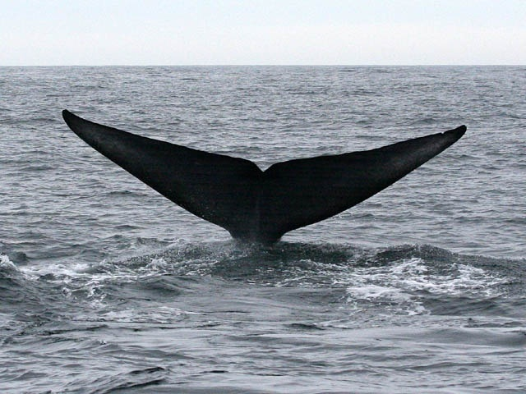
Paul’s Revolutionary Ideas
Paul closed chapter 2 with some shocking revelations. His listeners would have a very hard time with what he said. Therefore, as we open chapter 3, Paul seeks to answer some of the arguments that people would make by asking some questions and then giving the answers.

Slide 4
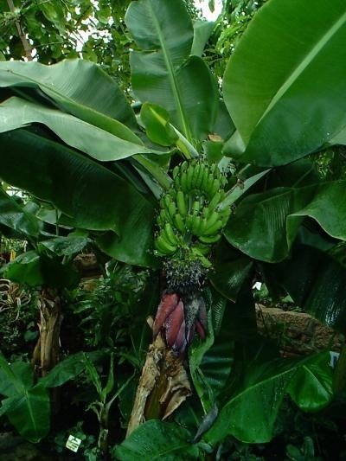
Romans 3:1,2
“What advantage then hath the Jew? or what profit is there of circumcision? Much every way: chiefly, because that unto them were committed the oracles of God.”

Slide 5
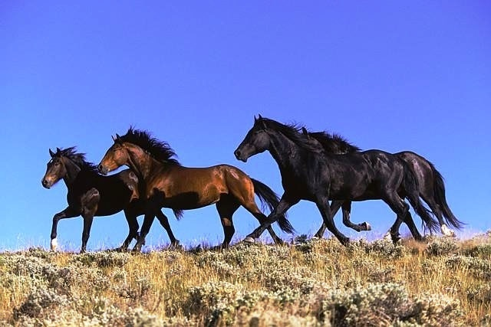
The Jews Advantage
To the Jews were given every advantage.
They were given :
The sanctuary services, revealing Christ.
2. The voice of prophecy.
3. The 10 Commandments
All of these were given to them to share with the world.

Slide 6
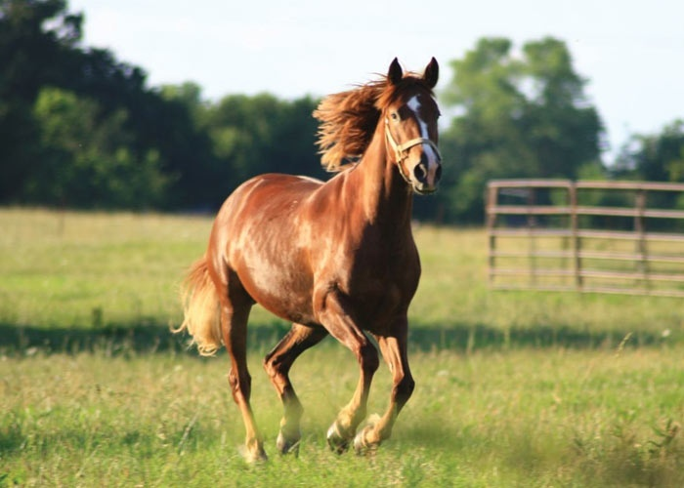
The Privilege and Responsibility
If these blessed privileges were not appreciated and shared, then they would turn to corruption. “The message of salvation is communicated to men through human agencies. But the Jews had sought to make a monopoly of the truth which is eternal life. They had hoarded the living manna, and it had turned to corruption. The religion which they tried to shut up to themselves became an offense. They robbed God of His glory, and defrauded the world by a counterfeit of the gospel. They had refused to surrender themselves to God for the salvation of the world, and they became agents of Satan for its destruction.” DA pg. 36

Slide 7
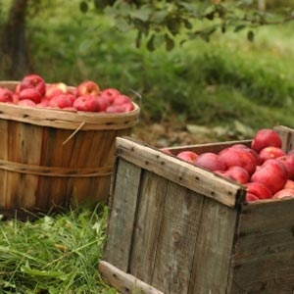
Romans 3:3-4
“For what if some did not believe? shall their unbelief make the faith of God without effect?
God forbid: yea, let God be true, but every man a liar; as it is written, That thou mightest be justified in thy sayings, and mightest overcome when thou art judged.”

Slide 8
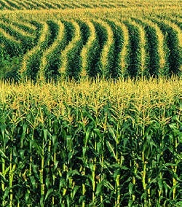
Will God’s Plan fail because of human frailty?
Because of Jews, or Christians, or Adventists failing to do God’s will and purpose, will God’s plan fail then? “Then Mordecai commanded to answer Esther, Think not with thyself that thou shalt escape in the king's house, more than all the Jews. For if thou altogether holdest thy peace at this time, then shall there enlargement and deliverance arise to the Jews from another place; but thou and thy father's house shall be destroyed: and who knoweth whether thou art come to the kingdom for such a time as this?” Esther 4:13,14
God is held captive by no one. If anyone or group chooses to reject God’s purpose for mankind, then God will raise of people who will do the job.

Slide 9

The Stones Cry
“And some of the Pharisees from among the multitude said unto him, Master, rebuke thy disciples. And he answered and said unto them, I tell you that, if these should hold their peace, the stones would immediately cry out.” Luke 19:39,40

Slide 10
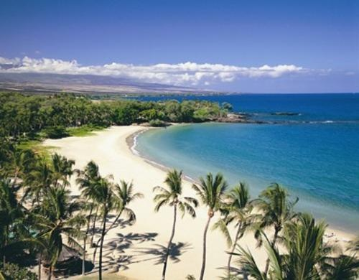
Romans 3:5-7
“But if our unrighteousness commend the righteousness of God, what shall we say? Is God unrighteous who taketh vengeance? (I speak as a man) God forbid: for then how shall God judge the world? For if the truth of God hath more abounded through my lie unto his glory; why yet am I also judged as a sinner?”

Slide 11
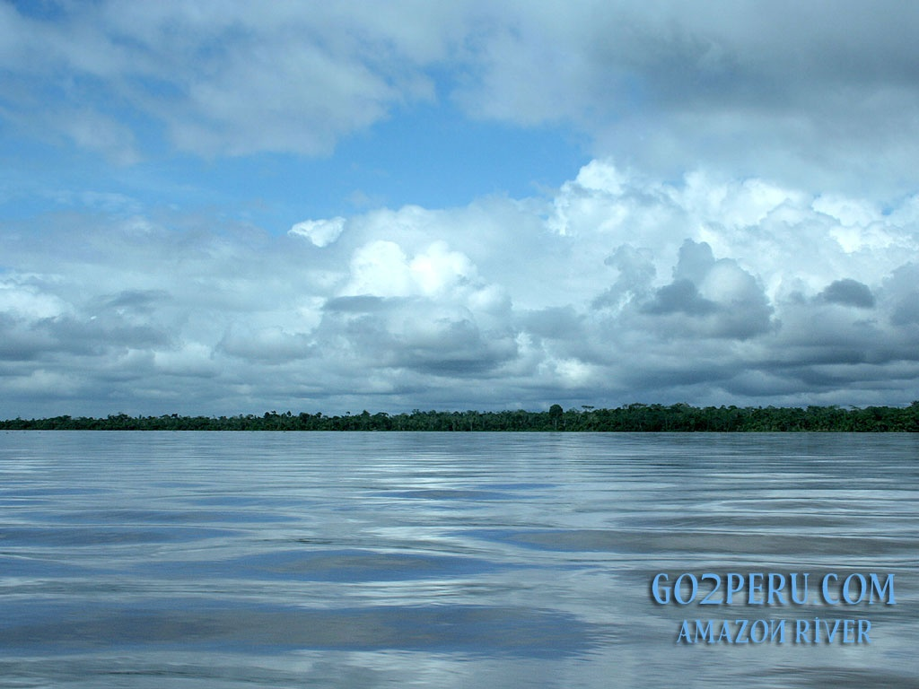
God’s Purity vs. Man’s Wickedness
Since we are unrighteous and it proves how righteous God is, then isn’t God wrong for judging us poor sinners? If my wickedness shows God to be pure and right, then wouldn’t it be right to cut me some slack? If God did, then how could He fairly and rightly judge the world? Paul asks all the questions and gives the answers that have come to him from unbelieving slanderers.

Slide 12
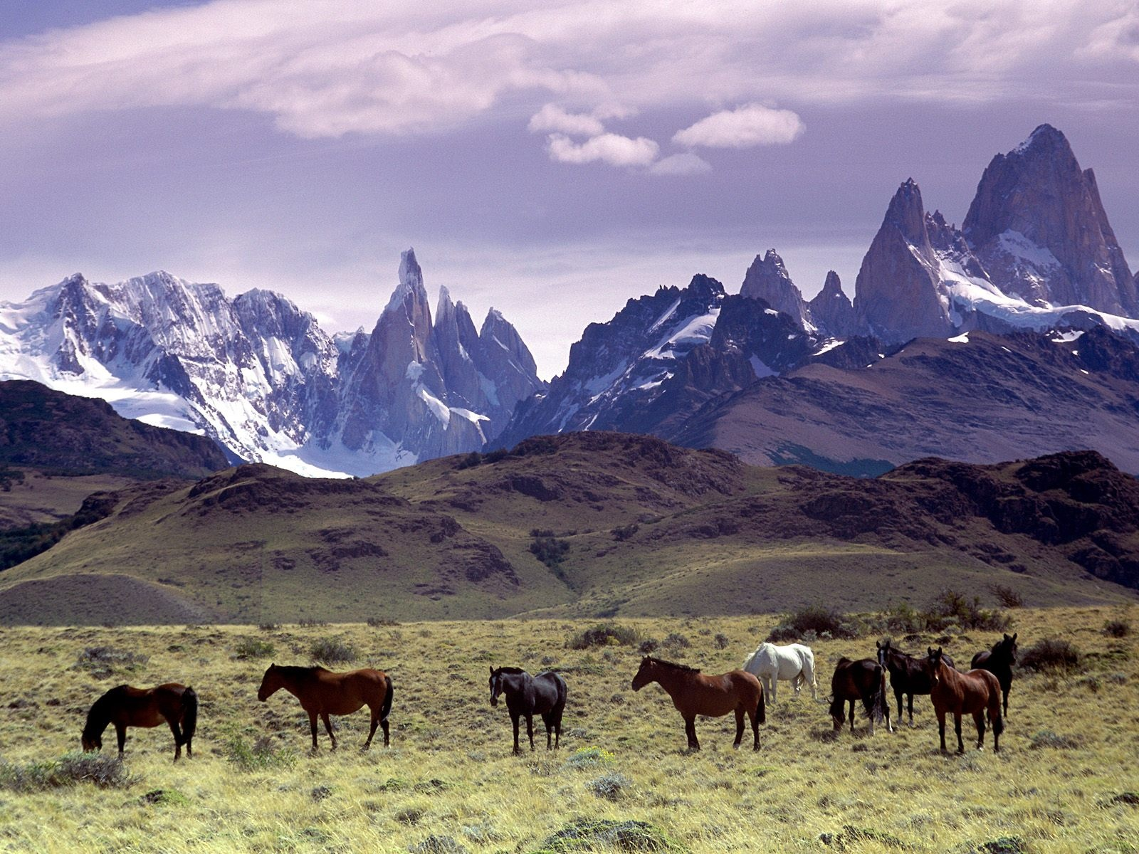
Why so Harsh in Judgment?
Why can’t God just accept the fact that mankind will always be bad and just accept us the way we are? How can He be so unkind to judge me as a sinner?

Slide 13

Romans 3:8
“And not rather, (as we be slanderously reported, and as some affirm that we say,) Let us do evil, that good may come? whose damnation is just.”

Slide 14
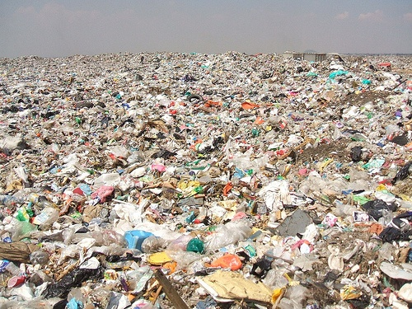
Good out of Evil?
Paul was being accused of saying that it didn’t matter what a person did, God would accept them. Mankind is really good in spite of his wickedness and that good will eventually come out of evil. This is universalism and spiritualism!

Slide 15
Impossible!
Man cannot produce good from evil.
“And he said, That which cometh out of the man, that defileth the man. For from within, out of the heart of men, proceed evil thoughts, adulteries, fornications, murders, thefts, covetousness, wickedness, deceit, lasciviousness, an evil eye, blasphemy, pride, foolishness: All these evil things come from within, and defile the man.“ Mark 7:20-23
Any attempt to elevate man apart from submission to Jesus Christ will always result in failure. The only element in the universe that can bring peace and uplift to man is the power of Christ alone.

Slide 16
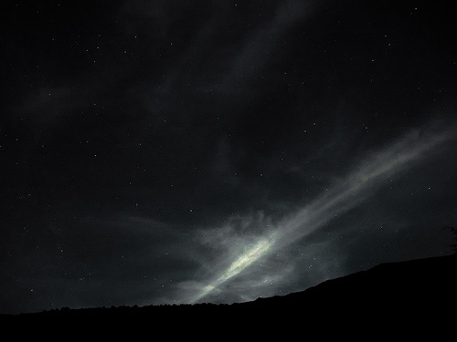
Better Than Another?
Romans 3:9 “What then? are we better than they? No, in no wise: for we have before proved both Jews and Gentiles, that they are all under sin;” The infidel arguments are silenced; all mankind is doomed in themselves.

Slide 17
Not a Pretty Picture
“As it is written, There is none righteous, no, not one: There is none that understandeth, there is none that seeketh after God. They are all gone out of the way, they are together become unprofitable; there is none that doeth good, no, not one. Their throat is an open sepulchre; with their tongues they have used deceit; the poison of asps is under their lips: Whose mouth is full of cursing and bitterness: Their feet are swift to shed blood: Destruction and misery are in their ways: And the way of peace have they not known: There is no fear of God before their eyes.” Romans 3:10-18

Slide 18
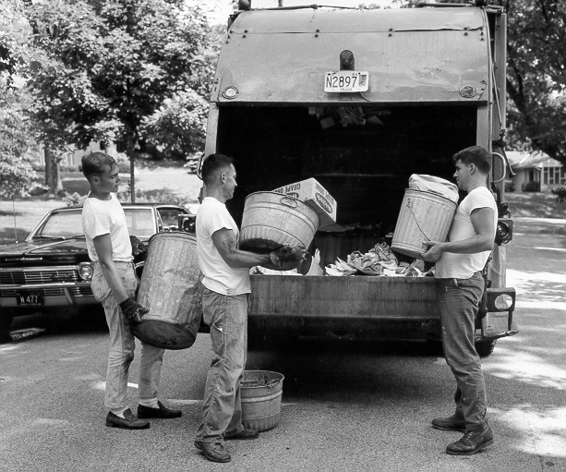
Left to himself, mankind can do nothing good. Everything we do is full of selfishness or with the goal of exalting and glorifying ourselves. We are a most pitiful and pathetic sight! All we produce belongs in the trash!

Slide 19
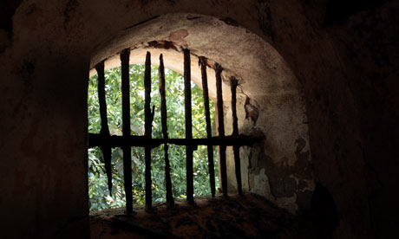
Guilty as Charged: Romans 3:19,20
“”Now we know that what things soever the law saith, it saith to them who are under the law: that every mouth may be stopped, and all the world may become guilty before God. Therefore by the deeds of the law there shall no flesh be justified in his sight: for by the law is the knowledge of sin.”

Slide 20
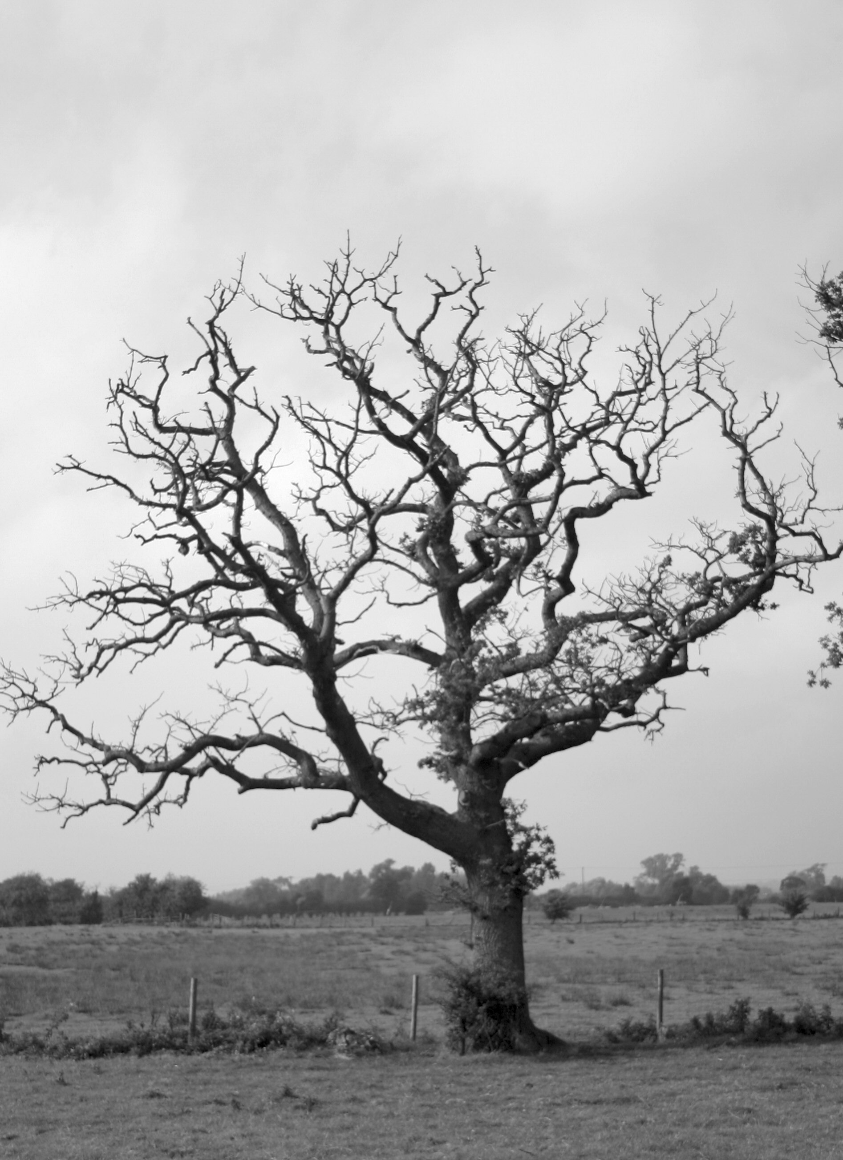
Without Hope
We are all unclean, condemned by the law of God because we have all broken it. No thing that we may attempt to produce can bring us righteousness. We are all guilty before God, without hope and without any possibility of restoration. Unless, unless……………………

Slide 21
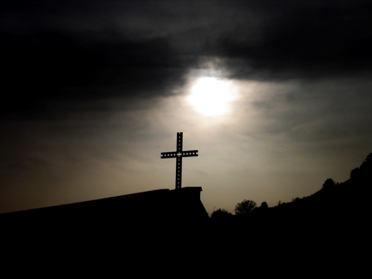
Unless He Would Intervene
“The cross of Christ will be the science and the song of the redeemed through all eternity. In Christ glorified they will behold Christ crucified. Never will it be forgotten that He whose power created and upheld the unnumbered worlds through the vast realms of space, the Beloved of God, the Majesty of heaven, He whom cherub and shining seraph delighted to adore--humbled Himself to uplift fallen man; that He bore the guilt and shame of sin, and the hiding of His Father's face, till the woes of a lost world broke His heart and crushed out His life on Calvary's cross. That the Maker of all worlds, the Arbiter of all destinies, should lay aside His glory and humiliate Himself from love to man will ever excite the wonder and adoration of the universe. As the nations of the saved look upon their Redeemer and behold the eternal glory of the Father shining in His countenance; as they behold His throne,…and know that His kingdom is to have no end, they break forth in rapturous song: "Worthy, worthy is the Lamb that was slain, and hath redeemed us to God by His own most precious blood!" GC, 651,652

