Slide 1
Elijah, pt. 10
‘Translation’

Slide 2
Active Life
Elijah had once had a quiet life in the hills of Gilead beyond the Jordan. It was not always to be that way. He was sent to Ahab’s palace to deliver Heaven’s judgments, then on to Zarapheth and years of famine and a price on his head. Then, return to Israel and a showdown with Ahab at Carmel. He fled from Jezebel and wished he might die, but God had a greater destiny for him! That time had finally come!

Slide 3
Knew What was Coming!
“As Elisha accompanied the prophet on his round of service from school to school, his faith and resolution were once more tested. At Gilgal, and again at Bethel and Jericho, he was invited by the prophet to turn back. "Tarry here, I pray thee," Elijah said; "for the Lord hath sent me to Bethel." But in his early labor of guiding the plow, Elisha had learned not to fail or to become discouraged, and now that he had set his hand to the plow in another line of duty he would not be diverted from his purpose. He would not be parted from his master, so long as opportunity remained for gaining a further fitting up for service. Unknown to Elijah, the revelation that he was to be translated had been made known to his disciples in the schools of the prophets, and in particular to Elisha. And now the tried servant of the man of God kept close beside him. As often as the invitation to turn back was given, his answer was, "As the Lord liveth, and as thy soul liveth, I will not leave thee." PK, pgs. 225,226

Slide 4
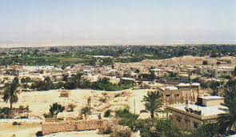
“And Elijah said unto Elisha, Tarry here, I pray thee; for the LORD hath sent me to Bethel. And Elisha said unto him, As the LORD liveth, and as thy soul liveth, I will not leave thee… And Elijah said unto him, Elisha, tarry here, I pray thee; for the LORD hath sent me to Jericho. And he said, As the LORD liveth, and as thy soul liveth, I will not leave thee. So they came to Jericho.” 2 Kings 2:2,4,6

Slide 5
Determination, Perseverance
“But in his early labor of guiding the plow, Elisha had learned not to fail or to become discouraged, and now that he had set his hand to the plow in another line of duty he would not be diverted from his purpose.” Pk. Pg. 225
“Seest thou a man diligent in his business? he shall stand before kings; he shall not stand before mean men.” Pro. 22:29
“Now when Daniel knew that the writing was signed, he went into his house; and his windows being open in his chamber toward Jerusalem, he kneeled upon his knees three times a day, and prayed, and gave thanks before his God, as he did aforetime.” Dan. 6:10
“No truth does the Bible more clearly teach than that what we do is the result of what we are. To a great degree the experiences of life are the fruition of our own thoughts and deeds.” ED, pg. 146

Slide 6
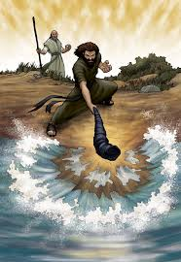
Divided the Waters
“And fifty men of the sons of the prophets went, and stood to view afar off: and they two stood by Jordan. And Elijah took his mantle, and wrapped it together, and smote the waters, and they were divided hither and thither, so that they two went over on dry ground.” 2 Kings 2:7,8

Slide 7
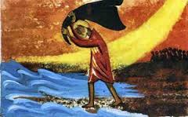
Same as of Old
The same power that split the Read Sea, that divided Jordan in two, was still in existence in Elijah’s day. The Lord had lost none of His power to work miracles on behalf of His children. The same power exists today! Praise God!

Slide 8
Deliverance Today
“This song and the great deliverance which it commemorates, made an impression never to be effaced from the memory of the Hebrew people. From age to age it was echoed by the prophets and singers of Israel, testifying that Jehovah is the strength and deliverance of those who trust in Him. That song does not belong to the Jewish people alone. It points forward to the destruction of all the foes of righteousness and the final victory of the Israel of God. The prophet of Patmos beholds the white-robed multitude that have "gotten the victory," standing on the "sea of glass mingled with fire," having "the harps of God. And they sing the song of Moses the servant of God, and the song of the Lamb." Revelation 15:2, 3. PP, pg. 289

Slide 9
Elisha’s Request
“And it came to pass, when they were gone over, that Elijah said unto Elisha, Ask what I shall do for thee, before I be taken away from thee. And Elisha said, I pray thee, let a double portion of thy spirit be upon me. And he said, Thou hast asked a hard thing: nevertheless, if thou see me when I am taken from thee, it shall be so unto thee; but if not, it shall not be so.” 2 Kings 2:9,10

Slide 10
“For your shame ye shall have double; and for confusion they shall rejoice in their portion: therefore in their land they shall possess the double: everlasting joy shall be unto them.” Isa. 61:7

Slide 11
Double Dose
“Elisha asked not for worldly honor, or for a high place among the great men of earth. That which he craved was a large measure of the Spirit that God had bestowed so freely upon the one about to be honored with translation. He knew that nothing but the Spirit which had rested upon Elijah could fit him to fill the place in Israel to which God had called him, and so he asked, "I pray thee, let a double portion of thy Spirit be upon me." PK, pg. 226, 227

Slide 12
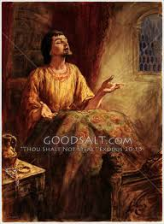
True to Their Call
“Above every earthly good, the king desired wisdom and understanding for the accomplishment of the work God had given him to do. He longed for quickness of mind, for largeness of heart, for tenderness of spirit. That night the Lord appeared to Solomon in a dream and said, "Ask what I shall give thee." In his answer the young and inexperienced ruler gave utterance to his feeling of helplessness and his desire for aid.” PK, pg. 28

Slide 13
A Wise Heart!
“In Gibeon the LORD appeared to Solomon in a dream by night: and God said, Ask what I shall give thee. And Solomon said, Thou hast shewed unto thy servant David my father great mercy, according as he walked before thee in truth, and in righteousness, and in uprightness of heart with thee; and thou hast kept for him this great kindness, that thou hast given him a son to sit on his throne, as it is this day. And now, O LORD my God, thou hast made thy servant king instead of David my father: and I am but a little child: I know not how to go out or come in. And thy servant is in the midst of thy people which thou hast chosen, a great people, that cannot be numbered nor counted for multitude. Give therefore thy servant an understanding heart to judge thy people, that I may discern between good and bad: for who is able to judge this thy so great a people?” 1 Kings 3:5-9

Slide 14
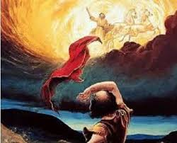
Translation!
“And it came to pass, as they still went on, and talked, that, behold, there appeared a chariot of fire, and horses of fire, and parted them both asunder; and Elijah went up by a whirlwind into heaven.” 2 Kings 2:11

Slide 15
“Elijah was a type of the saints who will be living on the earth at the time of the second advent of Christ and who will be "changed, in a moment, in the twinkling of an eye, at the last trump," without tasting of death. 1 Corinthians 15:51, 52. It was as a representative of those who shall be thus translated that Elijah, near the close of Christ's earthly ministry, was permitted to stand with Moses by the side of the Saviour on the mount of transfiguration. In these glorified ones, the disciples saw in miniature a representation of the kingdom of the redeemed. They beheld Jesus clothed with the light of heaven; they heard the "voice out of the cloud" (Luke 9:35), acknowledging Him as the Son of God; they saw Moses, representing those who will be raised from the dead at the time of the second advent; and there also stood Elijah, representing those who at the close of earth's history will be changed from mortal to immortal and be translated to heaven without seeing death.” PK, pgs. 227,228

Slide 16
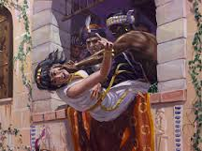
Where is Catholicism /Apostate Adventism?
Ahab died in battle and will perish for eternity. So goes apostate Adventism.
Jezebel was thrown out of a window and consumed by dogs. So, Romanism will be destroyed and eaten by vultures!
The faithful of God will go to paradise!!

Slide 17
Paradise
“In the desert, in loneliness and discouragement, Elijah had said that he had had enough of life and had prayed that he might die. But the Lord in His mercy had not taken him at his word. There was yet a great work for Elijah to do; and when his work was done, he was not to perish in discouragement and solitude. Not for him the descent into the tomb, but the ascent with God's angels to the presence of His glory. “ Pk, pg.228

Slide 18
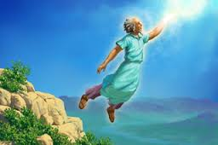
Home at Last
“For the Lord himself shall descend from heaven with a shout, with the voice of the archangel, and with the trump of God: and the dead in Christ shall rise first: Then we which are alive and remain shall be caught up together with them in the clouds, to meet the Lord in the air: and so shall we ever be with the Lord.” 1 Thess. 4:16, 17

