Slide 1
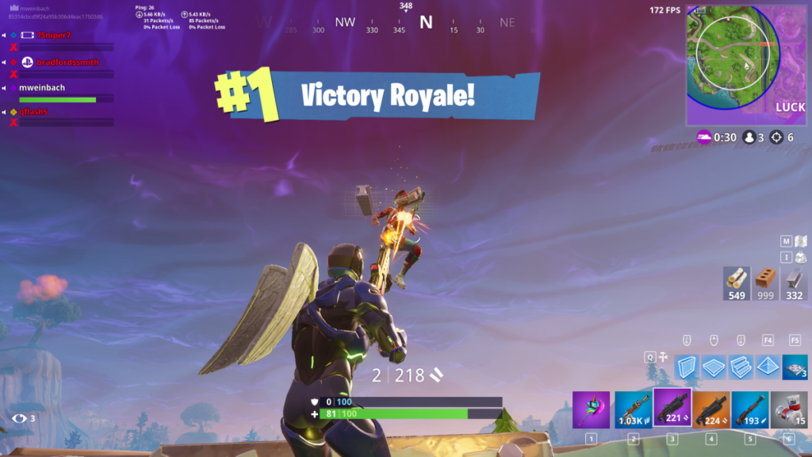
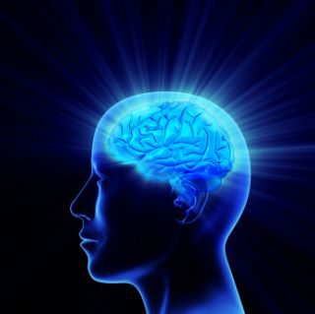
Only a Video Game?

Slide 2
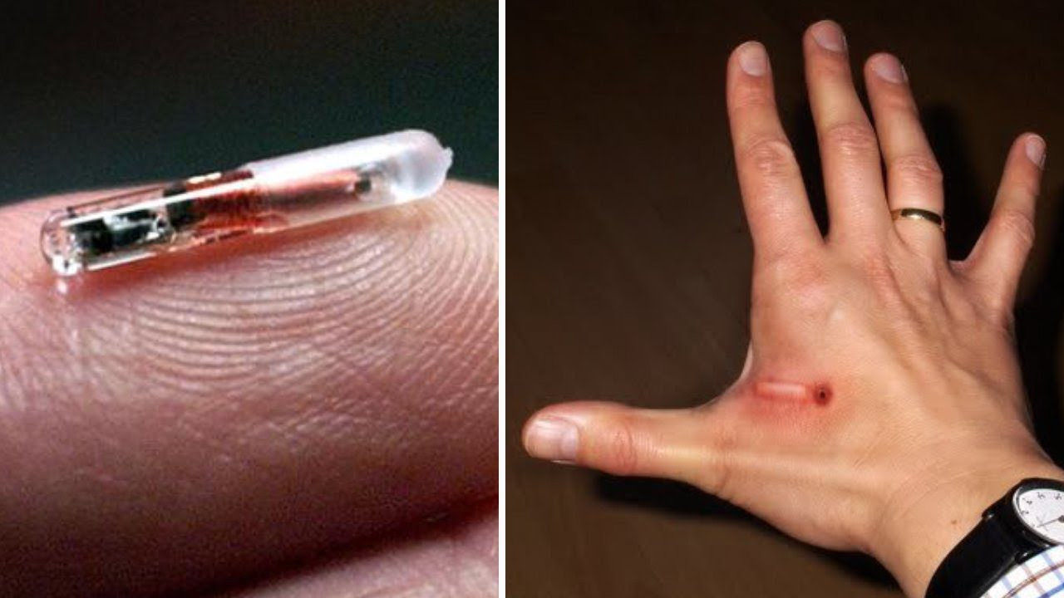
The Forehead and/or Hand is Where Our Destiny Lies. . . .
Rev. 14:9-10 “And the third angel followed them, saying with a loud voice, If any man worship the beast and his image, and receive his mark in his forehead, or in his hand, The same shall drink of the wine of the wrath of God, which is poured out without mixture into the cup of his indignation; and he shall be tormented with fire and brimstone in the presence of the holy angels, and in the presence of the Lamb”

Slide 3
The Bible Unlocks the Symbolism
Deut. 6:1, 7-8 “Now these are the commandments, the statutes, and the judgments, which the Lord your God commanded to teach you, that ye might do them in the land whither ye go to possess it. . . And thou shalt teach them diligently unto thy children, and shalt talk of them when thou sittest in thine house, and when thou walkest by the way, and when thou liest down, and when thou risest up. And thou shalt bind them for a sign upon thine hand, and they shall be as frontlets between thine eyes.”

Slide 4
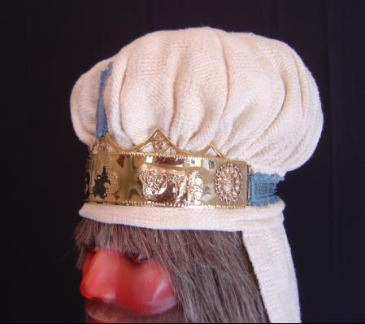
Ex. 28:36-38 “And thou shalt make a plate of pure gold, and grave upon it, like the engravings of a signet, Holiness To The Lord. And thou shalt put it on a blue lace, that it may be upon the mitre; upon the forefront of the mitre it shall be. And it shall be upon Aaron’s forehead”
Matt. 5:27-28 “Ye have heard that it was said by them of old time, Thou shalt not commit adultery: But I say unto you, That whosoever looketh on a woman to lust after her hath committed adultery with her already in his heart.”

Slide 5
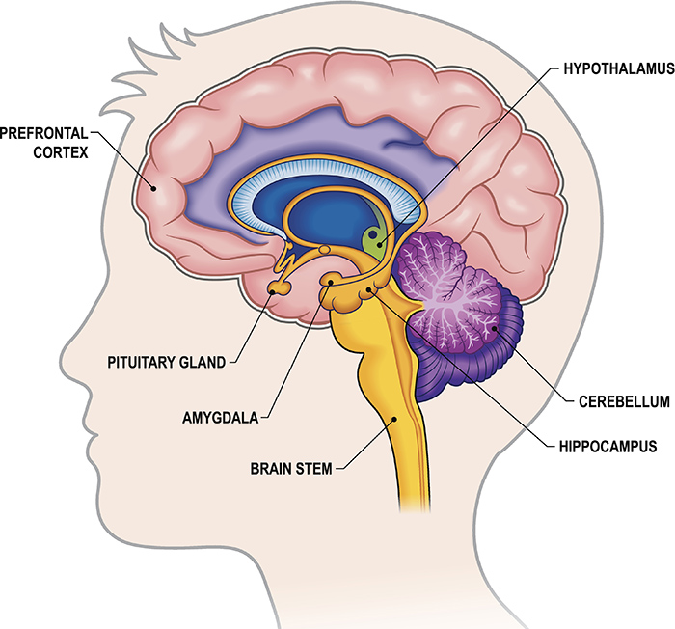

Slide 6
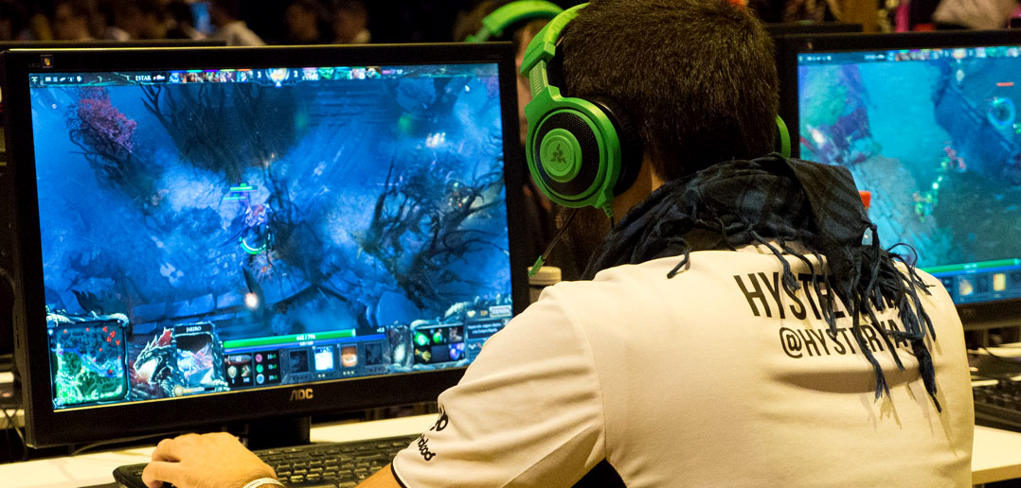
The War is for the Mind
John 4:24 “God is a Spirit: and they that worship him must worship him in spirit and in truth.”
Psalm 101:3 “I will set no wicked thing before mine eyes: I hate the work of them that turn aside; it shall not cleave to me.”
Job 31:1 “I made a covenant with mine eyes”

Slide 8
Video Games on the Mind…
“Professor Akio Mori, of Nihon University's College of Humanities and sciences in Japan, measured the brain activity 240 subjects aged between 6 and 29. Mori measured beta waves, which indicate activity in the prefrontal lobe, and alpha waves, which often appear when the brain is resting. The prefrontal lobe is thought to be the center of emotion and creativity in the brain. Mori divided the brain activity of participants into four categories: normal, visual, half-videogame, and videogame.”

Slide 9
“Normal subjects, who rarely played video games, were found to have much stronger beta waves than alpha waves. Little change was seen while these subjects did play video games.
the half-video game group, which played video games for 1-3 hours 3-4 days a week, had roughly equal strength beta and alpha waves when not playing video games; but when they did play video games their beta waves fell below their alpha waves.”

Slide 10
“The video game group, which played video games for 2-7 hours daily, showed nearly zero beta activity all the time, even when they were not playing video games. This means there was little to no activity in their prefrontal lobes. These subjects reported being easily angered, having difficulty concentrating, and having trouble socializing.
The visual group, comprised of people who largely engage in visual stimulation such as television, was found to easily develop symptoms similar to the video game group.”—Geek.com, July 9, 2002

Slide 11
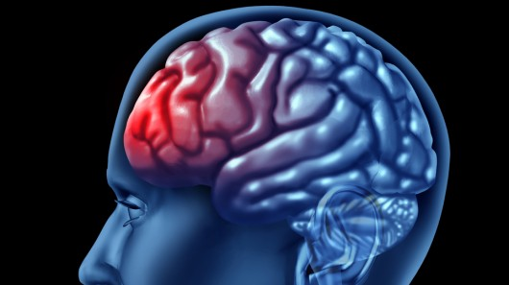
Another Study…
“The study, carried out by researchers at the University of Montreal, revealed that playing "shooter" games can damage the hippocampus area of the brain, causing it to lose cells. It suggests that this could weaken the brains of young people and put them at greater risk of dementia in later life”—Wells & Blagburn, The Telegraph, Aug. 8, 2017

Slide 12
What About Time??
Eph. 5:14-17 “Wherefore he saith, Awake thou that sleepest, and arise from the dead, and Christ shall give thee light. See then that ye walk circumspectly, not as fools, but as wise, Redeeming the time, because the days are evil. Wherefore be ye not unwise, but understanding what the will of the Lord is.

Slide 13
An Addiction?
1. Pre-occupation. Do you spend a lot of time thinking about games even when you are not playing, or planning when you can play next?
2. Withdrawal. Do you feel restless, irritable, moody, angry, anxious or sad when attempting to cut down or stop gaming, or when you are unable to play?
3. Tolerance. Do you feel the need to play for increasing amounts of time, play more exciting games, or use more powerful equipment to get the same amount of excitement you used to get?
4. Reduce/stop. Do you feel that you should play less, but are unable to cut back on the amount of time you spend playing games?
5. Give up other activities. Do you lose interest in or reduce participation in other recreational activities due to gaming?
6. Continue despite problems. Do you continue to play games even though you are aware of negative consequences, such as not getting enough sleep, being late to school/work, spending too much money, having arguments with others, or neglecting important duties?

