Slide 1
Final Scenes, pt. 4
Quibbling

Slide 2
A Thoughtful Hour
“It would be well for us to spend a thoughtful hour each day in contemplation of the life of Christ. We should take it point by point, and let the imagination grasp each scene, especially the closing ones. As we thus dwell upon His great sacrifice for us, our confidence in Him will be more constant, our love will be quickened, and we shall be more deeply imbued with His spirit. If we would be saved at last, we must learn the lesson of penitence and humiliation at the foot of the cross.” Desire of Ages, pg. 83

Slide 3
The Chronology
“And he left them, and went out of the city into Bethany; and he lodged there. Now in the morning as he returned into the city, he hungered. And when he saw a fig tree in the way, he came to it, and found nothing thereon, but leaves only, and said unto it, Let no fruit grow on thee henceforward for ever. And presently the fig tree withered away. And when the disciples saw it, they marvelled, saying, How soon is the fig tree withered away! Jesus answered and said unto them, Verily I say unto you, If ye have faith, and doubt not, ye shall not only do this which is done to the fig tree, but also if ye shall say unto this mountain, Be thou removed, and be thou cast into the sea; it shall be done. And all things, whatsoever ye shall ask in prayer, believing, ye shall receive.” Matthew 21:17-22

Slide 4
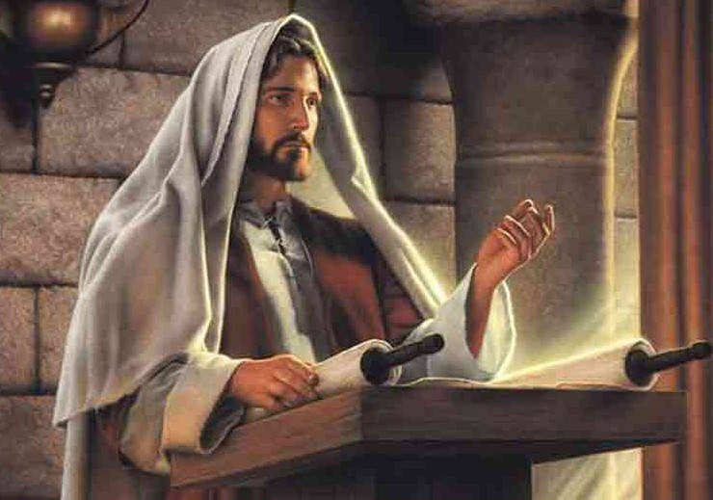
The Closing Scenes
On Monday, after Jesus cleansed the temple and ministered to the people, He left the city and lodged at Bethany. The next morning, Tuesday, the third day of Crucifixion week, Christ passed by the cursed tree and it was already wilting. He then went to the temple to teach the people, but was met by wicked men trying to entrap Him. There goal was to turn the people against Him. The first issue was over authority.

Slide 5
Who Said you could do that?
“The next morning the Sanhedrin again considered what course to pursue toward Jesus. Three years before, they had demanded a sign of His Messiahship. Since that time He had wrought mighty works throughout the land. He had healed the sick, miraculously fed thousands of people, walked upon the waves, and spoken peace to the troubled sea. He had repeatedly read the hearts of men as an open book; He had cast out demons, and raised the dead. The rulers had before them the evidences of His Messiahship. They now decided to demand no sign of His authority, but to draw out some admission or declaration by which He might be condemned.” DA, pg. 589

Slide 6
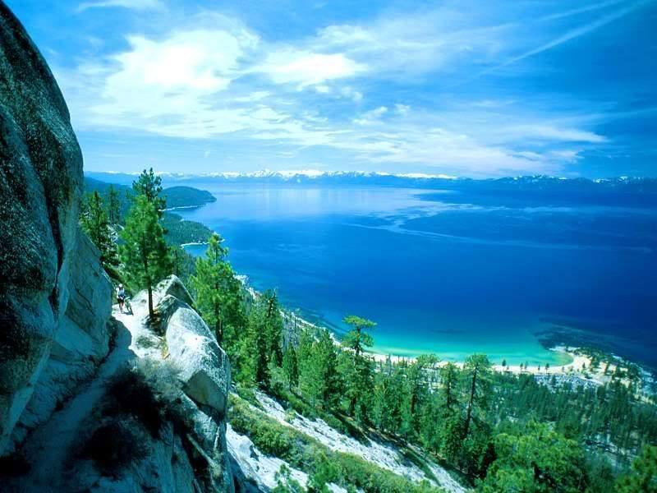
Authority
”And when he was come into the temple, the chief priests and the elders of the people came unto him as he was teaching, and said, By what authority doest thou these things? and who gave thee this authority? And Jesus answered and said unto them, I also will ask you one thing, which if ye tell me, I in like wise will tell you by what authority I do these things. The baptism of John, whence was it? from heaven, or of men? And they reasoned with themselves, saying, If we shall say, From heaven; he will say unto us, Why did ye not then believe him? But if we shall say, Of men; we fear the people; for all hold John as a prophet. And they answered Jesus, and said, We cannot tell. And he said unto them, Neither tell I you by what authority I do these things.” Matthew 21:23-27

Slide 7
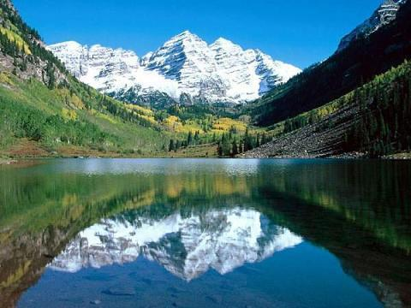
Cornered
Who gave You permission to do the works you do? Which leader said it was all right? Which conference official gave you approval? Jesus answered their question with a question. When you answer Me, I’ll answer you. Was John’s baptism from heaven or of men? Jesus knew that these men didn’t believe in John and the people did. If they tried to be politically correct and say yes, then Jesus would say, ‘Why don’t you believe in Me because John testified of Me?’ If they answered honestly and said no, then they would have to face the ire of the people; so, they said, ‘we can’t tell’. Jesus said, ‘Neither will I tell you by what authority I do these things.’

Slide 8
Trapped
“The priests saw that they were in a dilemma from which no sophistry could extricate them. If they said that John's baptism was from heaven, their inconsistency would be made apparent. Christ would say, Why have ye not then believed on him? John had testified of Christ, "Behold the Lamb of God, which taketh away the sin of the world." John 1:29. If the priests believed John's testimony, how could they deny the Messiahship of Christ? If they declared their real belief, that John's ministry was of men, they would bring upon themselves a storm of indignation; for the people believed John to be a prophet. With intense interest the multitude awaited the decision. They knew that the priests had professed to accept the ministry of John, and they expected them to acknowledge without a question that he was sent from God. But after conferring secretly together, the priests decided not to commit themselves. Hypocritically professing ignorance, they said, "We cannot tell." "Neither tell I you," said Christ, "by what authority I do these things."
Scribes, priests, and rulers were all silenced. Baffled and disappointed, they stood with lowering brows, not daring to press further questions upon Christ. By their cowardice and indecision they had in a great measure forfeited the respect of the people, who now stood by, amused to see these proud, self-righteous men defeated.” DA, pg. 593,594

Slide 9
Purpose in what He Did!
“All these sayings and doings of Christ were important, and their influence was to be felt in an ever-increasing degree after His crucifixion and ascension. Many of those who had anxiously awaited the result of the questioning of Jesus were finally to become His disciples, first drawn toward Him by His words on that eventful day. The scene in the temple court was never to fade from their minds. The contrast between Jesus and the high priest as they talked together was marked. The proud dignitary of the temple was clothed in rich and costly garments. Upon his head was a glittering tiara. His bearing was majestic, his hair and his long flowing beard were silvered by age. His appearance awed the beholders. Before this august personage stood the Majesty of heaven, without adornment or display. His garments were travel stained; His face was pale, and expressed a patient sadness; yet written there were dignity and benevolence that contrasted strangely with the proud, self-confident, and angry air of the high priest. Many of those who witnessed the words and deeds of Jesus in the temple from that time enshrined Him in their hearts as a prophet of God.” DA, pgs. 594,595

Slide 10
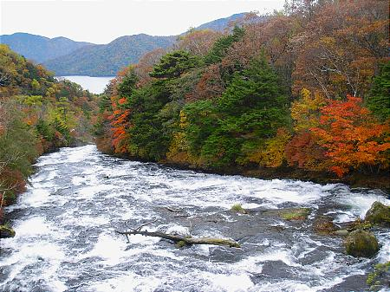
The conflict Continues
“And they send unto him certain of the Pharisees and of the Herodians, to catch him in his words. And when they were come, they say unto him, Master, we know that thou art true, and carest for no man: for thou regardest not the person of men, but teachest the way of God in truth: Is it lawful to give tribute to Caesar, or not? Shall we give, or shall we not give? But he, knowing their hypocrisy, said unto them, Why tempt ye me? bring me a penny, that I may see it. And they brought it. And he saith unto them, Whose is this image and superscription? And they said unto him, Caesar's. And Jesus answering said unto them, Render to Caesar the things that are Caesar's, and to God the things that are God's. And they marvelled at him.” Mark 12:13-17

Slide 11
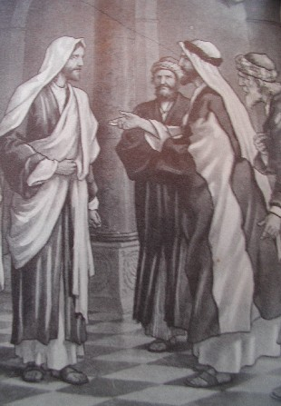
Trying to Trap Him
“The spies had expected Jesus to answer their question directly, in one way or the other. If He should say, It is unlawful to give tribute to Caesar, He would be reported to the Roman authorities and arrested for inciting rebellion. But in case He should pronounce it lawful to pay the tribute, they designed to accuse Him to the people as opposing the law of God. Now they felt themselves baffled and defeated. Their plans were disarranged. The summary manner in which their question had been settled left them nothing further to say.” DA, pg. 602

Slide 12
Deception Overboard
They were using religion to mask pretensions to holiness. They were trying to trap Jesus to kill Him. They did it so deceptively and cunningly that they really seemed to want to know the truth. “Those who put the question to Jesus thought that they had sufficiently disguised their purpose; but Jesus read their hearts as an open book, and sounded their hypocrisy. ” DA, pg. 602

Slide 13
Delusion
“And with all deceivableness of unrighteousness in them that perish; because they received not the love of the truth, that they might be saved. And for this cause God shall send them strong delusion, that they should believe a lie: That they all might be damned who believed not the truth, but had pleasure in unrighteousness.” 2Thessalonians 2:10-12

Slide 14
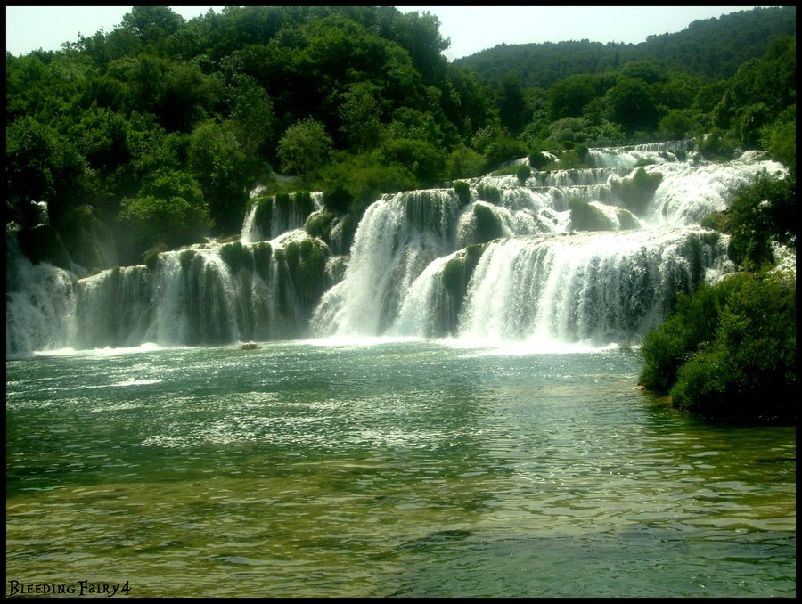
The Detector
“To the law and to the testimony: if they speak not according to this word, it is because there is no light in them.” Isa. 8:20
“Sanctify them through thy truth: thy word is truth.” JN. 17:17

Slide 15
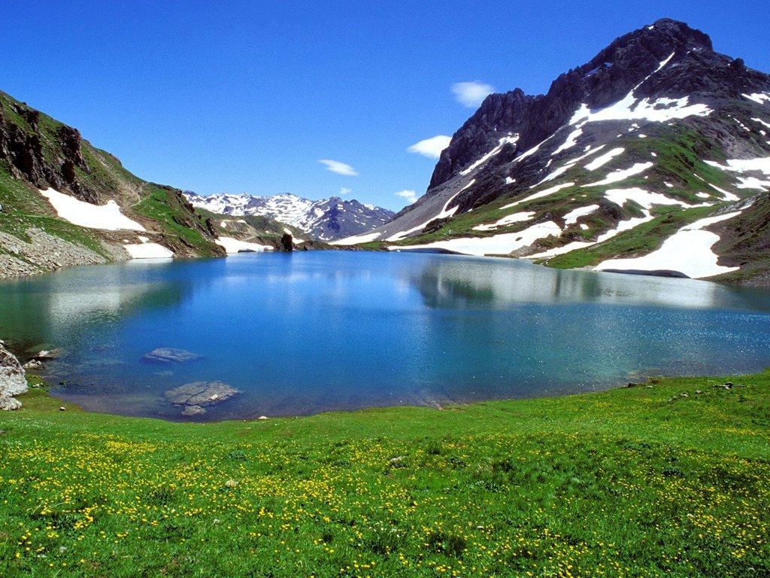
Liberals and Conservatives Unite
The SDA’s kept coming after Jesus with their false teachings, trying to entrap and overcome Him. They were hell bent on destroying Him.
The liberal Adventists, the Sadducees, who were throwing out key teachings, now challenged Christ on the resurrection. They didn’t believe in it. Funny, the liberal Sadducee and the conservative extremist, the Pharisees, finally united together on one thing; destroying the Son of God!

Slide 16
The Resurrection
“Then came to [him] certain of the Sadducees, which deny that there is any resurrection; and they asked him, Saying, Master, Moses wrote unto us, If any man's brother die, having a wife, and he die without children, that his brother should take his wife, and raise up seed unto his brother. There were therefore seven brethren: and the first took a wife, and died without children. And the second took her to wife, and he died childless. And the third took her; and in like manner the seven also: and they left no children, and died. Last of all the woman died also. Therefore in the resurrection whose wife of them is she? for seven had her to wife. And Jesus answering said unto them, The children of this world marry, and are given in marriage: But they which shall be accounted worthy to obtain that world, and the resurrection from the dead, neither marry, nor are given in marriage:
Neither can they die any more: for they are equal unto the angels; and are the children of God, being the children of the resurrection. Now that the dead are raised, even Moses shewed at the bush, when he calleth the Lord the God of Abraham, and the God of Isaac, and the God of Jacob. For he is not a God of the dead, but of the living: for all live unto him. Then certain of the scribes answering said, Master, thou hast well said.” Luke 20:27-39

Slide 17
Truth Shines
“Christ declared to His hearers that if there were no resurrection of the dead, the Scriptures which they professed to believe would be of no avail. He said, "But as touching the resurrection of the dead, have ye not read that which was spoken unto you by God, saying, I am the God of Abraham, and the God of Isaac, and the God of Jacob? God is not the God of the dead, but of the living." God counts the things that are not as though they were. He sees the end from the beginning, and beholds the result of His work as though it were now accomplished. The precious dead, from Adam down to the last saint who dies, will hear the voice of the Son of God, and will come forth from the grave to immortal life. God will be their God, and they shall be His people. There will be a close and tender relationship between God and the risen saints. This condition, which is anticipated in His purpose, He beholds as if it were already existing. The dead live unto Him.” DA, pg. 606

Slide 18
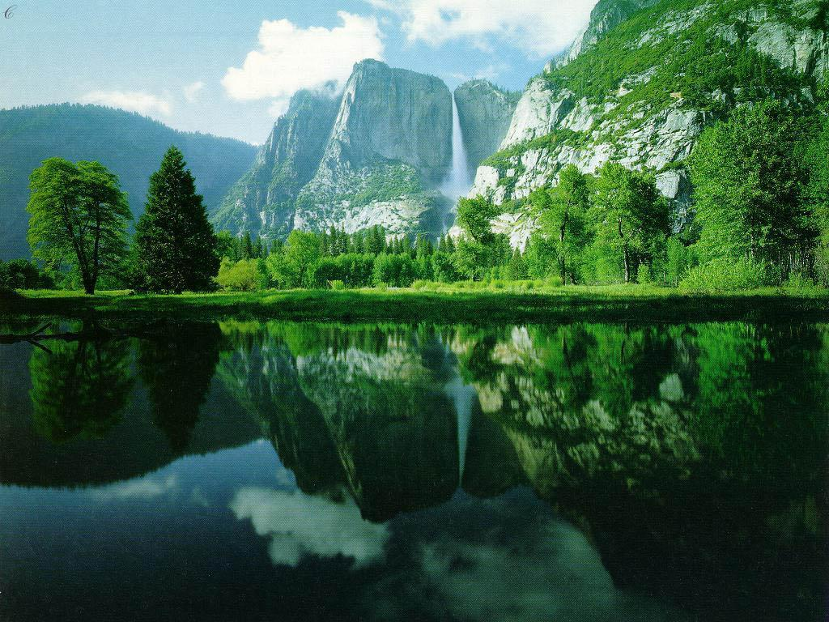
An Eventful Day
As this third day of the week , Tuesday, came to an end, Christ must have looked forward to spending time outside the city and away from these cunning and wicked people. I’m sure He slept well that night!
The next day, Wednesday, would be Christ’s final day of preaching in the temple. Woes were about to fall and judgment came with it!

